Slide 1
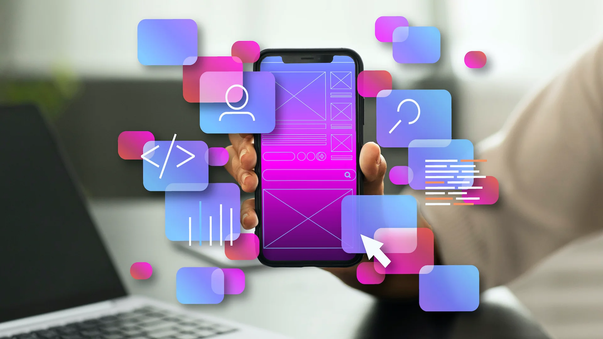

REPUBLIC OF CAMEROON
---
PEACE – WORK – FATHERLAND
---
MINISTRY OF HIGHER EDUCATION
---
UNIVERSITY OF BUEA
REPUBLIQUE DU CAMEROON
---
PAIX – TRAVAIL – PATRIE
---
MINISTERE DE L’ENSEIGNEMENT SUPERIEURE
---
UNIVERSITE DE BUEA
PRESENTATION OUTLINE
Introduction
Overview on major types of mobile applications
Overview on mobile app development programming language
Overview on mobile app development framework
Mobile application architecture and design pattens
Techniques used to collect and analyze user requirements
Cost estimation for mobile application development
FACULTY OF ENGINEERING AND TECHNOLOGY
---
DEPARTMENT OF COMPUTER ENGINEERING
PRESENTATION ON THE GENERAL OVERVIEW OF MOBILE APPLICATION DEVELOPMENT
Presented by
GROUP 13
Course Title: Internet Programming (J2EE) and Mobile Programming (CEF440)
Course Instructor: Dr. NKEMENI Valery
1
Academic year: 2024 -2025

Slide 2
PRESENTATION OUTLINE
Introduction
Overview on major types of mobile applications
Overview on mobile app development programming language
Overview on mobile app development framework
Mobile application architecture and design pattens
Techniques used to collect and analyze user requirements
Cost estimation for mobile application development
MAJOR TYPES OF MOBILE APPS
1
2
3
NATIVE APPS
Overview
Definition
Real-World example
PROGRESSIVE WEB APPS (PWAs)
Overview
Definition
Real-World example
HYBRID APPS
Overview
Definition
Real-World example
2
1

Slide 3
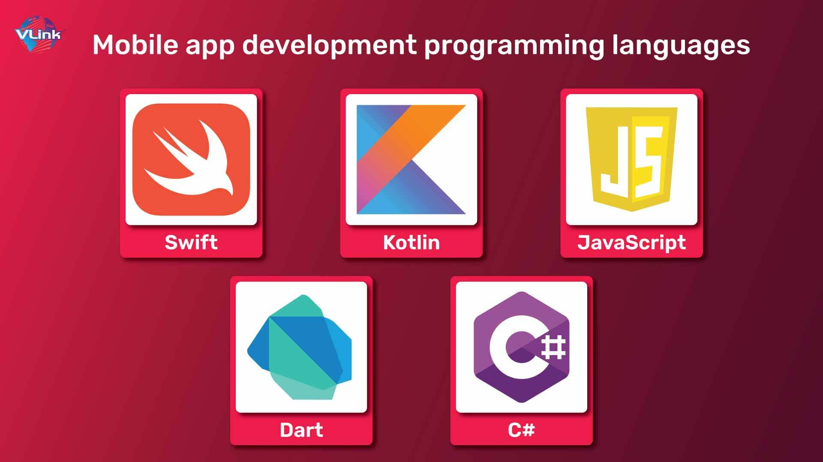
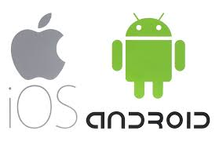
MAJOR TYPES OF MOBILE APPS
MOBILE APP DEVELOPMENT PROGRAMMING LANGUAGE
1
2
3
The overview of mobile app development languages will be done in a comparison analysis approach. It will be done based on the following aspects:
Performance
Use case
Platform support
NATIVE APPS
Overview
Definition
Real-World example
PROGRESSIVE WEB APPS (PWAs)
Overview
Definition
Real-World example
HYBRID APPS
Overview
Definition
Real-World example
3
2

Slide 4
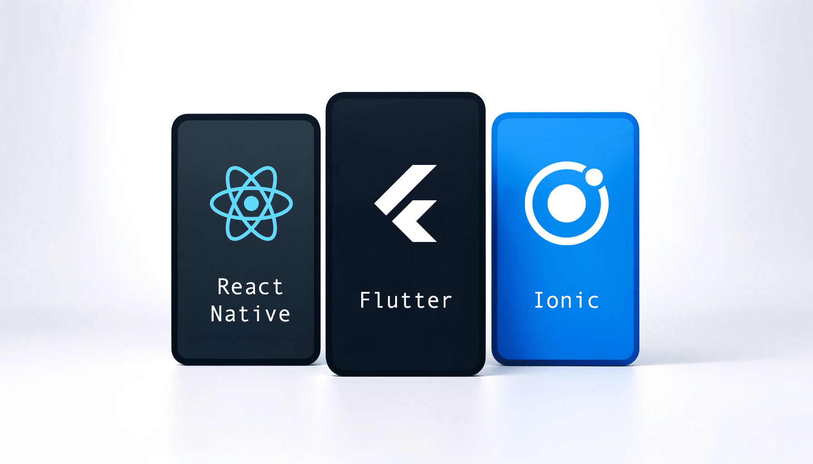
MOBILE APP DEVELOPMENT PROGRAMMING LANGUAGE
MOBILE APP DEVELOPMENT FRAMEWORK
The overview of mobile app development framework will be done in a comparison analysis approach. It will be done based on the following aspects:
Feature
Performance
Development time
UI/UX
Ideal use case
Lastly, Recommendations for the various mobile app development framework
The overview of mobile app development languages will be done in a comparison analysis approach. It will be done based on the following aspects:
Performance
Use case
Platform support
4
3

Slide 5
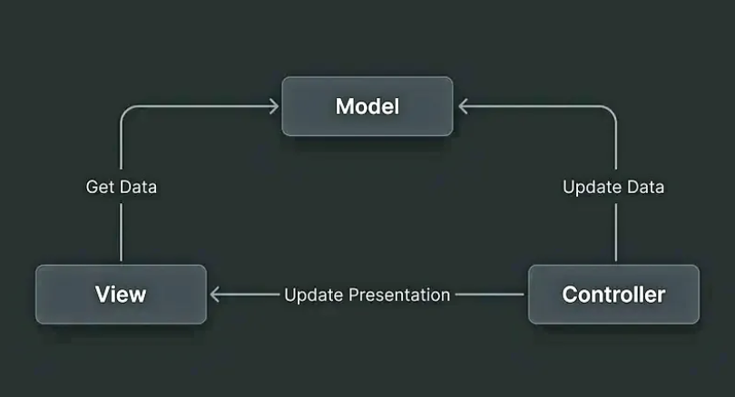
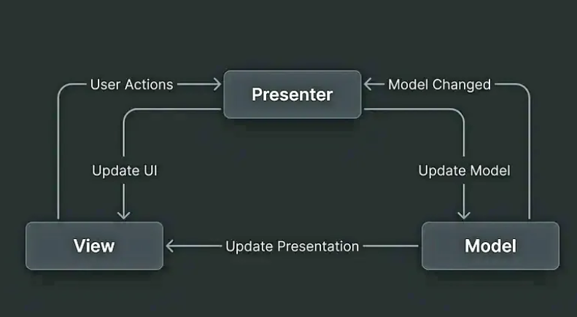
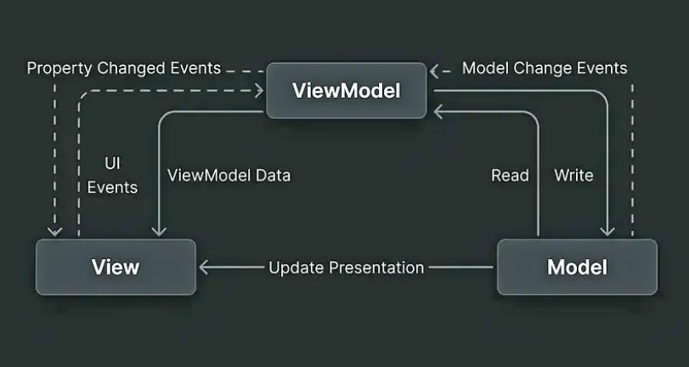
MOBILE APP ARCHITECTURE
MOBILE APP DEVELOPMENT FRAMEWORK
Definition
Importance of mobile app architecture (Why is it essential?)
Examples of common mobile app architectures
The overview of mobile app development framework will be done in a comparison analysis approach. It will be done based on the following aspects:
Feature
Performance
Development time
UI/UX
Ideal use case
Fig 1: MVC schema
Fig 2: MVP schema
Fig 3: MVVM schema
4
5

Slide 6
DESIGN PATTERNS
MOBILE APP ARCHITECTURE
Definition
Examples of common mobile app architectures
5
Fig 1: MVC schema
Fig 2: MVP schema
Fig 3: MVVM schema
6
Definition
In mobile app development, a design pattern is a reusable solution to a common problem, serving as a blueprint for creating maintainable, extensible, and efficient applications by addressing recurring design challenges.
Examples of mobile app design patterns
Singleton
Strategy
Observer

Slide 7
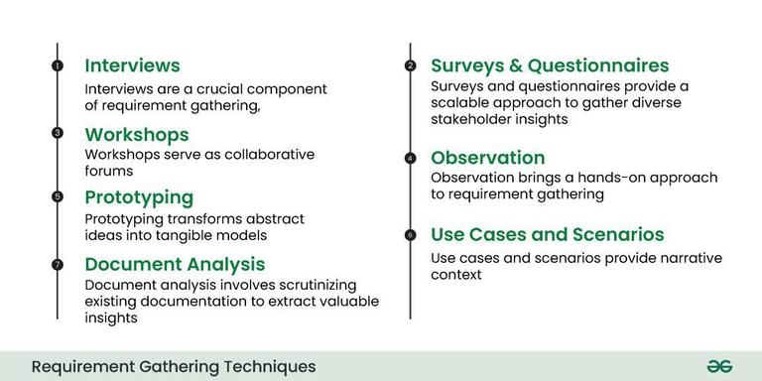
TECHNIQUES USED TO COLLECT AND ANALYSE USER REQUIREMENTS (REQUIREMENT ENGINEERING)
DESIGN PATTERNS
TECHNIQUES USED TO COLLECT USER REQUIREMENTS
TECHNIQUES USED TO ANALYZE USER REQUIREMENTS
Definition
In mobile app development, a design pattern is a reusable solution to a common problem, serving as a blueprint for creating maintainable, extensible, and efficient applications by addressing recurring design challenges.
Examples of mobile app design patterns
Singleton
Strategy
Observer
Refining, classification and prioritization of requirements.
Use Visual Aids and Tools.
Documenting requirements.
7
6

Slide 8
COST ESTIMATION FOR MOBILE APP DEVELOPMENT
TECHNIQUES USED TO COLLECT AND ANALYSE USER REQUIREMENTS (REQUIREMENT ENGINEERING)
TECHNIQUES USED TO COLLECT USER REQUIREMENTS
TECHNIQUES USED TO ANALYZE USER REQUIREMENTS
THIRD PARTY INTEGRATION
API Integrations. E.g. Payment gateways (Stripe, PayPal), Google Maps, social media login
Database & Cloud storage. E.g. Firebase, AWS, Google Cloud, Microsoft Azure
Push Notification & Real Time Features. E.g. Firebase Cloud Messaging, OneSignal
The cost estimation for mobile app development can be done in a sequence of steps that include:
Step 1: Choose the Platform
Step 2: Evaluate App Design Complexity
Step 3: Estimate Development Hours
Step 4: Research Development Rates
Step 5: Consider Additional Expenses
Step 6: Include a Contingency Budget
Refining, classification and prioritization of requirements.
Use Visual Aids and Tools.
Documenting requirements.
7
8

Slide 9

COST ESTIMATION FOR MOBILE APP DEVELOPMENT
THIRD PARTY INTEGRATION
API Integrations. E.g. Payment gateways (Stripe, PayPal), Google Maps, social media login
Database & Cloud storage. E.g. Firebase, AWS, Google Cloud, Microsoft Azure
Push Notification & Real Time Features. E.g. Firebase Cloud Messaging, OneSignal
The cost estimation for mobile app development can be done in a sequence of steps that include:
Step 1: Choose the Platform
Step 2: Evaluate App Design Complexity
Step 3: Estimate Development Hours
Step 4: Research Development Rates
Step 5: Consider Additional Expenses
8

