Slide 1
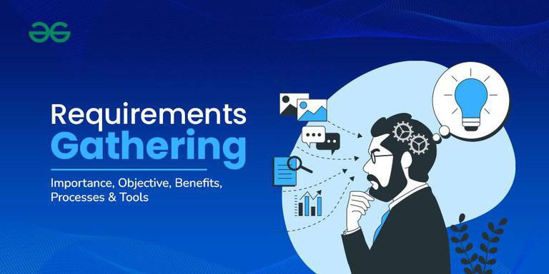

REPUBLIC OF CAMEROON
---
PEACE – WORK – FATHERLAND
---
MINISTRY OF HIGHER EDUCATION
---
UNIVERSITY OF BUEA
REPUBLIQUE DU CAMEROON
---
PAIX – TRAVAIL – PATRIE
---
MINISTERE DE L’ENSEIGNEMENT SUPERIEURE
---
UNIVERSITE DE BUEA
1
FACULTY OF ENGINEERING AND TECHNOLOGY
---
DEPARTMENT OF COMPUTER ENGINEERING
PRESENTATION ON THE
REQUIREMENT GATHERING PROCESS
Presented by
GROUP 13
Course Title: Internet Programming (J2EE) and Mobile Programming (CEF440)
Course Instructor: Dr. NKEMENI Valery
Academic year: 2024 -2025
PRESENTATION OUTLINE
Introduction
Stakeholders identification
Requirement gathering techniques
Data gathering
Data cleaning
User reluctance assessment
Conclusion

Slide 2
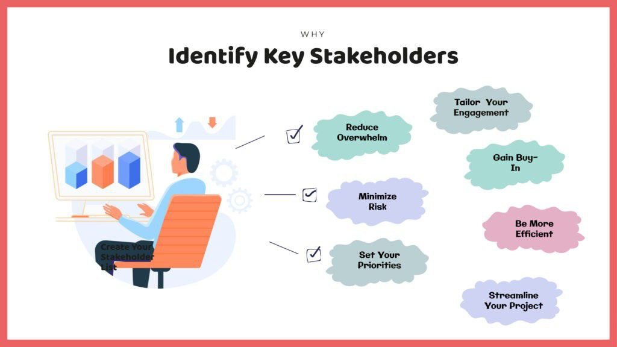
STAKEHOLDERS IDENTIFICATION
Who are stakeholders?
Stakeholder are the people or groups who are directly or indirectly affected by the system being built.
During the process, the following stakeholders were identified:
Mobile network subscribers (Users)
Mobile network operators
(Example: MTN, Orange, CAMTEL)
Project Team (Us)
Lecturer (Project evaluator)
2
PRESENTATION OUTLINE
Introduction
Stakeholders identification
Requirement gathering techniques
Data gathering
Data cleaning
User reluctance assessment
Conclusion
1

Slide 3
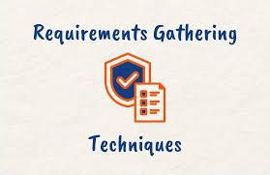
STAKEHOLDERS IDENTIFICATION
Who are stakeholders?
Stakeholder are the people or groups who are directly or indirectly affected by the system being built.
During the process, the following stakeholders were identified:
Mobile network subscribers (Users)
Mobile network operators
(Example: MTN, Orange, CAMTEL)
Project Team (Us)
Lecturer (Project evaluator)
2
3
REQUIREMENT GATHERING TECHNIQUES
It should be noted that different stakeholders have different needs and the collection of accurate, clear, and complete requirements is the foundation for building a useful mobile app.
For the requirement gathering process, we made use of the following techniques:
Surveys
Interviews
Brainstorming
Reverse engineering

Slide 4

DATA GATHERING
The data gathering phase served as the foundation for understanding the needs and
expectations of both end-users and other stakeholders.
Types of Data collected
Subjective data
Objective data
Data sources
Google form surveys
Hardcopy surveys
Stakeholder interviews.
Data recording and organization
Digital responses
Manual responses
Interview summaries
4
REQUIREMENT GATHERING TECHNIQUES
It should be noted that different stakeholders have different needs and the collection of accurate, clear, and complete requirements is the foundation for building a useful mobile app.
For the requirement gathering process, we made use of the following techniques:
Surveys
Interviews
Brainstorming
Reverse engineering
3

Slide 5
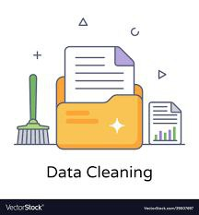
5
DATA CLEANING
This process involved identifying and correcting errors, handling missing values, and standardizing responses to make the dataset suitable for further analysis and system design.
Cleaning method applied
- Responses from hardcopy survey forms were manually entered into another google
form for analysis.
- Each entry was reviewed for clarity and correctness before the response was submitted.
- For the interviews conducted with the network operator agents, unclear or unstructured responses were clarified when possible.
DATA GATHERING
The data gathering phase served as the foundation for understanding the needs and
expectations of both end-users and other stakeholders.
Types of Data collected
Subjective data
Objective data
Data sources
Google form surveys
Hardcopy surveys
Stakeholder interviews.
Data recording and organization
Digital responses
Manual responses
Interview summaries
4

Slide 6
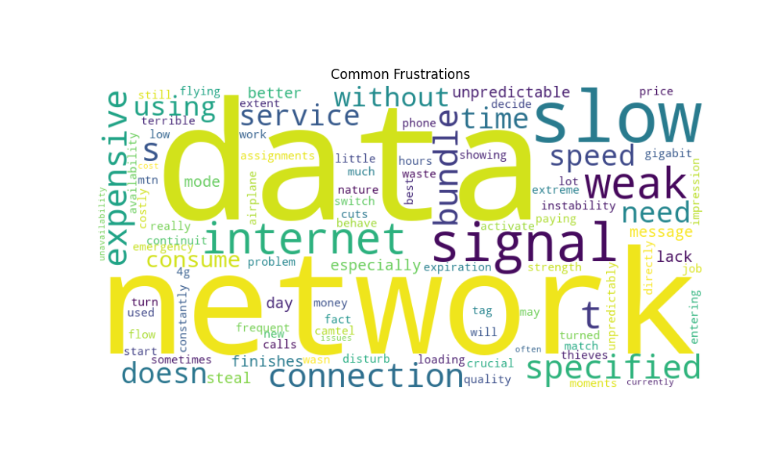
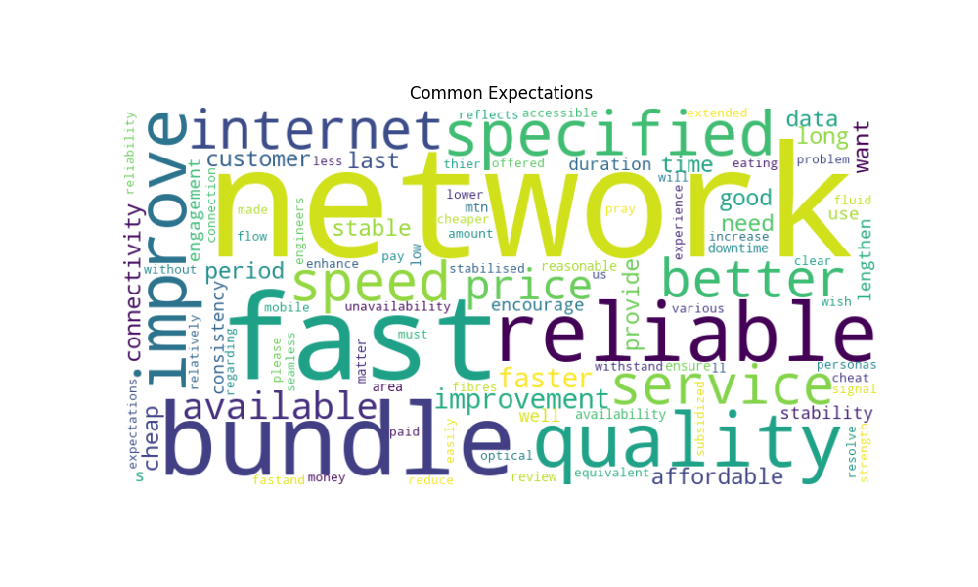
DATA CLEANING
Definition: This is the process of detecting, correcting, or removing corrupt or inaccurate records from the gathered dataset. This cleaned dataset is suitable for further analysis and system design.
Objectives of Data cleaning process
- Improve data quality
- Enhance performance
- Ensure integrity
Cleaning method applied
- We made use of pandas (python) in order to handle missing data through intelligent imputation.
- We carried out sentiment analysis on the cleaned dataset in order to get insights about factors like user expectations and user frustration.
5
6

Slide 7
7
6
USER RELEUCTANCE ASSESSMENT
Through the data collection process that was conducted, we experienced a certain level of reluctance from some users which was characterized by:
Some complains like time availability: Some users showed some reluctance by turning us down when we pleaded for some of their time to carry out the survey.
Limited awareness: Some users just directly expose their disinterest when the purpose of the survey was explained to them.
Lack of trust in the purpose of the app: Some users didn’t fully understand the purpose of QoE data collection.

Slide 8
This task involved the identification of the stakeholders, data gathering through the various requirement gathering techniques and data cleaning.
From the gathered data, we could identify that 87% of the users showed positive interest in using the app.
The work done during this task provides a strong base for the next phase of the development process.
CONCLUSION
USER RELEUCTANCE ASSESSMENT
Through the data collection process that was conducted, we experienced a certain level of reluctance from some users which was characterized by:
Some complains like time availability: Some users showed some reluctance by turning us down when we pleaded for some of their time to carry out the survey.
Limited awareness: Some users just directly expose their disinterest when the purpose of the survey was explained to them.
Lack of trust in the purpose of the app: Some users didn’t fully understand the purpose of QoE data collection.
8
7

Slide 9
This task involved the identification of the stakeholders, data gathering through the various requirement gathering techniques and data cleaning.
From the gathered data, we could identify that 87% of the users showed positive interest in using the app.
The work done during this task provides a strong base for the next phase of the development process.
CONCLUSION
8

