Slide 1
MANAGEMENT REVIEW
Ames Housing
Price Prediction
End-to-end ML pipeline · Detailed analysis for decision
0.129
$29.3k
0.864
80
OOF RMSE (log)
OOF RMSE ($)
OOF R²
Features used
Data Analytics Team · October 2026

Slide 2
AMES HOUSING · PRICE PREDICTION
AGENDA
Session roadmap
01
Executive summary & decision ask
05
Model training & validation
Results at a glance and what we need from management
Algorithms, CV scores, residuals, ensemble logic
02
Business context & data profile
06
Test predictions & artifacts
Objective, success criteria, sample, missingness
Submission distribution, delivery package
03
What drives sale price
07
Recommendations & next steps
Correlations, neighborhood, quality, size, age
Deploy, monitor, improve — owners and timing
04
Feature pipeline
Engineering, selection path, final 80 features
Management Review · Confidential
02 / 14

Slide 3
AMES HOUSING · PRICE PREDICTION
EXECUTIVE SUMMARY
Production-ready ensemble with ~$29k typical absolute error
0.129
$29,250
$15,200
0.864
OOF RMSE (log)
OOF RMSE (USD)
OOF MAE (USD)
OOF R²
DECISION ASK
Approve deployment of the 4-model ensemble (HistGradientBoosting + Ridge + RandomForest + GradientBoosting) for batch valuation scoring.
Expected typical absolute error $15k–$30k on homes in the $100k–$250k band. Full pipeline, models, and submission file are ready for use.
Strongest drivers
Method integrity
Known risks
OverallQual, TotalSF (engineered), HouseAge, GarageCars, KitchenQual / ExterQual. Quality and size explain most of the variance.
All imputation, encoding, and selection fit on train only. 212 engineered features reduced to 80 via variance, correlation, and RFE without CV loss.
Two extreme GrLivArea outliers; sparse luxury features (pool, tennis). Tree models already dampen their influence. Monitor residual drift post-deploy.
Management Review · Confidential
03 / 14

Slide 4
AMES HOUSING · PRICE PREDICTION
BUSINESS CONTEXT
Build a transparent, reproducible automated valuation model
Objective
Success criteria
Predict SalePrice for held-out Ames homes with accuracy suitable for listing guidance and portfolio screening. Output must be explainable and fully auditable.
OOF log-RMSE ≤ 0.14 and absolute RMSE competitive with industry AVMs (roughly 10–18% of median price). Clear feature importance for stakeholders.
Audience & decision
Constraints
Management go/no-go on internal deployment. Secondary use: optional public leaderboard submission for external benchmarking.
No external data sources. Only the provided 2006–2010 Ames train/test files. Strict train-only fitting to prevent leakage. Reproducible notebooks required.
Management Review · Confidential
04 / 14

Slide 5
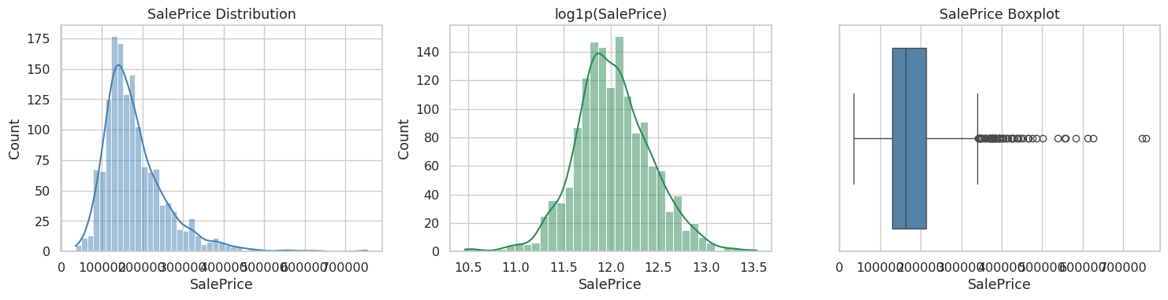
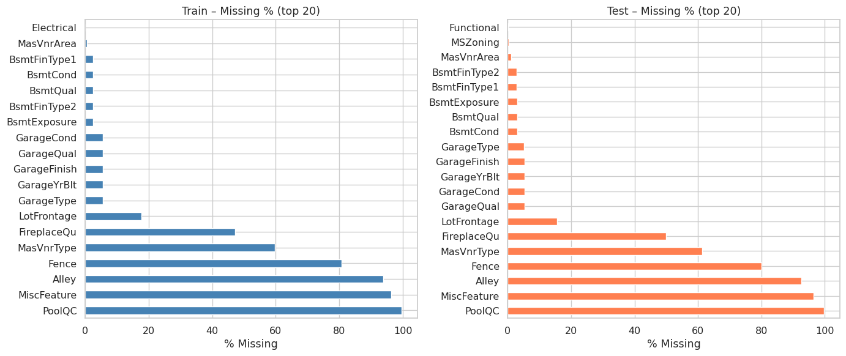
AMES HOUSING · PRICE PREDICTION
DATA PROFILE
1,460 labeled + 1,459 test homes · informative missingness, not random gaps
1,460
1,459
81
$163k
$181k
1.88
Train homes
Test homes
Raw columns
Median price
Mean price
Target skew
Management Review · Confidential
05 / 14

Slide 6
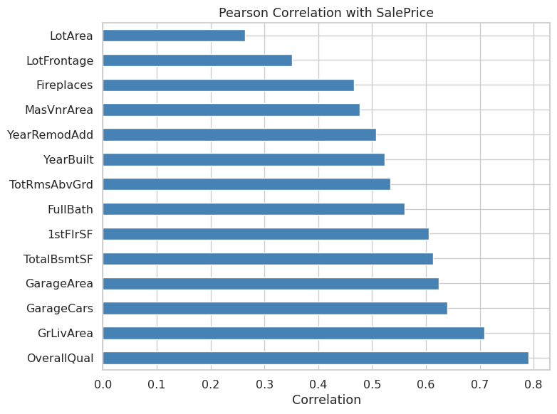
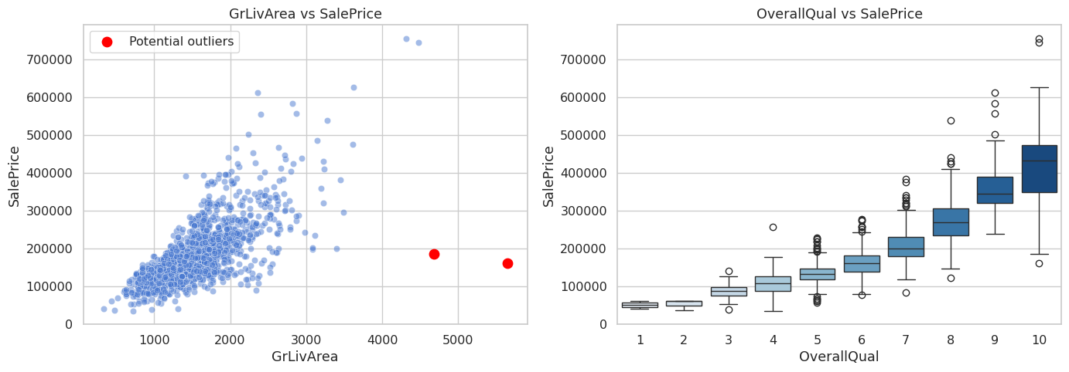
AMES HOUSING · PRICE PREDICTION
KEY DRIVERS
Quality and living area dominate — correlation with SalePrice
Management Review · Confidential
06 / 14

Slide 7
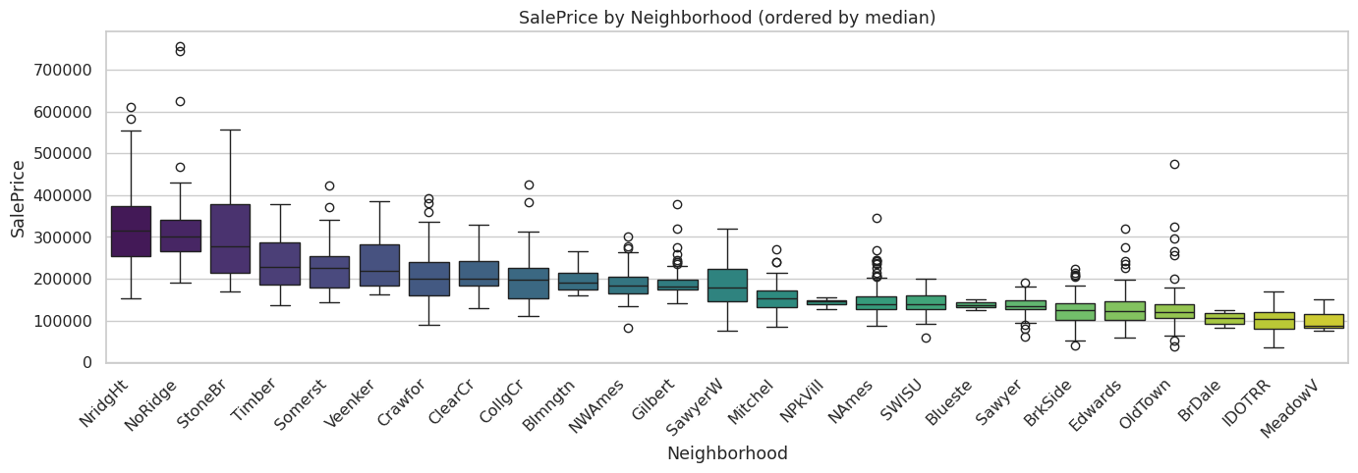
AMES HOUSING · PRICE PREDICTION
LOCATION & TIME
Neighborhood premiums and construction era both matter after quality is controlled
INSIGHTS
Top neighborhoods (NoRidge, NridgHt, StoneBr) command 2× the median of lower-tier areas.
Newer construction and recent remodels show clear price premiums. Mild seasonality by month sold is secondary to quality and size.
Engineered HouseAge and RemodAge capture these effects more cleanly than raw year fields.
Management Review · Confidential
07 / 14

Slide 8
AMES HOUSING · PRICE PREDICTION
FEATURE ENGINEERING
Domain-aware transforms that preserve information and avoid leakage
01
Impute
OUTPUT
“None”/0 for absence features (Pool, Alley, Garage*, Bsmt*). LotFrontage by Neighborhood median. Mode for sparse categoricals.
212
features
02
Derive
TotalSF, TotalBath, TotalPorchSF, HouseAge, RemodAge, GarageAge, OverallGrade, binary flags (HasPool, HasFireplace…).
After engineering, before selection. All steps fit on train only and applied identically to test.
03
Encode
Ordinal maps (Ex→5 … Po→1) for quality/condition. One-hot for remaining nominals. CentralAir → binary.
04
Transform
log1p(SalePrice) used as modeling target to stabilize variance.
log1p on continuous features with |skew| > 0.75. Drop near-constant columns (Utilities, Street).
Management Review · Confidential
08 / 14

Slide 9
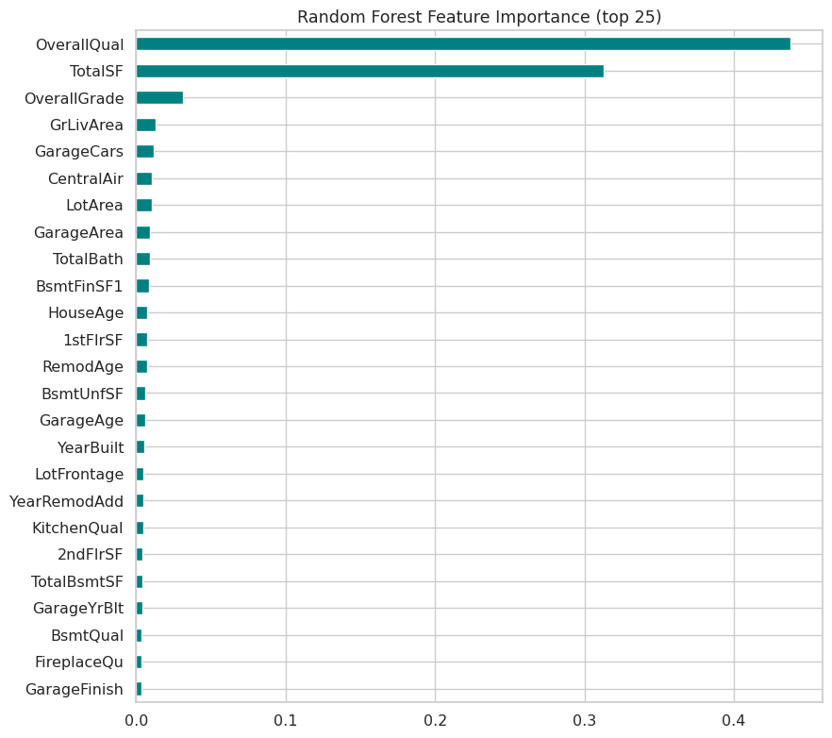
AMES HOUSING · PRICE PREDICTION
FEATURE SELECTION
212 → 80 features with no loss in cross-validated accuracy
Selection path
212 → ~200
Variance threshold (0.01)
~200 → ~190
Drop |corr| > 0.95 pairs
~190 → 80
RFE (Random Forest, k=80)
CV RMSE unchanged after reduction — selected set is sufficient and simpler to deploy.
Management Review · Confidential
09 / 14

Slide 10
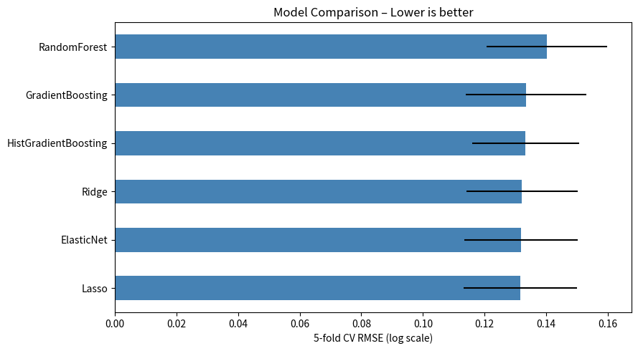
AMES HOUSING · PRICE PREDICTION
MODEL PERFORMANCE
Four models + simple average — lowest OOF error without added complexity
Model | CV RMSE (log) | Std
Ridge (α=50) | 0.132 | 0.018
HistGradientBoosting | 0.133 | 0.017
GradientBoosting | 0.134 | 0.019
RandomForest | 0.140 | 0.019
Ensemble average | 0.129 | —
$15,200
$29,250
0.864
OOF MAE ($)
OOF RMSE ($)
OOF R²
Management Review · Confidential
10 / 14

Slide 11
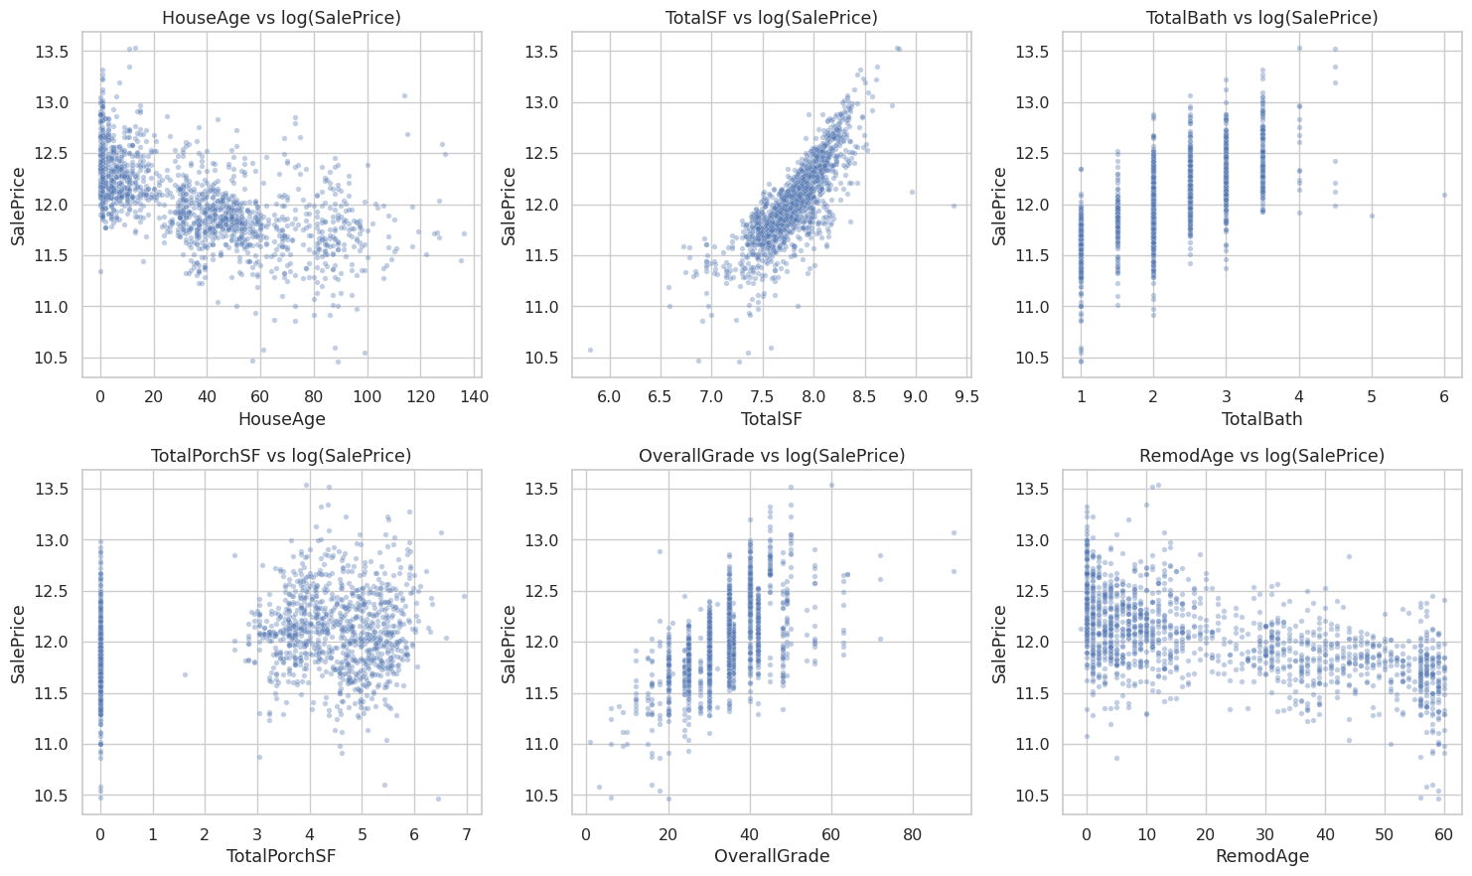
AMES HOUSING · PRICE PREDICTION
ENGINEERED FEATURES
Post-FE relationships confirm TotalSF, age, and quality composites carry signal
WHY THESE
FEATURES?
TotalSF aggregates basement + floors into one size measure that models prefer over separate area fields.
HouseAge / RemodAge capture depreciation and update premiums more cleanly than YearBuilt alone.
Binary flags (HasFireplace, HasGarage) give tree models simple high-signal splits.
Management Review · Confidential
11 / 14

Slide 12
AMES HOUSING · PRICE PREDICTION
TEST PREDICTIONS
1,459 predictions — distribution aligns closely with training SalePrice
1,459
$177k
$156k
$54k
$530k
Predictions
Mean pred.
Median pred.
Min
Max
Train vs predicted distribution
DELIVERY PACKAGE
Metric | Train | Predicted
Mean | $180,921 | $177,154
Median | $163,000 | $155,887
Std | $79,443 | $73,840
25th pct | $129,975 | $127,909
75th pct | $214,000 | $207,602
• submission.csv — Id + SalePrice
• models/ — 4 joblib models
• processed/ — 80-feature matrices
• Kernels/01–06 — audit notebooks
• This management deck (PPT + PDF)
All paths under artifacts/ for full reproducibility.
Management Review · Confidential
12 / 14

Slide 13
AMES HOUSING · PRICE PREDICTION
RECOMMENDATIONS
Deploy · Monitor · Improve
01
Deploy the ensemble
Use the 4-model average for batch valuation. Expected error band $15k–$30k on typical homes. Owner: Analytics. Timing: immediate after approval.
02
Instrument monitoring
Track residual mean and RMSE on new closed sales quarterly. Retrain trigger: RMSE drift > 15%. Owner: Data Eng + Analytics.
03
Document the pipeline
Promote imputation rules, ordinal maps, and the 80-feature list to a versioned production transform. Owner: Analytics. Timing: this sprint.
04
Next-wave improvements
Add LightGBM/XGBoost + stacking; nested target-encoding for Neighborhood; collect post-2010 sales for market-trend features. Expected gain: 2–4% RMSE.
Management Review · Confidential
13 / 14

Slide 14
READY FOR DECISION
Approve deployment of the
Ames housing price ensemble
OOF RMSE ≈ $29k · R² 0.86 · 80 features · Full audit trail
Questions & discussion
Data Analytics Team · October 2026

