Slide 1

File Sharing Website
Guided By:
Prof. Snehal Gavale
Presented By:
Chetan Soni (69)
Naveed Shaikh (64)
Rajesh Shivthare (68)
Nishant Thakre (71)

Slide 2
Table of Contents
Introduction
Literature Survey
Problem Statement
Block Diagram
Algorithm
Flow Chart
Implementation
Conclusion
References

Slide 3
Introduction
File sharing tool enables end users to exchange a wide range of file formats such as text documents, images, and videos and shared access to storage space.
It is commonly used to download and share media files with other people.
Privacy is a concern while using public access computers.
Logging in personal accounts for sharing and receiving files can be risky.
File may end up getting stored in the pc and can be misused.
Using an online method of sharing file reduces the privacy concern.

Slide 4
Literature Survey

Slide 5
Literature Survey
Title | Author | Description
Online File Sharing Innovations in Media Consumption -2018 | Jonas Andersson Schwarz | It is apparent that file sharing on the Internet has become an emerging norm of media consumption—especially among young people. This book provides a critical perspective on this phenomenon, exploring issues related to file sharing, downloading, peer-to-peer networks, "piracy," and (not least) policy issues regarding these practices.
Web Development with Node and Express: Leveraging the JavaScript Stack -2019 | Ethan Brown | Build dynamic web applications with Express, a key component of the Node/JavaScript development stack. In this updated edition, author Ethan Brown teaches you Express fundamentals by walking you through the development of an example application. This hands-on guide covers everything from server-side rendering to API development suitable for usein single-page apps (SPAs).

Slide 6
Problem Statement
Creation of an online site to be able to share files without forming a direct connection between two devices. Create a file sharing system where the sent file can be accessed and downloaded only through the given link and the file gets automatically deleted from the server after a certain period of time to prevent misuse and for privacy concerns.

Slide 7
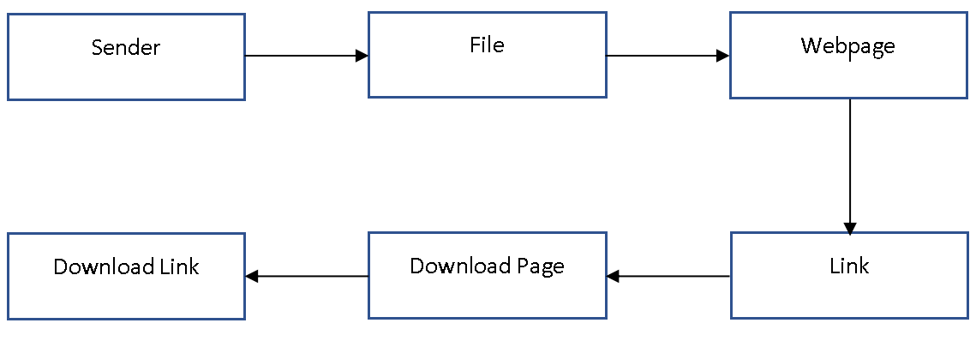
Block Diagram

Slide 8
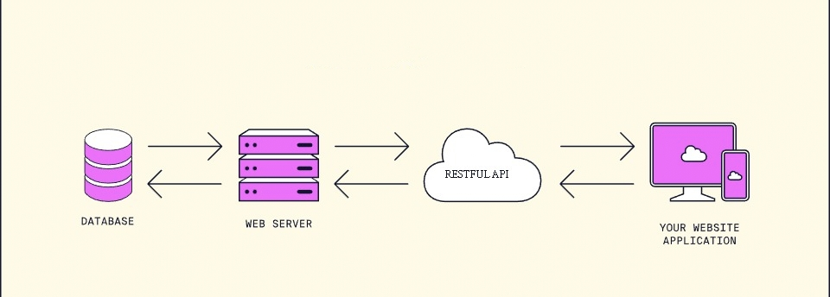
API Working
Rest API

Slide 9
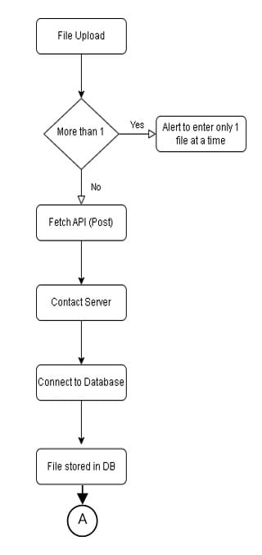
Flowchart

Slide 10
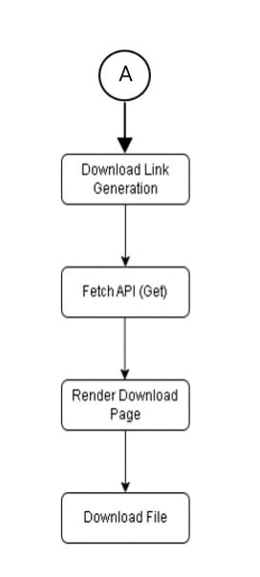

Slide 11
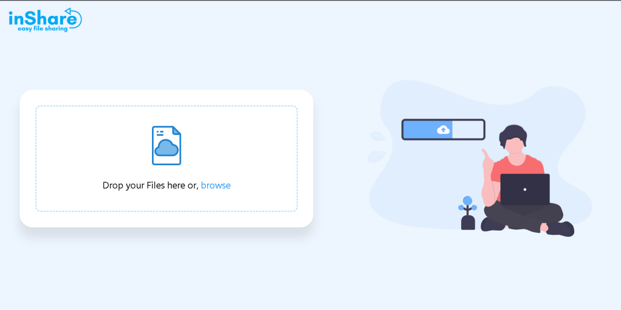
Outputs
Home Page

Slide 12
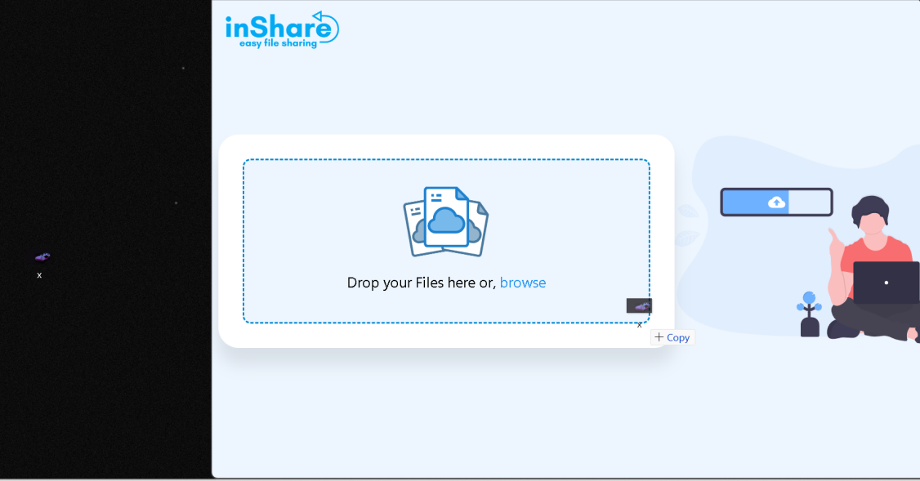
Drag & Drop

Slide 13
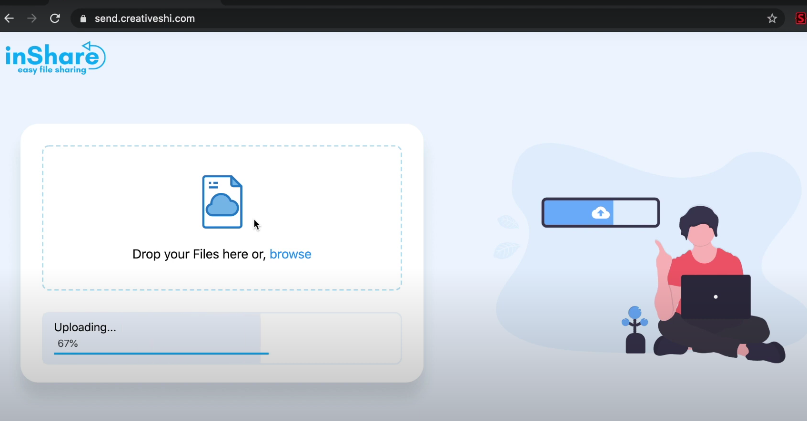
Uploading Bar

Slide 14
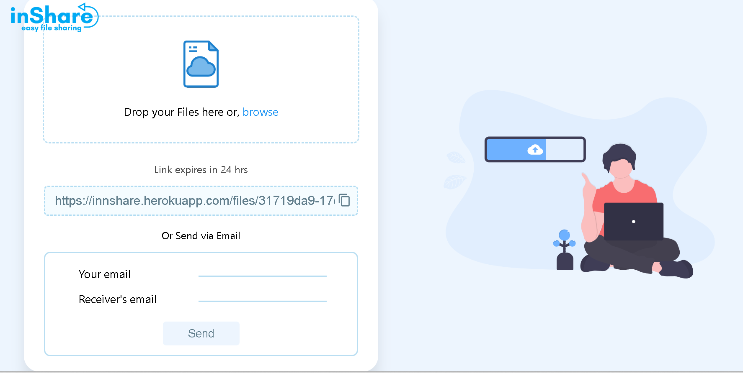
Download Page link

Slide 15
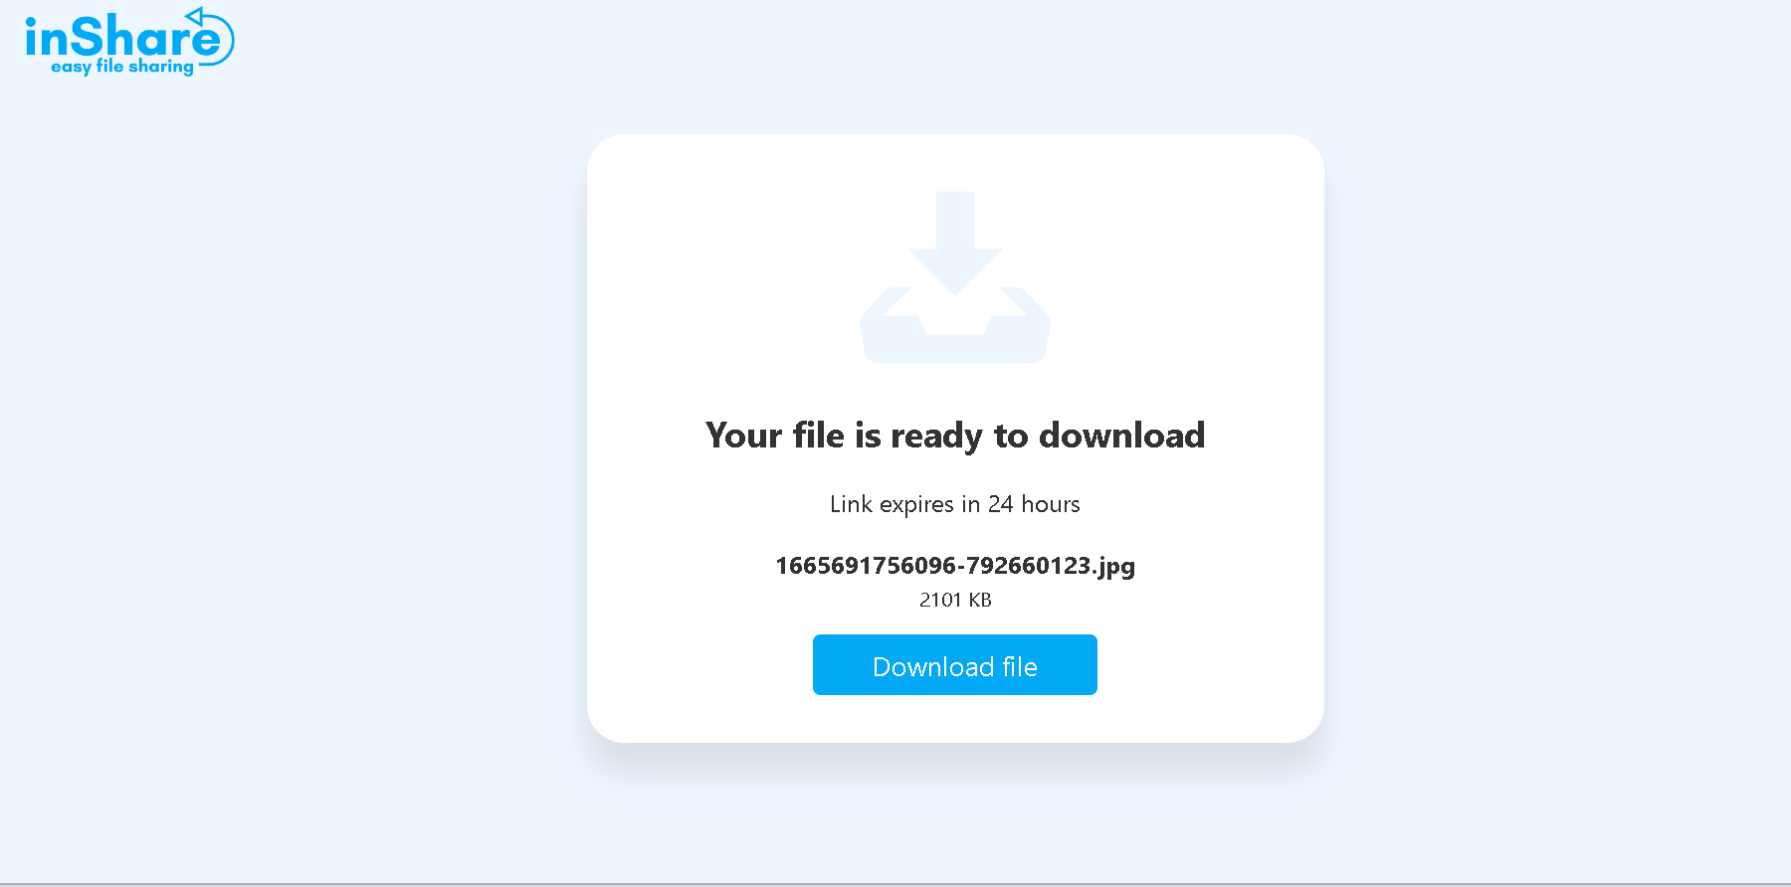
Download Page

Slide 16
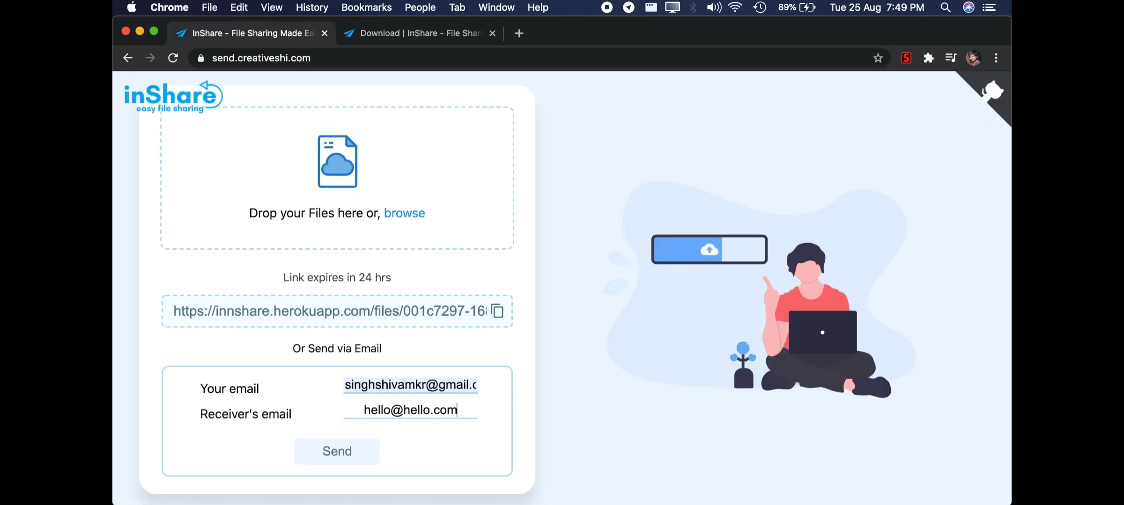
Emai Service

Slide 17
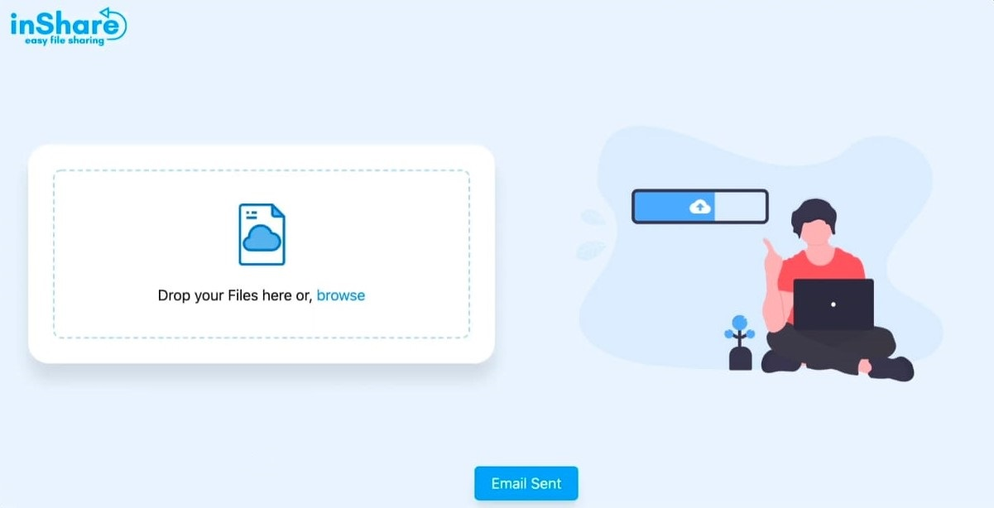
Email Sent Alert

Slide 18
Conclusion
Creation of this file sharing website provides a platform for the user to send and receive files over the internet with the helper middle man being the website. The problem of sharing files between two computers without wired connection is solved by the file sharing website which allows to share file in any format.

Slide 19
References
https://developer.mozilla.org/en-US/docs/Web/CSS
https://nodejs.org/en/docs/
https://www.w3schools.com/xml/ajax_intro.asp
https://www.w3schools.com/html/html5_draganddrop.asp
https://developer.mozilla.org/en-US/docs/Web/API/Fetch_API
https://www.w3schools.com/html/html_forms.asp
Survey Paper: FrameWork of Rest APIs (IJERT)
Review on various Aspects of MongoDB Databases

Slide 20


