Slide 1
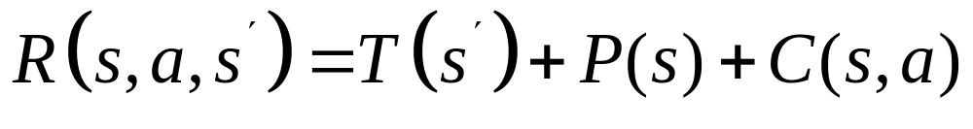
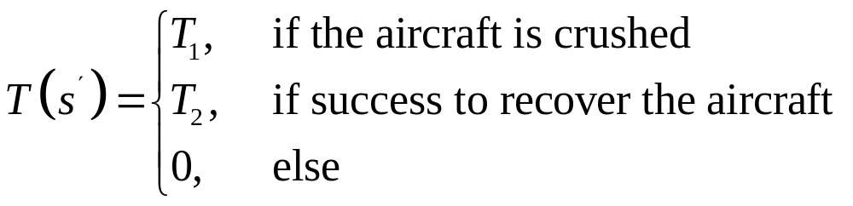
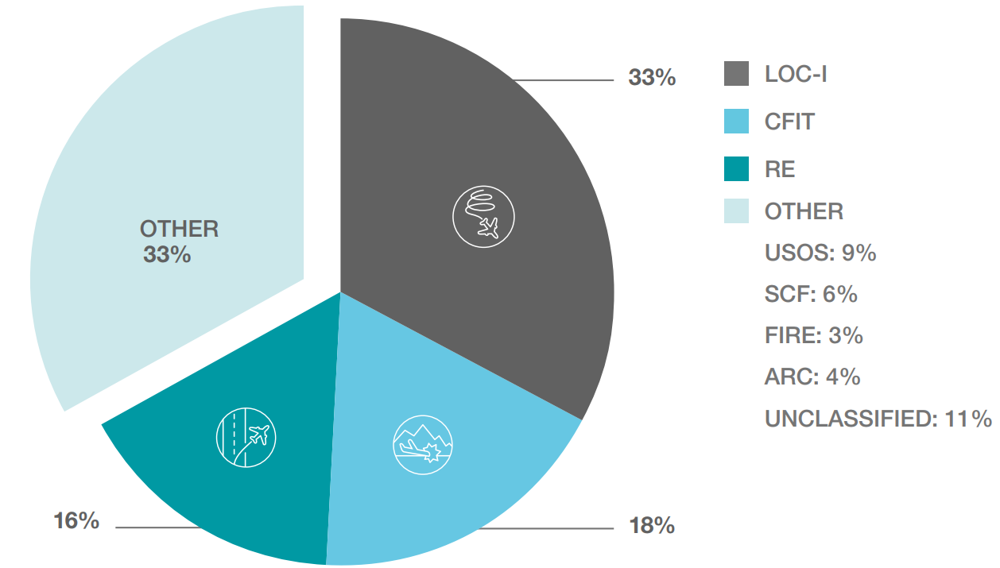
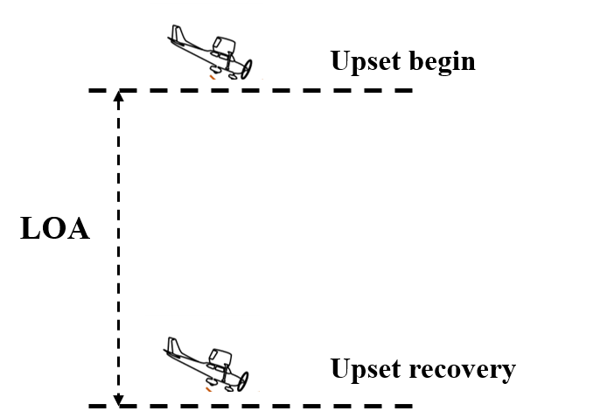
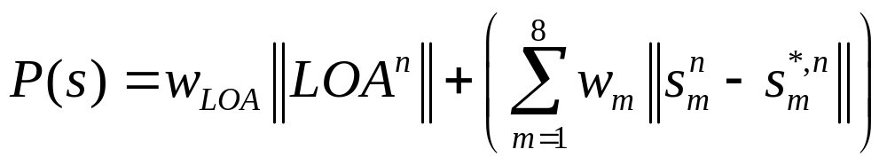
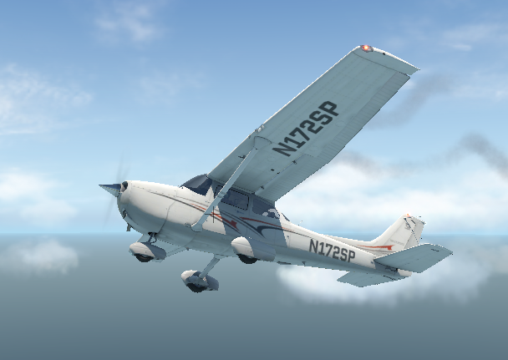
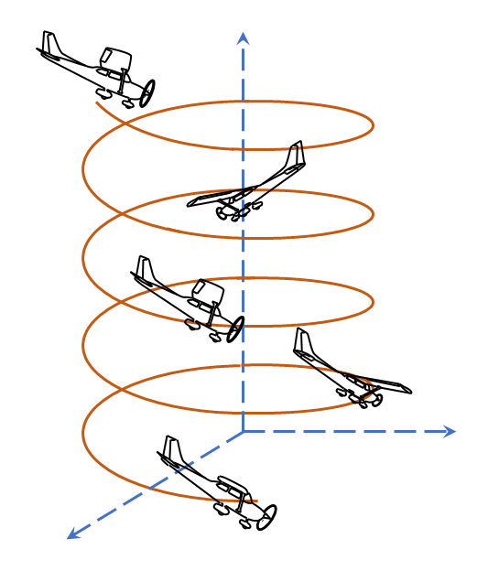
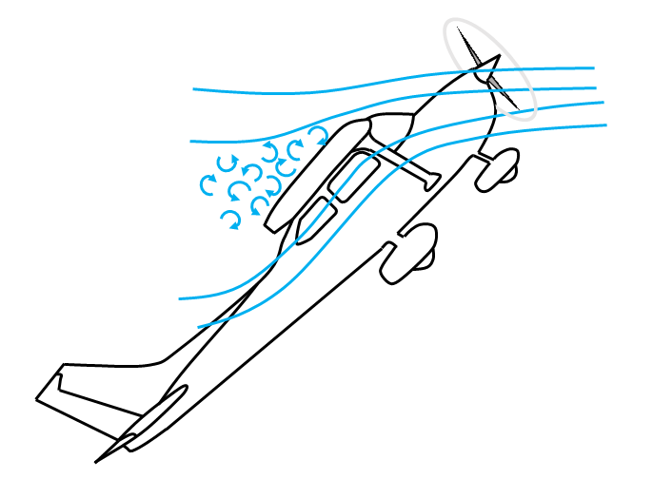
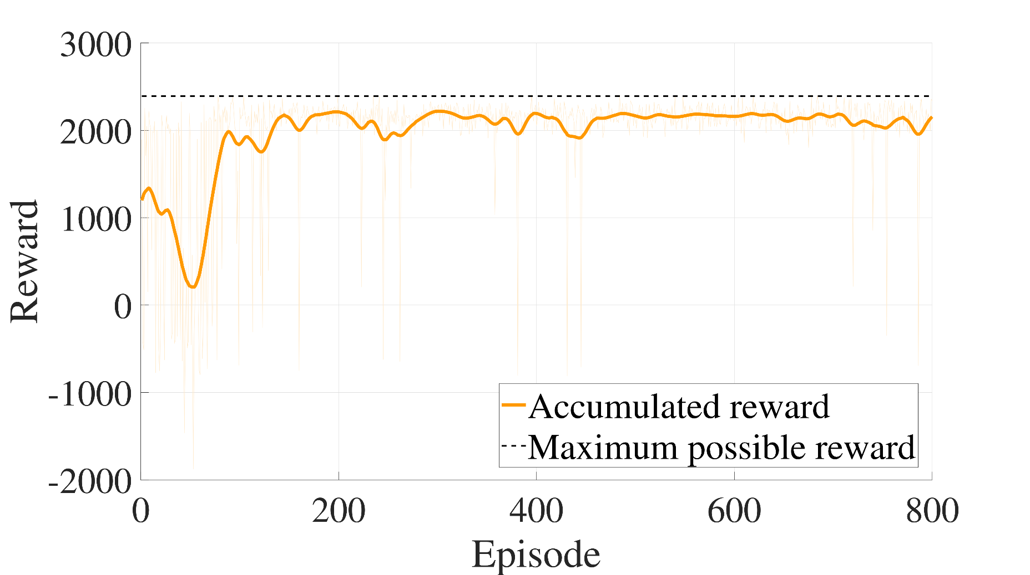
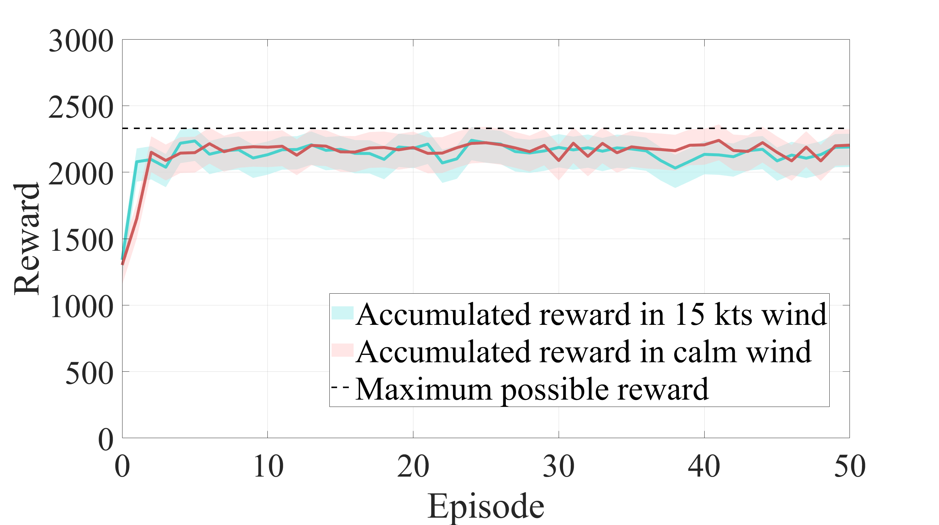
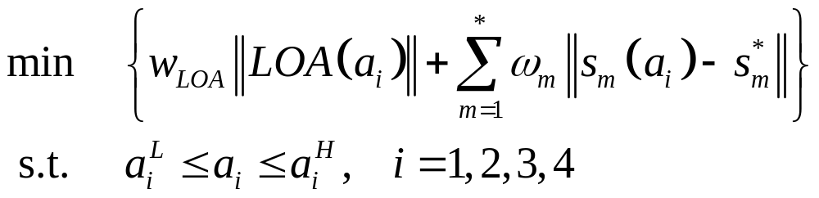
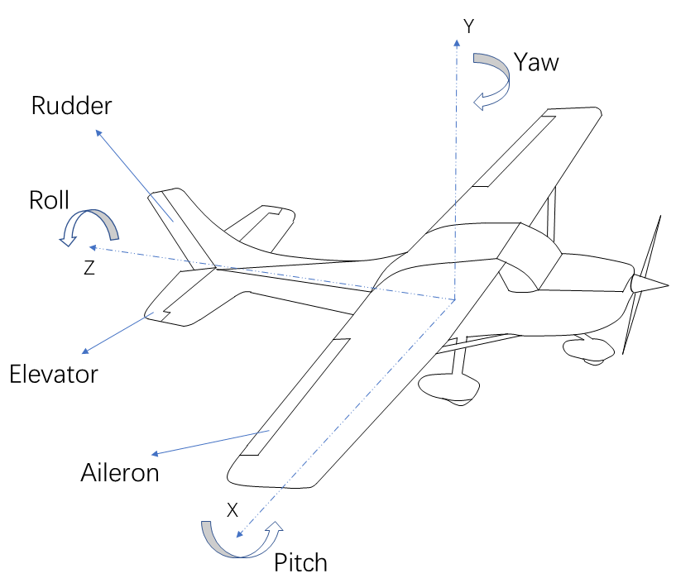
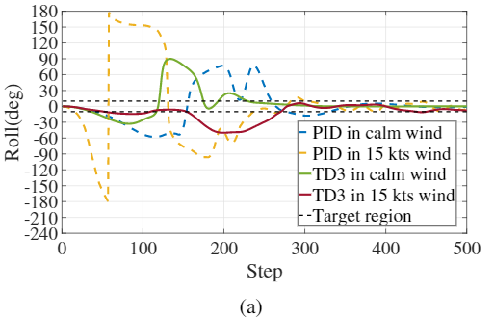
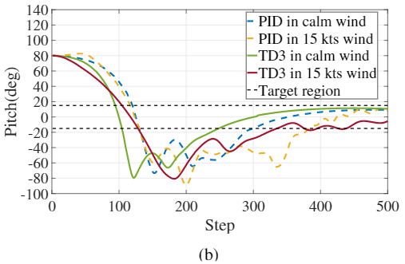
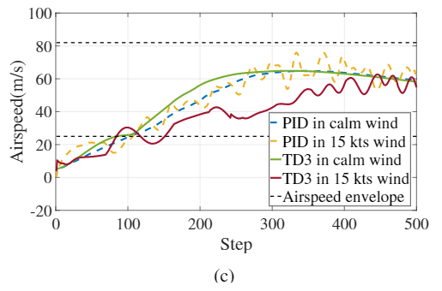
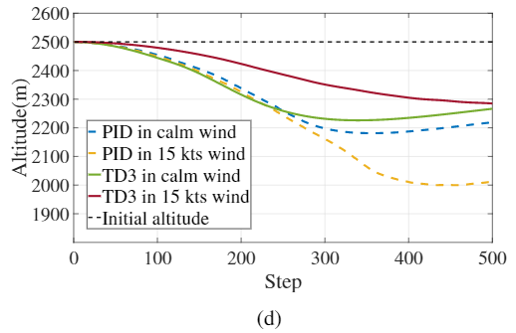
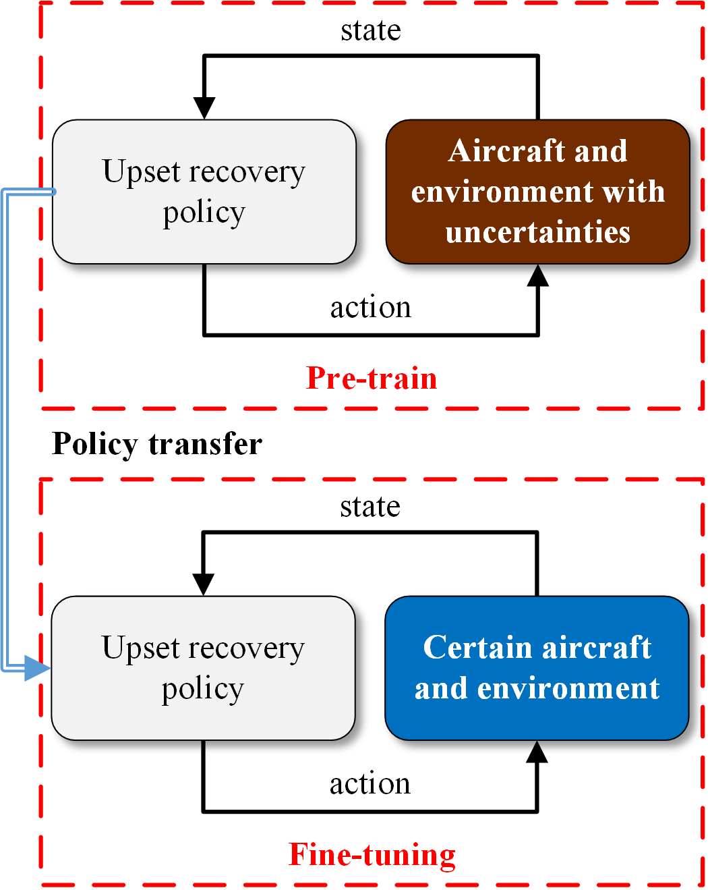
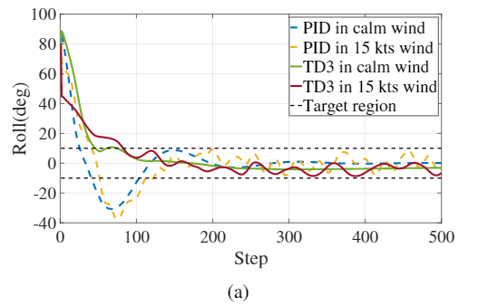
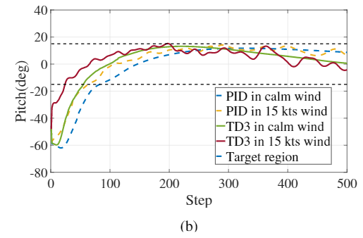
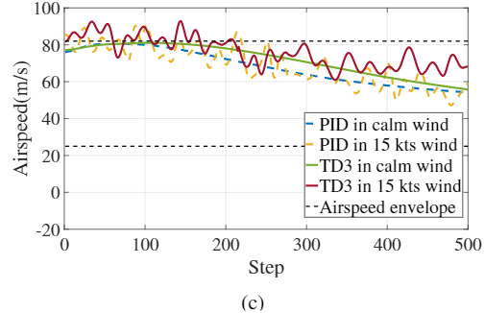
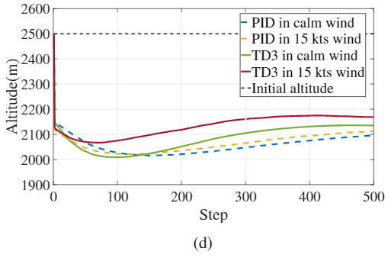
Two-Stage Strategy to Achieve a Reinforcement Learning-Based Upset Recovery Policy for Aircraft
（ID: 3598）
Huanhui Cao, Weifeng Zeng, Hantao Jiang, Hao Hu, Chaoran Li, Wenjie Lu, and Hao Xiong*
School of Mechanical Engineering and Automation
Harbin Institute of Technology
Shenzhen, China
xionghao@hit.edu.cn
Problem
Reward Function
Aircraft upset situations are the highest risk to civil aviation from decades ago to now.
Traditional control strategies may fail to address the high complexity of upset situations.
  reward shaping：
  Termination reward：
  State-related reward：
  C(s,a) depends on the attitude and angular velocity of an aircraft.
Experiments
A Cessna172SP in X-Plane 11
  X-Plane 11 is a professional flight simulator.
  A Cessna172SP is included in experiments based on X-Plane 11.
Fatal accidents distribution per accident category 1999-2019
Loss of Altitude
Experiments
Upset situations of an aircraft
Training of upset recovery policies
  In pre-train stage, the weight of the aircraft and wind condition are with uncertainties. An upset recovery policy can converge in 100 episodes.
  In fine-tuning stage, the weight of the aircraft and wind condition are determined. An upset recovery policy can converge in three episodes.
A Cessna172SP in X-Plane 11
Stall
Spin
Method
Reinforcement Learning (RL) is applied to develop an upset recovery strategy for aircraft suffering complex upset situations.
The problem addressed by an upset recovery strategy can be expressed as
Reward achieved in the pre-train stage
Rewards achieved in the fine-tuning stage
Evaluation of upset recovery policies
  The performance of upset recovery policies achieved according to the proposed two-stage strategy is evaluated based on stall recovery and spin recovery. A Proportional-Integral-Differential (PID) controller is well-tuned and works as a reference.
  Stall recovery
  Spin recovery
The control surfaces of an aircraft
An RL-based upset recovery strategy includes two stages - a pre-train stage and a fine-tuning stage.
The a) roll, b) pitch, c) airspeed, and d) altitude of an aircraft in stall recovery
The a) roll, b) pitch, c) airspeed, and d) altitude of an aircraft in spin recovery
Contributions
A two-stage strategy to achieve an RL-based upset recovery policy has ben proposed to recover an aircraft from an arbitrary upset situation to level flight taking the time of recovery and LOA into account.
According to the proposed two-stage strategy, an algorithm to achieve a TD3-based upset recovery policy has been developed.
An RL-based upset recovery strategy

