Slide 1
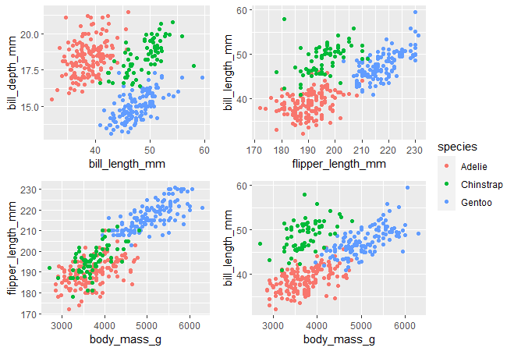
library(palmerpenguins)
library(ggpubr)
# save each plot as an object
p1 <- ggplot(penguins,
aes(x=bill_length_mm,
y=bill_depth_mm,
color = species)) +
geom_point()
p2 <- ggplot(penguins,
aes(x=flipper_length_mm,
y=bill_length_mm,
color = species)) +
geom_point()
p3 <- ggplot(penguins,
aes(x=body_mass_g,
y=flipper_length_mm,
color = species)) +
geom_point()
p4 <- ggplot(penguins,
aes(x=body_mass_g,
y=bill_length_mm,
color = species)) +
geom_point()
# arrange plots as you like
ggarrange(p1, p2, p3, p4, nrow=2, ncol=2, common.legend=TRUE, legend="right")

Slide 2
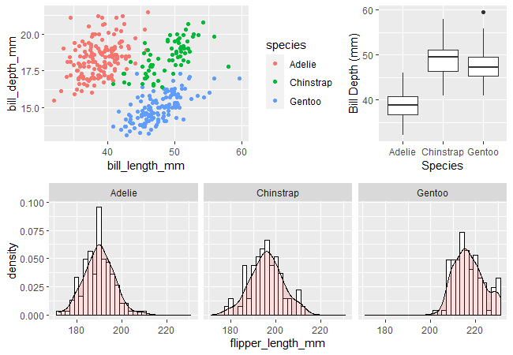
library(palmerpenguins)
library(ggpubr)
# save each plot as an object
p1 <- ggplot(penguins, aes(x=bill_length_mm, y=bill_depth_mm, color = species)) +
geom_point()
p2 <- ggplot(penguins, aes(x=species, y=bill_length_mm)) + geom_boxplot() +
xlab("Species") +
ylab("Bill Depth (mm)")
p3 <- ggplot(penguins, aes(x=flipper_length_mm)) + geom_histogram(aes(y=..density..), binwidth=2, colour="black", fill="white") +
geom_density(alpha=.2, fill="#FF6666") + facet_wrap(vars(species))
# arrange plots as you like
ggarrange(ggarrange(p1, p2, widths=c(2, 1)), p3, nrow=2, ncol=1)

