Slide 1
DASSI experiment
Professor:
Student:

Slide 2
Contents
1
System identification of DC motor
2
Control of DC motor
3
Control of rotary inverted pendulum
4
Swing control of rotary inverted pendulum

Slide 3
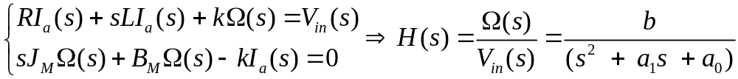

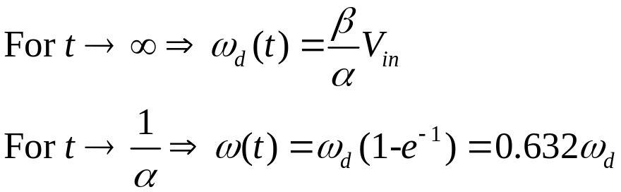
Identification
Thus,
Notes:
mathtype

Slide 4
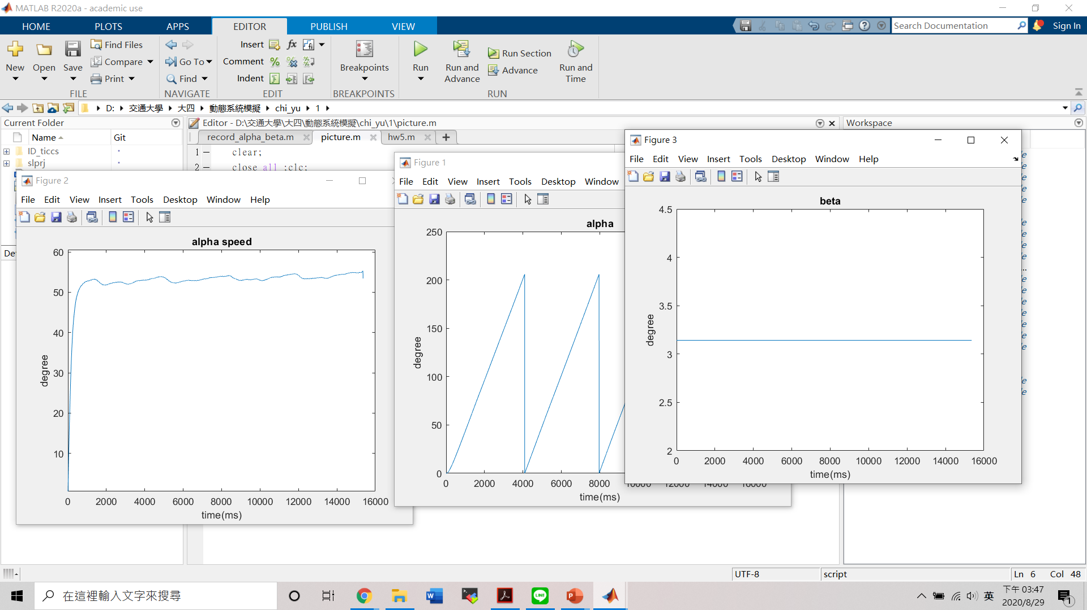

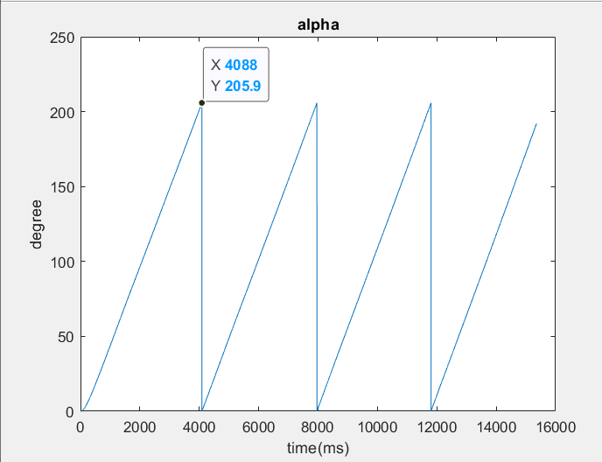
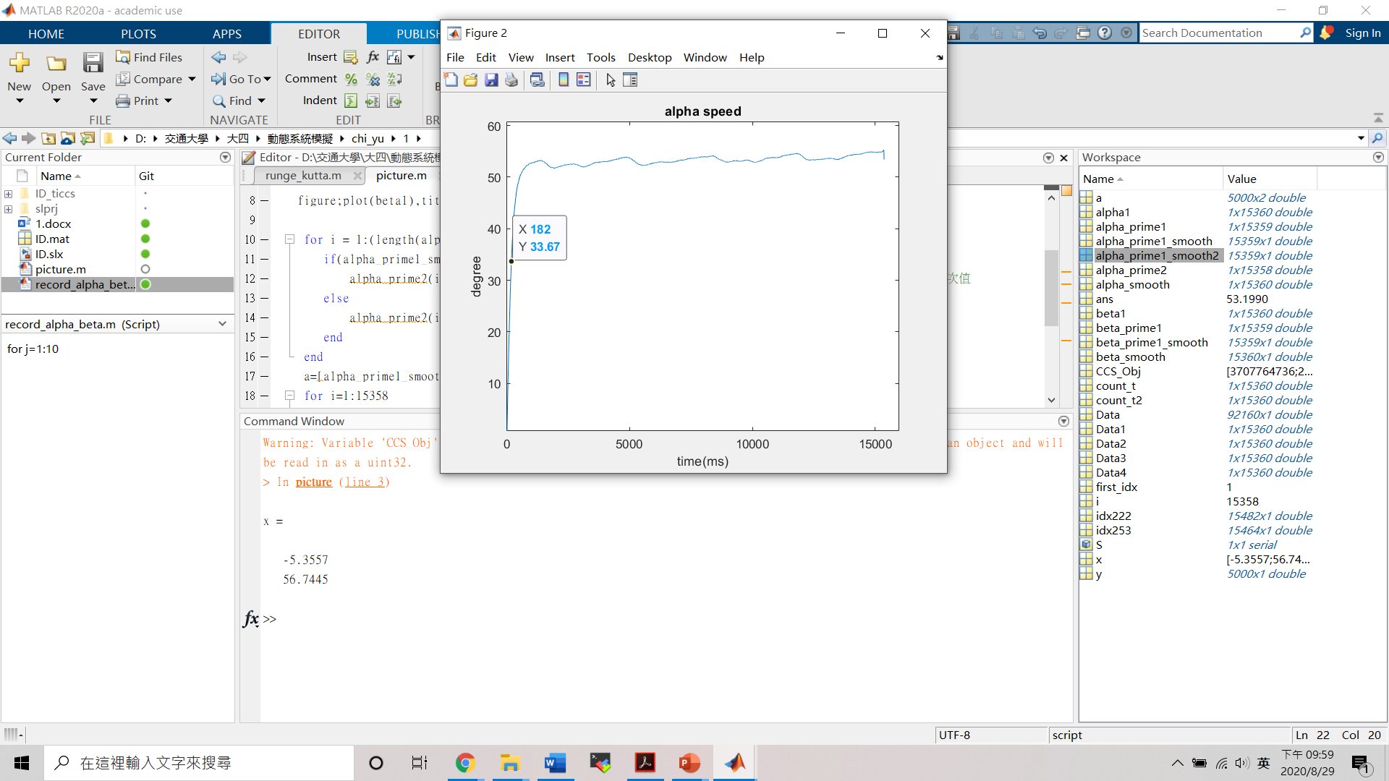
Identification
Input voltage Vs | 5V
Smooth span | 5

Slide 5
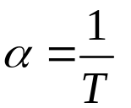
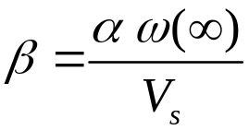
Time constant method
System equation
Steady state output | 55.38 (rad/s)
Time constant | 0.182 (s)
α | 5.52
β | 60.81

Slide 6
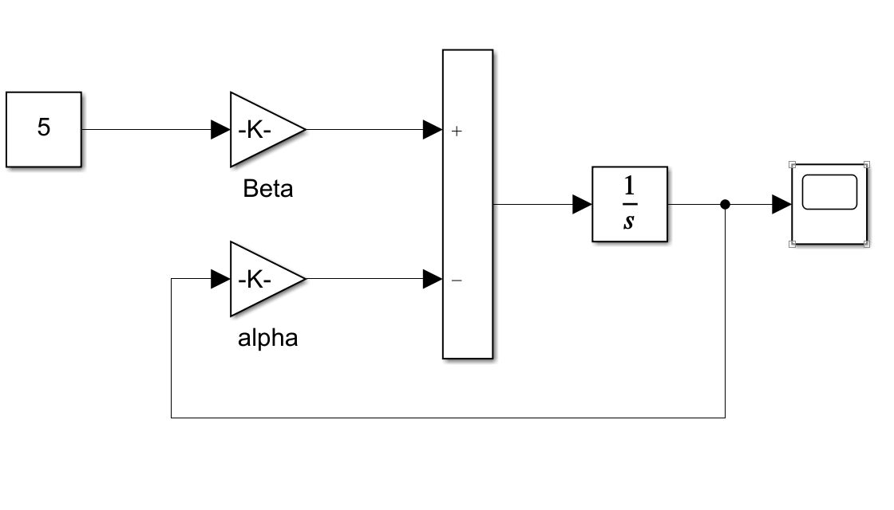
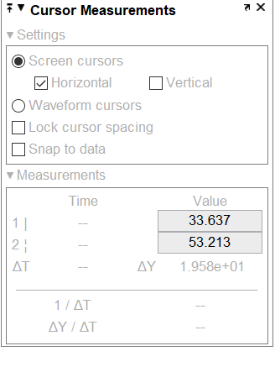
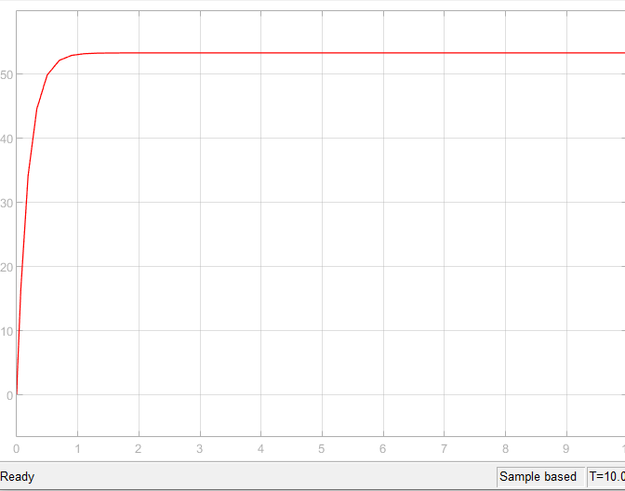
Time constant method

Slide 7


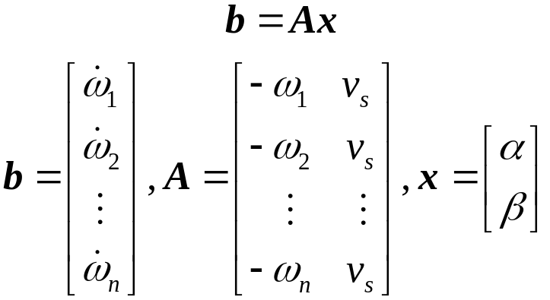
Least square method
Get α
Get β
points | 1500 | 2000
α | 5.71 | 5.61
β | 68.72 | 67.65

Slide 8
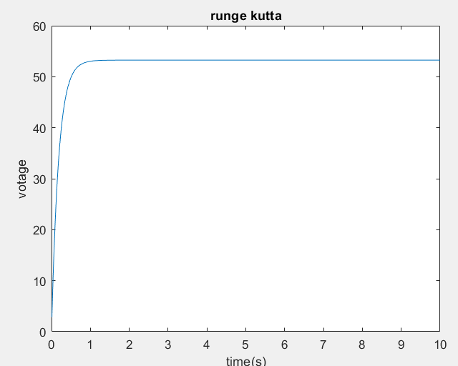
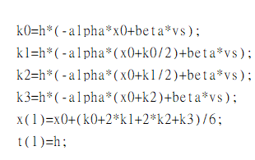
Runge-Kutta method

Slide 9
Contents
1
System identification of DC motor
2
Control of DC motor
3
Control of rotary inverted pendulum
4
Swing control of rotary inverted pendulum

Slide 10
Speed control

Slide 11


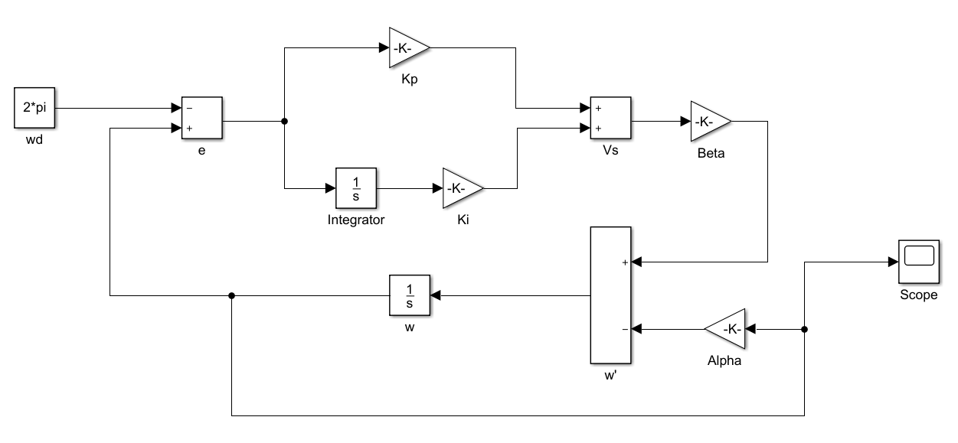

Speed control-Simulation
Notes:
simulink

Slide 12
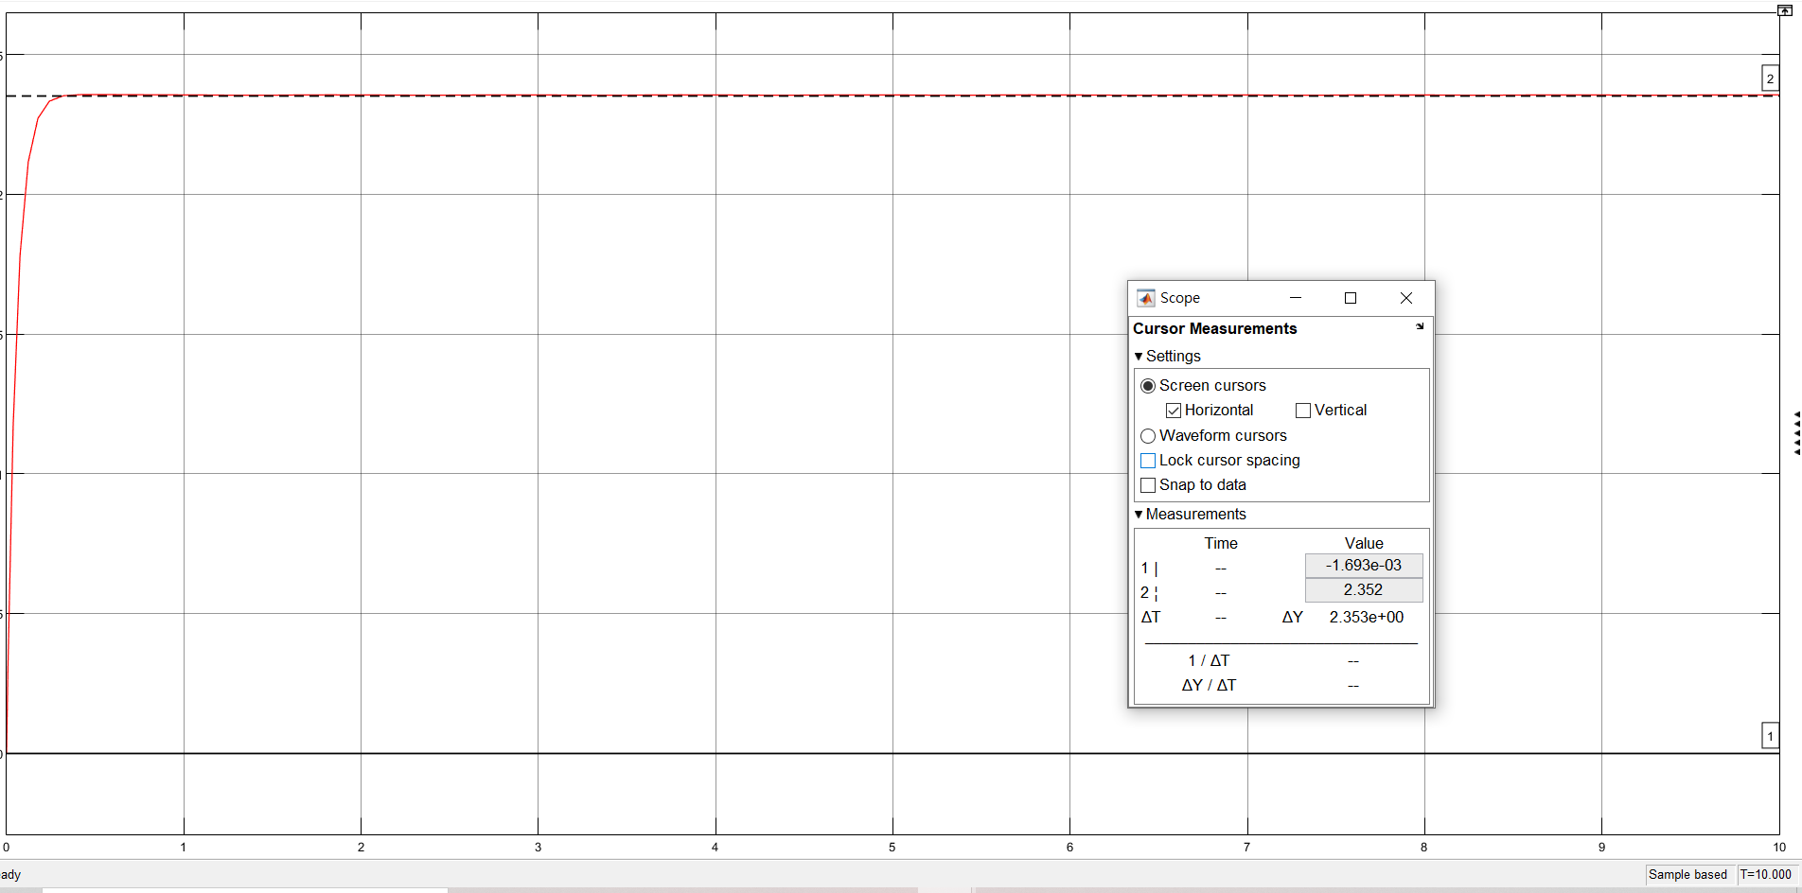
Simulation result

Slide 13
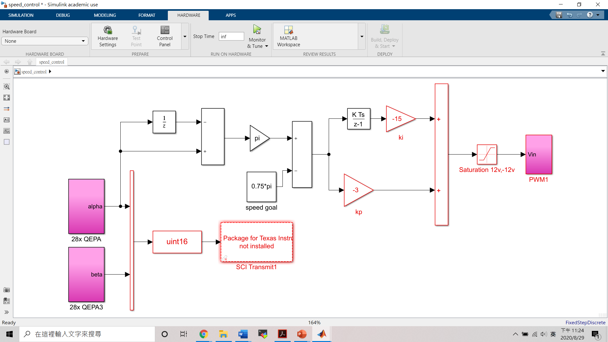
Speed control
Notes:
1：the output of the sensor,which its unit is the number of counts
2：produces the difference between the current signal and previous signal, and it can be seen as the approximation of the motor’s current velocity
3：transforms the signal’s from count to ωω
4：converts the data type to 16 bits digital data
5：is a constant input, which is the desired value we want to obtain
6：is a PI controller

Slide 14
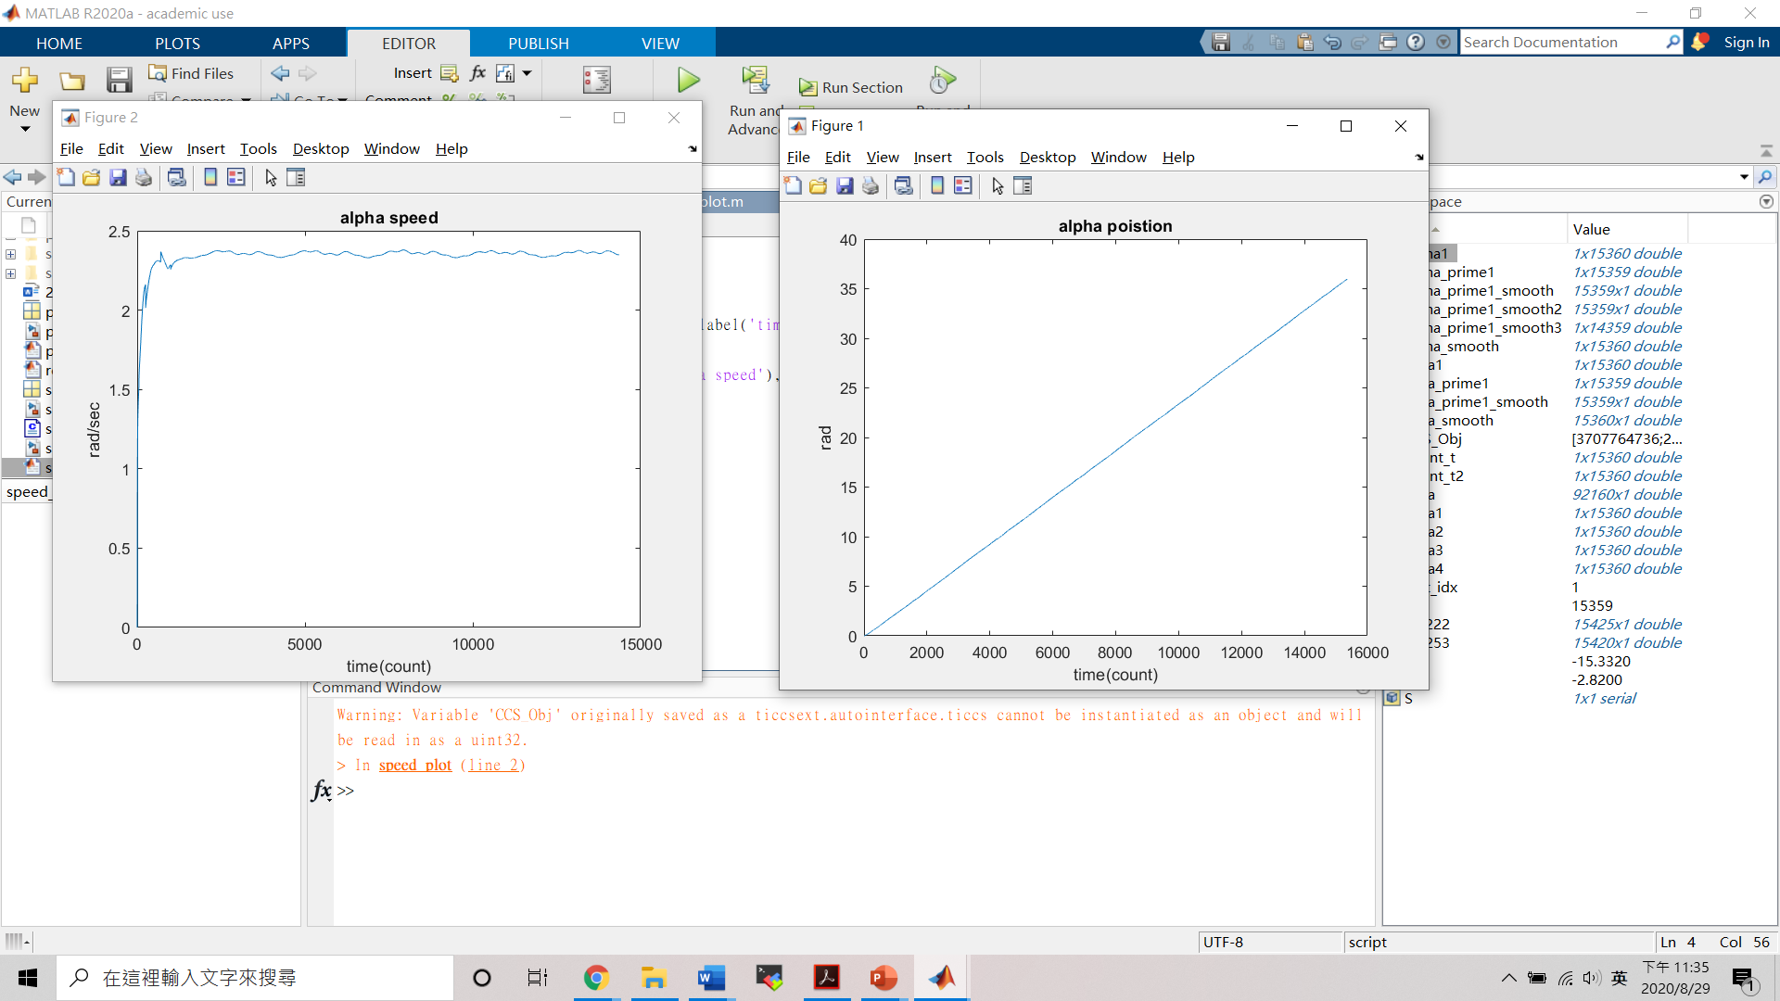
Experiment result
Speed
Angle

Slide 15
Position control

Slide 20
Contents
1
System identification of DC motor
2
Control of DC motor
3
Control of rotary inverted pendulum
4
Swing control of rotary inverted pendulum

Slide 21
Contents
1
System identification of DC motor
2
Control of DC motor
3
Control of rotary inverted pendulum
4
Swing control of rotary inverted pendulum

Slide 22
Hot Tip
How do I incorporate my logo to a slide that will apply to all the other slides?
  On the [View] menu, point to [Master], and then click [Slide Master] or [Notes Master]. Change images to the one you like, then it will apply to all the other slides.

Slide 23
Diagram
Title
Add your text
ThemeGallery is a Design Digital Content & Contents mall developed by Guild Design Inc.
ThemeGallery is a Design Digital Content & Contents mall developed by Guild Design Inc.

Slide 24
Cycle Diagram
Add Your Text
Text
Text
Text
Cycle name
Text
Text

Slide 25
Diagram
Text
Add Your
Title Text
Text 1
Text 2
Text 3
Text 4
Text 5
Add Your
Title Text
Text 1
Text 2
Text 3
Text 4
Text 5
Text
Text
Text
Text

Slide 26
Diagram
Text
Text
Concept
Text
Text
Text
Text
Add Your Text

Slide 27
Diagram
Add Your Text
Add Your Text
Add Your Text
Add Your Text
Add Your Text
Add Your Text
Add Your Text
Add Your Text

Slide 28
Diagram
Add Your Title
Add Your Title
ThemeGallery is a Design Digital Content & Contents mall developed by Guild Design Inc.
Add Your Title
ThemeGallery is a Design Digital Content & Contents mall developed by Guild Design Inc.
ThemeGallery is a Design Digital Content & Contents mall developed by Guild Design Inc.

Slide 29
Diagram
Text
Text
Text
ThemeGallery is a Design Digital Content & Contents mall developed by Guild Design Inc.
ThemeGallery is a Design Digital Content & Contents mall developed by Guild Design Inc.
ThemeGallery is a Design Digital Content & Contents mall developed by Guild Design Inc.

Slide 30
Marketing Diagram
Concept
Concept
concept
Concept

Slide 31
Diagram
Add Your Text
Add Your Text
Add Your Text
Text
Add Your Text
Add Your Text
Add Your Text

Slide 32
Diagram
1
2
3
ThemeGallery is a Design Digital Content & Contents mall developed by Guild Design Inc.
ThemeGallery is a Design Digital Content & Contents mall developed by Guild Design Inc.
ThemeGallery is a Design Digital Content & Contents mall developed by Guild Design Inc.

Slide 33
Diagram
2001
2002
2003
2004
Your Text
Your Text
Your Text
Your Text
Your Text
Your Text
Your Text
Your Text

Slide 34
Diagram
ThemeGallery is a Design Digital Content & Contents mall developed by Guild Design Inc.
Title
ThemeGallery is a Design Digital Content & Contents mall developed by Guild Design Inc.
Title
ThemeGallery is a Design Digital Content & Contents mall developed by Guild Design Inc.
Title

Slide 35
Block Diagram
TEXT
TEXT
TEXT
TEXT
TEXT
TEXT
TEXT
TEXT

Slide 36
Table
 | Title | Title | Title | Title | Title
Title | O | O | O | O | O
Title | O | O | O | O | O
Title | O | O | O | O | O
Title | O | O | O | O | O
Title | O | O | O | O | O
Title | O | X | O | X | O

Slide 37
3-D Pie Chart
Text2
Text3
Text1
Text4
Text5

Slide 38
Block Diagram
Add Your Text
Add Your Text
concept
Concept
Concept
Concept

Slide 39
Thank You !
www.themegallery.com

