Slide 1
DC motor control
Student ： YAO-MAO CHENG

Slide 2
Table of Contents
Identification
Speed control
Position control
1
2
3

Slide 3
Identification
Speed control
Position control
1
2
3

Slide 4
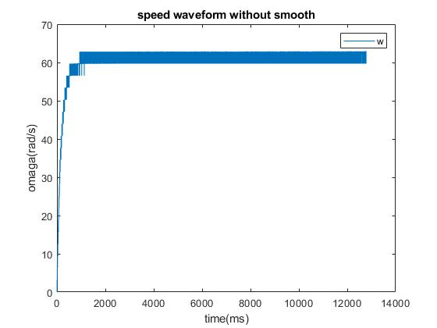
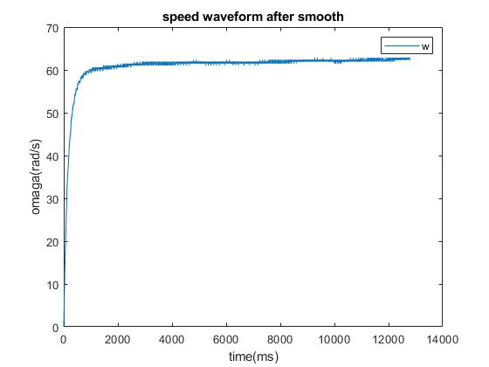

Identification
$$\dot{ω}\left(t\right)+αω\left(t\right)=βV_{s}\left(t\right)$$
Input voltage Vs |  | 5V
Smooth span |  | 7

Slide 5
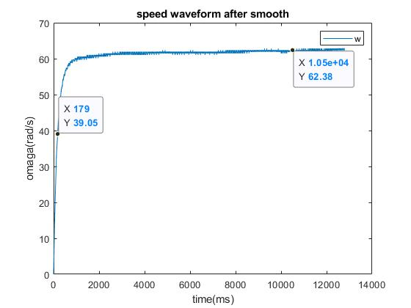

Time constant method
System equation
$$\dot{ω}\left(t\right)+αω\left(t\right)=βV_{s}\left(t\right)$$
Steady state output |  | 62.38 (rad/s)
Time constant |  | 0.179 (s)
α |  | 5.56
β |  | 69.37

Slide 6
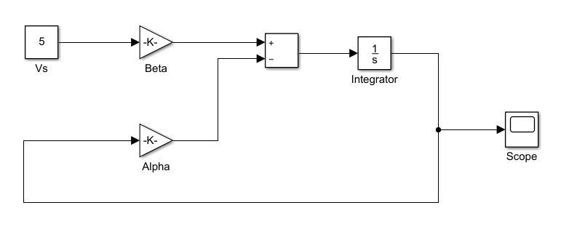
Time constant method
Block Diagram

Slide 7
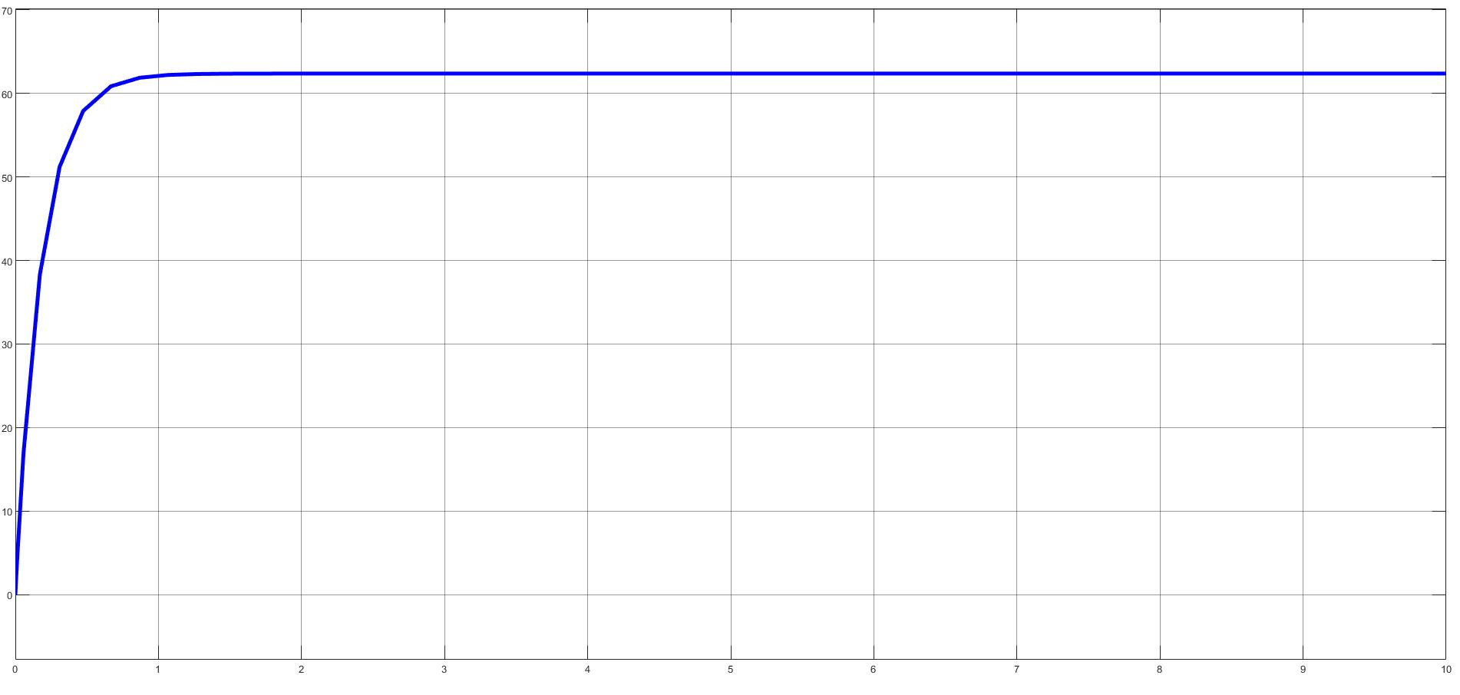
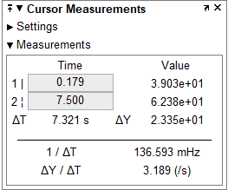
Time constant method
Speed waveform

Slide 8

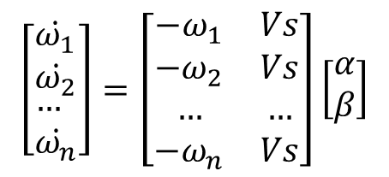



Least square method
$$\dot{ω}\left(t\right)+αω\left(t\right)=βv_{s}\left(t\right)$$
$$\underline{x}={\left(\underline{A^{T}} \underline{A}\right)}^{−1}\underline{A^{T}} \underline{y}$$
Get α
Get β
$$\left[\begin{aligned}&\begin{matrix}\dot{ω_{1}} \\ \dot{ω_{2}}\end{matrix} \\ &… \\ &\dot{ω_{n}}\end{aligned}\right]=\left[\begin{matrix}−ω_{1} & Vs \\ −ω_{2} & Vs \\ … & … \\ −ω_{n} & Vs\end{matrix}\right]\left[\begin{matrix}α \\ β\end{matrix}\right]$$
points |  | 1500 | 2000
α |  | 5.71 | 5.61
β |  | 68.72 | 67.65
$$\underline{y} \underline{x}$$
$$\underline{A}$$

Slide 9
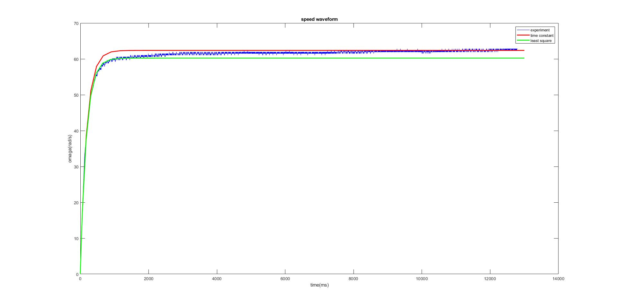
Comparison(Simulink simulation)

Slide 10
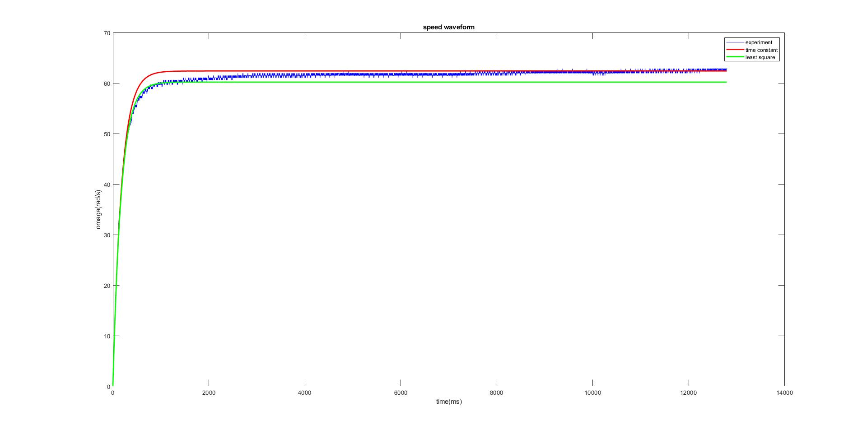
Comparison(Fourth-order Runge-Kutta method)

Slide 11
Identification
Speed control
Position control
1
2
3

Slide 12







Goal：2 (rad/s)
Method ：PI control
$$K_{P}=\frac{α−λ_{1}−λ_{2}}{β}$$
$$K_{I}= −\frac{λ_{1}λ_{2}}{β}$$
$$K_{P}$$ | -0.3208
$$K_{I}$$ | -1.7841
Use known β to design $K_{P} , K_{I}$
$$\dot{ω}\left(t\right)+αω\left(t\right)=βv_{s}\left(t\right)$$
Use known α to design eigenvalues
Simulink simulation
τ | 0.1796(s)
λ1 | 5.56
λ2 | 22.26
$v_{s}\left(t\right)=K_{P}e\left(t\right)+K_{I}\int_{0}^{t}{e(τ)dτ}$
$$e(t) = ω(t)−ω_{d}$$

Slide 13
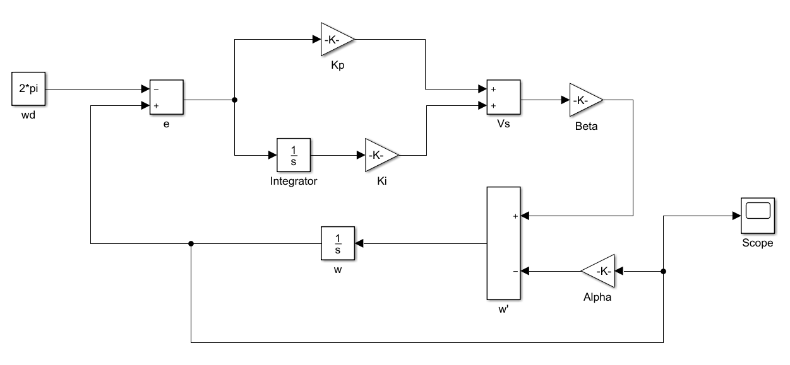



Speed control block diagram
$v_{s}\left(t\right)=K_{P}e\left(t\right)+K_{I}\int_{0}^{t}{e(τ)dτ}$
$$e(t) = ω(t)−ω_{d}$$
$$\dot{ω}\left(t\right)+αω\left(t\right)=βv_{s}\left(t\right)$$

Slide 14
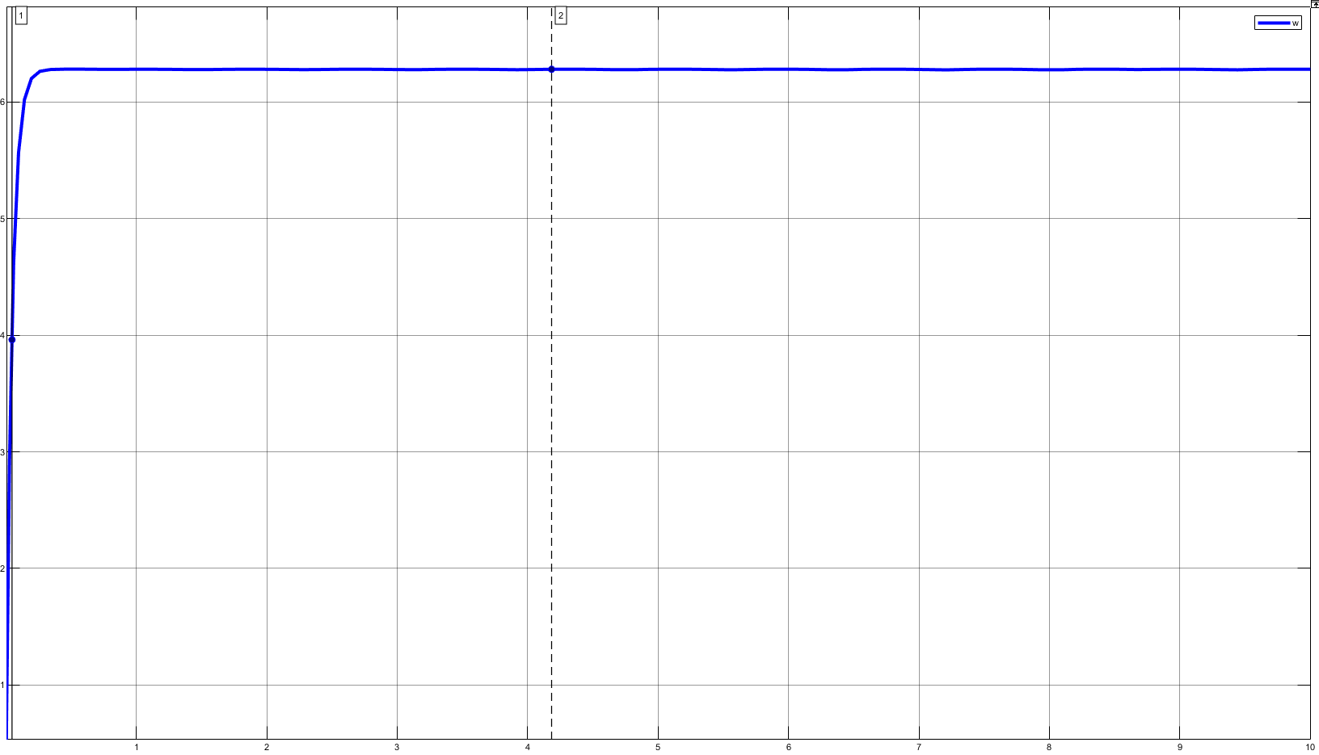
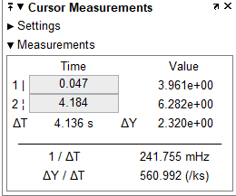
Speed control simulation waveform

Slide 15
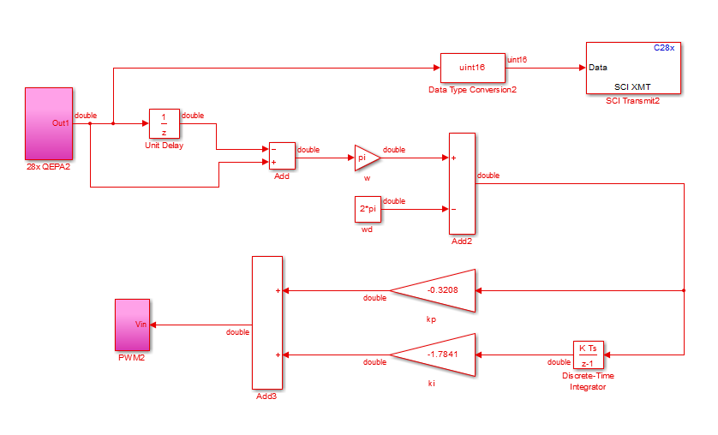
Verification block diagram

Slide 16
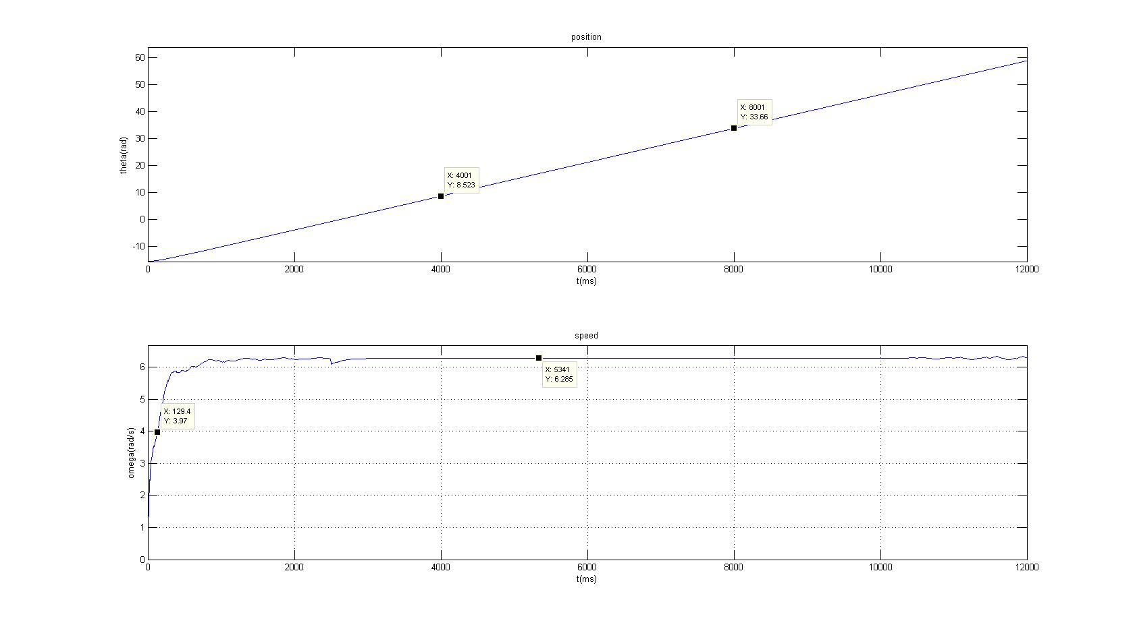
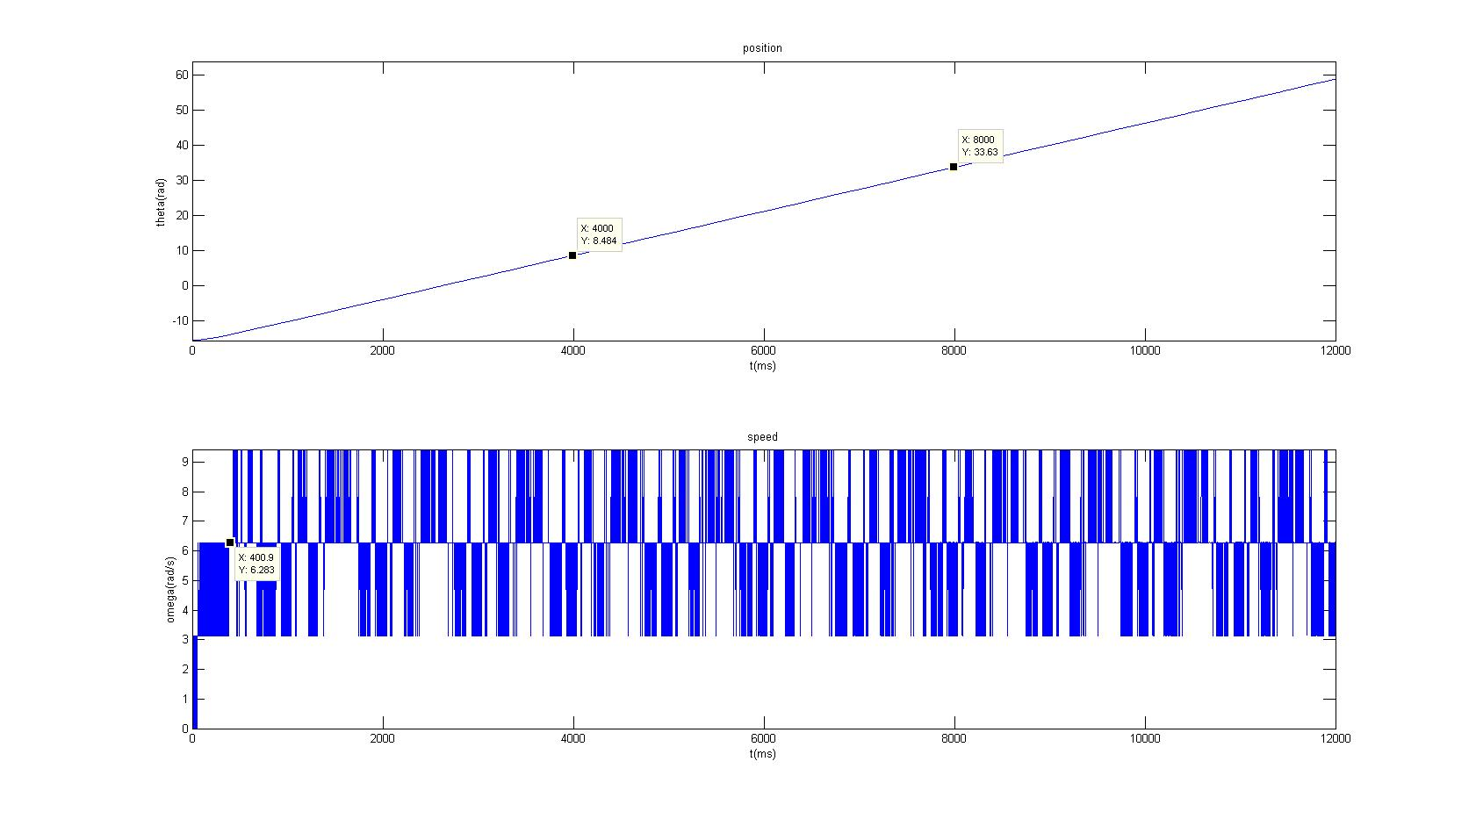
Experiment waveform
Smooth span |  | 5000

Slide 17
Identification
Speed control
Position control
1
2
3

Slide 18
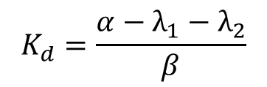


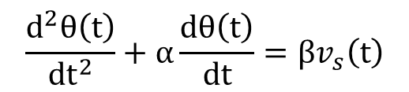
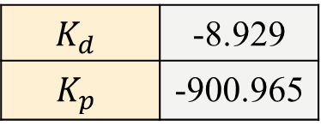

Goal：Amplitude 4.71( 270ﾟ) / Period 6s / Duty 50%
Method ：PD control
$$K_{d}=\frac{α−λ_{1}−λ_{2}}{β}$$
$$K_{p}= −\frac{λ_{1}λ_{2}}{β}$$
$$K_{d}$$ | -8.929
$$K_{p}$$ | -900.965
Use known$α,$β to design $K_{d} ,K_{p}$
$$\frac{d^{2}θ\left(t\right)}{dt^{2}}+α\frac{dθ\left(t\right)}{dt}=βv_{s}\left(t\right)$$
Choose τ to design eigenvalues
Simulink simulation
τ | 0.008(s)
λ1 | 125
λ2 | 500
$v_{s}$(𝑡) = $K$𝑑𝑒′(𝑡) + $K$𝑝𝑒(𝑡) = $K$𝑑𝜔(𝑡) + $K$𝑝𝑒(𝑡)
𝑒(𝑡) = 𝜃(𝑡) − 𝜃𝑑

Slide 19
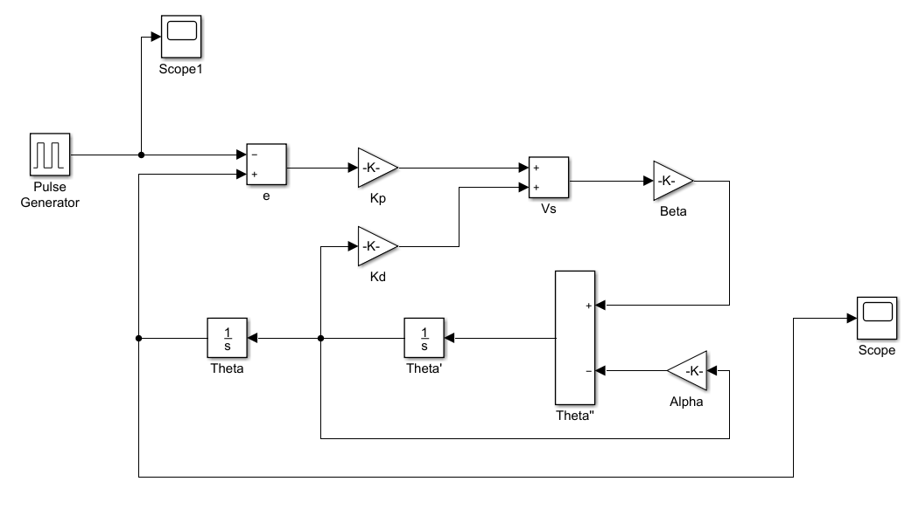
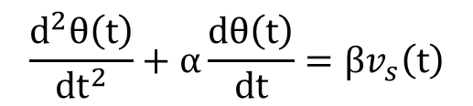

Position control block diagram
$v_{s}$(𝑡) = $K$𝑑𝑒′(𝑡) + $K$𝑝𝑒(𝑡) = $K$𝑑𝜔(𝑡) + $K$𝑝𝑒(𝑡)
𝑒(𝑡) = 𝜃(𝑡) − 𝜃𝑑
$$\frac{d^{2}θ\left(t\right)}{dt^{2}}+α\frac{dθ\left(t\right)}{dt}=βv_{s}\left(t\right)$$

Slide 20
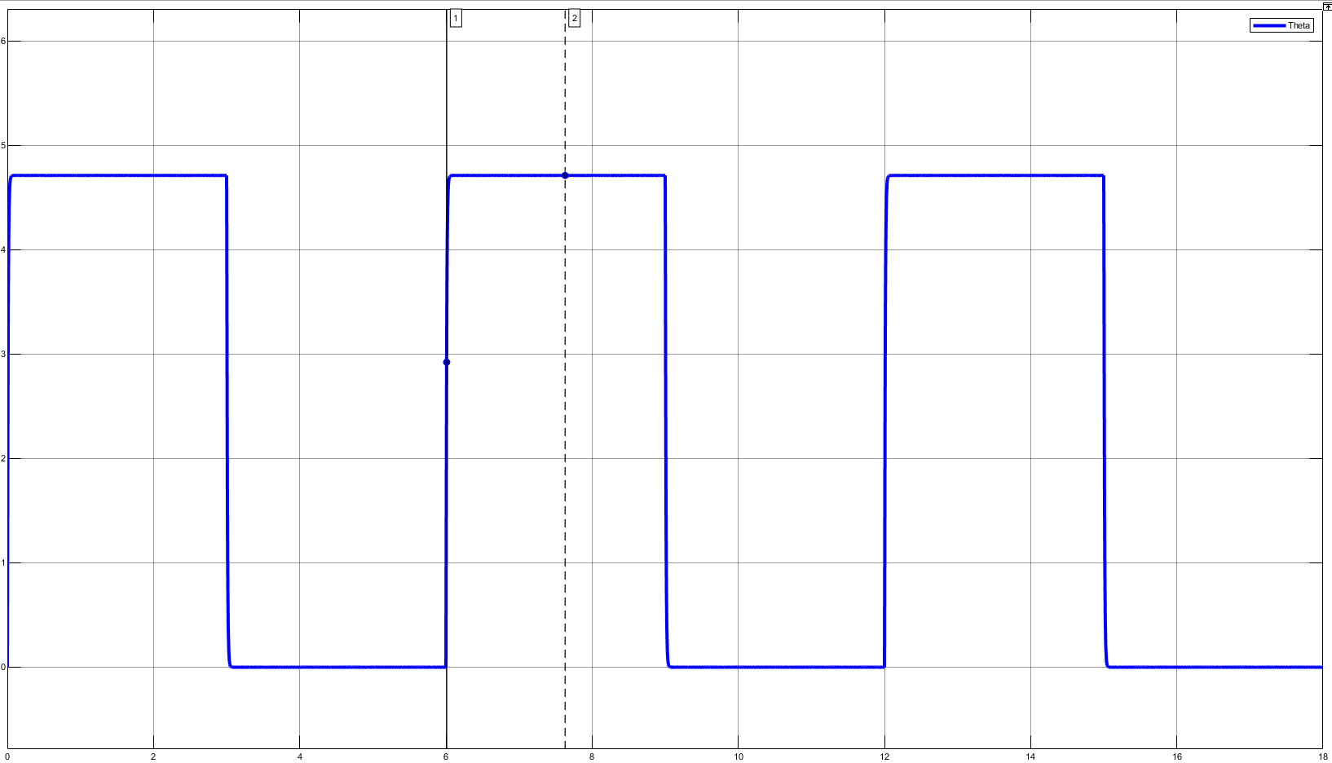
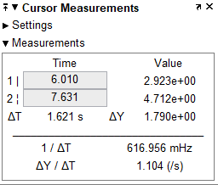
Position control simulation waveform

Slide 21
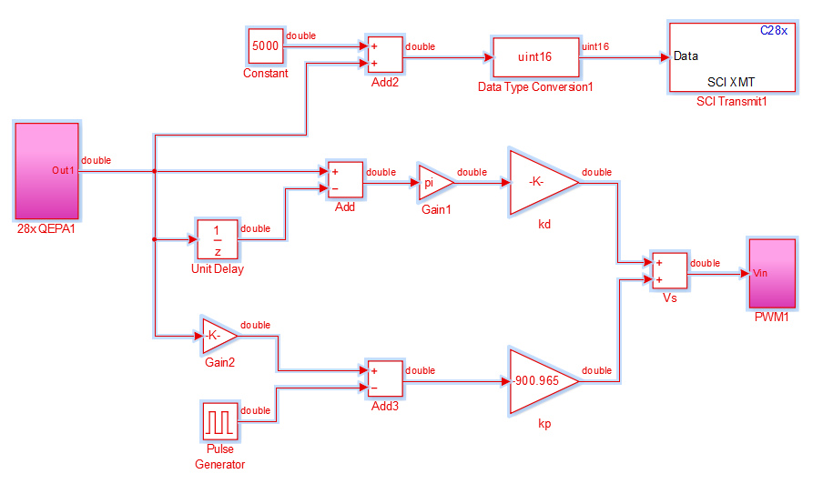
Verification block diagram

Slide 22
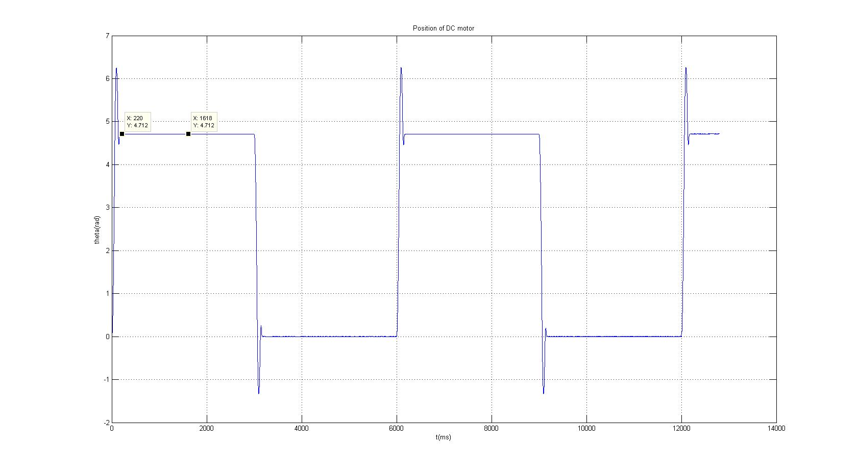
Experiment waveform

Slide 23
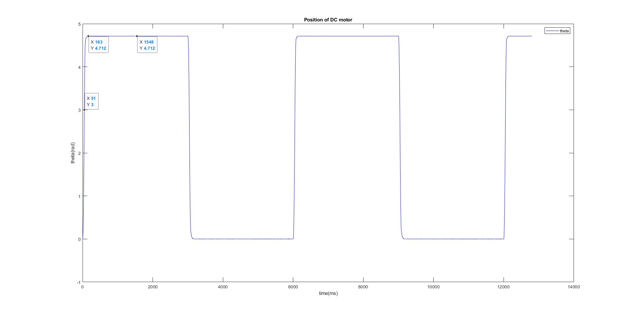
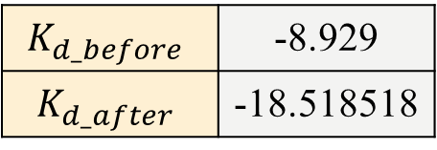
Experiment waveform
$$K_{d_before}$$ | -8.929
$$K_{d_after}$$ | -18.518518
λ1 | 50.412
λ2 | 1239.777

Slide 24
Thanks for listening !

