Slide 1
Relational Database Design

Slide 2
BAD Design
Design “anomalies”
Redundancy
Update anomaly
Deletion anomaly
Stu( sno, sname, age, gende, ID, dept, cno, cname, credit, grade )

Slide 3
GOOD Design
Decompose into “GOOD”
Functional Dependency (FD,函数依赖)
Multivalued Dependency (MVD,多值依赖)
Normal Form
FD,1NF-2NF-3NF-BCNF
MVD,4NF

Slide 4
FD
Let R be a relation schema
α ⊆ R and β ⊆ R
The functional dependency α → β holds on R if and only if for any legal relations r(R), whenever any two tuples t₁ and t₂ of r agree on the attributes α, they also agree on the attributes β . That is,
t₁[α] = t₂ [α]
⇒ t₁[β] = t₂ [β]

Slide 5
FD, Example
Consider r ( A, B ) with the following instance of r.
On this instance, A → B does NOT hold, but B → A does hold
FD实质是约束，描述属性间的约束
4
1 5
3 7

Slide 6
FD, Example
Stu(sno,sname,age,gende,ID,dept,cno,cname,grade)

Slide 7
Key
K→R
K is a superkey for relation schema R if and only if K → R
K is a candidate key for R if and only if
K → R, and
for no α ⊂ K, α → R

Slide 8
Trivial(平凡) FD
A functional dependency is trivial if it is satisfied by all instances of a relation
Example:
ID, name → ID
name → name
In general, α → β is trivial if β ⊆ α

Slide 9
Armstrong’s Axioms
if β ⊆ α, then α → β (自反律)
if α → β,then γα → γβ (增补律)
if α → β,and β → γ,then α → γ (传递律)
Additional rules:
If α → β and α → γ, then α → β γ (合并律)
If α → β γ, then α → β and α → γ (分解律)
If α → β and γβ → δ,then αγ → δ (伪传递律)

Slide 10
Closure
根据相关定理，找出已知的FD所蕴涵的函数依赖
函数依赖集的闭包
属性的闭包

Slide 11
Normal Form
1NF
属性是原子的
2NF
所有的非主属性，不能部分依赖于码
3NF
所有的非主属性，不能传递依赖于码
BCNF
所有的非平凡函数依赖，应依赖于码

Slide 12
NF的分解
分解的要求
Lossless-join decomposition
R₁ ∩ R₂ → R₁
R₁ ∩ R₂ → R₂
Dependency preserving
(F₁ ∪ F₂ ∪ … ∪ F_{n} )⁺ = F ⁺
NF要求

Slide 13
Canonical Cover(正则覆盖)
a canonical cover of F is a “minimal” set of functional dependencies equivalent to F, having no redundant dependencies or redundant parts of dependencies
Canonical Cover的特征
左边是唯一的，右边多属性合并
两边均不含无关属性(extraneous)
用于校验依赖保持

Slide 14
无关属性的判断
For α→β
To test if attribute A∈α is extraneous in α
compute ({α} – A)⁺ using the dependencies in F
check that ({α} – A)⁺ contains β; if it does, A is extraneous in α
To test if attribute A∈β is extraneous in β
compute α+ using only the dependencies in F’ = (F – {α → β}) ∪ {α →(β – A)},
check that α+ contains A; if it does, A is extraneous in β

Slide 15
Canonical Cover(正则覆盖)
R = (A, B, C) F = {A→BC, B→C, A→B, AB→C}
F = {A→BC, B→C, AB→C}
F = {A→BC, B→C}
F = {A→B, B→C}

Slide 16
范式分解
1）For R，求Key，找出违反范式要求的FD，A→B;
2）求A⁺
3）R1 = {A⁺} √
R2 = {A ∪ ( R-A⁺ )}
4）对R2重复1-3，直至均满足范式要求
R1∩R2→R1,无损连接
验证 (F₁ ∪ F₂ ∪ … ∪ F_{n} )⁺ = F ⁺
亦可验证Fc

Slide 17
范式分解
R = (A, B, C) F = {A→B, B→C)
Can be decomposed in two different ways
R1 = (A, B), R2 = (B, C)
Lossless-join decomposition:
R1∩R2 = {B} and B→BC
Dependency preserving
R1 = (A, B), R2 = (A, C)
Lossless-join decomposition:
R1∩R2 = {A} and A→AB
Not dependency preserving (cannot check B→C without computing R1 R2)

Slide 18
范式分解
R = (A, B, C) F = {A→B, B→C, B→A)
R1 = (A, B), R2 = (A, C)
Lossless-join decomposition:
R1∩R2 = {A} and A→AB
dependency preserving？
B→C ?
(F1 ∪ F2 ∪ … ∪ Fn )⁺ = F ⁺

Slide 19
范式分解
R(T,S,C),每位教师T只上一门课C，每门课可能有多个教学班，S为学生。
T→C,SC→T
Key
SC,TS
分解
R1(T,C),R2(T,S)
无损连接，依赖保持？

Slide 20
例子
图书馆
ISBM，分类号：TP311.13

Slide 21
MVD

Slide 22
MVD
inst_info(ID, child_name, phone_number)
BCNF,why？
仍有冗余，仍有异常
MVD
ID→→child_name
ID→→phone_number
ID | Child_name | Phone_number
99999 | David | 512-555-1234
99999 | David | 512-555-4321
99999 | William | 512-555-1234
99999 | William | 512-555-4321

Slide 23
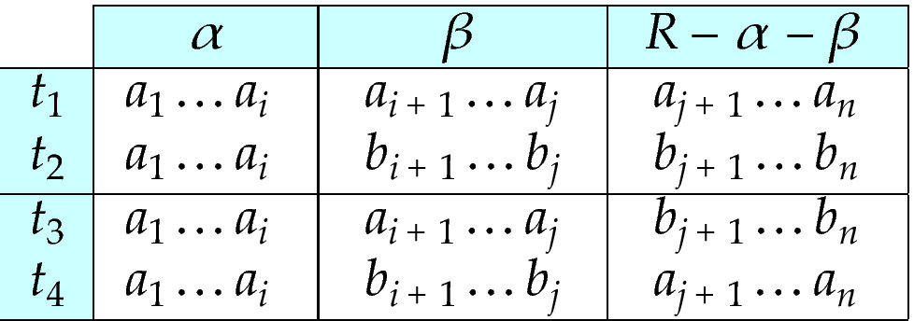
MVD

Slide 24
MVD
平凡的MVD，α →→ β
β ⊆ α
α ∪ β = R
If α → β then α →→ β
If α → β then α →→ R - α - β

Slide 25
练习
对R(A,B,C)，存在A→→B,且R中有这些实例：
(a1,b1,c1)
(a1,b2,c3)
(a1,b1,c2)
则，R中至少还应有哪些元组？

Slide 26
4NF
对所有的非平凡多值依赖，其决定因子均来自超码。
ID→→child_name
ID→→phone_number
R1(ID,child_name),R2(ID,phone_number)
ID | Child_name | Phone_number
99999 | David | 512-555-1234
99999 | David | 512-555-4321
99999 | William | 512-555-1234
99999 | William | 512-555-4321

Slide 27
练习
学生-同学-所选课程

Slide 28
练习
教师-课程-所用参考资料

Slide 29
ER Model and Normalization
In a real (imperfect) design, there can be functional dependencies from non-key attributes of an entity to other attributes of the entity
Example: an employee entity with attributes department_name and building, and a functional dependency department_name→ building
Good design would have made department an entity

Slide 30
Denormalization for Performance
May want to use non-normalized schema for performance
For example, displaying prereqs along with course_id, and title requires join of course with prereq
Use denormalized relation containing attributes of course as well as prereq with all above attributes
faster lookup
extra space and extra execution time for updates
extra coding work for programmer and possibility of error in extra code

Slide 31
用户权限管理
DB中的用户管理
应用中的用户管理
用户信息
功能权限
角色-功能
基于角色的用户权限管理

Slide 32
练习
在线购物
商品
用户
订单

