Slide 1
Transaction （事务）

Slide 2
Transaction Concept
A transaction is a unit of program execution that accesses and possibly updates various data items
SQL DML/C++ Java
操作的集合、逻辑工作单元
可能由多条语句构成

Slide 3
Example of transaction
E.g. transaction to transfer $50 from account A to account B:
1. read(A)
2. A := A – 50
3. write(A)
4. read(B)
5. B := B + 50
6. write(B)

Slide 4
ACID Properties
Atomicity
Consistency
Isolation
Durability

Slide 5
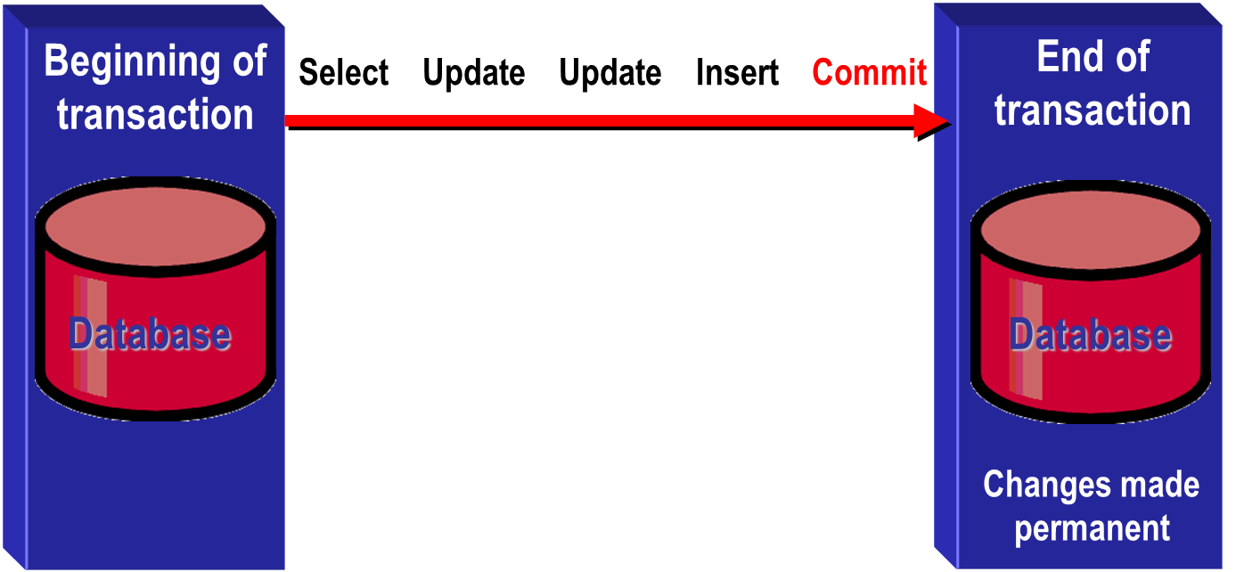
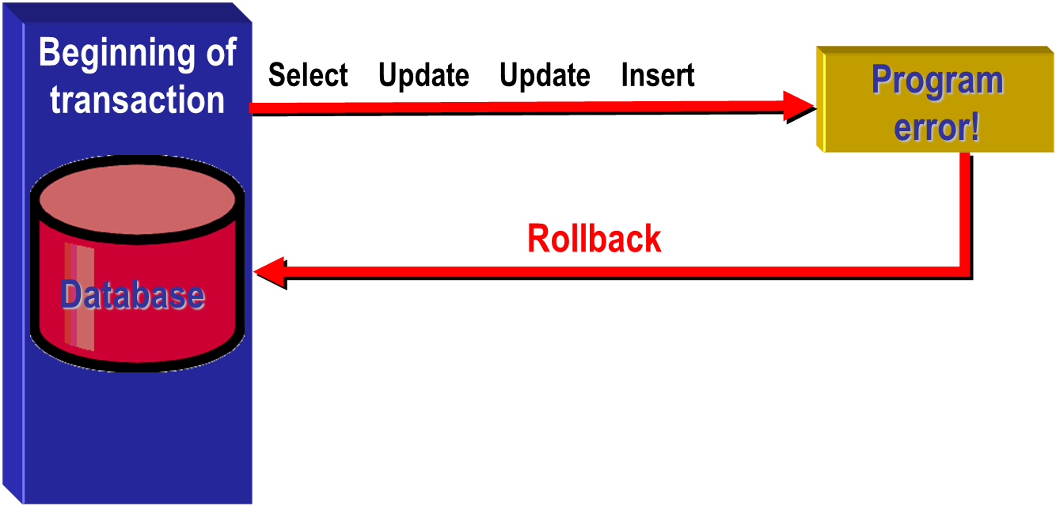
Transaction
Commit
Rollback

Slide 6

Transaction process

Slide 7
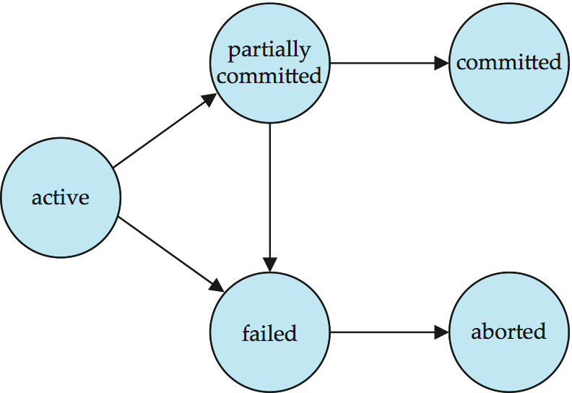
Transaction State

Slide 8
Tracsaction State
Active – the initial state; the transaction stays in this state while it is executing
Partially committed – after the final statement has been executed.
Failed -- after the discovery that normal execution can no longer proceed.
Aborted – after the transaction has been rolled back and the database restored to its state prior to the start of the transaction. Two options after it has been aborted:
restart the transaction
can be done only if no internal logical error
kill the transaction
Committed – after successful completion.

Slide 9
Schedules
指令执行的时间顺序
必须包含被调度的事务的所有指令，并保持指令在各事务中的原顺序
调度，实现事务的并发运行
可串行调度，多事务并发运行的结果，与串行运行一致

Slide 10
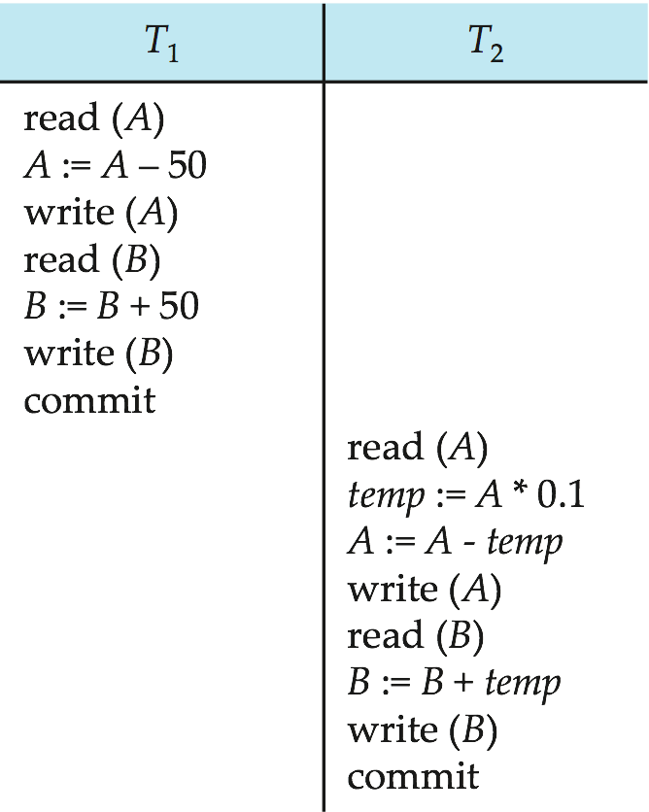
Schedule 1
A serial schedule in which T₁ is followed by T₂

Slide 11
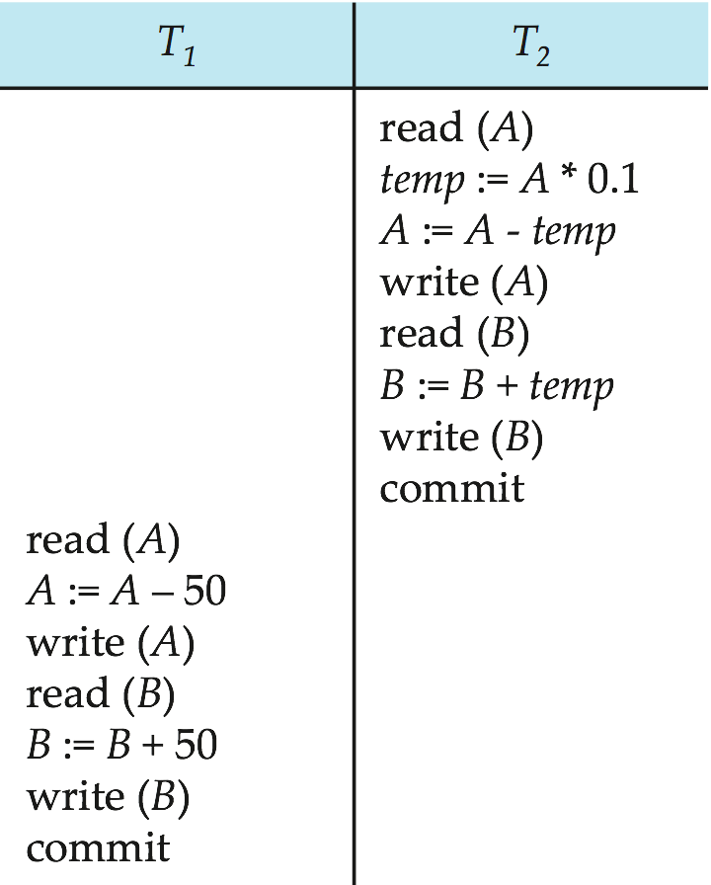
Schedule 2
A serial schedule where T₂ is followed by T₁

Slide 12
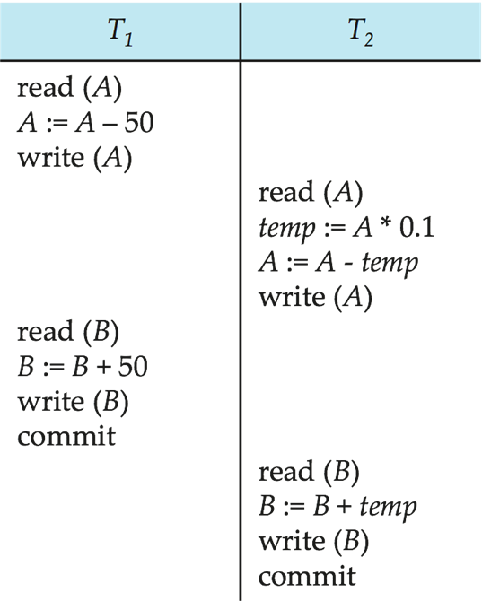
Schedule 3
In Schedules 1, 2 and 3, the sum A + B is preserved.

Slide 13
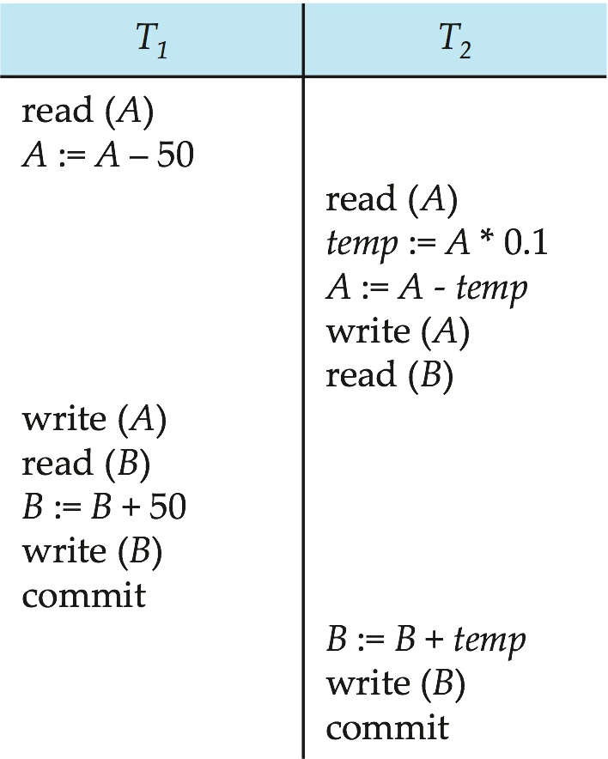
Schedule 4
This concurrent schedule does not preserve the value of (A + B ).

Slide 14
Lock

Slide 15
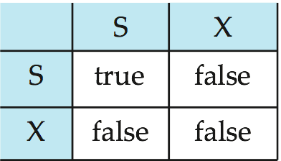
锁的机制
共享锁（Shared）、排它锁（exclusive）

Slide 16
Lock & Transaction
A transaction may be granted a lock on an item if the requested lock is compatible with locks already held on the item by other transactions.
Any number of transactions can hold shared locks on an item,
but if any transaction holds an exclusive on the item no other transaction may hold any lock on the item.
If a lock cannot be granted, the requesting transaction is made to wait till all incompatible locks held by other transactions have been released. The lock is then granted.

Slide 17
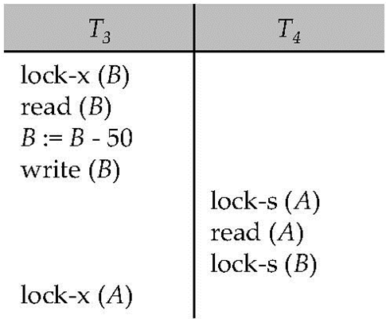
Lock
Neither T₃ nor T₄ can make progress — executing lock-S(B) causes T₄ to wait for T₃ to release its lock on B, while executing lock-X(A) causes T₃ to wait for T₄ to release its lock on A.
Such a situation is called a deadlock.
To handle a deadlock one of T₃ or T₄ must be rolled back and its locks released.

Slide 18
Isolation level

Slide 19
Isolation level
事务的隔离层次（隔离级别）
并发性能vs完整一致之间的一种弱化、折中
Read uncommitted Isolation_Level = 3
Read committed Isolation_Level = 2
Repeatable read Isolation_Level = 1
Serializable Isolation_Level = 0

Slide 20
0 - Read uncommitted
Read permitted on row with or without write lock
No read locks are applied
No guarantee that concurrent transaction will not modify row or roll back changes to row
Corresponds to table hints NOLOCK and READUNCOMMITTED
Allow dirty reads, non-repeatable reads, and phantom rows

Slide 21
1 - Read committed
Read only permitted on row with no write lock
Read lock acquired and held for read on current row only, but released when cursor moves off the row
No guarantee that data will not change during transaction
Corresponds to table hint READCOMMITTED
Prevent dirty reads
Allow non-repeatable reads and phantom rows

Slide 22
2 - Repeatable
Read only permitted on row with no write lock
Read lock acquired as each row in the result set is read, and held until transaction ends
Corresponds to table hint REPEATABLEREAD
Prevent dirty reads and non-repeatable reads
Allow phantom rows

Slide 23
3 - serializable
Read only permitted on rows in result without write lock
Read locks acquired when cursor is opened and held until transaction ends
Corresponds to table hints HOLDLOCK and SERIALIZABLE
Prevent dirty reads, non-repeatable reads, and phantom rows

Slide 24
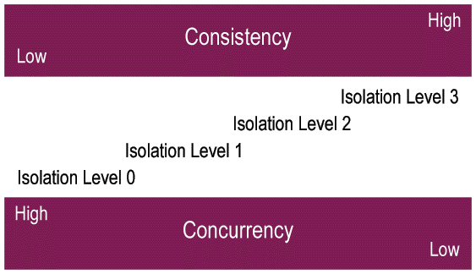
Isolation Level

