Slide 1
Recovery System

Slide 2
Failure Classification
Transaction failure:
Logical errors: transaction cannot complete due to some internal error condition
System errors: the database system must terminate an active transaction due to an error condition (e.g., deadlock)
System crash: a power failure or other hardware or software failure causes the system to crash.
Disk failure: a head crash or similar disk failure destroys all or part of disk storage

Slide 3
恢复策略
即使发生故障，仍需保持数据库的基本特性ACID
在正常事务处理时采取措施，保障有足够的信息可用于故障恢复；
故障发生后，使数据库恢复到某一保证ACID的状态。

Slide 4
Classification of Physical Storage Media
Speed with which data can be accessed
Cost per unit of data
Reliability
data loss on power failure or system crash
physical failure of the storage device
Can differentiate storage into:
volatile storage:
loses contents when power is switched off
non-volatile storage:
Contents persist even when power is switched off.
Includes secondary and tertiary storage, as well as batter-backed up main-memory.

Slide 5
Physical Storage Media
Cache – fastest and most costly form of storage; volatile; managed by the computer system hardware.

Slide 6
Physical Storage Media
Main memory:
fast access (10s to 100s of nanoseconds; 1 nanosecond = 10^{–9} seconds)
generally too small (or too expensive) to store the entire database
capacities of up to a few Gigabytes widely used currently
Capacities have gone up and per-byte costs have decreased steadily and rapidly (roughly factor of 2 every 2 to 3 years)
Volatile — contents of main memory are usually lost if a power failure or system crash occurs.

Slide 7
Physical Storage Media (Cont.)
Flash memory
Data survives power failure
Data can be written at a location only once, but location can be erased and written to again
Reads are roughly as fast as main memory
But writes are slow (few microseconds), erase is slower
Widely used in embedded devices such as digital cameras, phones, and USB keys
SSD（Solid-State Disk）

Slide 8
Physical Storage Media (Cont.)
Magnetic-disk
Data is stored on spinning disk, and read/written magnetically
Primary medium for the long-term storage of data; typically stores entire database.
Data must be moved from disk to main memory for access, and written back for storage
direct-access – possible to read data on disk in any order, unlike magnetic tape

Slide 9
Physical Storage Media (Cont.)
Magnetic-disk
Capacities range up to roughly 1.5 TB as of 2009
Much larger capacity and cost/byte than main memory/flash memory
Growing constantly and rapidly with technology improvements (factor of 2 to 3 every 2 years)
Survives power failures and system crashes
disk failure can destroy data, but is rare

Slide 10
Physical Storage Media (Cont.)
Optical storage
non-volatile, data is read optically from a spinning disk using a laser
CD-ROM (640 MB) and DVD (4.7 to 17 GB) most popular forms
Blu-ray disks: 27 GB to 54 GB

Slide 11
Physical Storage Media (Cont.)
Optical storage
Write-one, read-many (WORM) optical disks used for archival storage (CD-R, DVD-R, DVD+R)
Multiple write versions also available (CD-RW, DVD-RW, DVD+RW, and DVD-RAM)
Reads and writes are slower than with magnetic disk
Juke-box systems, with large numbers of removable disks, a few drives, and a mechanism for automatic loading/unloading of disks available for storing large volumes of data

Slide 12
Physical Storage Media (Cont.)
Tape storage
non-volatile, used primarily for backup (to recover from disk failure), and for archival data
sequential-access – much slower than disk
very high capacity (40 to 300 GB tapes available)

Slide 13
Physical Storage Media (Cont.)
Tape storage
tape can be removed from drive ⇒ storage costs much cheaper than disk, but drives are expensive
Tape jukeboxes available for storing massive amounts of data
hundreds of terabytes (1 terabyte = 10⁹ bytes) to even multiple petabytes (1 petabyte = 10¹² bytes)

Slide 14
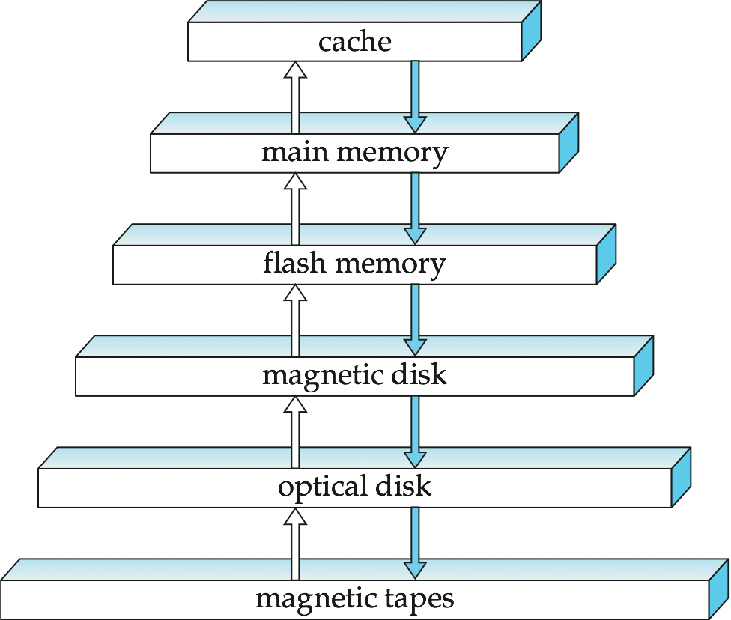
Storage Hierarchy

Slide 15
Storage Hierarchy (Cont.)
primary storage: Fastest media but volatile (cache, main memory).
secondary storage: next level in hierarchy, non-volatile, moderately fast access time
also called on-line storage
E.g. flash memory, magnetic disks
tertiary storage: lowest level in hierarchy, non-volatile, slow access time
also called off-line storage
E.g. magnetic tape, optical storage

Slide 16
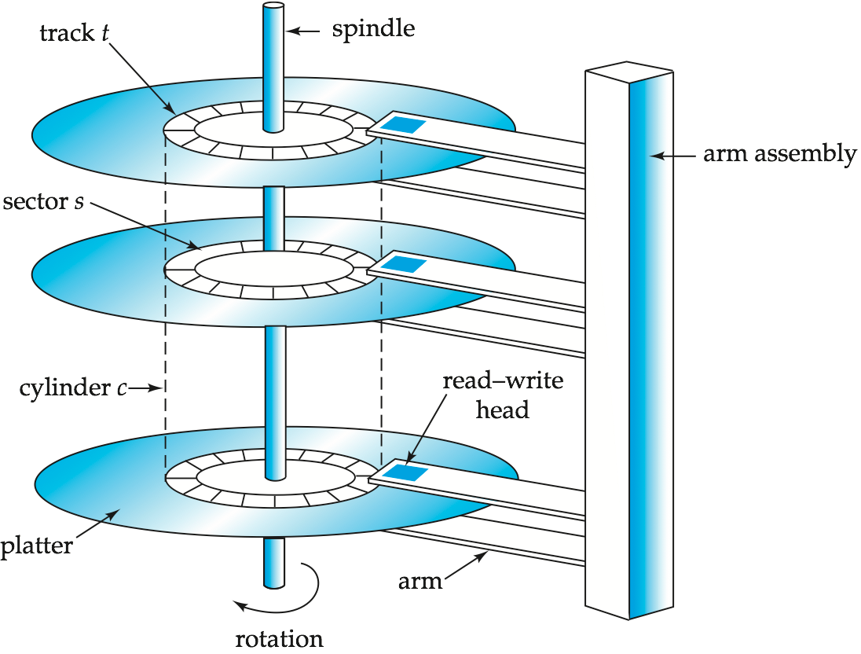
Magnetic Hard Disk Mechanism
NOTE: Diagram is schematic, and simplifies the structure of actual disk drives

Slide 17
Magnetic Disks
Read-write head
Positioned very close to the platter surface (almost touching it)
Reads or writes magnetically encoded information.
Surface of platter divided into circular tracks
Over 50K-100K tracks per platter on typical hard disks
Each track is divided into sectors.
A sector is the smallest unit of data that can be read or written.
Sector size typically 512 bytes
Typical sectors per track: 500 to 1000 (on inner tracks) to 1000 to 2000 (on outer tracks)
To read/write a sector
disk arm swings to position head on right track
platter spins continually; data is read/written as sector passes under head
Head-disk assemblies
multiple disk platters on a single spindle (1 to 5 usually)
one head per platter, mounted on a common arm.
Cylinder i consists of ith track of all the platters

Slide 18
Magnetic Disks (Cont.)
Earlier generation disks were susceptible to head-crashes
Surface of earlier generation disks had metal-oxide coatings which would disintegrate on head crash and damage all data on disk
Current generation disks are less susceptible to such disastrous failures, although individual sectors may get corrupted

Slide 19
Magnetic Disks (Cont.)
Disk controller – interfaces between the computer system and the disk drive hardware.
accepts high-level commands to read or write a sector
initiates actions such as moving the disk arm to the right track and actually reading or writing the data
Computes and attaches checksums to each sector to verify that data is read back correctly
If data is corrupted, with very high probability stored checksum won’t match recomputed checksum
Ensures successful writing by reading back sector after writing it
Performs remapping of bad sectors

Slide 20
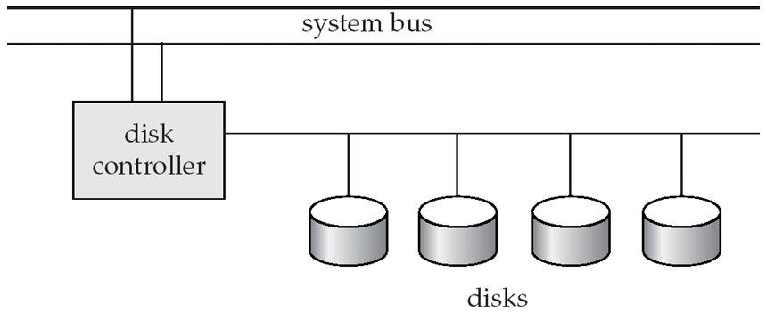
Disk Subsystem
Multiple disks connected to a computer system through a controller
Controllers functionality (checksum, bad sector remapping) often carried out by individual disks; reduces load on controller
Disk interface standards families
ATA (AT adaptor) range of standards
SATA (Serial ATA)
SCSI (Small Computer System Interconnect) range of standards
SAS (Serial Attached SCSI)
Several variants of each standard (different speeds and capabilities)

Slide 21
Disk Subsystem
Disks usually connected directly to computer system
In Storage Area Networks (SAN), a large number of disks are connected by a high-speed network to a number of servers
In Network Attached Storage (NAS) networked storage provides a file system interface using networked file system protocol, instead of providing a disk system interface

Slide 22
Performance Measures of Disks
Access time – the time it takes from when a read or write request is issued to when data transfer begins. Consists of:
Seek time – time it takes to reposition the arm over the correct track.
Average seek time is 1/2 the worst case seek time.
Would be 1/3 if all tracks had the same number of sectors, and we ignore the time to start and stop arm movement
4 to 10 milliseconds on typical disks
Rotational latency – time it takes for the sector to be accessed to appear under the head.
Average latency is 1/2 of the worst case latency.
4 to 11 milliseconds on typical disks (5400 to 15000 r.p.m.)
Data-transfer rate – the rate at which data can be retrieved from or stored to the disk.
25 to 100 MB per second max rate, lower for inner tracks
Multiple disks may share a controller, so rate that controller can handle is also important
E.g. SATA: 150 MB/sec, SATA-II 3Gb (300 MB/sec)
Ultra 320 SCSI: 320 MB/s, SAS (3 to 6 Gb/sec)
Fiber Channel (FC2Gb or 4Gb): 256 to 512 MB/s

Slide 23
Performance Measures (Cont.)
Mean time to failure (MTTF) – the average time the disk is expected to run continuously without any failure.
Typically 3 to 5 years
Probability of failure of new disks is quite low, corresponding to a “theoretical MTTF” of 500,000 to 1,200,000 hours for a new disk
E.g., an MTTF of 1,200,000 hours for a new disk means that given 1000 relatively new disks, on an average one will fail every 1200 hours
MTTF decreases as disk ages

Slide 24
Optimization of Disk-Block Access
Block – a contiguous sequence of sectors from a single track
data is transferred between disk and main memory in blocks
sizes range from 512 bytes to several kilobytes
Smaller blocks: more transfers from disk
Larger blocks: more space wasted due to partially filled blocks
Typical block sizes today range from 4 to 16 kilobytes
Disk-arm-scheduling algorithms order pending accesses to tracks so that disk arm movement is minimized

Slide 25
Optimization of Disk Block Access(Cont.)
File organization – optimize block access time by organizing the blocks to correspond to how data will be accessed
E.g. Store related information on the same or nearby cylinders.
Files may get fragmented over time
E.g. if data is inserted to/deleted from the file
Or free blocks on disk are scattered, and newly created file has its blocks scattered over the disk
Sequential access to a fragmented file results in increased disk arm movement
Some systems have utilities to defragment the file system, in order to speed up file access

Slide 26
Optimization of Disk Block Access(Cont.)
Nonvolatile write buffers speed up disk writes by writing blocks to a non-volatile RAM buffer immediately
Non-volatile RAM: battery backed up RAM or flash memory
Even if power fails, the data is safe and will be written to disk when power returns
Controller then writes to disk whenever the disk has no other requests or request has been pending for some time
Database operations that require data to be safely stored before continuing can continue without waiting for data to be written to disk
Writes can be reordered to minimize disk arm movement

Slide 27
Optimization of Disk Block Access(Cont.)
Log disk – a disk devoted to writing a sequential log of block updates
Used exactly like nonvolatile RAM
Write to log disk is very fast since no seeks are required
No need for special hardware (NV-RAM)
File systems typically reorder writes to disk to improve performance
Journaling file systems write data in safe order to NV-RAM or log disk
Reordering without journaling: risk of corruption of file system data

Slide 28
Flash Storage
NOR flash vs NAND flash
NAND flash
used widely for storage, since it is much cheaper than NOR flash
requires page-at-a-time read (page: 512 bytes to 4 KB)
transfer rate around 20 MB/sec
solid state disks: use multiple flash storage devices to provide higher transfer rate of 100 to 200 MB/sec

Slide 29
Flash Storage
NOR flash vs NAND flash
NAND flash
erase is very slow (1 to 2 millisecs)
erase block contains multiple pages
remapping of logical page addresses to physical page addresses avoids waiting for erase
translation table tracks mapping
also stored in a label field of flash page
remapping carried out by flash translation layer
after 100,000 to 1,000,000 erases, erase block becomes unreliable and cannot be used
wear leveling

Slide 30
Example of Data Access
buffer
Buffer Block A
input(A)
X
A
Buffer Block B
Y
B
output(B)
read(X)
write(Y)
x₂
x₁
y₁
work area
of T₁
work area
of T₂
memory
disk

Slide 31
Data Access
Physical blocks are those blocks residing on the disk.
Buffer blocks are the blocks residing temporarily in main memory.
Block movements between disk and main memory are initiated through the following two operations:
input(B) transfers the physical block B to main memory.
output(B) transfers the buffer block B to the disk, and replaces the appropriate physical block there.

Slide 32
Data Access
Each transaction Ti has its private work-area in which local copies of all data items accessed and updated by it are kept.
Ti's local copy of a data item X is called xi.
We assume, for simplicity, that each data item fits in, and is stored inside, a single block.

Slide 33
Data Access (Cont.)
Transaction transfers data items between system buffer blocks and its private work-area using the following operations:
read(X) assigns the value of data item X to the local variable xi.
write(X) assigns the value of local variable xi to data item {X} in the buffer block.
Both these commands may necessitate the issue of an input(BX) instruction before the assignment, if the block BX in which X resides is not already in memory.

Slide 34
Data Access (Cont.)
Transactions
Perform read(X) while accessing X for the first time;
All subsequent accesses are to the local copy.
After last access, transaction executes write(X).
output(BX) need not immediately follow write(X). System can perform the output operation when it deems fit.

Slide 35
基于Log的备份
To ensure atomicity despite failures, we first output information describing the modifications to stable storage without modifying the database itself.
log-based recovery

Slide 36
基于Log的恢复
A log is kept on stable storage.
The log is a sequence of log records, and maintains a record of update activities on the database
Two approaches using logs
Deferred database modification
Immediate database modification

Slide 37
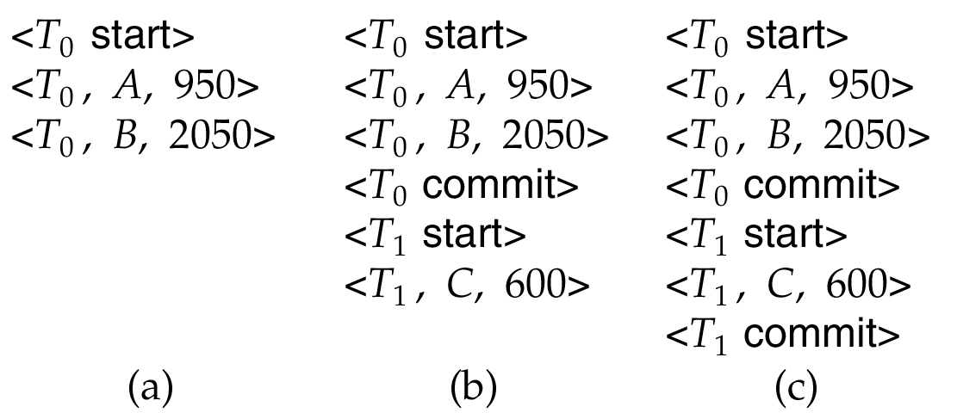
Deferred Database Modification

Slide 38
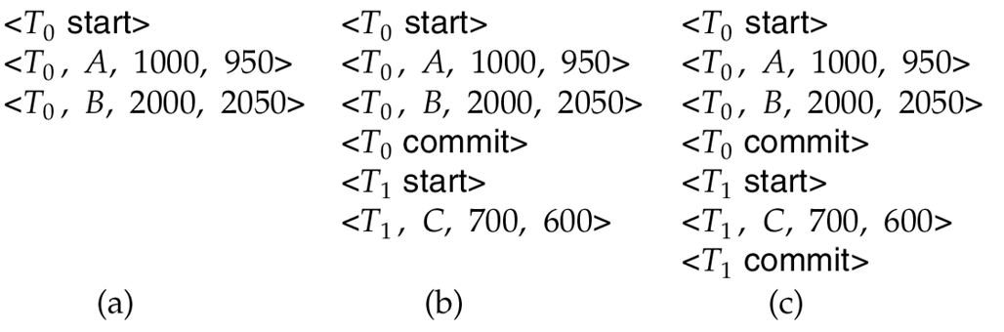
Immediate database modification

Slide 39
Immediate database modification
Log Write Output
<T₀ start>
<T₀, A, 1000, 950>
T_{o}, B, 2000, 2050
A = 950
B = 2050
<T₀ commit>
<T₁ start>
<T₁, C, 700, 600>
C = 600
B_{B}, B_{C}
<T₁ commit>
B_{A}
Note: B_{X} denotes block containing X.

Slide 40
checkpoint
Problems in recovery procedure
searching the entire log is time-consuming
we might unnecessarily redo transactions which have already
output their updates to the database.
Streamline recovery procedure by periodically performing checkpointing
Output all log records currently residing in main memory onto stable storage.
Output all modified buffer blocks to the disk.
Write a log record < checkpoint> onto stable storage

Slide 41
日常备份策略
Dump Database
Dump Log
Dump Log
Recovery Database
Recovery Log
Recovery Log

