Slide 1
Query Processing & Performance Tuning

Slide 2
INDEX
Primary mechanism to get improved performance on a database
Indexing mechanisms used to speed up access to desired data
Search Key - attribute or set of attributes used to look up records in a file.
search-key
pointer

Slide 3
INDEX
Two basic kinds of indices:
Ordered indices
search keys are stored in sorted order
Balanced trees
Hash indices
search keys are distributed uniformly across “buckets” using a “hash function”
Hash tables

Slide 4
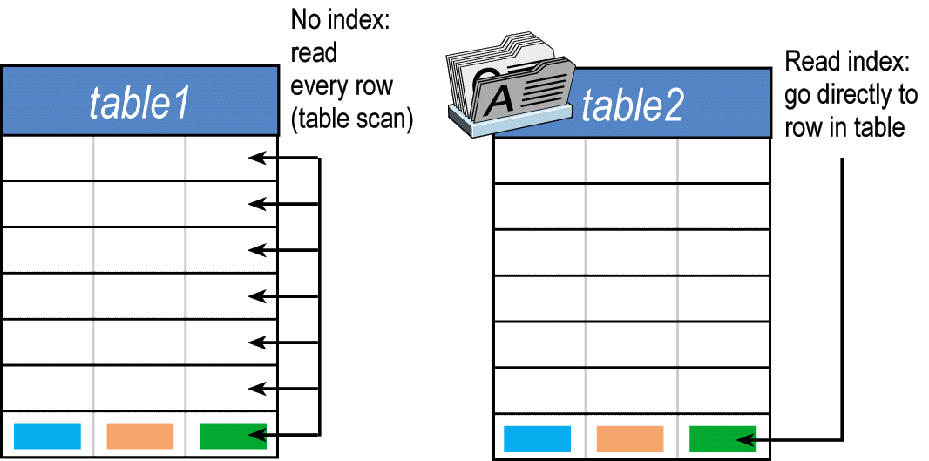
INDEX - Query

Slide 5
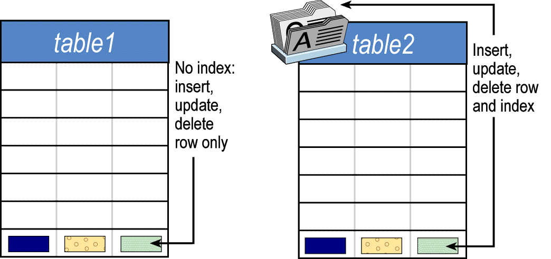
INDEX - Modification

Slide 6
Ordered Indices
In an ordered index, index entries are stored sorted on the search key value.
Primary index: in a sequentially ordered file, the index whose search key specifies the sequential order of the file.
Also called clustering index
The search key of a primary index is usually but not necessarily the primary key.

Slide 7
Ordered Indices
Secondary index: an index whose search key specifies an order different from the sequential order of the file. Also called non-clustering index.
Index-sequential file: ordered sequential file with a primary index.

Slide 8
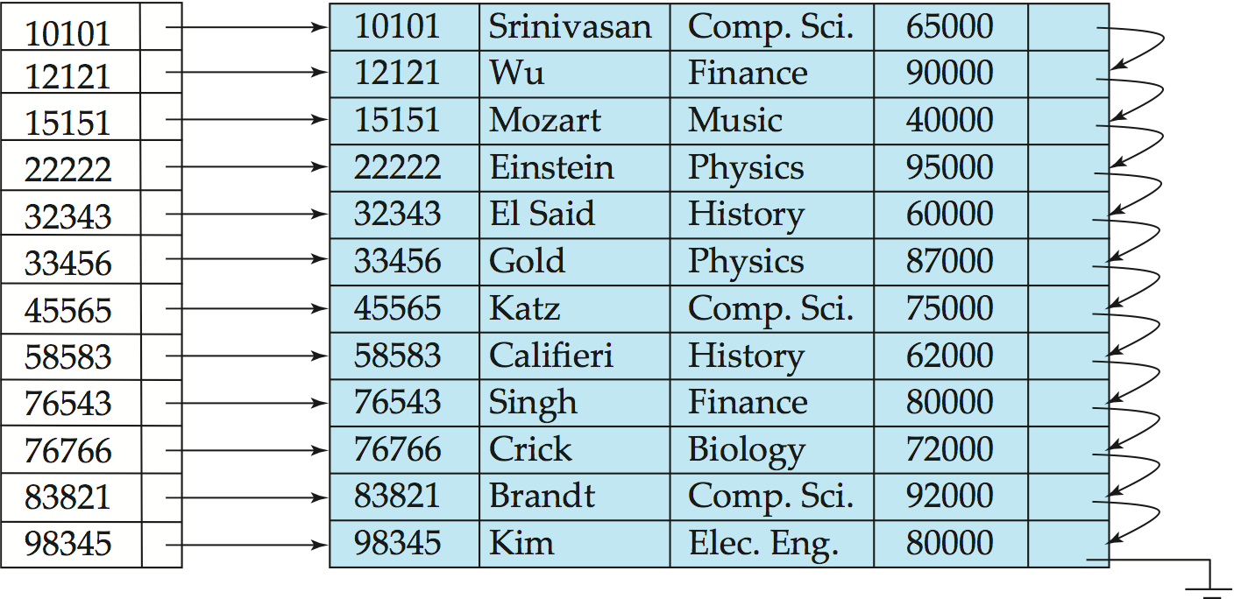
Dense Index Files
Dense index — Index record appears for every search-key value in the file.
E.g. index on ID attribute of instructor relation

Slide 9
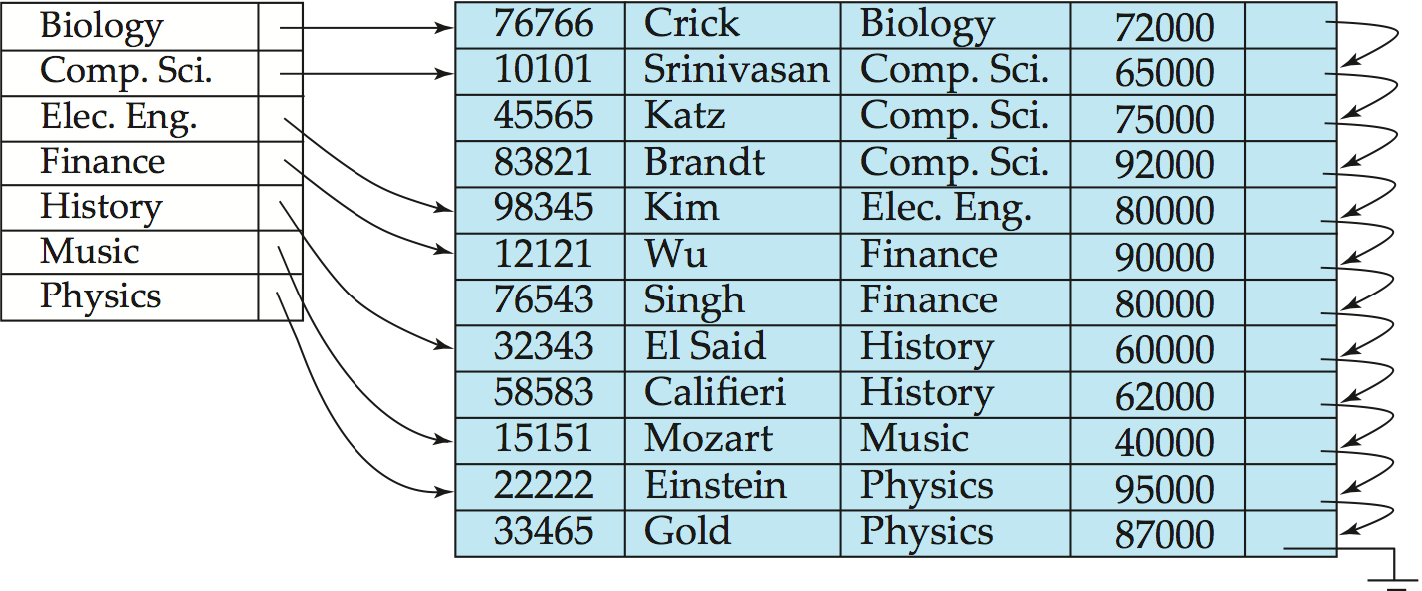
Dense Index Files (Cont.)
Dense index on dept_name, with instructor file sorted on dept_name

Slide 10
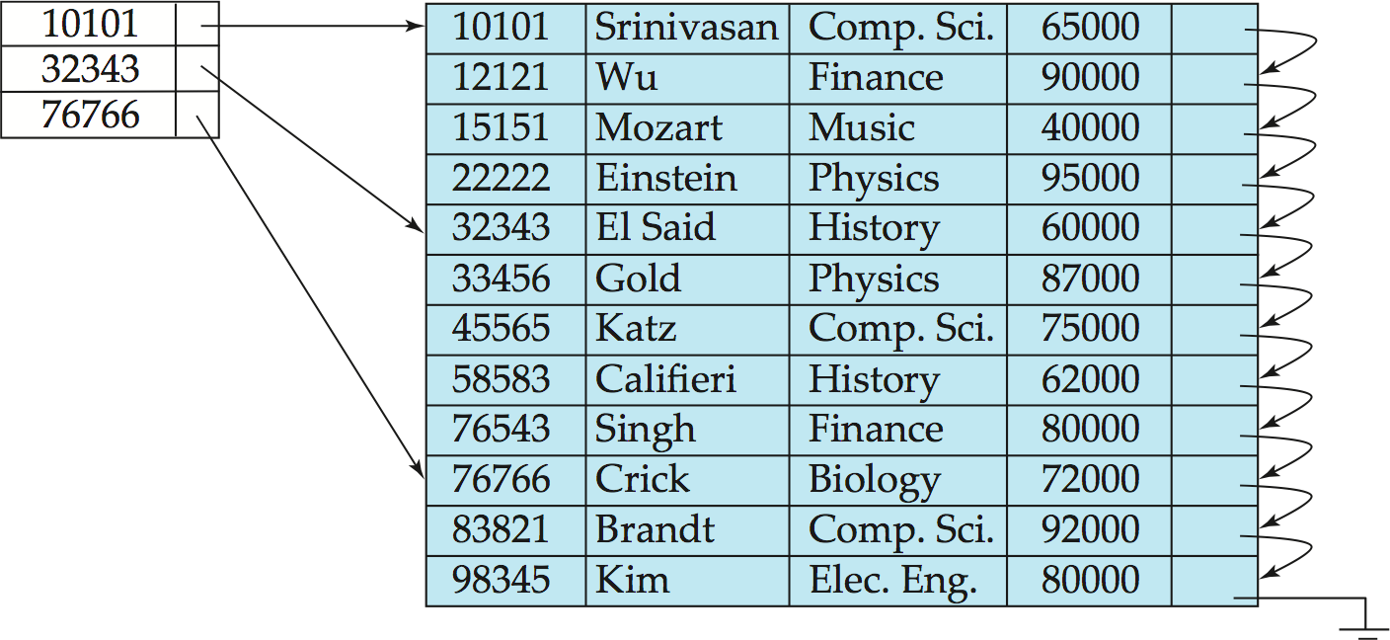
Sparse Index Files
Sparse Index: contains index records for only some search-key values.
Applicable when records are sequentially ordered on search-key
To locate a record with search-key value K we:
Find index record with largest search-key value <= K
Search file sequentially starting at the record to which the index record points

Slide 11
Multilevel Index
If primary index does not fit in memory, access becomes expensive.
Solution: treat primary index kept on disk as a sequential file and construct a sparse index on it.
outer index – a sparse index of primary index
inner index – the primary index file
If even outer index is too large to fit in main memory, yet another level of index can be created, and so on.
Indices at all levels must be updated on insertion or deletion from the file.

Slide 12
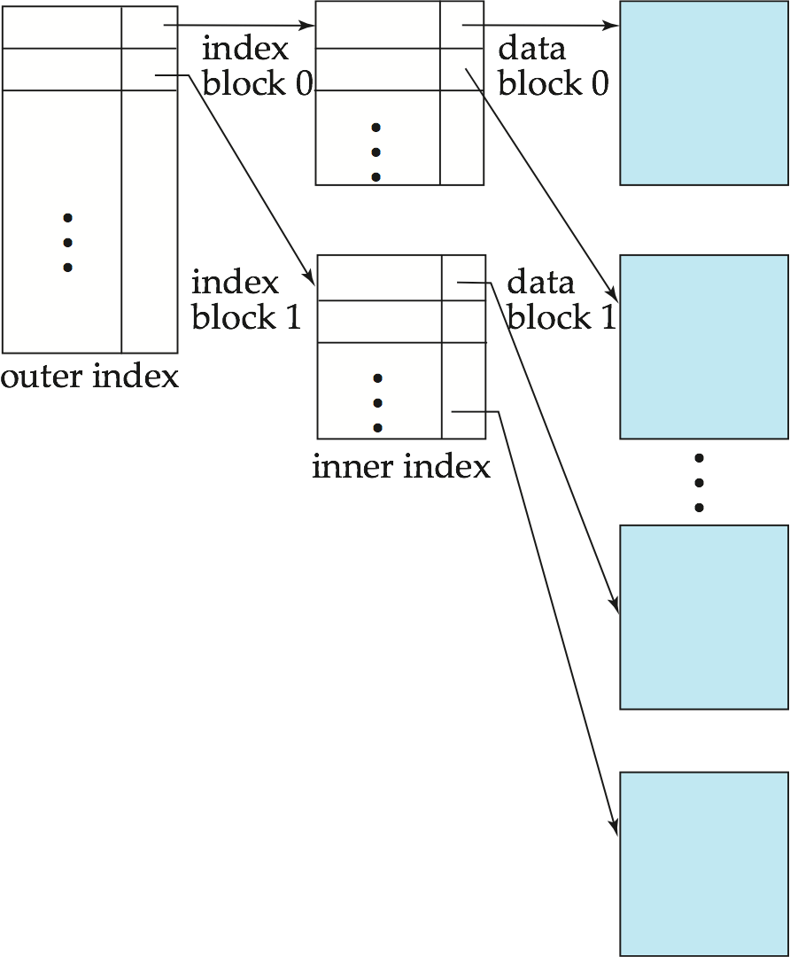
Multilevel Index (Cont.)

Slide 13
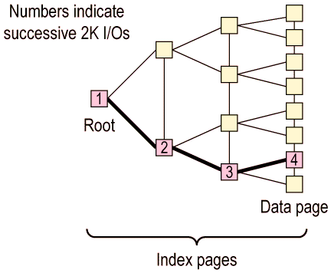
Multilevel Index (primary index)

Slide 14
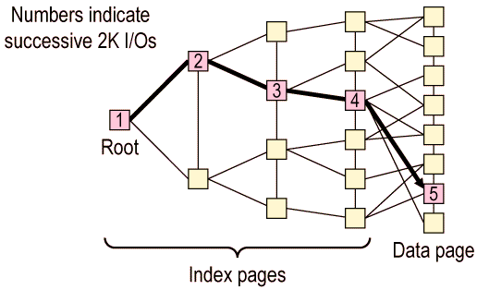
Multilevel Index (secondary index)

Slide 15
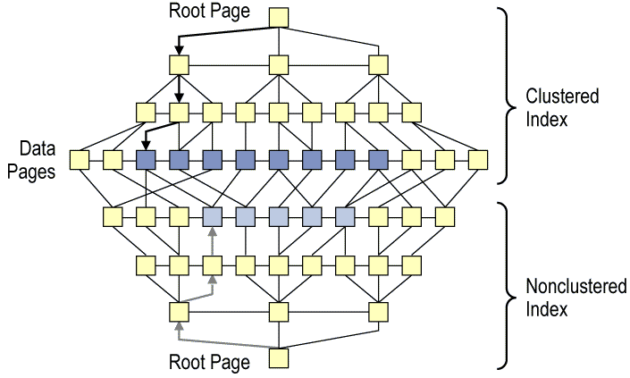
Multilevel Index (Cont.)

Slide 16
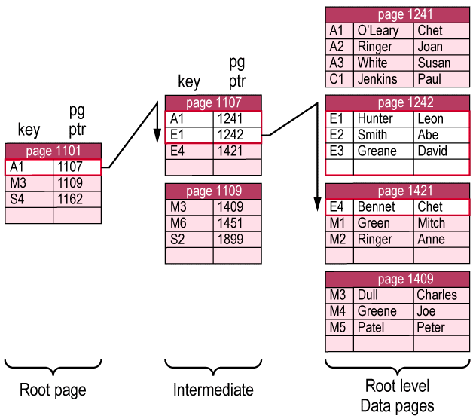
Covering indices (primary)
select * from employee
where emp_id like "E%"

Slide 17
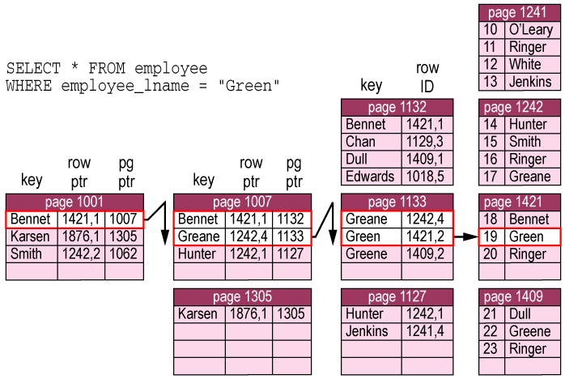
Covering indices (secondary)

Slide 18
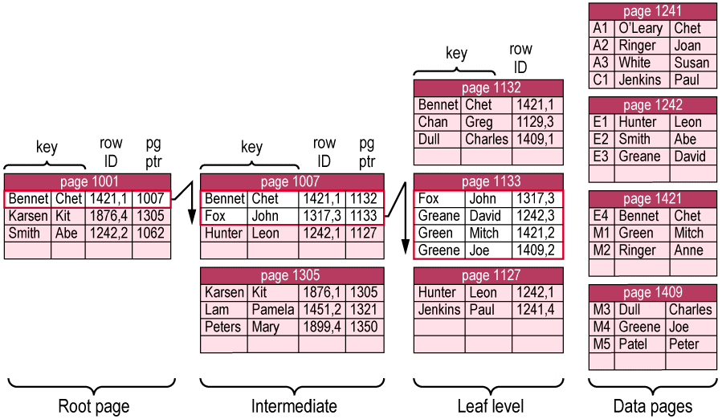
Covering indices (Multiple Attributes)
select emp_fname, emp_lname from employee
where emp_lname like “Gr%”and
emp_fname like “M%”

Slide 19
Covering indices (Multiple Attributes)

Slide 20
Query Processing

Slide 21
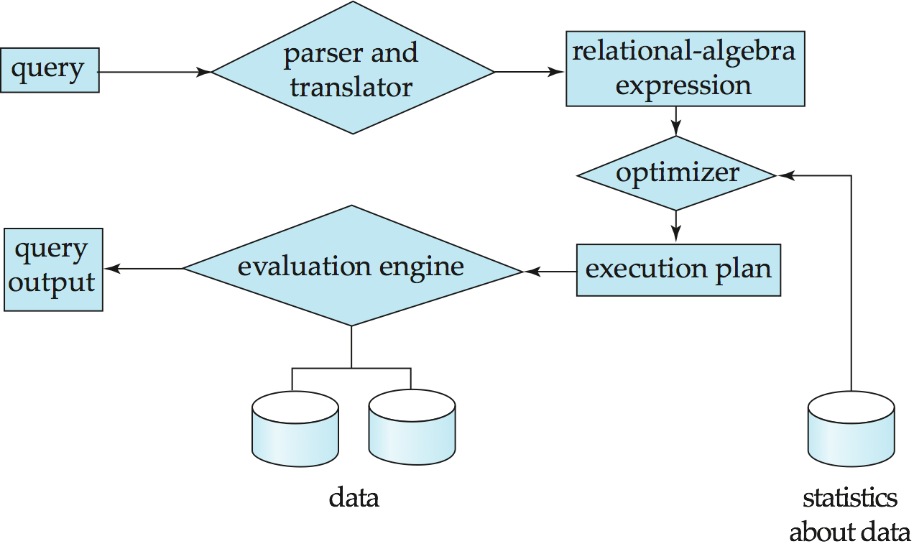
Basic Steps in Query Processing
1. Parsing and translation
2. Optimization
3. Evaluation

Slide 22
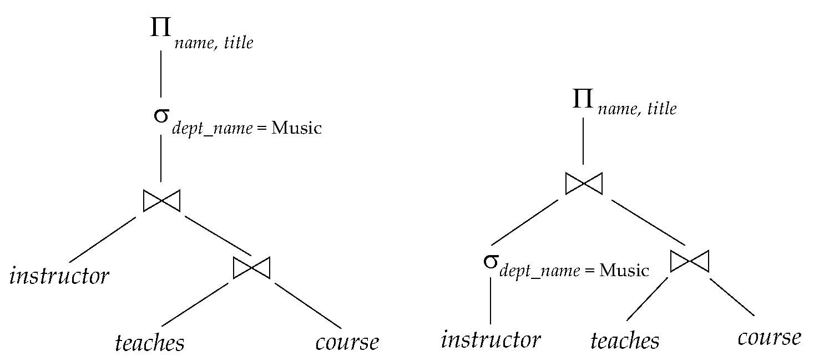
Alternative ways of evaluating a given query
Equivalent expressions
Different algorithms for each operation

Slide 23
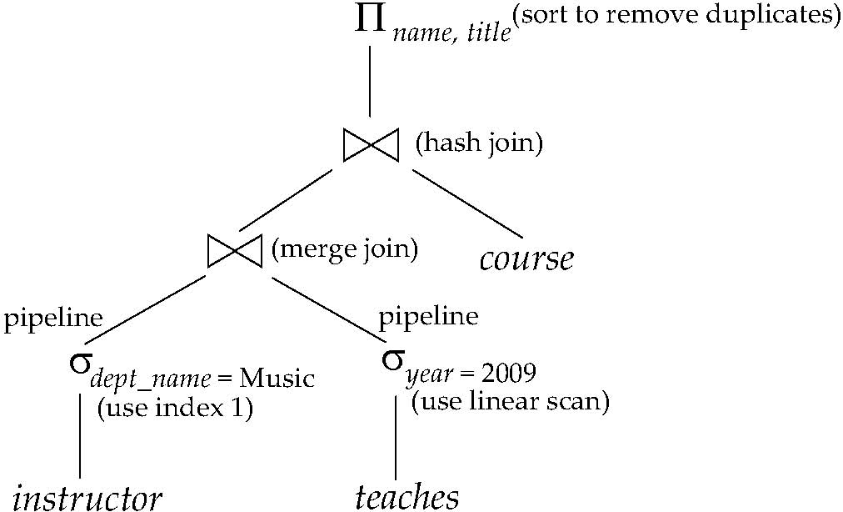
An evaluation plan defines exactly what algorithm is used for each operation, and how the execution of the operations is coordinated.
Find out how to view query execution plans on your favorite database

Slide 24
Transformation of Relational Expressions
Two relational algebra expressions are said to be equivalent if the two expressions generate the same set of tuples on every legal database instance
Note: order of tuples is irrelevant
we don’t care if they generate different results on databases that violate integrity constraints

Slide 25
Transformation of Relational Expressions
In SQL, inputs and outputs are multisets of tuples
Two expressions in the multiset version of the relational algebra are said to be equivalent if the two expressions generate the same multiset of tuples on every legal database instance.
An equivalence rule says that expressions of two forms are equivalent
Can replace expression of first form by second, or vice versa

Slide 26
Equivalence Rules
1. Conjunctive selection operations can be deconstructed into a sequence of individual selections.
2. Selection operations are commutative.
3. Only the last in a sequence of projection operations is needed, the others can be omitted.
Selections can be combined with Cartesian products and theta joins.
σ_{θ}(E₁ X E₂) = E₁ _{θ} E₂
σ_{θ1}(E₁ _{θ2} E₂) = E₁ _{θ1∧ θ2} E₂

Slide 27
Equivalence Rules (Cont.)
5. Theta-join operations (and natural joins) are commutative. E_{1 θ} E₂ = E₂ _{θ} E₁
6. (a) Natural join operations are associative:
(E₁ E₂) E₃ = E₁ (E₂ E₃) (b) Theta joins are associative in the following manner: (E_{1 θ1} E₂) _{θ2∧ θ3} E₃ = E_{1 θ1∧ θ3} (E₂ _{θ2} E₃) where θ₂ involves attributes from only E₂ and E₃.

Slide 28
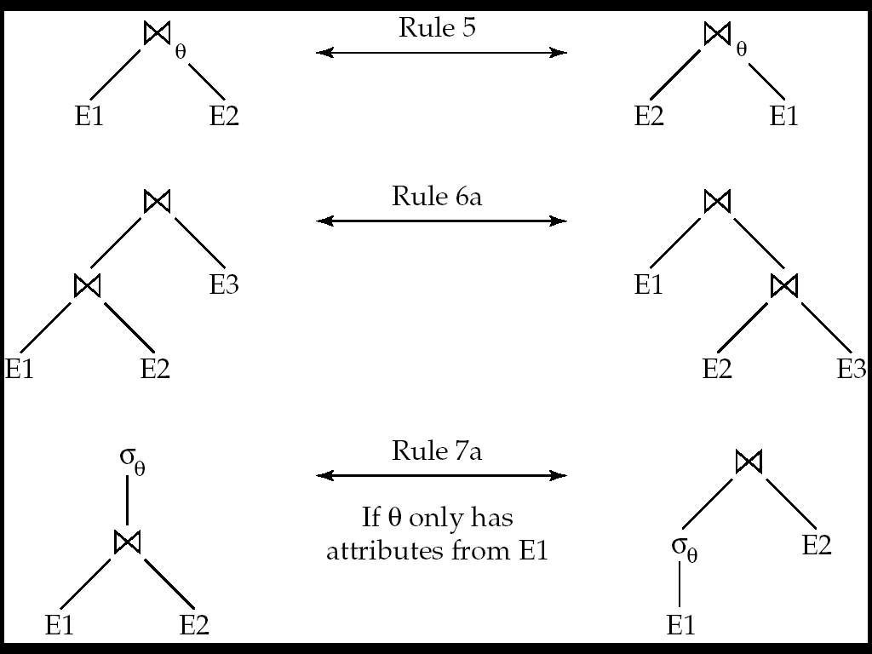
Pictorial Depiction of Equivalence Rules

Slide 29
Equivalence Rules (Cont.)
7. The selection operation distributes over the theta join operation under the following two conditions: (a) When all the attributes in θ₀ involve only the attributes of one of the expressions (E₁) being joined. σ_{θ0}(E₁ _{θ} E₂) = (σ_{θ0}(E₁)) _{θ} E₂
(b) When θ ₁ involves only the attributes of E₁ and θ₂ involves only the attributes of E₂.
σ_{θ1}∧_{θ2} (E₁ _{θ} E₂) = (σ_{θ1}(E₁)) _{θ} (σ_{θ2} (E₂))

Slide 30
Equivalence Rules (Cont.)
8. The projection operation distributes over the theta join operation as follows:
(a) if θ involves only attributes from L₁ ∪ L₂:
(b) Consider a join E_{1 θ} E₂.
Let L₁ and L₂ be sets of attributes from E₁ and E₂, respectively.
Let L₃ be attributes of E₁ that are involved in join condition θ, but are not in L₁ ∪ L₂, and
let L₄ be attributes of E₂ that are involved in join condition θ, but are not in L₁ ∪ L₂.
∏
(
E
E
)
=
(
∏
(
E
))
(
∏
(
E
))
L
1
∪
L
2
1
θ
2
L
1
1
θ
L
2
2
∏
(
E
E
)
=
∏
((
∏
(
E
))
(
∏
(
E
)))
L
1
∪
L
2
1
θ
2
L
1
∪
L
2
L
1
∪
L
3
1
θ
L
2
∪
L
4
2

Slide 31
Equivalence Rules (Cont.)
The set operations union and intersection are commutative E₁ ∪ E₂ = E₂ ∪ E₁ E₁ ∩ E₂ = E₂ ∩ E₁
(set difference is not commutative).
Set union and intersection are associative.
(E₁ ∪ E₂) ∪ E₃ = E₁ ∪ (E₂ ∪ E₃) (E₁ ∩ E₂) ∩ E₃ = E₁ ∩ (E₂ ∩ E₃)
The selection operation distributes over ∪, ∩ and –. σ_{θ} (E₁ – E₂) = σ_{θ} (E₁) – σ_{θ}(E₂) and similarly for ∪ and ∩ in place of – Also: σ_{θ} (E₁ – E₂) = σ_{θ}(E₁) – E₂ and similarly for ∩ in place of –, but not for ∪
12.The projection operation distributes over union
Π_{L}(E₁ ∪ E₂) = (Π_{L}(E₁)) ∪ (Π_{L}(E₂))

Slide 32
Transformation Example: Pushing Selections
Query: Find the names of all instructors in the Music department, along with the titles of the courses that they teach
Π_{name, title}(σ_{dept_name= “Music”} (instructor (teaches Π_{course_id, title} (course))))
Transformation using rule 7a.
Π_{name, title}((σ_{dept_name= “Music”}(instructor)) (teaches Π_{course_id, title} (course)))
Performing the selection as early as possible reduces the size of the relation to be joined.

Slide 33
Example with Multiple Transformations
Query: Find the names of all instructors in the Music department who have taught a course in 2009, along with the titles of the courses that they taught
Π_{name, title}(σ_{dept_name= “Music”∧gear = 2009} (instructor (teaches Π_{course_id, title} (course))))
Transformation using join associatively (Rule 6a):
Π_{name, title}(σ_{dept_name= “Music”∧gear = 2009} ((instructor teaches) Π_{course_id, title} (course)))
Second form provides an opportunity to apply the “perform selections early” rule, resulting in the subexpression
σ_{dept_name = “Music”} (instructor) σ _{year = 2009} (teaches)

Slide 34
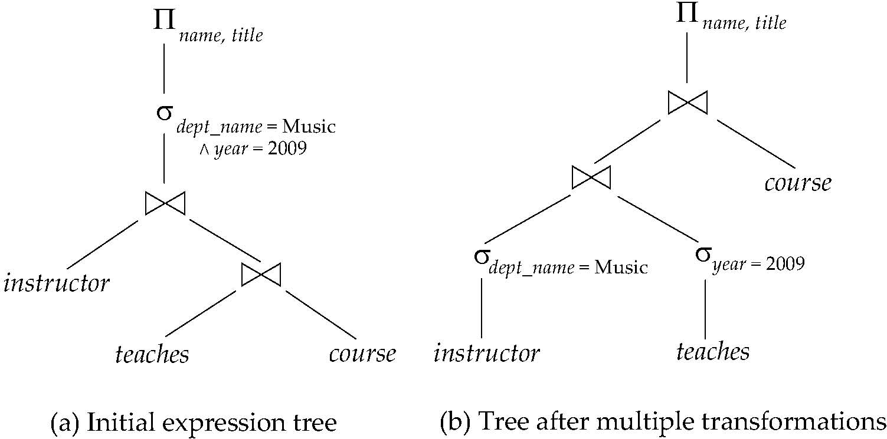
Multiple Transformations (Cont.)

Slide 35
Transformation Example: Pushing Projections
Consider: Π_{name, title}(σ_{dept_name= “Music”} (instructor) teaches) Π_{course_id, title} (course))))
When we compute
(σ_{dept_name = “Music”} (instructor teaches)
we obtain a relation whose schema is: (ID, name, dept_name, salary, course_id, sec_id, semester, year)
Push projections using equivalence rules 8a and 8b; eliminate unneeded attributes from intermediate results to get: Π_{name, title}(Π_{name, course_id} ( σ_{dept_name= “Music”} (instructor) teaches)) Π_{course_id, title} (course))))
Performing the projection as early as possible reduces the size of the relation to be joined.

Slide 36
Measures of Query Cost
Cost is generally measured as total elapsed time for answering query
Many factors contribute to time cost
disk accesses, CPU, or even network communication
Typically disk access is the predominant cost, and is also relatively easy to estimate. Measured by taking into account
Number of seeks * average-seek-cost
Number of blocks read * average-block-read-cost
Number of blocks written * average-block-write-cost
Cost to write a block is greater than cost to read a block
data is read back after being written to ensure that the write was successful

Slide 37
Measures of Query Cost (Cont.)
For simplicity we just use the number of block transfers from disk and the number of seeks as the cost measures
t_{T} – time to transfer one block
t_{S} – time for one seek
Cost for b block transfers plus S seeks b * t_{T} + S * t_{S}
We ignore CPU costs for simplicity
Real systems do take CPU cost into account
We do not include cost to writing output to disk in our cost formulae

Slide 38
Measures of Query Cost (Cont.)
Several algorithms can reduce disk IO by using extra buffer space
Amount of real memory available to buffer depends on other concurrent queries and OS processes, known only during execution
We often use worst case estimates, assuming only the minimum amount of memory needed for the operation is available
Required data may be buffer resident already, avoiding disk I/O
But hard to take into account for cost estimation
Notes:
38

Slide 39
Selection Operation

Slide 40
File scan
Algorithm A1 (linear search). Scan each file block and test all records to see whether they satisfy the selection condition.
Cost estimate = b_{r} block transfers + 1 seek
b_{r} denotes number of blocks containing records from relation r
If selection is on a key attribute, can stop on finding record
cost = (b_{r} /2) block transfers + 1 seek

Slide 41
File scan
Linear search can be applied regardless of
selection condition or
ordering of records in the file, or
availability of indices
Note: binary search generally does not make sense since data is not stored consecutively
except when there is an index available,
and binary search requires more seeks than index search

Slide 42
Selections Using Indices
Index scan – search algorithms that use an index
selection condition must be on search-key of index.
A2 (primary index, equality on key). Retrieve a single record that satisfies the corresponding equality condition
Cost = (h_{i} + 1) * (t_{T} + t_{S})
A3 (primary index, equality on nonkey) Retrieve multiple records.
Records will be on consecutive blocks
Let b = number of blocks containing matching records
Cost = h_{i} * (t_{T} + t_{S}) + t_{S} + t_{T} * b

Slide 43
Selections Using Indices
A4 (secondary index, equality on nonkey).
Retrieve a single record if the search-key is a candidate key
Cost = (h_{i} + 1) * (t_{T} + t_{S})
Retrieve multiple records if search-key is not a candidate key
each of n matching records may be on a different block
Cost = (h_{i} + n) * (t_{T} + t_{S})
Can be very expensive!
Notes:
43

Slide 44
Selections Involving Comparisons
Can implement selections of the form σ_{A≤V} (r) or σ_{A ≥ V}(r) by using
a linear file scan,
or by using indices in the following ways:
A5 (primary index, comparison). (Relation is sorted on A)
For σ_{A ≥ V}(r) use index to find first tuple ≥ v and scan relation sequentially from there
For σ_{A≤V} (r) just scan relation sequentially till first tuple > v; do not use index

Slide 45
Selections Involving Comparisons
A6 (secondary index, comparison).
For σ_{A ≥ V}(r) use index to find first index entry ≥ v and scan index sequentially from there, to find pointers to records.
For σ_{A≤V} (r) just scan leaf pages of index finding pointers to records, till first entry > v
In either case, retrieve records that are pointed to
requires an I/O for each record
Linear file scan may be cheaper

Slide 46
Implementation of Complex Selections
Conjunction: σ_{θ1}∧ _{θ2}∧. . . _{θn}(r)
A7 (conjunctive selection using one index).
Select a combination of θ_{i} and algorithms A1 through A7 that results in the least cost for σ_{θi} (r).
Test other conditions on tuple after fetching it into memory buffer.
A8 (conjunctive selection using composite index).
Use appropriate composite (multiple-key) index if available.

Slide 47
Implementation of Complex Selections
Conjunction: σ_{θ1}∧ _{θ2}∧. . . _{θn}(r)
A9 (conjunctive selection by intersection of identifiers).
Requires indices with record pointers.
Use corresponding index for each condition, and take intersection of all the obtained sets of record pointers.
Then fetch records from file
If some conditions do not have appropriate indices, apply test in memory.

Slide 48
Algorithms for Complex Selections
Disjunction:σ_{θ1}∨ _{θ2} ∨. . . _{θn} (r).
A10 (disjunctive selection by union of identifiers).
Applicable if all conditions have available indices.
Otherwise use linear scan.
Use corresponding index for each condition, and take union of all the obtained sets of record pointers.
Then fetch records from file

Slide 49
Algorithms for Complex Selections
Negation: σ_{¬θ}(r)
Use linear scan on file
If very few records satisfy ¬θ, and an index is applicable to θ
Find satisfying records using index and fetch from file

Slide 50
Sorting
We may build an index on the relation, and then use the index to read the relation in sorted order. May lead to one disk block access for each tuple.
For relations that fit in memory, techniques like quicksort can be used. For relations that don’t fit in memory, external sort-merge is a good choice.

Slide 51
Join Operation
Several different algorithms to implement joins
Nested-loop join
Block nested-loop join
Indexed nested-loop join
Merge-join
Hash-join
Choice based on cost estimate
Examples use the following information
Number of records of student : 5,000
takes : 10,000
Number of blocks of student : 100 takes : 400

Slide 52
Nested-Loop Join
To compute the theta join r _{θ} s
for each tuple t_{r} in r do begin for each tuple t_{s} in s do begin test pair(t_{r},t_{s}) to see if they satisfy the join condition θ if they do, add t_{r} • t_{s} to the result. end end
r is called the outer relation and s the inner relation of the join.
Requires no indices and can be used with any kind of join condition.
Expensive since it examines every pair of tuples in the two relations.

Slide 53
Nested-Loop Join (Cont.)
In the worst case, if there is enough memory only to hold one block of each relation, the estimated cost is n_{r} ∗ b_{s} + b_{r} block transfers, plus n_{r} + b_{r} seeks
If the smaller relation fits entirely in memory, use that as the inner relation.
Reduces cost to b_{r} + b_{s} block transfers and 2 seeks
Assuming worst case memory availability cost estimate is
with student as outer relation:
5000 ∗ 400 + 100 = 2,000,100 block transfers,
5000 + 100 = 5100 seeks
with takes as the outer relation
10000 ∗ 100 + 400 = 1,000,400 block transfers and 10,400 seeks
If smaller relation (student) fits entirely in memory, the cost estimate will be 500 block transfers.
Block nested-loops algorithm (next slide) is preferable.

Slide 54
Block Nested-Loop Join
Variant of nested-loop join in which every block of inner relation is paired with every block of outer relation.
for each block B_{r} of r do begin for each block B_{s} of s do begin for each tuple t_{r} in B_{r} do begin for each tuple t_{s} in B_{s} do begin Check if (t_{r},t_{s}) satisfy the join condition if they do, add t_{r} • t_{s} to the result. end end end end

Slide 55
Block Nested-Loop Join (Cont.)
Worst case estimate: b_{r} ∗ b_{s} + b_{r} block transfers + 2 * b_{r} seeks
Each block in the inner relation s is read once for each block in the outer relation
Best case: b_{r} + b_{s} block transfers + 2 seeks.
Improvements to nested loop and block nested loop algorithms:
In block nested-loop, use M — 2 disk blocks as blocking unit for outer relations, where M = memory size in blocks; use remaining two blocks to buffer inner relation and output
Cost = ⎡b_{r} / (M-2)⎤ ∗ b_{s} + b_{r} block transfers + 2 ⎡b_{r} / (M-2)⎤ seeks
If equi-join attribute forms a key or inner relation, stop inner loop on first match
Scan inner loop forward and backward alternately, to make use of the blocks remaining in buffer (with LRU replacement)
Use index on inner relation if available (next slide)

Slide 56
Indexed Nested-Loop Join
Index lookups can replace file scans if
join is an equi-join or natural join and
an index is available on the inner relation’s join attribute
Can construct an index just to compute a join.
For each tuple t_{r} in the outer relation r, use the index to look up tuples in s that satisfy the join condition with tuple t_{r}.
Worst case: buffer has space for only one page of r, and, for each tuple in r, we perform an index lookup on s.
Cost of the join: b_{r} (t_{T} + t_{S}) + n_{r} ∗ c
Where c is the cost of traversing index and fetching all matching s tuples for one tuple or r
c can be estimated as cost of a single selection on s using the join condition.
If indices are available on join attributes of both r and s, use the relation with fewer tuples as the outer relation.

Slide 57
Example of Nested-Loop Join Costs
Compute student takes, with student as the outer relation.
Let takes have a primary B⁺-tree index on the attribute ID, which contains 20 entries in each index node.
Since takes has 10,000 tuples, the height of the tree is 4, and one more access is needed to find the actual data
student has 5000 tuples
Cost of block nested loops join
400*100 + 100 = 40,100 block transfers + 2 * 100 = 200 seeks
assuming worst case memory
may be significantly less with more memory
Cost of indexed nested loops join
100 + 5000 * 5 = 25,100 block transfers and seeks.
CPU cost likely to be less than that for block nested loops join

