Slide 1

Spatial Analysis of Gene Expression Patterns in Human Lung Cancer
A Comparative Study of GraphST and BANKSY
Suhas Uttarala
Supervisor: Dr. Daniel D'Andrea
Master of Data Science in the Faculty of Engineering

Slide 2

Motivation: Why AI for Spatial Analysis in Lung Cancer?
The spatial arrangement of the Tumour Microenvironment (TME) is critical for lung cancer development, metastasis, and therapy response.
Spatial Transcriptomics (ST) is a key technology for mapping the TME's complex architecture at a molecular level. ST experiments produce massive datasets (tens of thousands of coordinates, thousands of genes), making AI-driven computational models essential to identify meaningful biological patterns.

Slide 3


Two Competing AI Philosophies: GraphST vs. BANKSY
GraphST (Global Approach)
BANKSY (Local Approach)
Uses a Graph Neural Network (GNN) to learn a combined embedding of spatial and transcriptional similarity.
Uses a filter/kernel-based framework to interpret local neighborhoods.
Designed to detect spatially continuous domains and maintain tissue integrity.
Designed to capture subtle expression transitions and local heterogeneity.
Project Contribution: The first head-to-head comparison of GraphST and BANKSY on a Visium HD lung cancer ROI.

Slide 4


Methodology: A Fair & Reproducible Comparison
Single Shared ROI: Both methods analyzed the exact same tissue region: 14,880 spots and over 18,000 genes.
This rigorous methodology minimizes confounding variables, providing unprecedented clarity in comparing these two distinct AI approaches.
Harmonised Pipeline: Identical preprocessing, clustering (Leiden), and marker discovery (Wilcoxon test) were used for both branches.
Deterministic Execution: Fixed seeds and versioned code ensure 100% reproducibility of all artifacts.

Slide 5
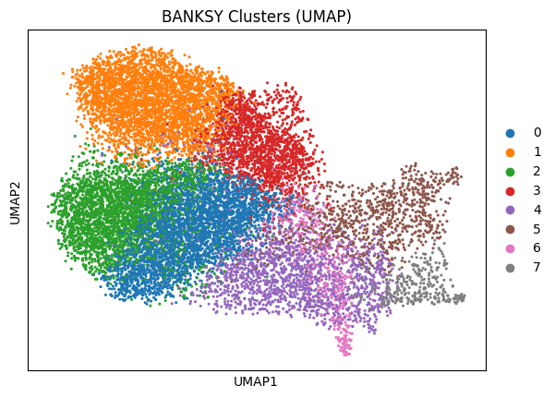
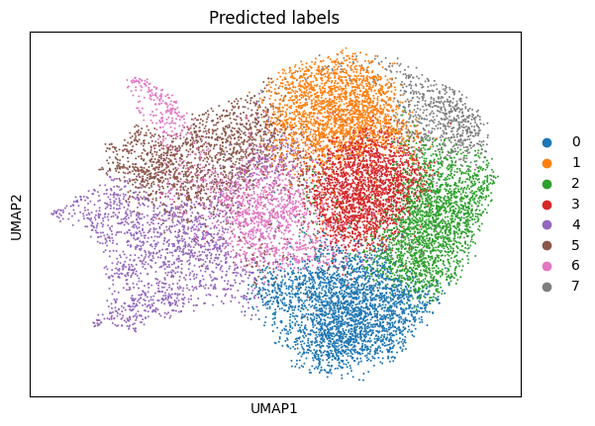
Key Finding 1: Different Views, Same Geography
Fig: Banksy UMAP
Fig: GraphST UMAP
Different Learned Geometry: GraphST preserves smooth chains, suggesting gradual transitions, while BANKSY emphasizes crisp island separation.
Consistent Spatial Geography: Despite different UMAPs, both models form large, coherent domains in comparable physical locations on the tissue slide.
Conclusion: Both methods find robust, real biological structures; their main difference lies in how they represent the boundaries between them.
Figure 4.1: UMAP Views
Figure 4.2: Spatial Overlays

Slide 6
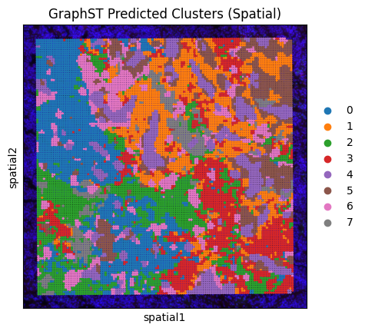
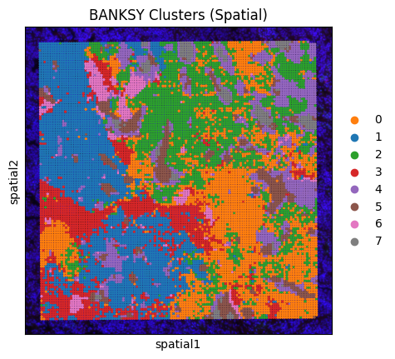
Spatial Cluster Maps: GraphST vs. BANKSY
Both GraphST and BANKSY models demonstrate successful identification of large, coherent tissue domains
within the lung cancer Region of Interest (ROI), indicating robust detection of primary tissue compartments.
A crucial distinction emerges in how these models delineate cluster boundaries:
GraphST: Generates more transitional belts at interfaces, a characteristic reflective of its graph-learning methodology that accommodates
gradual state changes between spatial domains.
BANKSY: Emphasizes crisp, well-defined borders and exhibits fewer "salt-and-pepper" artifacts, consistent with its approach of
leveraging neighbor-enriched features to enhance local contrast.
Despite these methodological differences in boundary definition, the first-order adjacencies—that is, the qualitative neighboring relationships between clusters—are largely conserved across both models, suggesting a shared understanding of macro-level tissue organization.

Slide 7
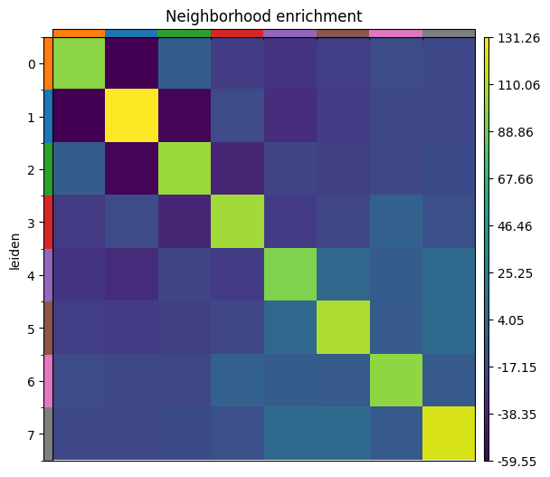
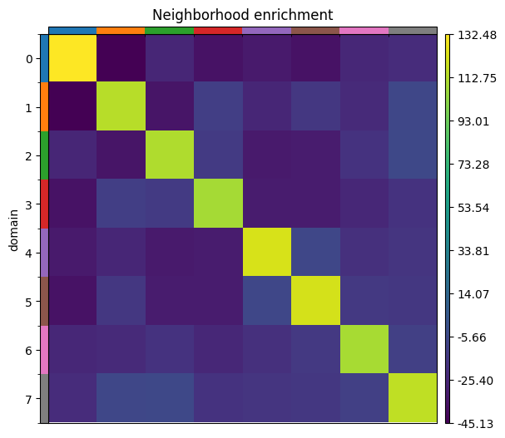
Key Finding 2: Highlighting Interfaces vs. Coherent Domains
Fig: GraphSt Enrichment
Fig: Banksy Enrichment
Neighbourhood Enrichment quantifies spatial contact patterns between cluster pairs.
Bright Off-Diagonals indicate enriched interfaces between different clusters.
Key Difference: BANKSY shows slightly stronger off-diagonal contrast, better highlighting local boundaries,
while GraphST's brighter diagonal reflects its focus on globally smoother domains.
Figure 4.3: GraphST
Figure 4.4: BANKSY

Slide 8
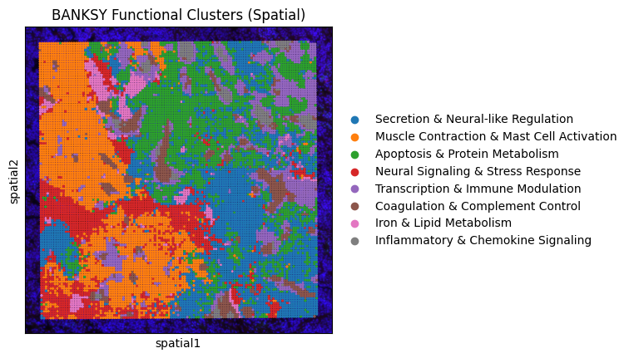
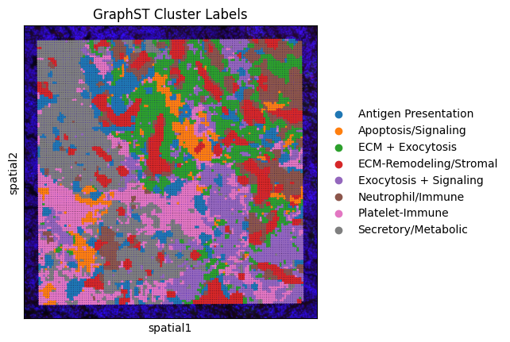
Functional Annotation (GO/Enrichr): Broader vs. Specialised
Figure 4.6: GraphST Clusters
Gene Ontology (GO) was used to assign biological functions to each cluster's marker genes.
Fig: BANKSY Go Analysis
Fig: GraphSt Go Analysis
BANKSY: Its boundary-centric features lead to more specialized labels at interfaces, such as "Inflammatory & Chemokine Signaling".
GraphST: Its emphasis on smooth transitions results in broader functional domains, like "ECM-Remodeling/Stromal".

Slide 9
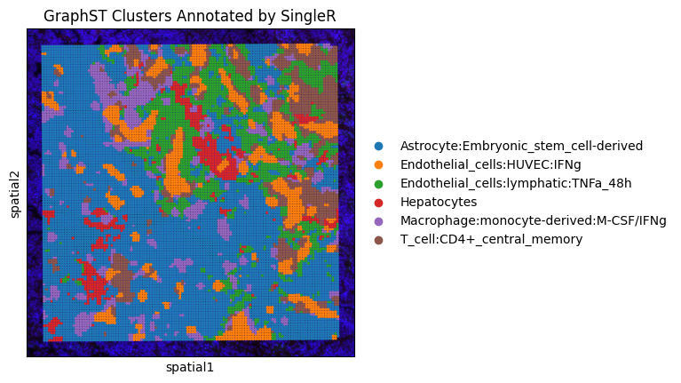
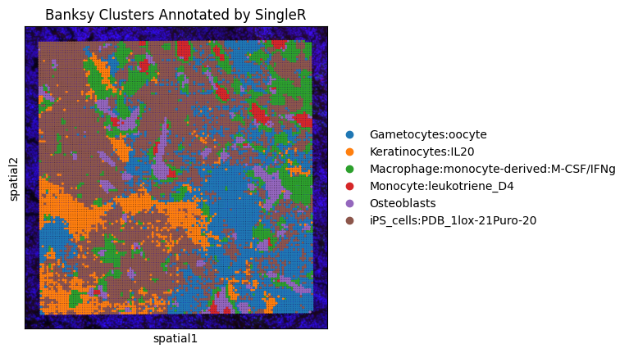
Cell-Type Annotation (SingleR): Mixed vs. Niche-Specific
SingleR was used to map clusters to likely cell types by comparing them to a reference atlas.
Fig: GraphSt Go Analysis
Fig: BANKSY SingleR Analysis
GraphST: Its transition-aware partitions often result in broader,
mixed identities across gradients.
BANKSY: Its boundary-focused segmentation drives more specialized cell-type calls at tumor-stroma interfaces.
Figure 4.8: GraphST Clusters
Figure 4.7: BANKSY Clusters
These differences are principled and reflect each model's distinct approach to partitioning tissue.

Slide 10
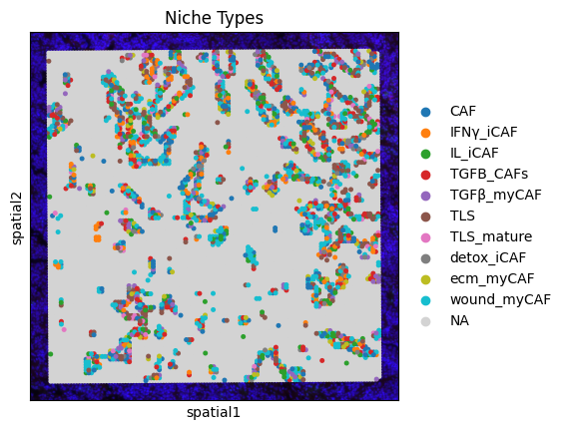
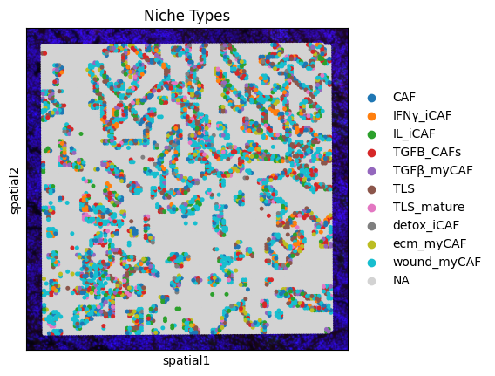
Key Finding 3: Deep Dive into CAF/TLS Niches
Mapping Key TME Niches: Cancer-Associated Fibroblasts (CAFs) and Tertiary Lymphoid Structures (TLS).
Fig: BANKSY SingleR Analysis
Fig: GraphST SingleR Analysis
BANKSY (Boundary-Focused): Identifies CAF programs as thin, crisp rings outlining tumor cores and TLS as compact foci.
GraphST (Transition-Focused): Identifies CAF programs as broader belts representing gradual transitions.
Figure 4.10: BANKSY Niche Map
Figure 4.11: GraphST Niche Map

Slide 11
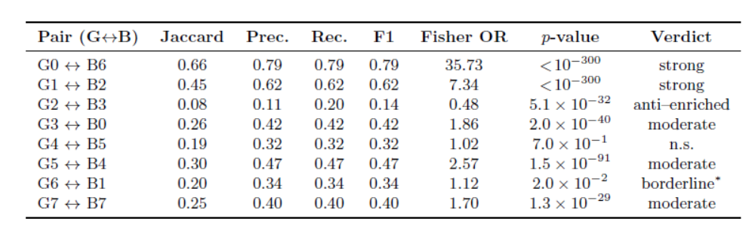
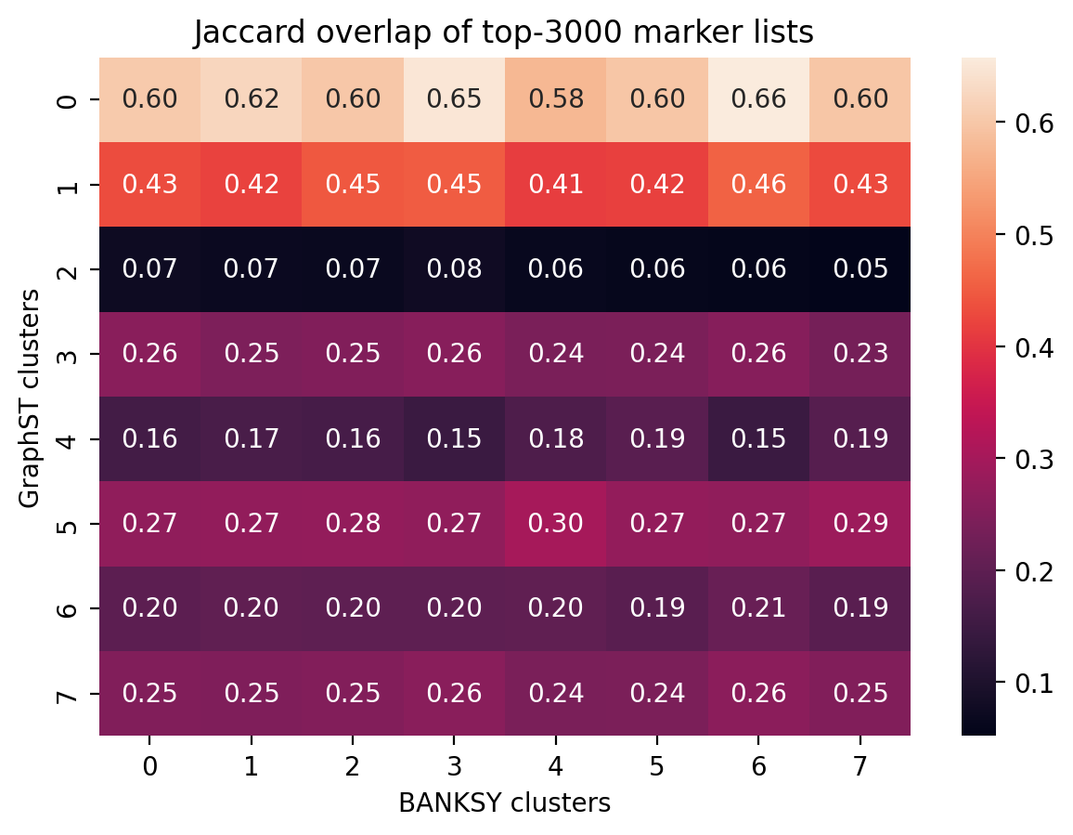
Quantifying the Agreement
Table 4.3: Comparison Metrics
Method: Compared the top-3000 marker genes for each cluster pair using the Jaccard index and Fisher's exact test.
Strong Agreement: The highest-matching pairs (Jaccard = 0.66 and 0.45) correspond to core tumor and immune niches.
Principled Disagreement: Lower overlap pairs correspond to interface zones, where BANKSY creates finer niches while GraphST models
a wider transition.
Figure 4.12: Jaccard Similarity Heatmap

Slide 12
Conclusion
Future Work
GraphST and BANKSY are complementary, not competing, tools for spatial transcriptomics analysis.
Multi-scale Neighbourhood Analysis
GraphST is ideal for studying global tissue architecture, broad domains, and smooth biological transitions.
Develop and apply methods for analysing spatial neighborhoods at multiple resolutions to capture a more complete picture of tissue organization.
BANKSY excels at dissecting sharp micro-niche boundaries, localized gradients, and fine-grained spatial heterogeneity.
Broader Benchmarking
Apply this comparative framework to a wider range of spatial transcriptomics datasets and tumour types to validate generalizability and identify context-specific strengths.
Histological Integration
Integrate high-resolution histological images directly into the computational models for orthogonal validation and improved biological interpretability of identified spatial structures.
Thank You
Questions?

