Slide 1
Power Electronics
Seminar #2
Part 2
Reporter
NIE YONGXIN
：
CHANG YI
WANG DAOXI
：
：

Slide 2
division of work
NIE YONGXIN:
Carry out the simulation.
The part 2 of PPT.
The images of part 2.
The analysis of the result.
CHANG YI:
The information searching.
Carry out the simulation.
The analysis of the result.
The theoretical calculations of the part 1
WANG DAOXI:
Carry out the simulation.
The part 1 of PPT.
The analysis of the result.

Slide 3
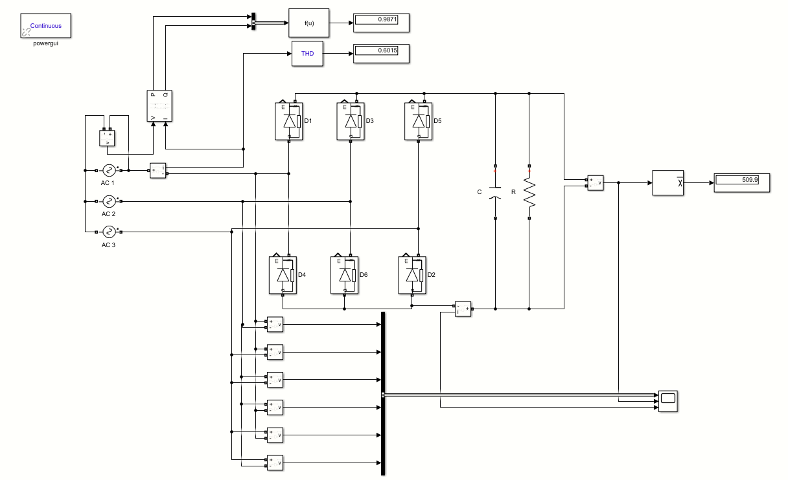
Simulink Circuit Diagram

Slide 4
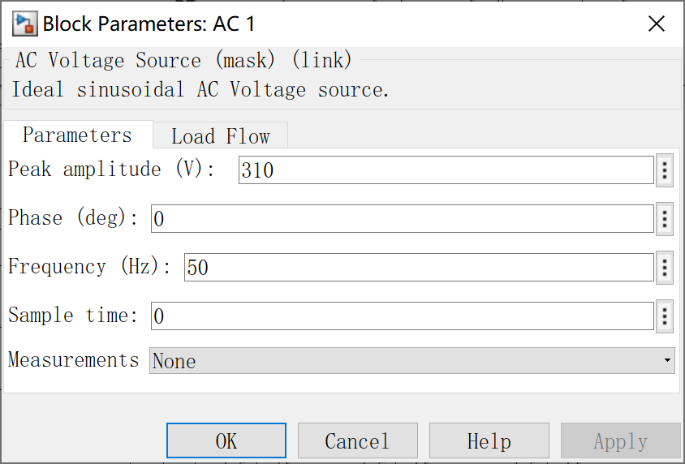
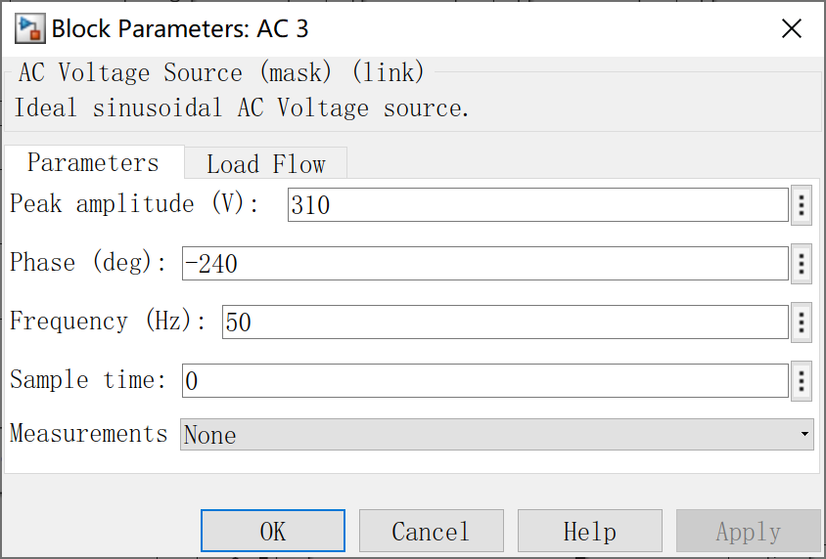
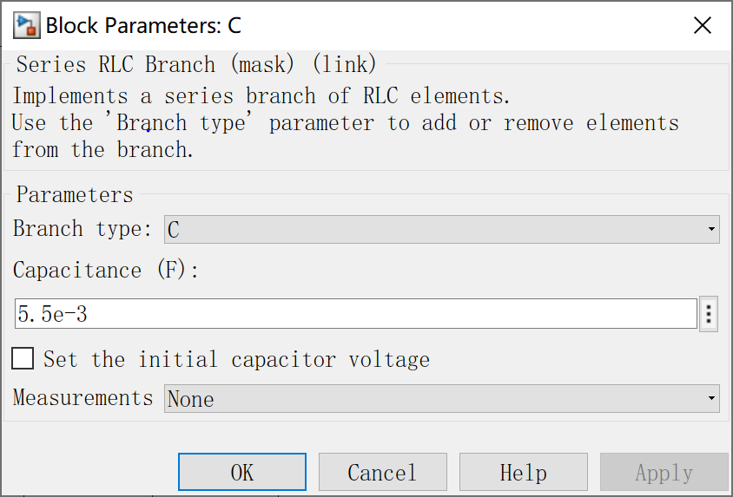

Parameter Setup
Power Supply
capacitor

Slide 5
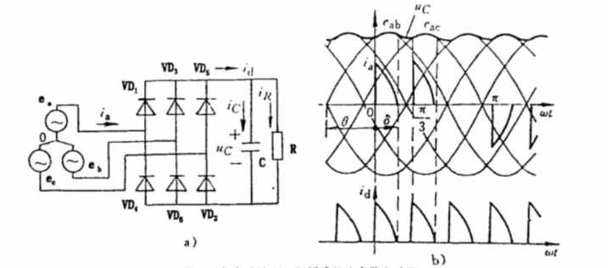
Theoretical waveform of model 2

Slide 6
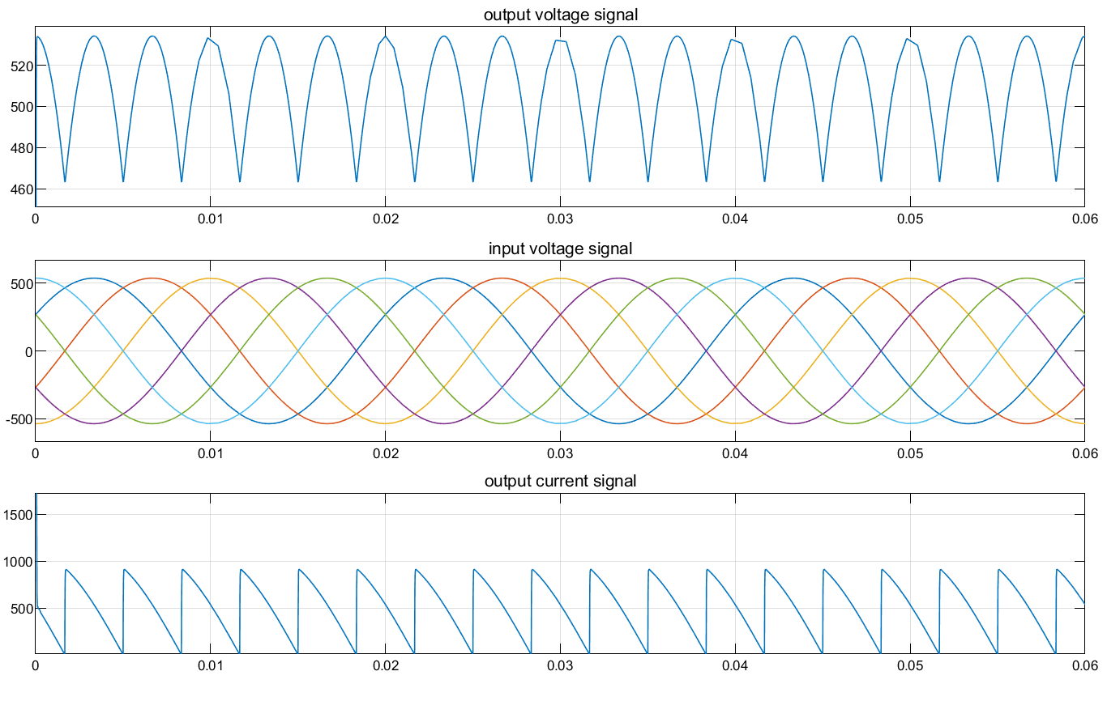
Waveform of model 2

Slide 7
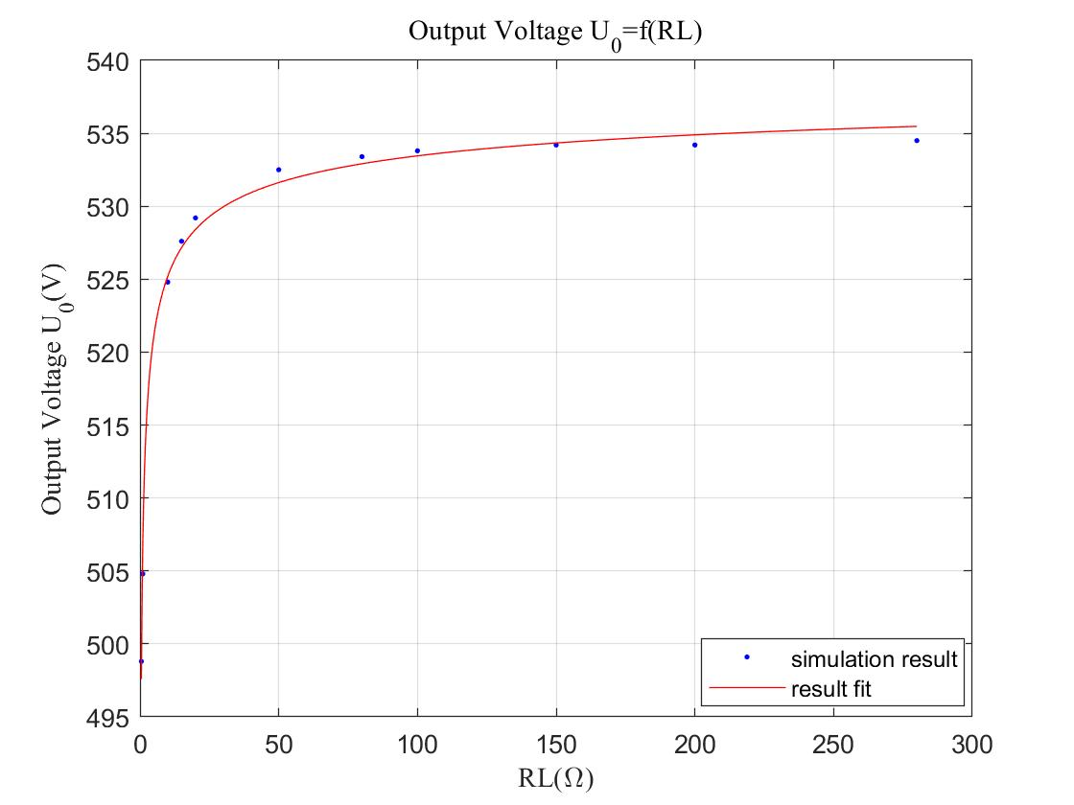
Simulation Result
Output Voltage

Slide 8
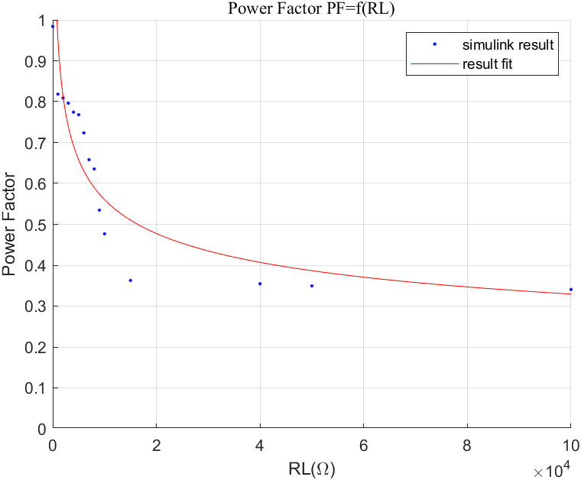
Simulation Result
Power Factor

Slide 9
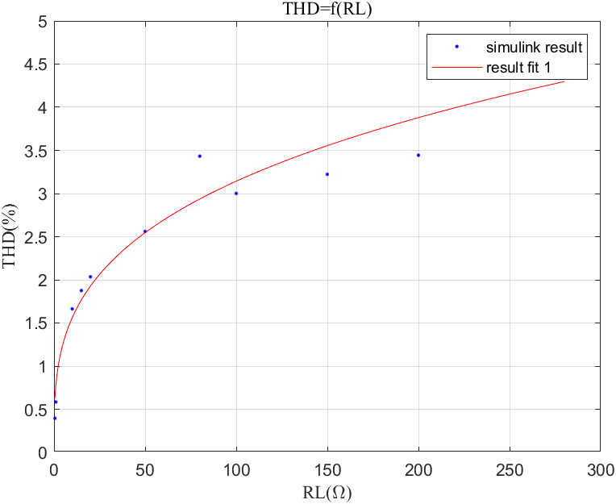
Simulation Result
Total Harmonic Distortion

Slide 10
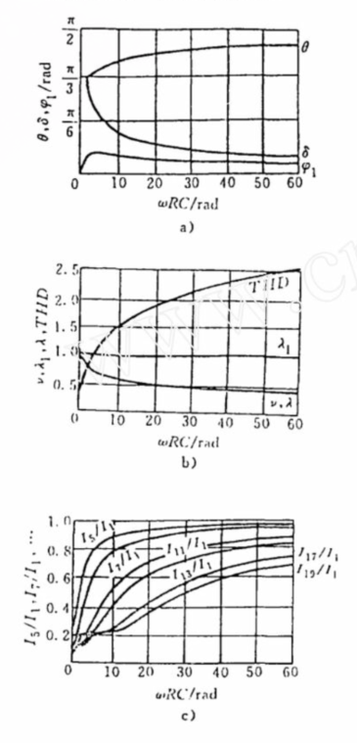
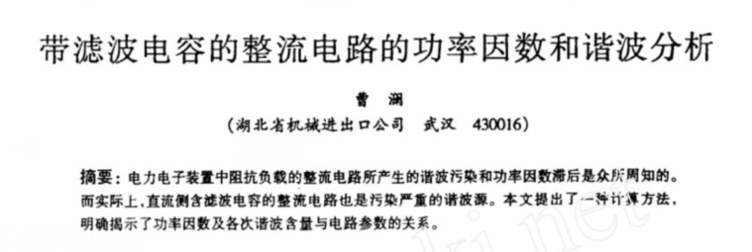
Results from Literature

Slide 11
Our Questions About Simulink

Slide 12
Your Questions and Comments are welcome

