Slide 1
Power Electronics
Seminar #3
Part 2
Reporter
NIE YONGXIN
：
LI HAONAN
NIE SHAOHAO
：
：

Slide 2
division of work
NIE YONGXIN:
Carry out the simulation.
The images of part 1.
The analysis of the result.
The PPT of part 1.
LI HAONAN:
The data collection.
Carry out the simulation.
The analysis of the result.
The PPT of part 1.
NIE SHAOHAO:
The theoretical calculations of the part 2
The PPT of part 2.
The analysis of the result.

Slide 3
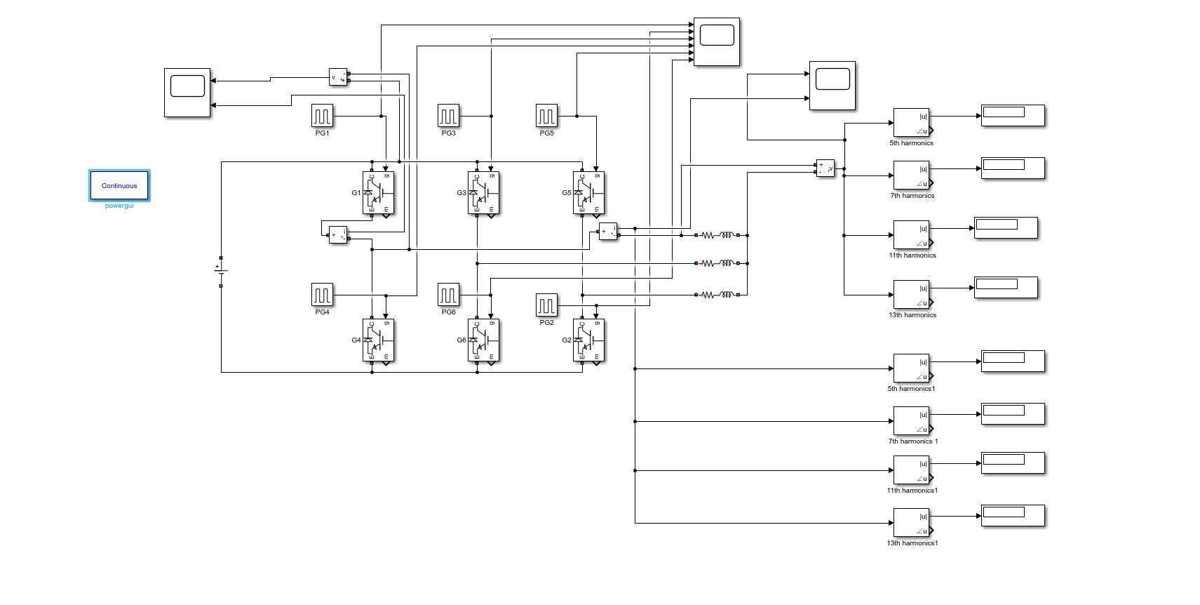
Circuit

Slide 4
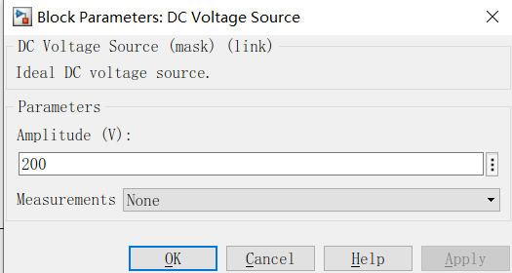
Parameter Setup
Resistor and inductor
Power Supply
L | R
0.01H | 5Ω

Slide 5
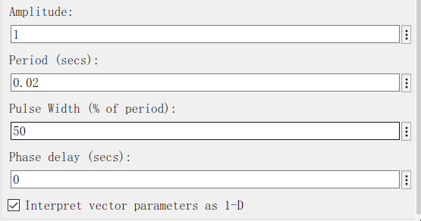
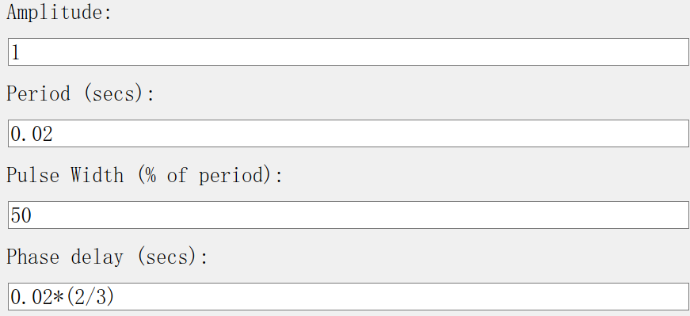
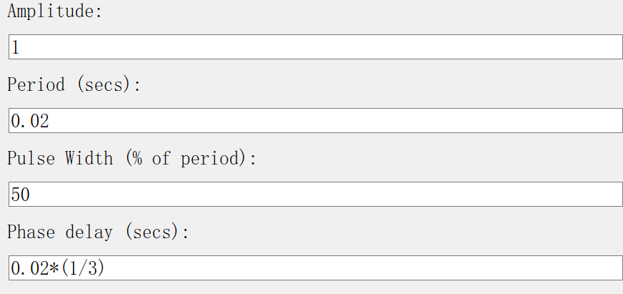
Parameter Setup
Pulse setting

Slide 6
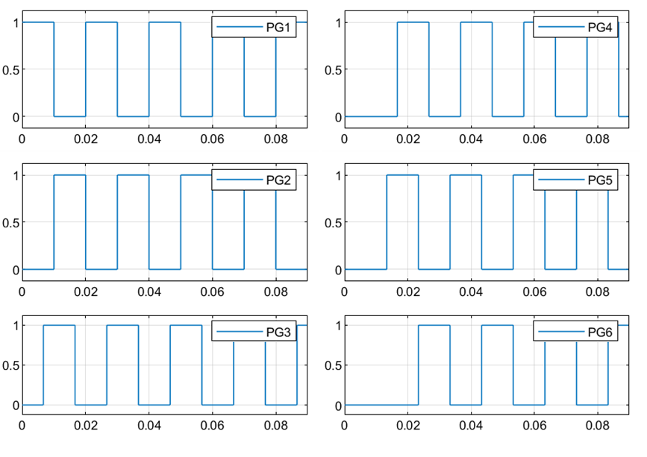
Pulse Signal

Slide 7
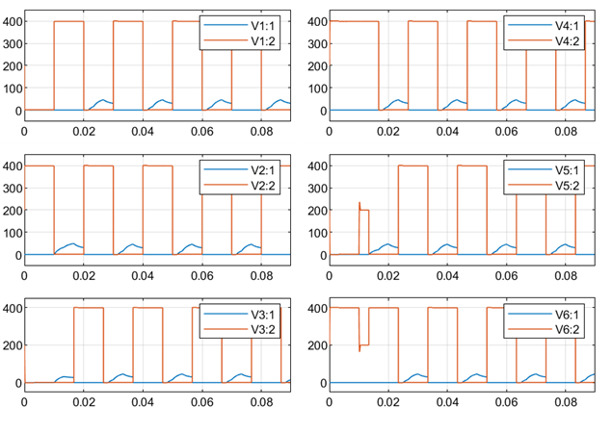
Signal of IGBT

Slide 8
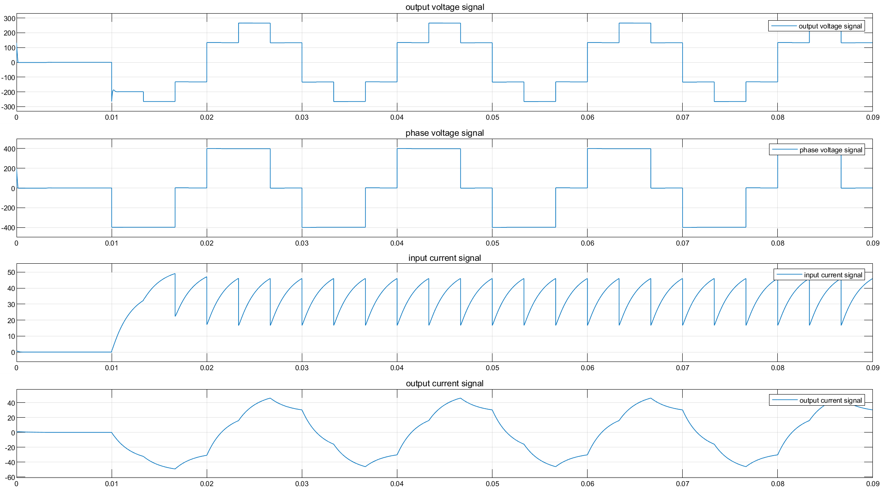
Voltage and current waveform of power switch

Slide 9
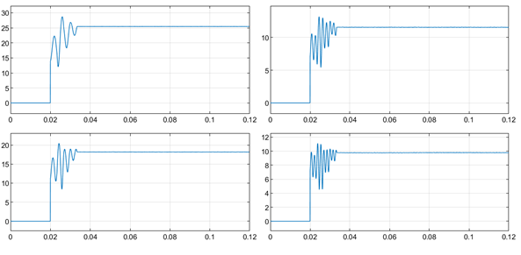
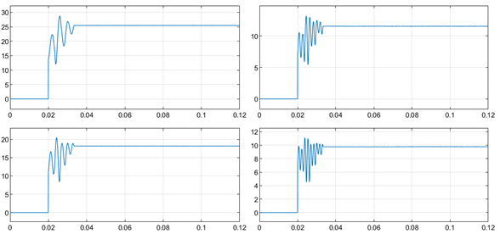
Harmonics Component

Slide 10
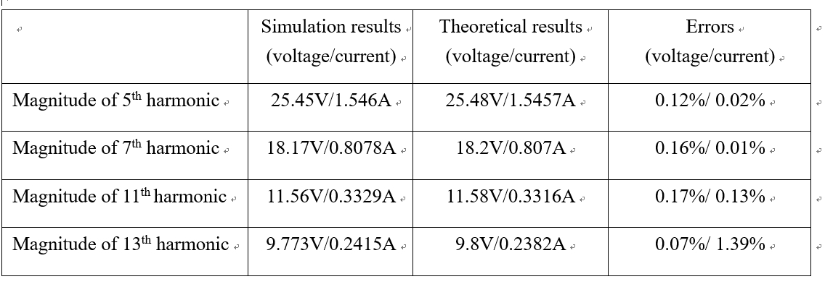
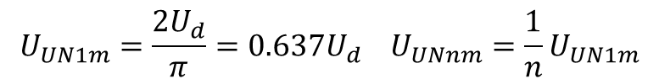


Simulation Result
$$U_{UN1m}=\frac{2U_{d}}{π}=0.637U_{d} U_{UNnm}=\frac{1}{n}U_{UN1m}$$
${ I}_{UNnm}=\frac{U_{UNnm}}{\sqrt{R^{2}+{\left(ω_{n}L\right)}^{2}}} ω_{n}=nω$
$f=50HZ, ω=2πf, R=5Ω$, L=0.01H

Slide 11
Your Questions and Comments are welcome

