Slide 1


Seminar #4
Topic 1
the step-up converter
Reporter：DingYibo NieYongxin WuDi
Group 7
Nov.23 2020

Slide 2
Work Division
Ding Yibo:
Powerpoint , Simulation, Discussion
Wu Di:
Simuation, Discussion
Nie Yongxin
Simulation , Powerpoint , Discussion

Slide 3


01
Simulation model
02
Task 1
calculate the theoretical value of Δu_{L}, Δi_{L}
03
Task 2
the relationships between D and G, Δu_{L}, Δi_{L}

Slide 4
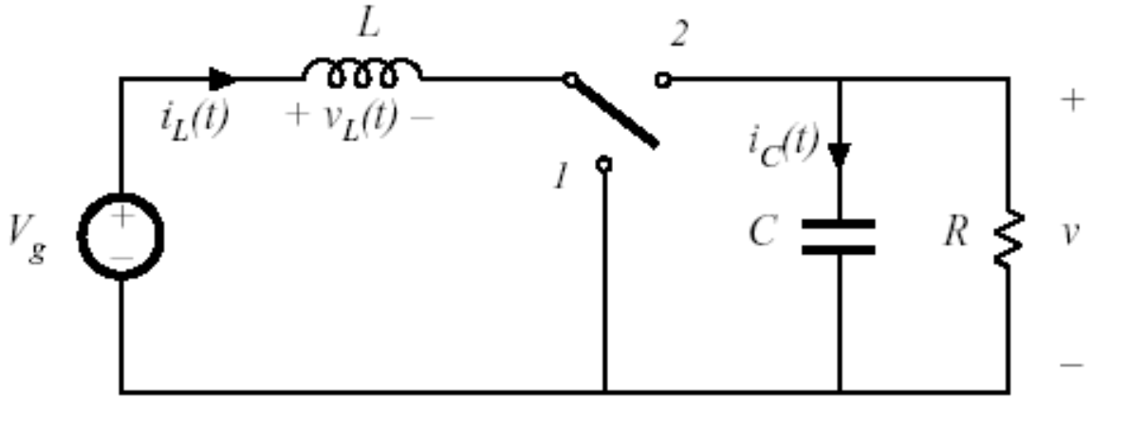
Circuit diagram
Fig. 1 Boost converter
1

Slide 5

Task 1

Slide 6
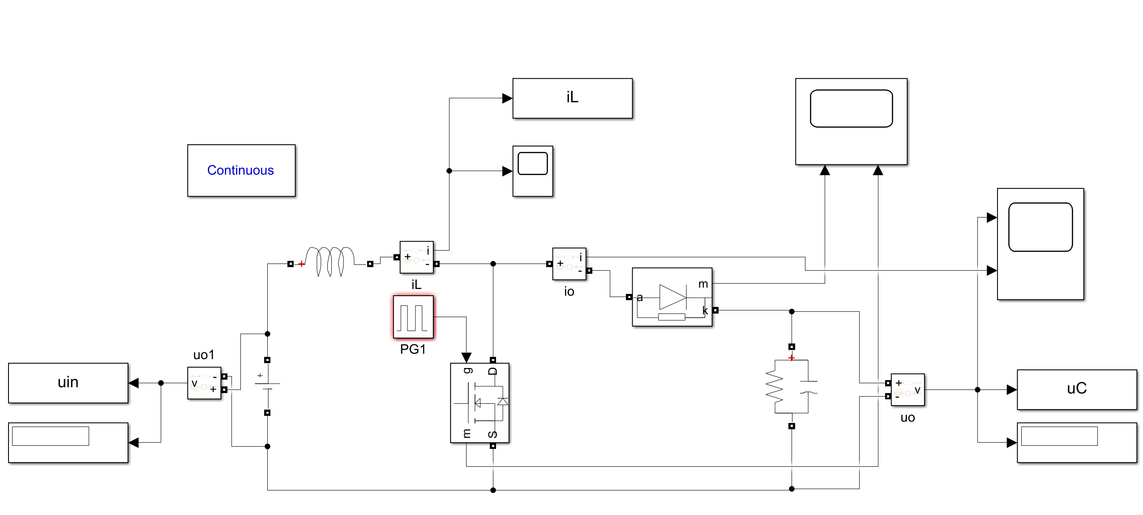
Simulink circuit diagram
Fig. 1-1 Simulation model
Tab. 1-1 Parameter setup of our group
Boost converter | Vin | Vo | RL | fs | L | C
 | 300V | 400V | 100Ω | 100kHz | 800uH | 200uF
2

Slide 7
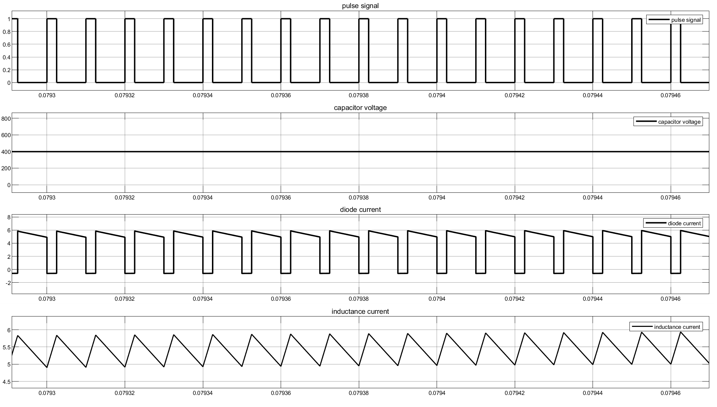
Waveform of Simulation for checking
Fig. 1-2 Waveform of Simulation for checking
3

Slide 8
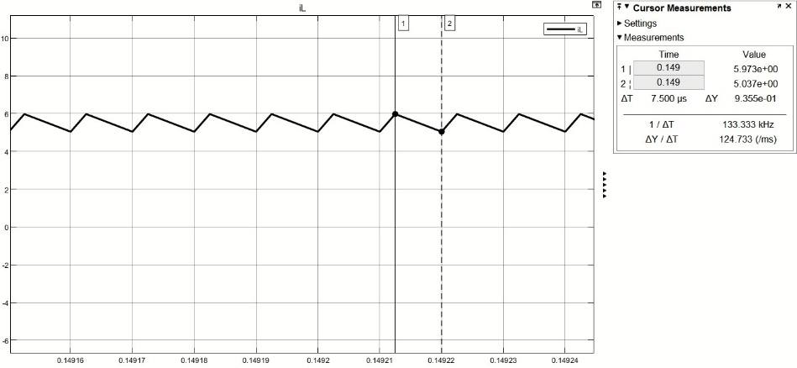
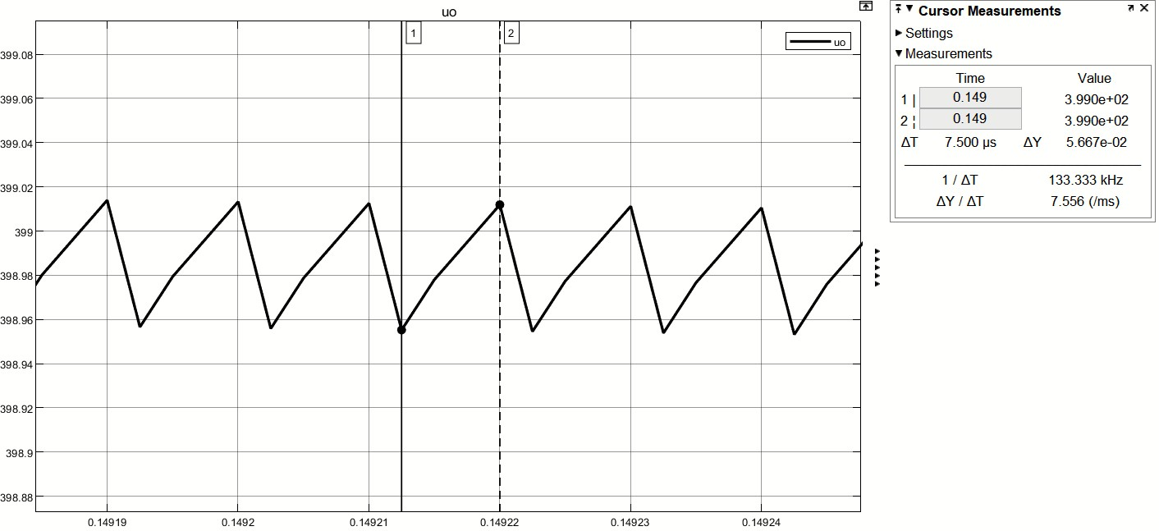
Result waveform
When the duty cycle is 25%, the output voltage is 400V.
Fig. 1-3 Inductor current ripple
Fig. 1-4 Capacitor voltage ripple
4

Slide 9
Comparison between theory and simulation
Tab. 1-2 Comparison of theoretical and simulation value
 | Theoretical value | Simulation value | Percentage error
Inductor current ripple | 0.9375A | 0.9355A | 0.213%
Capacitor voltage ripple | 0.05V | 0.05567V | 13.34%
5

Slide 10
Task 2

Slide 11
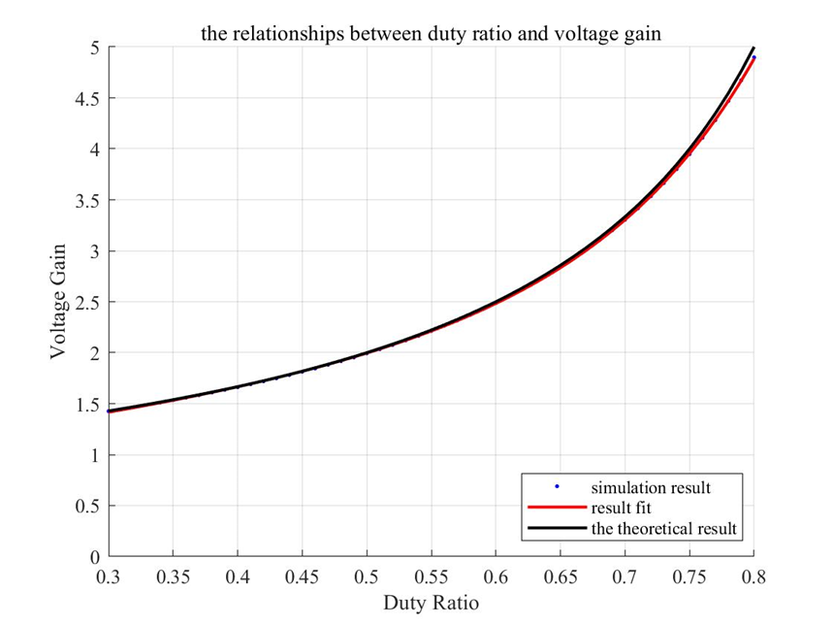
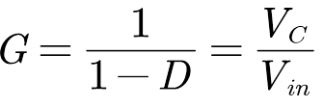
Relationship between duty ratio and voltage gain
Fit Result
gof =
sse: 0.0010
rsquare: 1.0000
dfe: 47
adjrsquare: 1.0000
rmse: 0.0046
6
Fig. 1-5 Relationship between G and D

Slide 12
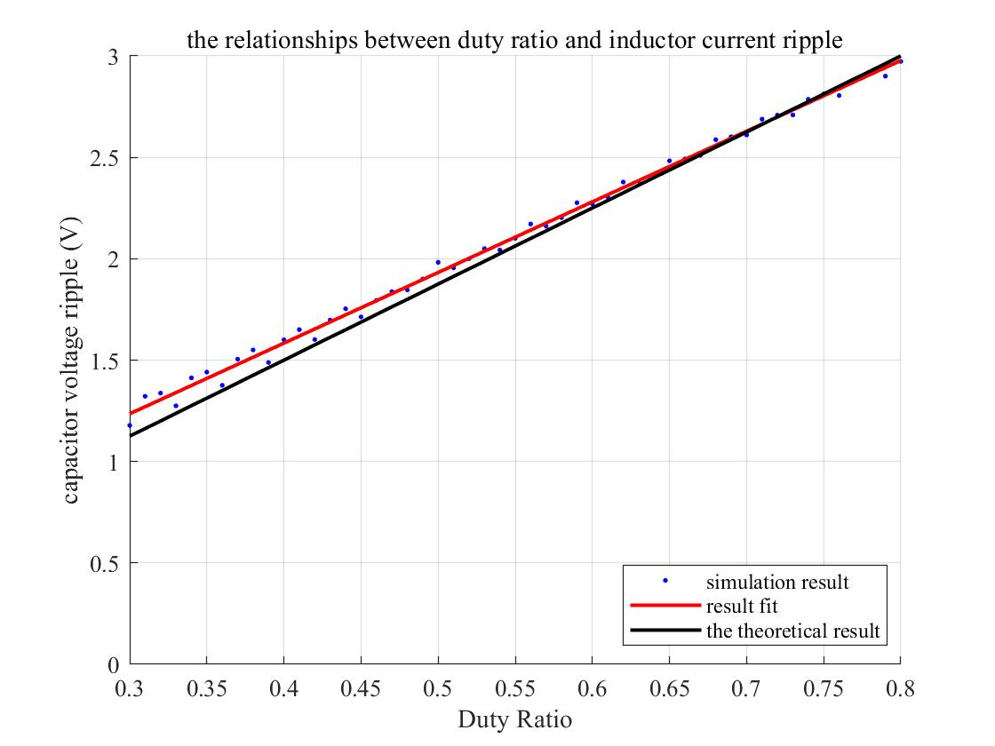

Relationship between duty ratio
and inductor current ripple
Fit Result
gof =
sse: 0.0452
rsquare: 0.9966
dfe: 49
adjrsquare: 0.9966
rmse: 0.0304
7
Fig. 1-6 Relationship between ${∆i}_{L}$ and $D$

Slide 13
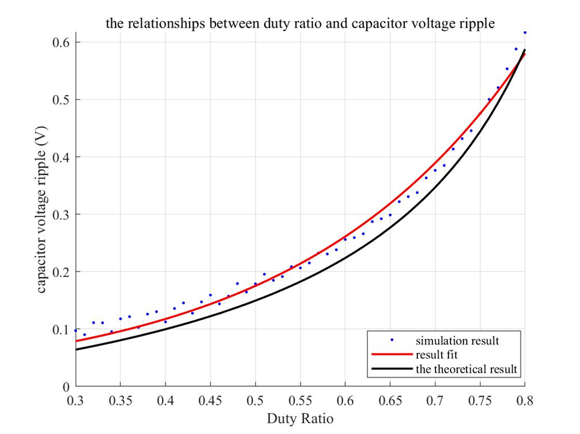

Relationship between duty ratio
and capacitor voltage ripple
Fit Result
gof =
sse: 0.0104
rsquare: 0.9898
dfe: 49
adjrsquare: 0.9896
rmse: 0.0146
8
Fig. 1-7 Relationship between $∆u_{C}$ and $D$

Slide 14
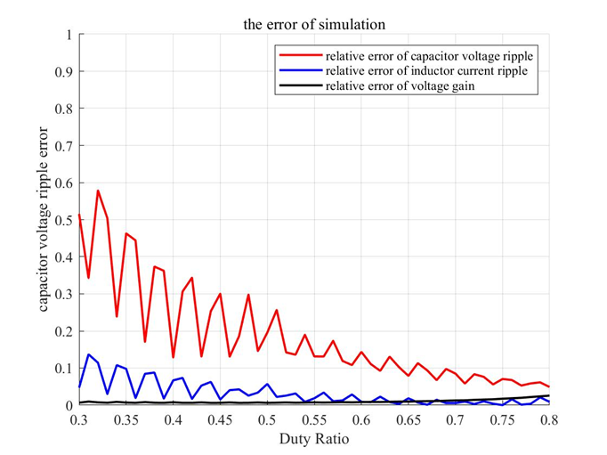
Simulation Relative Error
9

Slide 15
Thanks for listening.
Your question and your comments
are welcome

