Slide 1


Power Electronics
Three-Phase Full Bridge Rectifier
——Thyristor Version
1

Slide 2
Power Electronics
Division of tasks:
1)Finish our own report independently
2)ppt of topic 1 Tan Jiaxin electric 810 class
3)ppt of topic 2 Huang Xiujun electric 810 class
Presentation：
Part1 Tan Jiaxin
Part2 Huang Xiujun
2

Slide 3
Power Electronics
Part1: Rectification Mode
reported by Tan Jiaxin
3

Slide 4
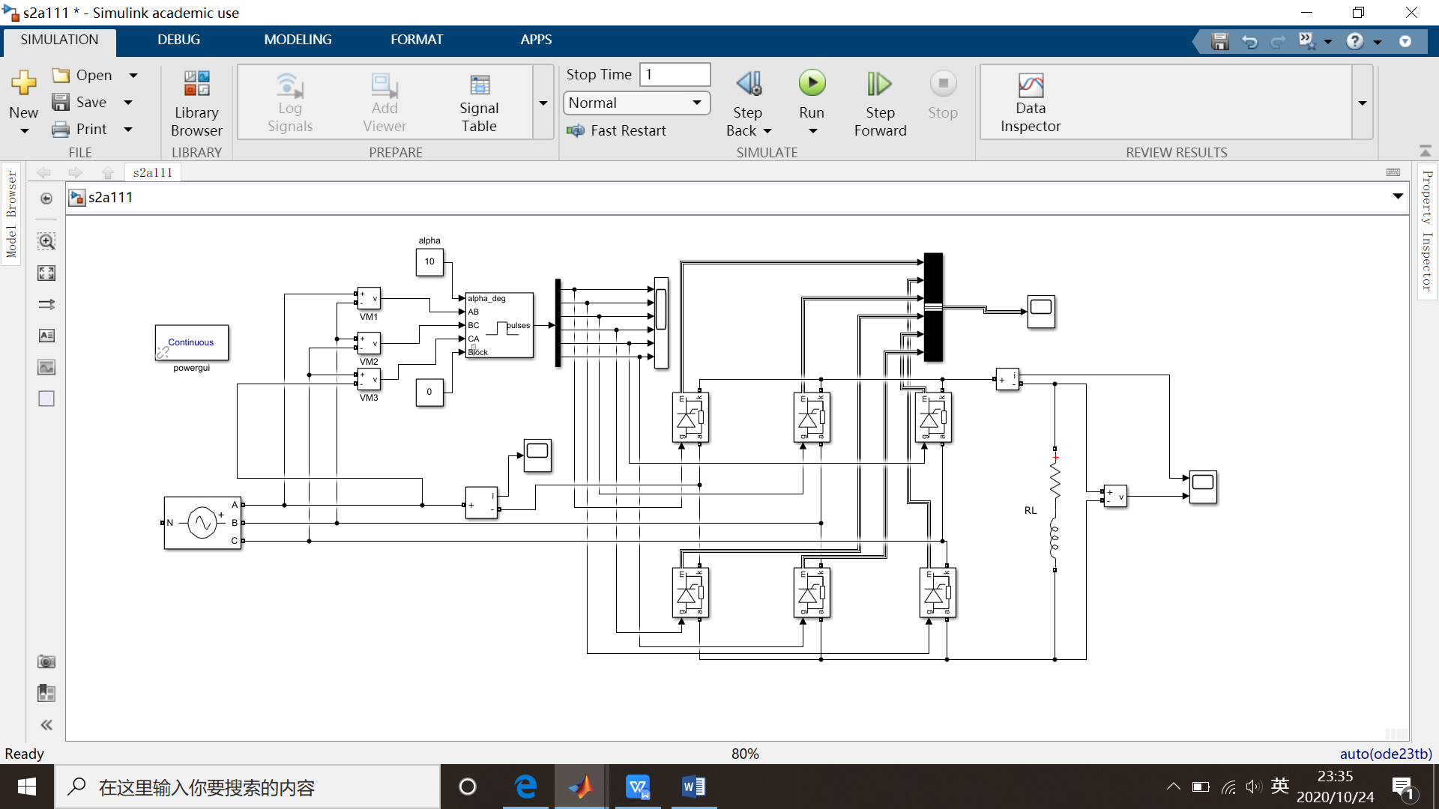
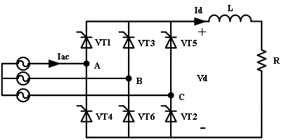
5

Slide 5
Three-phase AC voltage source:
50 Hz, 380 V , 0.
L=3mH , R=15Ω.
α1=10°
7

Slide 6
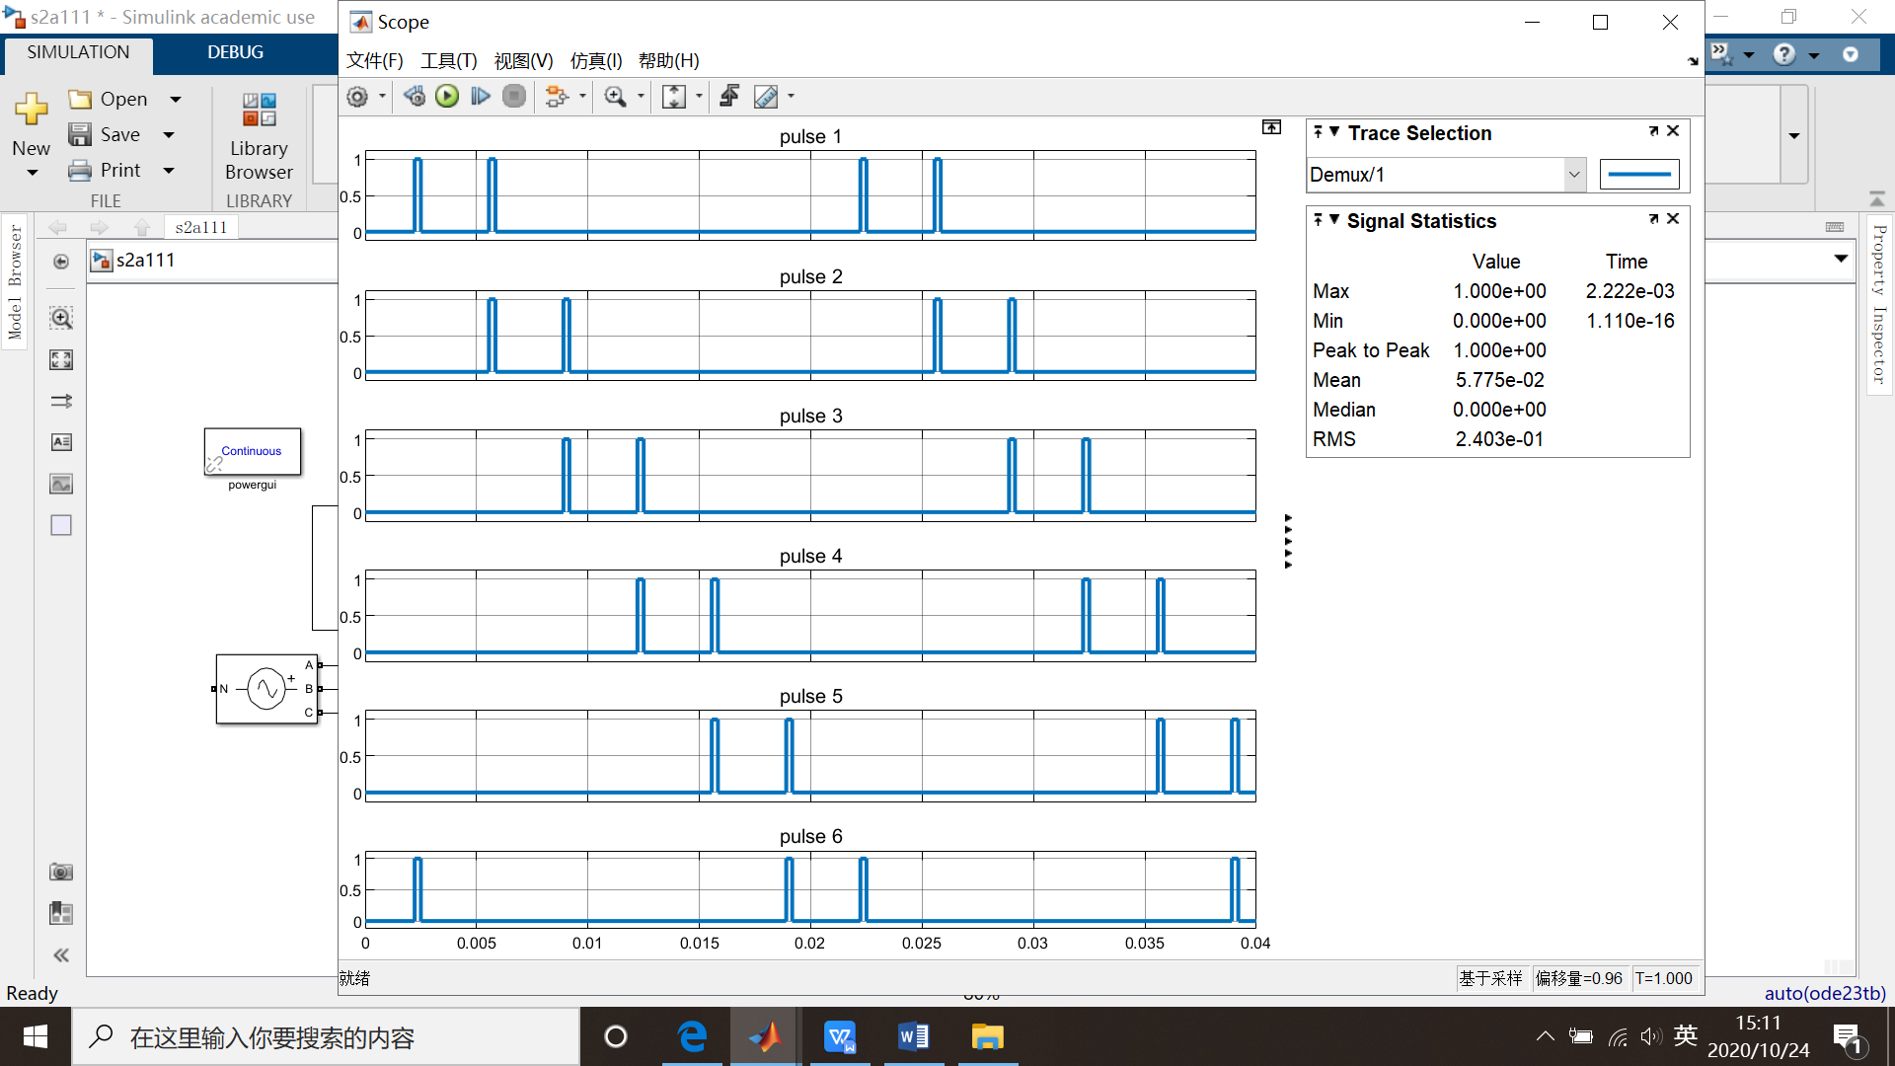
The six thyristors turn on in sequence of :
VT1-VT2-VT3-VT4-VT5-VT6
The phase difference is 60°.
9

Slide 7
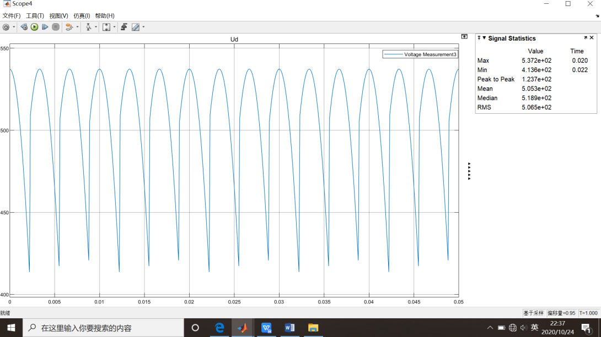
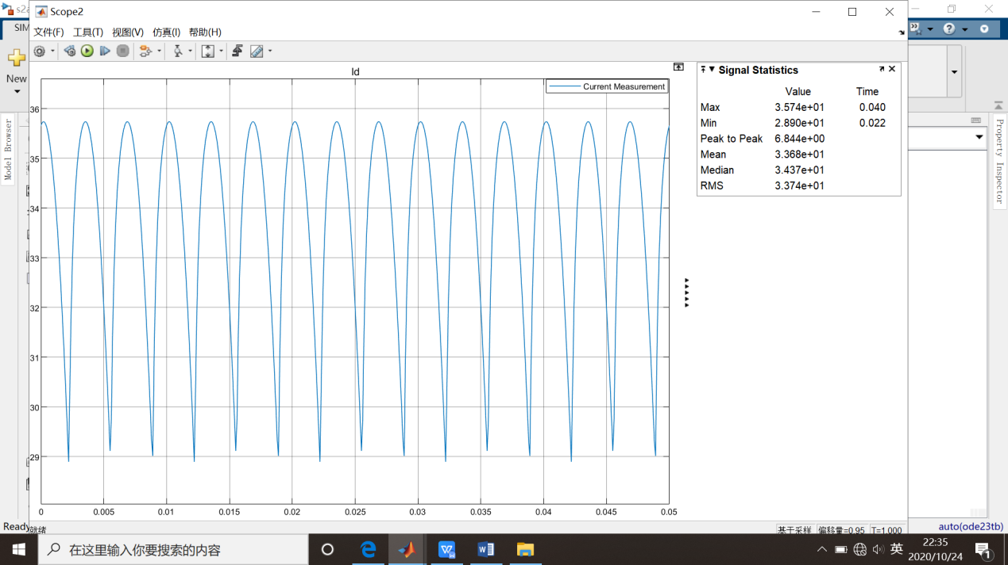
9

Slide 8
9

Slide 9
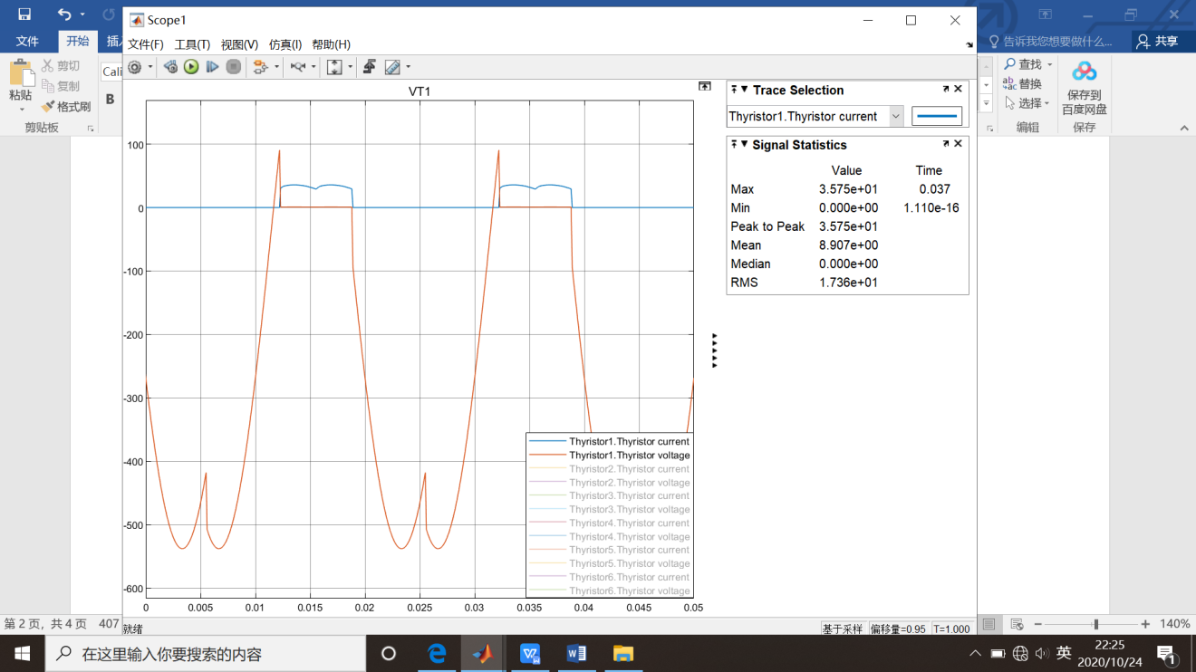
9

Slide 10
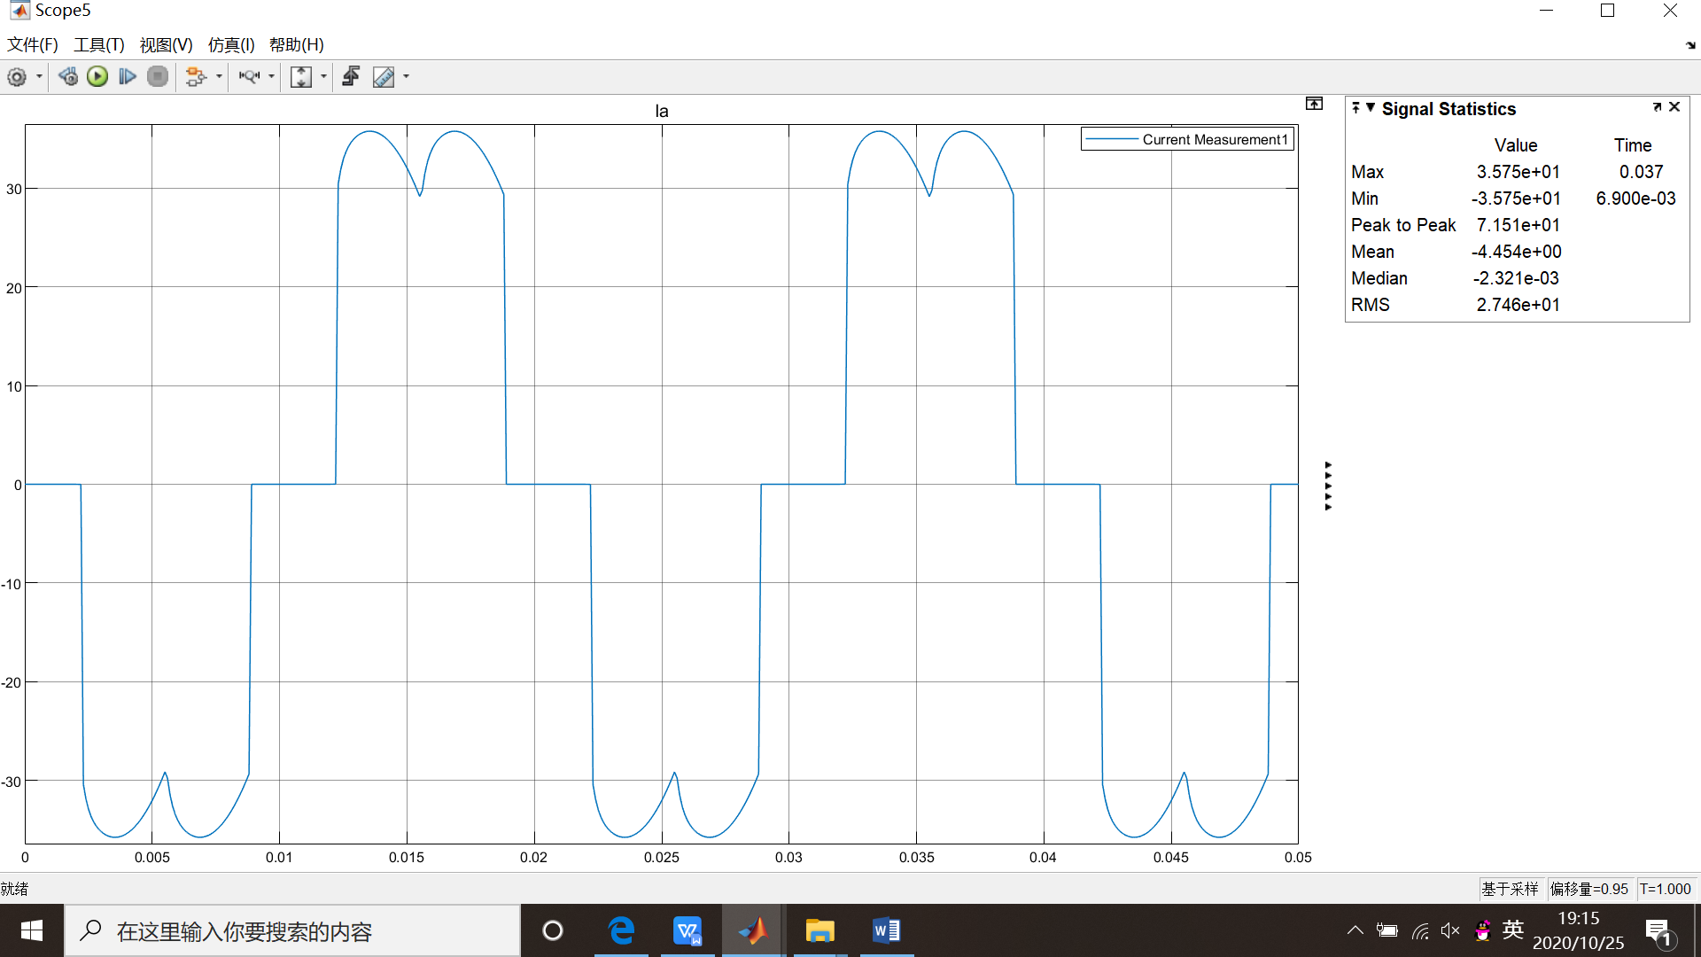
9

Slide 11
9

Slide 12
Power Electronics
Part2: Active Inversion Mode
reported by Huang Xiujun
8

Slide 13


6

Slide 14
10

Slide 15
11

Slide 16
Power Electronics
Thank you!
12

