Slide 1
Power Electronics
Seminar #5
Reporter
Liu Zixuan
Nie Yongxin
Tian Wenrui
：

Slide 2
division of work
Nie Yongxin:
Simulation.
The PPT of part 1.
Liu Zixuan:
Simulation.
The PPT of part 2.
Tian Wenrui:
Simulation.
The PPT of part 3.

Slide 3
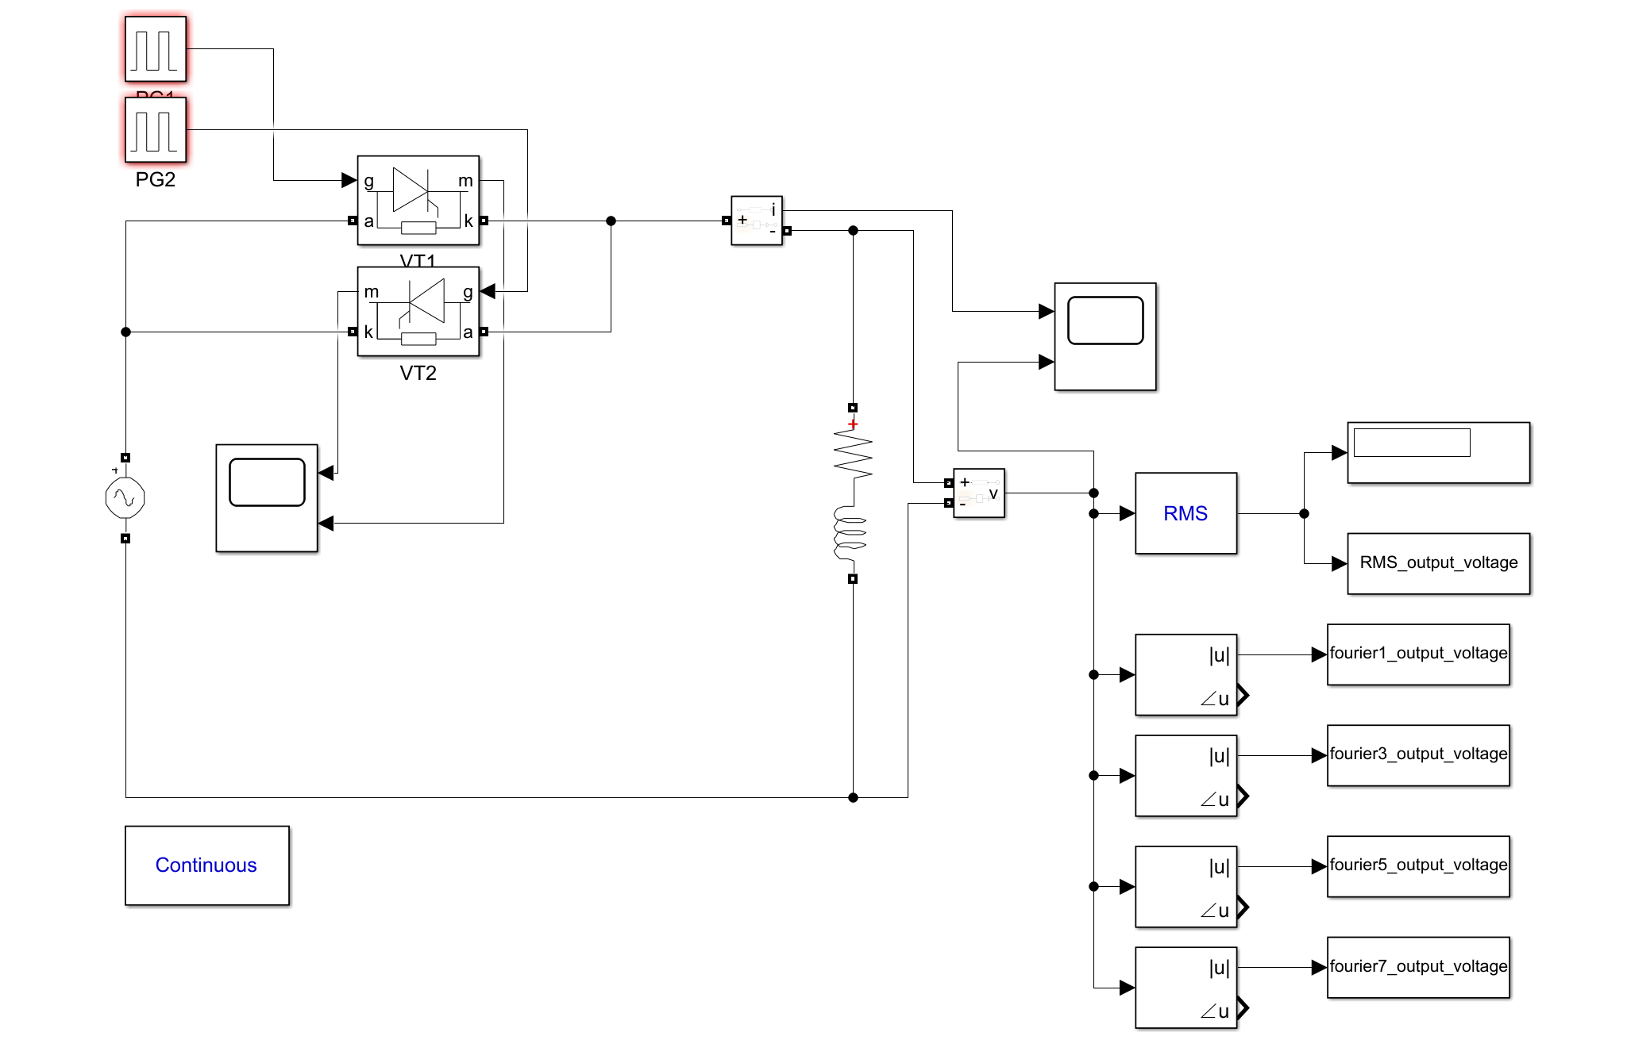
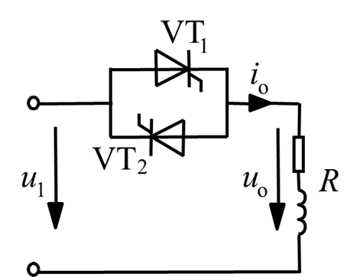
Circuit

Slide 4
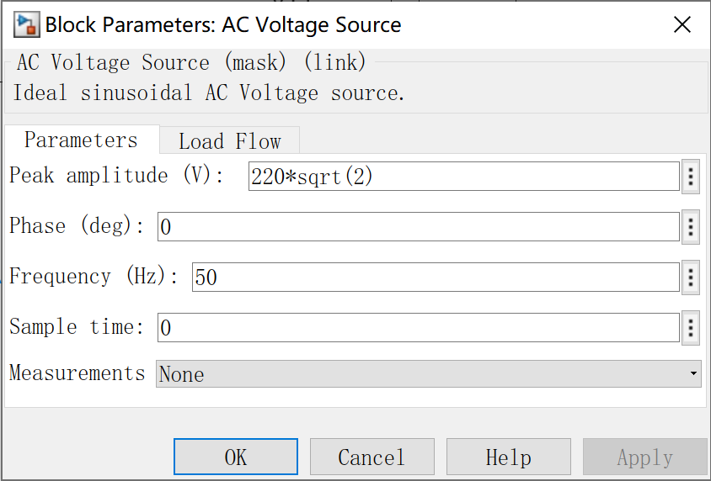
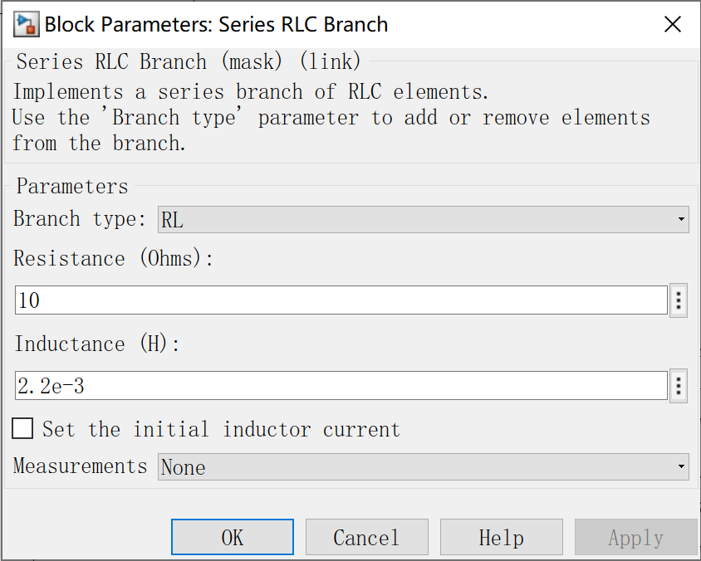
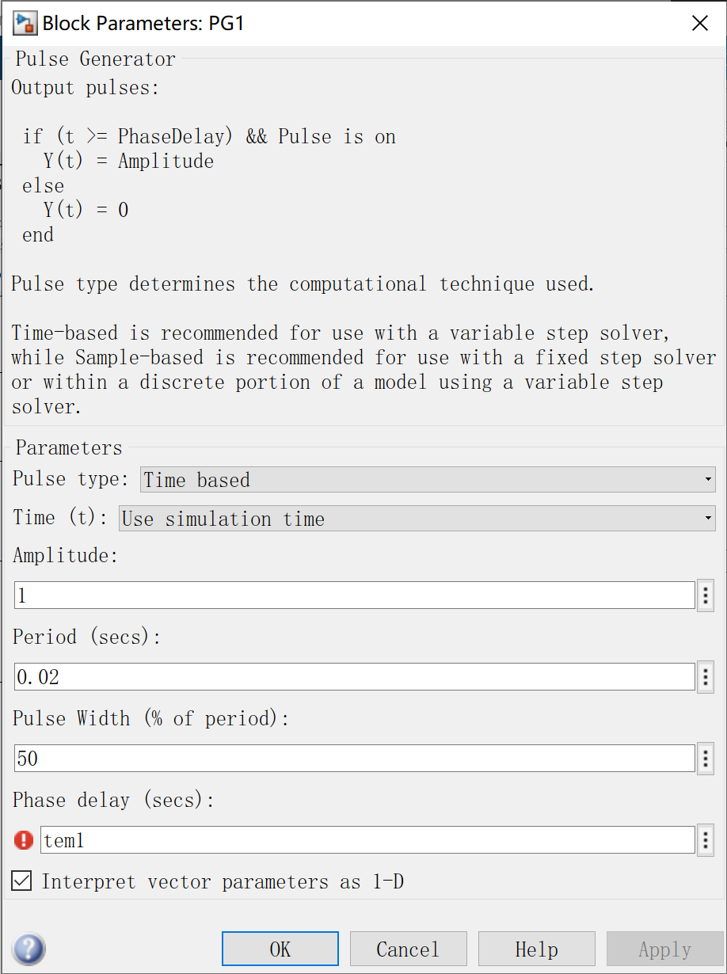
Parameter Setup

Slide 5
Theoretical Calculation
Impedance Angle:

Slide 6
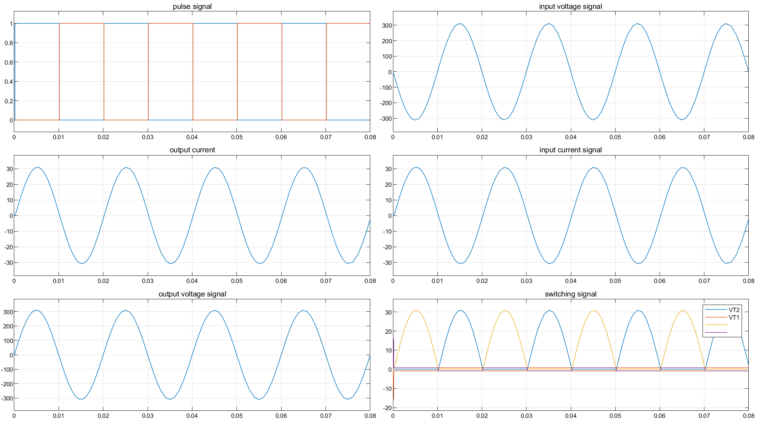
Result waveform (phase delay angle=3.9°)
Simulation result

Slide 7
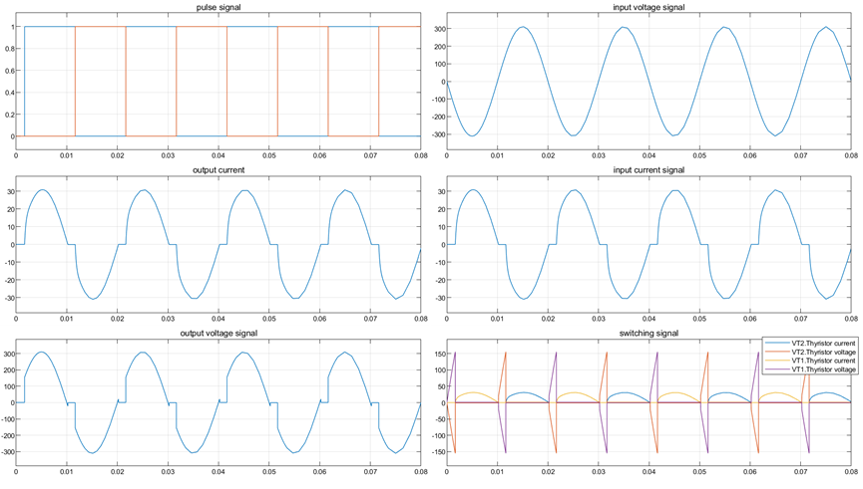
Simulation result
Result waveform (phase delay angle=30°)

Slide 8
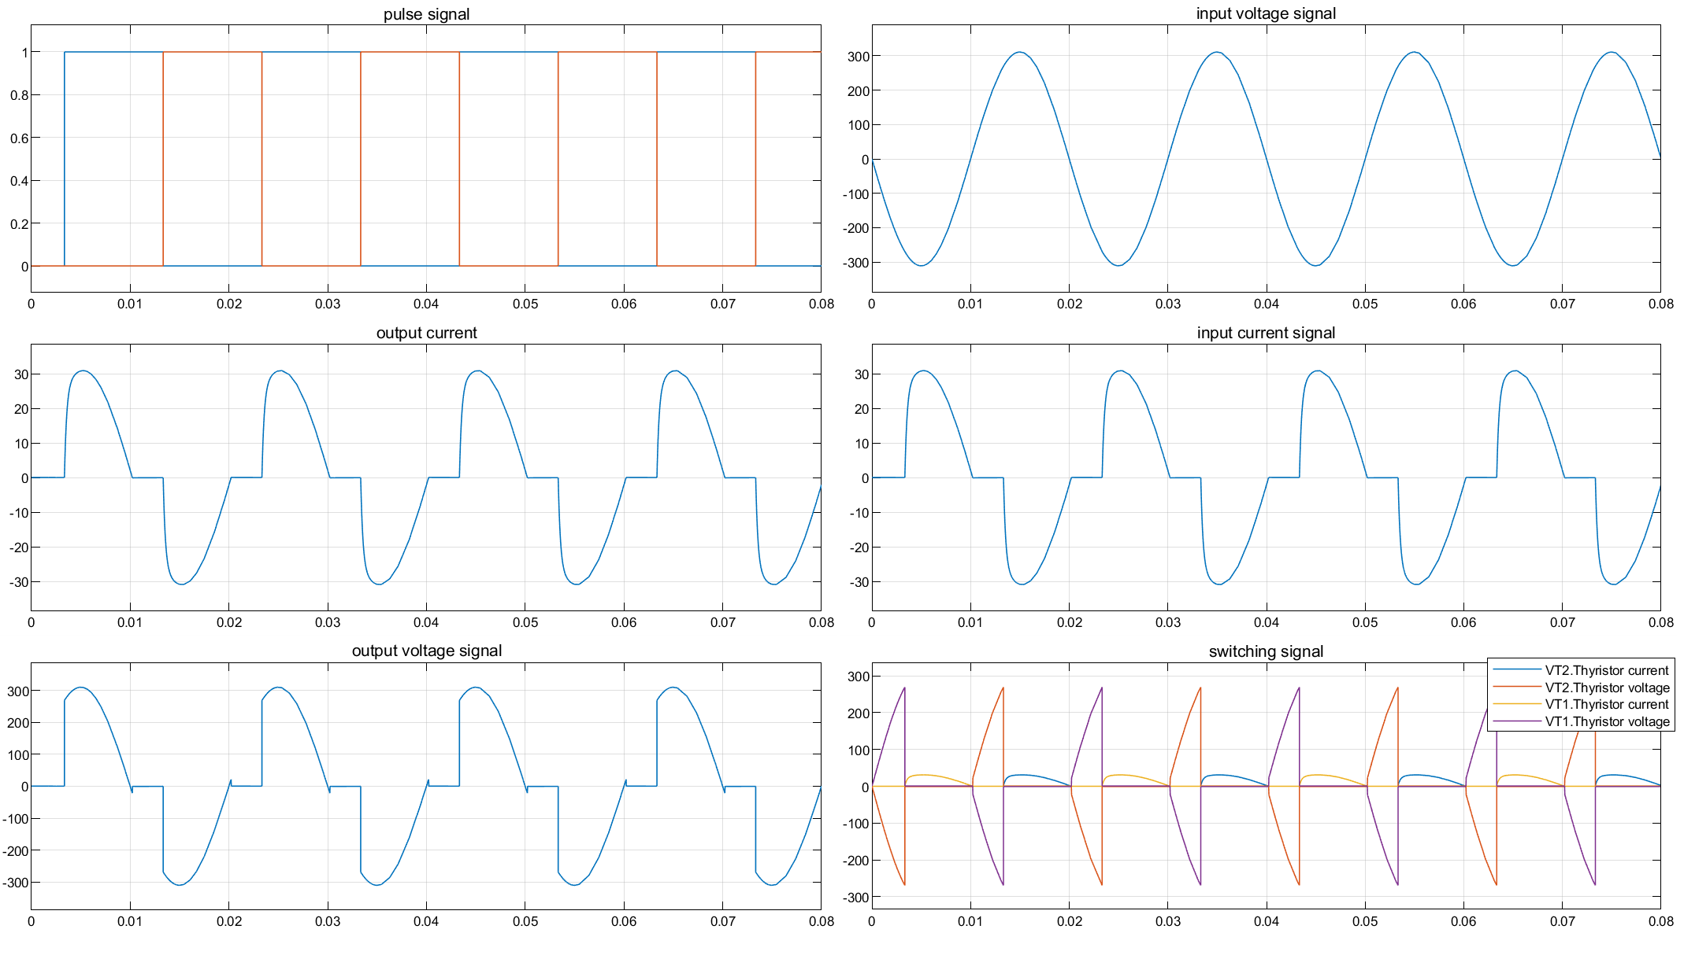
Result waveform (phase delay angle=60°)
Simulation result

Slide 9
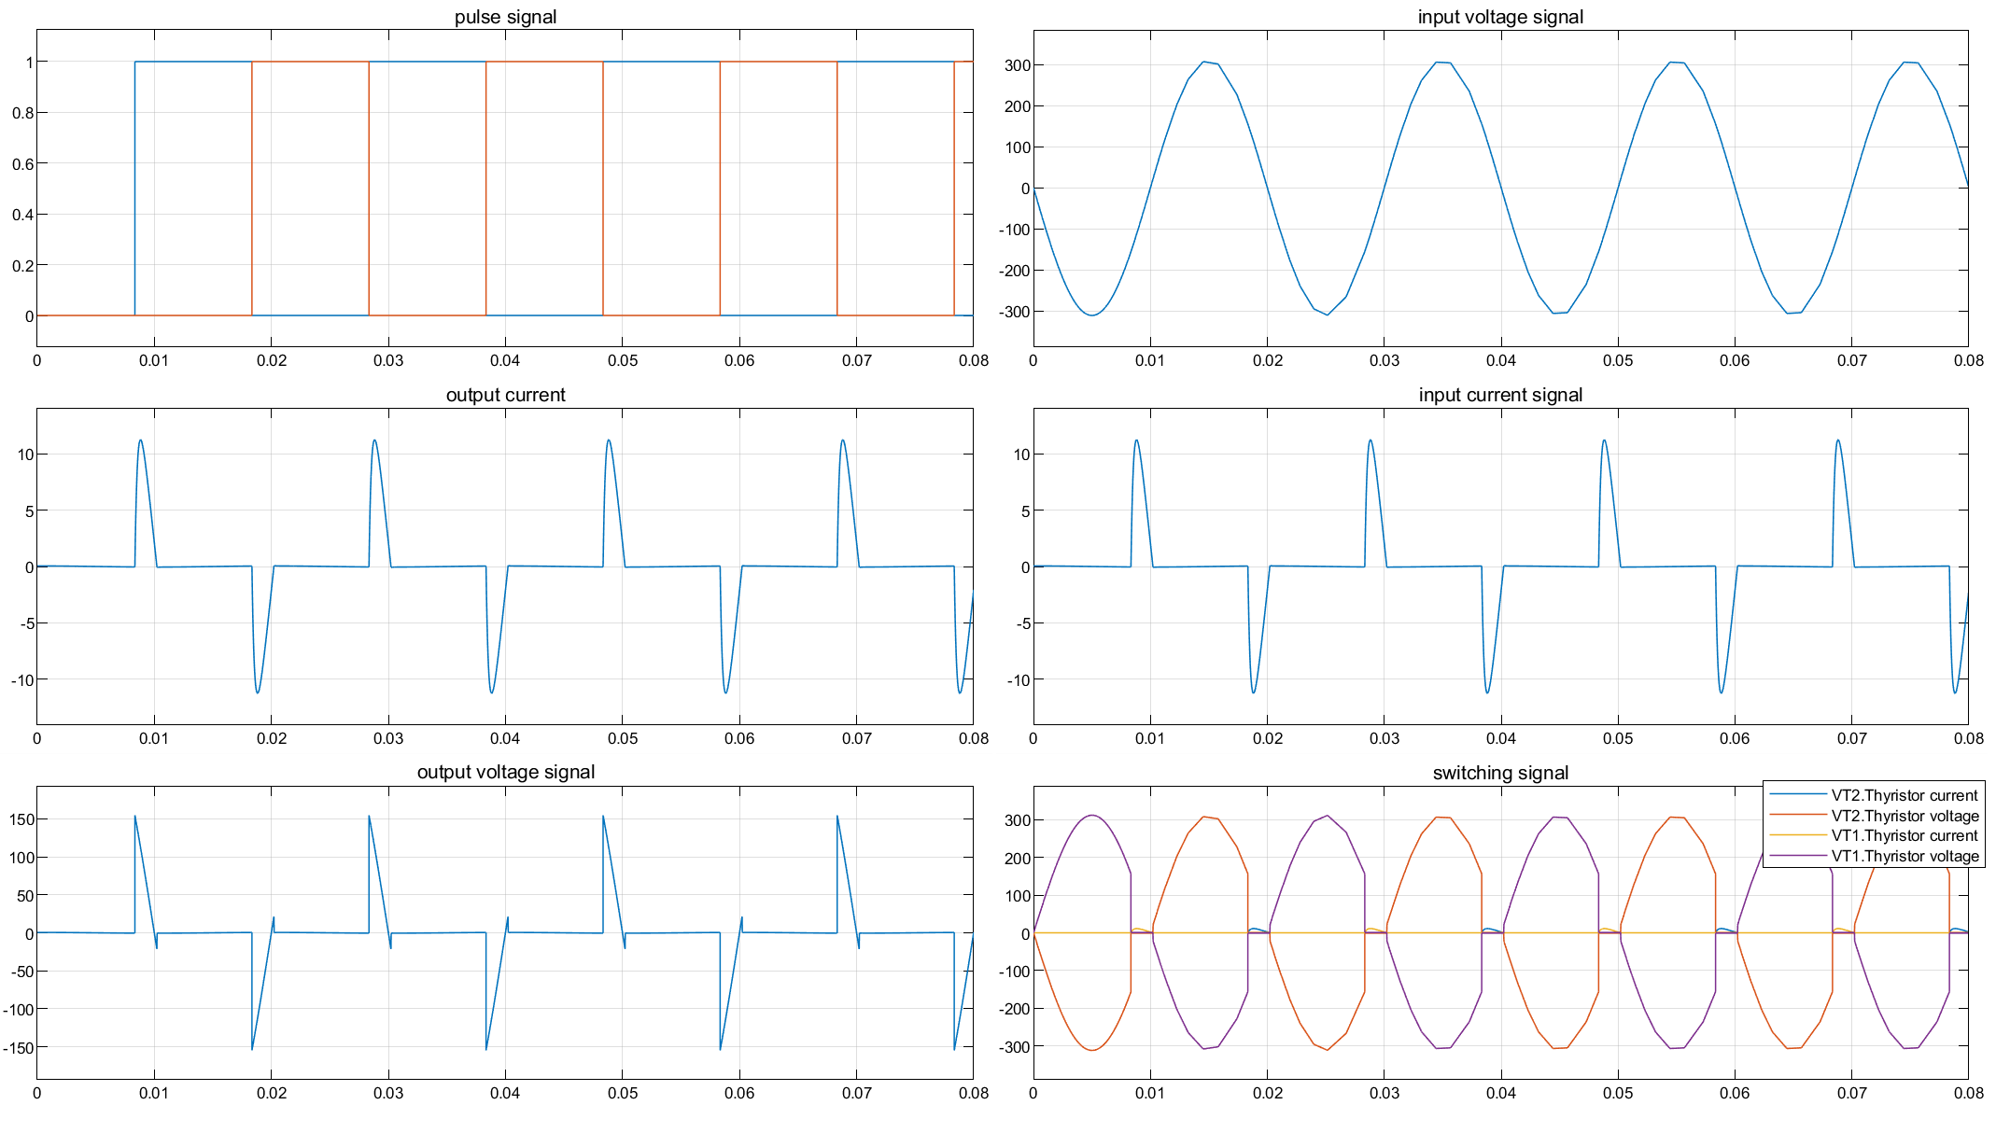
Result waveform (phase delay=150°)
Simulation result

Slide 10
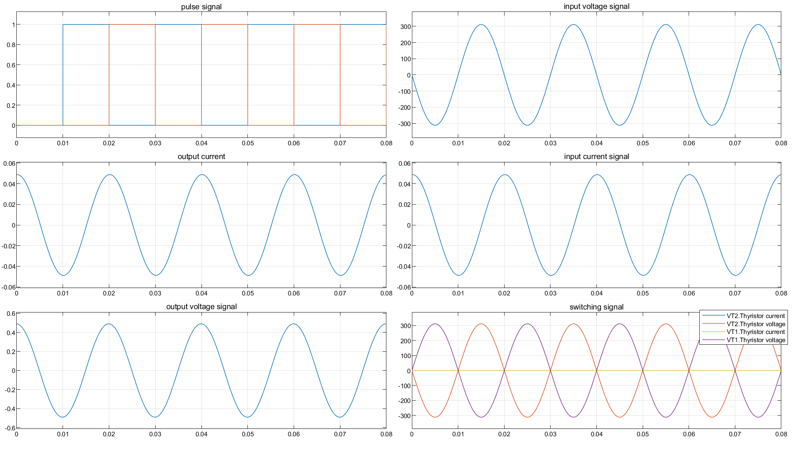
Result waveform (phase delay angle=150°)
Simulation result

Slide 11
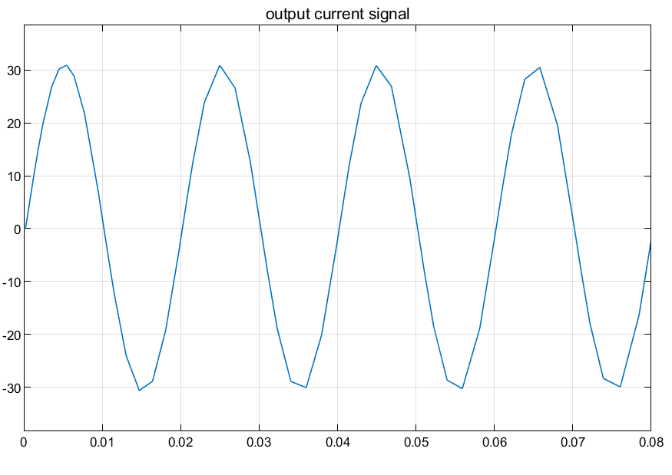
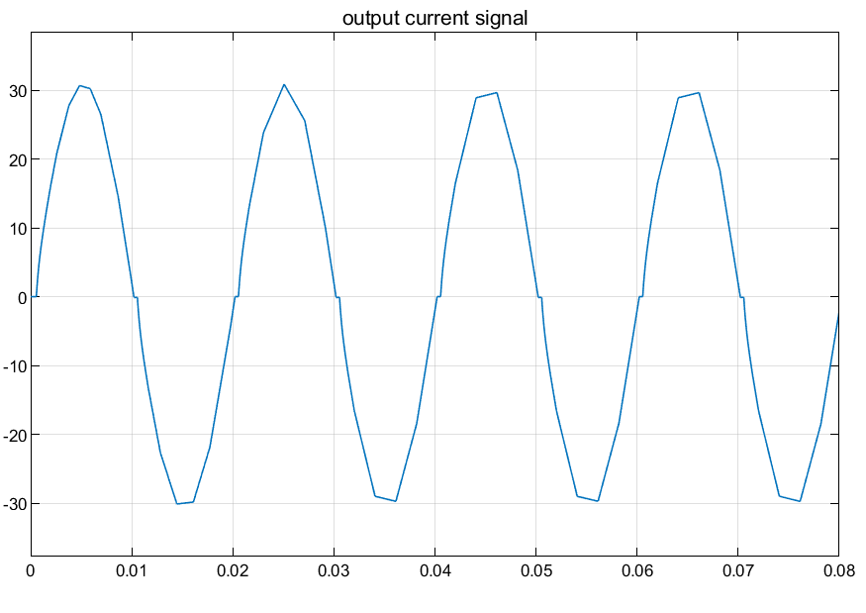
phase delay angle=3.8°
DCM and CCM
phase delay angle=4.0°

Slide 12
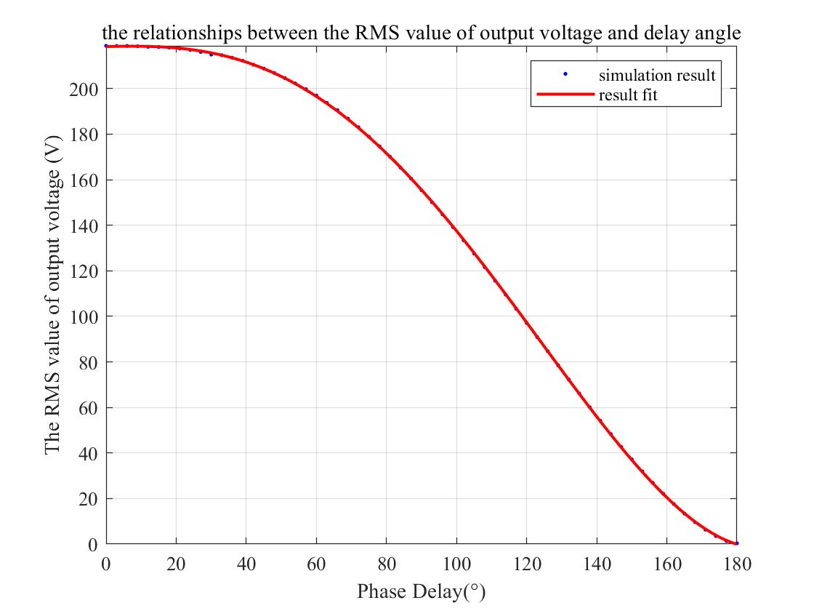
Relationship between delay angle and the RMS value of output voltage

Slide 13
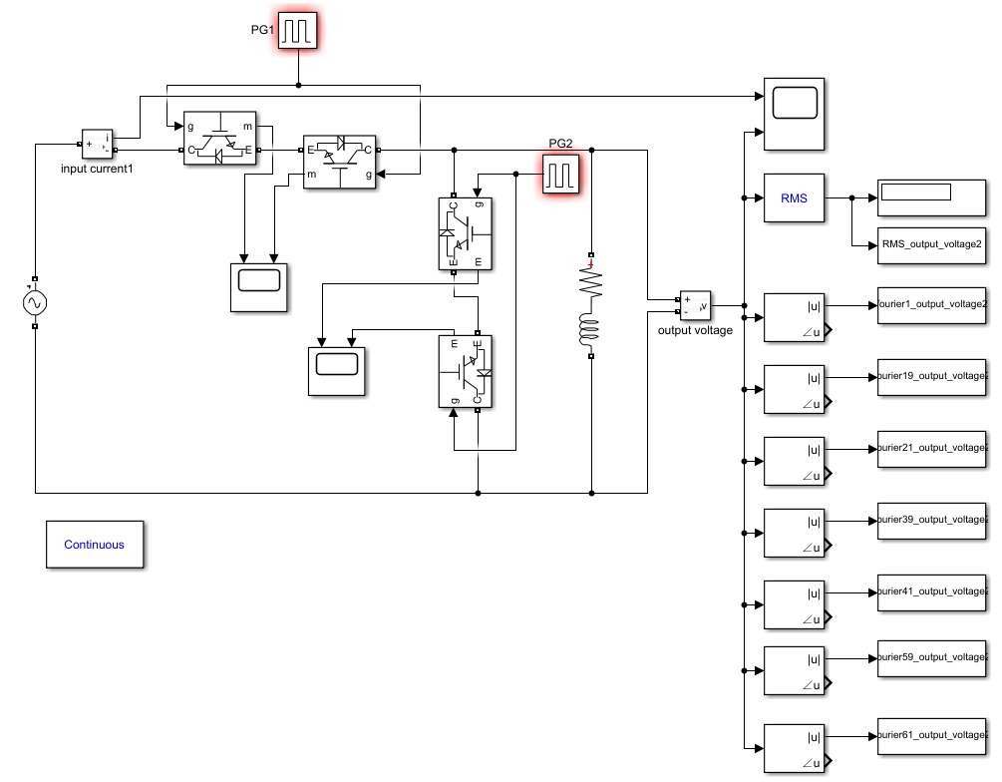
Circuit

Slide 14
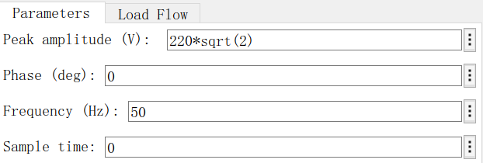
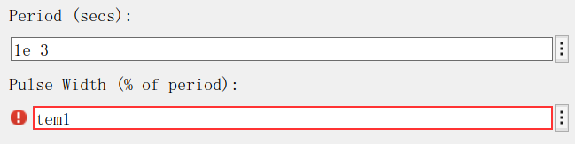
Parameter Setup
Resistor and inductor
Power Supply
L | R
2.2mH | 10Ω
IGBT

Slide 15
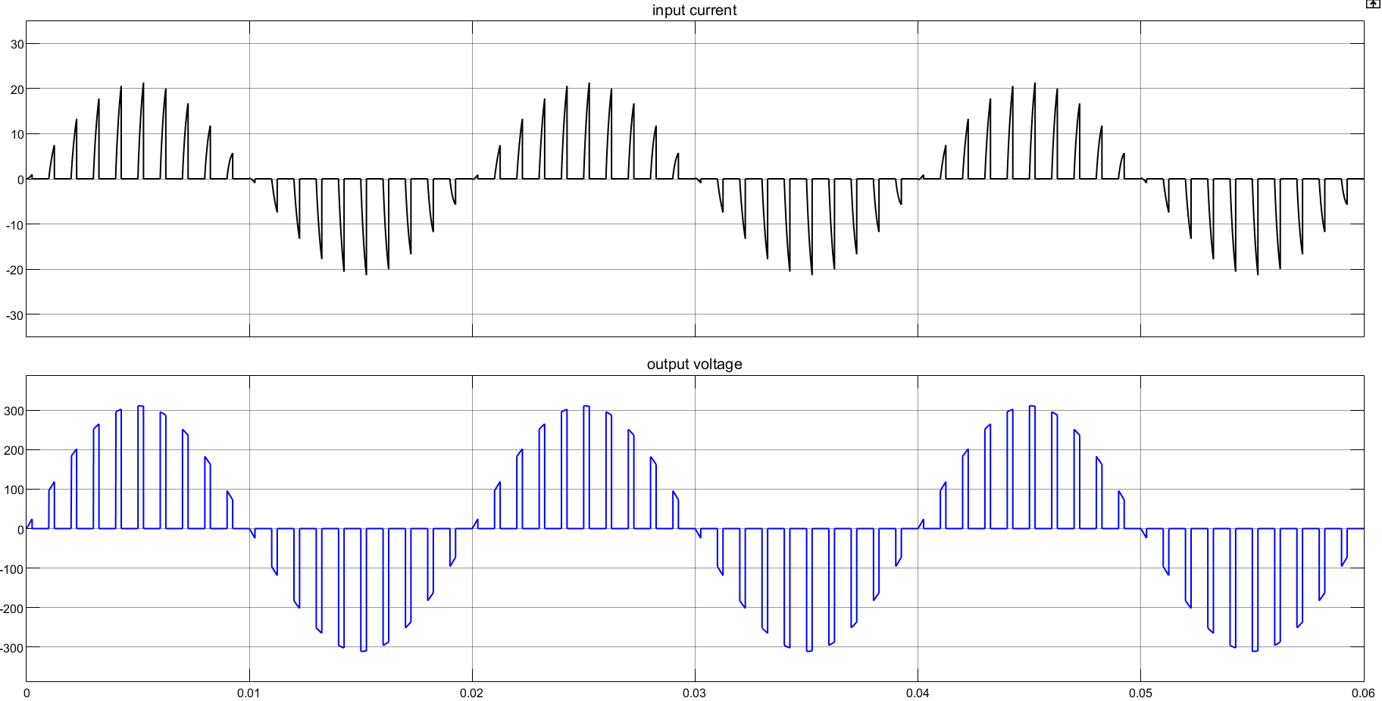
output voltage and input current waveform(duty cycle=25%)

Slide 16
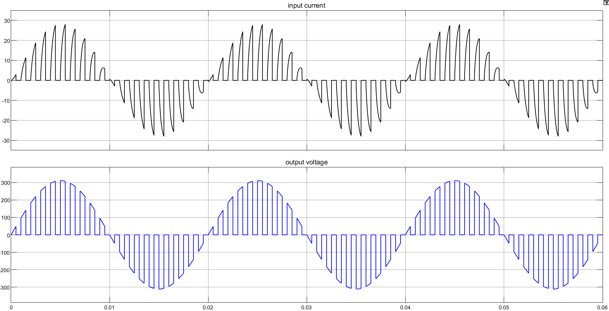
output voltage and input current waveform(duty cycle=50%)

Slide 17
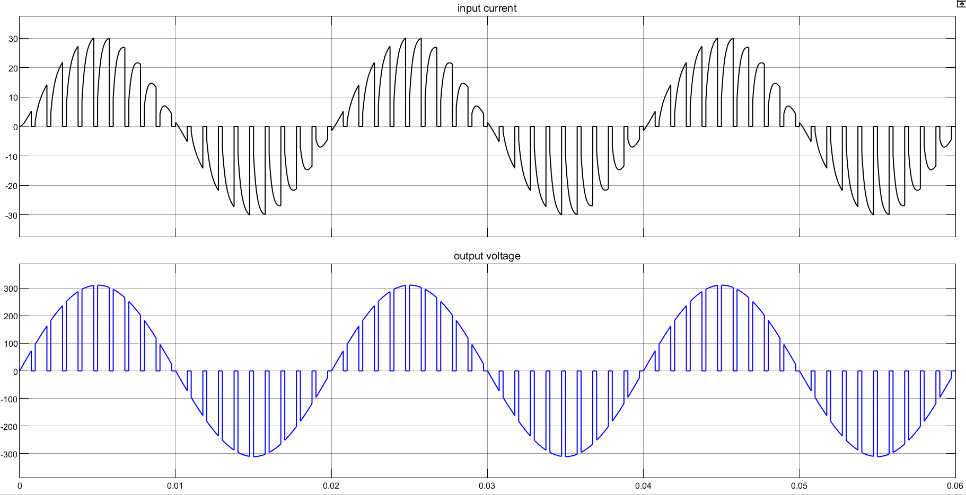
output voltage and input current waveform(duty cycle=75%)

Slide 18
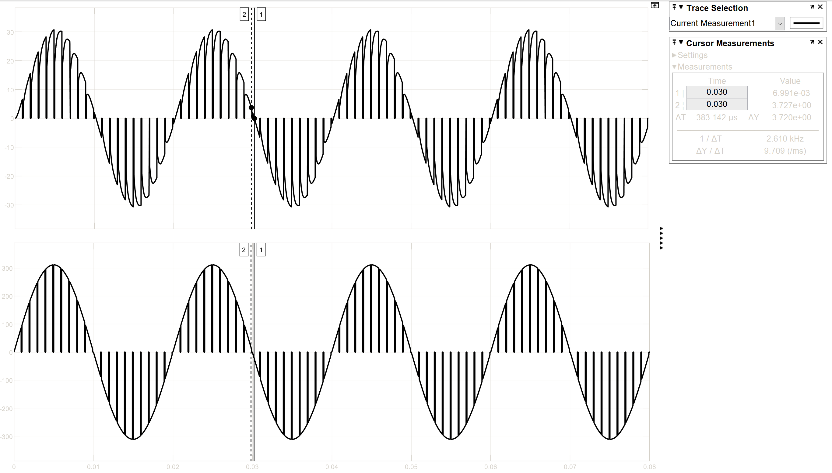
ΔT=383.142μs

Slide 19
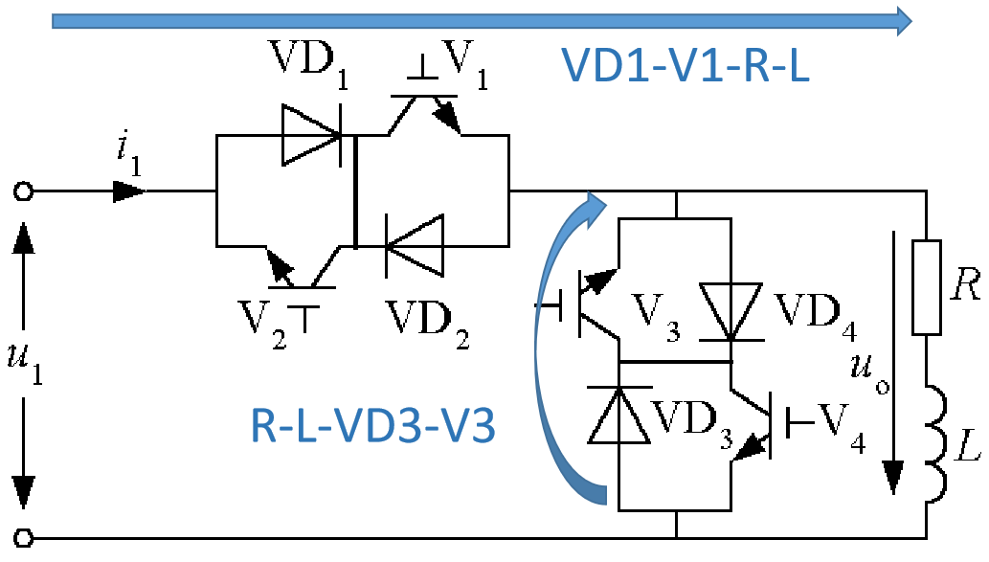
Commutation Process

Slide 20
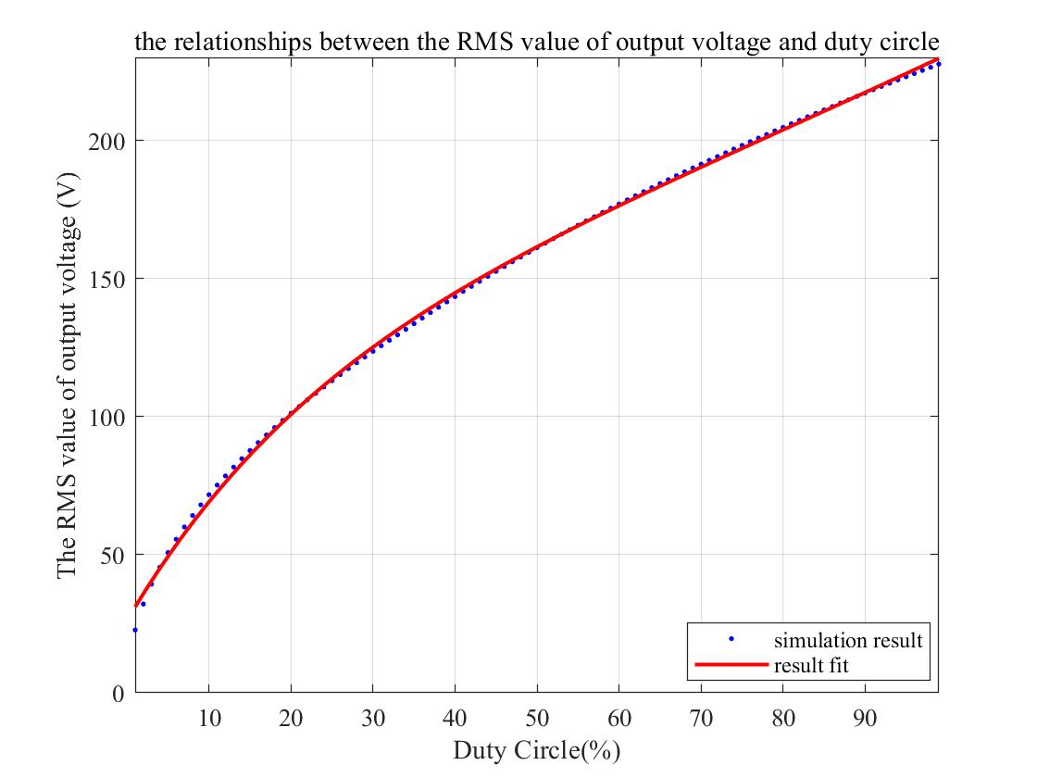
Relationship between duty cycle and the RMS value of output voltage

Slide 21
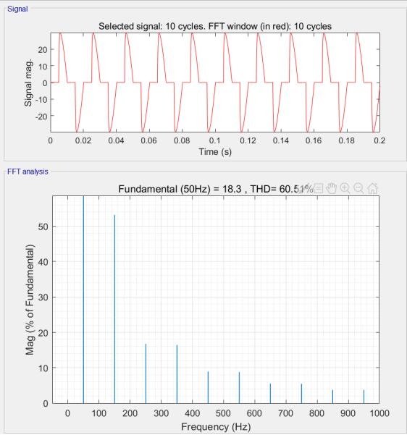
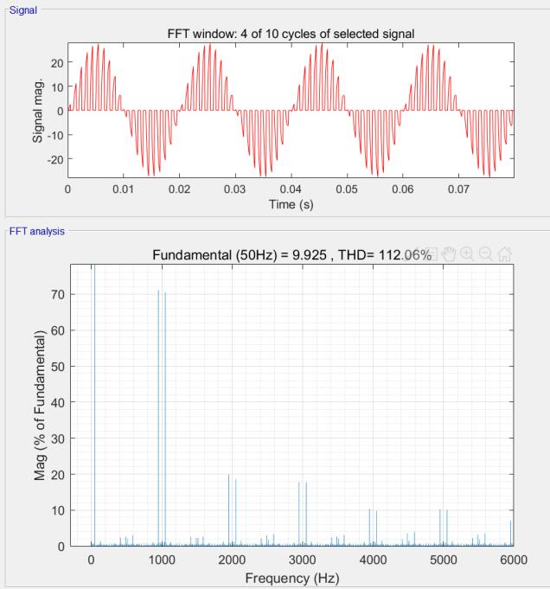
FFT analysis of output voltage

Slide 22
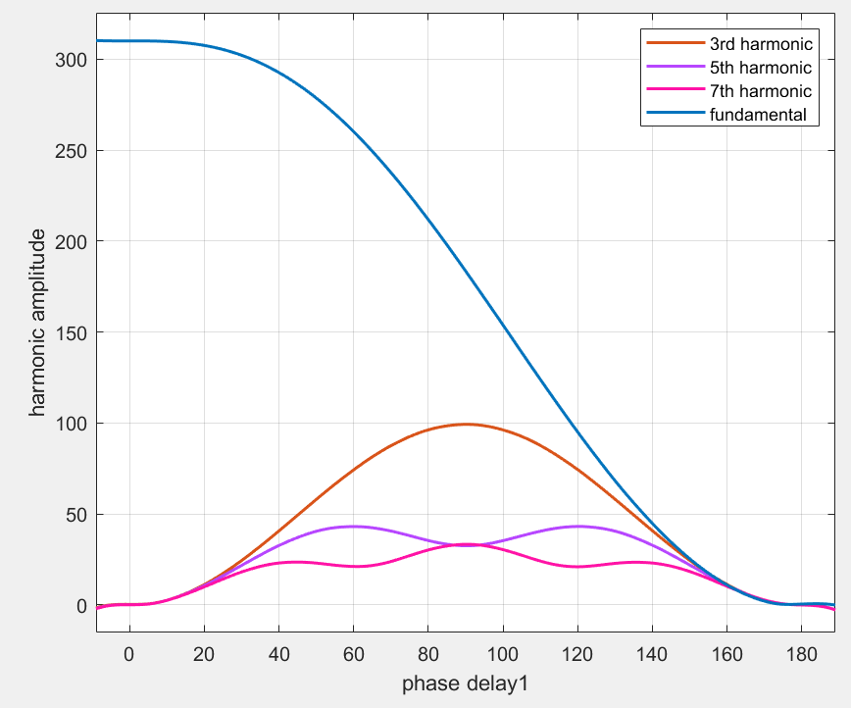
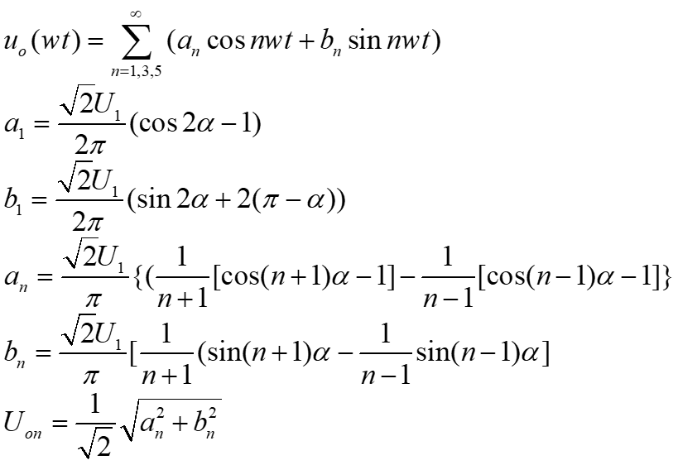
Voltage harmonics for the inductive load

Slide 23
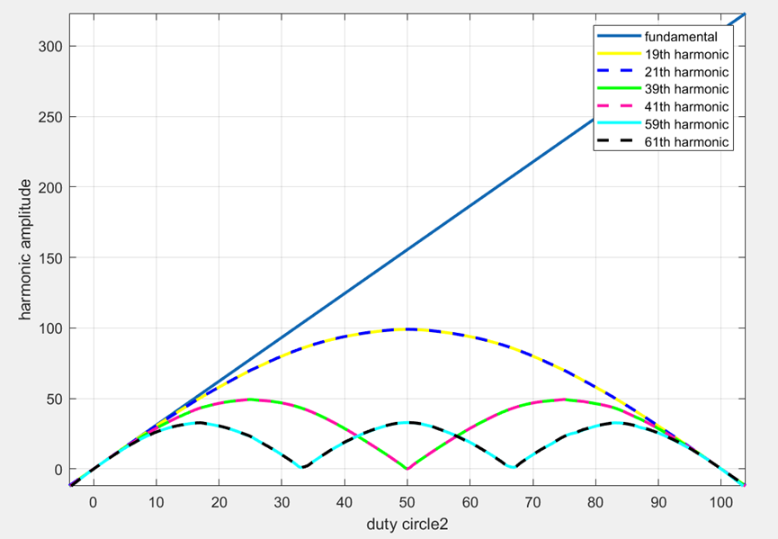
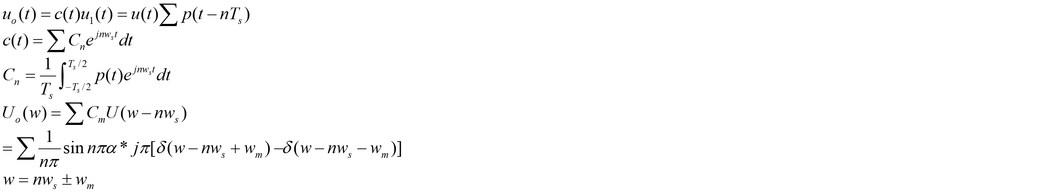
Voltage harmonics for the inductive load

Slide 24
Your Questions and Comments are welcome

