Slide 1
Power Electronics
Seminar #5
Part 2
Reporter
Liu Zixuan
Nie Yongxin
：

Slide 2
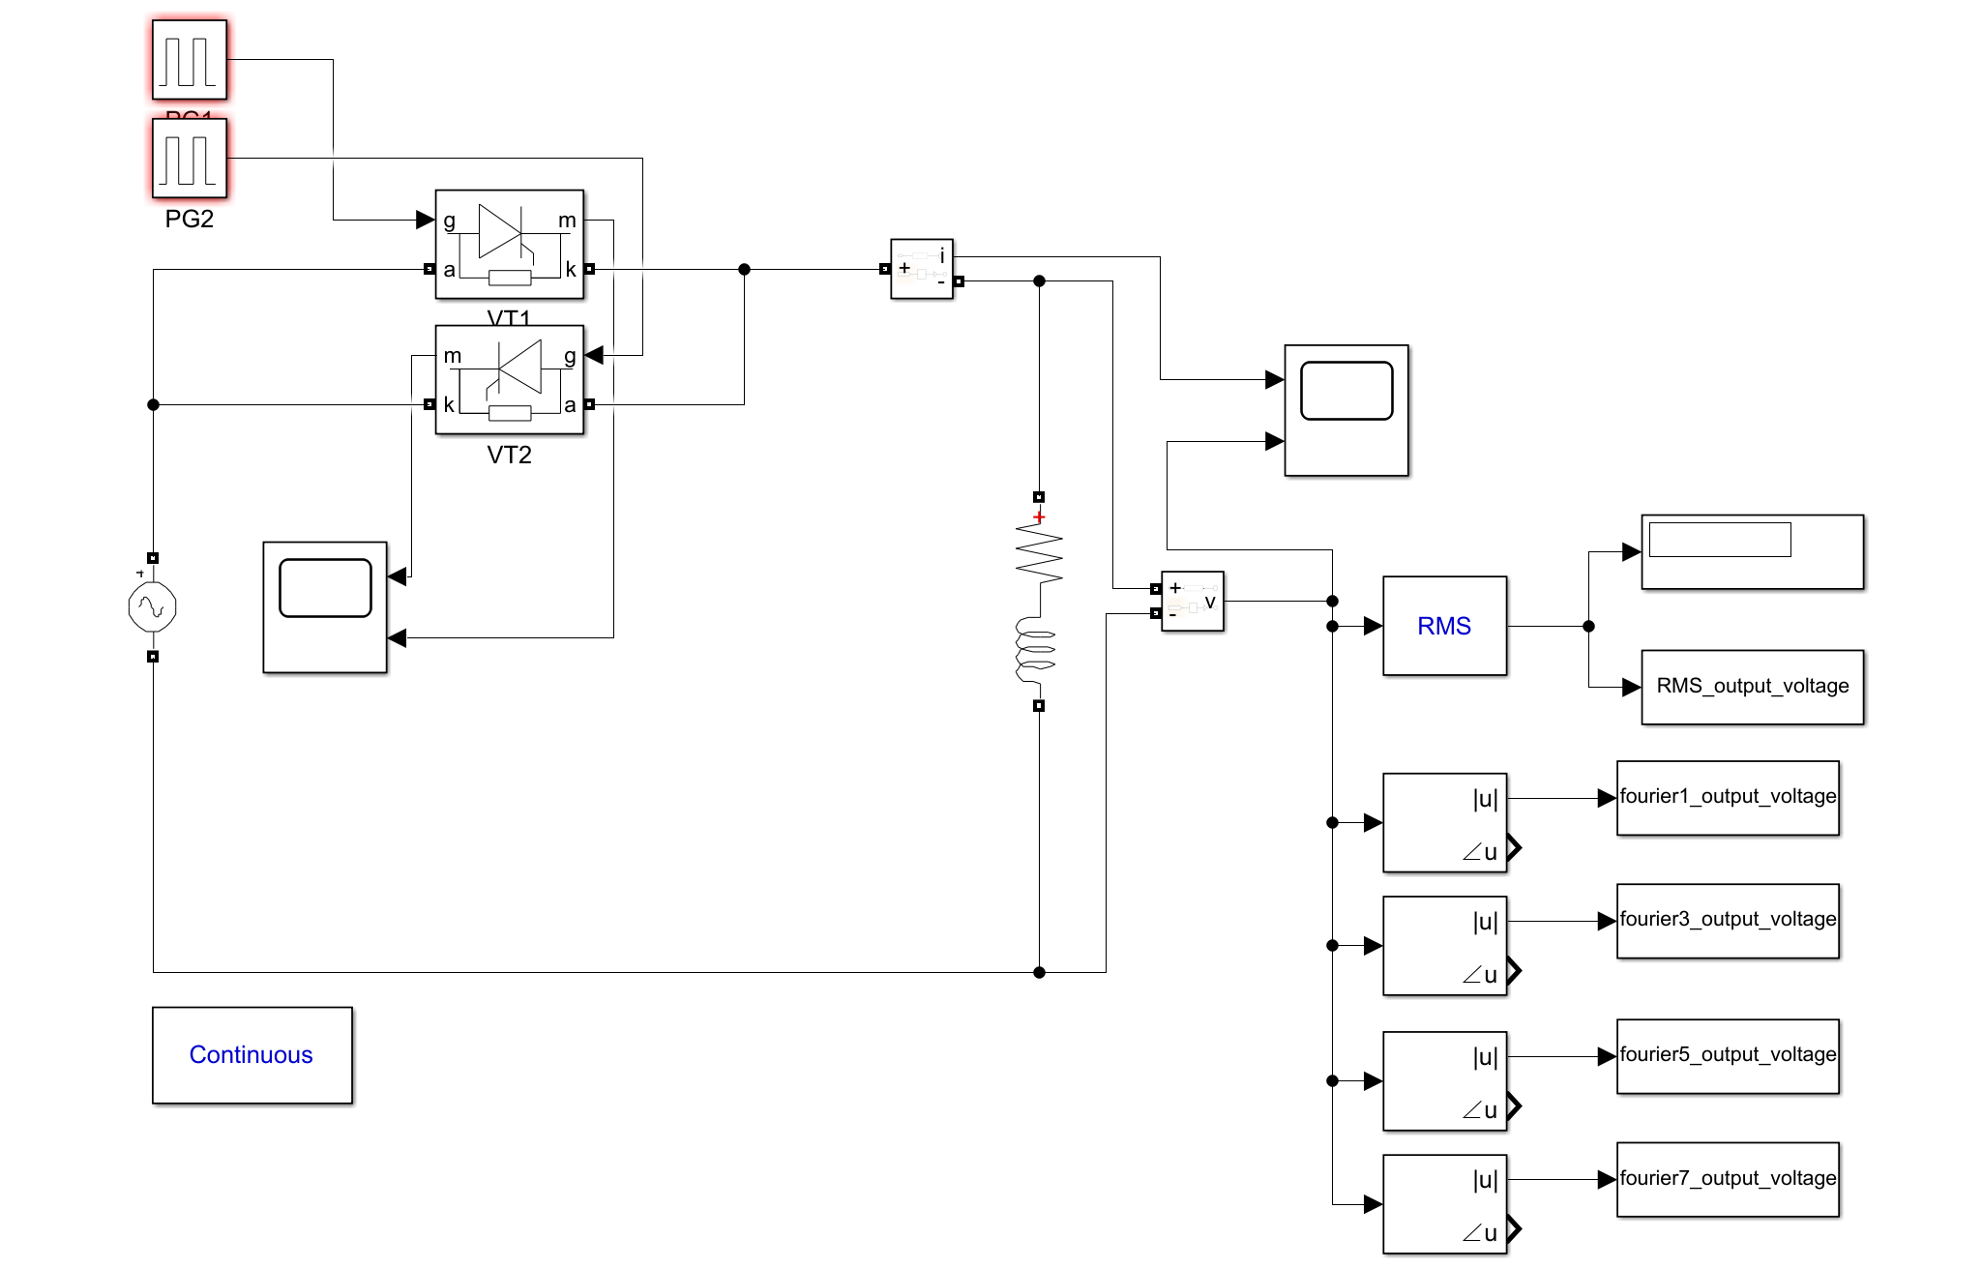
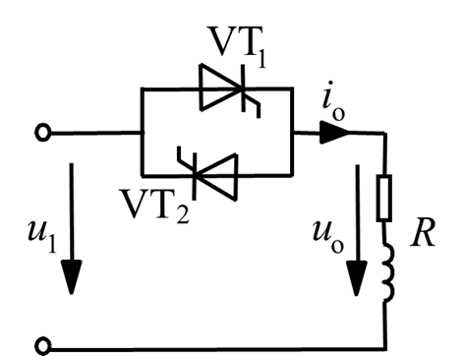
Circuit

Slide 3
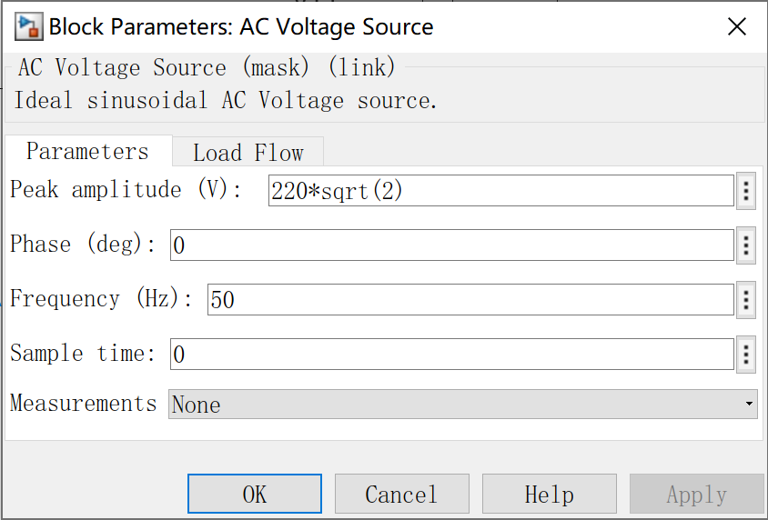
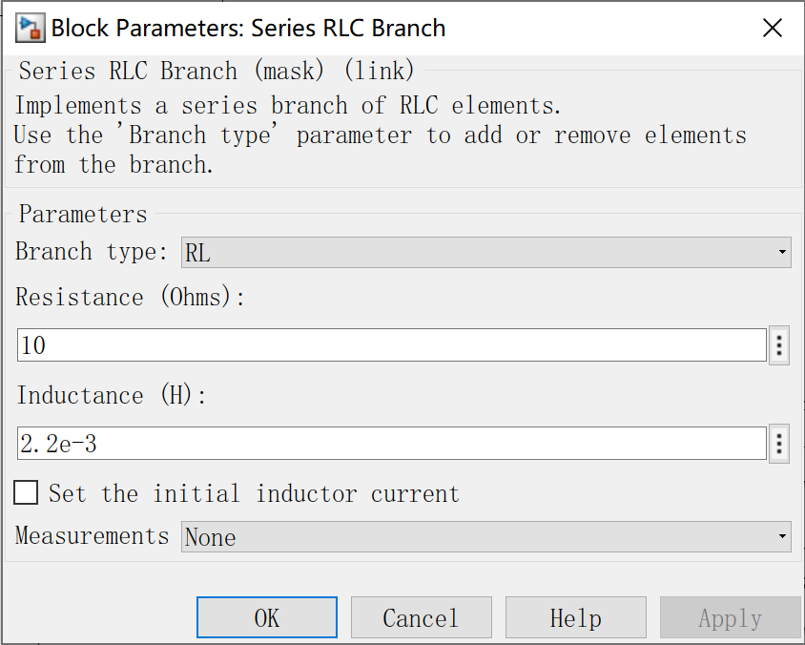
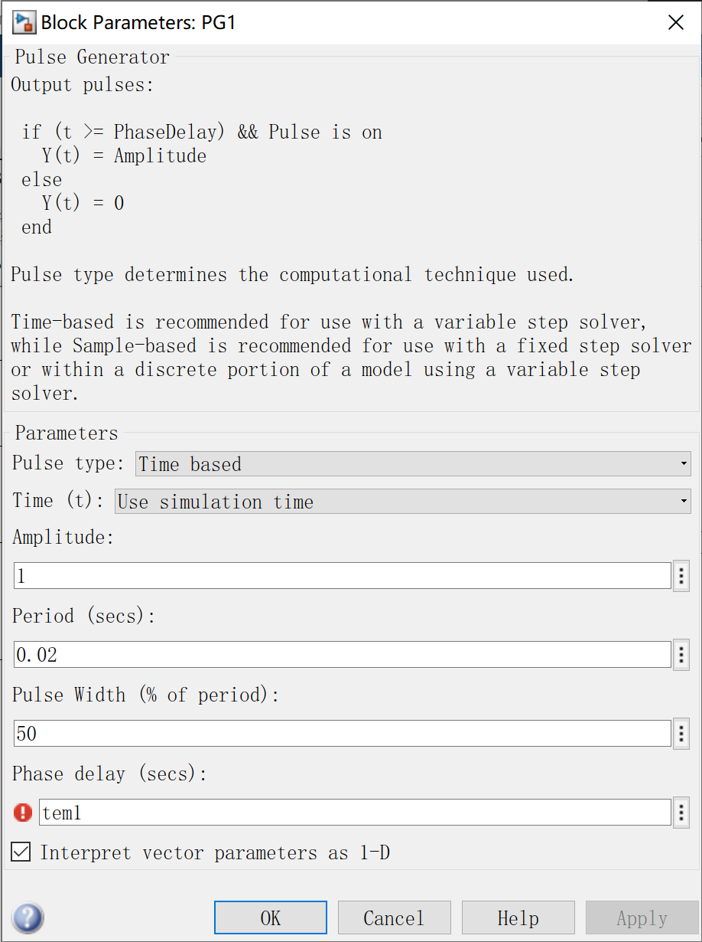
Parameter Setup

Slide 4
Theoretical Calculation
Impedance Angle:

Slide 5
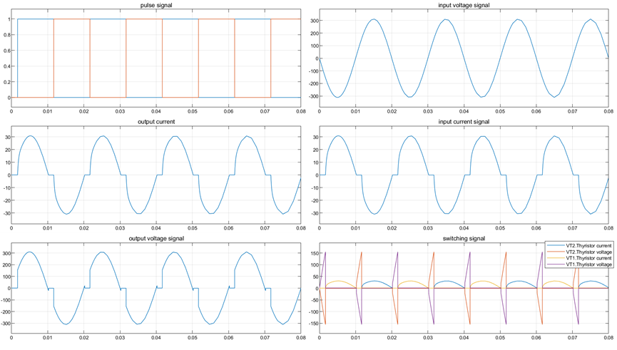
Result waveform (phase delay=30°)
Simulation result

Slide 6
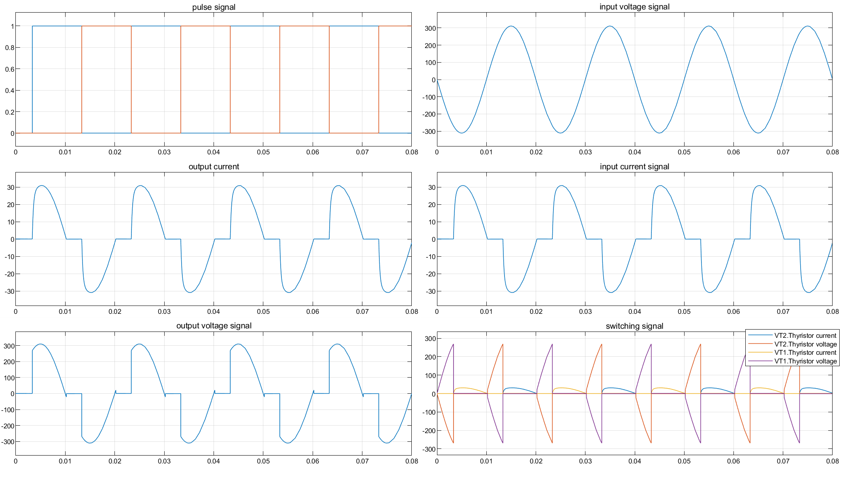
Result waveform (phase delay=60°)
Simulation result

Slide 7
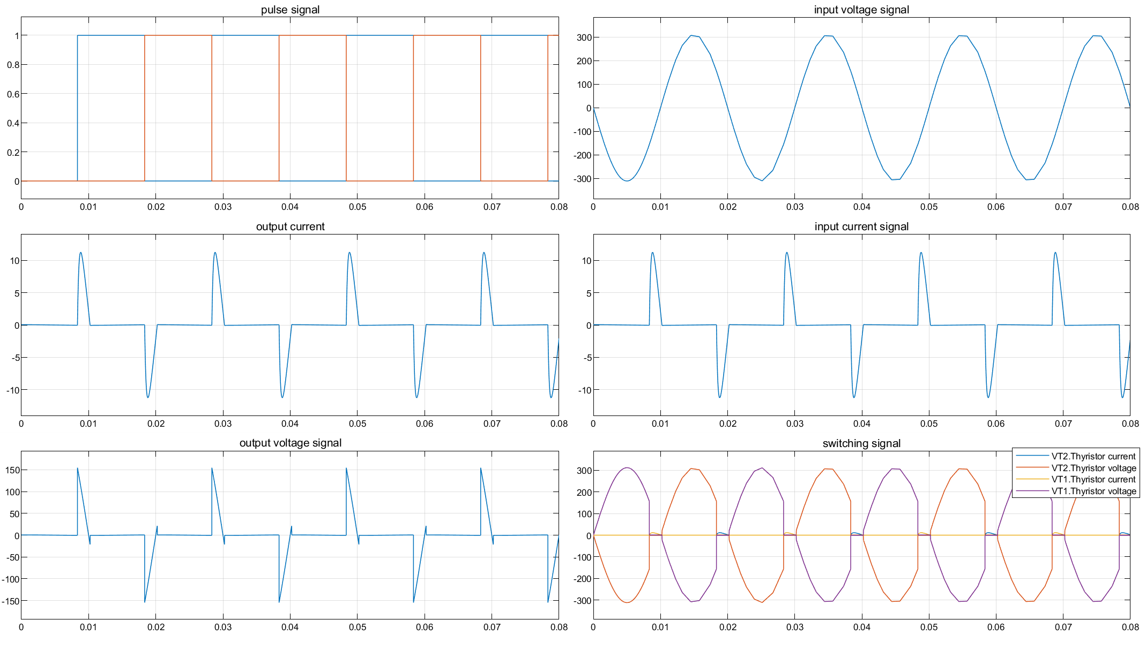
Result waveform (phase delay=150°)
Simulation result

Slide 8
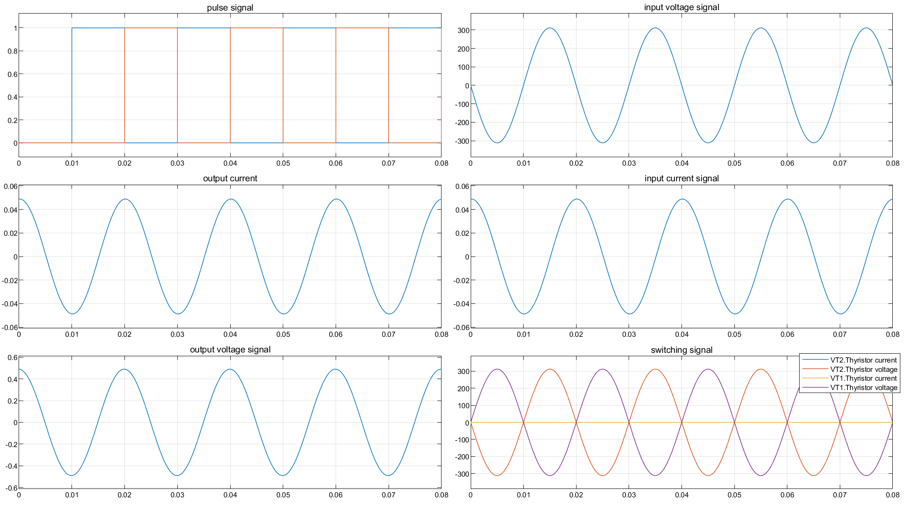
Result waveform (phase delay=150°)
Simulation result

Slide 9
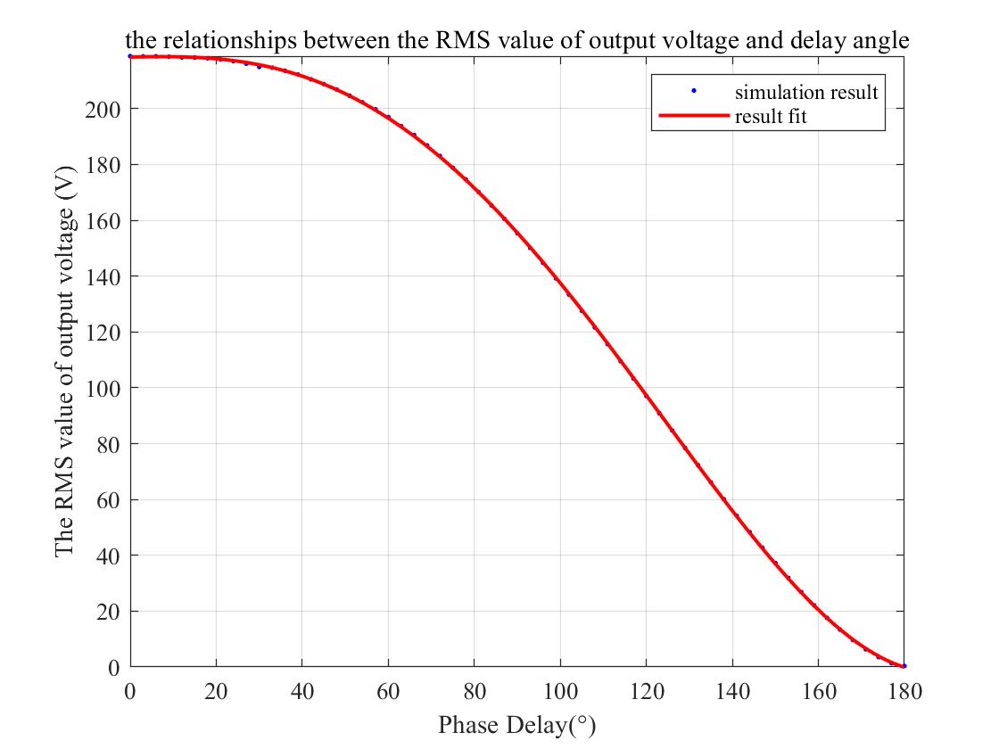
Relationship between delay angle and the RMS value of output voltage

Slide 10
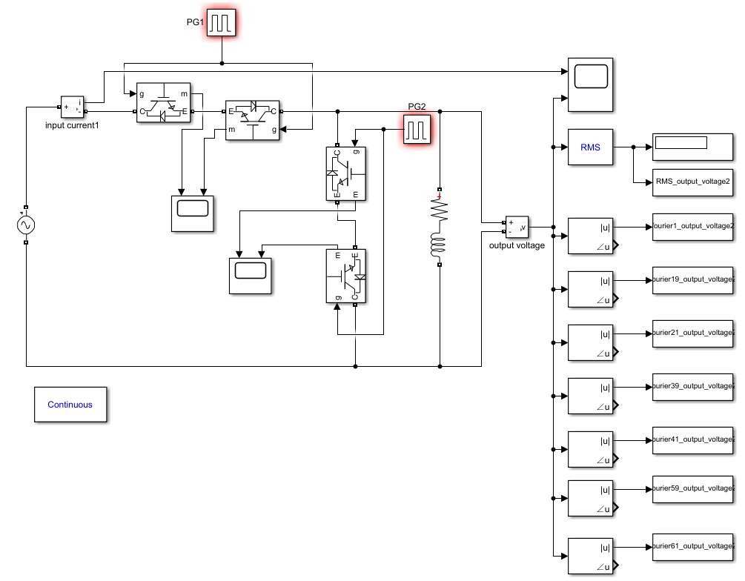
Circuit

Slide 11
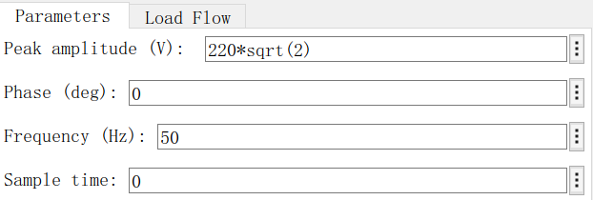
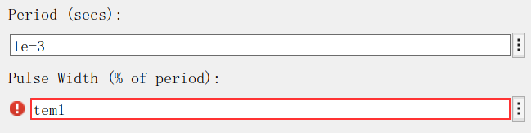
Parameter Setup
Resistor and inductor
Power Supply
L | R
2.2mH | 10Ω
IGBT

Slide 12
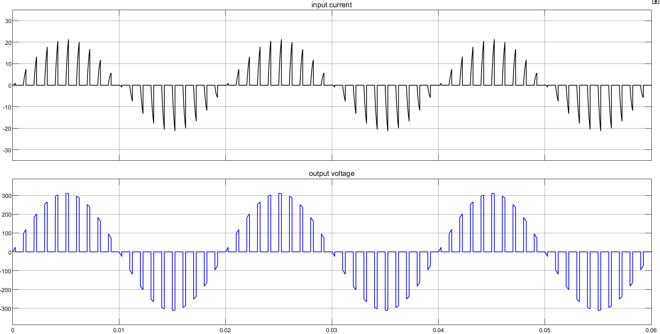
output voltage and input current waveform(duty cycle=25%)

Slide 13
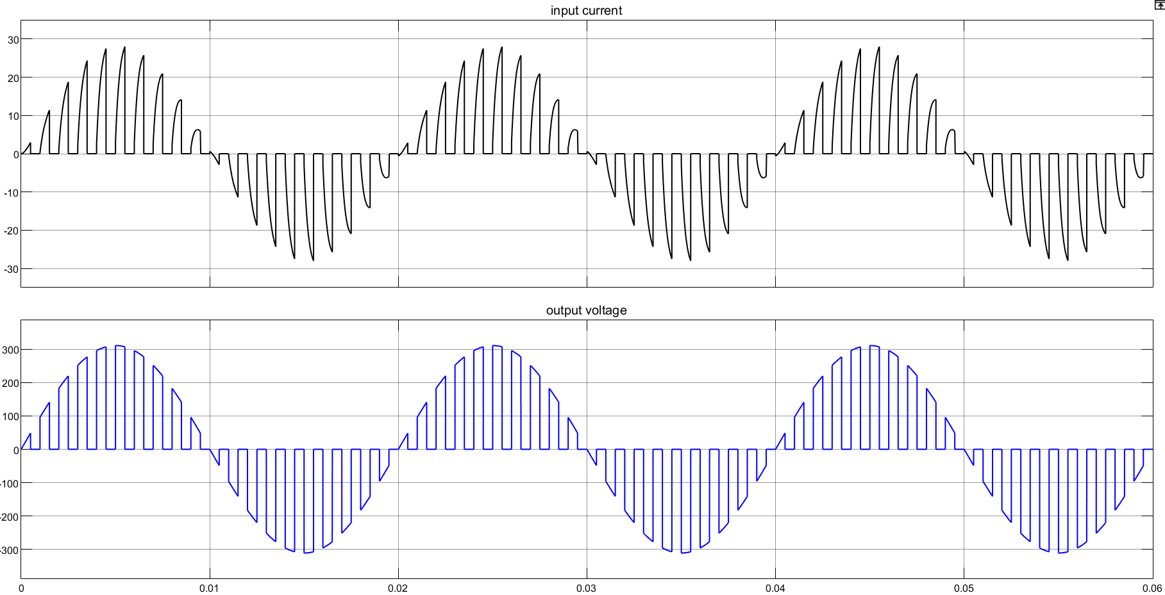
output voltage and input current waveform(duty cycle=50%)

Slide 14
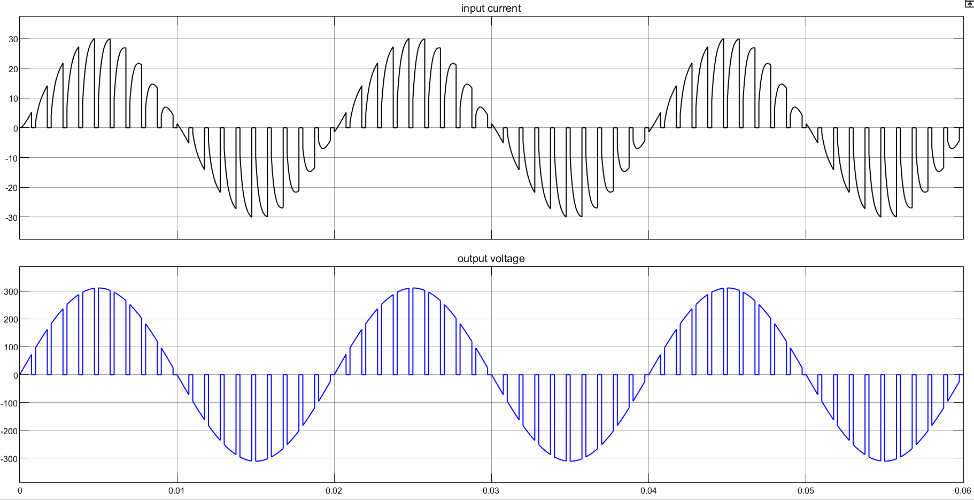
output voltage and input current waveform(duty cycle=75%)

Slide 15
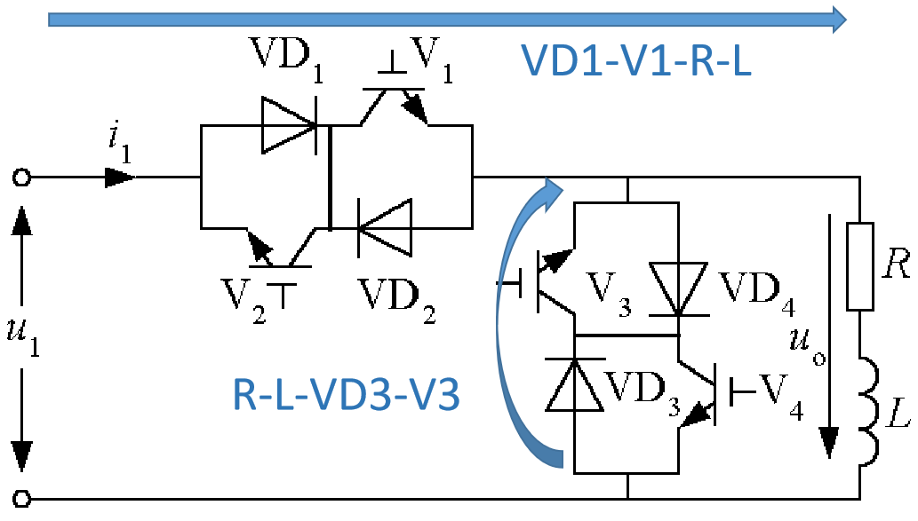
Commutation Process

Slide 16
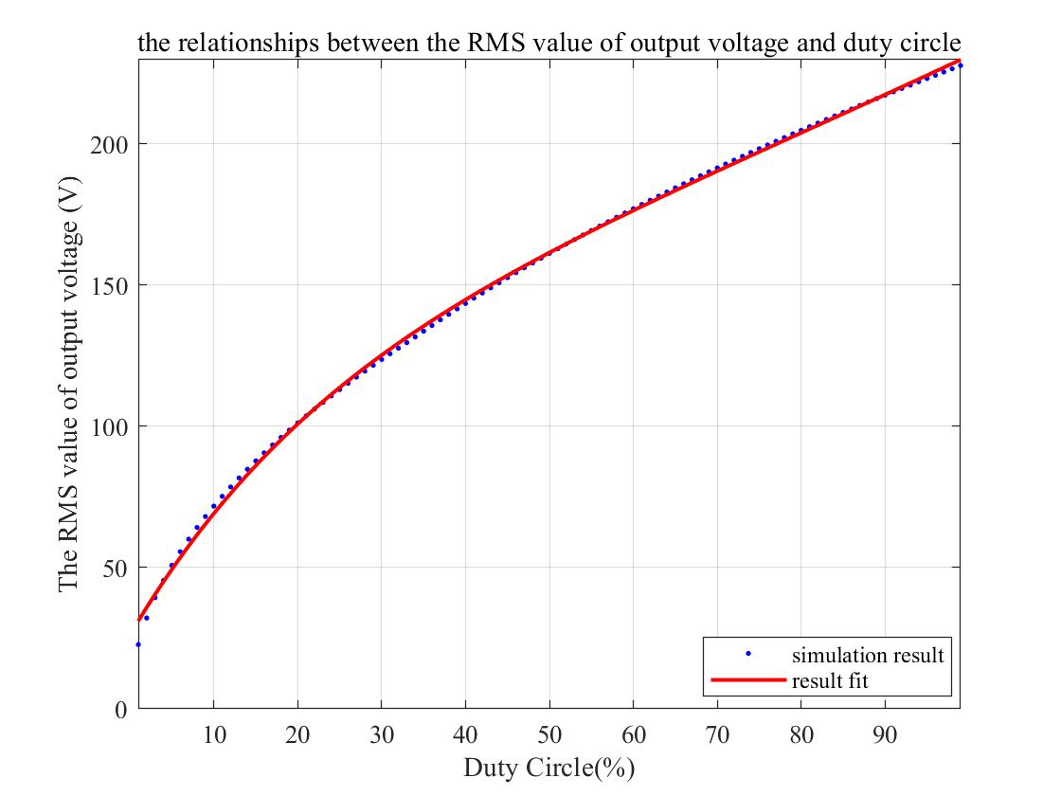
Relationship between duty cycle and the RMS value of output voltage

Slide 17
Relationship between duty cycle and the RMS value of output voltage

