Slide 1
Power Electronics
Seminar #6
Part 1
Reporter
NIE YONGXIN
：
AN TENGYU
HUI HENG
：
：

Slide 2
Division of Work
NIE YONGXIN:
Carry out the simulation.
The images of part 1.
The analysis of the result.
The PPT of part 1.
AN TENGYU:
The analysis of the operating sequence.
Carry out the simulation.
The PPT of part 2.
HUI HENG:
The simulation circuit of the part 1
The analysis of the simulation model.
The PPT of part 1.

Slide 3
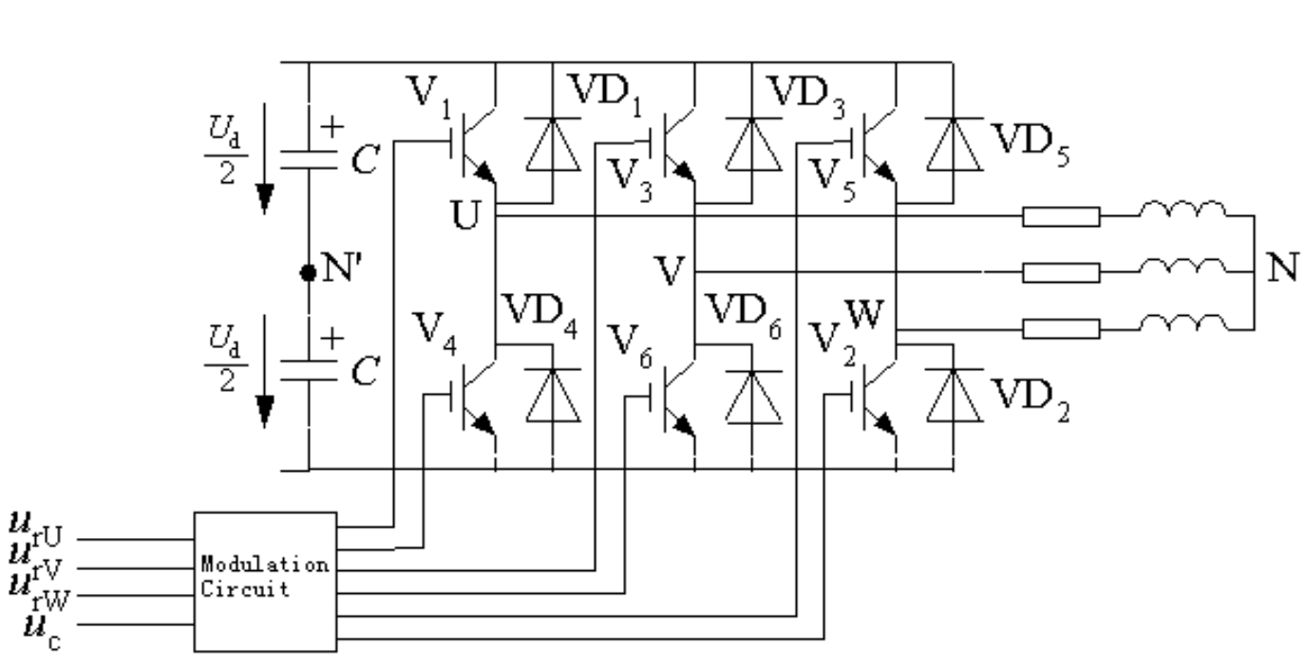
Theoretical Circuit Diagram
Fig 1-1 Three phase PWM voltage source inverter

Slide 4
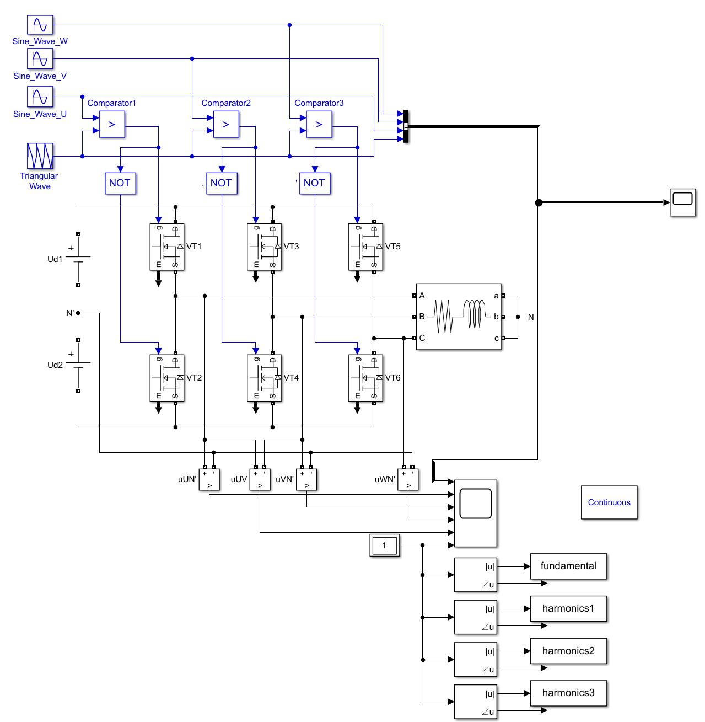
Simulation Circuit Diagram
Fig 1-2 Simulation model

Slide 5
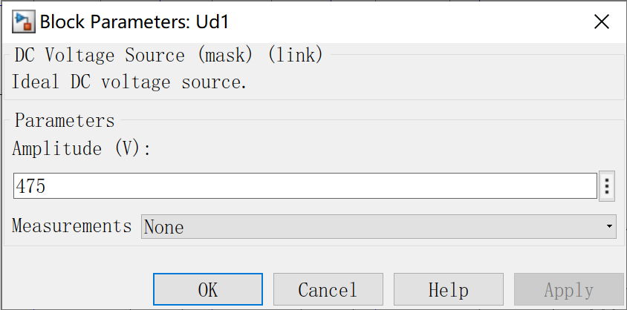
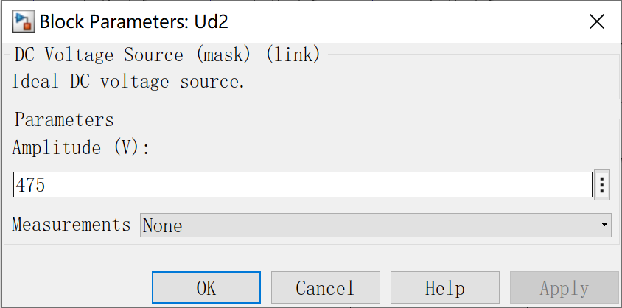
Parameter Setup
In order to show the imaginary neutral point,
the DC side power supply adopts two DC voltage sources
with the amplitude of 475V:
Fig 1-4 DC voltage source

Slide 6
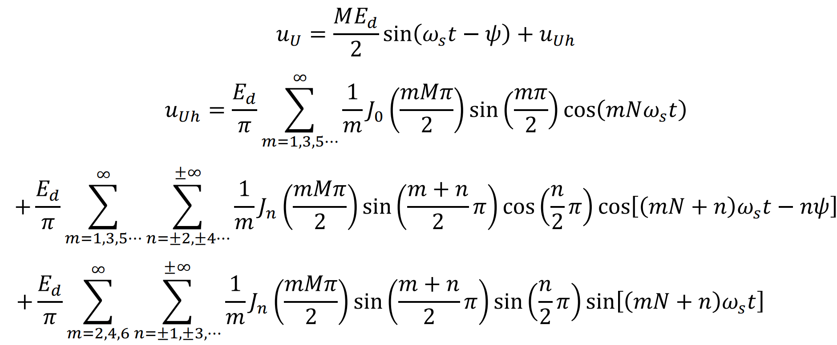
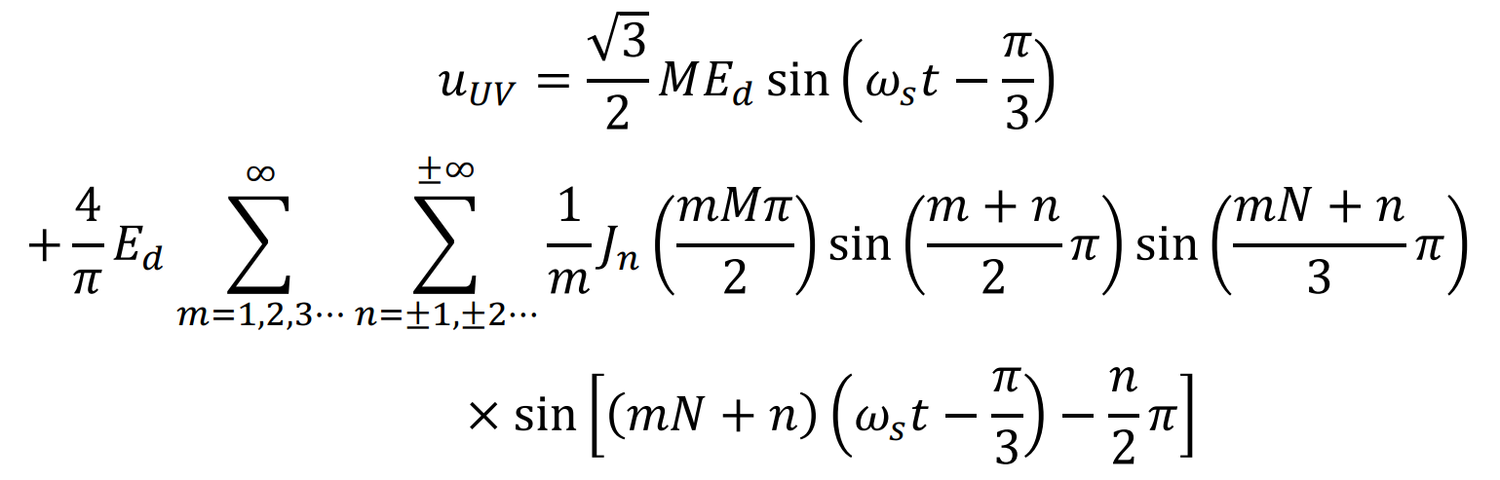
Spectrum Analysis of Output Voltage
Output Phase Voltage
Fundamental Component Part
Therefore, the harmonic spectrum is symmetrical near the frequency doubling of each switch.
Harmonics Component Part

Slide 7
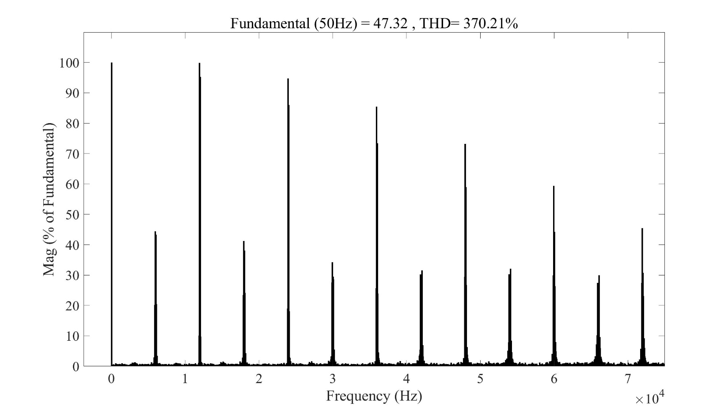
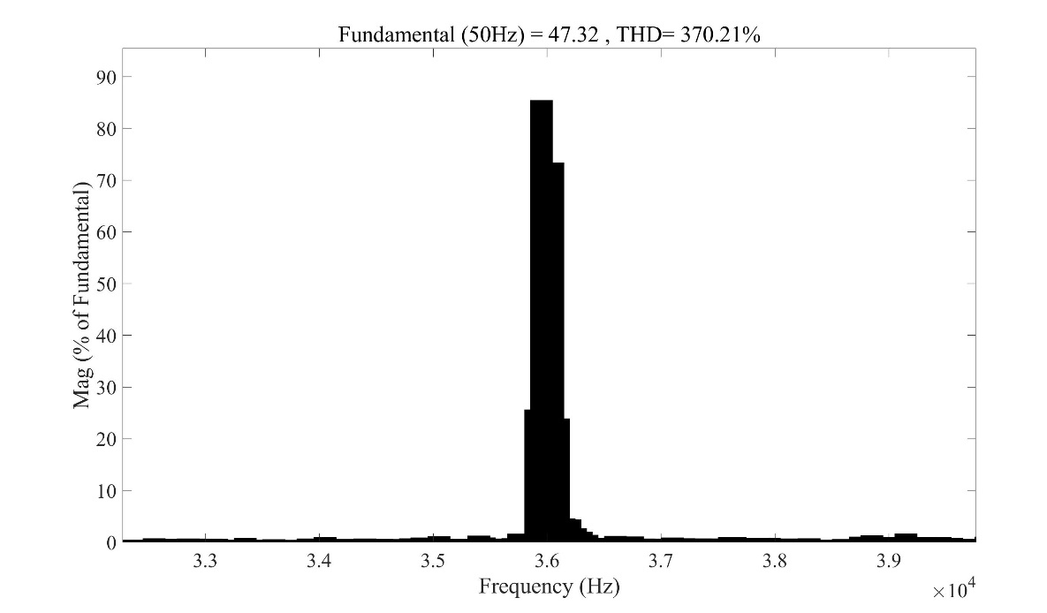
Simulation Result
FFT analysis result:
Fig 1-7 modulation ratio m=0.1 (zoom in)
Fig 1-6 modulation ratio m=0.1

Slide 8
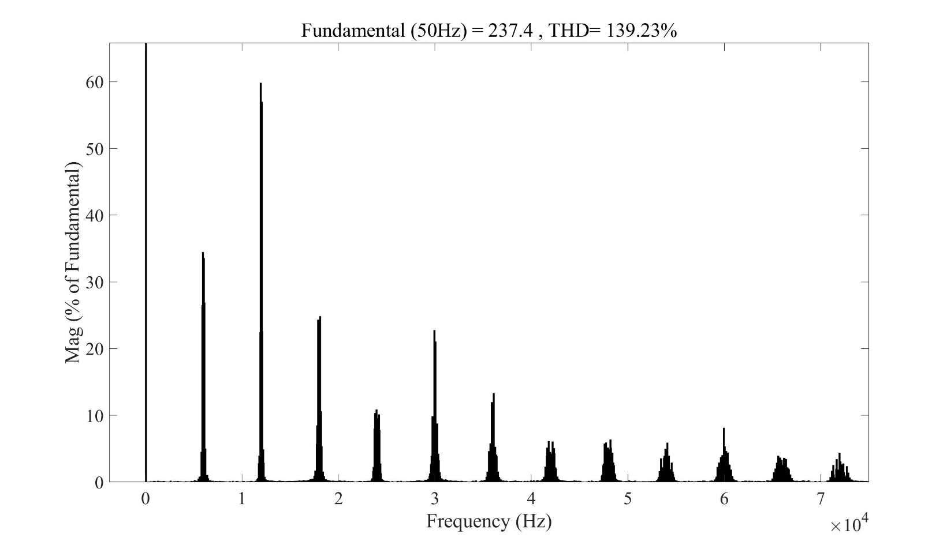
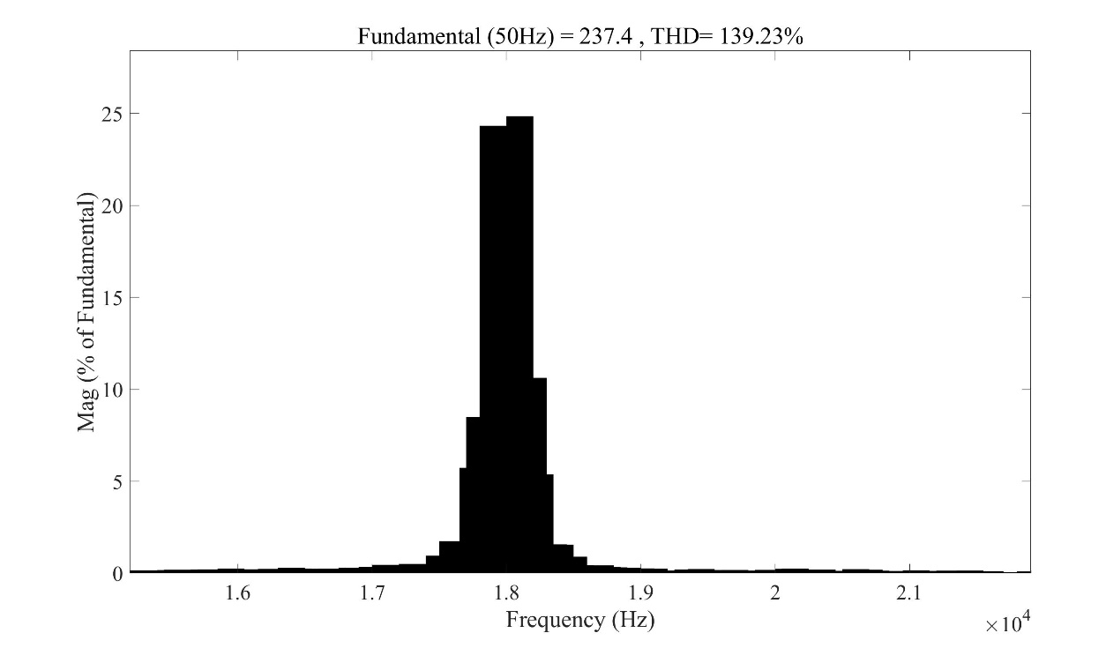
Simulation Result
FFT analysis result:
Fig 1-9 modulation ratio m=0.5 (zoom in)
Fig 1-8 modulation ratio m=0.5

Slide 9
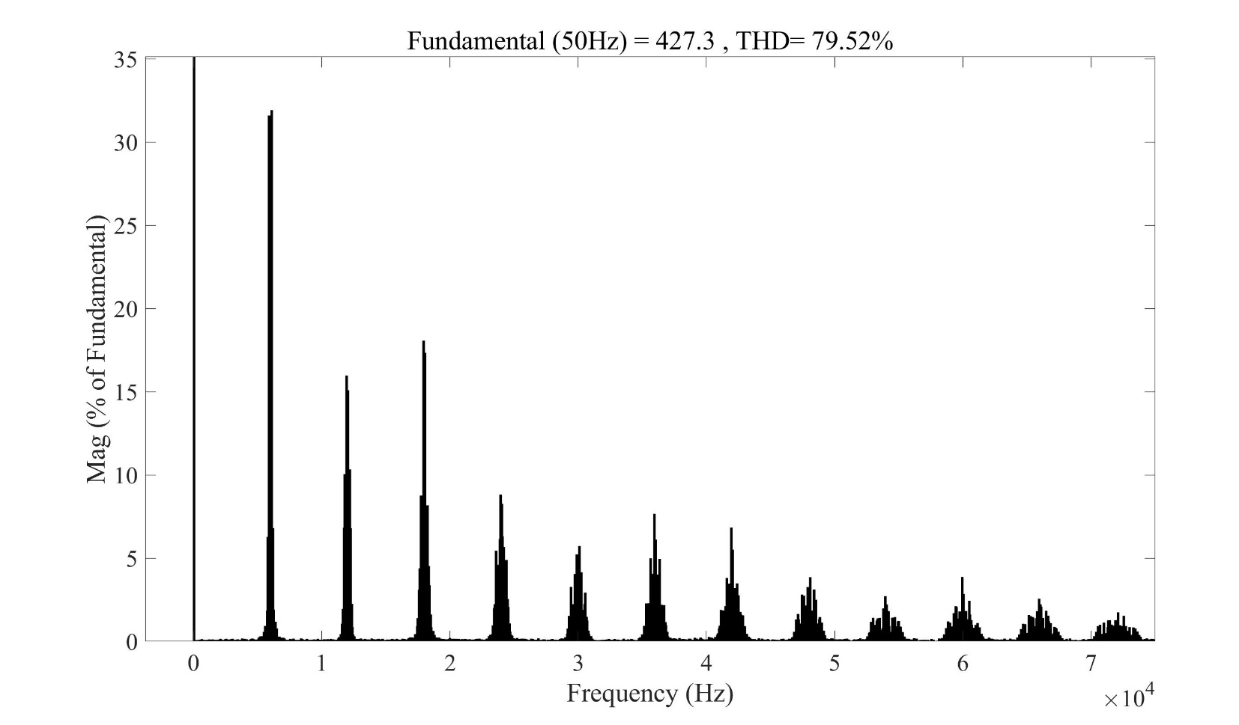
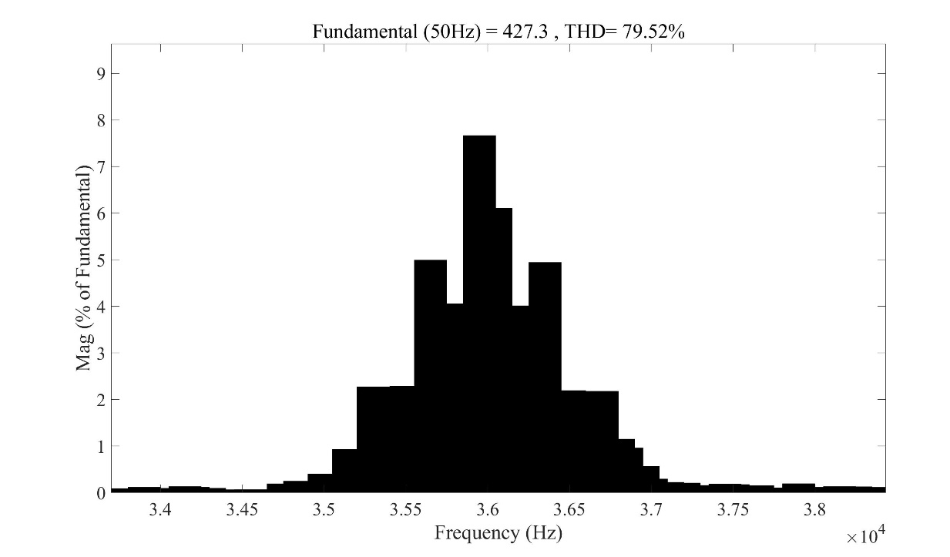
Simulation Result
FFT analysis result:
Fig 1-11 modulation ratio m=0.9 (zoom in)
Fig 1-10 modulation ratio m=0.9

Slide 10
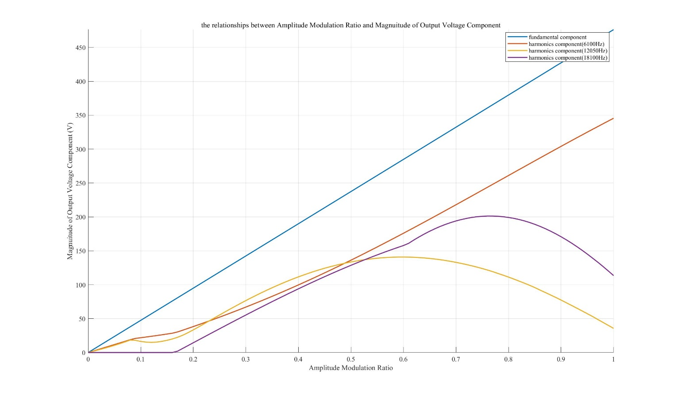
Analysis of Result
Among the above harmonics, the harmonic component with high amplitude and the greatest influence is
Fig 1-12 the relationship between Amplitude Modulation Ratio and Amplitude of Output Voltage

Slide 11
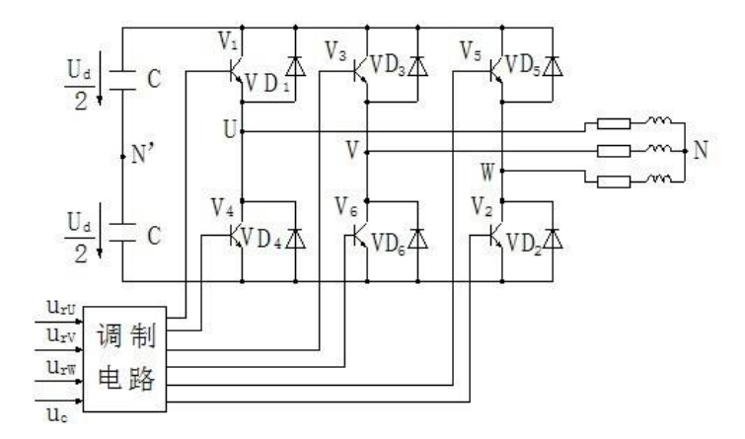
Operating sequence according to simulation waveforms
Two levels of u_{UN'} :
Output line voltage :
Three levels of u_{UV} : 0、
Output phase voltage :
Five levels of u_{UN} : 0、

Slide 12
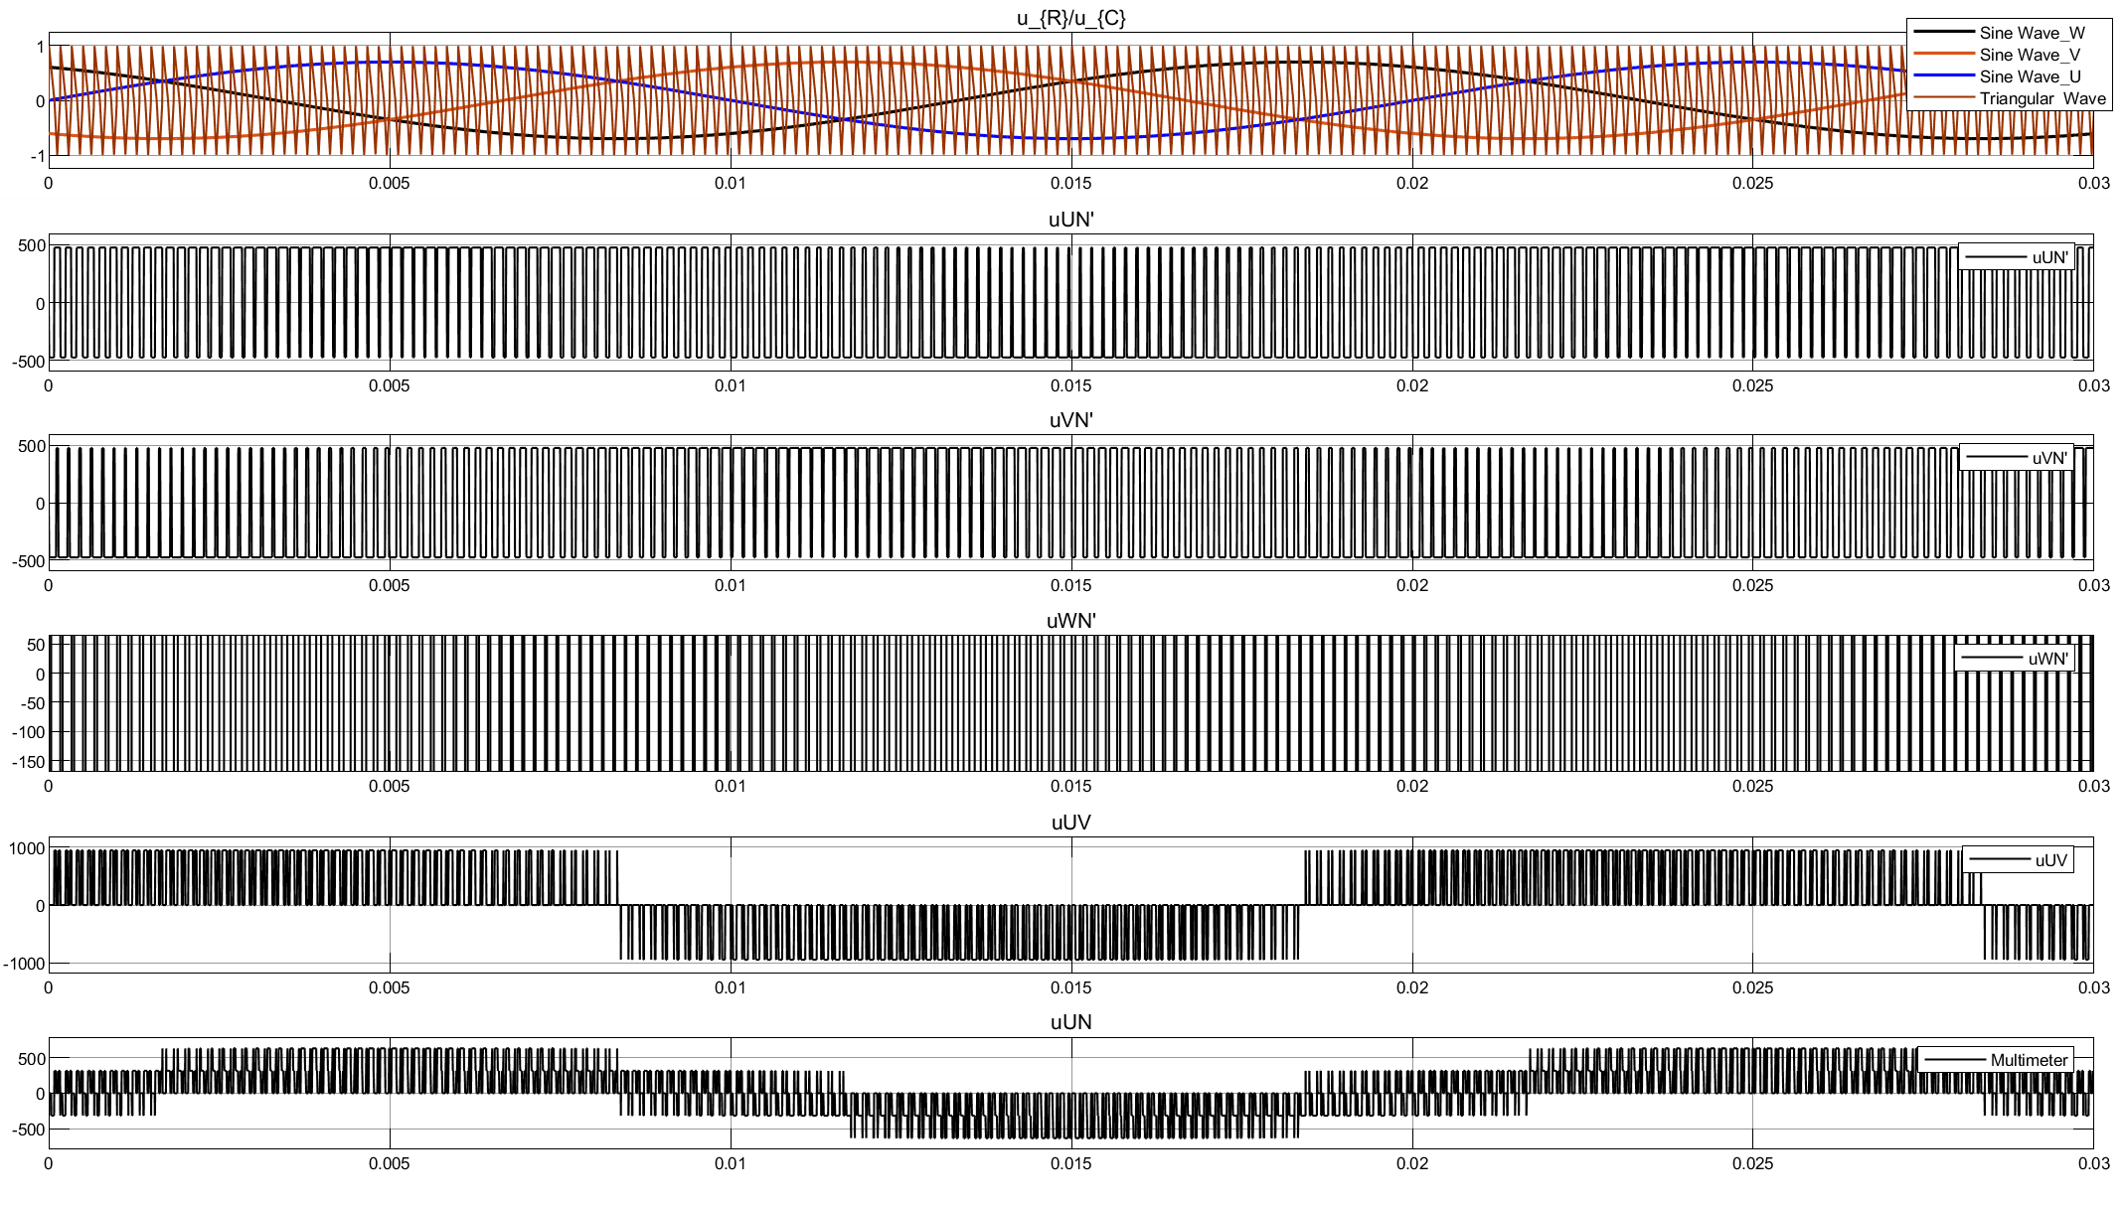
Operating sequence according to simulation waveforms
Fig 1-13 Result waveform

Slide 13
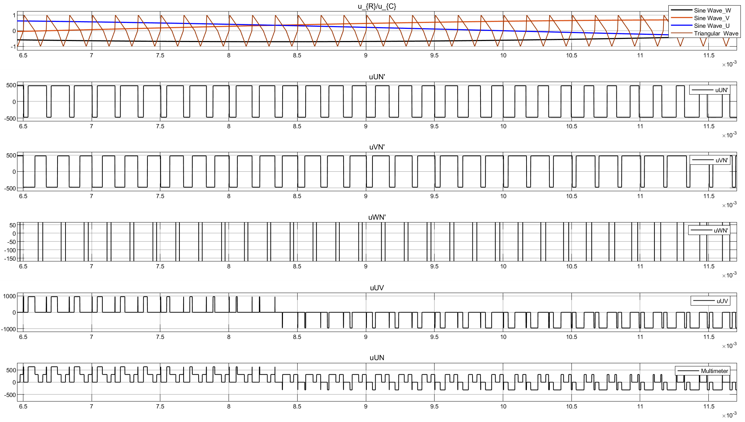
Operating sequence according to simulation waveforms
Fig 1-14 Result waveform

Slide 14
Your Questions and Comments are welcome

