Slide 1
Power Electronics
Seminar 6
Part 2
Reporter
NIE YONGXIN
：
HUI HENG
An Tengyu
：
：

Slide 2
Division of work
NIE YONGXIN:
Carry out the simulation.
The images of part 1.
The analysis of the result.
The PPT of part 1.
HUI HENG:
The data collection.
Carry out the simulation.
The analysis of the result.
The PPT of part 1.
AN TENGYU:
The theoretical calculations of the part 2
The PPT of part 2.
The analysis of the result.

Slide 3
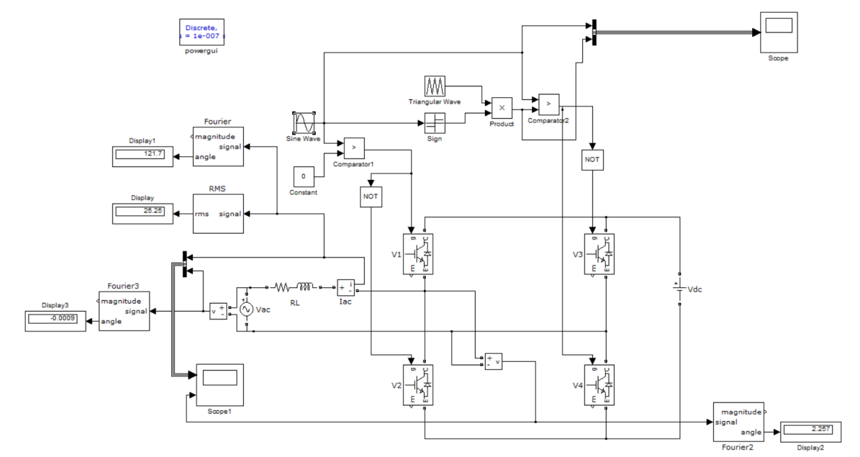
Circuit

Slide 4
Parameter Setup
V_{ac}, rms | 220V
Inductance | 6mH
V_{dc} | 630V
f_{line} | 50Hz
f_{s} | 20kHz
I_{ac}, rms | 25A
φ(v,i) | 120°

Slide 5
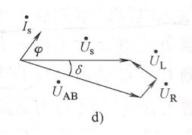
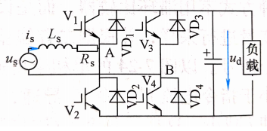
Theoretical analysis
By changing the amplitude and phase of u_{AB}, the amplitude of AC side current and the phase difference between current and voltage can be the required value.

Slide 6
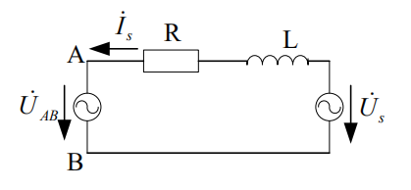
Theoretical calculation
Kirchhoff voltage law:
Further calculation:
The effective value of u_{AB}:
Equivalent circuit
Its phase difference with u_{s.}:
Relationship between U_{AB,} E and M:

Slide 7

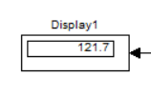
Simulation result
I_{ac}, rms
φ(i,v)
 | Measured value | Theoretical value | Error
Iac, rms | 25.25A | 25A | 1.00%
φ(v,i) | 121.7° | 120° | 1.42%

Slide 8
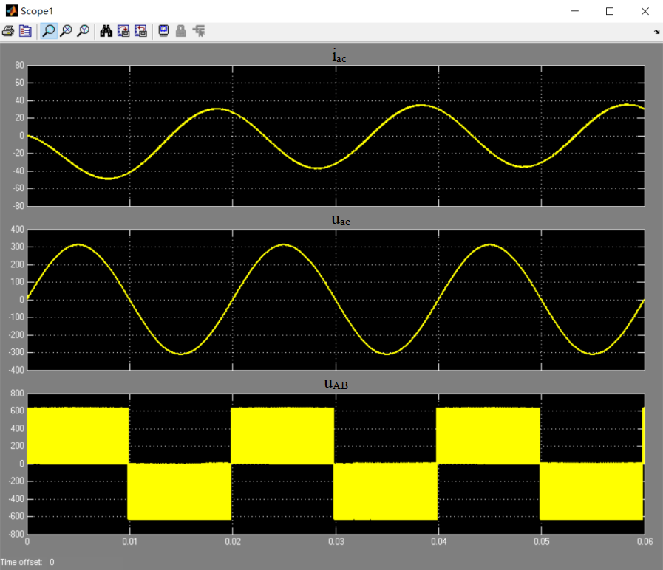
Simulation result
Four states:
Positive and positive
Positive and negative
Negative and posetive
Negative and negative
u_{ac}∙i_{ac}<0
Inverter mode
u_{ac}∙i_{ac}>0
Rectification mode

Slide 9
Your Questions and Comments are welcome

