Slide 1
Power Electronics
Seminar 6
Part 2
Reporter
NIE YONGXIN
：
：
HUI HENG
AN TENGYU
：

Slide 2
Division of work
NIE YONGXIN:
Theoretical analysis and calculation
The PPT of part 1.
HUI HENG:
Carry out the simulation.
The analysis of the result.
The PPT of part 1.
AN TENGYU:
The simulation model of part 2
The analysis of the simulation model.
The PPT of part 2.

Slide 3
Contents
Part1:
Simulation model and operating principle
Part2:
Theoretical analysis and calculation
Part3:
Simulation result and result analysis

Slide 4
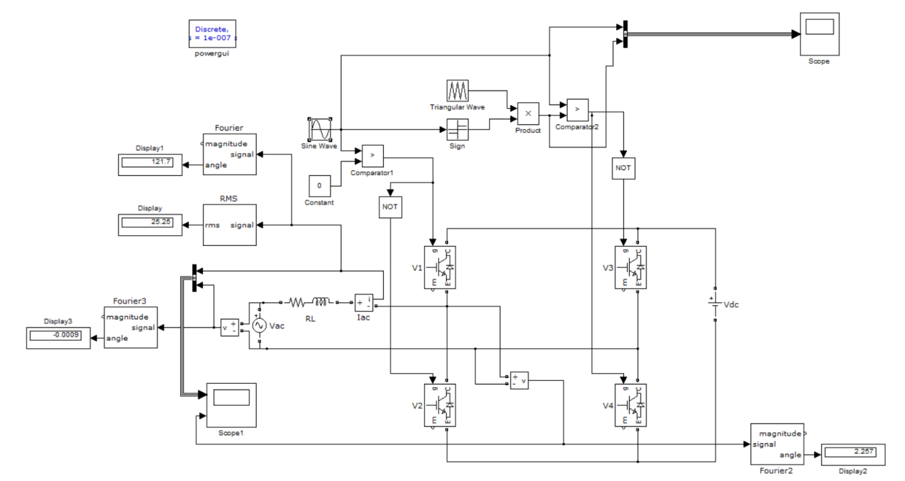
Simulation model

Slide 5
Parameter Setup
Table 1-1 Parameter Setup of our group
RMS of AC voltage | 220V
Inductance | 6mH
DC voltage | 630V
Line frequency | 50Hz
Carrier frequency f_{s} | 20kHz
RMS of AC current | 25A
Phase difference φ(v,i) | 120°

Slide 6
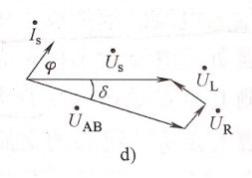
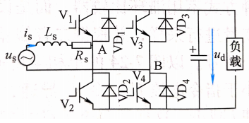
Theoretical analysis
By changing the amplitude and phase of u_{AB}, the amplitude of AC side current and the phase difference between current and voltage can be the required value.

Slide 7
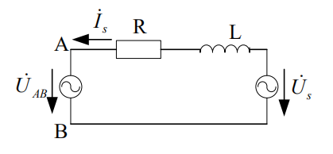
Theoretical calculation
Kirchhoff voltage law:
Further calculation:
The effective value of U_{AB}:
Fig 1-6 Equivalent circuit
Its phase difference with u_{s.}:
Relationship between U_{AB,} E and M:

Slide 8

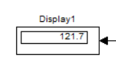
Simulation result
I_{ac}, rms
φ(i,v)
Table 1-2 Simulation Result of our group
 | Measured value | Theoretical value | Error
Iac, rms | 25.25A | 25A | 1.00%
φ(v,i) | 121.7° | 120° | 1.42%

Slide 9
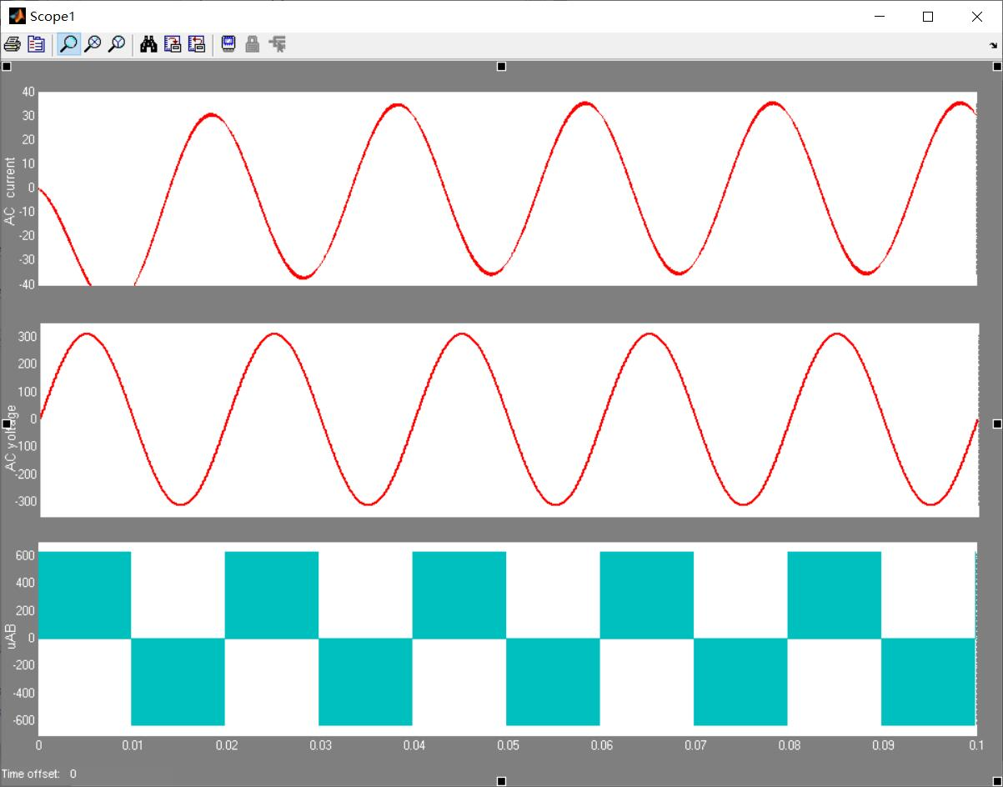
Simulation result
Four states for u_{ac} and i_{ac}:
Positive and positive
Positive and negative
Negative and posetive
Negative and negative
u_{ac}∙i_{ac}<0
Inversion mode
u_{ac}∙i_{ac}>0
Rectification mode
Fig 1-7 Result Waveform

Slide 10
Your Questions and Comments are welcome

