Slide 1
Power Electronics
Seminar #7
Reporter
NIE YONGXIN
：
TAN JIAXIN
ZHU JIAYI
：
：

Slide 2
Division of Work
TAN JIAXIN
Carry out the simulation.
The PPT of part 1.
NIE YONGXIN:
Carry out the simulation.
The PPT of part 2.
ZHU JIAYI:
The analysis of the simulation model.
The PPT of part 2.

Slide 3
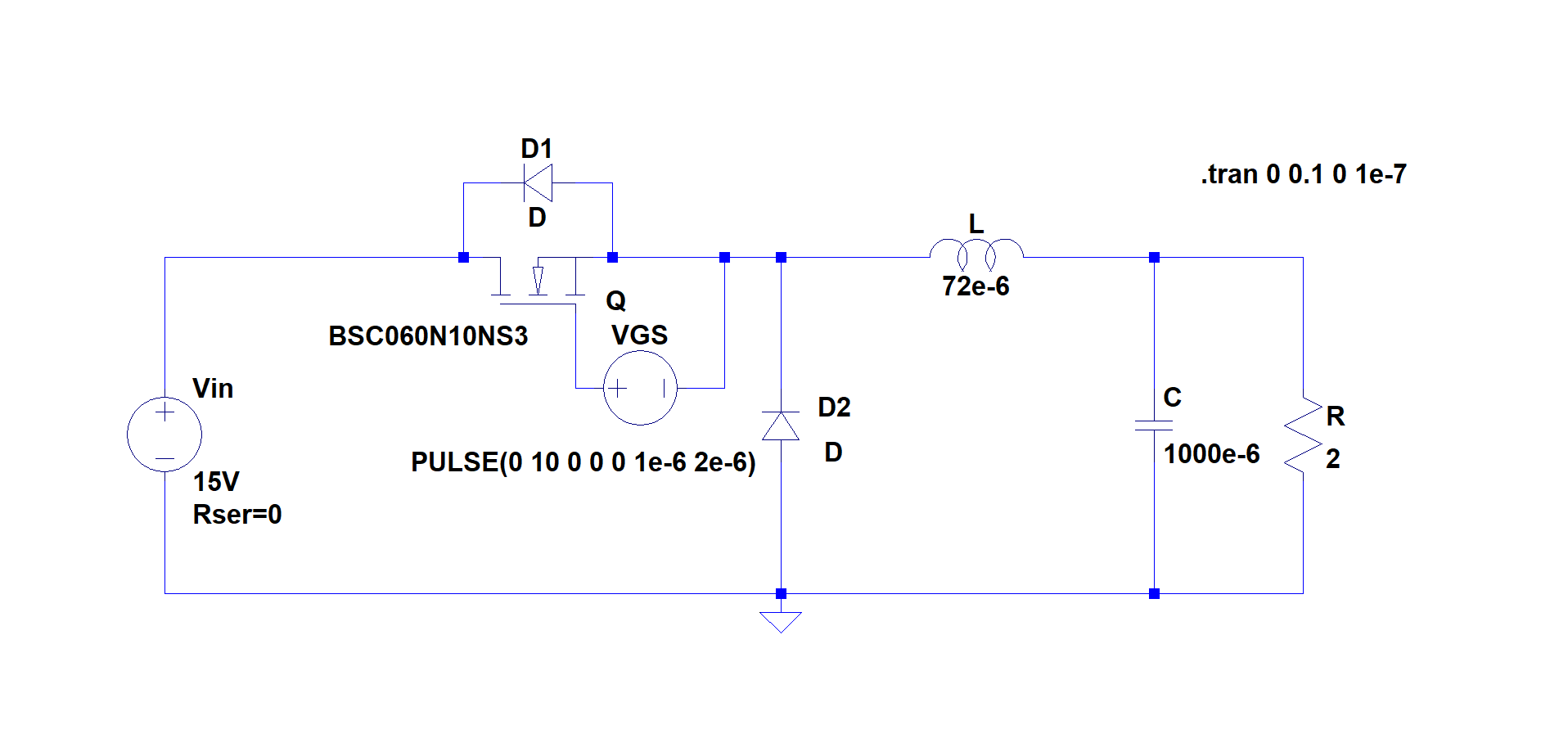
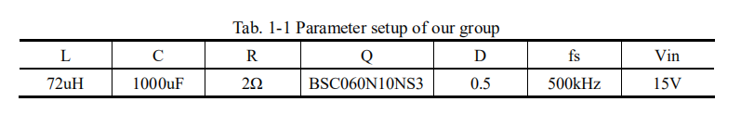
Circuit Diagram

Slide 4
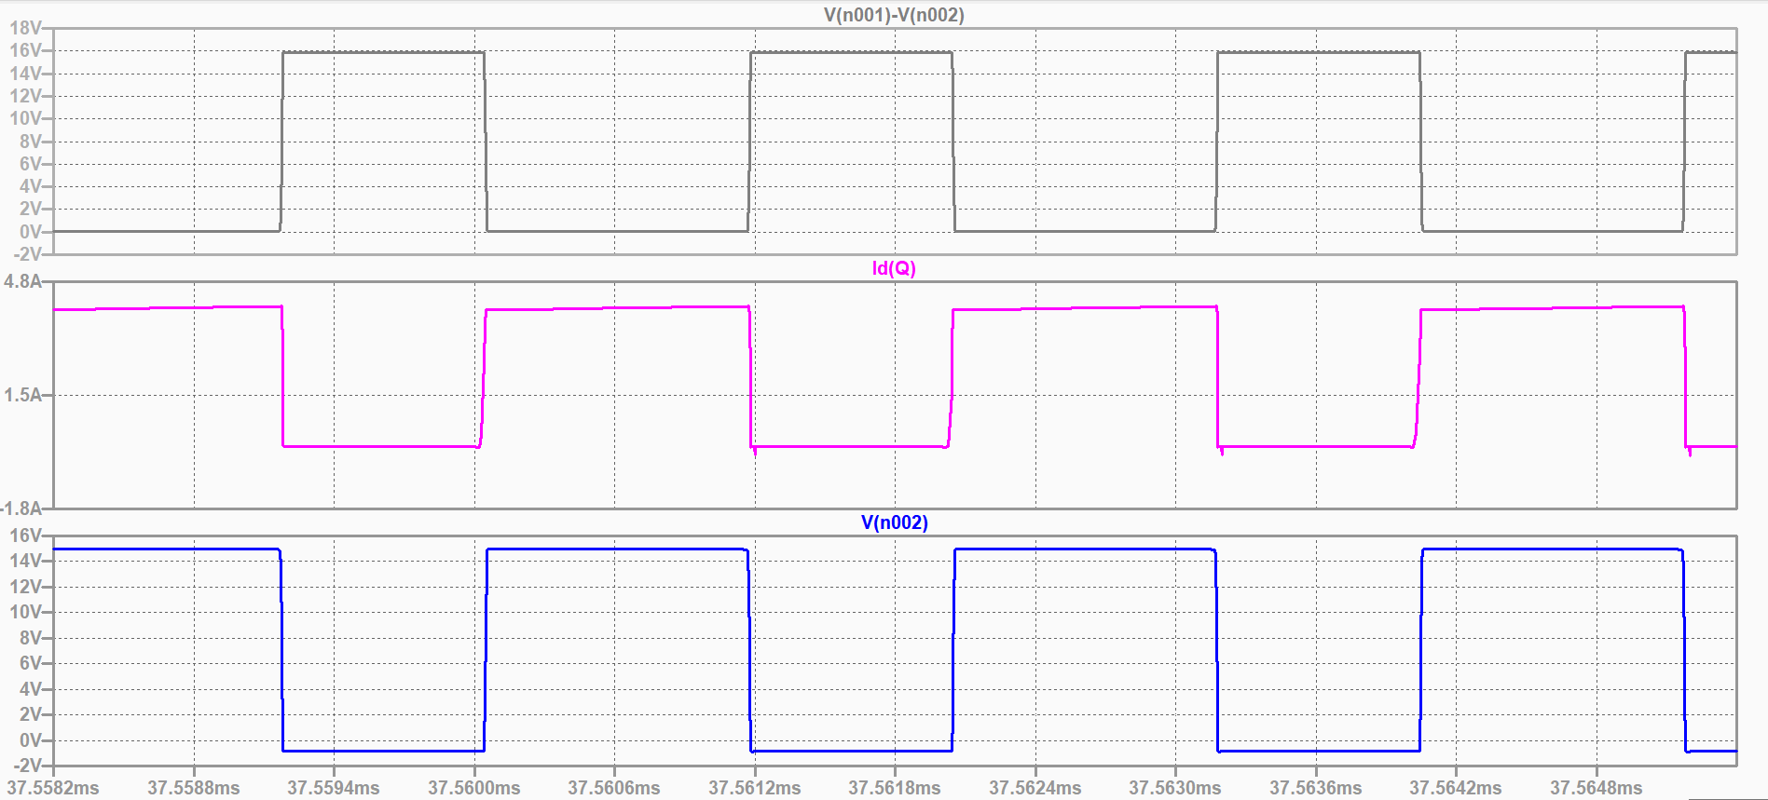
Simulation Result
u_{s}
i_{s}
u_{VD}

Slide 5
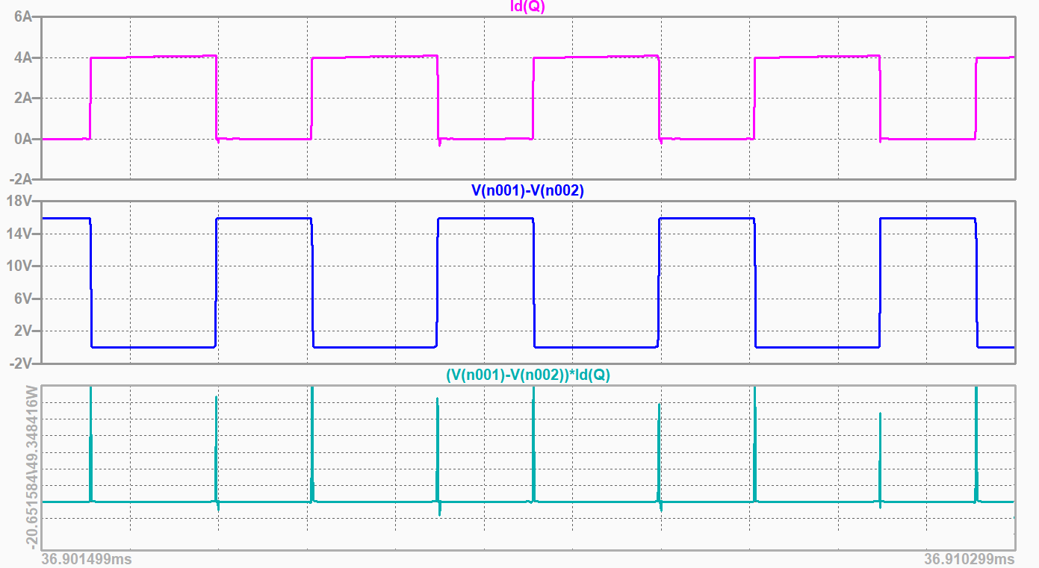
Simulation Result
u_{s}
i_{s}
P

Slide 6
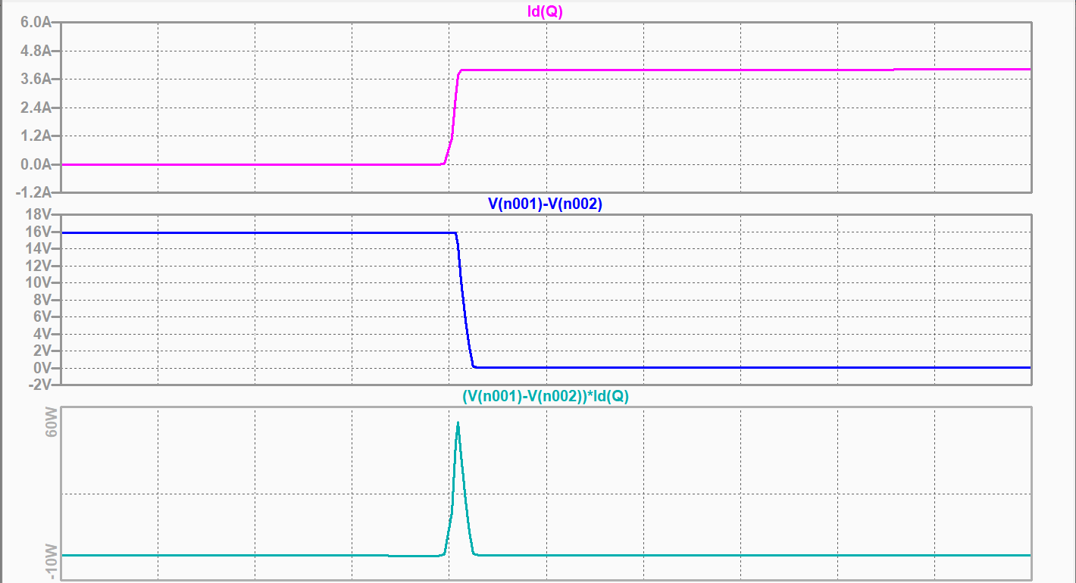
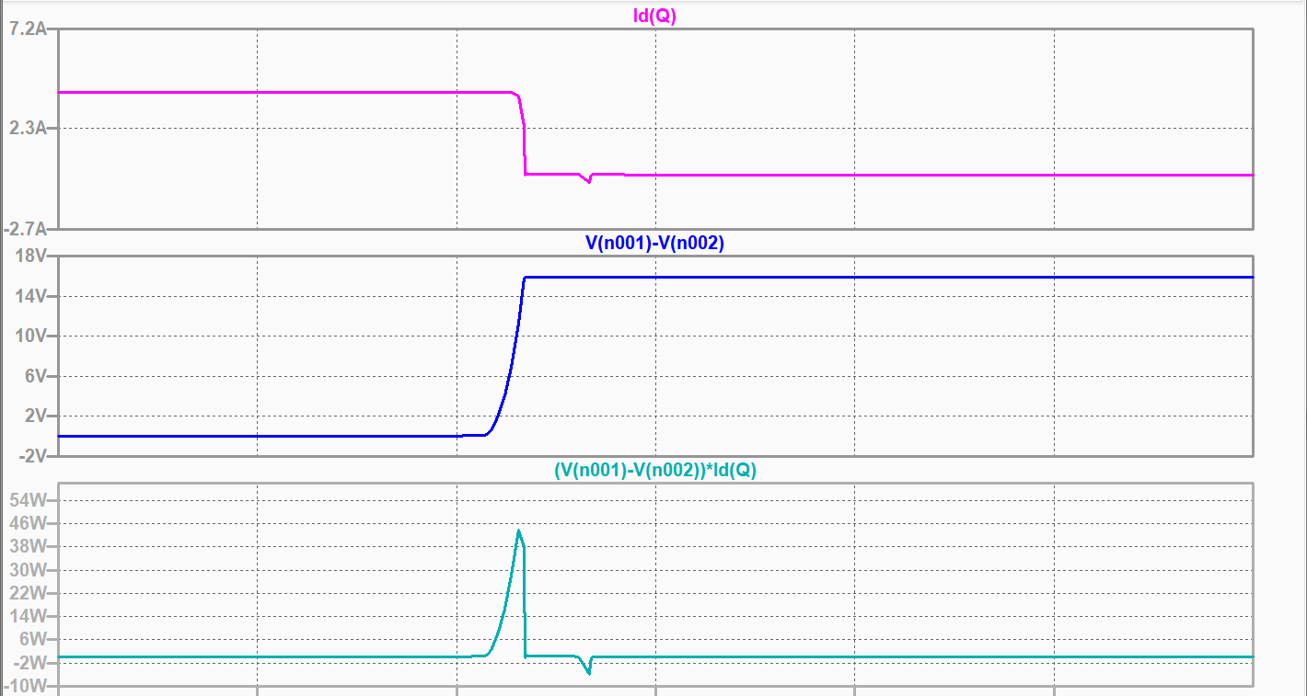
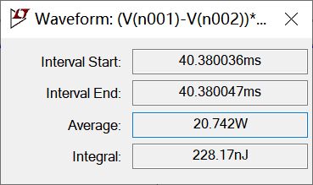
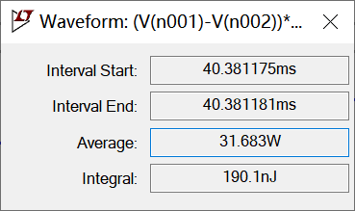
Simulation Result

Slide 7
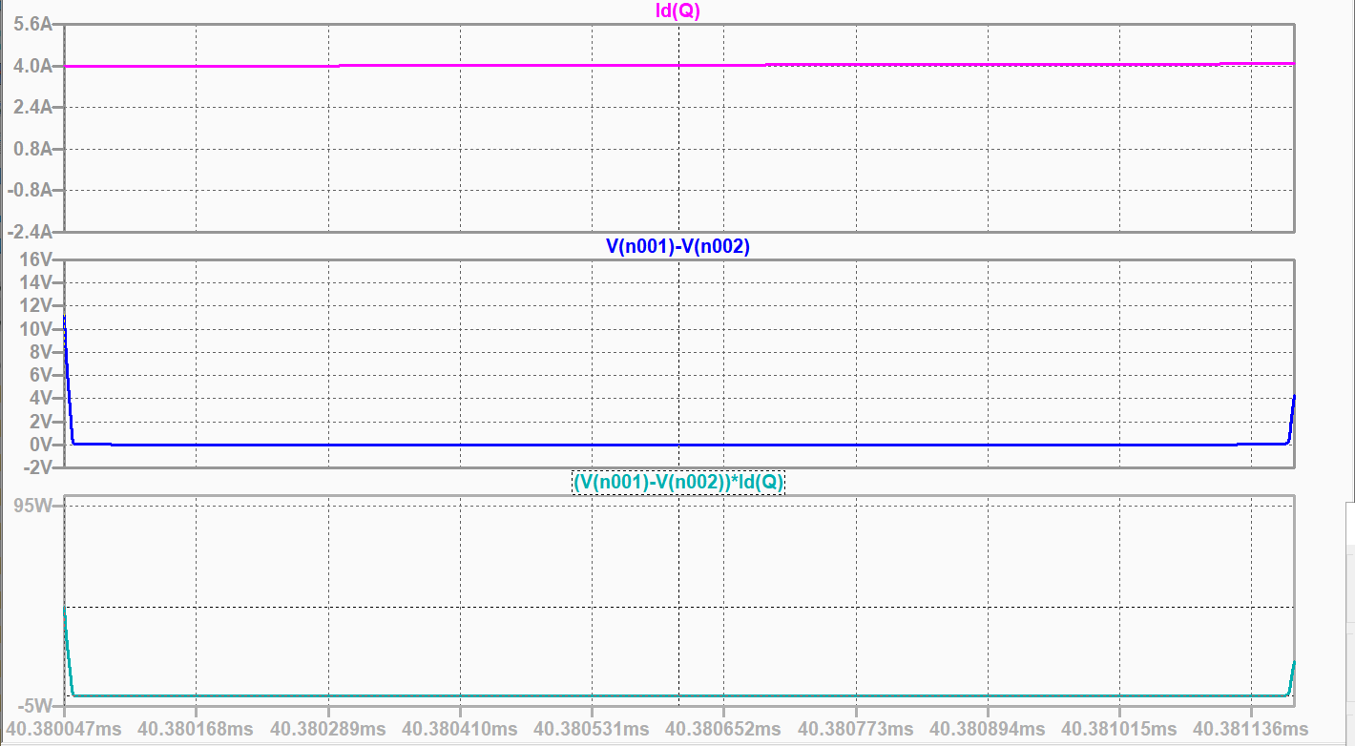
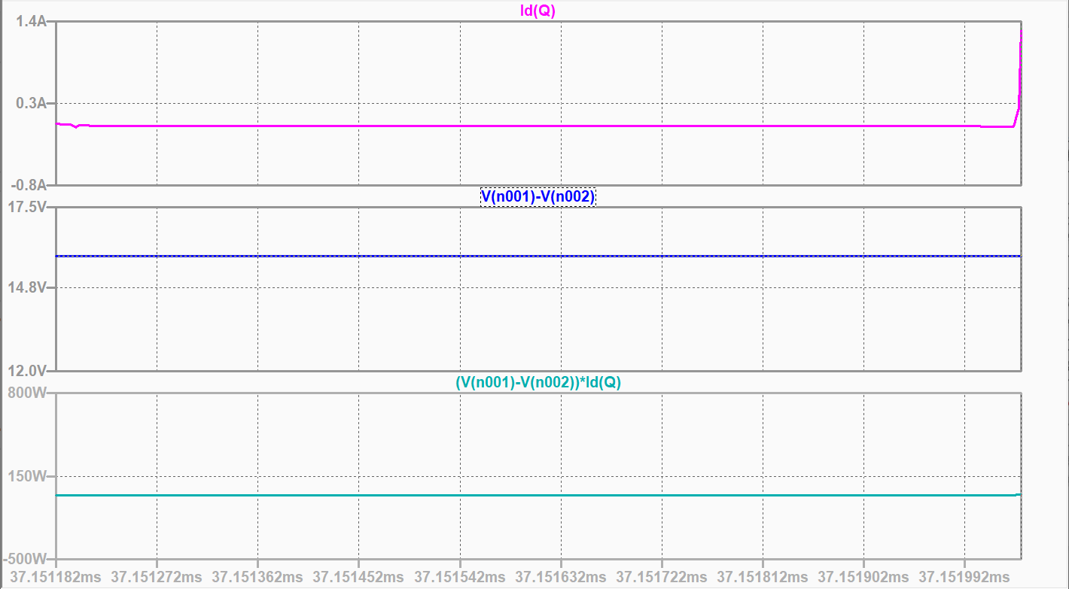
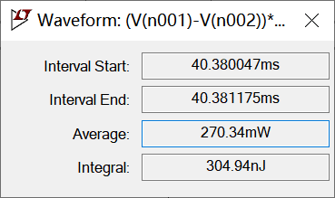
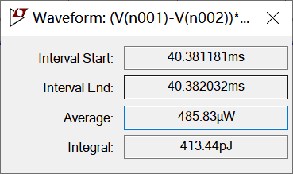
Simulation Result

Slide 8
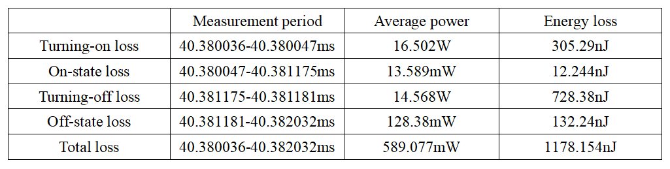
Simulation Result
Table 1-1 Average Power and Energy Loss of hard-switching in Different Period

Slide 9
Theoretical Circuit Diagram
Fig 2-1 ZVS QRC Buck Converter

Slide 10
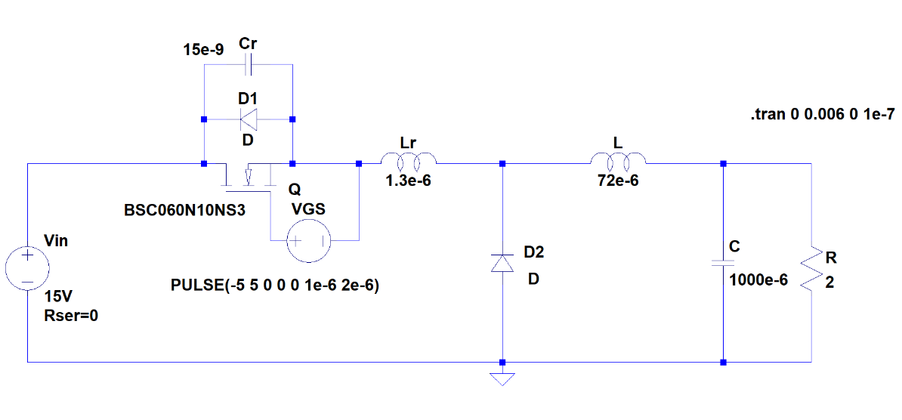
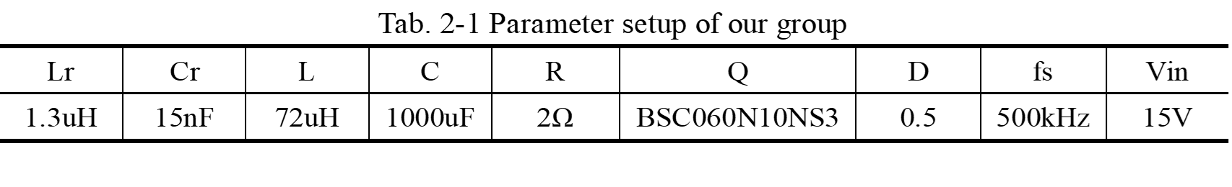
Simulation Circuit Diagram
Fig 2-2 Simulation model

Slide 11
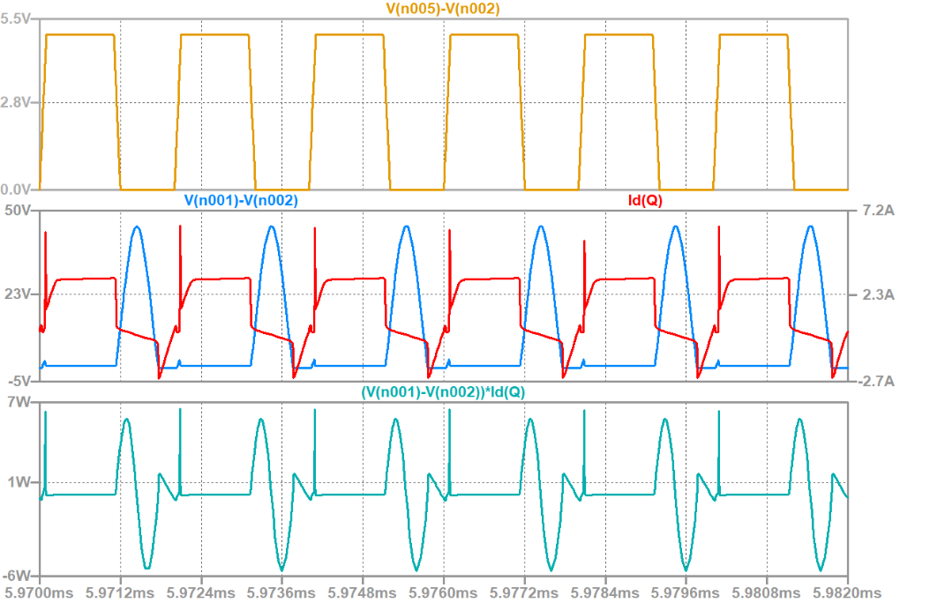
Simulation Result
Fig 2-3 Gate Signal, V_{DS}, I_{d} Waveform

Slide 12
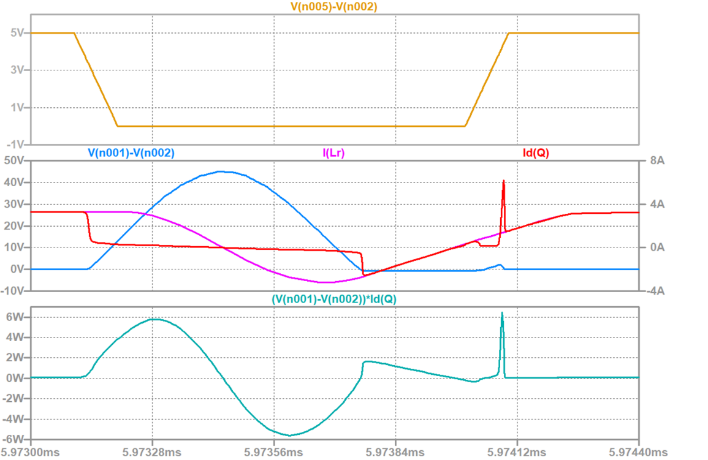
Simulation Result
Fig 2-4 Gate Signal, VDS, Id Waveform (enlarged map)

Slide 13
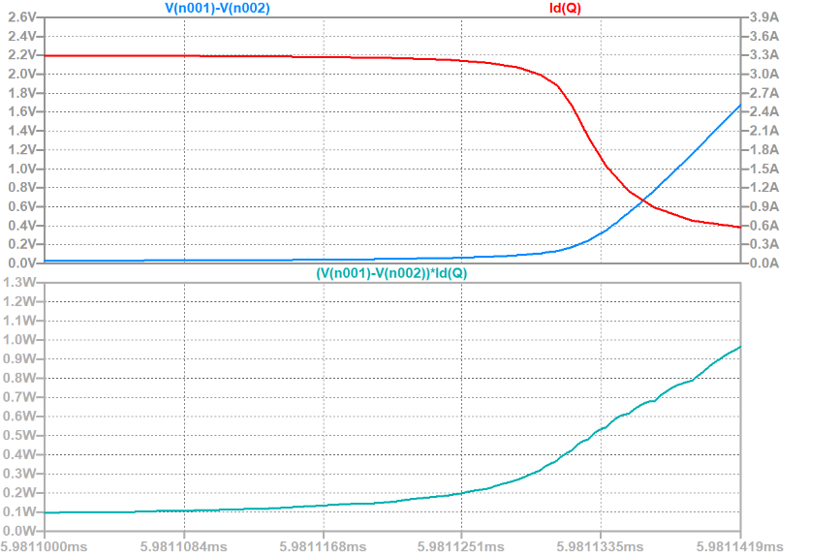
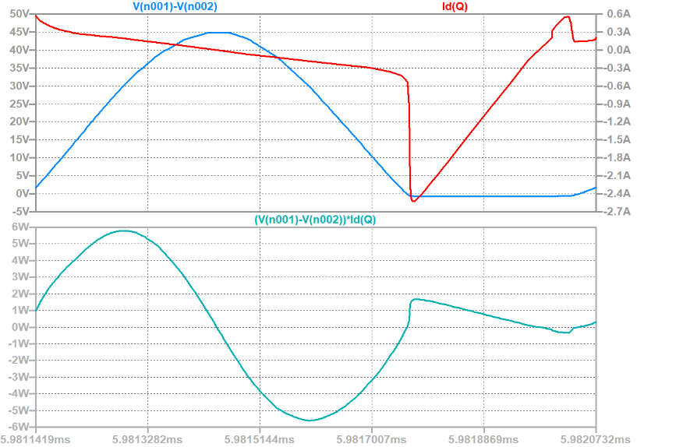
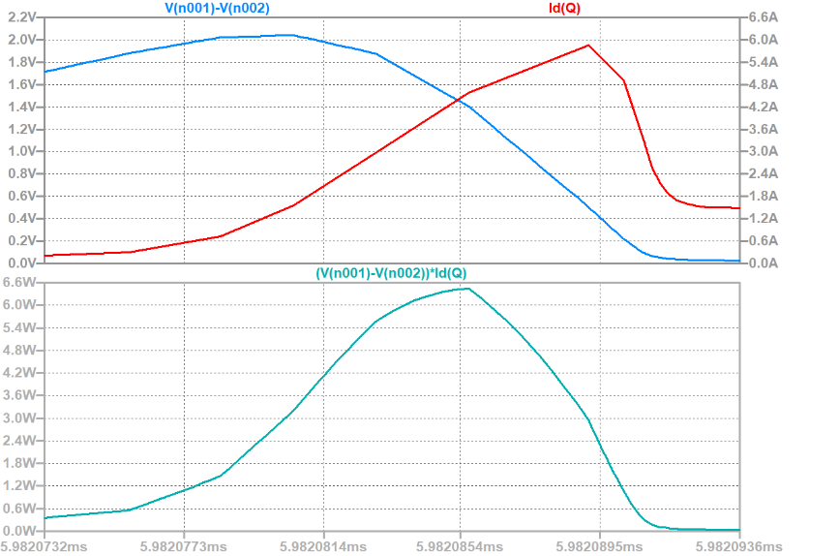
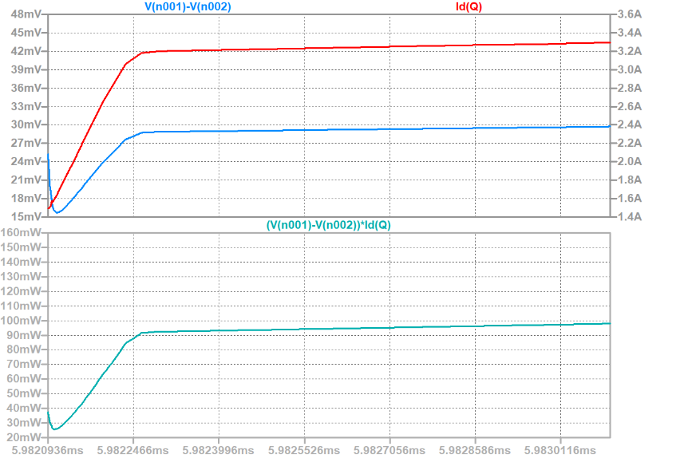
Simulation Result
Fig 2-5 Voltage, Current, Power Waveform and Statistics of the Power Loss
(when MOSFET is in turning-off process)
Fig 2-6 Voltage, Current, Power Waveform and Statistics of the Power Loss
(when MOSFET is off)
Fig 2-7 Voltage, Current, Power Waveform and Statistics of the Power Loss
(when MOSFET is in turning-on process)
Fig 2-8 Voltage, Current, Power Waveform and Statistics of the Power Loss
(when MOSFET is on)

Slide 14
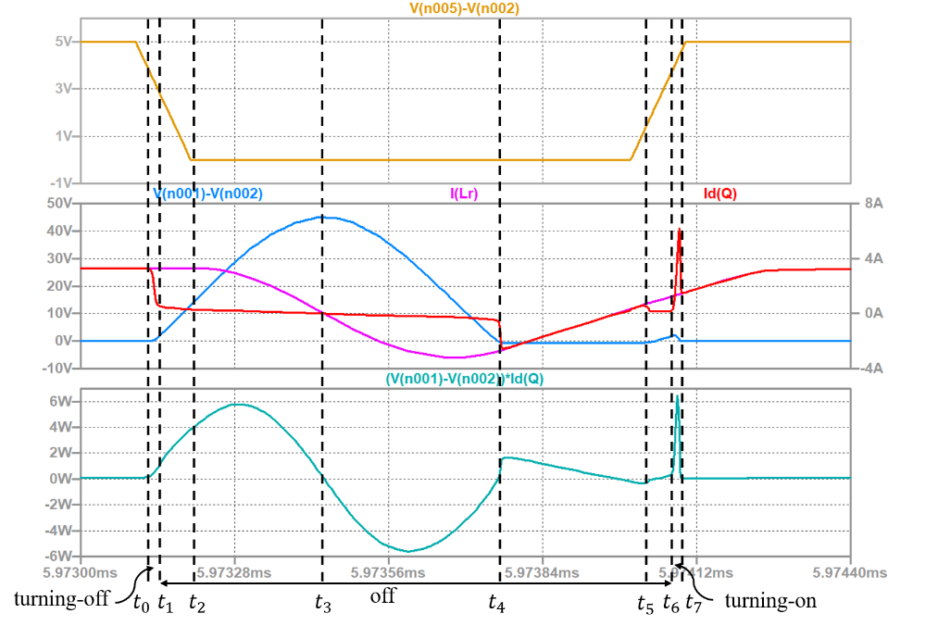
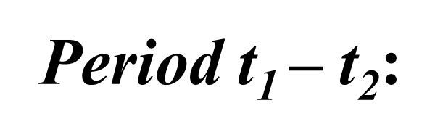
Analysis of the Results
Fig 2-9 Waveforms of ZVS QRC

Slide 15
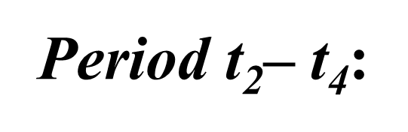
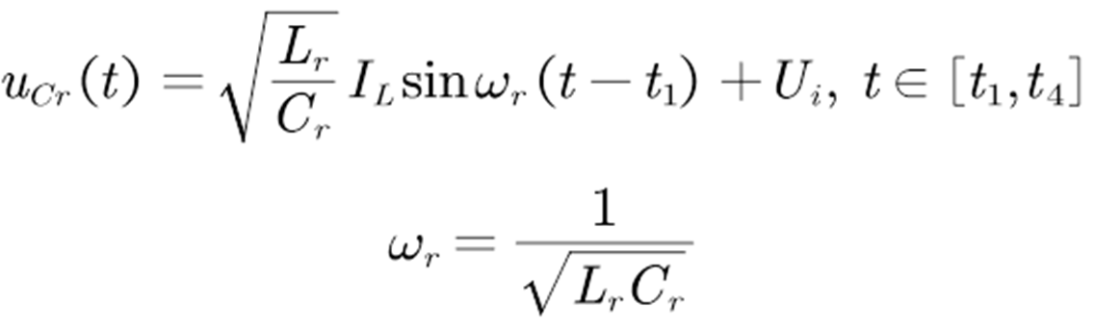
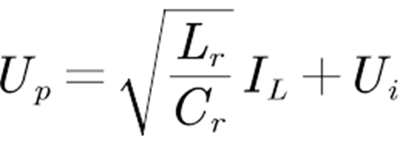
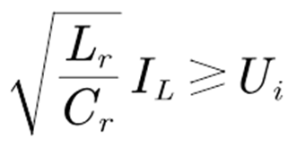
Analysis of the Results
Fig 2-9 Waveforms of ZVS QRC

Slide 16
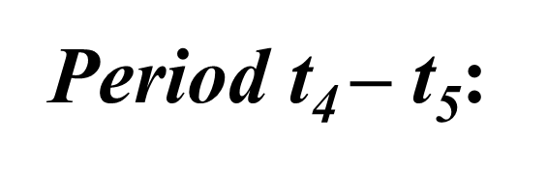
Analysis of the Results
Fig 2-9 Waveforms of ZVS QRC

Slide 17
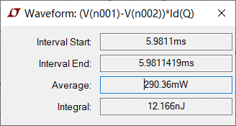
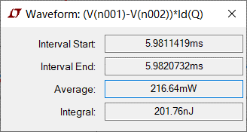
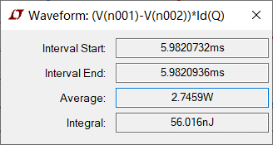
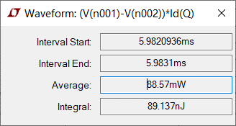
Simulation Result
Fig 2-9 Statistics of the Power Loss

Slide 18
Power Loss of ZVS QRC
Table 2-1 Average Power and Energy Loss of ZVS QRC in Different Period
 | Measurement period | Average power | Energy loss
Turning-off loss | 5.9811-5.9811419ms | 290.36mW | 12.166nJ
Off-state loss | 5.9811419-5.9820732ms | 216.64mW | 201.76nJ
Turning-on loss | 5.9820732-5.9820936ms | 2.7459W | 56.016nJ
On-state loss | 5.9820936-5.9831ms | 88.57mW | 89.137nJ
Total loss | 5.9811-5.9831ms | 179.54mW | 359.079nJ

Slide 19
Comparison of the Power Loss of Hard-Switching Converter and ZVS QRC
Table 2-2 Comparison of Average Power and Energy Loss between Hard-Switching Converter and ZVS QRC
 | Hard-switching converter |  | Soft-switching converter
 | Average power | Energy loss | Average power | Energy loss
Turning-off loss | 16.502W | 305.29nJ | 290.36mW | 12.166nJ
Off-state loss | 13.589mW | 12.244nJ | 216.64mW | 201.76nJ
Turning-on loss | 14.568W | 728.38nJ | 2.7459W | 56.016nJ
On-state loss | 128.38mW | 132.24nJ | 88.57mW | 89.137nJ
Total loss | 589.077mW | 1178.154nJ | 179.54mW | 359.079nJ
perfect period

Slide 20
Your Questions and Comments are welcome

