Slide 1
Power Loss of ZVS QRC
Table 2-1 Average Power and Energy Loss of ZVS QRC in Different Period
 | Measurement period | Average power | Energy loss
Turning-off loss | 5.9811-5.9811419ms | 290.36mW | 12.166nJ
Off-state loss | 5.9811419-5.9820732ms | 216.64mW | 201.76nJ
Turning-on loss | 5.9820732-5.9820936ms | 2.7459W | 56.016nJ
On-state loss | 5.9820936-5.9831ms | 88.57mW | 89.137nJ
Total loss | 5.9811-5.9831ms | 179.54mW | 359.079nJ

Slide 2
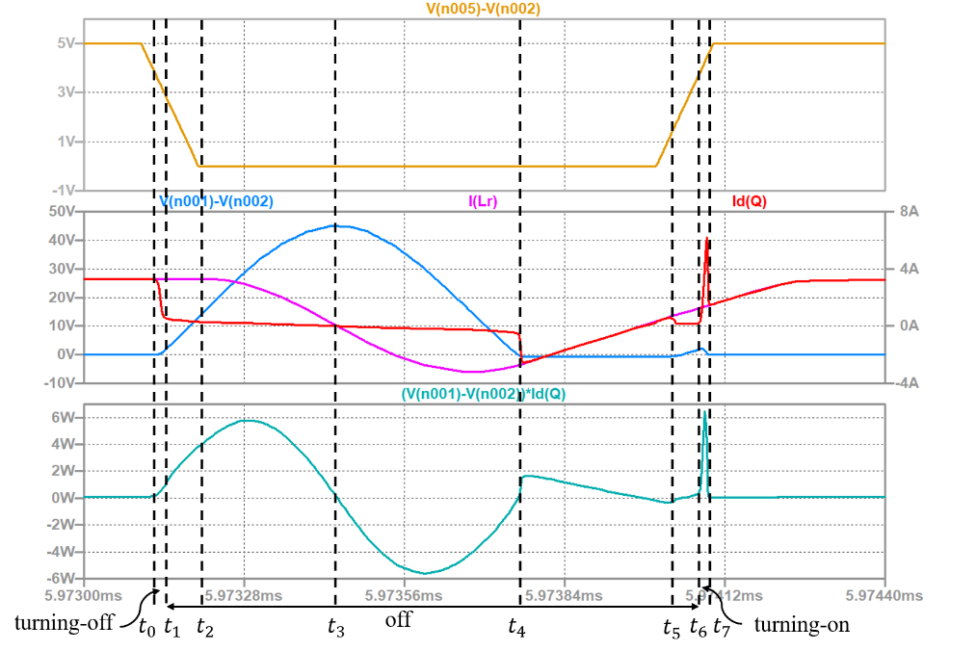
Comparison of the Power Loss of Hard-Switching Converter and ZVS QRC
Table 2-2 Comparison of Average Power and Energy Loss between Hard-Switching Converter and ZVS QRC
 | Hard-switching converter |  | Soft-switching converter
 | Average power | Energy loss | Average power | Energy loss
Turning-off loss | 16.502W | 305.29nJ | 290.36mW | 12.166nJ
Off-state loss | 13.589mW | 12.244nJ | 216.64mW | 201.76nJ
Turning-on loss | 14.568W | 728.38nJ | 2.7459W | 56.016nJ
On-state loss | 128.38mW | 132.24nJ | 88.57mW | 89.137nJ
Total loss | 589.077mW | 1178.154nJ | 179.54mW | 359.079nJ
perfect period

Slide 3
Your Questions and Comments are welcome

