Slide 1
Theoretical Circuit Diagram
Fig 2-1 ZVS QRC Buck Converter

Slide 2
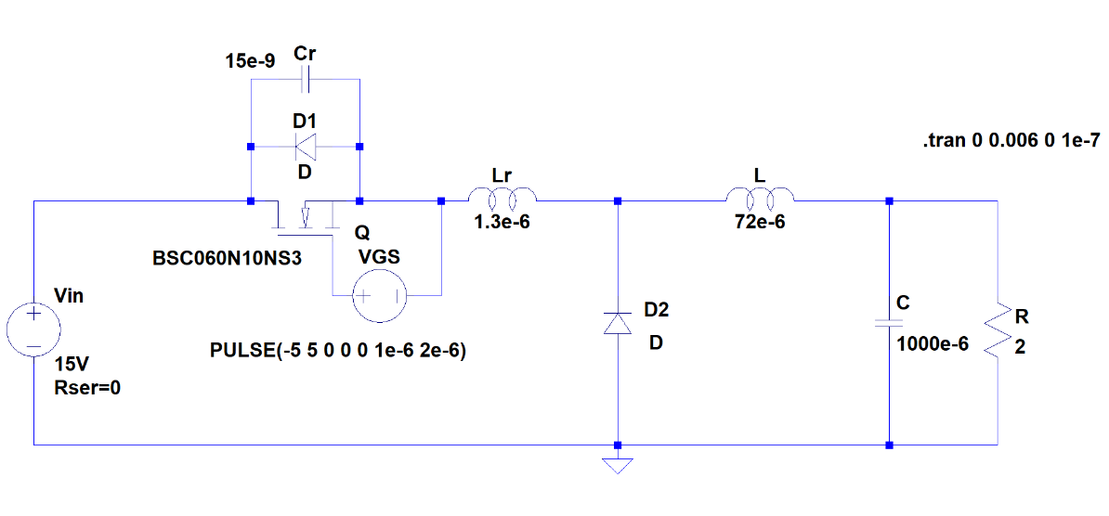
Simulation Circuit Diagram
Fig 2-2 Simulation model

Slide 3
Parameter Setup

Slide 4
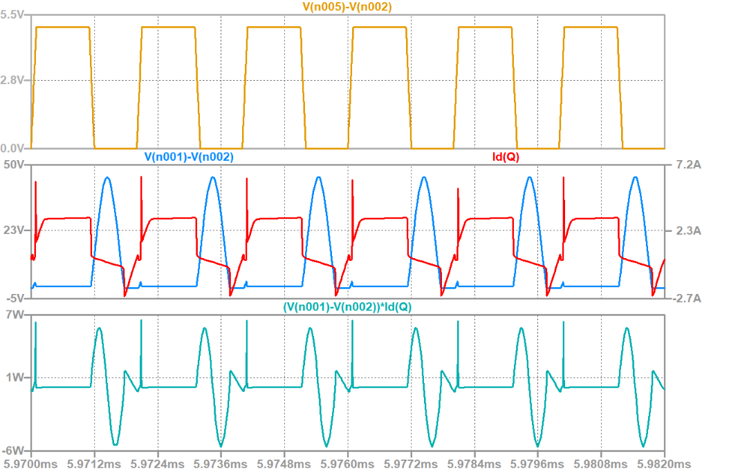
Simulation Result
Fig 2-3 Gate Signal, VDS, Id Waveform, and Power Loss of the MOSFET

Slide 5
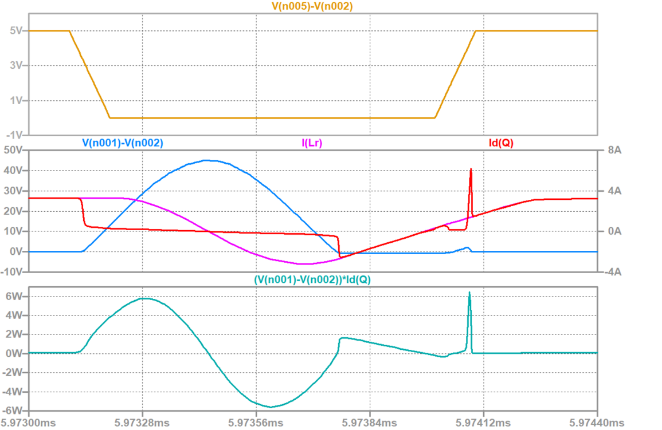
Simulation Result
Fig 2-4 Gate Signal, VDS, Id Waveform, and Power Loss of the MOSFET (enlarged map)

Slide 6
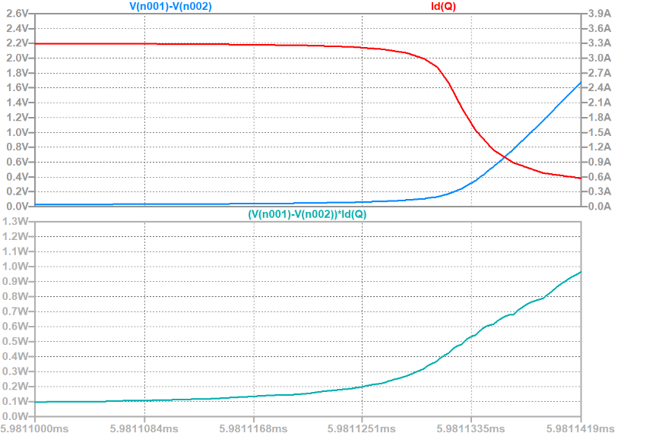
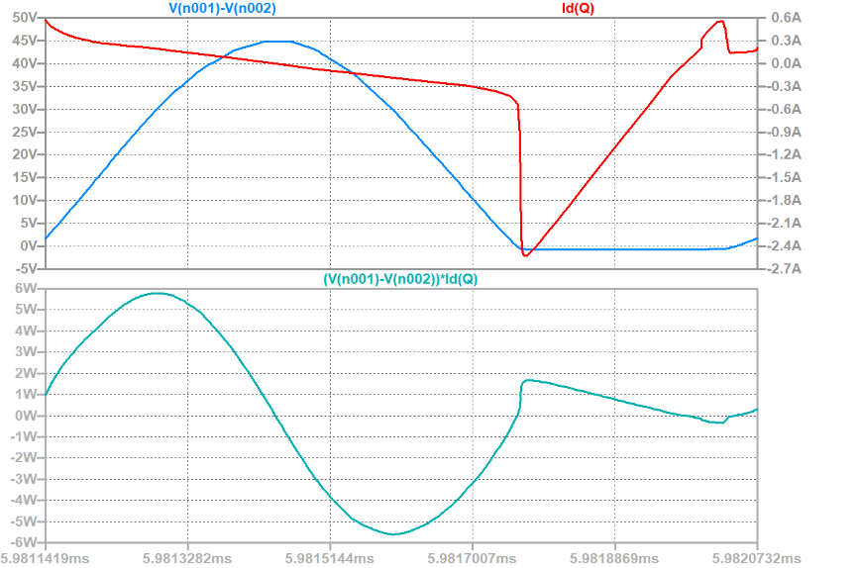
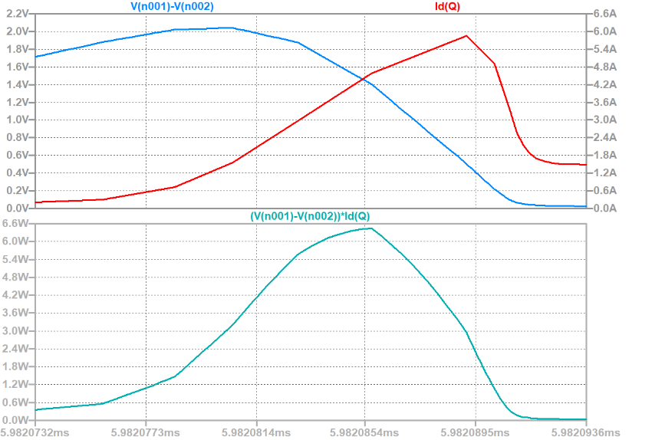
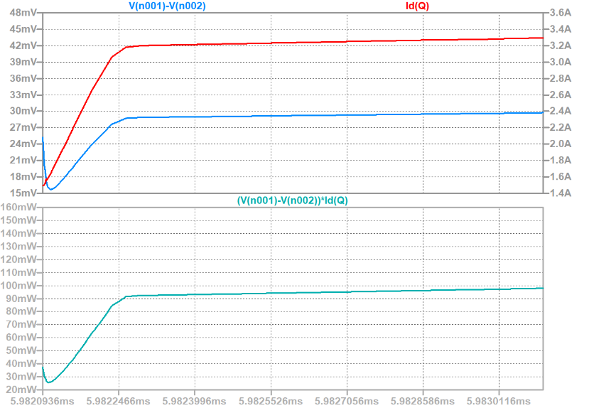
Simulation Result
Fig 2-5 Voltage, Current, Power Waveform and Statistics of the Power Loss
(when MOSFET is in turning-off process)
Fig 2-6 Voltage, Current, Power Waveform and Statistics of the Power Loss
(when MOSFET is off)
Fig 2-7 Voltage, Current, Power Waveform and Statistics of the Power Loss
(when MOSFET is in turning-on process)
Fig 2-8 Voltage, Current, Power Waveform and Statistics of the Power Loss
(when MOSFET is on)

Slide 7
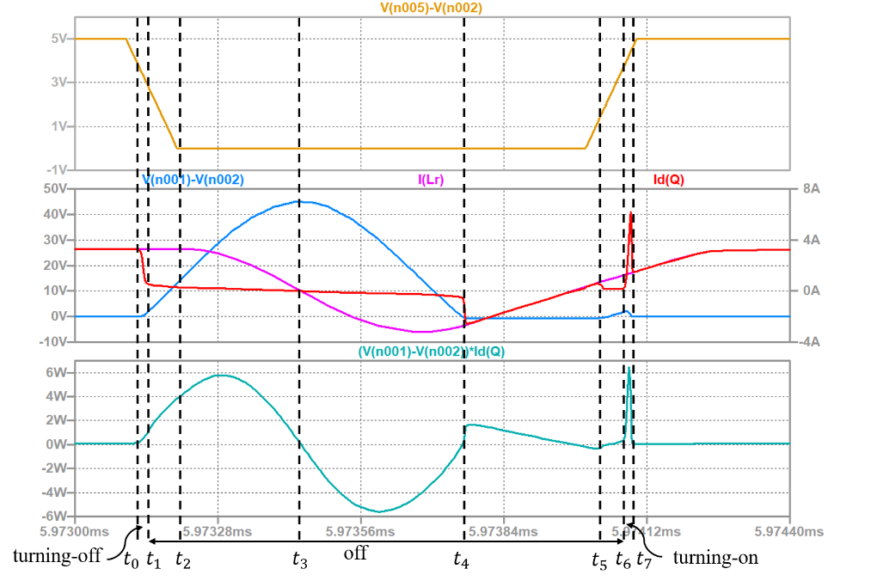
Analysis of the Results
Fig 2-9 Waveforms of ZVS QRC

Slide 8
Analysis of the Results
Period t₁ – t₂:

Slide 9
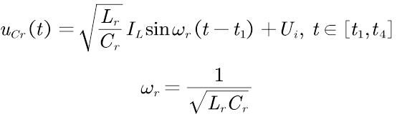

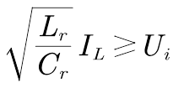
Analysis of the Results
Period t₂– t₄:

Slide 10
Analysis of the Results
Period t₄ – t₅:

Slide 11
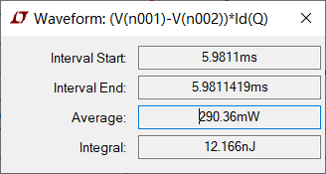
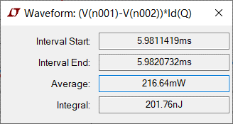
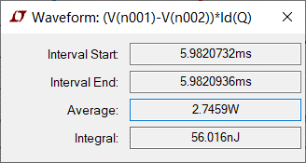
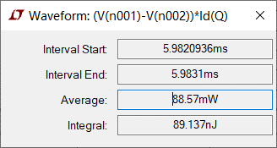
Simulation Result
Fig 2-9 Statistics of the Power Loss

