Slide 1
Power Electronics
Seminar #8
Reporter
NIE YONGXIN
：
DING YIBO
HUI HENG
：
：

Slide 2
Division of Work
NIE YONGXIN:
Carry out the simulation.
The PPT of part 1.
DING YIBO:
Carry out the simulation.
The PPT of part 2.
HUI HENG:
The analysis of the simulation model.
The PPT of part 3.

Slide 3
Signment of Seminar
Electric Motor Drive System, AC-DC-AC VFD (Variable Frequency Drive). Three-phase AC voltage source (phase voltage 220V) as input, control Squirrel-Cage Asynchronous Motor rotating speed to realize the operation of in 4 quadrants.
Machine operates in motor mode with positive and negative speed (i.e. clockwise and counter-clockwise rotation) of 900r/min
Machine operates in generator mode with positive and negative speed of 1500r/min

Slide 4
Parameters

Slide 5
Speed regulation of asynchronous motor

Slide 6
Part 1
double-sided PWM converters

Slide 7
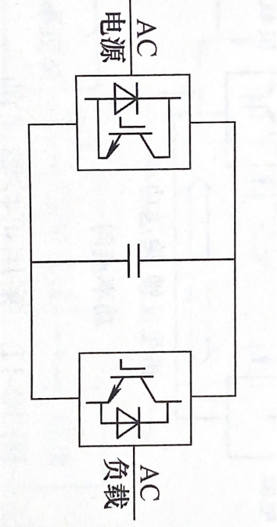
Circuit Diagram
Fig 1-1 Theoretical Circuit Diagram
Fig 1-2 Simulation Circuit Diagram

Slide 8
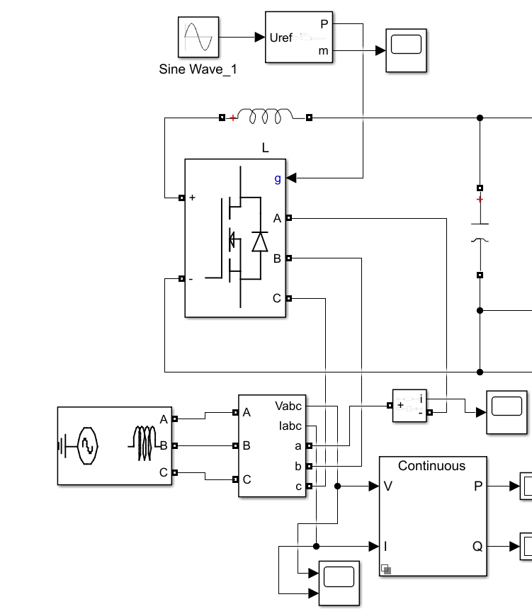
Rectification Part of the Circuit
Fig 1-3 Rectification Part of the Circuit

Slide 9
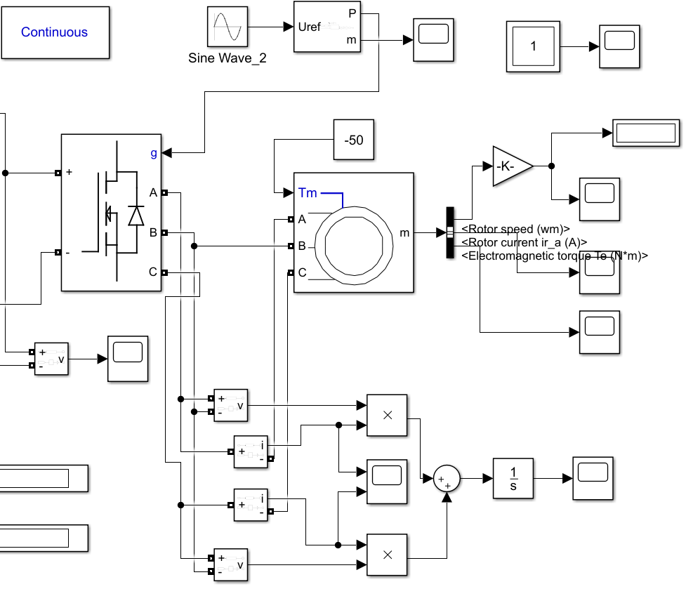
Inversion Part of the Circuit
Fig 1-4 Inversion Part of the Circuit

Slide 10
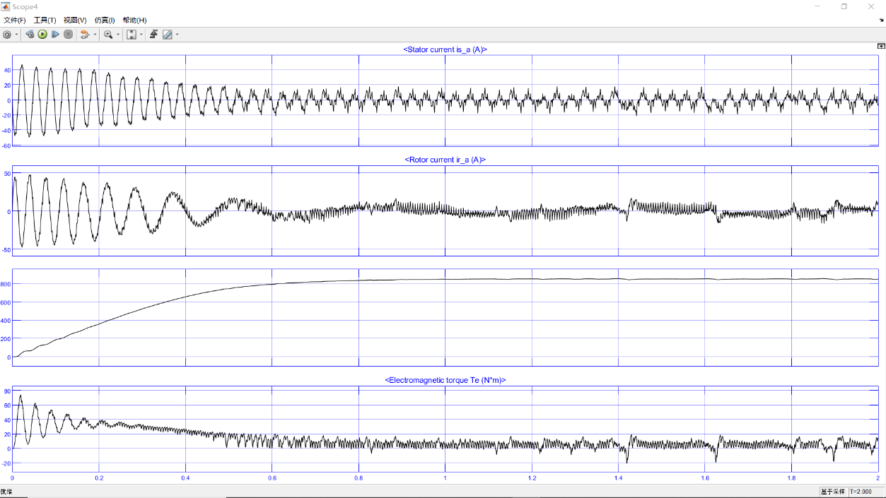
Inversion Part of the Circuit
Fig 1-5 the motor parameter waveform

Slide 11
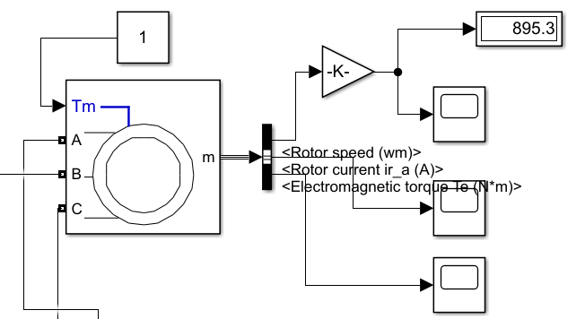
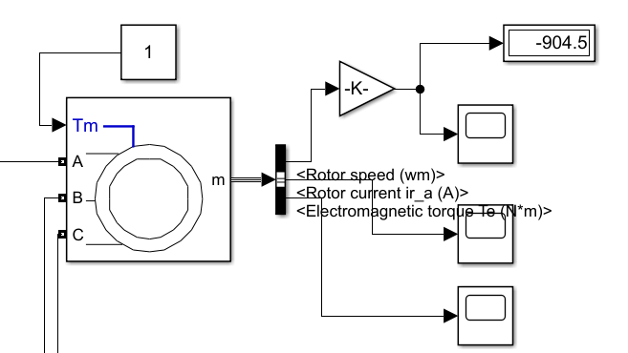
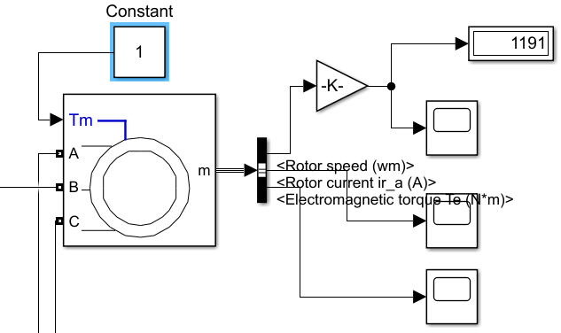
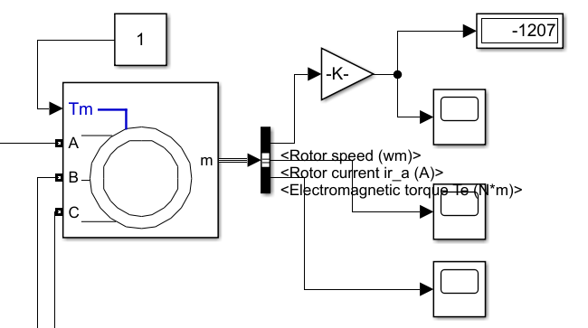
Simulation Result
Fig. 1-5 Motor Mode (clockwise)
Fig. 1-6 Motor Mode (counter-clockwise)
Fig. 1-7 Generator Mode (clockwise)
Fig. 1-8 Generator Mode (counter-clockwise)

Slide 12
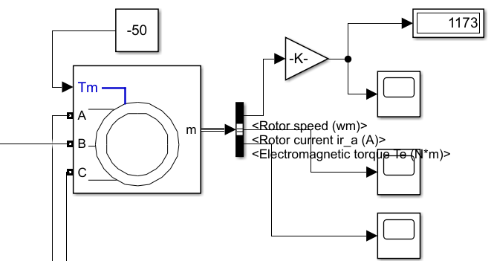
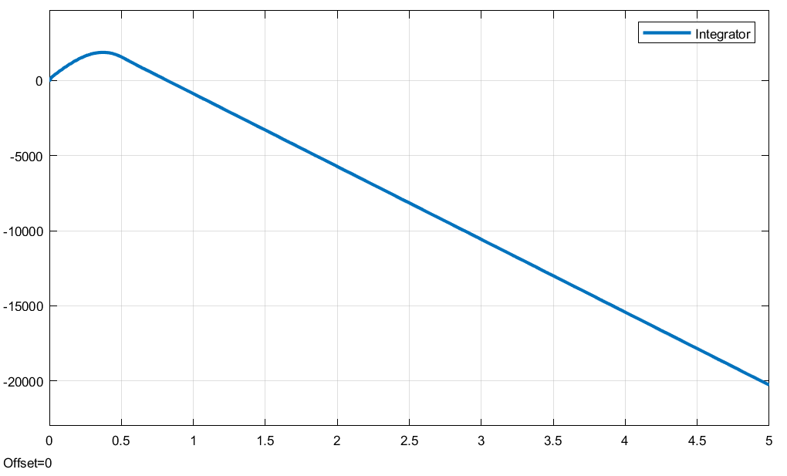
Verification of simulation results
Fig. 1-9 Generator Mode (Torque = -50N∙m, AC frequency=35Hz)
Fig. 1-10 Total output energy of three phase power supply

Slide 13
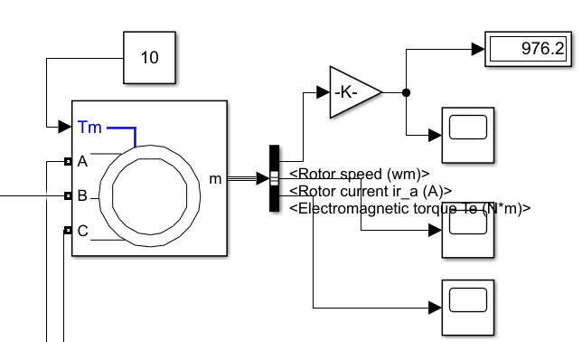
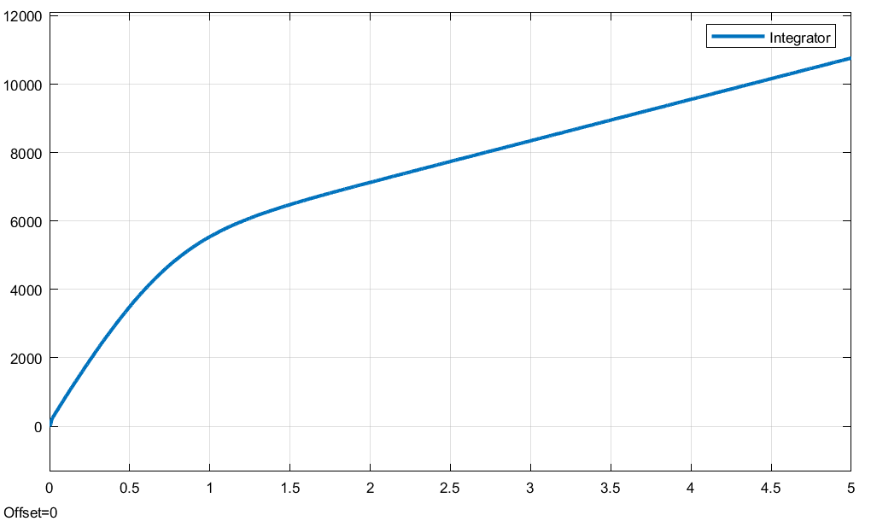
Verification of simulation results
Fig. 1-11 Motor Mode (Torque = 10N∙m, AC frequency=35Hz)
Fig. 1-12 Total output energy of three phase power supply

Slide 14
Inversion Part of the Circuit
Table 1-2 Working characteristics of motor

Slide 15
Part 2
inversion-mode thyristor rectifier circuit

Slide 16
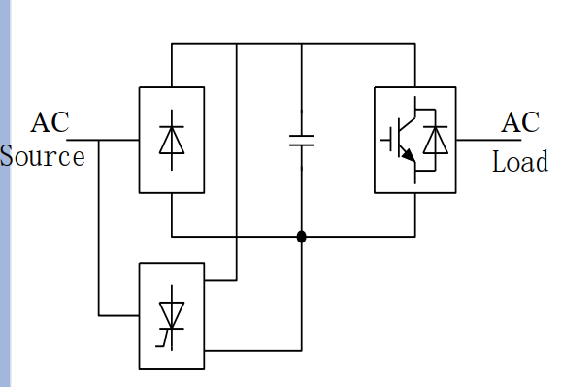
Circuit Diagram
Fig. 2-1 Theoretical Circuit Diagram
Fig. 2-2 Simulation Circuit Diagram

Slide 17
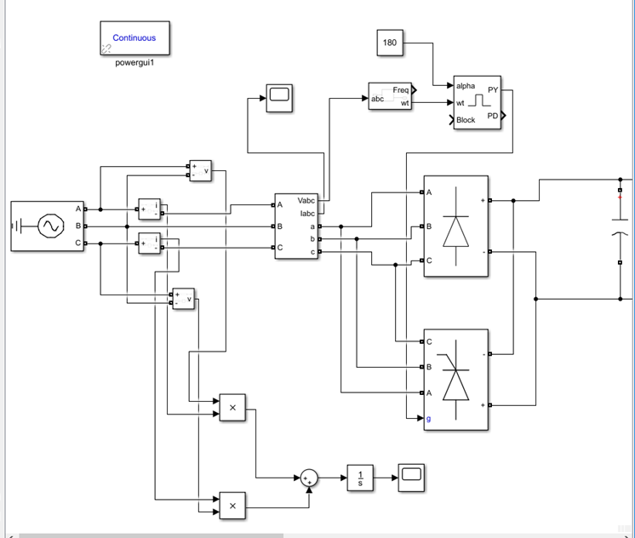
Rectification Part of the Circuit
Fig. 2-3 Rectification Part of the Circuit

Slide 18
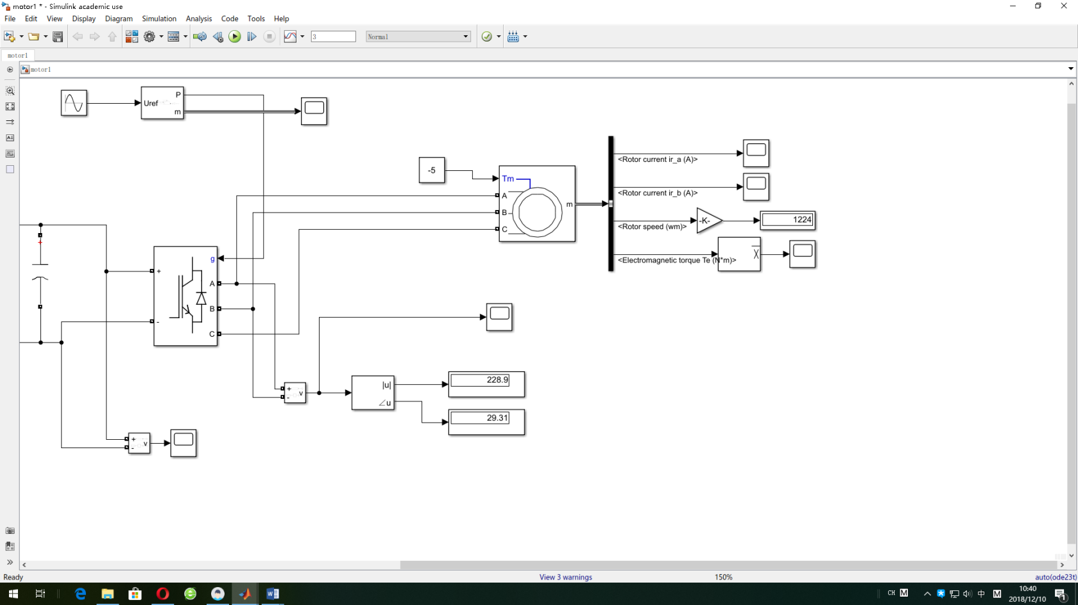
Inversion Part of the Circuit
Fig. 2-4 Inversion Part of the Circuit

Slide 19
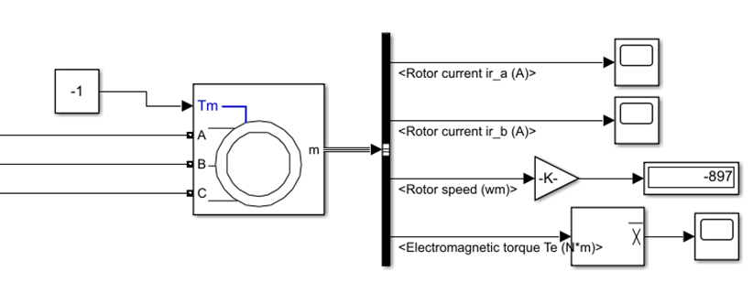
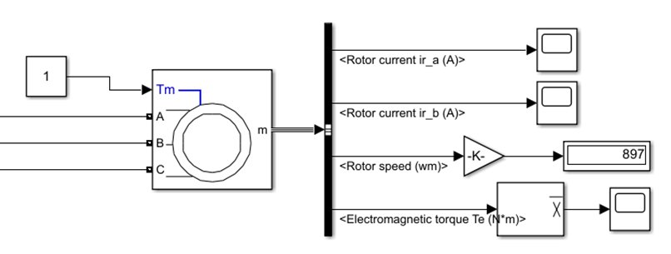
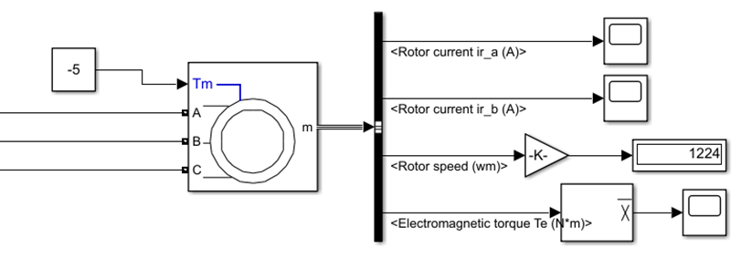
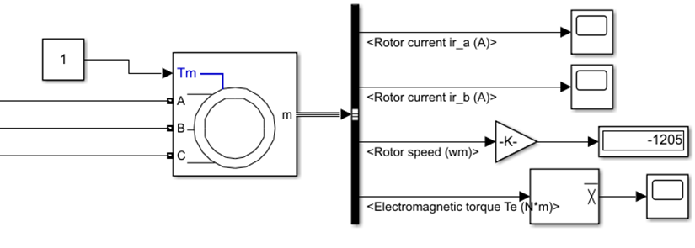
Simulation Result
Fig. 2-5 Motor Mode (clockwise)
Fig. 2-6 Motor Mode (counter-clockwise)
Fig. 2-7 Generator Mode (clockwise)
Fig. 2-8 Generator Mode (counter-clockwise)

Slide 20
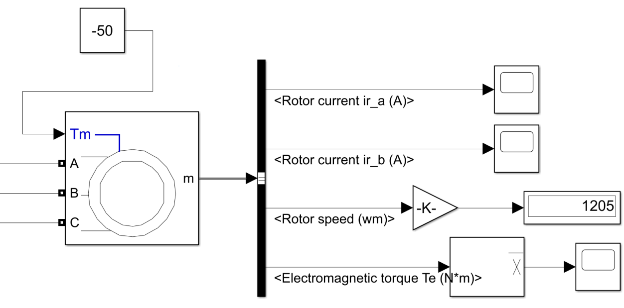
Verification of simulation results
Fig. 2-9 Generator Mode (Torque = -50N∙m, AC frequency=35Hz)

Slide 21
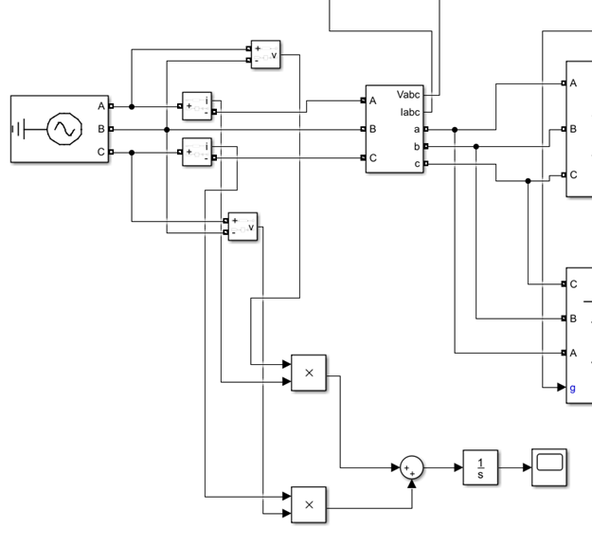
Verification of simulation results
Fig. 2-10 Output power & energy measurement circuit

Slide 22
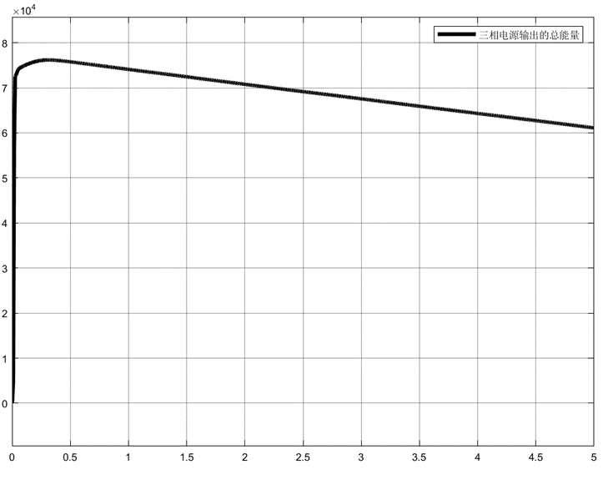
Simulation Result
Fig 1-11 Total output energy of three phase power supply

Slide 23
Part 3

Slide 24
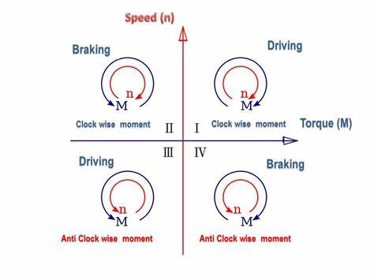
Improvement of the scheme
Fig 3.1 Four quadrant operation of motor

Slide 25
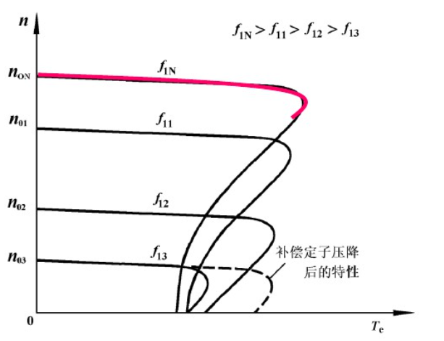
Improvement of the scheme
With the increase of the load, the slip becomes larger.The actual speed is much smaller than the synchronous speed.

Slide 26
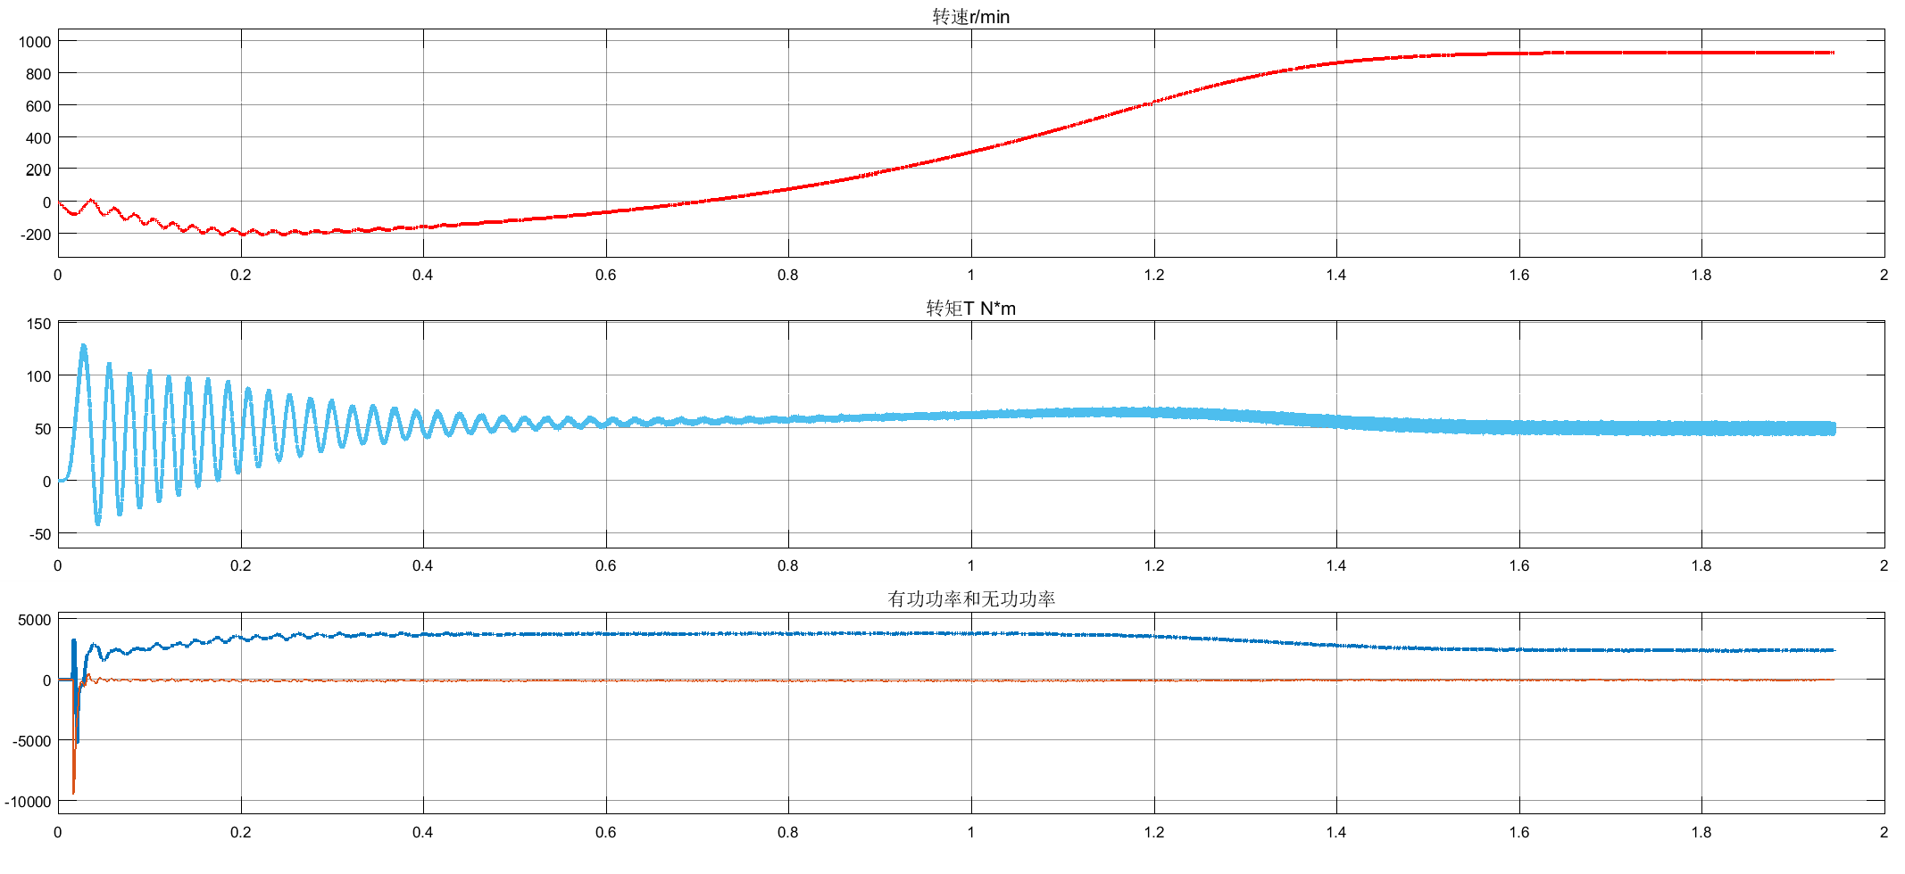
Improvement of the scheme
Given speed is 1200r / min, load torque is 50N•m
Fig 3.2 Actual speed without a closed loop speed control system

Slide 27
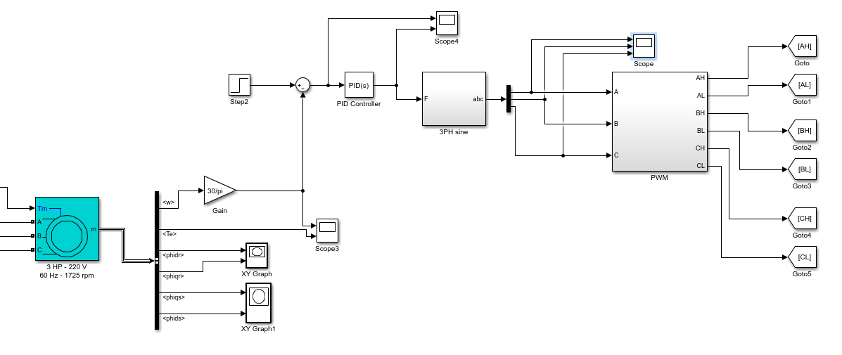
Improvement of the scheme
Fig 3.2 Model of closed loop speed control system

Slide 28
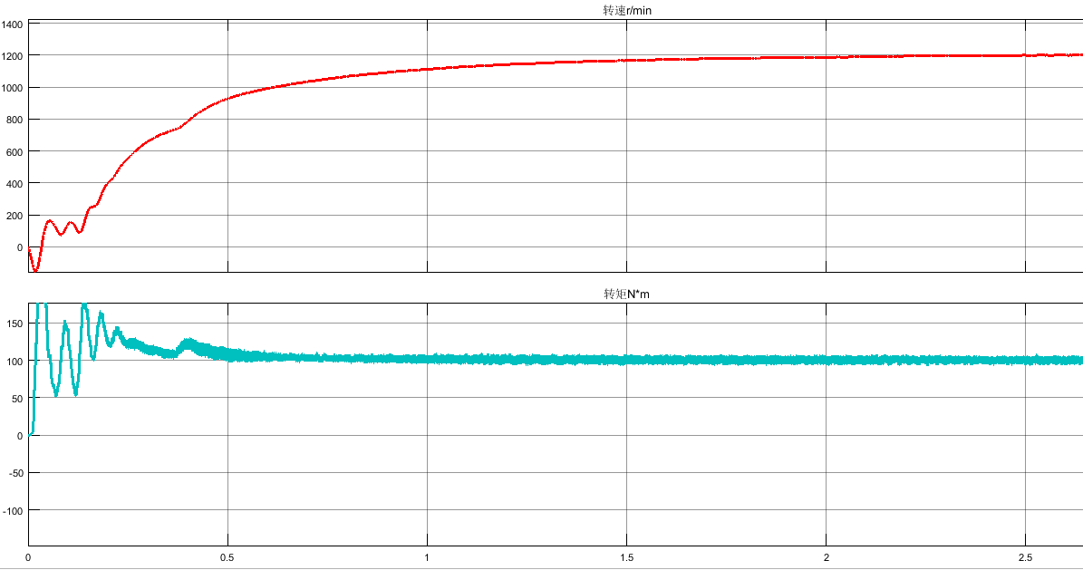
Improvement of the scheme
Fig 3.3 Actual speed with a closed loop speed control system

Slide 29
Your Questions and Comments are welcomed

