Slide 1
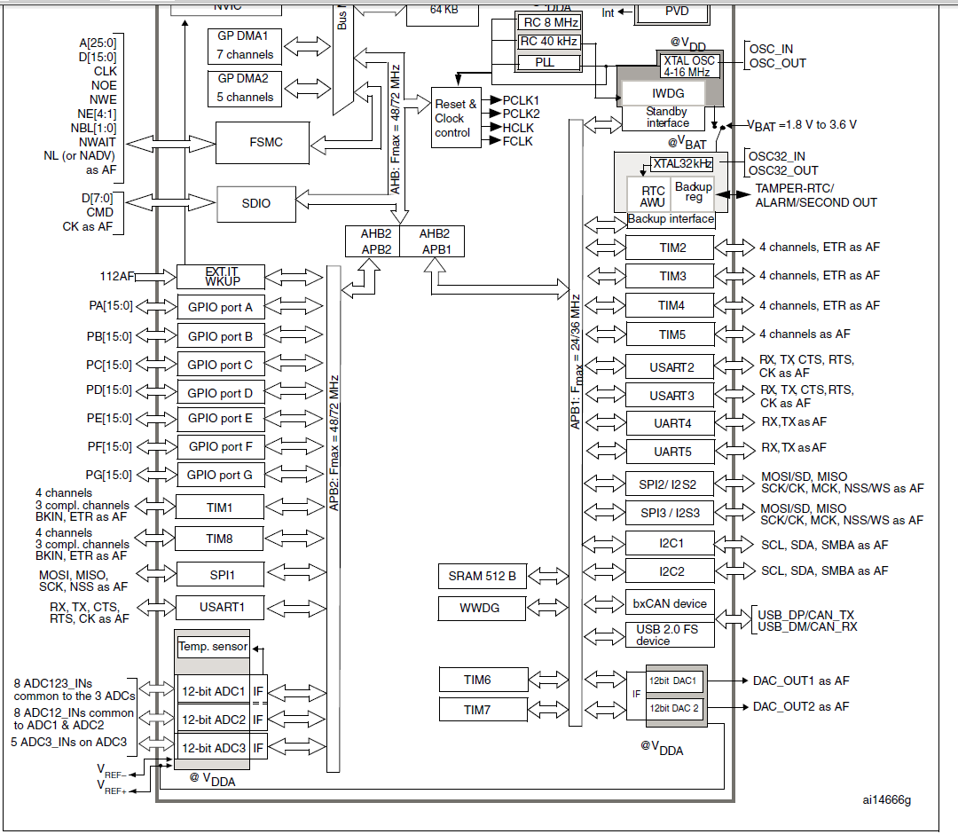
第9章 ADC_DMA
STM32F103 MCU
The 12-bit ADC is a successive approximation analog-to-digital converter.
It has up to 18
multiplexed channels allowing it measure signals from 16 external and two internal sources.
A/D conversion of the various channels can be performed in single, continuous, scan or
discontinuous mode.
The result of the ADC is stored in a left-aligned or right-aligned 16-bit data register.

Slide 2
ADC main features
• 12-bit resolution
• Interrupt generation at End of Conversion, End of Injected conversion and Analog
watchdog event
• Single and continuous conversion modes
• Scan mode for automatic conversion of channel 0 to channel ‘n’
• Self-calibration
• Data alignment with in-built data coherency
• Channel by channel programmable sampling time
• External trigger option for both regular and injected conversion
• Discontinuous mode
• Dual mode (on devices with 2 ADCs or more)
• ADC conversion time:
– STM32F103xx performance line devices: 1 μs at 56 MHz (1.17 μs at 72 MHz)

Slide 3
Single ADC block diagram

Slide 4
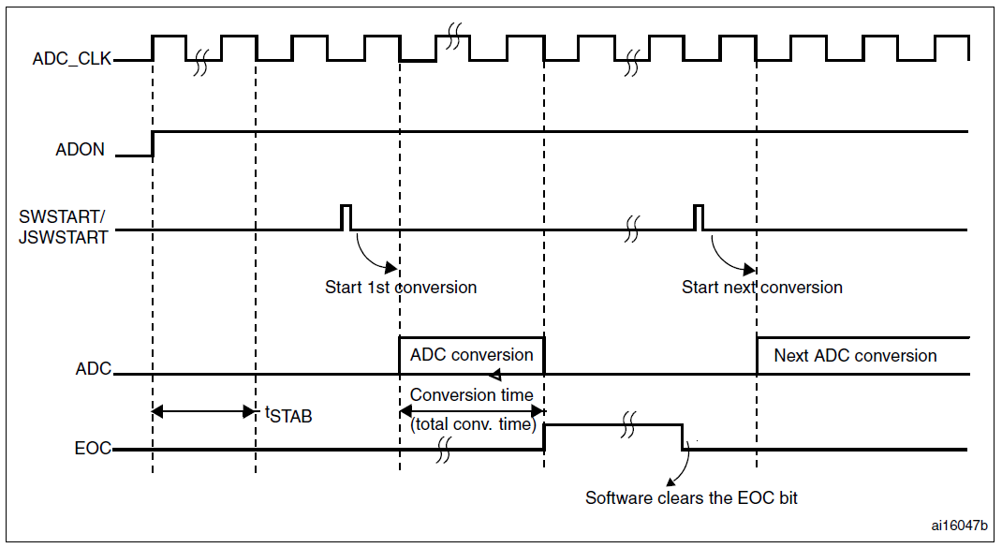
ADC Timing diagram
Timing diagram

Slide 5
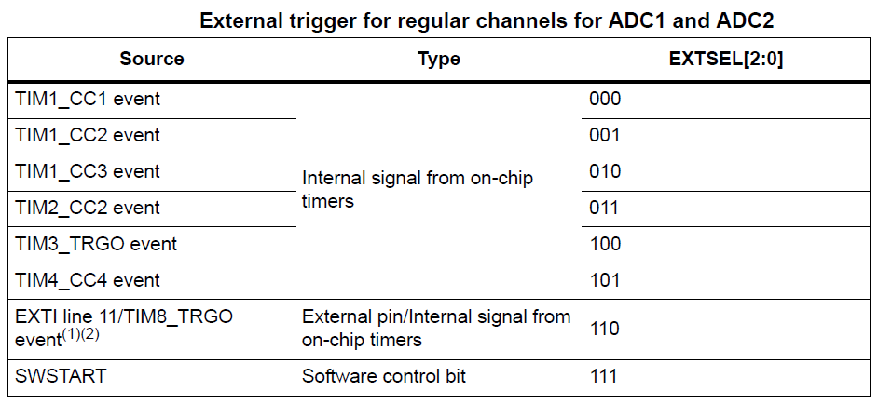
ADC STRAT---启动、触发源（部分）

Slide 6
多个ADC通道，依次启动转换
Scan mode
This mode is used to scan a group of analog channels.
Scan mode can be selected by setting the SCAN bit in the ADC_CR1 register.
Once this bit is set, ADC scans all the channels selected in the ADC_SQRx registers (for regular channels) or in the ADC_JSQR (for injected channels).
A single conversion is performed for each channel of the group. After each end of conversion the next channel of the group is converted automatically. If the CONT bit is set, conversion does not stop at the last selected group channel but continues again from the first selected group channel.
When using scan mode, DMA bit must be set and the direct memory access controller is
used to transfer the converted data of regular group channels to SRAM after each update of
the ADC_DR register.

Slide 7
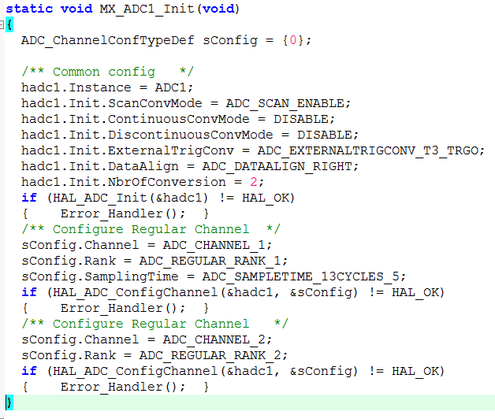
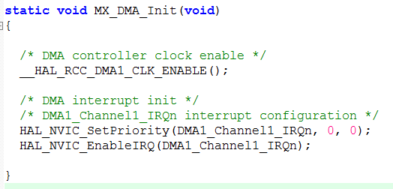

Slide 8
ADC 寄存器

Slide 9
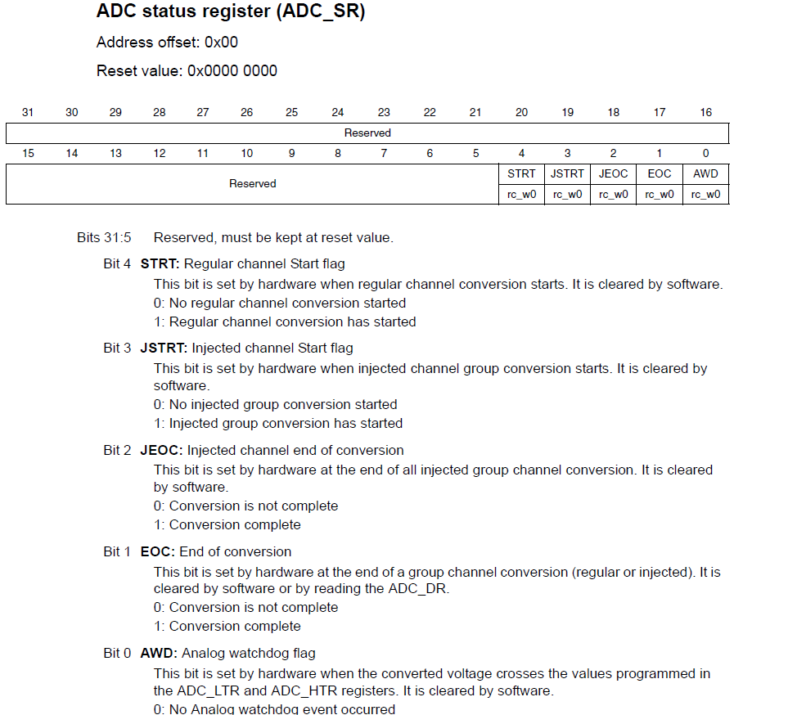
ADC 状态寄存器

Slide 10
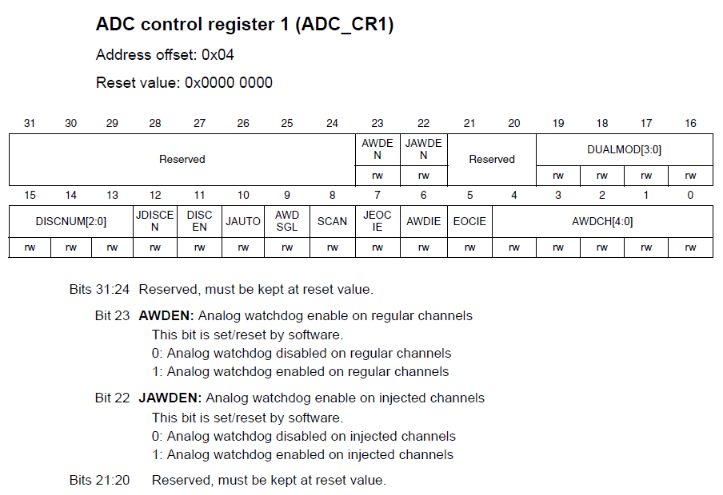
ADC 控制寄存器

Slide 11
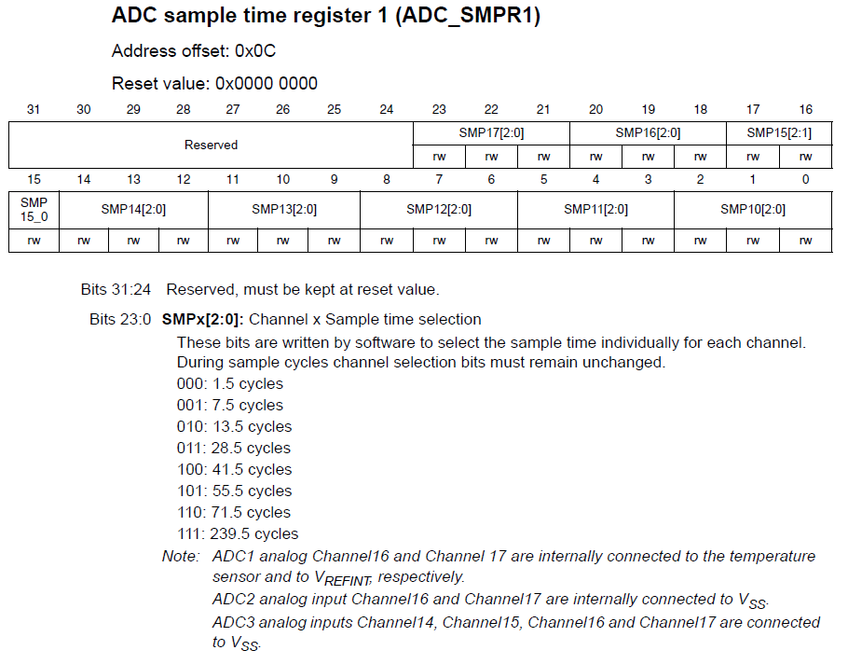
ADC 控制采样时间寄存器

Slide 12
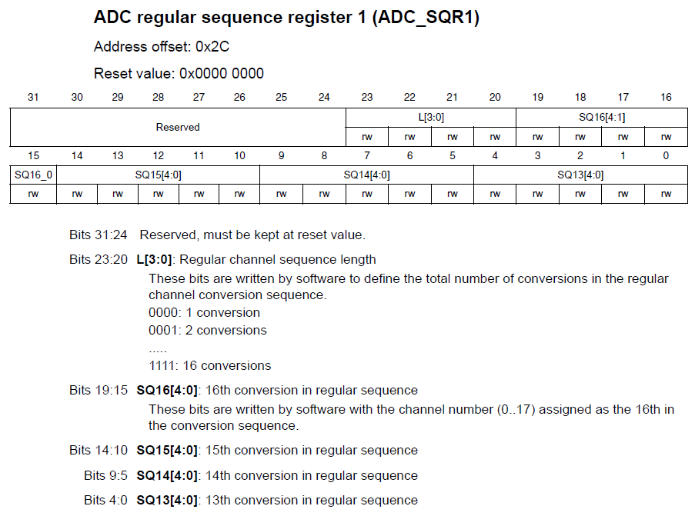
ADC 通道序列寄存器

Slide 13
DMA introduction
Direct memory access (DMA) is used in order to provide high-speed data transfer between
peripherals and memory as well as memory to memory. Data can be quickly moved by DMA
without any CPU actions. This keeps CPU resources free for other operations..

Slide 14


Slide 15
DMA 寄存器

Slide 16
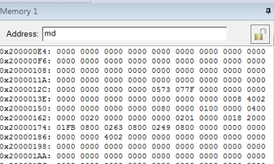
ADC PA1(CH1) PA2(CH2) 采样结果

