Slide 1
Group 6 EE610
M10607501 陳俊瑋
M10607502 黃莉雯

Slide 2
Outline
Problem
Environment
Methods
Result
Analysis
Conclusion
Work

Slide 3
Problem

Slide 4
Problem
Air Quality：samples
Stations：locations
Grid：features
features
train
prediction
answer

Slide 5
Environment

Slide 6
environment
Platform：Computer of Lab
Main program： Tensorflow with Python
Data：CSV with Pandas
Tensorflow
Pandas

Slide 7
methods

Slide 8
Methods - training
Adjust the data
whole data in 2017
April and May in 2018
whole data in 2017
April and May
in 2018

Slide 9
Methods - training
Sample in AQs
Station ID in samples
Location of stations
GRID at locations
Features in GRIDs

Slide 10
methods - samples
Answer：PM2.5, PM10, O3, NO2, CO, SO2
Missing data：discard
Mean & Standard Deviation：1000 samples at random
Choose：the values less than one standard deviation away from the mean account
Station ID：get location of stations
Sample in AQs
Station ID in samples
Location of stations
GRID at locations
Features in GRIDs

Slide 11

Methods - locations
Standardization：$\overset{⃑}{L}\left(\overset{⃑}{l}\right)=round\left(\overset{⃑}{l}, 1\right)$
City（Beijing & London）：longitude、latitude
Sample in AQs
Station ID in samples
Location of stations
GRID at locations
Features in GRIDs

Slide 12

Methods - GRIDs
Grid name number：$g=10×\left(21\overset{⃑}{Δ_{lng}}+\overset{⃑}{Δ_{lat}}\right)$
Relative locations to the center of its city：$\overset{⃑}{Δ}=\overset{⃑}{L}−\overset{⃑}{C}$
Center of cities：$\overset{⃑}{C_{beijing}}=\left(115, 39\right)$，$\overset{⃑}{C_{london}}=\left(−2, 50.5\right)$
Sample in AQs
Station ID in samples
Location of stations
GRID at locations
Features in GRIDs

Slide 13
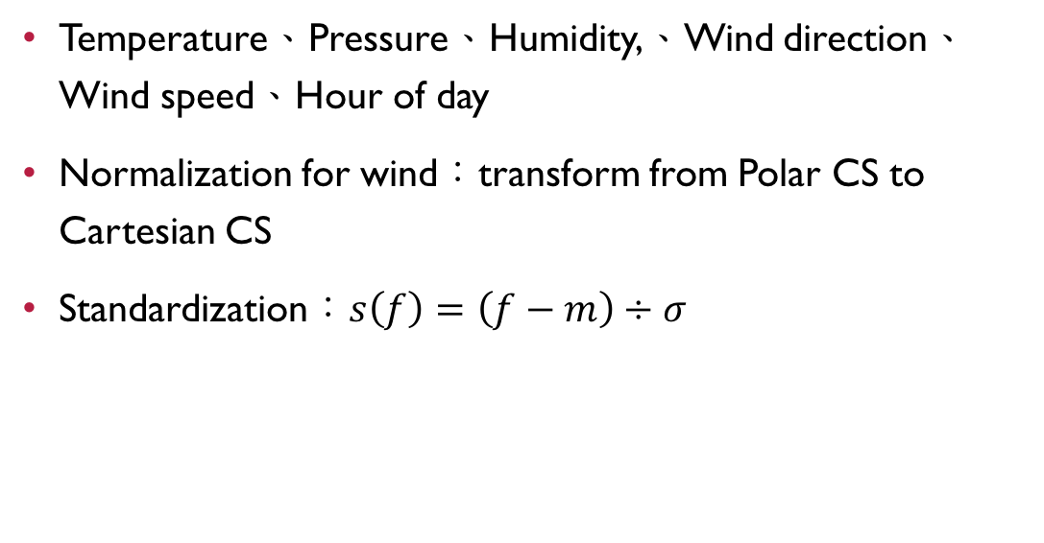
Methods - features
Temperature、Pressure、Humidity,、Wind direction、Wind speed、Hour of day
Normalization for wind：transform from Polar CS to Cartesian CS
Standardization：$s\left(f\right)=\left(f−m\right)÷σ$
Sample in AQs
Station ID in samples
Location of stations
GRID at locations
Features in GRIDs

Slide 14

Methods - model
Neural Network with Tensorflow
Inputs$\left[6\right]$ → Hidden Layers$\left[1024\right]\left[4096\right]\left[1024\right]$ → Outputs$\left[6\right]$
i1
o1
i2
h2
o2
h1
h3
i3
o3
i4
o4
i5
o5
i6
o6

Slide 15
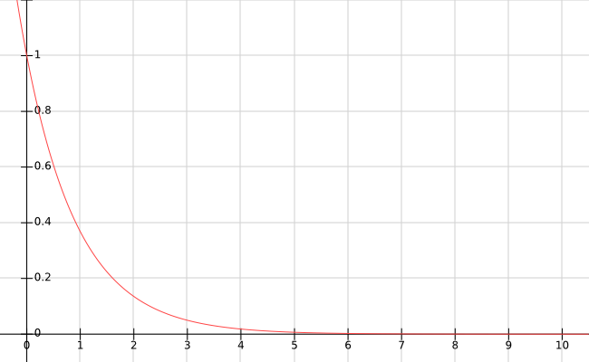

Methods - accuracy
Accuracy：$a_{i}=e^{−\left|p−b\right|÷σ^{′}}$
Overall accuracy：$\overline{a}=\frac{1}{n}\sum_{i}{a_{i}}$
Accuracy
error

Slide 16
result

Slide 17
Result - Phase I
submit：2018 - 4/30
Entries：1
Ranking：229/356
Score：1.96
Best Score：0.93

Slide 18
Result - Phase II
submit：2018 - 5/1 ~ 5/31
Entries：60
Ranking：139/662
Score：0.63
Best Score：0.47

Slide 19
Result - for the last 10 days
submit：2018 - 5/22 ~ 5/31
Entries：30
Ranking：109/662
Score：0.58
Best Score：0.47

Slide 20
Result - the second-day prediction
submit：2018 - 5/1 ~ 5/31
Entries：60
Ranking：88/662
Score：0.65
Best Score：0.44

Slide 21
analysis

Slide 22
analysis
Samples
Feature
temperature | pressure | humidity | wind direction | wind speed
24 | 971.9402 | 20 | 301.94 | 9.6
24 | 958.7562 | 21 | 302.97 | 10.21
17 | 945.5722 | 22 | 303.87 | 10.82
17 | 930.5258 | 23 | 304.37 | 11.27
17 | 913.617 | 25 | 304.54 | 11.55
17 | 896.7082 | 27 | 304.69 | 11.84
17 | 878.7114 | 28 | 304.03 | 11.78
18 | 860.7146 | 30 | 303.37 | 11.72
16.1 | 853.5882 | 30 | 295.44 | 11.69
16.1 | 857.3322 | 30 | 280.86 | 12.29

Slide 23
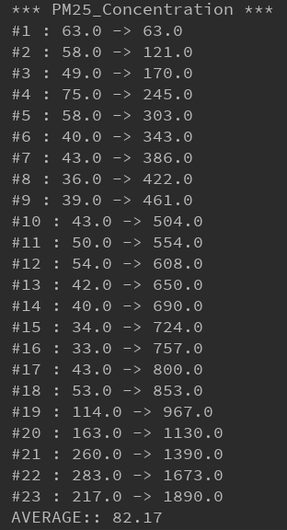
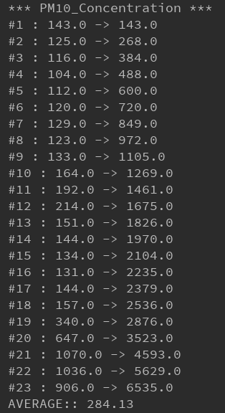
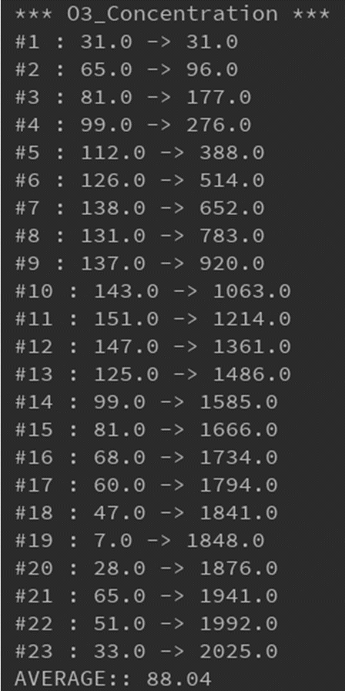
analysis

Slide 24
analysis
Temperature

Slide 25
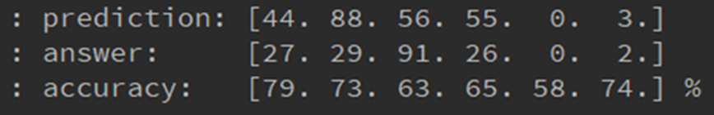

analysis
Output
Feature
Accuracy
error

Slide 26
conclusion

Slide 27
conclusion
Data selection
Feature analysis
External factor

Slide 28
work

Slide 29
work
陳俊瑋：Training Model、Data Analysis
黃莉雯：Data Processing、Problem Analysis

Slide 30
Q & A

