Slide 1
DEEPFAKE IMAGE DETECTION
Detecting DeepFakes, Protecting Truth.

Slide 2
Team Members
2110030020 - Ch. Sri Chandana
2110030085 - N. Manas
2110030359 - B. Chihnita Reddy
2110030028 - P. Praneeth

Slide 3
Table of contents
01
02
03
Clarity of Project title
Project Feasibility Analysis
Societal needs
04
05
06
Novelty of project title
Tools/Technology
Timeline

Slide 4
Clarity of Project title
What are DeepFakes?
DeepFakes are AI-generated fake images.
DeepFakes involve creating fake images or videos that appear genuine but are manipulated. People use them to deceive others or spread false information on social media.
These deceptive media can take the form of realistic-looking pictures or videos, making it challenging for viewers to distinguish between what is real and what is not.
DeepFakes can quickly spread on social media and change people's opinions on a large scale. Detecting them is a serious challenge because new technology makes it easy to create convincing fake images using just a starting picture and some planned changes.

Slide 5
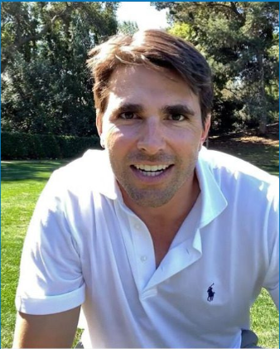
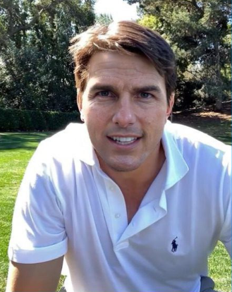
Example of DeepFakes
Original
Deepfake
The image which is captured originally.
The image which is fake and manipulated by AI.

Slide 6
Project Feasibility Analysis
The objective of this project is to identify Deepfake images(The images that are manipulated and generated by AI).
Modern image editing software has advanced to the point where it is now possible to make subtle changes to images that are difficult for the human eye to notice.
Even with advanced computer software, it's hard to detect if an image is real or fake unless we find something that's the same in most fake images.
The objective is to identify manipulated deepfake images created by altering original pictures, as these may contribute to illegal and deceptive activities that negatively impact individuals.
Deepfake detection projects play a crucial role in maintaining the integrity and trustworthiness of digital media in various contexts, including social media, journalism, and online platforms.

Slide 7
Societal needs
1
2
Preventing Misinformation
Preserving
Reputation
3
4
Media Trustworthiness
Authentication and verification

Slide 8
Timeline
Review-1
Review-3
Data Collection and integration
Testing and deployment
Gathering relevant dataset
and integrating it
Testing the model and
deploying it
Overview
Training
Discussion on the selected project
Cleaning data and training
Review-2
Review-4

Slide 9






Tools/Technology

Slide 10
Novelty of project title
Advanced Neural Network Architectures
Creative Data Augmentation Strategies
Continuous Learning and Adaptation
Real-time Detection Capabilities
Evaluation Metrics for better performance

Slide 11
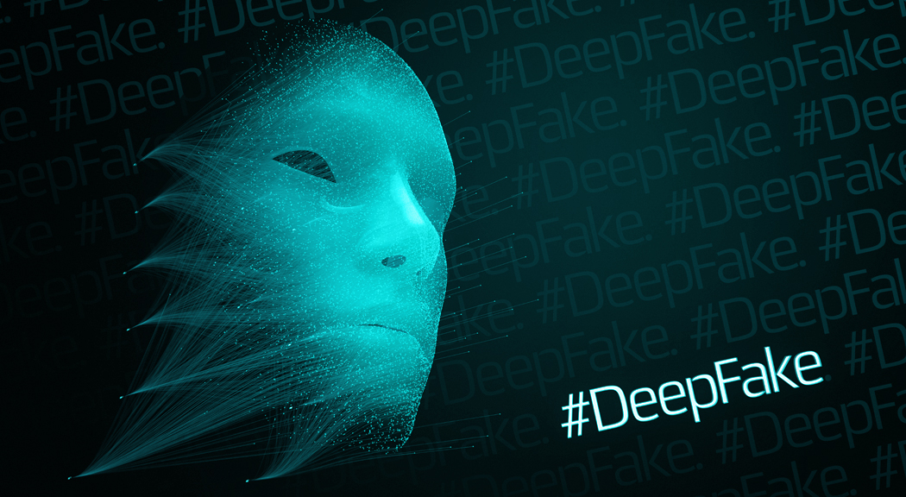
Queries?

