Slide 1
Technical skilling Image to Text
By
Under the guidance of
Madhu Priya Mam
Roll Number | Name
2110030359 | B Chihnita Reddy
2110030320 | SIRISILLA NIKHITHA
2110030284 | Shivani Konduri
2110030283 | N Rajashri

Slide 2
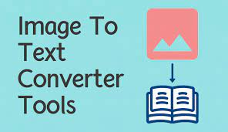
Problem Statement
Our goal is to convert a given text image into a string of text.
Converting scanned typed, handwritten, or printed text into machine-encoded text. It is widely used as a form of data entry from printed paper data records, whether passport documents, invoices, bank statements, bills, receipts, etc. Computer software is used to convert scanned text back into editable text.

Slide 3
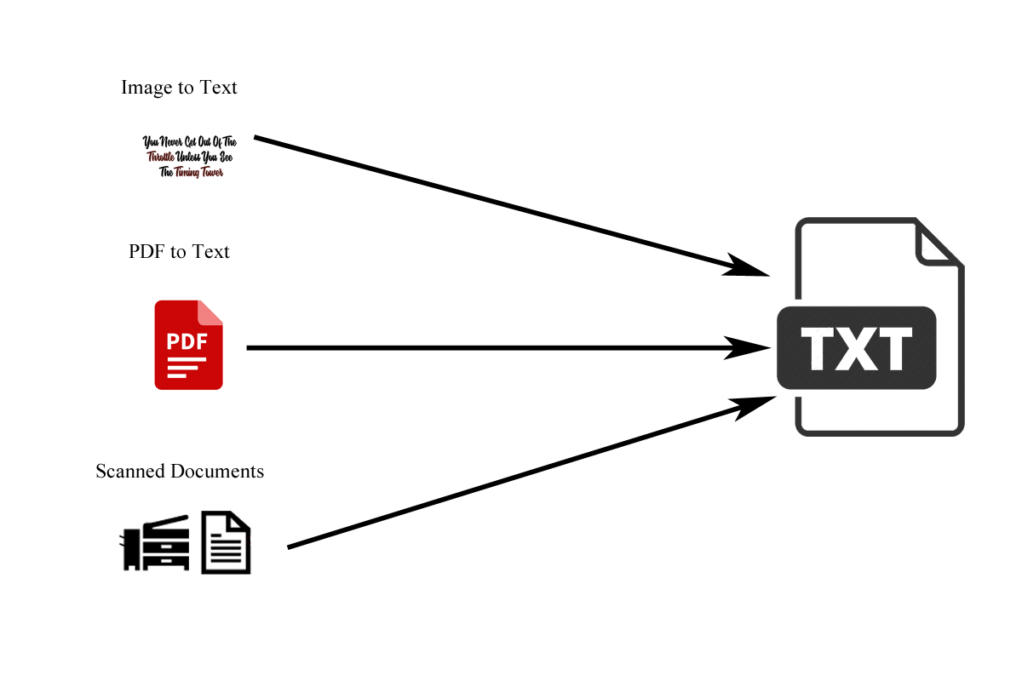

Slide 4
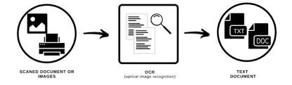
Existing solutions/ Naive solutions
Create a web application to generate text from an image.
OCR (optical character recognition or optical character reader) is the electronic or mechanical conversation of images of typed, handwritten, or printed text into machine-encoded text, whether from a scanned document, a photo of a document, or a photo of a document.
We are not saying it is having a fault or drawback it saying some are having in this way

Slide 5
Problems in the present system
OCR text works efficiently with the printed text only and not with handwritten text. Handwriting must be learned by the pc.
OCR systems are expensive.
There is the need of a lot of space required by the image produced.
The quality of the image can be lost during this process.
Quality of the ultimate image depends on the quality of the first image.
All the documents got to be checked over carefully and then manually corrected. Not 100% accurate, there are likely to be some mistakes made during the method.
When users take a picture of their ID document with their smartphone or webcam, multiple steps are required to extract and structure the information.

Slide 6
Proposed Algorithm Design Technique
The technique is the development of web applications.
Using the proposed design method is easily accessible without any flaws.
You can use infinite times it gives the accurate content given in the image.
In python: the image to string function of by python-tesseract library is used to convert images into text. The function takes the path of the image as an argument and returns the text in the image which can be saved in a variable or can be saved as a text file. print

Slide 7

Project Requirements
SOFTWARE REQUIREMENTS
FRONT END: PYTHON ,HTML, CSS
BACK END: JAVASCRIPT, MYSQL
CONTROL END: Software Engineering

Slide 8
LITERATURE REVIEW
https://www.geeksforgeeks.org/advantages-and-disadvantages-of-optical-character-reader-ocr/
https://theenterpriseworld.com/7-benefits-of-image-to-text-converter/
https://tweakyourbiz.com/business/technology-trends/top-8-benefits-of-an-image-to-text-technology-for-your-business

Slide 9
TOOLS
PYTHON
MYSQL
JAVASCRIPT
HTML
CSS
TERRA
STAR UML

Slide 10
GitHub setup
https://github.com/CHIHNITA-REDDY-B
https://github.com/NIKHITHA-SIRISILLA
https://github.com/KONDURISHIVANI
https://github.com/RAJASHRINOULURI

Slide 11
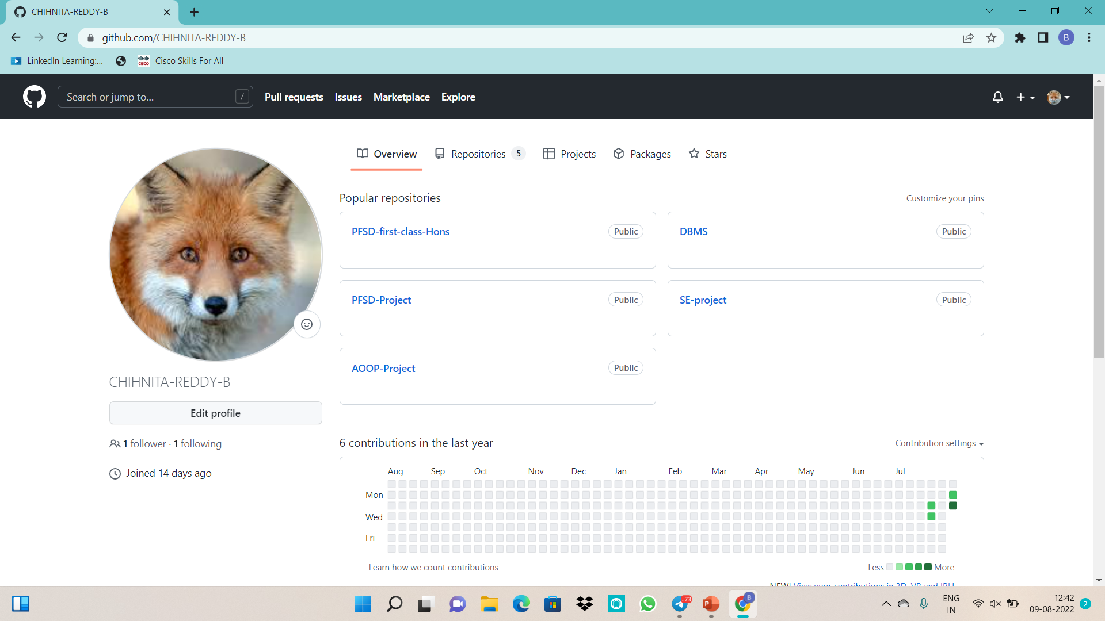
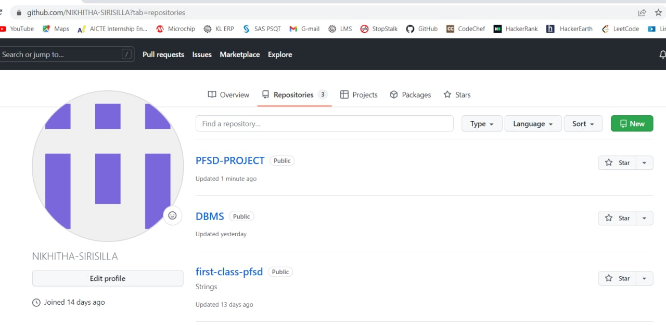

Slide 12
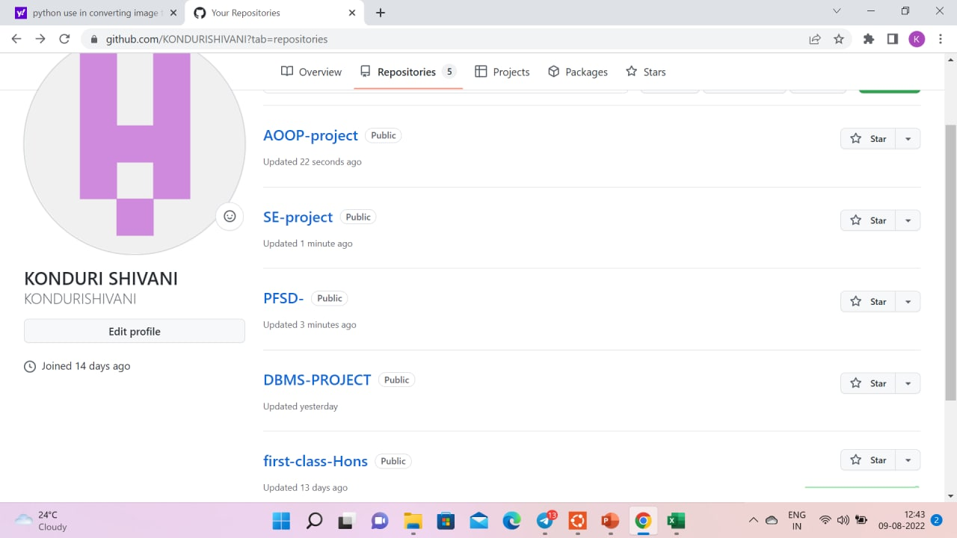
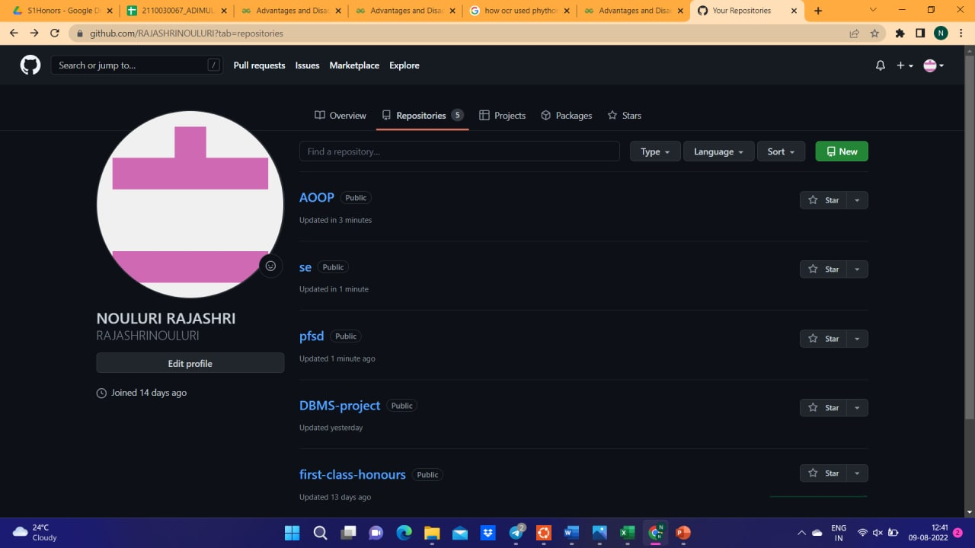

Slide 13
Division of work among the group members
2110030359- Web Application
2110030320-Web Application (researching)
2110030284-APPLICATION
2110030283-RESEARCH

Slide 14


