Slide 1
SOFTWARE ENIGNIEERING Image to Text
BY
Under the guidance of
Dr. Sheikh Fahad Ahmad
Roll Number | Name
2110030359 | B Chihnita Reddy
2110030320 | SIRISILLA Nikhitha Reddy
2110030284 | Shivani Konduri
2110030283 | N Rajashri

Slide 2
CONTENTS
Data set collection
Tools setups
Total Documentation
Flow chart
Github commits
Work progress

Slide 3
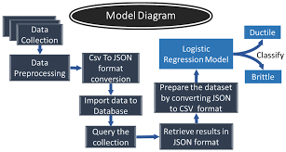
DATA SET COLLECTION

Slide 4
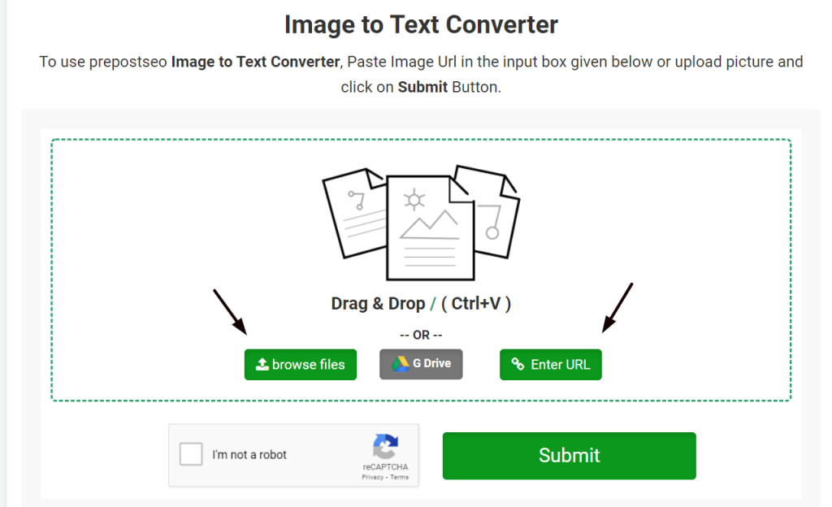
TOOLS SETUP

Slide 5
DOCUMENTATION
Image processing generally involves three steps:
Importing and Loading the image by using image acquisition tools.
Analyzing and manipulating images to extract information.
Output the result. The result might be the image or a picture altered in some way or it may be a report based on an analysis of the image
Text recognition software generally does:
Size: Although the text size can vary a lot, assumptions can be made depending on the application domain.
Alignment: The characters in the caption text appear in clusters and usually lie horizontally, although sometimes they can appear as non-planar texts as a result of special effects. This does not apply to Text, which can have various perspective distortions. Text can be aligned in any direction and can have geometric distortions.
Inter-character distance: Characters in a text line have a uniform distance between them.

Slide 6
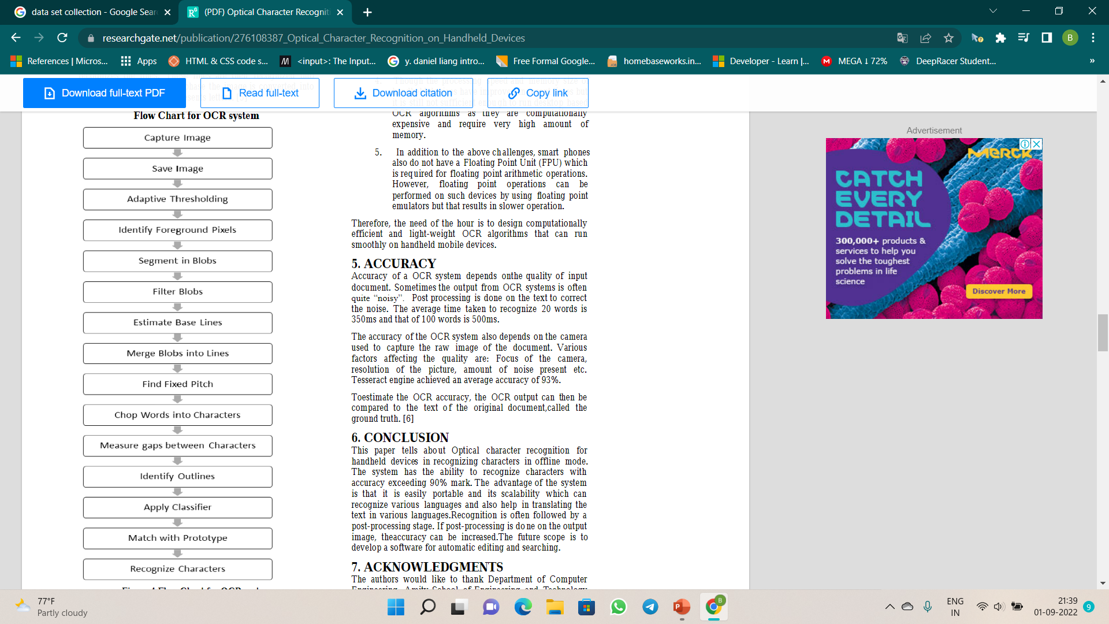
FLOWCHART
Edge: Most caption and scene text is designed to be easily read, thereby resulting in strong edges at the boundaries of text and background
Compresion: Many digital images are recorded, transferred and processed in a compressed format. Thus, a faster TIE (Text Information Extraction) system can be achieved if one can extract text without decompression.

Slide 7
GITHUB COMMITS
https://github.com/CHIHNITA-REDDY-B
https://github.com/NIKHITHA-SIRISILLA
https://github.com/KONDURISHIVANI
https://github.com/RAJASHRINOULURI
Repository of group
https://github.com/CHIHNITA-REDDY-B/SE-project

Slide 8
WORK PROGRESS
Front End part is done using html, css, java script
Backend we are working on it.

Slide 9
THANK YOU

