Slide 1
Full steps on a new computer (Linux / Mac)
Step 1 | Install Miniconda (one time only, ~2 minutes)
# Download the installer
wget https://repo.anaconda.com/miniconda/Miniconda3-latest-Linux-x86_64.sh
# Run the installer (press Enter / yes throughout)
bash Miniconda3-latest-Linux-x86_64.sh
# Open a NEW terminal window (so the conda command takes effect)
Step 2 | Navigate to the project folder
cd /path/to/GCN-BILSTM-BAN
Step 3 | One-click environment setup
bash setup.sh
▎ Automatically: creates the drugban environment → installs PyTorch / DGL / RDKit and all other packages → verifies installation →
▎ prints Setup complete!
▎ First run takes 5–15 minutes (downloading packages)
Step 4 | Activate the environment every time before use
conda activate drugban
--- --- --- ---
So your understanding is correct, with one prerequisite
Miniconda installed ──► cd into folder ──► bash setup.sh ──► Done
Miniconda is free and only needs to be installed once.
After that, bash setup.sh handles everything automatically.

Slide 2
Demo files are ready | examples/ folder
examples/
├── drugs.txt ← 5 drugs (caffeine, aspirin, ibuprofen, metformin, tamoxifen)
├── proteins.fasta ← 4 proteins (CDK2, ESR1, DHFR, A2AR)
├── one_drug.txt ← single drug (caffeine)
└── one_protein.txt ← single protein (ESR1 estrogen receptor)
Ready-to-run commands | copy and paste as-is
Demo 1 | 1 drug vs 4 proteins (Mode 1:N)
python3 predict_batch.py --ligands examples/one_drug.txt --receptors examples/proteins.fasta --output
examples/demo1_1drug_vs_4proteins.csv
Demo 2 | 5 drugs vs 1 protein (Mode N:1 virtual screening)
python3 predict_batch.py --ligands examples/drugs.txt --receptors examples/one_protein.txt --output examples/demo2_5drugs_vs_ESR1.csv
Demo 3 | 5 drugs vs 4 proteins (Mode N:M all 20 combinations)
python3 predict_batch.py --ligands examples/drugs.txt --receptors examples/proteins.fasta --output
examples/demo3_5drugs_vs_4proteins.csv
All three commands have been tested and confirmed working.
Results are saved as CSV files inside the examples/ folder open directly in Excel.

Slide 3
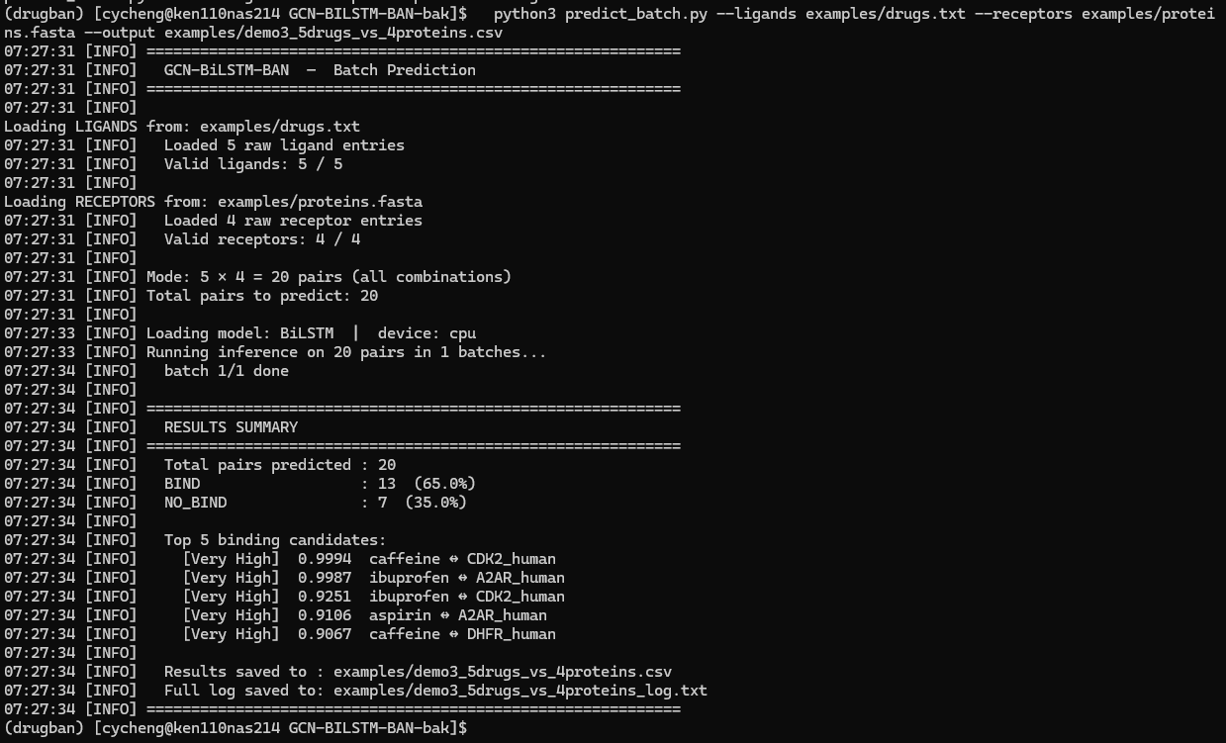

Slide 4
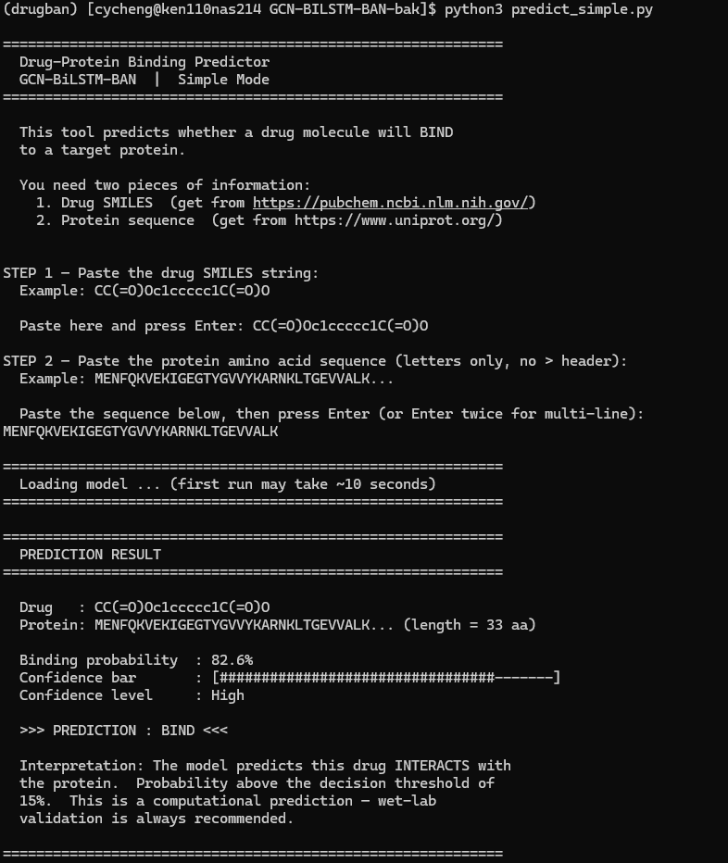
Step 1 | mamba activate drugban
Step 2 | python3 predict_simple.py
Step 3 | input ligand: smiles
Step 4 | input protein: sequence

