Slide 1
The Art and Science of a Confident Smile
how to smile?

Slide 2
Overview
Understanding the profound impact of a genuine smile on personal well-being and social interaction.
Exploring the physiological and psychological mechanisms behind smiling.
Identifying common challenges and self-consciousness that can inhibit a confident smile.
Discovering practical techniques, lifestyle adjustments, and modern dental solutions for enhancing your smile.

Slide 3
The Power of a Genuine Smile
A genuine smile, often termed a Duchenne smile, engages specific facial muscles, signaling true joy.
Smiling releases endorphins, promoting stress reduction and mood elevation.
It fosters positive first impressions, enhancing approachability and trustworthiness.
Smiling is a universal language, transcending cultural barriers and building connections.
The psychological benefits extend to increased self-confidence and resilience.

Slide 4
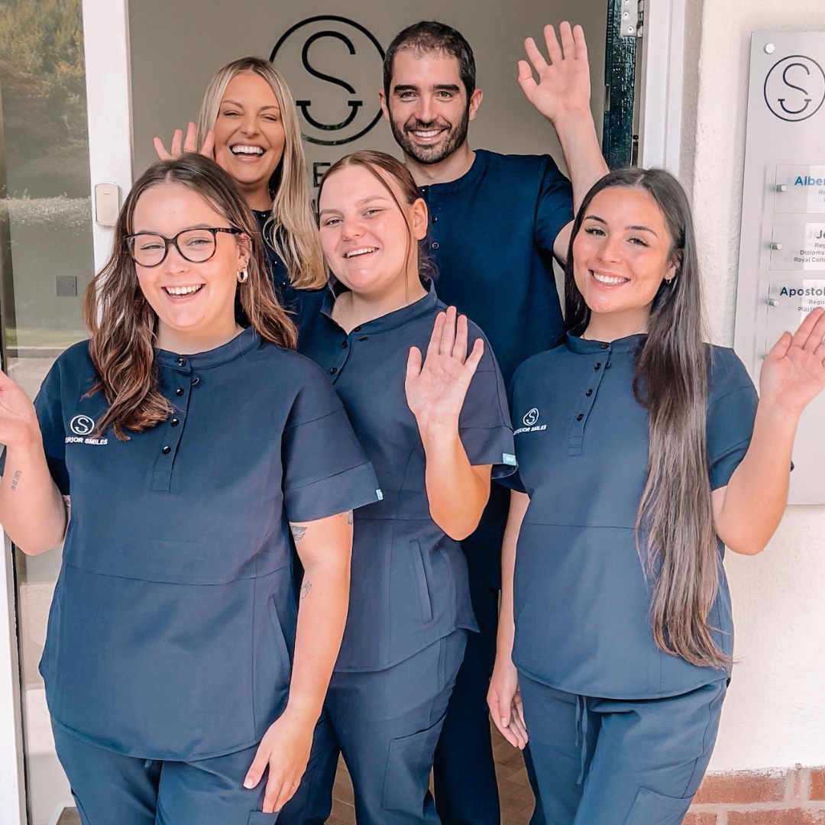
Overcoming Barriers to Confident Smiling
Self-consciousness due to dental imperfections such as misalignment, gaps, or discoloration.
Poor oral hygiene practices leading to bad breath, gum disease, or tooth decay.
**Kick the Tobacco Habit:** Smoking severely stains teeth, causes gum disease, and increases oral cancer risk.
Dietary habits that contribute to tooth erosion or cavities.
Psychological factors like anxiety or low self-esteem hindering natural expression.

Slide 5
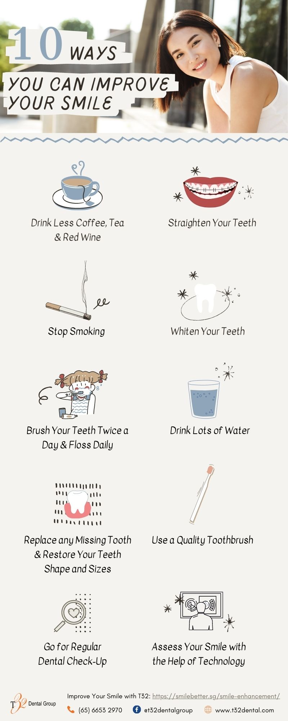
Enhancing Your Smile: Modern Strategies
**This article examines the** latest advancements in cosmetic dentistry for smile makeovers.
**2024 Smile Makeover Trends Recommended by Dentists** include minimally invasive procedures.
**Get Orthodontic Care:** Braces, aligners, and retainers are essential for correcting misaligned teeth and bite issues.
Professional teeth whitening and stain removal for a brighter, more vibrant smile.
Cosmetic bonding, veneers, and crowns offer solutions for chipped, discolored, or misshapen teeth.

Slide 6

Sustaining a Healthy and Radiant Smile
Maintain consistent oral hygiene: brush twice daily, floss once daily, and use mouthwash.
**Drink Plenty of Water:** Hydration promotes saliva production, which helps neutralize acids and wash away food particles.
**Embrace a Tooth-Friendly Diet:** Limit sugary snacks, acidic beverages, and starchy foods; incorporate fruits, vegetables, and dairy.
Regular dental check-ups and professional cleanings are vital for early detection and prevention.
Protect your teeth from grinding (bruxism) and sports injuries with custom-fitted guards.

Slide 7
Conclusion
Smiling is a powerful, multifaceted human expression with profound personal and social benefits.
Achieving a confident smile involves understanding its mechanics, addressing barriers, and adopting healthy habits.
Modern dental science offers numerous accessible solutions for enhancing and perfecting your smile.
Invest in your smile's health and appearance – it is a cornerstone of confidence and a reflection of your inner joy.

