Slide 1
Oods系统简介
Online operation data service

Slide 2
实时数据计算查询
接口 /fetch_operation
参数: game, [platform, channel, statistics], beginDate, endDate
返回全量指标数据(json数组格式)
Statistics参数不为0的时候，会存储计算数据
有一定耗时，http请求需要等待
182.254.230.39:9001/fetch_operation?game=wow&beginDate=2014-12-01&endDate=2014-12-01&channel=uc
{"game":"wow","platform":"","channel":"uc","date":"2014-12-01","totalUser":101228,"newUser":599,"totalDevice":76600,"newDevice":349,"userLogin":8883,"deviceLogin":8298,"totalPayUser":9344,"payUser":151,"totalPayDevice":8524,"payDevice":149,"totalPayMoney":2240910,"payMoney":6560,"ARPU":0.7384893,"ARPD":0.79055196,"ARPPU":43.44371,"PayRate":0.016998762,"LTV2":7.762938,"LTV3":8.898164,"LTV7":11.15192,"LTV14":21.368948,"LTV30":38.163605,"userRetention2":0.61435723,"userRetention3":0.5509182,"userRetention7":0.43405676,"userRetention14":0.30217028,"userRetention30":0.21869783,"deviceRetention2":0.55873924,"deviceRetention3":0.48137537,"deviceRetention7":0.38395417,"deviceRetention14":0.25501433,"deviceRetention30":0.18051577}

Slide 3
实时数据查询显示
[{"game":"wow","platform":"","channel":"uc","date":"2014-12-01","totalUser":101228,"newUser":599,"totalDevice":76600,"newDevice":349,"userLogin":8883,"deviceLogin":8298,"totalPayUser":9344,"payUser":151,"totalPayDevice":8524,"payDevice":149,"totalPayMoney":2240910,"payMoney":6560,"ARPU":0.7384893,"ARPD":0.79055196,"ARPPU":43.44371,"PayRate":0.016998762,"LTV2":7.762938,"LTV3":8.898164,"LTV7":11.15192,"LTV14":21.368948,"LTV30":38.163605,"userRetention2":0.61435723,"userRetention3":0.5509182,"userRetention7":0.43405676,"userRetention14":0.30217028,"userRetention30":0.21869783,"deviceRetention2":0.55873924,"deviceRetention3":0.48137537,"deviceRetention7":0.38395417,"deviceRetention14":0.25501433,"deviceRetention30":0.18051577}]
显示模式？
表格显示太单一，考虑key-value显示模式？

Slide 4
历史统计数据查询
接口 /fetch_statistics
参数: game, beginDate, endDate, [platform, channel]
返回全量指标数据(json格式)
182.254.230.39:9001/fetch_statistics?game=wow&beginDate=2014-09-01&endDate=2014-09-02&platform=ios
[{"game":"wow","platform":"ios","channel":"","date":"2014-09-01","totalUser":316830,"newUser":3594,"totalDevice":286044,"newDevice":2760,"userLogin":12528,"deviceLogin":11265,"totalPayUser":21176,"payUser":659,"totalPayDevice":20154,"payDevice":563,"totalPayMoney":6679130,"payMoney":48050,"ARPU":3.8354087,"ARPD":4.265424,"ARPPU":72.913506,"PayRate":0.052602172,"LTV2":3.3611574,"LTV3":6.5831943,"LTV7":13.010573,"LTV14":18.252644,"LTV30":23.845297,"userRetention2":0.52865887,"userRetention3":0.47468004,"userRetention7":0.37479132,"userRetention14":0.28937116,"userRetention30":0.17807457,"deviceRetention2":0.47210145,"deviceRetention3":0.41847825,"deviceRetention7":0.34166667,"deviceRetention14":0.27463767,"deviceRetention30":0.1731884},
{"game":"wow","platform":"ios","channel":"","date":"2014-09-02","totalUser":316830,"newUser":3870,"totalDevice":286044,"newDevice":3222,"userLogin":13836,"deviceLogin":12535,"totalPayUser":21176,"payUser":669,"totalPayDevice":20154,"payDevice":572,"totalPayMoney":6679130,"payMoney":51890,"ARPU":3.7503614,"ARPD":4.139609,"ARPPU":77.56353,"PayRate":0.048352126,"LTV2":5.5142117,"LTV3":7.390181,"LTV7":11.612403,"LTV14":15.095607,"LTV30":20.072351,"userRetention2":0.53126615,"userRetention3":0.46434107,"userRetention7":0.37932816,"userRetention14":0.2896641,"userRetention30":0.17829457,"deviceRetention2":0.49751708,"deviceRetention3":0.44072005,"deviceRetention7":0.3659218,"deviceRetention14":0.28646803,"deviceRetention30":0.18249534}]

Slide 5
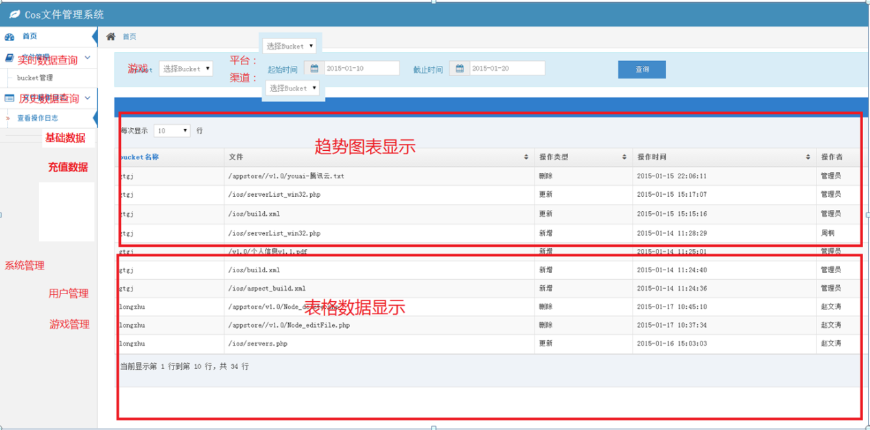
历史数据查询显示
图表+数据表单模式

Slide 6
历史数据重新计算
接口 /daily_analyze
参数: game, date
计算此游戏指定日期数据
用途是修正因为数据遗漏导致的计算错误进行重新计算修正

Slide 7
用户管理
1.用户登录
2.用户游戏权限(可选可见哪些游戏)
3.管理员账户可编辑修改用户密码，用户权限，备注(用户名字)
4.管理员账户可新增，修改，删除游戏,平台,渠道信息

Slide 8
游戏,平台,渠道信息管理
1.游戏信息由三部分组成[game, platform, channel, logUserName, logUserPwd, logPath, sshPort]
2.游戏一旦创建, game不可变, 可再编辑platform,channel, , logUserName, logUserPwd, logPath, sshPort

Slide 9
平台渠道信息查询编辑
#获取所有游戏信息:
182.254.230.39:9001/fetch_game
-> [{"game":"wow","platform":"android,ios,appstore","channel":"91,bddk,360,xm,uc“, "logUserName":"", "logUserPwd":"", "logPath":"", "sshPort":"0"}]
# 创建/更新游戏信息
182.254.230.39:9001/create_game?game=wow&platform=android,ios,appstore&channel=91,bddk,360,xm,uc &logUserName=hawk&logUserPwd=000000&logPath=&sshPort=0
-> {"game":"wow","platform":"android,ios,appstore","channel":"91,bddk,360,xm,uc "logUserName":"", "logUserPwd":"", "logPath":"", "sshPort":"0", "status":0}
备注: status为0表示成功

Slide 10
Json格式解析
/**
* 游戏名
*/
public String game = "";
/**
* 平台名
*/
public String platform = "";
/**
* 渠道名
*/
public String channel = "";
/**
* 数据日期
*/
public String date = "";
/**
* 总用户
*/
public int totalUser = 0;
/**
* 总设备
*/
public int totalDevice = 0;
/**
* 总付费用户
*/
public int totalPayUser = 0;
/**
* 总付费设备
*/
public int totalPayDevice = 0;
/**
* 总付费金额
*/
public int totalPayMoney = 0;
/**
* 当日付费设备
*/
public int payDevice = 0;
/**
* 当日付费用户
*/
public int payUser = 0;
/**
* 当日付费金额
*/
public int payMoney = 0;
public float ARPU = 0;
public float ARPD = 0;
public float ARPPU = 0;
/**
* 付费率
*/
public float PayRate = 0;
public float LTV2 = 0;
public float LTV3 = 0;
public float LTV7 = 0;
public float LTV14 = 0;
public float LTV30 = 0;
/**
* 新增用户
*/
public int newUser = 0;
/**
* 新增设备
*/
public int newDevice = 0;
/**
* 日活跃用户
*/
public int userLogin = 0;
/**
* 日活跃设备
*/
public int deviceLogin = 0;
/**
* 用户留存数据
*/
public float userRetention2 = 0;
public float userRetention3 = 0;
public float userRetention7 = 0;
public float userRetention14 = 0;
public float userRetention30 = 0;
/**
* 设备留存数
*/
public float deviceRetention2 = 0;
public float deviceRetention3 = 0;
public float deviceRetention7 = 0;
public float deviceRetention14 = 0;
public float deviceRetention30 = 0;

Slide 11
谢各位支持~~~

