Slide 1
Unit IX
Intellectual Property
https://www.clic.org.hk/en/topics/intellectualProperty/

Slide 2
What is intellectual property?
Property – something that can be owned
Like real estate
Can be sold or bought (transferred from one person to another)
Sophisticated forms of transactions apply, as bound by local legislation
Intellectual – Something out of the mind
There must be a person or group of people who create(s) it

Slide 3
Basic rules
The very first basic rule is “ownership is automatic”
When I create something, I own it
The second basic rule is “transferability”
I can sell mine or buy others’
More rules (laws and ordinances)
In developed countries, there are a lot of rules bound by law regarding how IPs are transferred, used, and protected. The spirit is to provide a level playing field for all and to encourage creativity

Slide 4
Different kinds of intellectual properties
IP is divided into two categories:
Industrial property – patents, trademarks, industrial designs, etc.
Copyright – literary, artistic works such as novels, poems, and plays, films, musical works, drawings, etc.
In engineering research, research results often lead to patents (such as new industrial designs) and copyrights of papers, books, data sets, etc.

Slide 5
Patent and copyright
What is a Patent?
A patent is a legal document usually issued by a government that provides protection for an invention in that country
E.g., the US patents are issued by the Patent Office of the US federal government
A patent gives the inventor to stop others from making, using, selling, or even importing the patented invention
However, a patent usually has regional limitations
A US patent does not afford protection in another country such as China

Slide 6
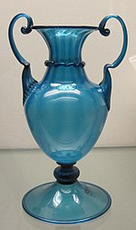
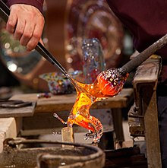
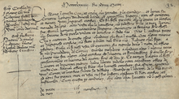
Where did the patent system come from?
The first statutory patent system is generally regarded to be the Venetian Patent Statute of 1474
The Senate of Venice was concerned that the knowhow in glass making might be lost due to the emigration or death of artisans
It asked its skilled glassmakers to share their knowledge by training apprentices, rather than taking their secrets abroad or to the grave
The glassmakers were understandably reluctant because they feared competition from the younger generation
The Senate offered them protection from competition for a limited period in exchange for the sharing of their knowledge
This marked the birth of the patent system
Inventors published their technical secrets in return for a short-lived exclusive right to their new technology
The Venetian Patent Statute
https://en.wikipedia.org/wiki/Patent

Slide 7
Why do we need Patents?
Patents obliterate competition
Patents create a barrier to entry, which blocks others from copying the idea to sell a similar product in direct competition
Compensate the risk and investment in developing new ideas
Important for SMEs to compete against large corporations which have more resources
Generate revenue
By controlling the supply in the market
By licensing or selling the patents to other companies. E.g.,
Microsoft’s purchase of 800 patents from AOL for over $1 billion in 2012
The sale of Nortel Networks’ patent for $4.5 billion in 2011
Increase company valuation
A strong patent portfolio attracts investors, particularly important for startups

Slide 8
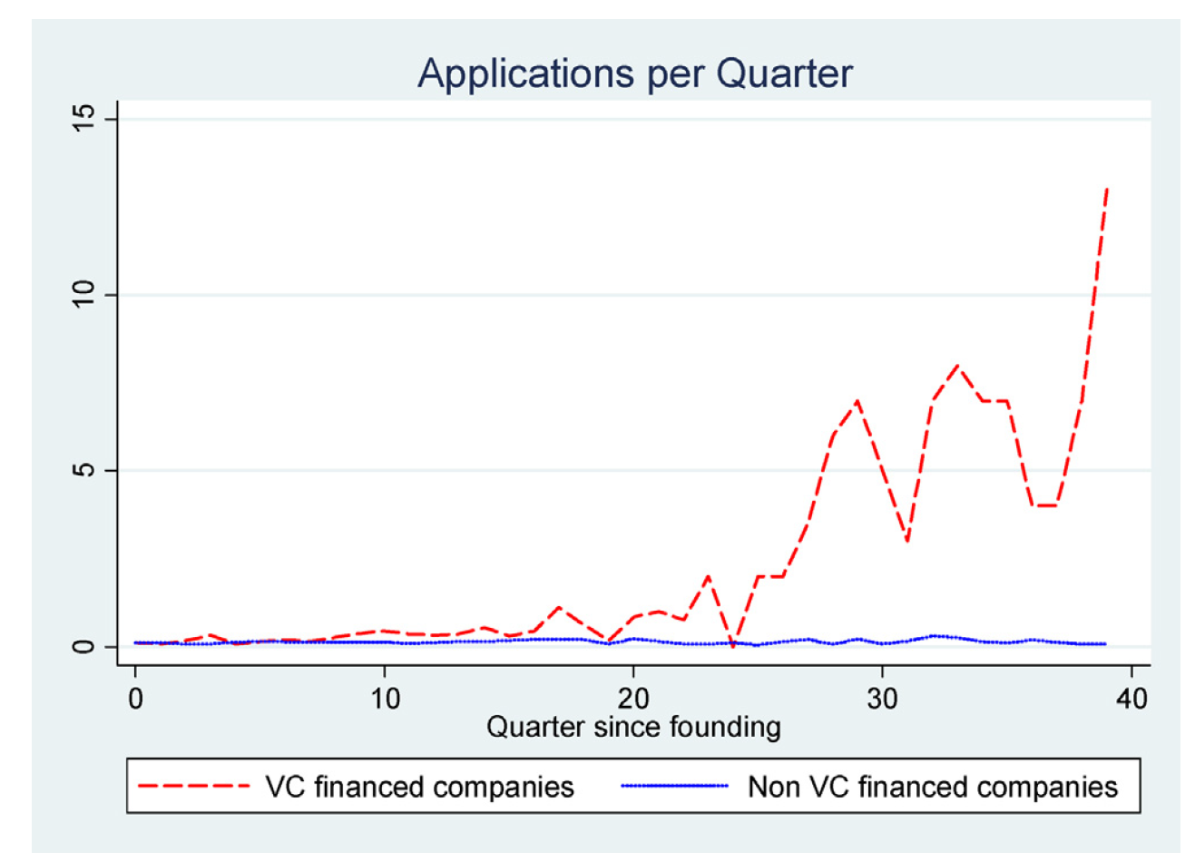
Patents increase technology startups’ valuation
From a study [1] of Germany and the UK biotechnology industry, companies with good patent portfolios could more easily attract venture capital investment
[1] Carolin Haeussler, Dietmar Harhoff, Elisabeth Mueller, “How patenting informs VC investors – The case of biotechnology,” Research Policy, Volume 43, Issue 8, 2014, Pages 1286-1298

Slide 9
What can be patented?
Three criteria for an invention to be patented
Novelty – Novelty refers to innovations in an invention and must not be based on any existing knowledge or prior art
Non-obviousness – The invention should be non-obvious, that is someone familiar with the art should not be able to predict similar steps thereby making the invention completely unique
Usefulness – The invention must be useful at least in some specific situations
No need to implement the invention before applying for a patent. Thus, the feasibility of realizing the invention is not a criterion for patenting

Slide 10
How to get a Patent?
Need to prepare a patent document for examination by a related government office
Such as the Patent Office of the US government
Usually prepared by a patent attorney although the inventors can do it themselves
Prepared in a way that someone could realize the invention using the patent as a guide
No need to provide every technical detail as they may not be available anyway
Need to explain the application of the invention and why the proposed idea is novel
Should include a survey of existing similar ideas
If a patent application is granted, the inventor will have the right to stop others from using the invention for 20 years in general
Also have some short-term patents (less than 5 years) that are easier to apply

Slide 11
How do we know if an idea was patented?
Many countries have developed their own databases for people to search for issued patents. E.g., in the US,
United States Patent and Trademark Office (USPTO) Patent Full-Text Databases
Full-image patents from 1790 to present
Google patent
Content is provided by USPTO. The entire collection is full-text searchable
Free Patents Online
Includes U.S. patents and applications as well as European patents (EP) and World Intellectual Property Organization (WIPO) documents

Slide 12
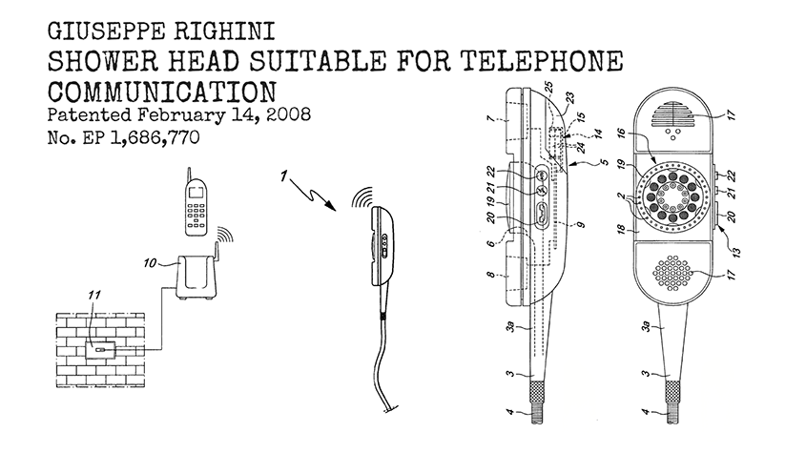
Interesting patents
What can be more annoying than receiving an urgent phone call while halfway through a shower?
Patented in 2006, inventor Giuseppe Righini was thinking particularly of those who live alone or are only at home for short amounts of time, for whom taking a shower while waiting for an “extremely urgent call” can be a “genuine problem”.
https://www.wipo.int/web/patents/2023-patent-picks

Slide 13
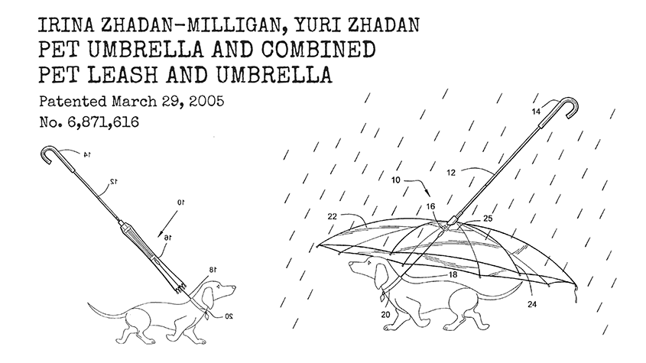
Interesting patents
This combined pet umbrella and leash, patented by Irina Zhadan-Milligan and Yuri Zhadan in 2005, will “protect [your] pet from inclement weather conditions while also serving as a leash for the pet in both umbrella canopy opened and closed positions”.
https://www.wipo.int/en/web/patents/2021_patent_picks

Slide 14
Copyright
What is Copyright?
Copyright is the right given to the owner of an original work as soon as the author fixes the work in a tangible form of expression
Original work – Independently created by a human author and has a minimal degree of creativity
Thus, titles, names, short phrases, slogans, etc., do not have copyright
Fixed work – Captured (either by or under the authority of an author) in a sufficiently permanent medium
The work can be perceived, reproduced, or communicated for more than a short time
E.g., paintings, photographs, illustrations, musical compositions, sound recordings, computer programs, books, poems, blog posts, movies, plays, papers …

Slide 15
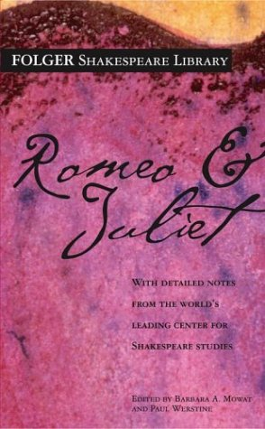
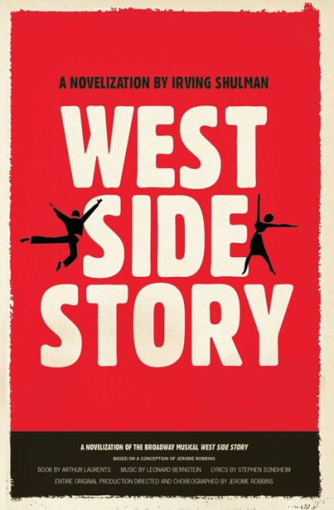
What is Copyright?
Copyright only protects expressions, but not ideas, procedures, methods, systems, processes, concepts, principles, or discoveries if they have not been fixed as expressions
Thus, two different expressions of the same idea can form two different copyrights
A storyline about two families disallowing their children to be in love does not have a copyright
Based on that storyline, the novels “Romeo and Juliet” and “West Side Story” have their own copyright
Because the idea is fixed in two different expressions – different eras, settings, etc., to allow substantial differences in creative contents

Slide 16
What can be done with the copyright?
Copyright law provides copyright owners with the following exclusive rights:
Reproduce the work in copies or phonorecords
Prepare derivative works based upon the work (such as translating a work to another language)
Distribute copies or phonorecords of the work to the public by sale or other transfer of ownership or by rental, lease, or lending
Perform the work publicly if it is a literary, musical, dramatic, or choreographic work; a pantomime; or a motion picture or other audiovisual work
Display the work publicly if it is a literary, musical, dramatic, or choreographic work; a pantomime; or a pictorial, graphic, or sculptural work. This right also applies to the individual images of a motion picture or other audiovisual work
Perform the work publicly by means of a digital audio transmission if the work is a sound recording

Slide 17
Who own a copyright?
The ownership of a copyright is automatic – once an author creates an original work and fixes it, he/she owns its copyright. No need to register a copyright
There is no official registry in HK for registration of copyright works
As an exception, the US has a registration office for copyright
The duration of the ownership is usually 50 years after the death of the author
Companies, organizations, and other people besides the work’s creator can also be copyright owners
Copyright law allows ownership through “works made for hire,” which establishes that works created by an employee within the scope of employment are owned by the employer
Like other IPRs, copyright can be transferred by assignment or licensing
Licensing – Share the right for specific acts
Assignment – Transfer of ownership

Slide 18
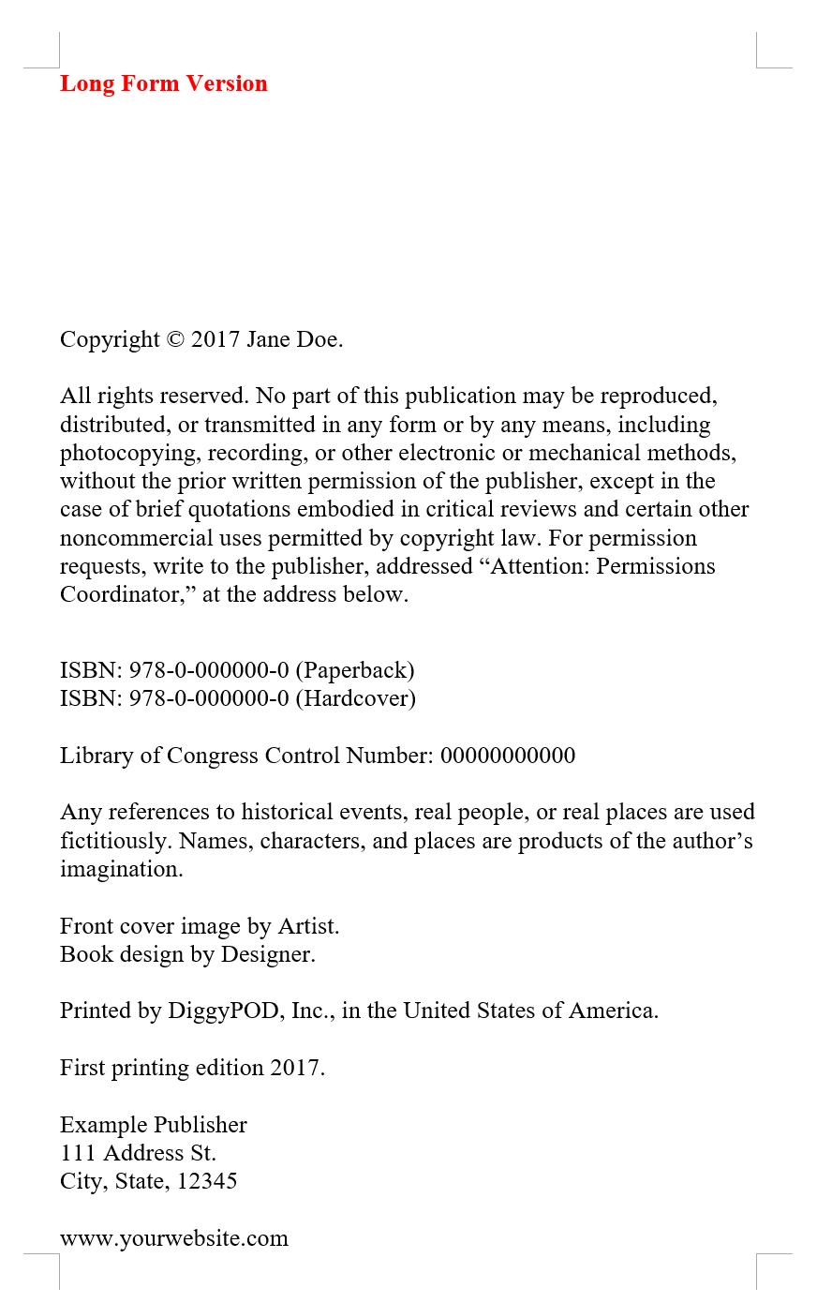
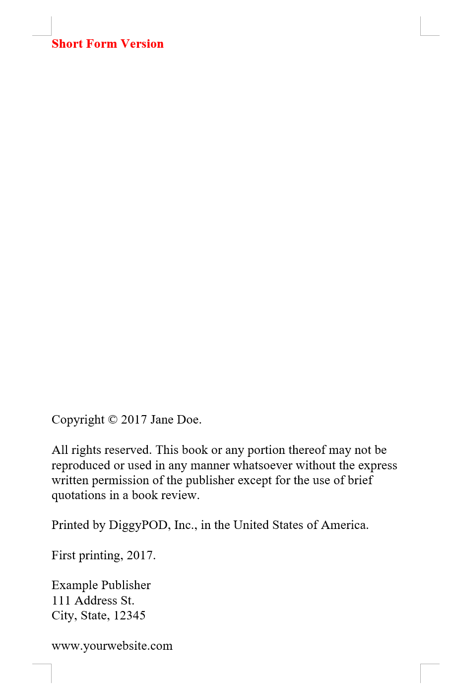
How to find out who owns the copyright?
Example: Short version in books
Since most countries (including HK) do not have a registry for copyrights, there is no automatic method to check copyright ownership in general
For published work, can check the provided copyright notice that gives details of copyright ownership
Otherwise, can contact the author directly to ascertain the owner of the copyright
Example: Long version in books
https://www.diggypod.com/self-publishing/copyright/

Slide 19
How to find out who owns the copyright?
There are a few collecting societies in Hong Kong representing authors, publishers, composers, lyricists, and record producers
The main function is to negotiate licensing terms, grant licenses, and collect license fees on behalf of the copyright owners for the use of their copyright works.
For example,
Hong Kong Reprographic Rights Licensing Society (HKRRLS) – representing authors and publishers of printed works
Hong Kong Copyright Licensing Association (HKCLA) – representing authors and publishers of 12 local newspapers and 19 local magazines
Composers and Authors Society of Hong Kong Limited (CASH) – representing composers and lyricists of musical works
Phonographic Performance (South East Asia) Limited (PPSEAL) – representing producers of musical sound/visual recordings

Slide 20
Copyright exception
Works in the public domain are not protected by the copyright law
Public domain refers to works that the ownership is unknown or expired. Don’t mix it with publicly accessible. Works publicly accessible on the Web also have copyrights
A work will be infringed only if a substantial part is taken
A matter of quality rather than quantity
A musician who copies a very catchy musical phrase from another musician’s song is likely to infringe its copyright even if that phrase is very short
Subject to conditions, fair dealing for research and private study; criticism, review, and news reporting, for use of works in library and school are permitted
Be careful, photocopying an unreasonable amount of a book is not allowed

Slide 21
Secondary infringement
Students should also be careful to avoid secondary infringement
To import into or export from Hong Kong, otherwise than for his private and domestic use, infringing copies of a work.
To possess, sell, distribute, or otherwise deal with infringing copies of a work for the purpose of trade or business.
To distribute (like put them in your papers), otherwise than for the purpose of trade or business, infringing copies of a work to such an extent as to affect prejudicially the copyright owner (e.g. loss of income or business opportunities, etc.)
However, the person will only be liable if he knew or had reason to believe that he was dealing with infringing copies
If such knowledge or guilty state of mind cannot be proved, that person will not be liable for secondary infringement

Slide 22
Case study 1
You are the editor of a journal. One day, you receive a letter from a Russian professor saying that a paper that your journal published recently has content 70% similar to his work published in the USSR 55 years ago. That work was written in Russian and published in a national journal in the USSR. The Russian professor has now translated his work in English and requests your journal to publish it so as to claim he is the owner of the idea. Besides, he also requests the journal to make an open apology since the journal has infringed his copyright.
What are you going to do in this case?
Notes:
It is a real case that I was involved some years ago. I received a request from that journal editor to verify the claim of that Russian professor. Although I do not know Russian, I could, based on the equations in the paper, conclude that the claim of that Russian professor was valid. However, the journal editor did not apologize to that Russian professor nor retract the published paper. The journal just published the paper of that Russian professor also in that journal. The case was closed afterward.
Students should be made clear that ignorance is not an excuse for infringing other people’s copyright. If they publish a paper that is substantially similar to another, they have infringed its copyright, irrespective of whether they know its existence or not (but whether they will be charged will depend on the judge on a case-by-case basis). However, international copyright is not automatic, it is based on the treaties a country signed with the other countries. Most countries have joined such treaties, but not the USSR, which was known as the most active “pirate of copyright” at that time. Since the USSR did not sign those treaties until the mid-70s, the copyright of their publications before that time would also not be protected in other countries.
Besides, even if the copyright of that Russian professor was infringed, the journal has no responsibility since for every paper they publish, they would require the authors to sign the copyright transfer form, and there must be a disclaimer saying that if the paper infringes the copyright of other people, the responsibility is wholly on the authors. That’s why the journal will never apologize in such a situation.

Slide 23
Case study 2
William is a research student on a research team. Recently William developed a new speech recognition technique and published it in an IEEE Transactions. He, on behalf of the team, signed a copyright form to allow IEEE to publish his work. He also posted his paper in his personal blog to allow people to freely download the paper. Since his work is so useful, he suggested to the research team later to organize a workshop to teach people the related techniques. He charges people $1,100 each for registration to the workshop. In return, a set of course notes that include a copy of that paper and a CD that includes all software programs related to that work are distributed to the registrants. The money of the workshop partly will go to the University, partly will go to the research team, including the student.
Anything(s) that can go wrong in this case?
Notes:
There are a few things that the students should be clarified:
Some students have a misconception that when they submit the copyright transfer form, they will transfer all the rights of their paper to the journal. Then, they think they have no right to use their work for other purposes. It is certainly not the case. By submitting the copyright form, they just allow the journal to publish their paper. They keep all the rights of the paper without giving them up.
However, for those materials derived from the student’s work (including the manuscript, data, multimedia contents, etc.) developed by the journal, their copyrights are owned by the journal. Even as the authors of the paper, they cannot deliberately use the materials without the consent of the journal. Usually, the journal owns the copyright of anything downloaded from its website. If the paper William posted was directly downloaded from the journal website, he would have infringed the copyright of the journal. What William should do was to post the accepted version of the paper, i.e., the one that was accepted but had not been further processed by the journal.
The IP of all work done by students belongs to the university. William was only entrusted by the university to sign the copyright form, which is considered as a normal research activity that does not need approval separately. But if William wanted to use his research results for any commercial functions (like running a workshop with charges), he needed to seek approval from the university. Usually, it should go through his supervisor to make the application.

Slide 24
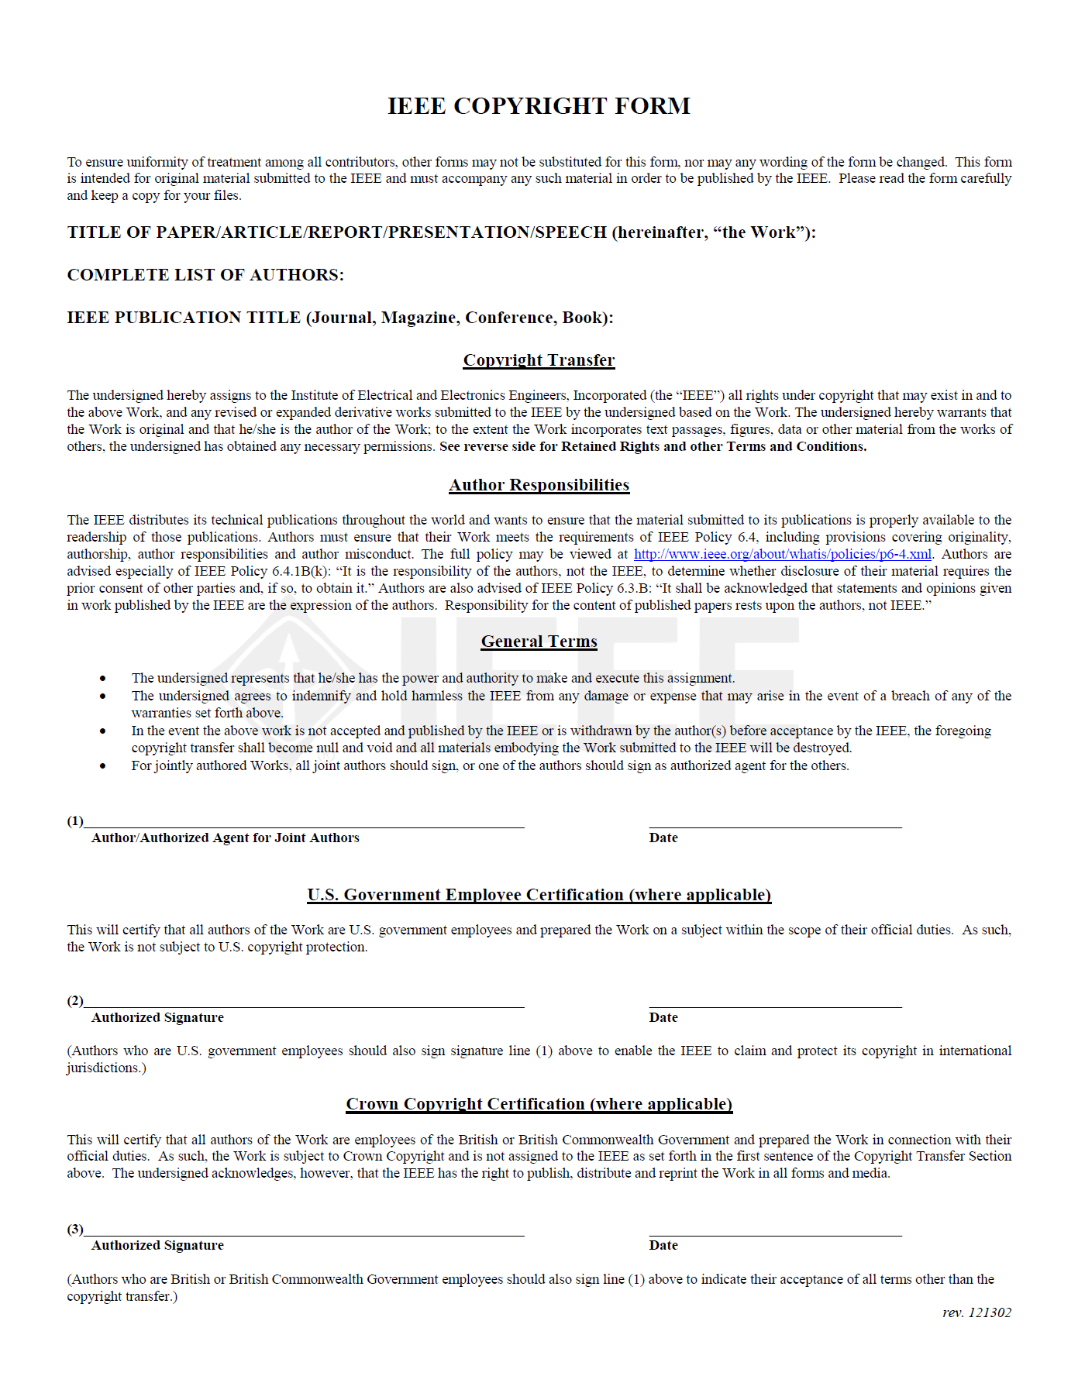
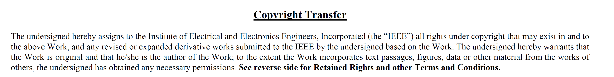
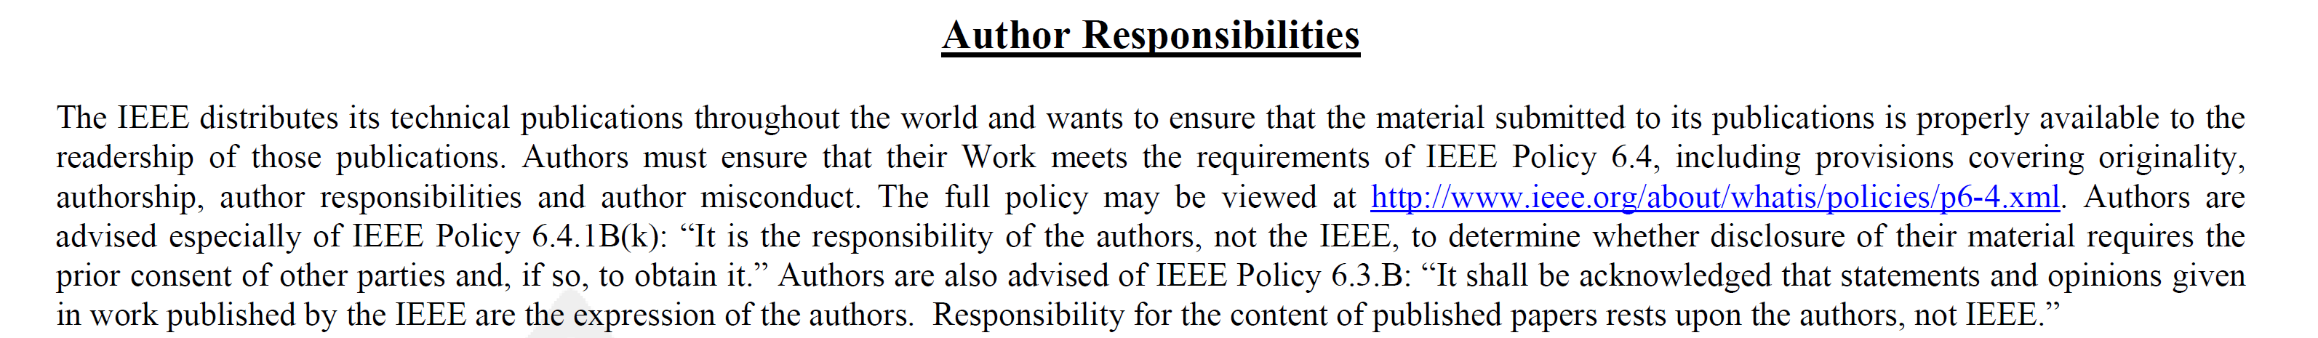
Copyright form example
IEEE requires the authors to submit the copyright form as on the right before their papers will be published

Slide 25
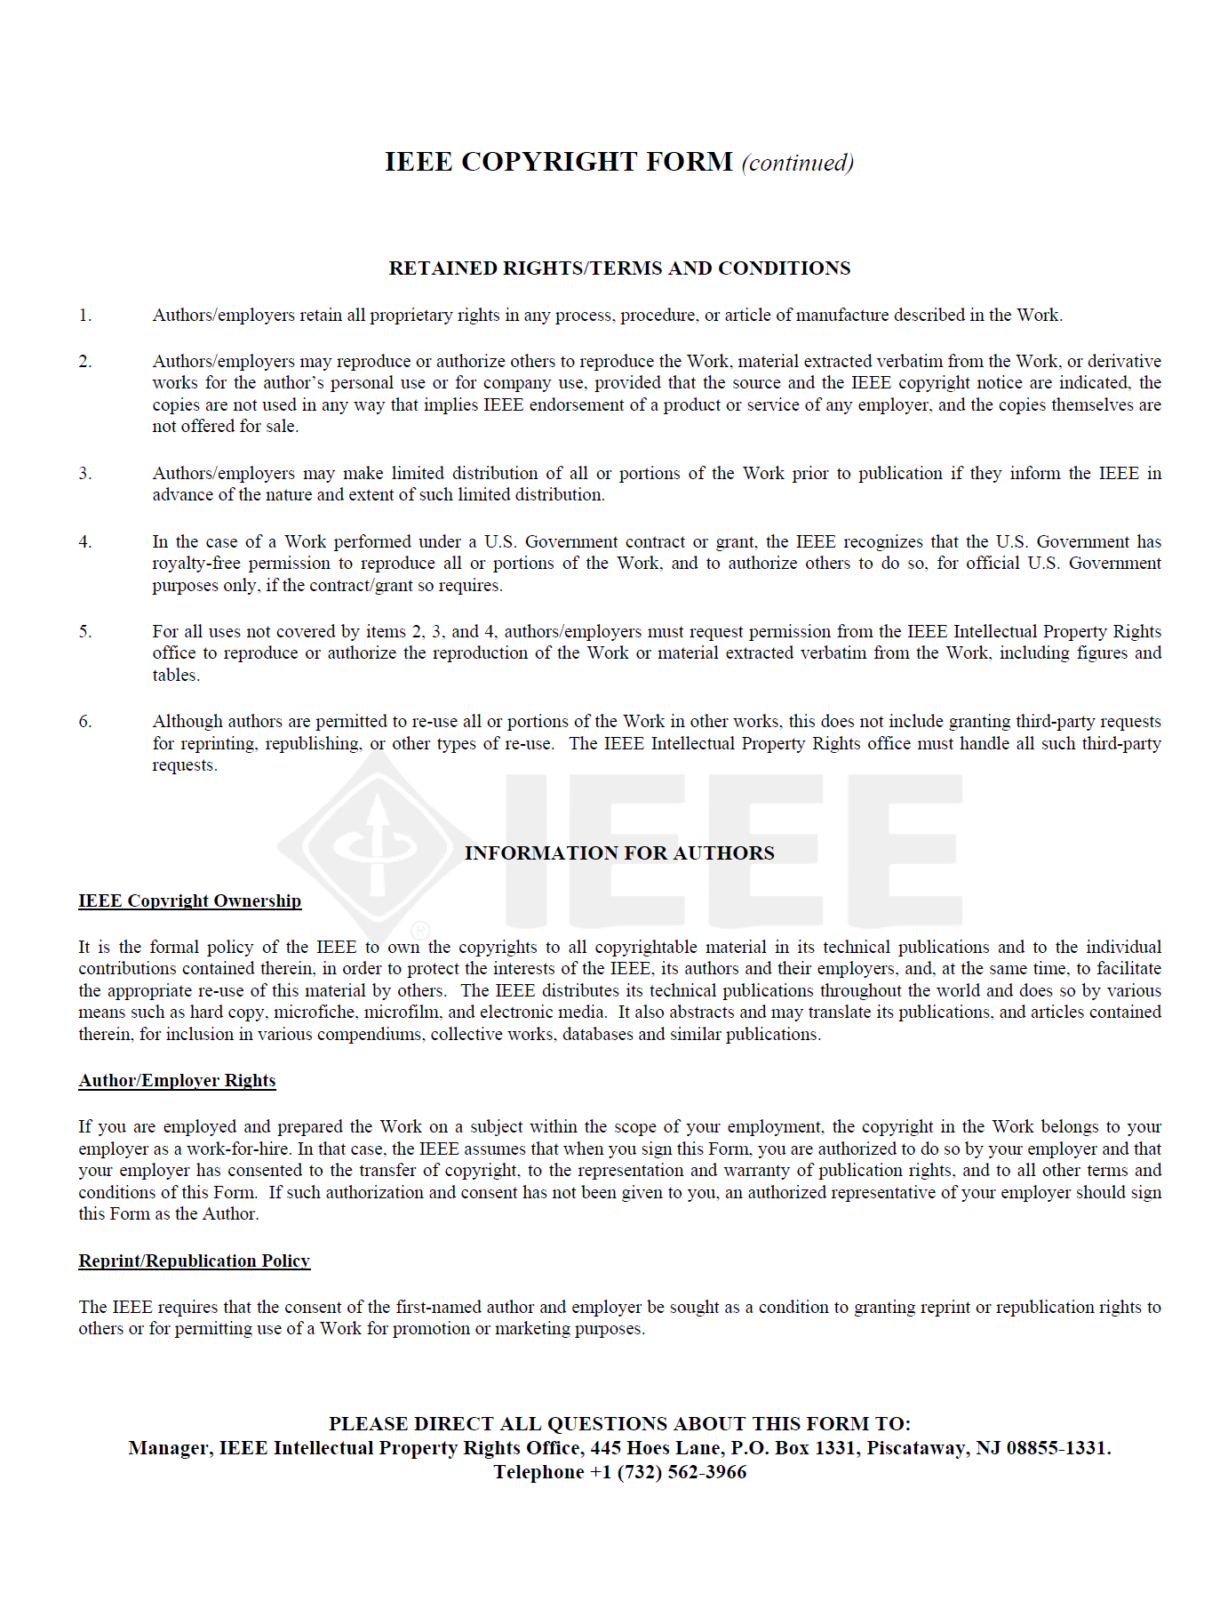
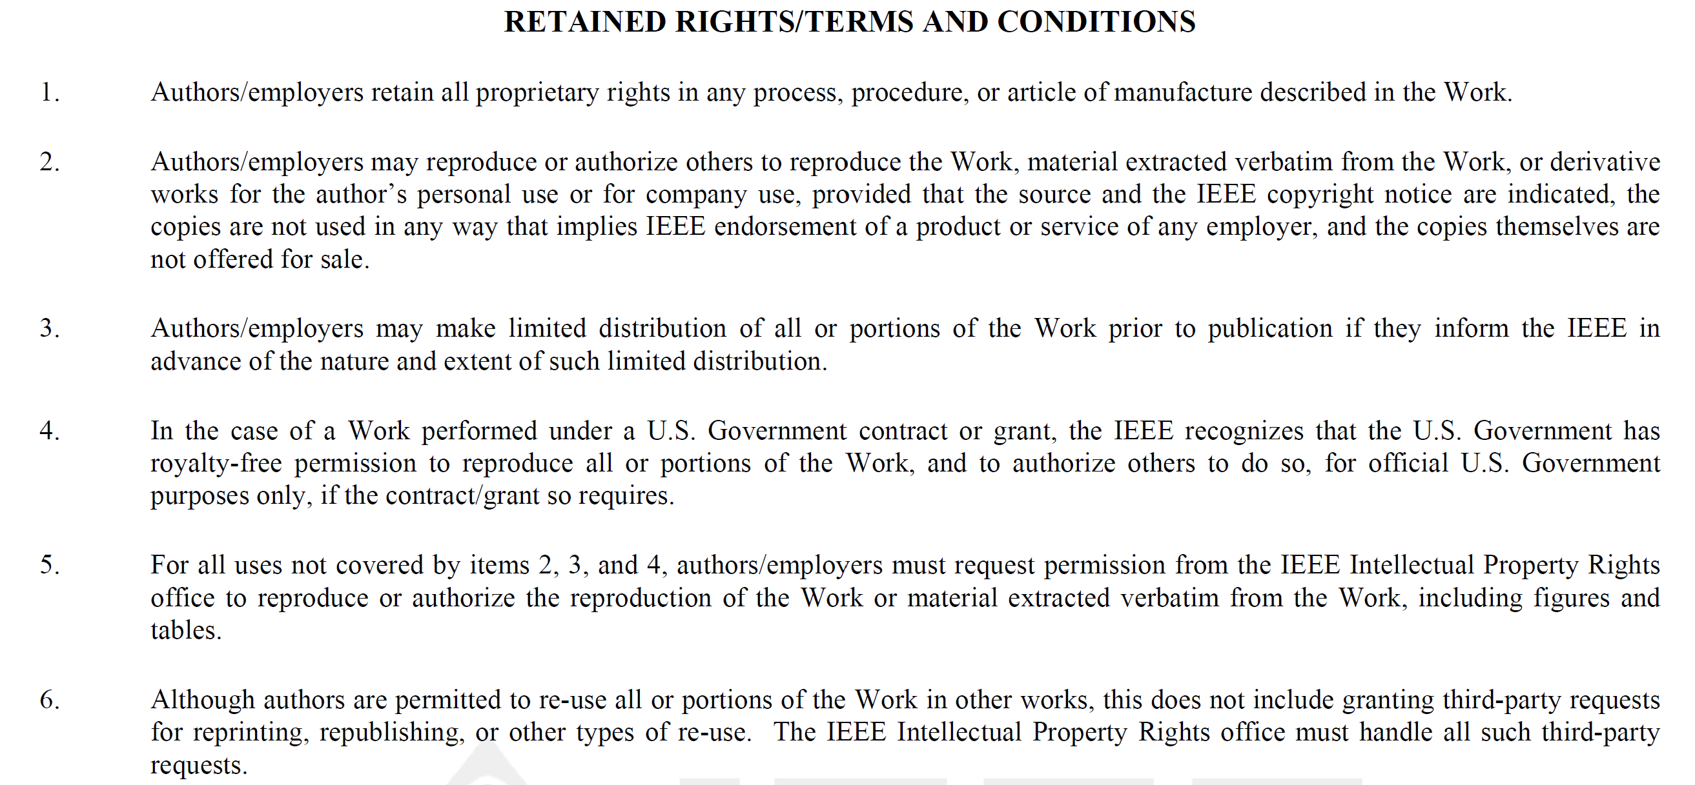
Copyright form example
Submitting a copyright form does not mean given up all the right of the Work to the publisher
Authors retain the right of the Work
Authors and/or their employers shall have the right to post the accepted version of IEEE-copyrighted articles on their own personal servers or the servers of their institutions or employers without permission from IEEE, provided that the posted version includes a prominently displayed IEEE copyright notice and, when published, a full citation to the original IEEE publication, including a link to the article abstract in IEEE Xplore. Authors shall not post the final, published versions of their papers.

Slide 26
Who owns the IP at PolyU?
As stated in the “Policy on Ownership of Intellectual Property (PIP)” of PolyU,
“Intellectual Property and Materials made and created by students during their study at the University shall be owned by the University and shall vest in the University upon the making and creation of the Intellectual Property and Materials in the following circumstances:
receives financial support from PolyU in the form of wages, salary, Postgraduate Scholarship, Teaching Postgraduate Studentship or other assistantship for undertaking his/her studies or research in PolyU;
makes material use of PolyU’s resources for his/her research work;
receives material guidance and intellectual input from PolyU’s staff for his/her research work; or
if his/her research work is funded by a grant to PolyU or to him/her by virtue of his/her studies with PolyU.”

Slide 27
Who owns the IP at PolyU?
Also stated in PIP,
“If an Intellectual Property created by a Staff Member or student of the University is commercialized upon the authorization of the University, a reasonable share of Net Revenue, if any, generated from such commercialization shall be given to the Inventor of such Intellectual Property and the department or operating unit the Inventor concerned belongs to. Methods and extent of sharing shall be determined by the Management of the University from time to time.”
Students have the obligation to report to the University (through the department or Knowledge Transfer and Entrepreneurship Office (KTEO)) if they have created any IP in their work
More details can be found in the “Policy on Ownership of Intellectual Property (PIP)” of PolyU

Slide 28
Who owns the IP at PolyU?
Although the University owns the IP, the University cannot claim itself as the creator or author of students’ work
Still – the student is the creator or author
Besides, the University usually will entrust the inventor (including students) to take care of normal activities related to the IP
It is built on trust that the inventor will not do something that will infringe on the benefit of the University

Slide 29
Ethical concern of IPR
The IPR system allows monopolizing a new idea or invention, which often leads to heated debate if it is ethical
Some criticisms include
Copyright laws introduce barriers to access to knowledge
Thus, under-developed countries have great difficulty advancing their technology level to improve their poverty status
E.g., many universities in under-developed countries did not have access to IEEE papers due to the huge cost of subscribing to IEEE databases
Widen the disparity between the rich and the poor
Patent system allows total control of an invention by individual
If the invention is essential to the well-being of humans (such as new medicines, new biotechnologies, etc.), allowing monopoly of the invention does not benefit the society at large
Allowing monopoly can also deter the interest of other people in the research topic and thus delay the advancement of the technology

Slide 30

Case Study 3 – The Turmeric patent case
Besides, patenting traditional knowledge is questionable ethically since the ownership of traditional knowledge is often controversial
In 1995, two Indian American scientists at the University of Mississippi were granted a Patent for the use of the healing capacities of Turmeric
Turmeric (姜黄) is used as a common condiment in most Indian households
A flavoring and coloring agent in curry powders, mustards, butter, cheese, etc.
In the ancient Indian medical system, Ayurveda, a poultice of turmeric paste is used to treat common eye infections, dress wounds, treat bites, burns, acne, and various skin diseases
Anusree Bhowmick, Smaranika Deb Roy and Mitu De, ”A Brief Review on the Turmeric Patent Case with Its Implications on the Documentation of Traditional Knowledge,” NDC E-BIOS, Volume 1, pp 83-88 (2021)

Slide 31
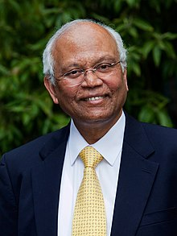
Case Study 3 – The Turmeric patent case
The news spread back to India and triggered the nerves of many people including Dr Raghunath Anant Mashelkar, the Director General of the Council of Scientific and Industrial Research (CSIR)
As an expert in patenting, he knew it was not right since an invention based on traditional knowledge cannot be novel and non-obvious
The patent effectively stole a traditional art of Indian people and let two American scientists become the owners of the knowledge
Dr Mashelkar decided to mount a legal challenge to the patent
Dr Mashelkar in 2009
https://en.wikipedia.org/wiki/Raghunath_Anant_Mashelkar
Anusree Bhowmick, Smaranika Deb Roy and Mitu De, ”A Brief Review on the Turmeric Patent Case with Its Implications on the Documentation of Traditional Knowledge,” NDC E-BIOS, Volume 1, pp 83-88 (2021)

Slide 32
Case Study 3 – The Turmeric patent case
Together with his team in CSIR, he located 32 references in different languages namely Sanskrit, Urdu, and Hindi, and also a paper published in 1953 by the Indian Medical Association to substantiate his claim that using turmeric powder for wound healing purposes is a traditional knowledge in India
After a year of lawsuit, the US Patent Office (USPTO) revoked the patent, stating that the claims made in the patent were obvious and anticipated, and agreeing that the use of turmeric was an old art of healing wounds
It was the first time that a patent based on traditional knowledge of a developing country had been successfully challenged
However, it was not the end of the story
Anusree Bhowmick, Smaranika Deb Roy and Mitu De, ”A Brief Review on the Turmeric Patent Case with Its Implications on the Documentation of Traditional Knowledge,” NDC E-BIOS, Volume 1, pp 83-88 (2021)

Slide 33
Case Study 3 – The Turmeric patent case
After further investigation, Dr Mashelkar found that patenting traditional knowledge was a common practice in Western countries
Some medicine companies, in particular, sent people to different countries to collect their traditional medical treatment methods and patent them – known as the biopirate
Famous case includes the patenting of a treatment for Hodgkin's disease that had come from the periwinkle plant in Madagascar
Later, Dr Mashelkar also chaired a Technical Committee, which successfully challenged the US patents on breeding Basmati Rice (another Indian’s traditional knowledge) by RiceTec Company, Texas
To avoid more Indian traditional knowledge being patented in Western countries, Dr Mashelkar formed a team in CSIR to develop a huge digital library of Indian traditional knowledge to facilitate easy examination by the patent offices of Western countries
Anusree Bhowmick, Smaranika Deb Roy and Mitu De, ”A Brief Review on the Turmeric Patent Case with Its Implications on the Documentation of Traditional Knowledge,” NDC E-BIOS, Volume 1, pp 83-88 (2021)

Slide 34
Case Study 3 – Discussion
Patenting traditional knowledge is ethically questionable as the “inventor” of the patent cannot be the owner of the knowledge
Such knowledge is a heritage of the ancestor so it should not be owned by an individual or an organization
The approval of such patent applications is not intentional, just the examiners do not have the time and knowledge to identify the traditional knowledge of different countries
Countries like India have the resources to build a digital library to protect their traditional knowledge. How about less developed countries such as Madagascar?
Currently, it is up to the scientists’ goodwill (or ethical consideration) to avoid further patenting of traditional knowledge. Is it sufficient?

Slide 35
Summary
Intellectual property (IP) is a kind of intangible asset and is owned automatically by its creator
IP can be transferred and the process is bounded by law and regulations
Patent is a kind of industrial IP to incentivize creativity and invention
A patented invention allows the inventor to stop others from using the invention for 20 years
Copyright is the right given to the owner of an original work as soon as the author fixes the work in a tangible form of expression
Copyright only protects expressions, but not ideas
The ownership of the copyright is automatic, no registration is required
Ethical concerns about the IP system – barriers to access to knowledge, monopoly of the invention essential to the human being, patenting of traditional knowledge

