Slide 1


Slide 2
INTRODUCTION TO ML

Slide 3
Machine learning is an interdisciplinary field that uses statistical techniques to give computer systems the ability to "learn" from data, without being explicitly programmed.

Slide 4
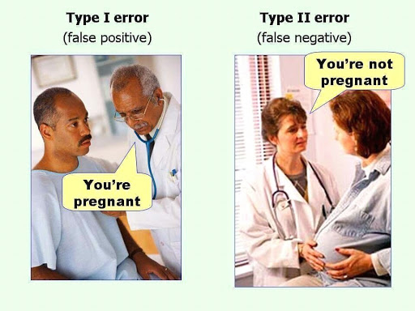

Slide 5


Slide 6
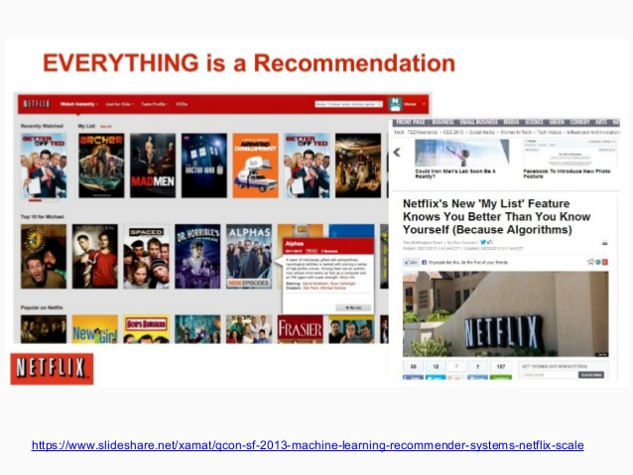
Recommender System
Netflix’s “My List” Feature knows you better than you know yourself.

Slide 7
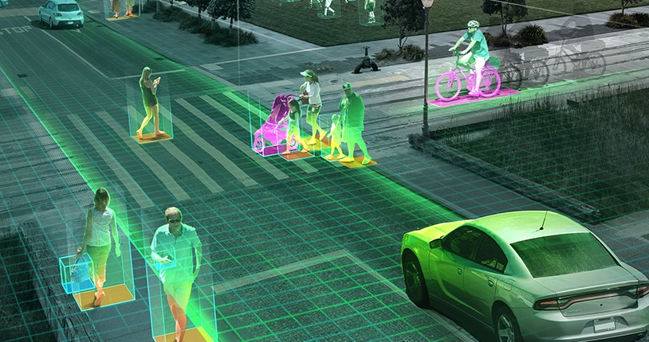
Computer vision

Slide 8

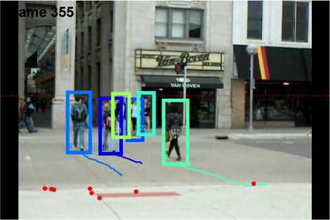
Image Processing

Slide 9

Self Driven Cars

Slide 10


Slide 11

NUMPY

Slide 12
What is NumPy

Slide 13

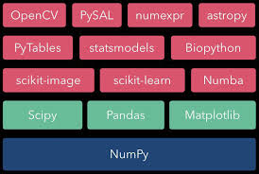
NUMPY ECOSYSTEM

Slide 14
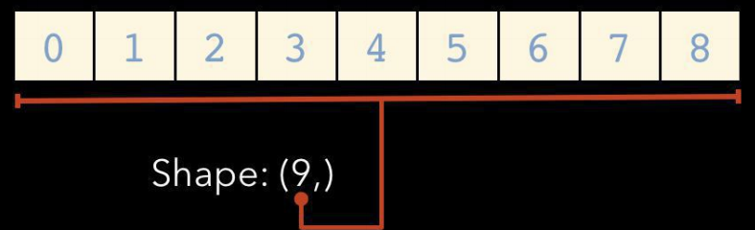
Array Shape

Slide 15
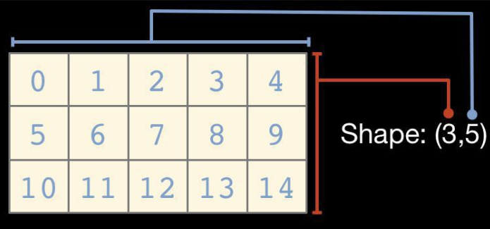
Two dimensional arrays

Slide 16
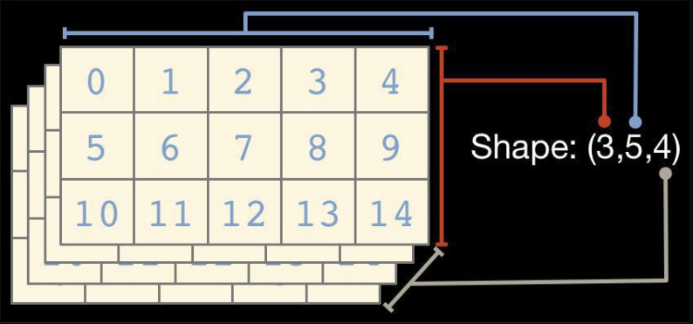
...And so on

Slide 17
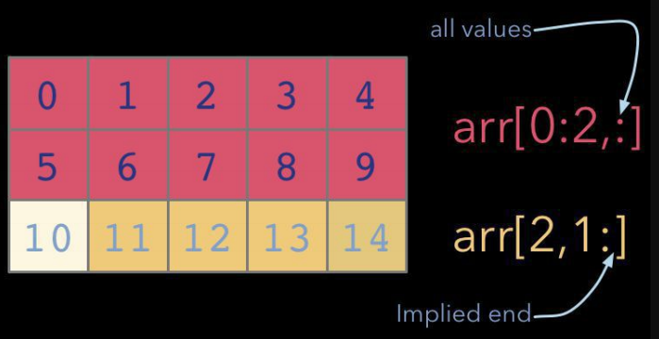
Indexing and Slicing

Slide 18
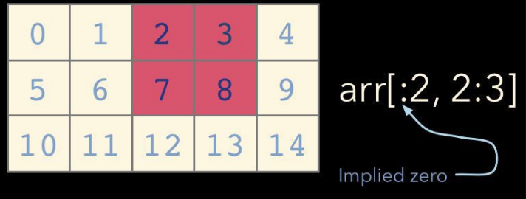

Slide 19
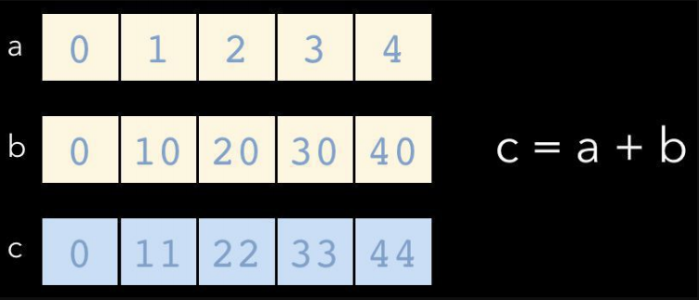
Maths Operations

Slide 20
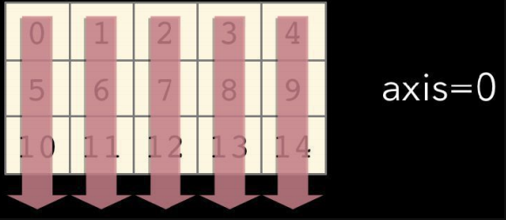
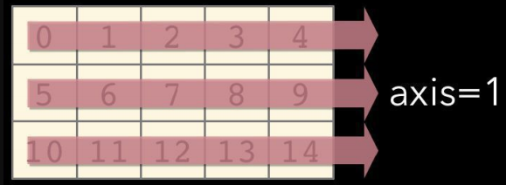
AXIS

Slide 21

So, lets start our practice

Slide 22
PANDAS

Slide 23
Agenda
What is Data Analysis?
What is Pandas?
How to perform data analysis with Pandas

Slide 24
Data Analysis:
Goals of Data Analysis:
Discover useful information
Provide insights
Suggest conclusions
Support Decision Making

Slide 25
What is pandas ?
Pandas is Python package for data analysis.
It Provides built-in data structures which simplify the manipulation and analysis of data sets.
Pandas is easy to use and powerful, but “with great power comes great responsibility”

Slide 26
Pandas Basics
Series
DataFrame
Creating a DataFrame from a dict
Select columns, Select rows with Boolean indexing

Slide 27
Pandas: Essential Concepts
Creating a Data frame and Viewing Data
Converting a Column into a list
Manipulating CSV text
Converting a Data Frame to a CSV
Renaming the Column name
String Methods
Manipulations on a Series
1. Creating a series
2. Selecting a series
3. Removing series from a data frame
4. Sorting a pandas Series

Slide 28
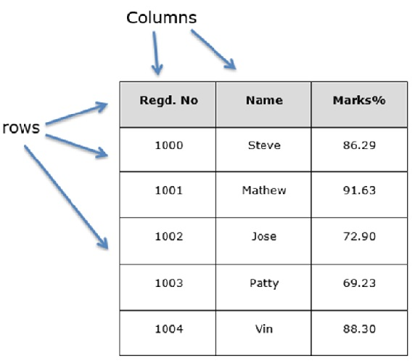
Dataframe

Slide 29
So, lets start our practice

