Slide 1
PYTHON HANGMAN GAME
Chirag Sharma 2210990241
22CS016

Slide 2
Index
Problem Statement
Objective
Code Snippets
Result
Source Code (screenshots)
Output
Conclusion
22CS016

Slide 3
PROBLEM STATEMENT
Develop a hangman game in Python that challenges users to guess a hidden word by providing letters, emphasising efficient coding practices, user-friendly design, and robust testing to ensure an engaging and error-free gaming experience.
22CS016

Slide 4
OBJECTIVE
Highlighting the practical application of Python programming fundamentals such as string manipulation, loops, and conditional statements through the development of the hangman game.
Showcase the importance of user experience by demonstrating the creation of a user-friendly interface, emphasizing usability principles in software design.
Emphasize the significance of rigorous testing and debugging in ensuring the reliability and functionality of the hangman game, showcasing problem-solving skills in software development.
22CS016

Slide 5
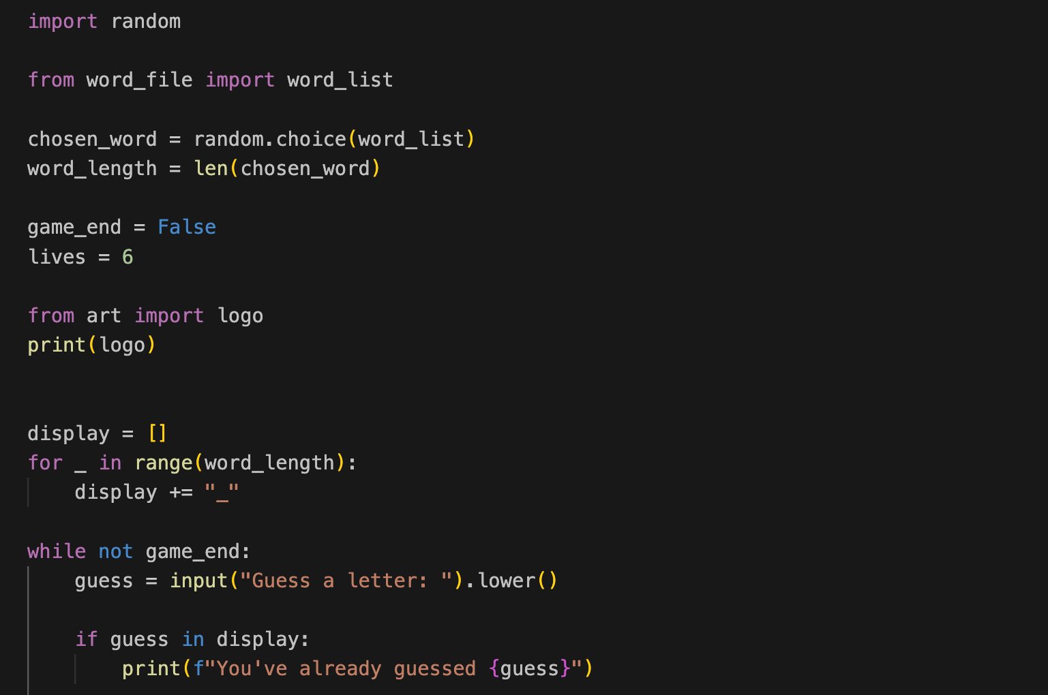
Code Snippets
C
22CS016

Slide 6
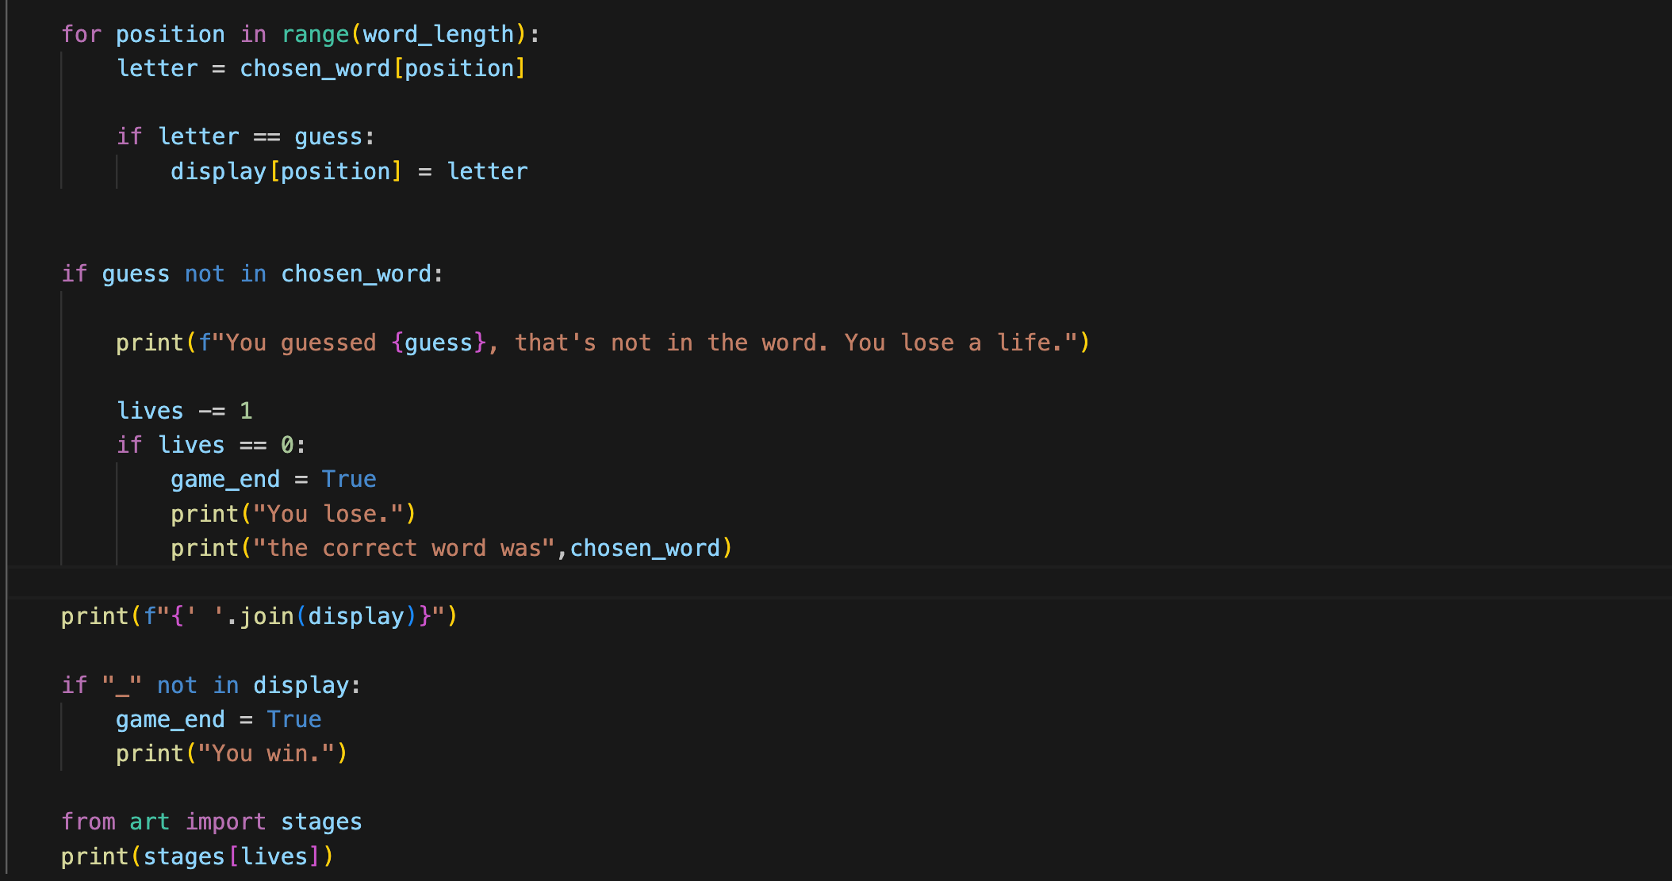
Code Snippets
22CS016

Slide 7
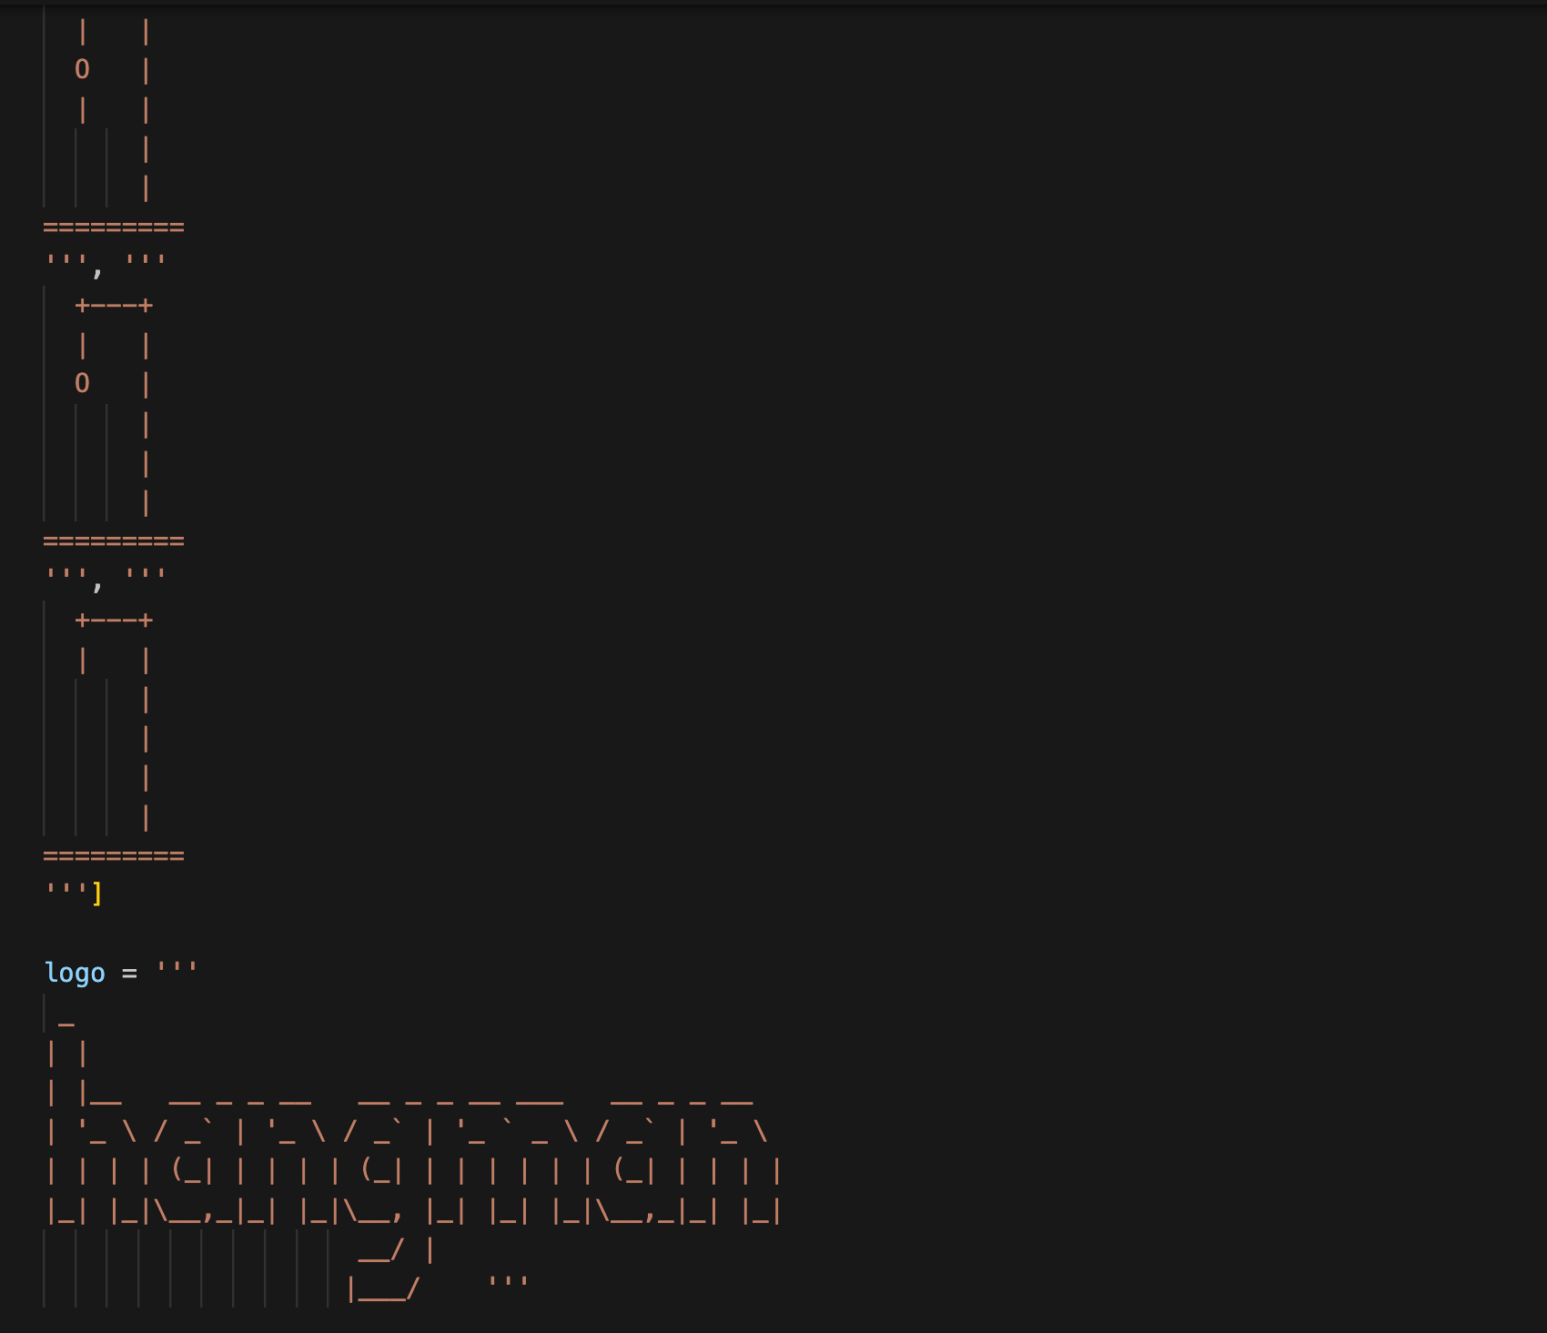
Code Snippets

Slide 8
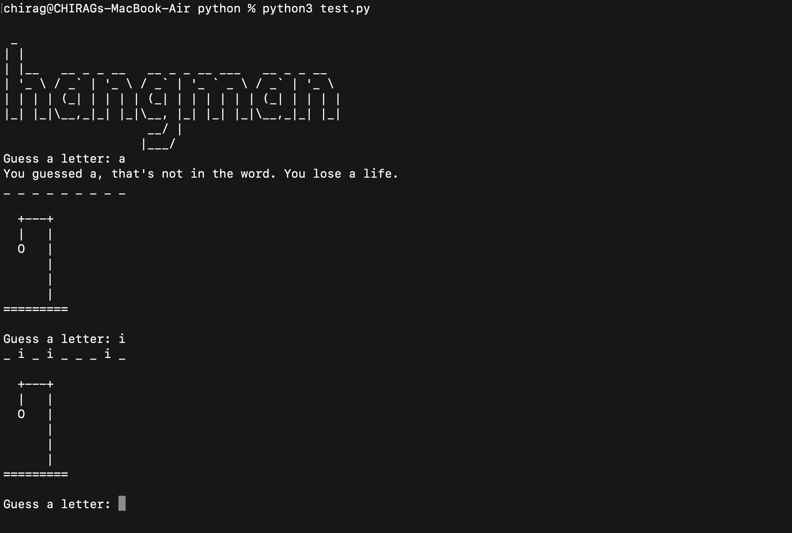
OUTPUT
22CS016

Slide 9
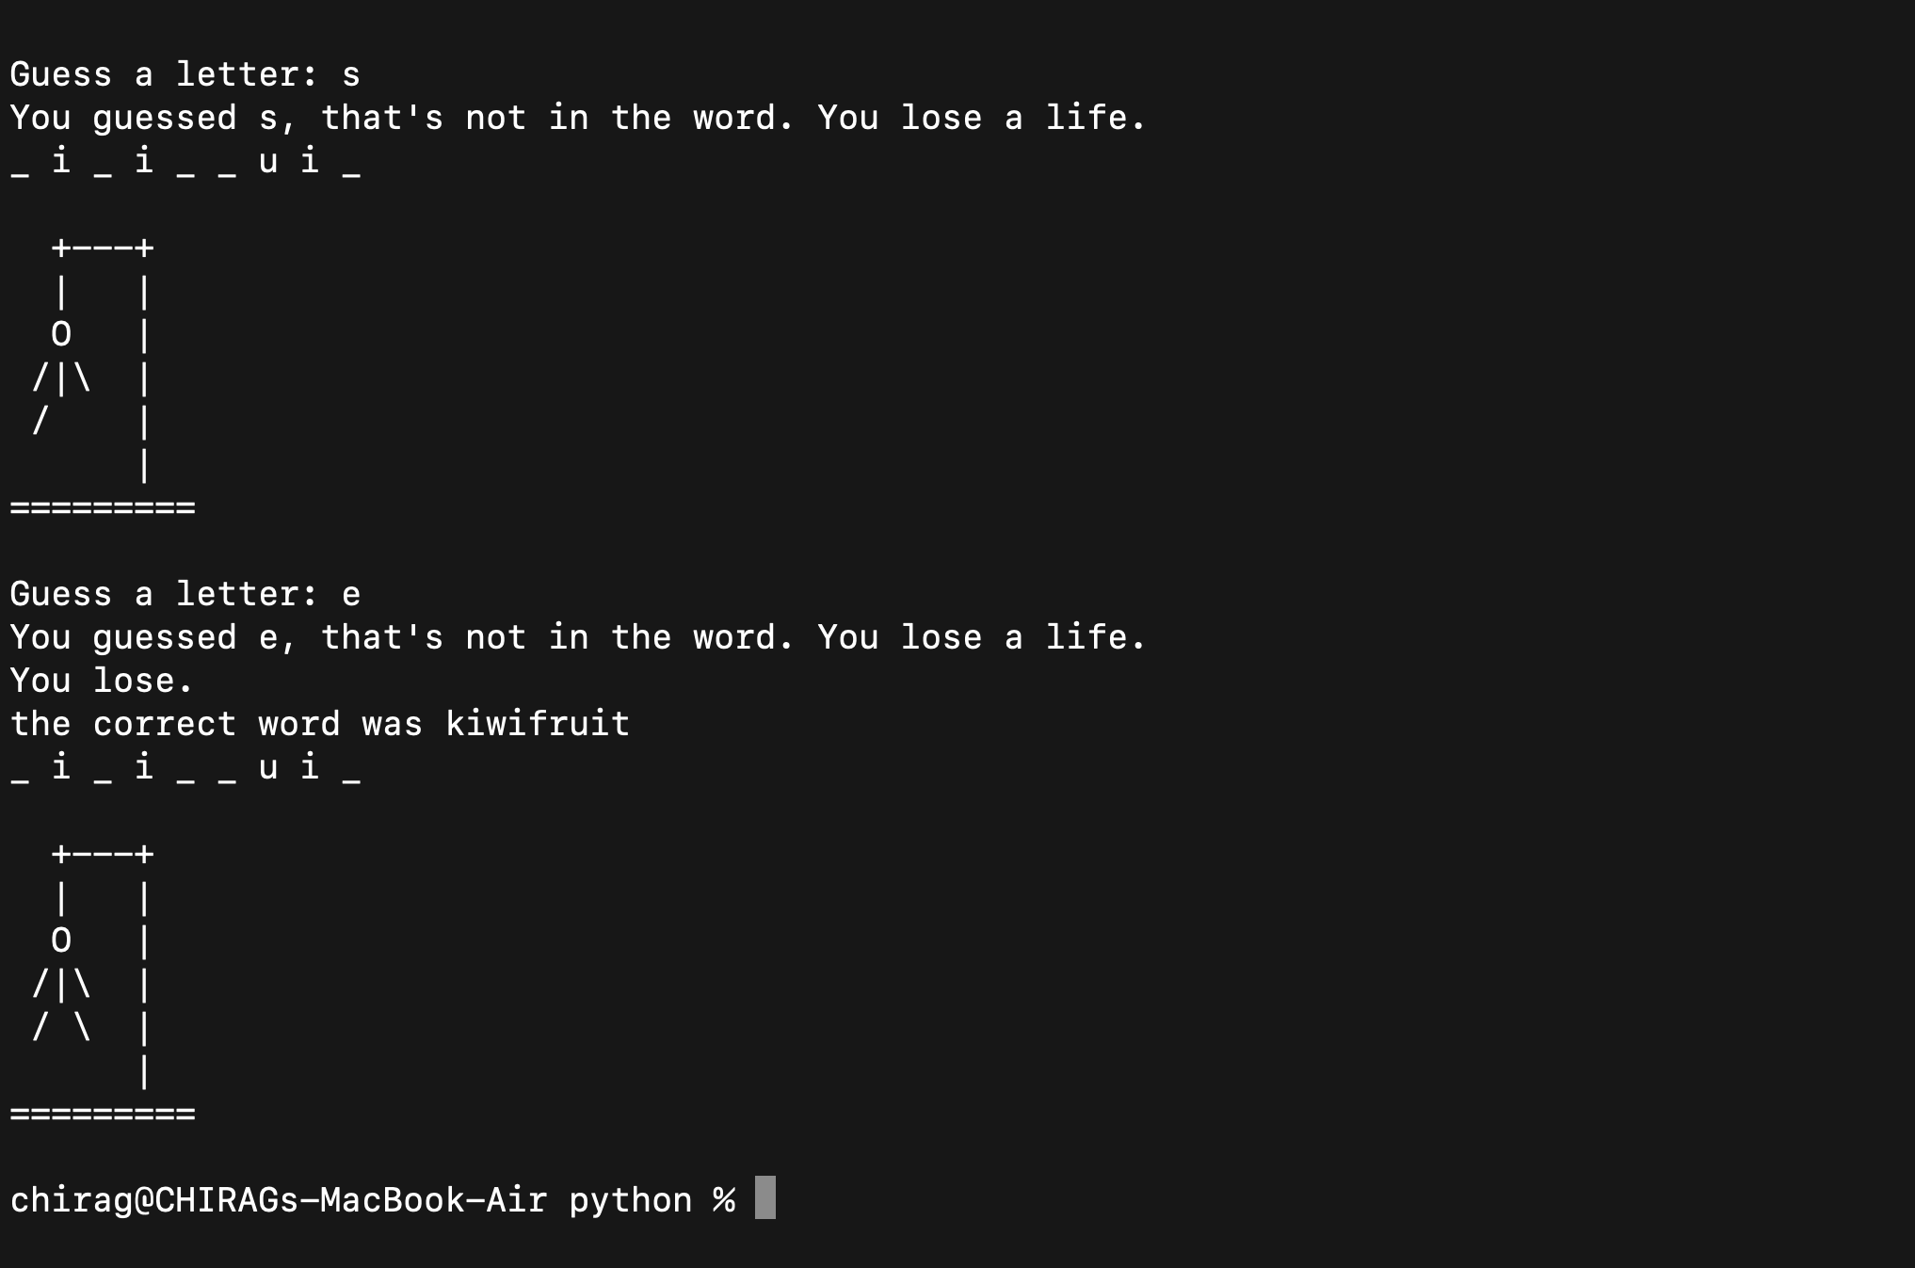
OUTPUT
22CS016

Slide 10
CONCLUSION
The hangman game project in Python provided hands-on experience with core programming concepts like string manipulation, loops, and conditionals.
Developing a user-friendly interface taught the importance of prioritizing user experience in software design.
22CS016

Slide 11

THANK YOU
22CS016

