Slide 1
Project Title:
Loan Eligibility Prediction
Team Member and Roll No.
Chirag Sharma (2210990241)-Leader Birinder Singh(2210990229)
22CS016

Slide 2
Index
Objective
Introduction
Approach & Technique
Algorithm
Result
Source Code (screenshots)
Conclusion
Reference
22CS016

Slide 3
Objective
The primary objective of this project is to develop machine learning models capable of predicting whether the candidate’s profile is relevant for Loan Approval or not. We aim to develop a model that accurately distinguishes between eligible and ineligible applicants using key features like Marital Status, Education, Applicant Income, Credit History, etc
22CS016

Slide 4
Introduction
• Loan approval is a critical process in the financial industry, with significant implications for both lenders and borrowers.
• However, traditional methods of assessing loan applications are often manual, time-consuming, and prone to errors.
• The problem statement revolves around developing automated models that can predict whether a loan application will be approved or rejected.
• By leveraging machine learning techniques, we aim to streamline the loan approval process and enhance decision accuracy.
22CS016

Slide 5
Approach & Techniques
Data Preprocessing:- Before building predictive models, it's essential to preprocess the dataset to ensure its quality and suitability for analysis.
The data preprocessing steps undertaken include:
Handling Missing Values: Identify and address missing values in the dataset using techniques such as imputation or removal.
Data Visualization Tools: Matplotlib was be employed for data visualization to gain insights into the dataset distribution and model performance, aiding in model interpretation and validation.
22CS016

Slide 6
Algorithm
We explore a variety of machine learning algorithms to identify the most suitable models for predicting loan eligibility.
The following machine learning algorithms are considered for model building:
Logistic Regression
Support Vector Machines (SVM)
Random Forest
Each algorithm has its unique characteristics and is suited to different types of problems. We evaluate their performance to determine the best-performing models.
By leveraging a diverse set of machine learning algorithms, we aim to maximise predictive accuracy.
22CS016

Slide 7
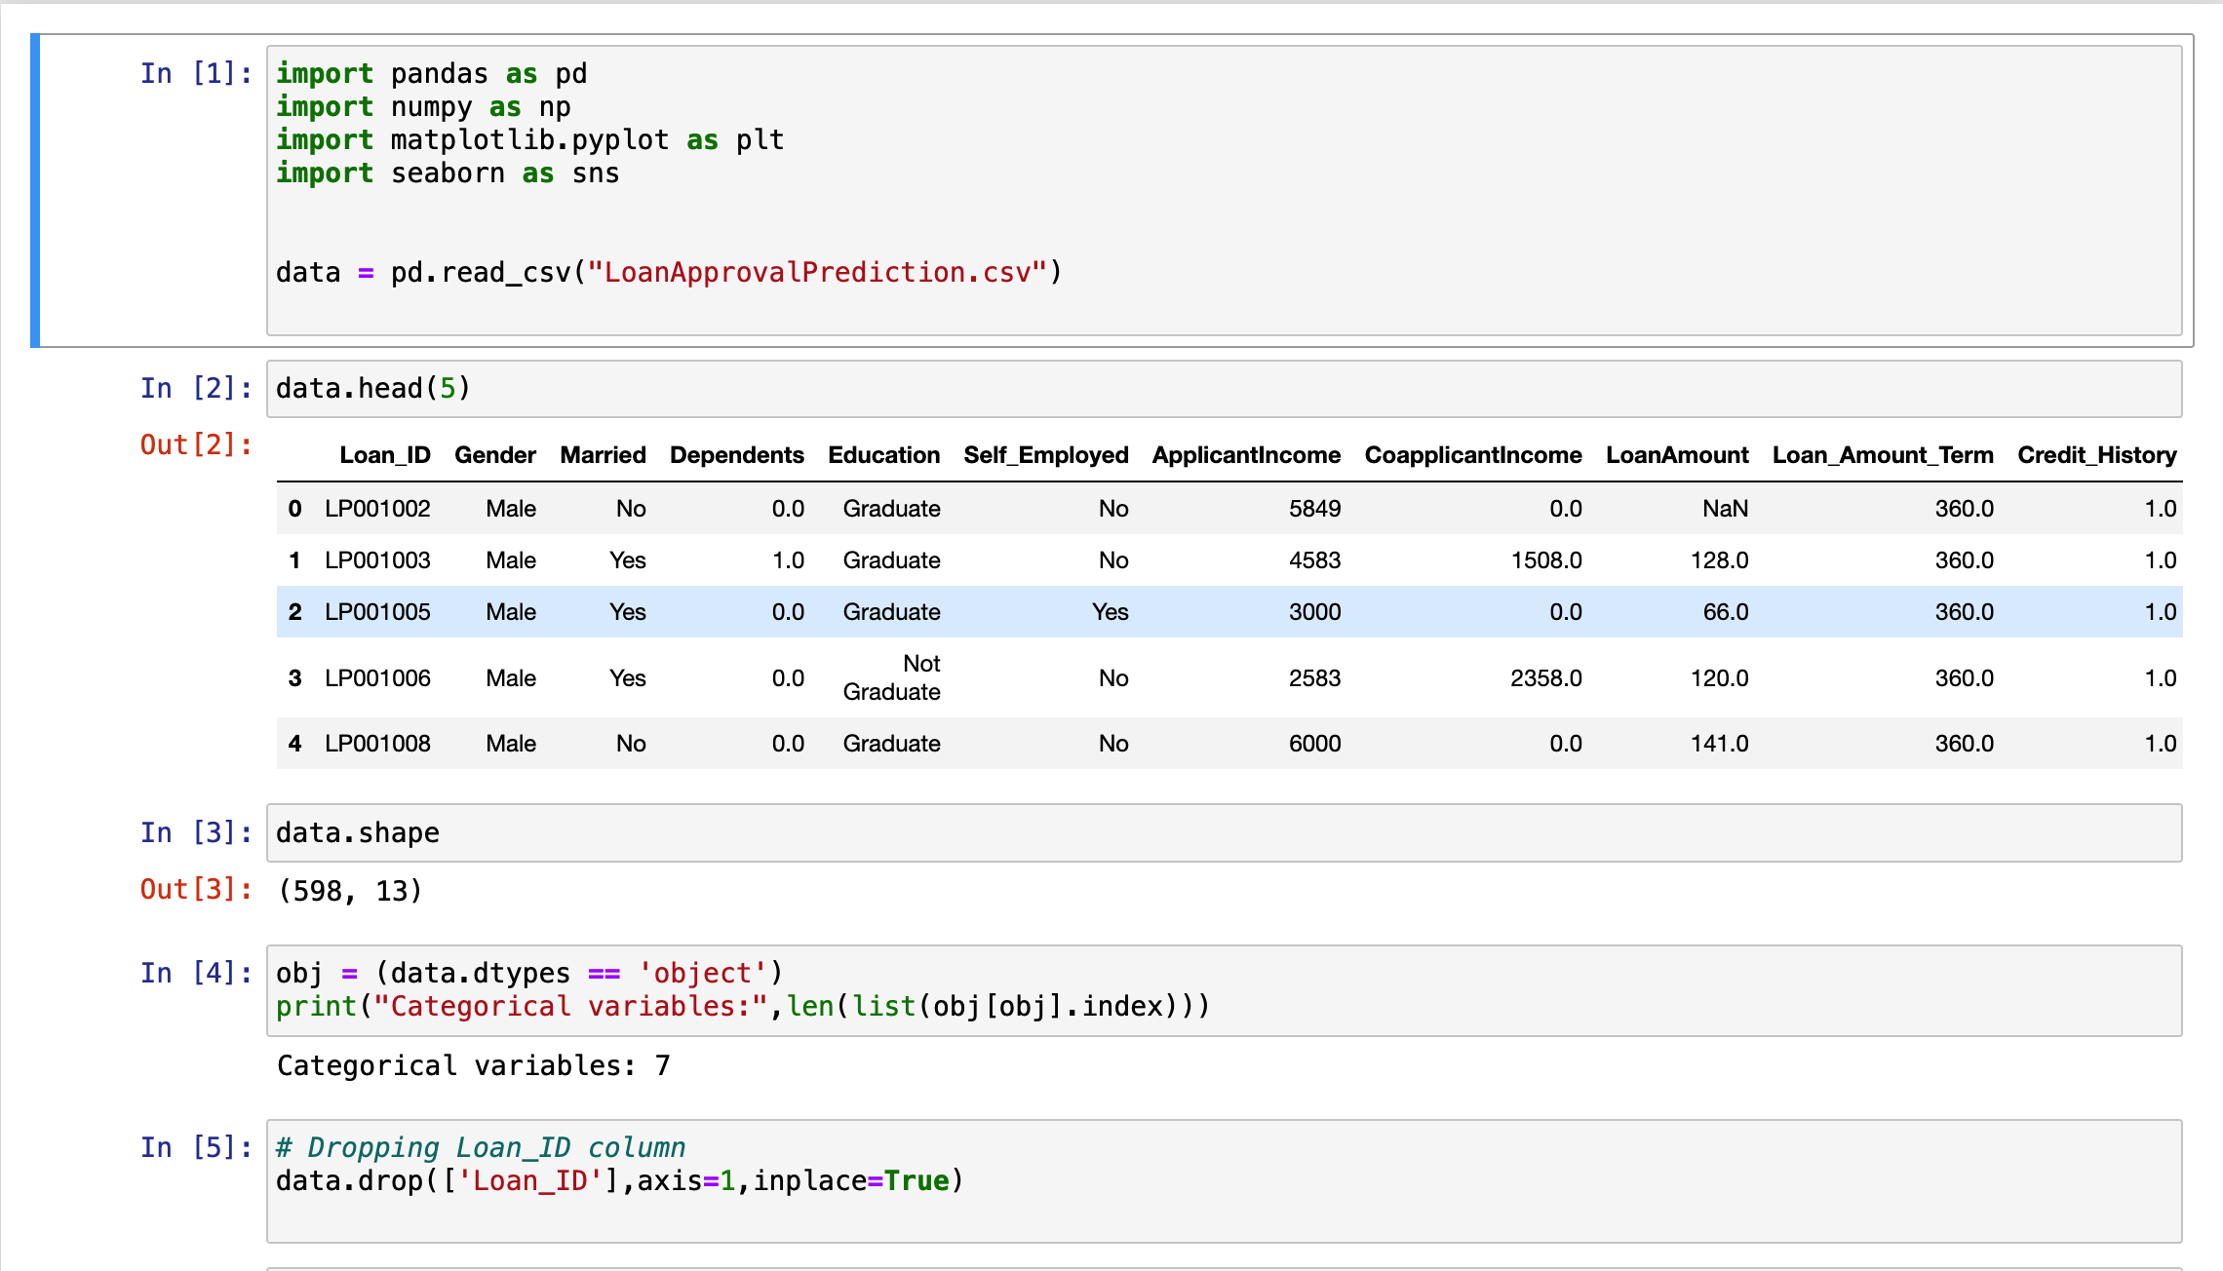
Screenshot
22CS016

Slide 8
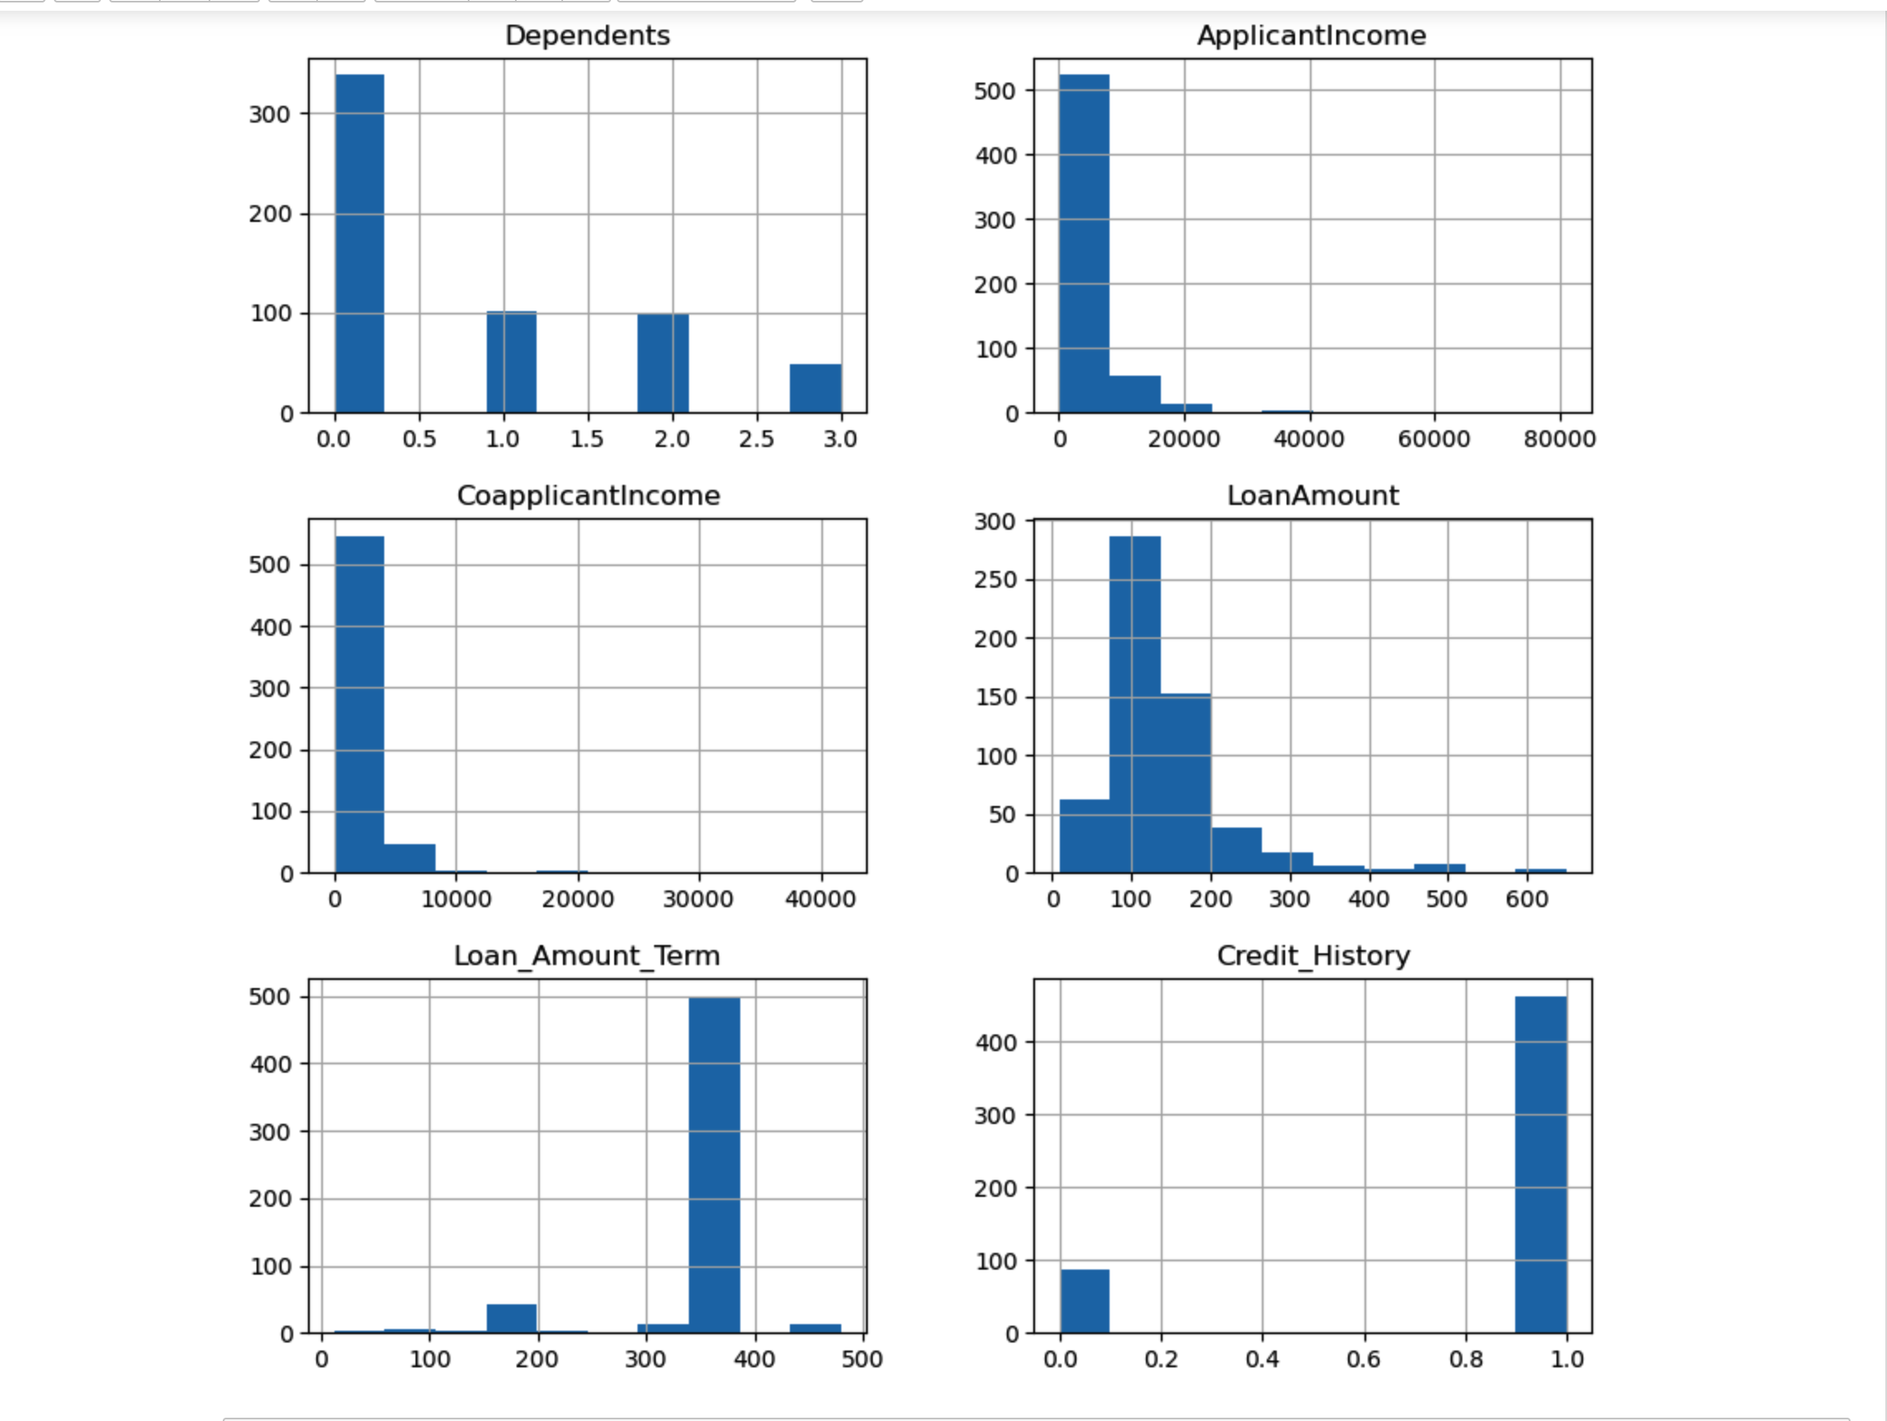
Screenshot
22CS016

Slide 9
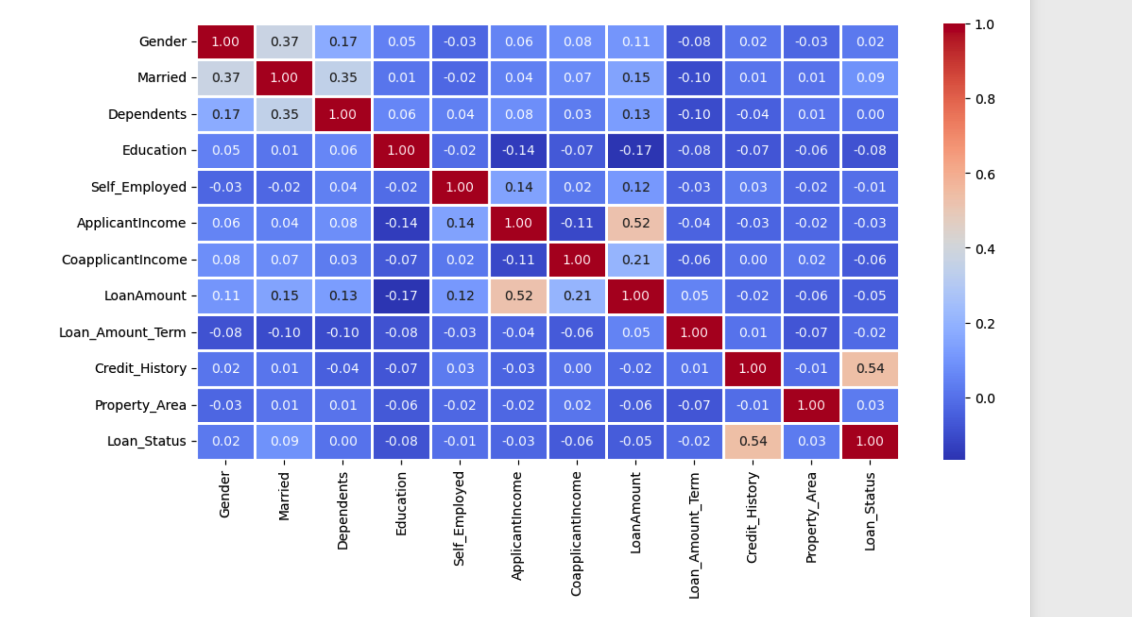
Screenshot

Slide 10
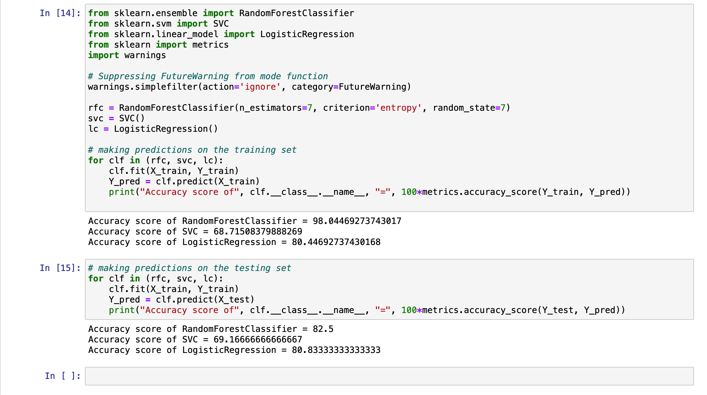
Result

Slide 11
Conclusion
In conclusion, our exploration into loan eligibility prediction using machine learning techniques has provided valuable insights into the predictive modelling process. Moving forward, there are several potential next steps to consider:
Deployment of Predictive Models: Implement the best-performing model(s) into production systems for real-time loan eligibility prediction.
Continuous Model Monitoring and Updates: Regularly monitor model performance and update models as new data becomes available to maintain accuracy and relevance.
22CS016

Slide 12
Reference
https://drive.google.com/file/d/1LIvIdqdHDFEGnfzIgEh4L6GFirzsE3US/view- (FOR THE DATASET)
https://www.youtube.com/
https://www.geeksforgeeks.org/python-for-machine-learning/?ref=shm
22CS016

Slide 13
Thank you!
22CS016

