Slide 1

CAR PRICE PREDICTOR USING LINEAR REGRESSION

Slide 2
MINI PROJECT CAR PRICE PREDICTOR USING LINEAR REGRESSION UNDER THE GUIDANCE OF: Prof. SUCHITRA PATIL NAME: CHIRAG WADKAR ADMISSION NO: 2020PE0280

Slide 3
ABSTRACT
Currently, owning a car is a necessity, as it plays a significant role in human transportation for different purposes such as going to work and to the hospital. However, with the current economic challenges, buying expensive cars can be a burden. The car market has shifted toward more affordable used cars. Due to the increasing number of used cars being sold, the price of used cars has become a major issue that could affect our sustainable way of living. The objective of this research is to understand the impact of the problem and to find empirical solutions by implementing a variety of machine learning techniques and big data tools on the prices of used cars. This solution will be helpful for first time used car buyers and also for sellers for determining the selling cost of the car. In this project, we develop a linear regression model that can estimate used car prices based on various features such as Company, Model, Purchase Year and Distance Travelled.

Slide 4
OBJECTIVE
The primary objective of the Car Price Predictor project is to develop a robust and user-friendly system that leverages Simple Linear Regression to predict the selling prices of used cars based on key features, specifically manufacturing year.
The integration of Flask, HTML, CSS, Bootstrap, and AJAX in the project's frontend ensures an intuitive user interface, facilitating seamless interactions with the predictive model.
The objective also extends to enhancing market research capabilities, aiding dealerships in inventory management, and providing valuable information to insurance companies for assessing the value of insured vehicles.
Additionally, the project aims to contribute to financial decision-making processes by offering potential car buyers insights into the estimated future values of cars, thus fostering a more transparent and informed used car market.
Overall, the Car Price Predictor project aspires to be a valuable tool for multiple stakeholders, contributing to a more efficient and data-driven approach to buying and selling used cars.

Slide 5
GOAL
Develop a predictive model capable of estimating car selling prices based on relevant features, with a focus on the impact of linear regression in this context.
Evaluate the effectiveness of the model in handling diverse scenarios, emphasizing the challenges and solutions associated with predicting prices for specific car models in certain years.
Assess the influence of dataset completeness and quality on the accuracy of predictions, emphasizing the importance of robust data handling in machine learning applications.
Compare the predictive performance of the developed model against alternative methods, highlighting the strengths and limitations of the proposed approach.
Discuss potential enhancements and extensions to the predictive model, including the integration of additional features, algorithmic refinements, and exploration of advanced machine learning techniques.
By achieving these goals, this research paper aims to advance the understanding of car price prediction models, providing a valuable resource for researchers, practitioners, and stakeholders in the automotive sector.

Slide 6
NEED OF THE SYSTEM
Informed Decision-Making
Market Transparency
User Empowerment
Time and Resource Efficiency
Improved User Experience
Research and Insights
Continuous Improvement

Slide 7
PURPOSE
This project is dedicated to the development and evaluation of a machine learning-based Car Price Predictor system, with a primary focus on advancing methodologies in the field of automotive pricing.
The project aspires to be a comprehensive decision support tool, empowering both buyers and sellers in making informed decisions and formulating competitive pricing strategies.
By contributing predicted prices for a diverse array of cars, the project aims to enhance market transparency, aiding users in comprehending fair market values.
Finally, the project establishes a foundation for iterative refinement, emphasizing continuous user feedback and ongoing research to ensure the model's sustained relevance and effectiveness in a dynamically evolving automotive landscape.

Slide 8
PROJECT SCOPE
This project focuses on developing a machine learning-based Car Price Predictor system, leveraging linear regression and real-world automotive data. The scope encompasses precise market valuation, comprehensive decision support for buyers and sellers, enhanced user experience, and contributions to market transparency. Additionally, the project showcases advanced machine learning techniques, provides strategic decision support for businesses, serves as a platform for research insights, and establishes a foundation for iterative refinement.

Slide 9
FEATURES
Model Development
The linear regression model is implemented and trained on the processed dataset. Evaluation metrics, including mean squared error and R-squared, are employed to assess the model's performance.
User Interface Design
A user-friendly interface has been designed to facilitate user interaction. Users can input specific details about a car, such as the company, model, and year and receive a predicted selling price.
Prediction Functionality
The project incorporates a dedicated module or function responsible for making predictions based on user input. This functionality is crucial for the practical application of the system.

Slide 10
TECHNOLOGIES USED
HTML & CSS
Python
Flask
JavaScript
AJAX (Asynchronous JavaScript and XML)
Bootstrap
SOFTWARE USED
Jupyter Notebook
PyCharm IDE

Slide 11
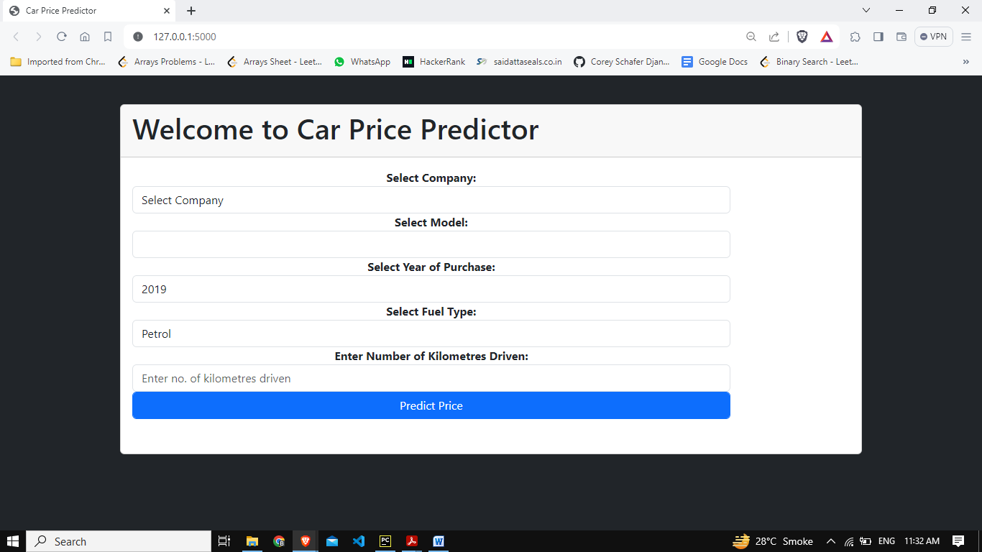
SNAPSHOT OF WORKING PROJECT

Slide 12
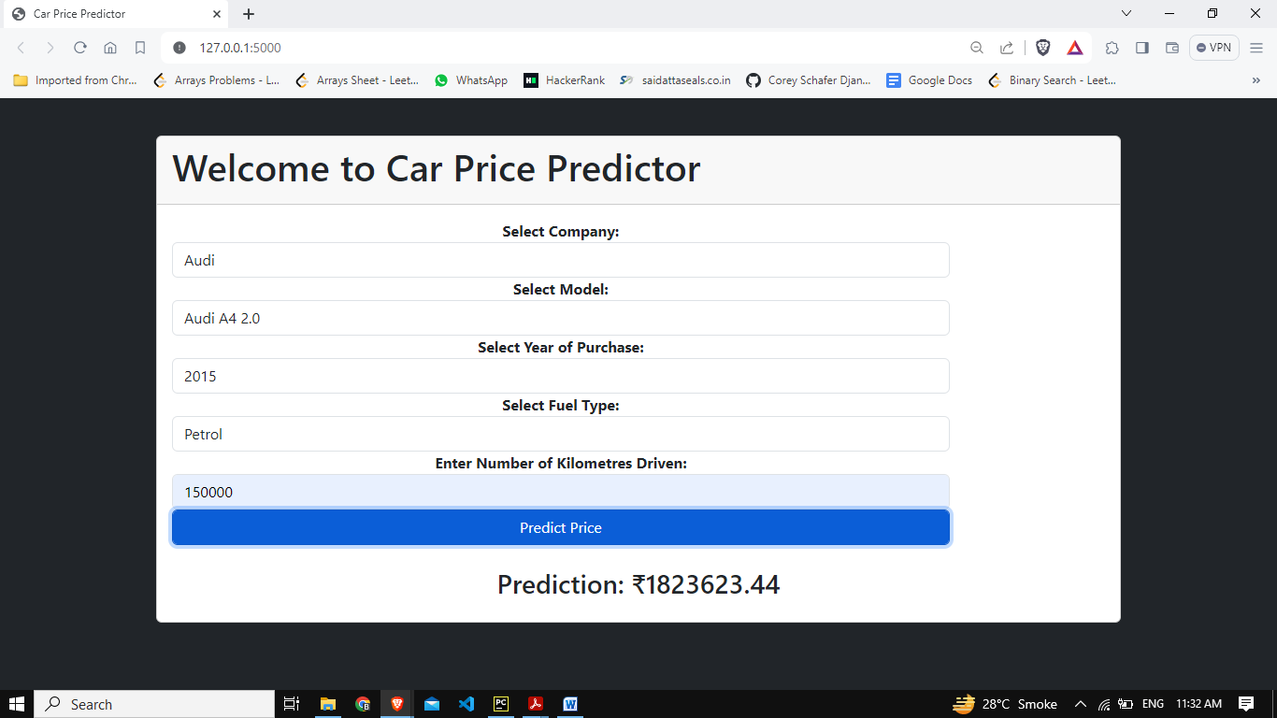
SNAPSHOT OF WORKING PROJECT

Slide 13
USE CASE
Buyer Guidance
Seller Pricing Strategy
Market Research
Insurance Assessment
Financial Decision-Making

Slide 14
CONCLUSION & FUTURE SCOPE
FUTURE SCOPE:
This web application involves the most basic machine learning algorithm, known as Linear Regression. In particular cases, difficult questions of judgment may arise.
CONCLUSION:
The project entitled “Car Price Predictor” is developed using Machine Learning in Python and Flask as frontend to predict the correct price of the car.

Slide 15
REFERENCES
https://www.kaggle.com/datasets/abhikalpsrivastava15/quikr-cars-dataset: Dataset
Alhakamy, A.; Alhowaity, A.; Alatawi, A.A.; Alsaadi, H. “Are Used Cars More Sustainable? Price Prediction Based on Linear Regression.” 2023, 15, 911. https://doi.org/10.3390/su15020911
Abishek R, Student, Big Data Analytics, SRM University, Chennai, Tamil Nadu, India; “Car Price Prediction Using Machine Learning Techniques”; Volume:04/Issue:02/February-2022 Impact Factor- 6.752 www.irjmets.com
Enis Gegic, Becir Isakovic, Dino Keco, Zerina Masetic, Jasmin Kevric, International Burch University, Sarajevo, Bosnia and Herzegovina, “Car Price Prediction Using Machine Learning Techniques”, Feb 2019, TEM Journal
Ramgiri Siva and Adimoola M, “Linear Regression Algorithm Based Price Prediction of Car and Accuracy Comparison with Support Vector Machine Algorithm”, 2022, The Electrochemical Society (ECS).
Sameerchand Pudaruth, Computer Science and Engineering Department, University of Mauritius, Reduit, Mauritius,“Predicting the Price of used Cars using Machine Learning Techniques”, International Journal of Information & Computation Technology. ISSN 0974-2239 Volume 4, Number 7 (2014)

Slide 16
THANK YOU

