Slide 1
💧 INDUSTRIAL EMBEDDED AUTOMATION
WTP-PLC 4.0: Clean Water Treatment
Low-Cost Micro-PLC Architecture with Integrated Local TFT HMI & Browser SCADA Digital Twin
• Core Processor: Espressif ESP32-S3 (Dual-Core LX7 @ 240MHz, 16MB Flash, 8MB PSRAM)
• Local HMI: 1.8" ST7735 SPI Color LCD (160x128) with Zero-Heap LVGL v8.3.11 Engine
• Remote SCADA: Embedded HTML5 Digital Twin (60 FPS Oscilloscope, Operations Audit Trail, P&ID)
• Target Application: Municipal & Industrial Sump Tank Level Management & Purification Stage Feeder

Slide 2
01. PROJECT INTRODUCTION
Executive Summary & System Purpose
The Industry Challenge
Traditional water pumping systems rely on fragmented multi-chip modules, LoRa transceivers, external cloud databases (e.g. Firebase), and proprietary mobile apps. These exhibit high latency, frequent cloud outages, and vulnerable multi-point failure chains.
The WTP-PLC 4.0 Solution
A unified, industrial-grade Micro-PLC that runs 100% standalone and offline. It directly couples dual-core deterministic pumping logic, hard electrical safety interlocks, local physical display, and browser SCADA onto a single monolithic system.
Key Engineering Value
• Sub-millisecond hard execution cycle
• Sub-$35 BOM cost vs $600+ industrial PLCs
• Zero recurring cloud subscriptions
• Zero-dependency offline SCADA web twin
• Auto-recovery electrical supervisor

Slide 3
02. MOTIVATION & PROBLEM STATEMENT
Why Build WTP-PLC 4.0? Architectural Comparison
Evaluation Metric | Legacy Multi-Chip / Cloud IoT Architecture | WTP-PLC 4.0 Embedded Architecture
Internet & Cloud Dependency | Fails completely during cloud, Wi-Fi or ISP outages. High network latency (500ms - 3s). | 100% Standalone & Offline. Deterministic local execution cycle (< 1 ms).
Electrical Motor Protection | Often relies on external passive fuses or unmonitored relay boards without fault telemetry. | Integrated quad active interlocks (Over/Under Volt, Dry Run, Overload) with instant cutoff.
Fault Recovery | Requires manual on-site reset or remote phone restart after momentary line transients. | Demand-Driven Auto-Recovery: restores operation immediately when power parameters normalize.
Local HMI Feedback | Primitive 16x2 character LCDs or no local display (requires operator phone app). | 1.8" Color TFT running rich LVGL graphics (telemetry, live clock, presets & alerts).
System Bill of Materials | $180 - $250 multi-module stack with frequent component obsolescence. | Under $35 total BOM cost on a compact, highly reliable single-board design.

Slide 4
03. ARCHITECTURAL OVERVIEW
System Block Diagram & Architecture Overview
INPUT SUBSYSTEM
ESP32-S3 CORE ENGINE
OUTPUT / ACTUATORS
DUAL HMI & SCADA
• Digital Start Button (GPIO 4)
10kΩ pull-down debounced
Short: Run | 3s: Clear E-Stop
• Digital Stop Button (GPIO 6)
10kΩ pull-down debounced
Short: Stop | 2s: Toggle Mode
• Latching E-Stop (GPIO 5)
Instant hardware lockout
• Virtual Float Level Sensors
High Level: >= 75%
Cutoff Level: <= 20%
• AC Telemetry Monitoring
Real-time Volts & Amps
• Dual-Core Xtensa @ 240MHz
16MB Flash + 8MB Octal PSRAM
• Deterministic Logic State Machine
Sub-millisecond loop cycle
• Demand-Driven Supervisor
Active demand latching &
autonomous fault recovery
• Non-Volatile Flash (NVS)
Saves trip points permanently
• FreeRTOS Task Scheduler
• Motor Contactor Relay (GPIO 7)
Active HIGH 5V optocoupled
driver to industrial pump
• WS2812B Status NeoPixel (GPIO 48)
White: Standby | Green: Run
Red: Stopped | Amber: Fault
Red Blink: E-STOP Active
• Hardware Interlock Circuit
Sub-ms cut-off response
• Local 1.8" Color LCD (ST7735)
Hardware SPI (16MHz clock)
Zero-heap LVGL v8.3.11
Montserrat font typography
• Embedded SCADA Digital Twin
Web server @ 192.168.4.1
Bi-directional WebSockets (<5ms)
60 FPS Canvas Oscilloscope
Full Audit Trail with durations

Slide 5
04. HARDWARE SPECIFICATION
Complete Hardware Bill of Materials (BOM)
Component Name | Technical Specification / Features | Pin / Interface | Role in WTP-PLC System
ESP32-S3-WROOM-1U | Xtensa LX7 Dual-Core @ 240MHz, 16MB Flash, 8MB PSRAM, Wi-Fi AP | Main Processing Core | PLC Logic, HMI Driver, SCADA Web Server
ST7735 1.8" TFT LCD | 160x128 Resolution, 16-bit RGB565, 4-wire SPI, Backlight control | GPIO 8, 9, 10, 11, 12, 21 | Control Cabinet Local Industrial HMI
5V Optocoupled Relay | Songle SRD-05VDC-SL-C, 10A 250VAC contact rating, Flyback diode | GPIO 7 (Active HIGH) | Clean Water Sump Pumping Motor Contactor
Industrial Push Buttons (x2) | Tactile momentary switches with 10kΩ external pull-down resistors | GPIO 4 (Start), GPIO 6 (Stop) | Start/Clear, Stop/Mode Switching
Emergency Stop Switch | Industrial latching mushroom-head switch with 10kΩ pull-down | GPIO 5 (Active HIGH) | Instant Hardware Cutoff & Latch
Onboard WS2812B RGB | Addressable single-wire NeoPixel optical indicator | GPIO 48 (Data) | Optical Plant Status & Diagnostics Code
Regulated Power Supply | 5V 2A DC Switch-Mode Power Supply (SMPS) with 3.3V LDO | VIN & 3V3 Rails | System Power to ESP32, Display & Relay

Slide 6
05. ELECTRICAL & PIN CONNECTIONS
Hardware Pin Allocation & Interfacing Details
Signal Name | ESP32-S3 Pin | Circuit Configuration & Role
MOSI / SDA | GPIO 11 | Hardware SPI Master Out (16 MHz SPI bus)
SCK / SCL | GPIO 12 | Hardware SPI Clock line to ST7735 display
CS (Chip Select) | GPIO 10 | Active LOW SPI Slave select for ST7735
DC / A0 | GPIO 9 | Data/Command Select (LOW: Cmd, HIGH: Data)
RESET | GPIO 8 | Active LOW Hardware display reset pulse on boot
Backlight (BL) | GPIO 21 | Active HIGH LCD Backlight via BC547 NPN
START Button | GPIO 4 | Input with 10kΩ pull-down (Short: Run, 3s: E-Reset)
STOP Button | GPIO 6 | Input with 10kΩ pull-down (Short: Stop, 2s: Mode)
E-STOP Button | GPIO 5 | Input with 10kΩ pull-down (Instant Cutoff Latch)
Motor Relay Out | GPIO 7 | Active HIGH Digital Output to 5V contactor relay
⚡ Digital Input Filtering Rules
• All 3 industrial push buttons utilize external 10kΩ pull-down resistors to GND.
• 50ms software debouncing prevents mechanical contact chatter from causing false triggers.
• Non-blocking millis() timer state machines allow simultaneous press & hold detection.
🛡️ Relay Isolation & Safety Interlock
• GPIO 7 drives optocoupled transistor isolation to prevent inductive motor kickback.
• Default boot state is strictly LOW (Pump OFF) to prevent unintended starts on power recovery.
• Hardware E-STOP unconditionally pulls relay LOW in sub-millisecond execution loop.

Slide 7
06. TECHNICAL APPROACH
Technical Approach & Firmware Logic Pipeline
1. Input Scanning & Debounce
Reads physical buttons every cycle. Evaluates press duration for short-press vs 2s mode toggle and 3s E-STOP hold reset without blocking.
2. Electrical Fault Evaluation
Samples live AC Voltage and Current. Instantly trips if V > 260V, V < 180V, I < 0.5A (dry run), or I > 12.0A (overload jam).
3. Demand-Driven Supervisor
Maintains active pumping demand. When electrical trips clear, supervisor automatically restores pump without requiring manual restarts.
4. Dual Telemetry Broadcast
Updates local ST7735 LCD via rate-limited dirty-check LVGL pipeline (250ms) and pushes WebSockets JSON to SCADA (<5ms latency).

Slide 8
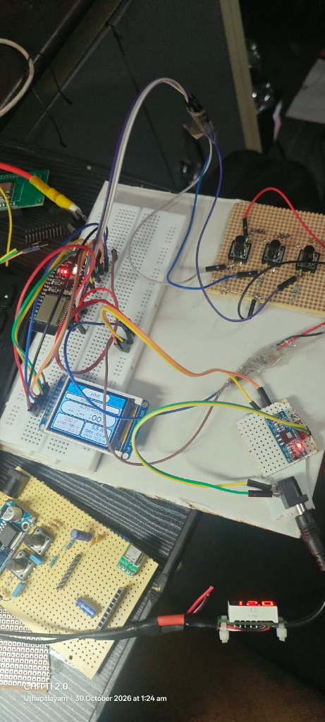
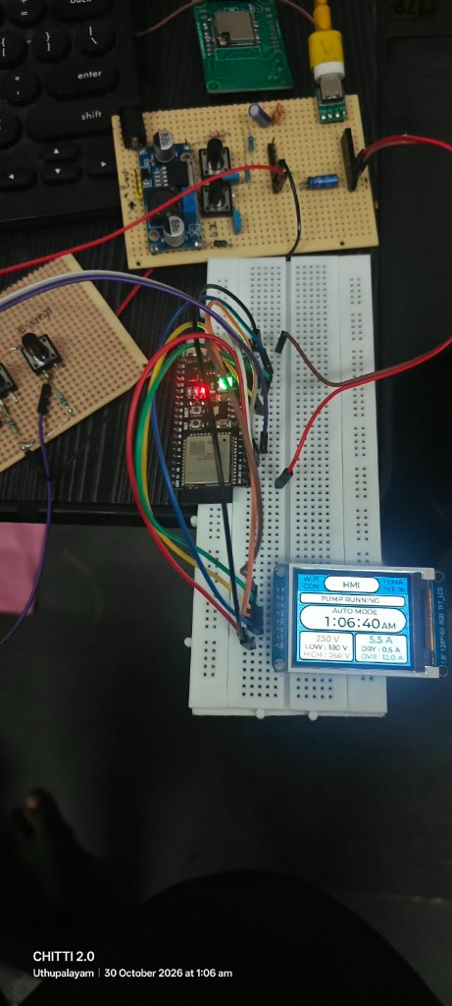
07. HARDWARE VERIFICATION
Physical Hardware Benchmarks & Breadboard Verification
⚡ Measured Live Benchmarks
• Flash Memory Usage:
1.39 MB / 4.0 MB (33.3% utilized) — Leaves >2.6 MB free for OTA upgrades.
• SRAM Internal Heap:
119.5 KB / 320 KB (36.5% utilized) — Zero dynamic heap allocations in main loop.
• PLC Execution Loop:
< 1 millisecond response cycle — Hard deterministic reaction time.
• Display Refresh Rate:
250ms dirty-check snapshot with instant forced refresh on critical state trips.
• WebSocket Latency:
< 5ms broadcast latency to connected mobile/tablet/PC dashboards.
Figure 1: Verified Breadboard Wiring (ESP32-S3, Buttons & LCD)
Figure 2: Real-time ST7735 LVGL Interface (Clock, V/I & Presets)

Slide 9
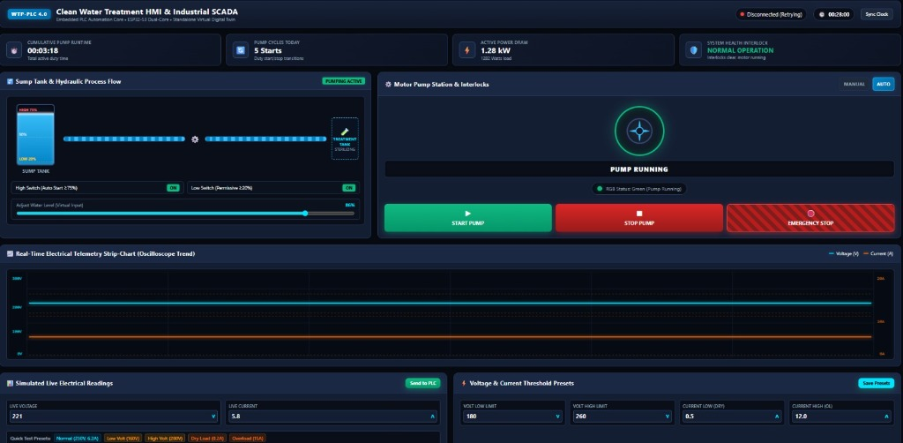
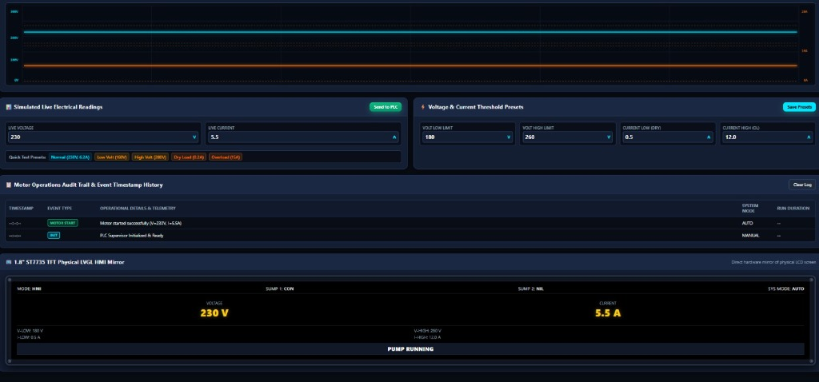
08. SCADA WEB INTERFACE
Embedded Web SCADA 4.0 Digital Twin
🖥️ Digital Twin Features
• Pure HTML5 Canvas 60 FPS Oscilloscope (Cyan V, Amber I).
• Complete audit trail recording start/stop durations (e.g. 'Ran for 48s').
• Dynamic hydraulic P&ID animation with moving pipe flow waves.
• 1.8" LCD mirror preview with industrial corner bolts.
• Zero-lag bidirectional parameter tuning.
Figure 3: Full SCADA Dashboard & Animated Hydraulic P&ID
Figure 4: 60 FPS HTML5 Oscilloscope & Motor Run Log

Slide 10
09. CONCLUSION & SUMMARY
Conclusion, Key Achievements & Future Scope
Engineering Achievements
• Successfully eliminated fragile cloud and LoRa dependencies.
• Monolithic single-chip ESP32-S3 PLC + HMI + SCADA architecture.
• Verified <1ms deterministic PLC loop cycle time.
• Zero-heap LVGL driver prevents memory fragmentation crashes.
Operational Impact
• Sub-$35 total bill of materials delivers enterprise-grade PLC performance.
• Quad active safety interlocks protect expensive commercial pump assets.
• Self-healing auto-recovery minimizes plant downtime without manual dispatch.
• Accessible across control cabinets (TFT) and field devices (SCADA).
Future Scalability Scope
• RS485 / Modbus RTU integration for physical industrial energy meters.
• Over-The-Air (OTA) firmware update partition utilized over Wi-Fi AP.
• Multi-tank cascade pumping algorithms for multi-stage water treatment.
• DIN-rail compliant injection molded enclosure design.

