Slide 1





SOCCER BETTING WITH MACHINE LEARNING
Ryan Chiu, Santiago Calvo, Mamadou Diallo and Steve Sibson

Slide 2
RUNDOWN
01
02
EXPANSION FROM PROJECT 2
API and EXPANDED FEATURES
03
04
SUCCESSES AND FAILURES
LOOKING FORWARD
Assessing our goals at the end of the second project, and how we’ve addressed them
Technical analysis of the added features and the API used
Challenges we faced in expanding our algorithm
Where we go from here. Market for the algorithm. Q&A

Slide 3
ADDRESSING OUR GOALS FROM PROJECT 2
GOALS
SOLUTIONS
Different compilation methods for individual teams
Predicting with player lineups evaluated
Function usage to improve Notebook efficiency
Expanding to other leagues and sports
We assessed each team with additional features
Individual player assessment deemed too labor intensive
Replaced CSVs with API for easier data access
Model is replicable across any league offered by API service

Slide 4
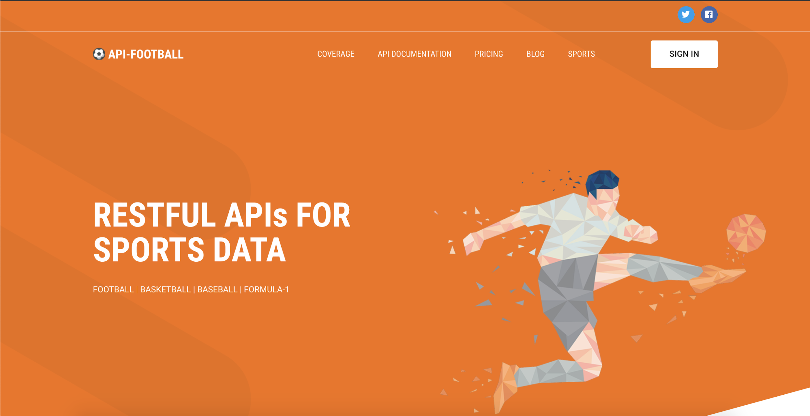
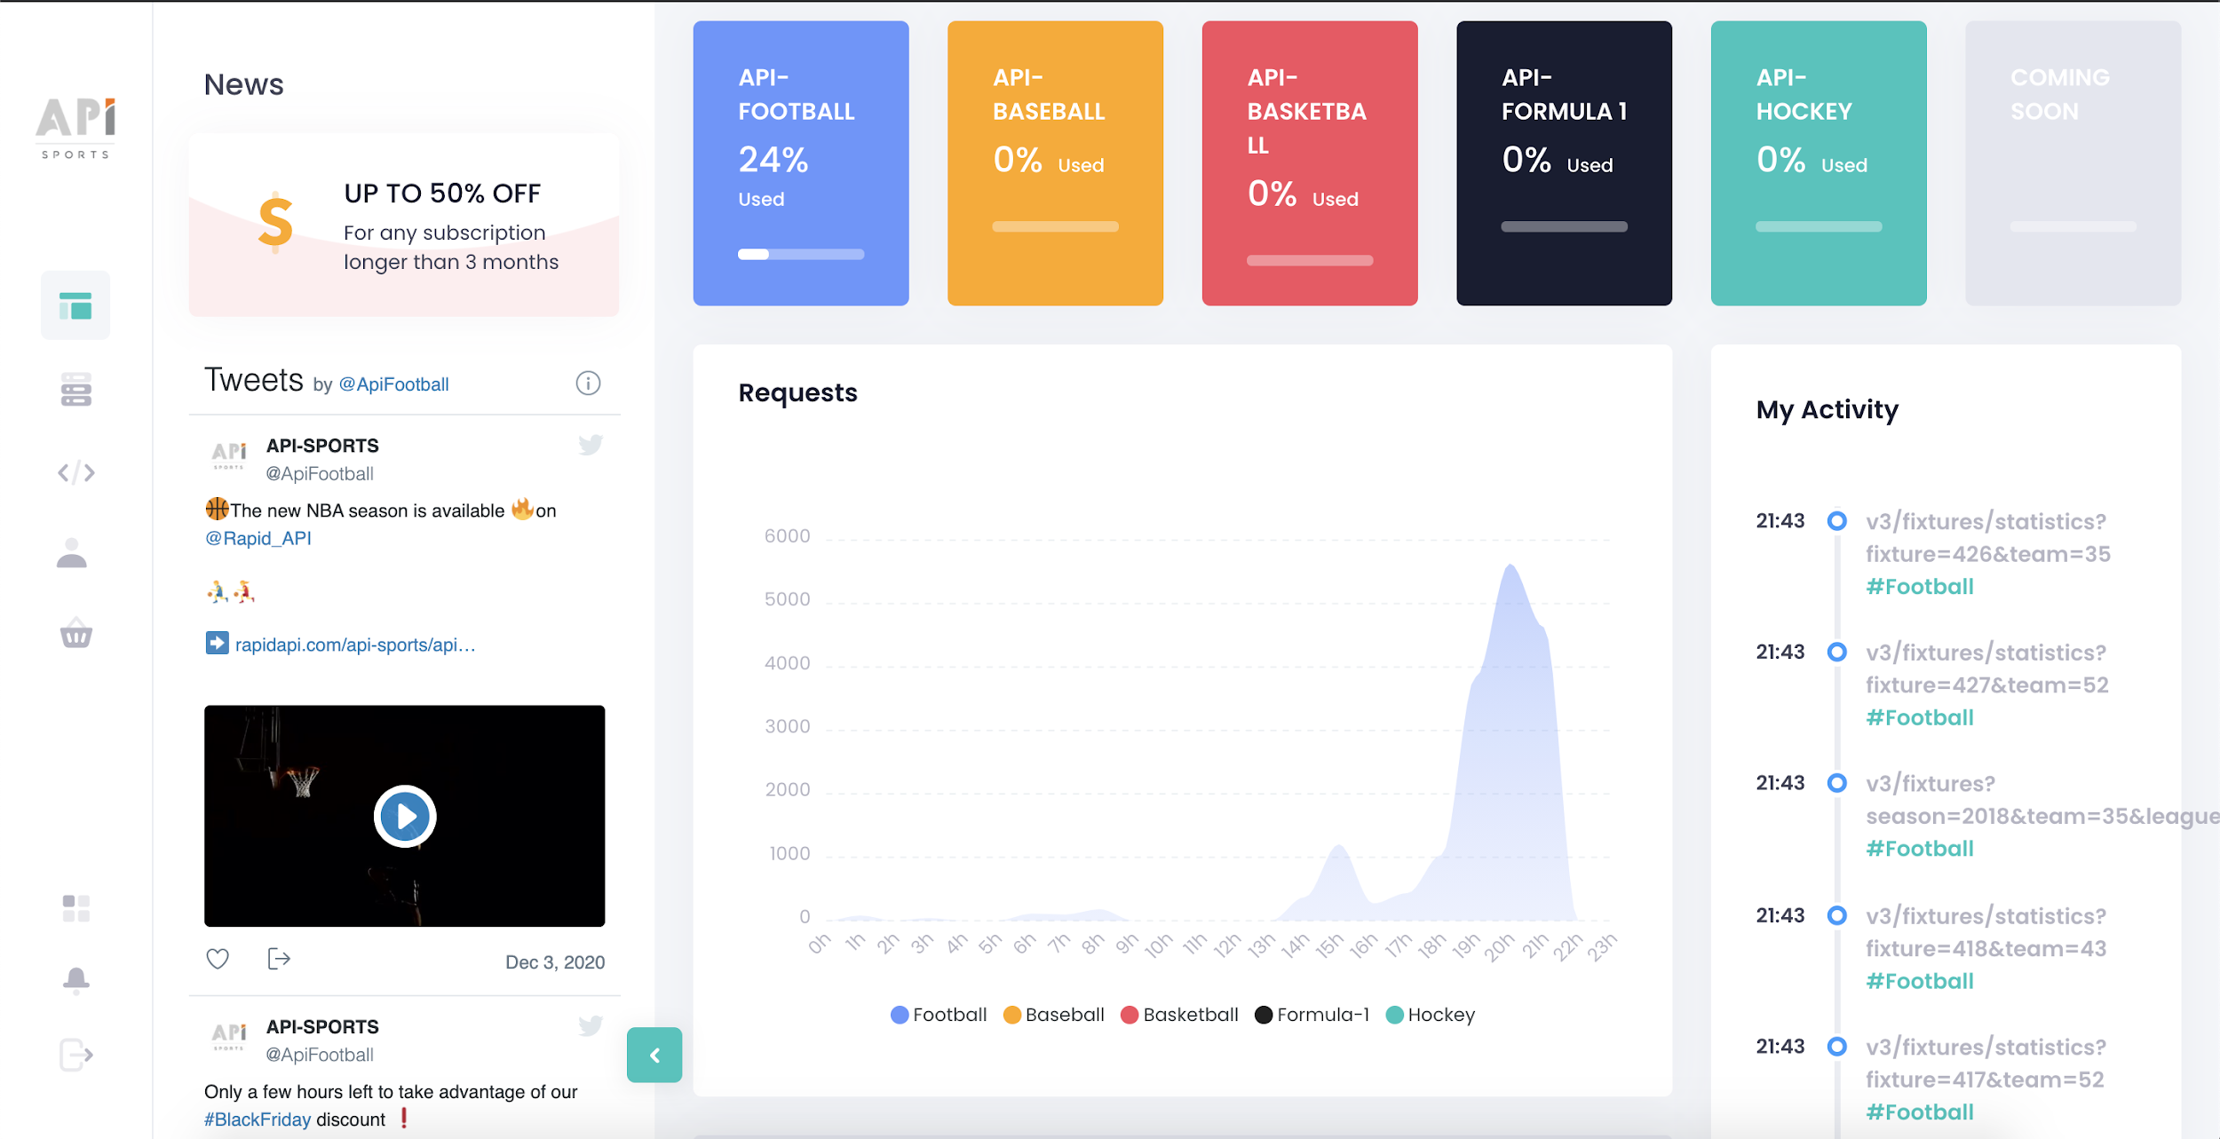
INCLUSION OF API-FOOTBALL

Slide 5
NEW FEATURES
Match Statistics (Shooting, Disciplinary, etc.)
Inclusion of Draws
Adaptability to include other leagues(La Liga, Ligue 1, Serie A, etc.)
Inclusion of margin of victory

Slide 6
NOTEBOOK and CODING

Slide 7
SUCCESSES AND CHALLENGES
SUCCESSES
CHALLENGES
Inclusion of comprehensive statistics
Improved accuracy over previous ML Model
Ability to assign our own odds without previous odds as a feature
Call time for API
Conversion of language between .JSON and Python
Figuring out how to create a shift for previous fixtures

Slide 8





MARKET and APPLICATIONS

Slide 9
FUTURE IMPROVEMENTS
Individual Player rating and assessment
Moving odds based on betting patterns
Additional Models outside of current LR model

Slide 10
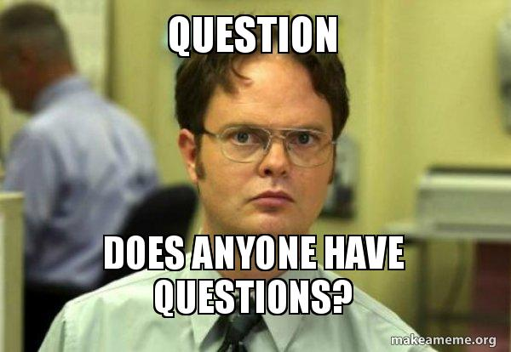

Slide 11
THANK YOU!

