Slide 1





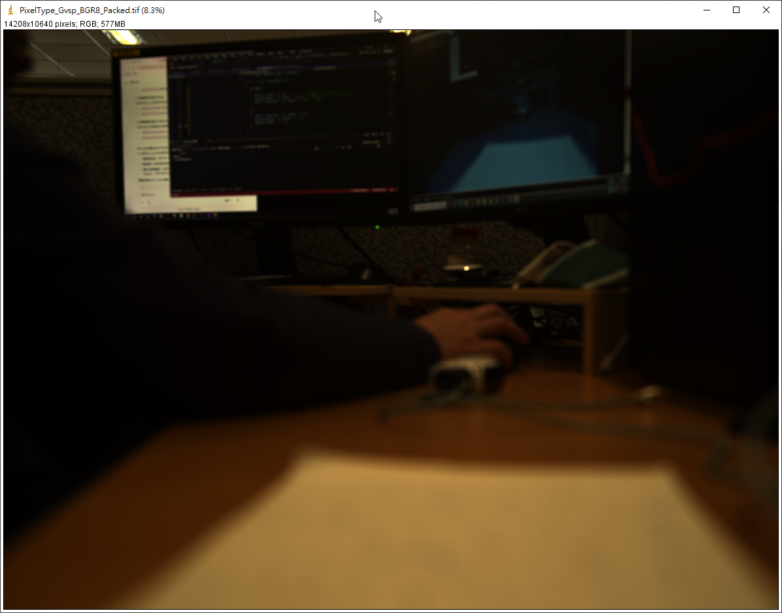





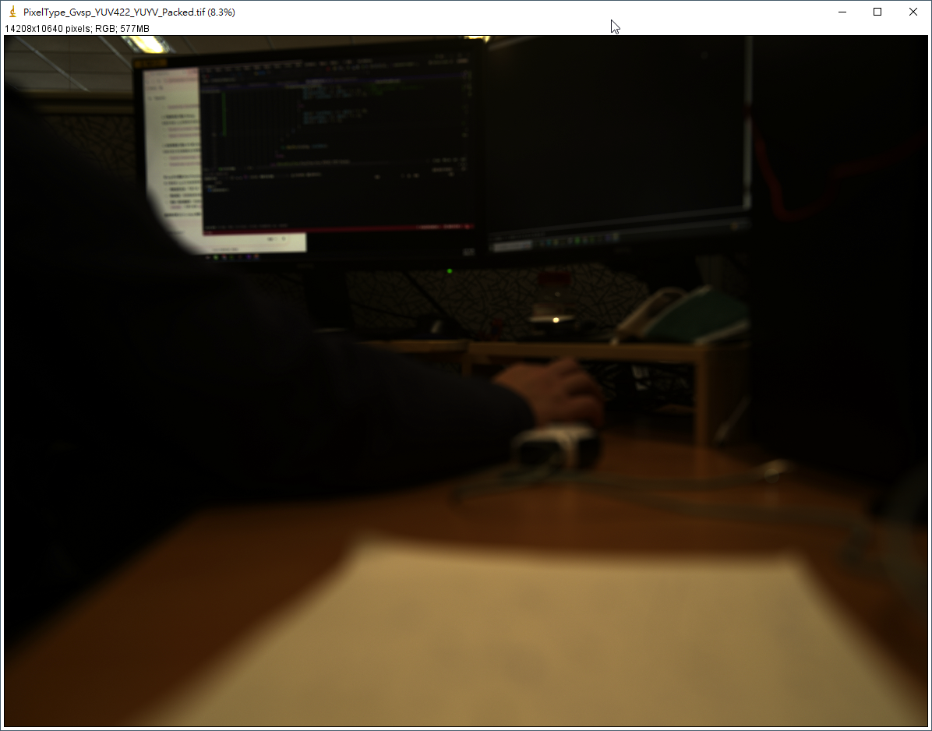
Bayer RG 8
Bayer RG 10
Bayer RG 10 Packed
Bayer RG 12
Bayer RG 12 Packed
BGR 8
Mono 8
Mono 10
Mono 12
RGB 8
YUV 422 Packed
YUV 422 (YUYV) Packed

Slide 2
Bayer RG 8
Bayer RG 10
Bayer RG 12
BGR 8
Bayer RG 10 Packed
Bayer RG 12 Packed
RGB 8
YUV 422 Packed
YUV 422 (YUYV) Packed
Mono 8
Mono 10
Mono 12

Slide 3
Bayer RG 8
Bayer RG 10
Bayer RG 12
BGR 8
Bayer RG 10 Packed
Bayer RG 12 Packed
RGB 8
YUV 422 Packed
YUV 422 (YUYV) Packed
Mono 8
Mono 10
Mono 12

