Slide 1
Polarised neutron reflectometry fitting
Oliver Paull and Jackson Wong

Slide 2
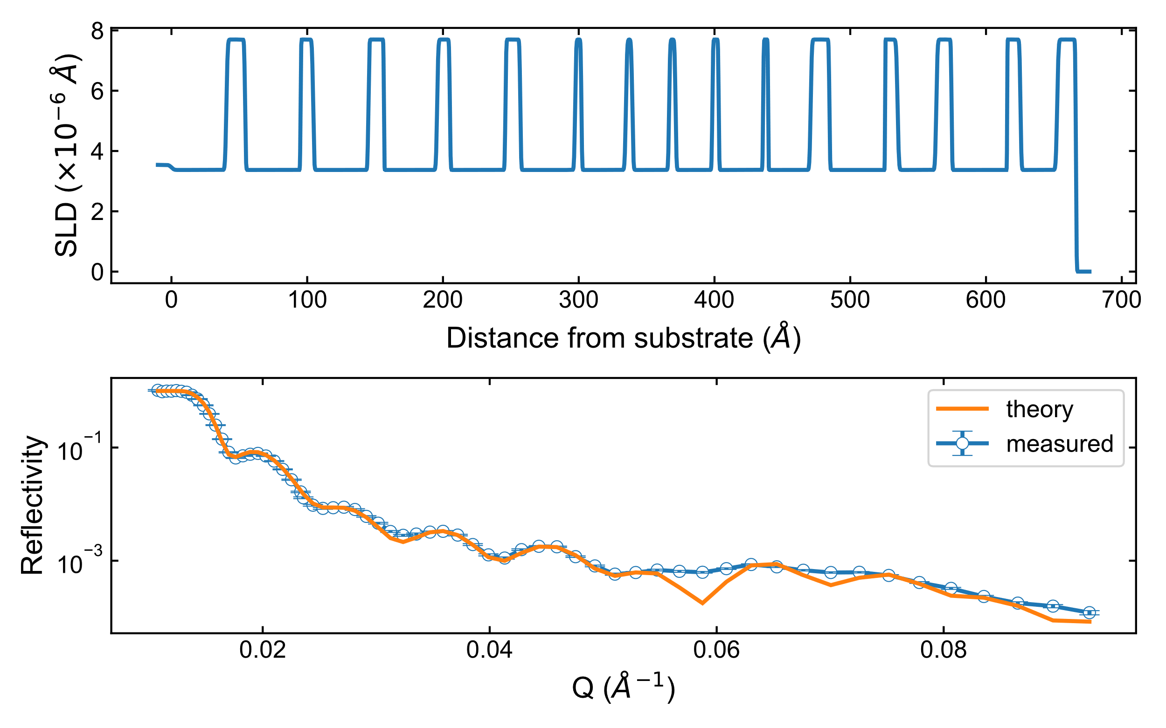
Triple-five: Unpolarised

