Slide 1
Thinking Aloud Test of alza.at
Luca Riedler, Sven Jansen, Dawid Chmal, Fabian Mehedincu (G1-09e)
Thu 21 May 2026, HCI SS 2026
This work is placed under a Creative Commons Attribution 4.0 International (CC BY 4.0) licence.

Slide 2
Evaluation Methodology
Heuristic evaluation based on Andrews General Usability Heuristics (2013)
Testing based on tasks that an average user may perform
Findings were gathered and rated individually
Final ranking was determined by the mean of all evaluator’s scores

Slide 3
Evaluation Environments
Devices: 2 desktop PCs and 2 smartphones
Each device had one evaluator with and one without an ad blocker for comparison
Web Browsers: Chrome, Firefox and Samsung Browser
All Evaluators conducted the Evaluation on 2026-04-20 to minimize the risk of website changes

Slide 4
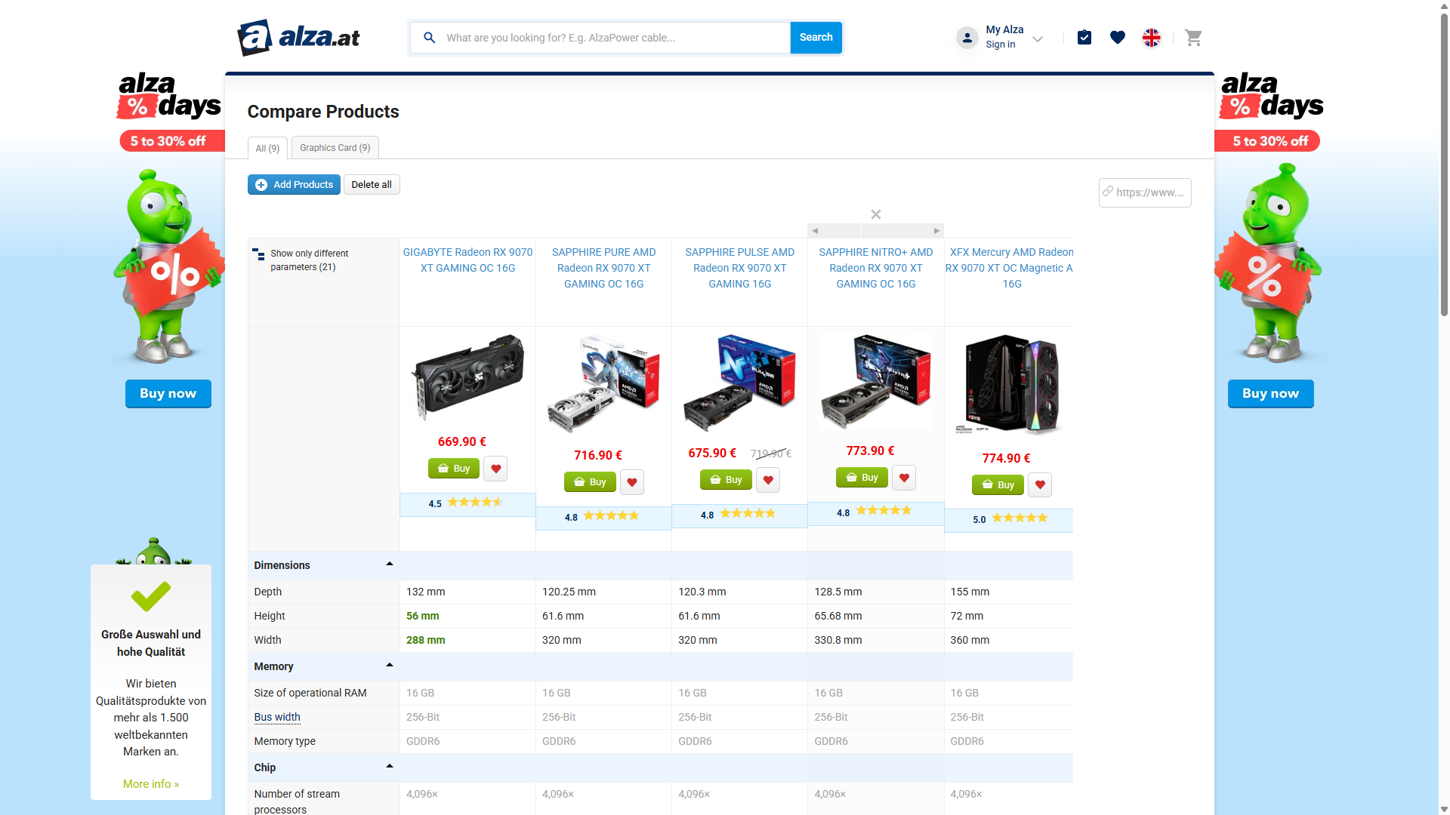
Positive Finding Mean: 3,25
Option to compare Alternative products
Alternatives section with similar products
Users can compare alternatives with current product

Slide 5
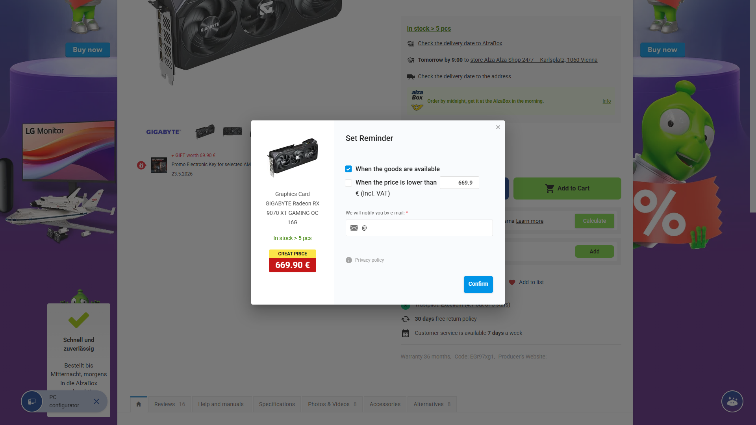
Positive Finding Mean: 3,00
Price Drop Notification Feature
Option to set a price alert for a product
The User will be notified when the price drops below a certain price

Slide 6
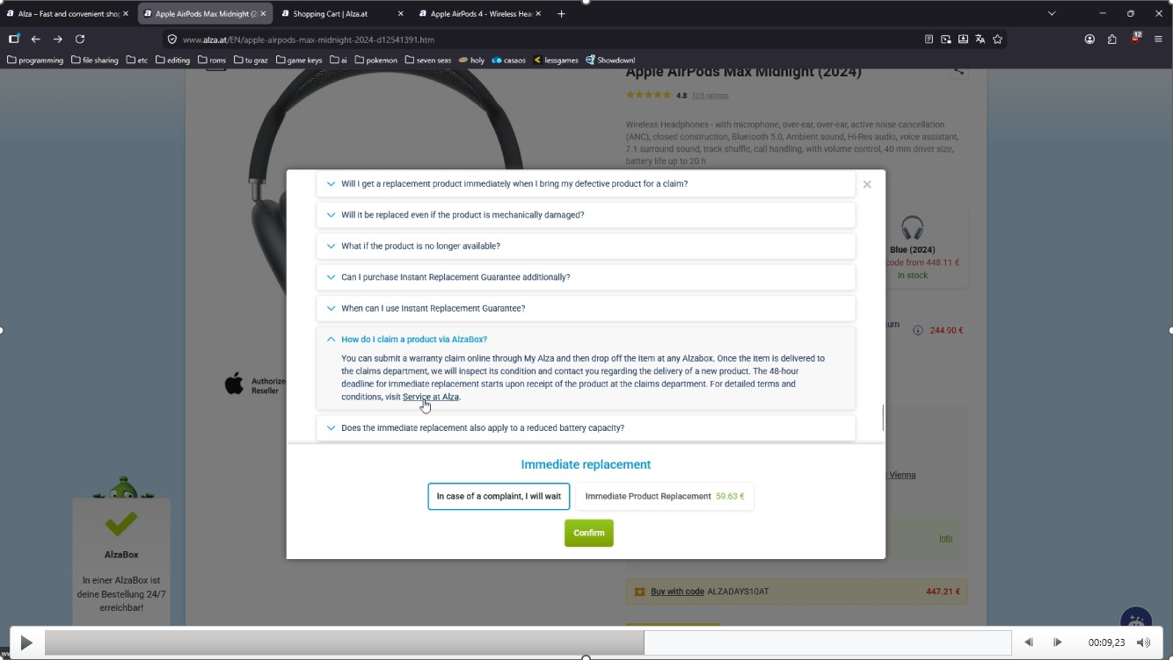
Negative Finding Mean: 3,50
Wrong URL redirect
Redirect link opens homepage instead of the desired page
Incorrect URL in FAQ links
Heuristic: A04 Consistency

Slide 7
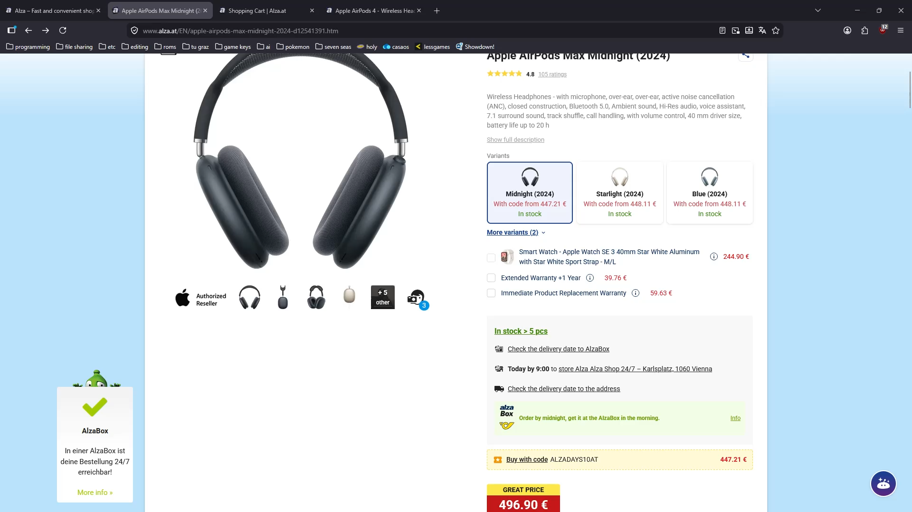

Slide 8
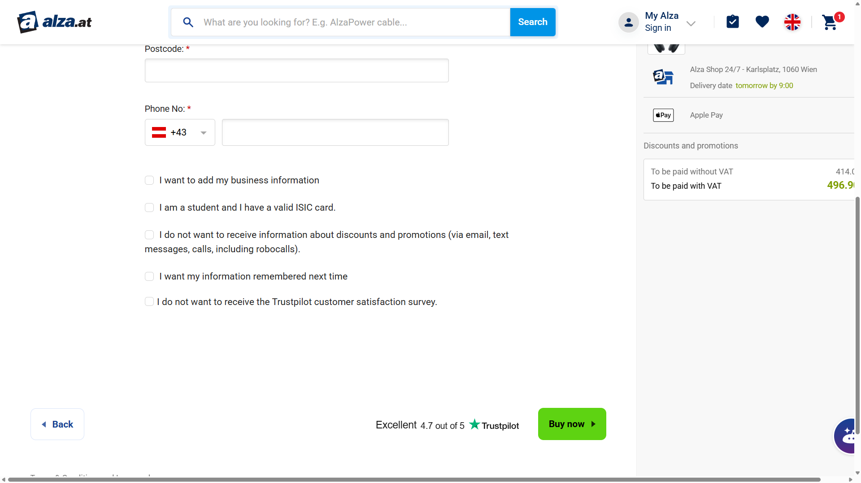
Negative Finding Mean: 3,50
Marketing Opt-Out Is On by Default When Placing an Order
Marketing emails are enabled by default
To avoid unwanted emails, the option must be manually disabled
Heuristic: A05 Error Prevention
Only when: Not logged in

Slide 9
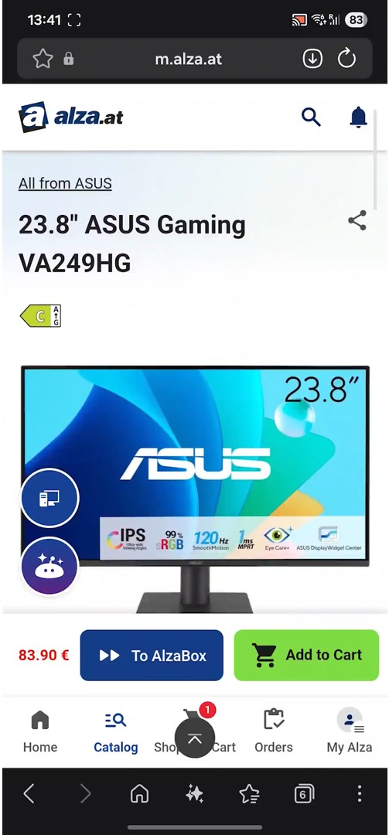
Negative Finding Mean: 3,25
AlzaBox Button Does Nothing and Gives No Feedback
The AlzaBox button is unresponsive on mobile devices
Tapping it does not produce any indicator that it is not functioning properly
Heuristic: A01 Feedback

Slide 10
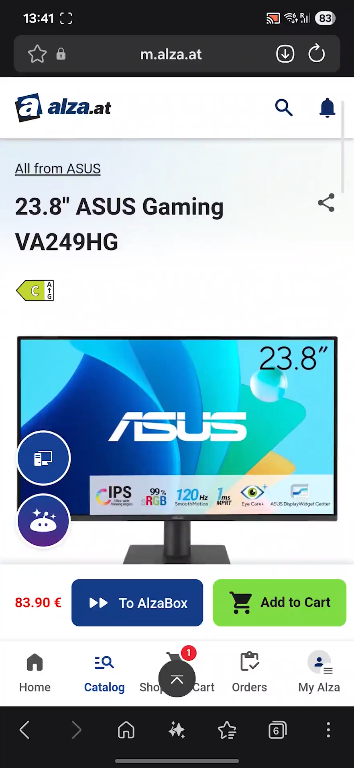

Slide 11
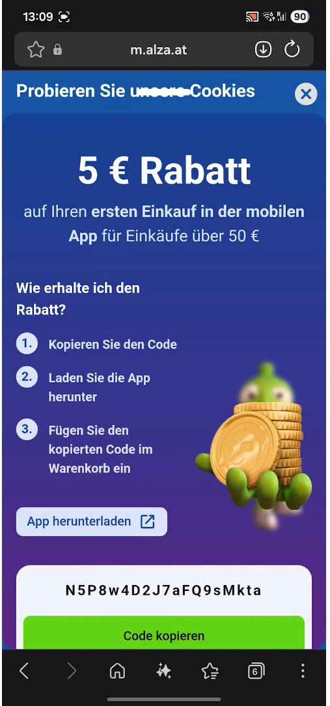
Negative Finding Mean: 3,25
Full-Screen popup shortly after loading site
Shortly after loading the page, a pop-up blocking the entire screen appears
The pop-up also blocks the entire cookie consent banner
Heuristic: A08 Aesthetic and Minimalist Design
Only when: Loading for the first time, potentially also after a certain time

Slide 12
