Slide 1
Pipelining: Basic and Intermediate Concepts
流水线基本原理
Notes:
Review today, not so fast in future

Slide 2
Do you remember?
Sequential Laundry
6 PM
7
8
9
10
11
Midnight
Time
30
40
20
30
40
20
30
40
20
30
40
20
T
a
s
k
O
r
d
e
r
A
B
C
D

Slide 3
Pipelined Laundry Start Work ASAP
Pipelining: Its Natural!
6 PM
7
8
9
Pipelining does not help latency of single task, it helps throughput of entire workload
Pipeline rate limited by slowest pipeline stage
Multiple tasks operating simultaneously
Potential speedup = Number of pipe stages
  Unbalanced lengths of pipe stages reduces speedup
  Time to “fill” pipeline and time to “drain” it reduces speedup
Time
T
a
s
k
O
r
d
e
r
30
40
40
40
40
20
A
B
C
D

Slide 4
Pipelining
流水线操作不能提高单个任务的执行时间，提高整体工作负载的吞吐量.
流水线的速率受限于最慢的流水段
多个不同任务同时操作，使用不同资源
潜在加速比=流水线级数
  流水段的执行时间如果不均衡,那么加速比就会降低
  开始填充流水线的时间和最后排放流水线的时间降低加速比
6 PM
7
8
9
Time
T
a
s
k
O
r
d
e
r
30
40
40
40
40
20
A
B
C
D

Slide 5
Content
流水线基本概念与实现
流水线冲突与解决
流水线性能
流水线实例

Slide 6
流水（线）技术
流水线技术：将一个重复的时序过程分解成为若干个子过程，而每个子过程都可有效地在其专用功能段上与其他子过程同时执行。
流水线中每个子过程及其功能部件称为流水线的段(级)，段与段相互连接形成流水线。
流水线的段数称为流水线的深度。

Slide 7
Characteristics of Pipelining
Pipelining is an implementation technique that multiple instructions are overlapped in execution (多条指令同时执行)
  Not visible to programmers
Each step in a pipeline completes a piece of an instruction
  Each step is completing different parts of different instructions in parallel
  Each of these steps is called a pipe stage or a pipe segment (流水节拍、流水阶段)

Slide 8
Characteristics of Pipelining (cont.)
The time required between moving an instruction one step down the pipeline is a processor cycle (指令沿流水线移动一次的时间间隔就是一个机器周期)
  All the stages must be ready to proceed at the same time 同步移动
  Slowest pipe stage determines processor cycle
  Processor cycle is usually one clock cycle (sometimes two, rarely more)
  The pipeline designer’s goal is to balance the length of each pipeline stage

Slide 9

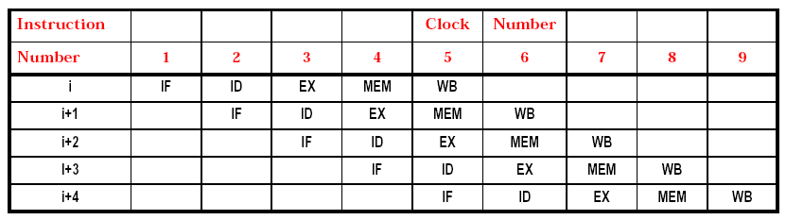
Benefits of Pipelining
If the stages are perfectly balanced and everything is perfect, then the time per instruction on the pipelined machine is equal to

Slide 10
Benefits of Pipelining
Completely hardware mechanism
No programming model shift required to exploit this form of concurrency(并行性)
All modern machines are pipelined
  Key technique in advancing performance in the 80’s
  In the 90’s we just moved to multiple pipelines

Slide 11
(appended) Model of Parallel Programming : MPI & OpenMP
Message Passing Interface (MPI) is both a computer specification and is an implementation that allows many computers to communicate with one another. It is used in computer clusters.
The OpenMP (Open Multi-Processing) is an API that supports multi-platform shared memory multiprocessing programming in C/C++ and Fortran on many architectures. It consists of a set of compiler directives(指示), library routines, and environment variables that influence run-time behavior. OpenMP is a portable, scalable model that gives programmers a simple and flexible interface for developing parallel applications for platforms ranging from the desktop to the supercomputer.
An application built with the hybrid model of parallel programming can run on a computer cluster using both OpenMP and MPI.
From: http://en.wikipedia.org

Slide 12
The Basics of a RISC Instruction Set (MIPS64)
All operations on data apply to data in registers and typically change the entire register.
The only operations that affect memory are load and store operations that move data from memory to a register or to memory from a register, respectively. Load and store operations that load or store less than a full register are often available.
The instruction formats are few in number with all instructions typically being one size.
Notes:
对所有数据操作，作用于在寄存器中的数据，通常改变整个寄存器。

Slide 13
Three Classes of Instructions of MIPS64
Most RISC architectures, like MIPS, have 3 classes of instructions
  1.ALU instructions
  These instructions take either two registers or a register and a sign-extended immediate, operate on them, and store the result into a third register.
  2.Load and store instructions
  These instructions take a register source, called the base register, and an immediate field, called the offset, as operands. The sum—called the effective address—is used as a memory address.
  3.Branches and jumps
  Branches are conditional transfers of control.
  Unconditional jumps.

Slide 14
A Simple Implementation of
A RISC Instruction Set
In a Pipelined Fashion

Slide 15
A Simple Implementation of A RISC Instruction Set
Every instruction can be executed in 5 steps
  Instruction Fetch cycle (IF)
  Instruction Decode/register fetch cycle (ID)
  EXecution/effective address cycle (EX)
  MEMory access (MEM)
  Write-Back cycle (WB)
Every instructions takes at most 5 clock cycles
The instruction length is 4 Bytes

Slide 16
Cycle 1 - Instruction Fetch (IF)
Fetch the current instruction from memory
Update the PC to the next sequential PC by adding 4 to the PC

Slide 17
Cycle 2 - Instruction Decode/register fetch (ID)
Decode the instruction and read the registers corresponding to register source specifiers from the register file. (e.g. IR6..10->A, IR11..15->B, Imm)
  fixed-field decoding 固定域译码
We latter assume
  Do the equality test on the registers as they are read, for a possible branch(分支预判的准备工作)
  (In an aggressive 主动积极的 implementation,) The branch can be completed at this stage by adding the offset to the incremented PC. (storing the branch-target address into the PC.) 需要增加一个加法器
Notes:
利用IR中的寄存器地址去访问通用寄存器组，读出所需的操作数。

Slide 18
Cycle 3 – EXecution/effective address (EX)
The ALU performs one of the following functions on the operands prepared in the prior cycle
  Memory reference
    Add the base register and the offset to form the effective address
  Register-Register ALU instructions
  Register-Immediate ALU instructions

Slide 19
Cycle 4 – MEMory access (MEM)
If the instruction is a load, memory does a read
If the instruction is a store, then the memory writes the data from the register

Slide 20
Cycle 5 – Write-Back (WB)
Write the result into the register file
  From the memory system (for a load)
  From the ALU (for an Register-Register ALU instruction)

Slide 21
In this implementation
  branch instructions require 2/4 cycles
  store instructions require 4 cycles
  all other instructions require 5 cycles

Slide 22
A Simple RISC Pipeline
Fill
Stable
(5 times throughput)
Drain
通过时间
排空时间

Slide 23
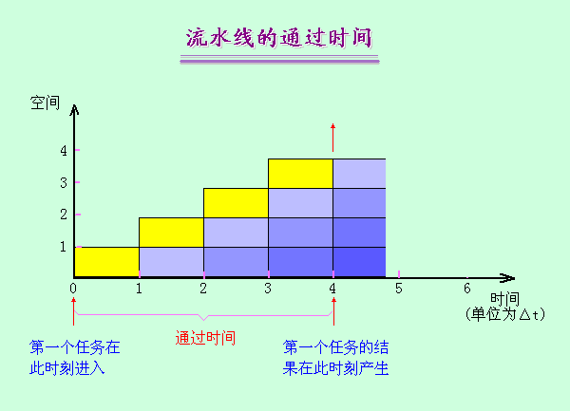
流水线的“通过时间”（第一个任务流出结果所需的时间），在此之后流水过程才进入稳定工作状态，每个时钟周期（拍）流出一个结果；

Slide 24
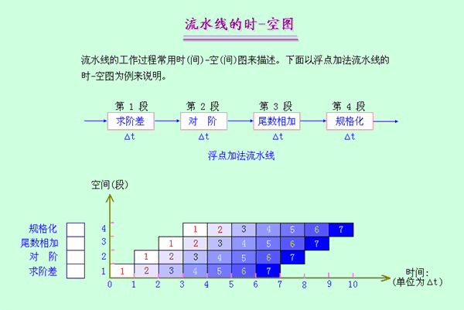
时－空图的另一种画法
时－空图从时间和空间两个方面描述了流水线的工作过程。横坐标代表时间，纵坐标代表流水线的各个段。下图：浮点加法（部件级流水）。我们：指令流水

Slide 25
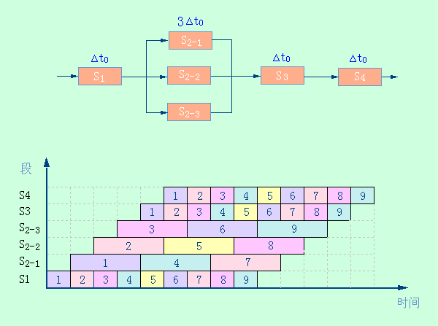
时-空图意义 (例：重复设置瓶颈段)

Slide 26
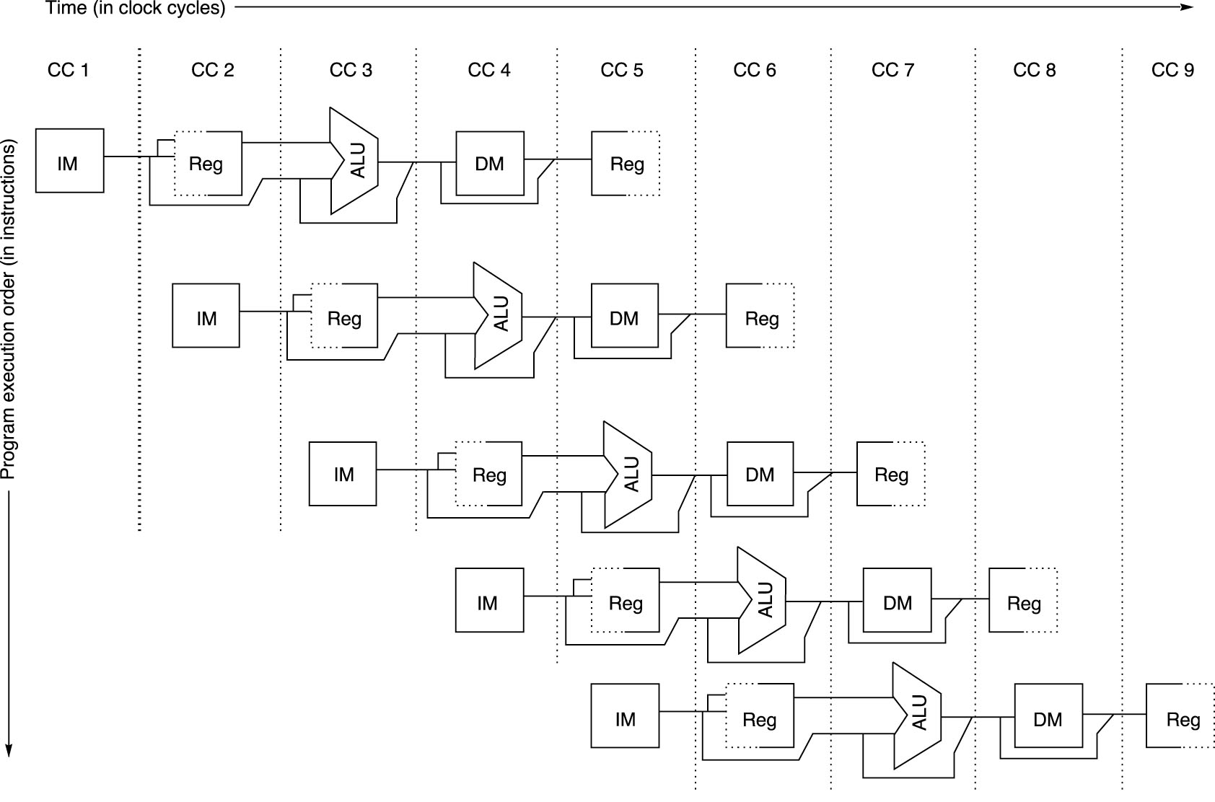
Pipeline as Data Paths
Shifted in Time
We need to perform two reads and one write every clock Cycle. To handle reads and a write to the same register, we perform the register write in the first half of the clock cycle and the read in the second half.

Slide 27
Assumption and Observation
Assumptions
  Separate instruction and data memories ( implement with separate instruction and data caches )
  Perform a register write in the first half of a cycle and the read in the second half
Observation
  Data memory reference only occurs at stage 4
    Load and Store
  Register update only occurs at stage 5
    All ALU operations and Load
Notes:
应保证不会在同一个时钟周期内在同一数据通路资源上做不同的操作。例如，不能要求一个ALU同时既做有效地址计算，又做减法操作。

Slide 28
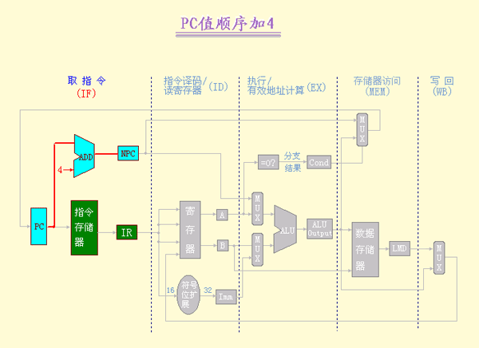
PC 问题：PC+4必须在IF段完成，每个周期启动新指令
Notes:
流水线为了能够每个时钟周期启动一条新的指令，就必须在每个时钟周期进行PC值的加4操作，并保留新的PC值。这种操作必须在IF段完成，以便为取下一条指令做好准备。

Slide 29
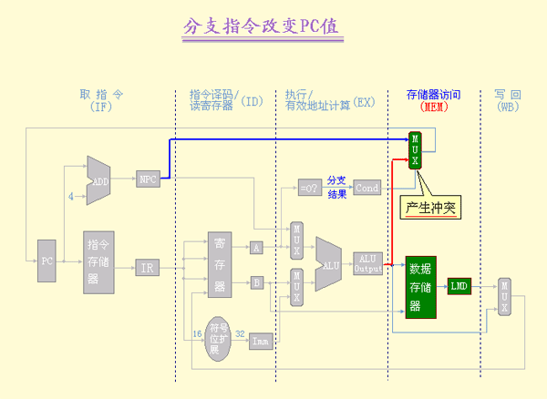
但分支指令也可能改变PC的值，而且是 在MEM段进行，这会导致冲突(和第i+3条指令的IF段发生冲突)。
Notes:
和第i+3条指令的IF段写PC发生冲突

Slide 30
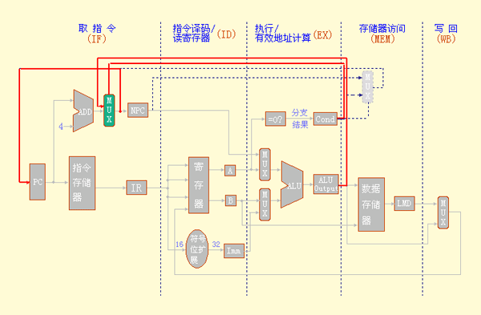
为解决问题，我们重新组织数据通路，把所有改变
PC值的操作都放在IF段进行。在第i+3条指令的IF段来做，因为发生跳转，i+1,i+2,i+3指令均作废。
Notes:
需要多加4.

Slide 31
Pipeline Registers / Latches between Successive Pipeline Stages
Time (clock cycles)
Play a critical role of carrying data for a given instruction from one stage to the other.
The edge-triggered property of registers is critical. Otherwise, the data from one instruction could interfere with the execution of another!
Cycle 1
Cycle 2
Cycle 3
Cycle 4
Cycle 5
Cycle 6
Cycle 7
I
n
s
t
r.
O
r
d
e
r
Ifetch
Reg
ALU
DMem
Reg
Ifetch
Reg
ALU
DMem
Reg
Ifetch
Reg
ALU
DMem
Reg
Ifetch
Reg
ALU
DMem
Reg

Slide 32
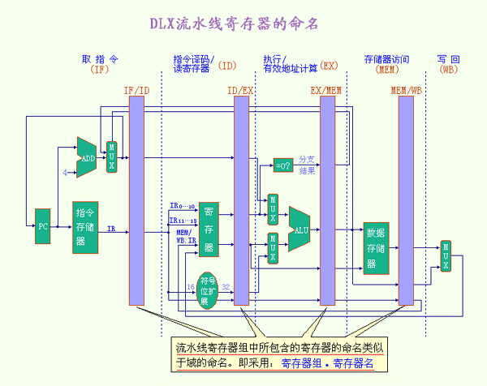
例如，ID段和EX段之间的流水线寄存器组中的IR寄存器的名称为:ID/EX.IR

Slide 33
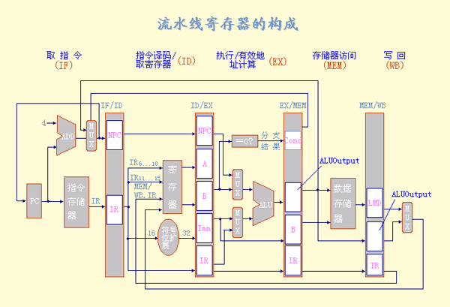
◆ 流水线寄存器的构成
Return

Slide 34
流水线的每个流水段的操作
流水段
任何指令类型
IF/ID.IR ← Mem[PC]
IF
IF/ID.NPC,PC ← (if EX/MEM.cond {EX/MEM.NPC} else {PC+4});
(动画演示)
ID/EX.A ← Regs[IF/ID.IR_{6..10}]; ID/EX.B ← Regs[IF/ID.IR_{11..15}];
ID
ID/EX.NPC ← IF/ID.NPC; ID/EX.IR ← IF/ID.IR;
ID/EX.Imm ← (IR₁₆)¹⁶##IR_{16..31};
(动画演示)
ALU 指令
Load/Store 指令
分支指令
EX/MEM.IR ← ID/EX.IR;
EX/MEM.ALUOutput ←
ID/EX.A op ID/EX.B
或
EX/MEM.ALUOutput ←
ID/EX.A op ID/EX.Imm;
EX/MEM.cond ← 0;
EX/MEM.ALUOutput ←
ID/EX.NPC +
ID/EX.Imm;
EX/MEM.cond ←
(ID/EX.A op 0);
EX/MEM.IR ←
ID/EX.IR; EX/MEM.ALUOutput ←
ID/EX.A + ID/EX.Imm;
EX
(动画演示)
(动画演示)
(动画演示)

Slide 35
流水线的每个流水段的操作
流水段
任何指令类型
ALU 指令
Load/Store 指令
分支指令
MEM/WB.IR ← EX/MEM.IR; MEM/WB.LMD ←
Mem[EX/MEM.ALUOutput];
或
Mem[EX/MEM.ALUOutput] ←
EX/MEM.B;
MEM
MEM/WB.IR ← EX/MEM.IR; MEM/WB.ALUOutput ←
EX/MEM.ALUOutput;
(动画演示)
(动画演示)
Regs[MEM/WB.IR_{16..20}]←
MEM/WB.ALUOutput;
或
Regs[MEM/WB.IR_{11..15}]←
MEM/WB.ALUOutput;
Regs[MEM/WB.IR_{11..15}]←
MEM/WB.LMD;
WB
(动画演示)
(动画演示)

Slide 36
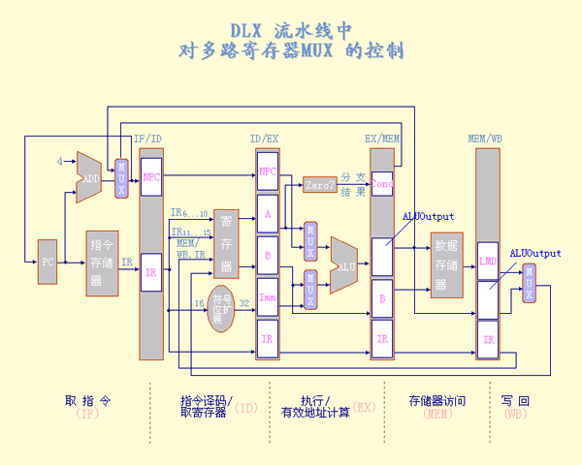
5．DLX流水线的控制
主要是确定如何 控制那四个多路选择器。

Slide 37
Pipelining is not quite that easy!
Limits to pipelining: Hazards (故障，冲突) prevent next instruction from executing during its designated clock cycle
  Structural hazards
    Hardware cannot support this combination of instructions (single person to fold and put clothes away)
  Data hazards
    Instruction depends on result of prior instruction still in the pipeline (missing sock)
  Control hazards
    Caused by delay between the fetching of instructions and decisions about changes in control flow (branches and jumps)

Slide 38
Stall (also called bubble)
Avoiding a hazard often requires that some instructions in the pipeline be allowed to proceed while others are delayed
When a instruction is stalled
  Instructions issued later than this instruction are stalled
  Instructions issued earlier than this instruction must continue

Slide 39
Structural Hazards
结构冲突
Why it happens?
  Some functional unit is not fully pipelined
  某些功能部件没有充分流水
    A sequence of instructions using that un-pipelined unit cannot proceed at the rate of one per clock cycle
  Some resource has not been duplicated enough to allow all combinations of instructions in the pipeline to execute
  某些资源没有充分重复设置

Slide 40
One Memory Port/Structural Hazards (若指令数据存取不分开)
Time (clock cycles)
Cycle 1
Cycle 2
Cycle 3
Cycle 4
Cycle 5
Cycle 6
Cycle 7
I
n
s
t
r.
O
r
d
e
r
Load
Ifetch
Reg
ALU
DMem
Reg
Instr 1
Ifetch
Reg
ALU
DMem
Reg
Instr 2
Ifetch
Reg
ALU
DMem
Reg
Instr 3
Ifetch
Reg
ALU
DMem
Reg
Instr 4
Ifetch
Reg
ALU
DMem
Reg

Slide 41
One Memory Port/Structural Hazards
How do you “bubble” the pipe?
Time (clock cycles)
Cycle 1
Cycle 2
Cycle 3
Cycle 4
Cycle 5
Cycle 6
Cycle 7
I
n
s
t
r.
O
r
d
e
r
Load
Ifetch
Reg
ALU
DMem
Reg
Instr 1
Ifetch
Reg
ALU
DMem
Reg
Instr 2
Ifetch
Reg
ALU
DMem
Reg
Stall
Bubble
Bubble
Bubble
Bubble
Bubble
Instr 3
Ifetch
Reg
ALU
DMem
Reg

Slide 42
Remove One Memory Port/Structural Hazards
 | Clock Cycle Number
Inst. | 1 | 2 | 3 | 4 | 5 | 6 | 7 | 8 | 9 | 10
i (Load) | IF | ID | EX | MEM | WB
i+1 |  | IF | ID | EX | MEM | WB
i+2 |  |  | IF | ID | EX | MEM | WB
i+3 |  |  |  | STALL | IF | ID | EX | MEM | WB
i+4 |  |  |  |  |  | IF | ID | EX | MEM | WB
i+5 |  |  |  |  |  |  | IF | ID | EX | MEM
i+6 |  |  |  |  |  |  |  | IF | ID | EX
i+1条指令不是load指令，不去内存取数据，所以不冲突。

Slide 43

Why Would A Designer Allow Structural Hazards?
A major effect of pipelining is to change the relative timing of instructions by overlapping their execution.
This overlap introduces data and control hazards.

Slide 44
Data Hazard on R1
Time (clock cycles)
IF
ID/RF
EX
MEM
WB
I
n
s
t
r.
O
r
d
e
r
add r1,r2,r3
Reg
Ifetch
Reg
ALU
DMem
sub r4,r1,r3
Ifetch
Reg
ALU
DMem
Reg
and r6,r1,r7
Ifetch
Reg
ALU
DMem
Reg
or r8,r1,r9
Ifetch
Reg
ALU
DMem
Reg
xor r10,r1,r11
Ifetch
Reg
ALU
DMem
Reg

Slide 45
Three Generic Data Hazards
Read After Write (RAW)
Instr J tries to read operand before Instr I writes it
Caused by a “Dependence” (in compiler nomenclature 术语). This hazard results from an actual need for communication.
I: add r1,r2,r3
J: sub r4,r1,r3

Slide 46
Three Generic Data Hazards (cont.)
Write After Read (WAR)
Instr J writes operand before Instr I reads it
Called an “anti-dependence” by compiler writers. This results from reuse of the name “r1”.
Can’t happen in MIPS 5 stage pipeline because:
  All instructions take 5 stages, and
  Reads are always in stage 2, and
  Writes are always in stage 5
I: sub r4,r1,r3
J: add r1,r2,r3
K: mul r6,r1,r7

Slide 47
Three Generic Data Hazards (cont.)
Write After Write (WAW)
Instr J writes operand before Instr I writes it
Called an “output dependence” by compiler writers. This also results from the reuse of name “r1”.
I: sub r1,r4,r3
J: add r1,r2,r3
K: mul r6,r1,r7

Slide 48
Data Hazard - WAW
Can’t happen in MIPS 5 stage pipeline because:
  All instructions take 5 stages, and
  Writes are always in stage 5
Will see WAR and WAW in later more complicated pipes

Slide 49
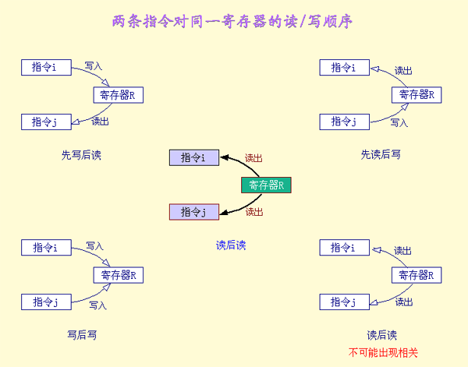
RAW
WAR
WAW

Slide 50
Forwarding (Bypassing or Short-circuiting) to Avoid Data Hazard
旁路（直接通路/短路）
Time (clock cycles)
I
n
s
t
r.
O
r
d
e
r
add r1,r2,r3
Ifetch
Reg
ALU
DMem
Reg
演示
sub r4,r1,r3
Ifetch
Reg
ALU
DMem
Reg
and r6,r1,r7
Ifetch
Reg
ALU
DMem
Reg
or r8,r1,r9
Ifetch
Reg
ALU
DMem
Reg
xor r10,r1,r11
Ifetch
Reg
ALU
DMem
Reg

Slide 51
Forwarding to Avoid LW-SW Data Hazard
Time (clock cycles)
I
n
s
t
r.
O
r
d
e
r
add r1,r2,r3
Ifetch
Reg
ALU
DMem
Reg
演示
lw r4, 0(r1)
Ifetch
Reg
ALU
DMem
Reg
sw r4,12(r1)
Ifetch
Reg
ALU
DMem
Reg
or r8,r6,r9
Ifetch
Reg
ALU
DMem
Reg
xor r10,r9,r11
Ifetch
Reg
ALU
DMem
Reg

Slide 52
Data Hazard Even with Forwarding
Time (clock cycles)
I
n
s
t
r.
O
r
d
e
r
lw r1, 0(r2)
Ifetch
Reg
ALU
DMem
Reg
sub r4,r1,r5
Ifetch
Reg
ALU
DMem
Reg
and r6,r1,r7
Ifetch
Reg
ALU
DMem
Reg
or r8,r1,r9
Ifetch
Reg
ALU
DMem
Reg
Notes:
MIPS actutally didn’t interlecok: MPU without Interlocked Pipelined Stages

Slide 53
Resolve the Load Data Hazard
Time (clock cycles)
I
n
s
t
r.
O
r
d
e
r
lw r1, 0(r2)
演示
Ifetch
Reg
ALU
DMem
Reg
Bubble
sub r4,r1,r5
Ifetch
Reg
ALU
DMem
Reg
Bubble
and r6,r1,r7
Ifetch
Reg
ALU
DMem
Reg
Bubble
or r8,r1,r9
Ifetch
Reg
ALU
DMem

Slide 54
HW Change for Forwarding
The ALU result from both the EX/MEM and MEM/WB pipeline registers is always fed back (反馈) to the ALU inputs
NextPC
ID/EX
EX/MEM
MEM/WR
Registers
mux
ALU
Data
Memory
mux
mux
Immediate
What circuit detects and resolves this hazard?

Slide 55
How to Detect the Hazard?
If the forwarding hardware detects that the previous ALU operation has written the register corresponding to a source for the current ALU operation, control logic selects the forwarded result as the ALU input rather than the value read from the register file.
当硬件检测到前面某条指令的结果寄存器就是当前指令的源寄存器时，控制逻辑会将前面那条指令的结果直接从其产生的地方前递到当前指令所需的位置。

Slide 56
在ID段检测数据相关，设置相应控制
如解决由Load指令引起的RAW相关的互锁(简称Load互锁) ；
流水线相关硬件可以检测到的各种相关情况（演示）
可以看出，仅需把Load指令的目的寄存器地址与Load指令后的两条指令的源寄存器地址进行比较

Slide 57
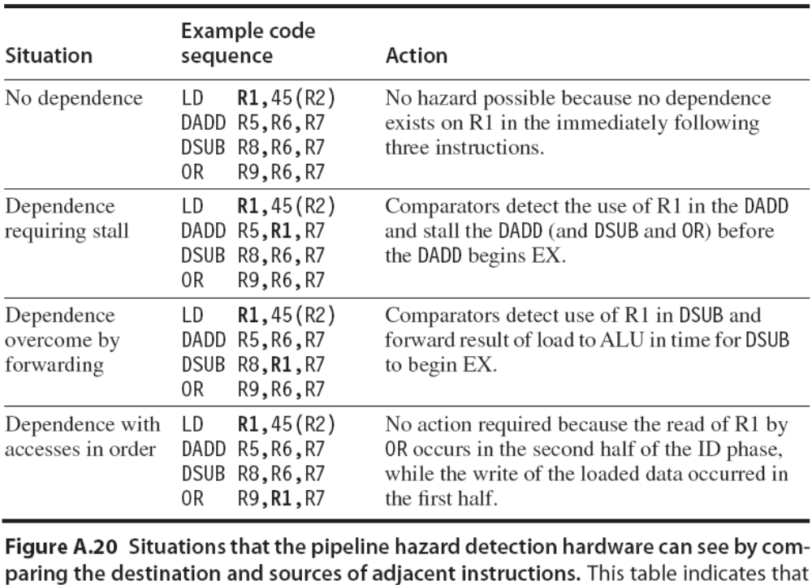

Slide 58
Software Scheduling to Avoid Load Hazards 编译调度方法
编译后生成代码会导致暂停例子
Try producing fast code for
a = b + c;
d = e – f;
assuming a, b, c, d ,e, and f in memory.
Slow code:
LW Rb,b
LW Rc,c
ADD Ra,Rb,Rc
SW a,Ra
LW Re,e
LW Rf,f
SUB Rd,Re,Rf
SW d,Rd
Fast code:
LW Rb,b
LW Rc,c
LW Re,e
ADD Ra,Rb,Rc
LW Rf,f
SW a,Ra
SUB Rd,Re,Rf
SW d,Rd

Slide 59
Control Hazard on Branches
Control hazards can cause a greater performance lose for our MIPS pipeline than do data hazards.
If a branch changes the PC, it is a taken branch; if it falls through, it is not taken, or untaken.
（选中分支与未选中分支）

Slide 60
Control Hazard on Branches
Three Stage Stall
MEM段末尾确定转移地址
10: beq r1,r3,36
Ifetch
Reg
ALU
DMem
Reg
14: and r2,r3,r5
Ifetch
Reg
ALU
DMem
Reg
18: or r6,r1,r7
Ifetch
Reg
ALU
DMem
Reg
22: add r8,r1,r9
Ifetch
Reg
ALU
DMem
Reg
36: xor r10,r1,r11
分支转移成功导致暂停3拍
Ifetch
Reg
ALU
DMem
Reg

Slide 61
Branch Stall Impact
If 30% branch, Stall 3 cycles significant, will yield a performance loss of 50%
Two part solution:
  Determine branch taken or not sooner, AND
  Compute taken branch address earlier
MIPS branch tests if register = 0 or ≠ 0
MIPS Solution:
  Move Zero test to ID/RF stage
  Adder to calculate new PC in ID/RF stage
  1 clock cycle penalty for branch versus 3

Slide 62
5 Steps of MIPS Datapath Reducing Stall from Branch Hazards
Instruction
Fetch
Instr. Decode
Reg. Fetch
Execute
Addr. Calc
Memory
Access
Write
Back
Next PC
Next SEQ PC
ID/EX
EX/MEM
MEM/WB
MUX
IF/ID
Adder
Adder
4
Zero?
RS1
Address
Reg File
Memory
RS2
ALU
Data
Memory
MUX
MUX
Sign
Extend
Imm
WB Data
RD
RD
RD
So, 3-cycle penalty becomes 1-cycle penalty

Slide 63
改进后流水线的分支操作
流 水 段
分 支 指 令 操 作
IF/ID.IR ← Mem[PC]; IF/ID.NPC,PC ←
(if ID/EX.cond {ID/EX.NPC} else {PC+4});
IF
(动画演示)
ID/EX.A ← Regs[IF/ID.IR_{6..10}]; ID/EX.B ← Regs[IF/ID.IR_{11..15}];
ID/EX.NPC ← IF/ID.NPC + (IR₁₆)¹⁶##IR_{16..31};
ID/EX.IR ← IF/ID.IR; ID/EX.cond ← (Regs[IF/ID.IR_{6..10}] op 0;
ID/EX.Imm ← (IR₁₆)¹⁶##IR_{16..31};
ID
(动画演示)
EX
MEM
WB

Slide 64
Four Branch Hazard Alternatives 编译时调度方法
#1: Stall until branch direction is clear
#2: Predict Branch Not Taken
  Execute successor instructions in sequence
  “Squash” (挤压，压碎) instructions in pipeline if branch actually taken
  Advantage of late pipeline state update (优点在于跳转失败时可以不改变状态)
  47% MIPS branches not taken on average
  PC+4 already calculated, so use it to get next instruction

Slide 65
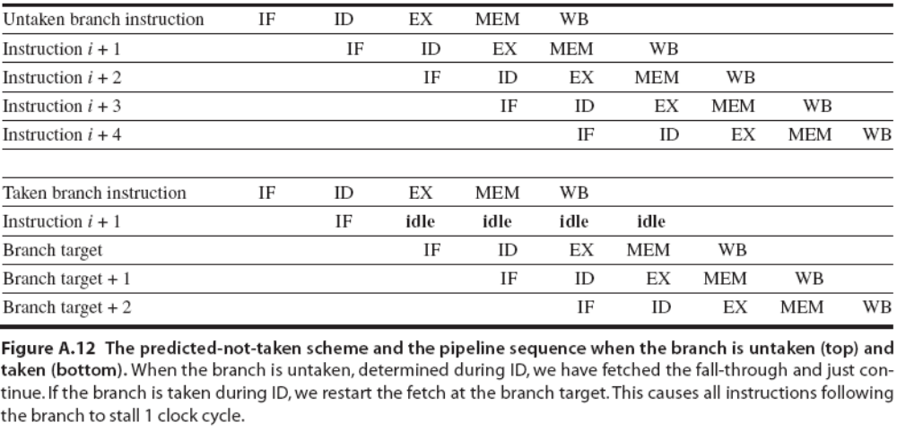
#2: Predict Branch Not Taken
处理过程说明

Slide 66
Four Branch Hazard Alternatives (cont.)
#3: Predict Branch Taken
  53% MIPS branches taken on average
  In our five-stage pipeline we don’t know the target address any earlier than we know the branch outcome, there is no advantage in this approach for this pipeline.
    MIPS still incurs 1 cycle branch penalty（用于计算跳转地址）
    Other machines: branch target known before outcome

Slide 67
Four Branch Hazard Alternatives (cont.)
#4: Delayed Branch 分支延迟
  Define branch to take place AFTER a following instruction
  branch instruction
  sequential successor₁
  sequential successor₂
  ........
  sequential successor_{n}
  branch target if taken
  1 slot delay (分支延迟槽) allows proper decision and branch target address in 5 stage pipeline
  MIPS uses this
演示：延迟分支以及指令的执行顺序
Branch delay of length n

Slide 68
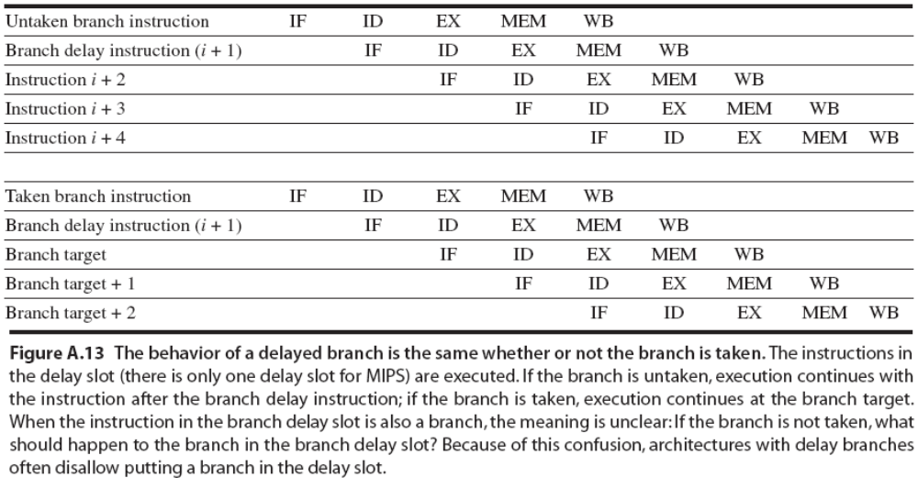
Delayed Branch (cont.)

Slide 69
Delayed Branch (cont.)
Where to get instructions to fill branch delay slot?
  Before branch instruction
  From the target address
    only valuable when branch taken
  From fall through
    only valuable when branch not taken

Slide 70
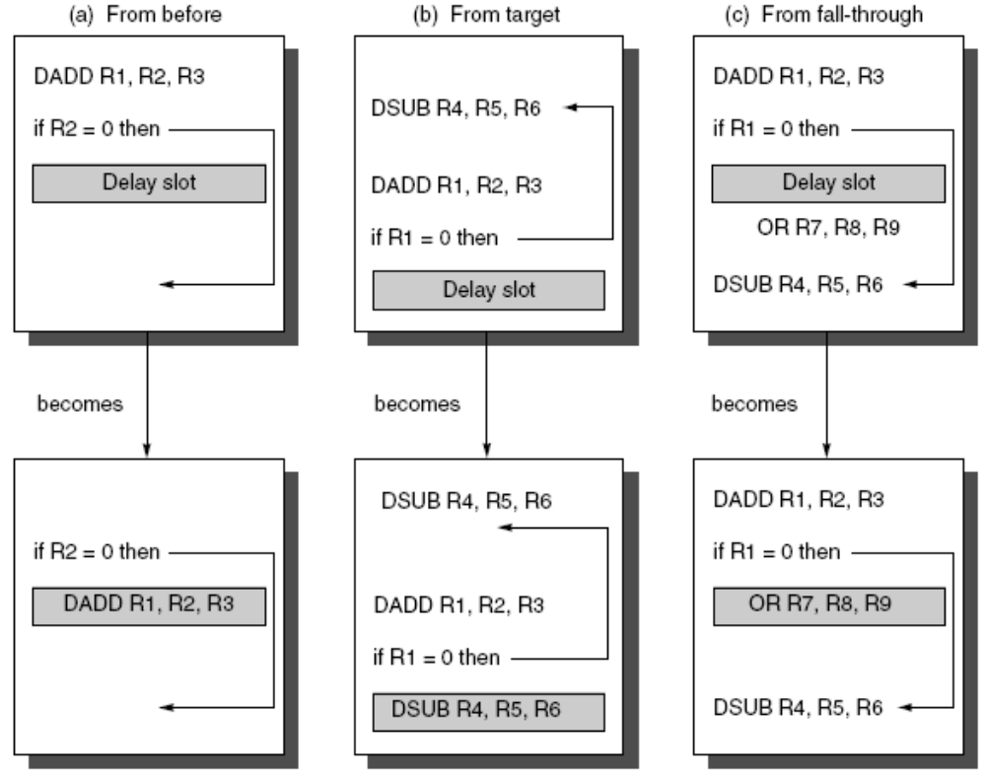
Scheduling the Branch Delay Slot
Taken
适用于循环
Not-Taken

Slide 71
Delay-Branch Scheduling Schemes and Their Requirements
Scheduling Strategy | Requirements | Improve Performance When?
From before | Branch must not depend on the rescheduled instructions (不相关) | Always
From target | Must be OK to execute rescheduled instructions if branch is not taken. May need to duplicate instructions | When branch is taken. May enlarge program if instructions are duplicated
From fall through | Must be OK to execute instructions if branch is taken | When branch is not taken

Slide 72
三种方法的要求及效果
调 度 策 略
对调度的要求
什么情况下起作用？
从 前 调 度
被调度的指令必须与分支无关
任何情况
必须保证在分支失败时执行被调度
的指令不会导致错误。有可能需要
复制指令。
分支成功时
(但由于复制指令，有
可能会增大程序空间)
从目标处调度
必须保证在分支成功时执行被调度
的指令不会导致错误。
从失败处调度
分支失败时

Slide 73
Delayed Branch (cont.)
Compiler effectiveness for single branch delay slot:
  Fills about 60% of branch delay slots
  (40%找不到可以填入分支延迟槽的指令)
  About 80% of instructions executed in branch delay slots useful in computation
  About 50% (60% x 80%) of slots usefully filled
Limitations
  Restrictions on the instructions that are scheduled into delay slots 指令受限
  Ability to predict at compile time if a branch is likely to be taken or not 分支预测能力

Slide 74
Canceling (Nullifying) Branch
分支取消或分支无效技术
To improve the ability of the compiler to fill branch delay slots Idea
  Associate each branch instruction the predicted direction
  If predicted, the instruction in the branch delay slot is simply executed as it would normal be with a delayed branch
  If unpredicted, the instruction in the branch delay slot is simply turned into a no-op

Slide 75
Performance Issues in Pipelining
流水线性能问题

Slide 76
流水线的性能指标——吞吐率
流水线的吞吐率TP (ThroughPut): 单位时间内流水线完成的任务数量或输出结果的数量。
最大吞吐率TPmax是指流水线在连续流动达到稳定状态后所得到的吞吐率。
  若流水线各段的时间相等，均为△t0 ，则：
  TPmax ＝ 1 /△t0
  若流水线各段的时间不等，则：
  最大吞吐率取决于流水线中最慢的一段所需的时间，这段就成了流水线的瓶颈。
1
TP_{max}＝
─────
max{△t_{i} }

Slide 77
流水线的性能指标——吞吐率
流水线的实际吞吐率TP （小于最大吞吐率）
  若流水线各段的时间相等，均为△t0 ，假设流水线由m段组成，完成n个任务。则TP ＝ n / T流水
  而完成 n 个任务所需的时间：
  T流水＝m△t0＋(n－1)△t0 （说明）
  若流水线各段的时间不等（时空图），则完成 n 个任务所需的时间
  T流水＝∑△ti＋(n－1)△tj △tj ＝max{△ti }
  实际吞吐率
m
i=1
n
TP ＝ ──────────
m
∑ △t_{i}＋(n－1)△t_{j}
i=1
Notes:
∑△ti = 执行第一条指令所需的时间，然后每隔△tj 时间出一条指令的结果

Slide 78
Example 1
设一条指令的执行过程分为取指令、分析指令和执行指令3个阶段，所需时间分别为△t， △t和2△t。分别求出下列情况下，连续执行N条指令所需的时间。
  顺序执行方式；
  只有“取指令”和“分析指令”重叠；
  “取指令”，“分析指令”和“执行指令”重叠；

Slide 79
Answer1
每条指令执行时间为△t +△t + 2△t = 4△t，连续执行N条时间为4N△t。
连续执行N条时间为：
4△t + (N-1)3△t 。
连续执行N条时间为：
4△t + (N-1)2△t 。

Slide 80
流水线的性能指标——加速比
加速比S是指流水线的速度与等功能非流水线的速度之比。S ＝T非流水／T流水
若流水线为 m 段，且各段时间相等，均为△t0 ，则：
T非流水＝nm△t0 ; T流水＝m△t0＋(n－1)△t0
T_{非流水}
nm△t₀
m
S＝ ─── ＝ ─────────
＝ ────
T_{流水}
m△t₀＋(n－1)△t₀
m－1
1＋
n
可以看出：当n >> m 时，S ≈ m

Slide 81
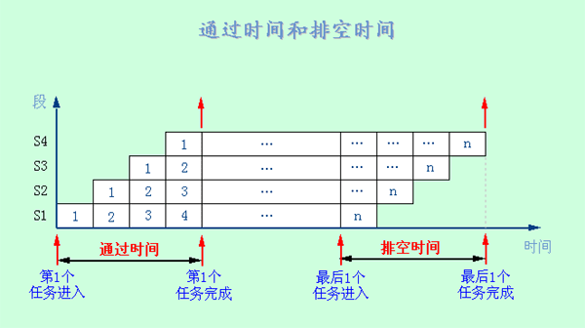
流水线的性能指标——效率
效率E 是指流水线的设备利用率。
(1) 由于流水线有通过时间和排空时间，所以流水线的各段并不是一直满负荷地工作。故：E ＜1

Slide 82
流水线的性能指标——效率
(2) 若各段时间相等，则各段的效率e_{i}相等，即
e₁＝e₂ ＝e₃＝ ＝e_{m}＝n△t₀／T_{流水}
(解释)
整个流水线的效率为:
……
n△t₀
n
1
E ＝ ─── ＝ ──── ＝ ─────
T_{流水}
m＋n－1
m－1
1＋
n
当 n >> m 时，E ≈ 1

Slide 83
流水线的性能指标——效率
(3) 从时－空图上看，效率实际上就是 n 个任务所占的时空区与 m 个段总的时空区之比，即：
n 个任务占用的时空区
E ＝━━━━━━━━━━━━━ (解释)
m 个段总的时空区
(4) 提高流水线效率所采取的措施对于提高吞吐率也有好处。

Slide 84
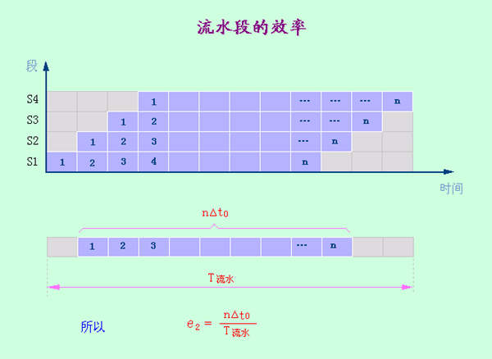
流水线的性能指标——效率

Slide 85
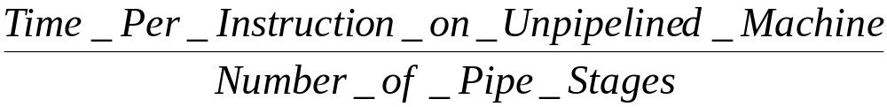
Ideal Status
If the stages are perfectly balanced and everything is perfect, then the time per instruction on the pipelined machine is equal to

Slide 86

Performance of Pipelines with Stalls
“Instruction Frequency”
Example: Branch Stall Impact
  Assume CPI = 1.0 ignoring branches
  Assume solution was stalling for 3 cycles
  If 30% branch, Stall 3 cycles
  Op Freq Cycles CPI(i) (% Time)
  Other 70% 1 .7 (37%)
  Branch 30% 4 1.2 (63%)
  => new CPI = 1.9, or almost 2 times slower

Slide 87
Example 2
Consider an unpipelined processor. Assume that it has a 1 ns clock cycle and that it uses 4 cycles for ALU operations and branches, 5 cycles for memory operations. Assume that the relative frequencies of these operations are 40%, 20%, and 40%, respectively.
Suppose that due to clock skew(时钟偏移) and pipeline register delay, pipelining the processor adds 0.2 ns of overhead to the clock. Ignoring any other latency impact, how much speedup in the instruction execution rate will we gain from a pipeline?
Notes:
假设非流水线实现的时钟周期时间为1ns，ALU和分支指令需要4个时钟周期，访问存储器指令需5个时钟周期，
上述指令在程序中出现的相对频率分别是：40%、20%和40%。
在基本的流水线中，假设由于时钟扭曲和寄存器建立延迟等原因，流水线要在其时钟周期时间上附加0.2ns的额外开销。
现忽略任何其他延迟因素的影响，请问：相对于非流水实现而言，基本的流水线执行指令的加速比是多少？

Slide 88

Answer2
Average instruction execution time on the unpipelined processor
  = Clock cycle × Average CPI
  = 1 ns × ((40% + 20%)×4+40%×5)
  = 1 ns × 4.4 = 4.4 ns
In the pipelined implementation, the average instruction execution time will be 1+0.2 =1.2 ns; Thus, the speedup from pipelining is

Slide 89
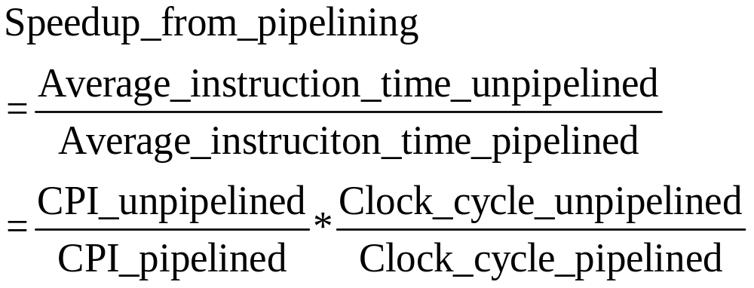
Speed Up Equation for Pipelining
Pipelining can be thought of as decreasing the CPI or the clock cycle time.

Slide 90
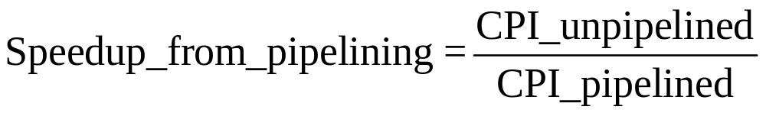
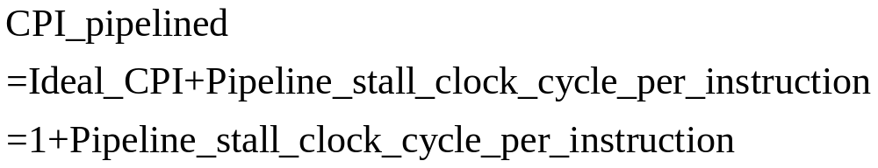
Speed Up Equation from the Viewpoint of Decreasing CPI
We ignore the cycle time overhead of pipelining and assume the stages are perfectly balanced, then the cycle time of the two processors can be equal.
The ideal CPI on a pipelined processor is almost always 1. Hence:

Slide 91
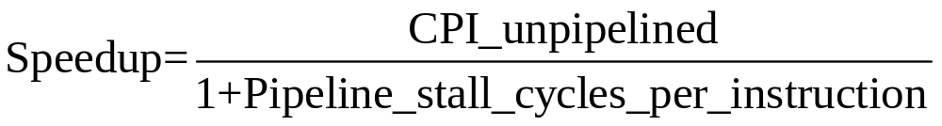
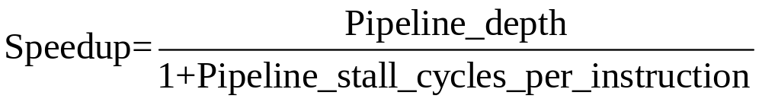
Speed Up Equation from the Viewpoint of Decreasing CPI
In a simple case, all instructions take the same number of cycles, which must also equal the number of pipeline stages. So..

Slide 92

Summary
Pipelining & Performance
Just overlap tasks; easy if tasks are independent
Speed Up ≤ Pipeline Depth; if ideal CPI is 1, then:
Hazards limit performance on computers:
  Structural: need more HW resources
  Data (RAW,WAR,WAW): need forwarding, compiler scheduling
  Control: delayed branch, prediction

Slide 93
MIPS R4000流水线计算机简介
1991年10月1日，MIPS Computer System正式发表了MIPS RISC处理器系列的最新成员—MIPS R4000。它是第一个采用超级流水线结构的64位RISC处理器。
超级流水线以增加流水线级数的方法来缩短机器周期，相同的时间内超级流水线执行了更多的机器指令。或者配置多个功能部件和指令译码电路，采用多条流水线并行处理，还有多个寄存器端口和总线，可以同时执行多个操作，因此比普通流水线执行的更快，在一个机器周期内可以流出多条指令。

Slide 94
    MIPS R4000流水线计算机简介
一、 MIPS R4000 整型流水线
1. 指令集：MIPS-3 指令集(64位)
2．MIPS R4000 流水线结构
共8个段：较深的流水线有利于提高时钟频率。
超级流水
与前述流水线相比：把访存操作进一步分段。
取指令：IF，IS
读写数据：DF，DS，TC
Notes:
从流水线的输入端看，每一个流水线周期启动一条指令；同样，从流水线的输出端看，每一个流水线周期执行完成一条指令。当流水线被充满时，如图5.75中的黑框内所示，有8条指令在同时执行。如果把两个流水线周期看作一个时钟周期，则在一个时钟周期内，R4000处理机分时发射了两条指令，同样，在一个时钟周期内，流水线也执行完成了两条指令；因此。R4000是一种很典型的超流水线处理机。
在取第一个数据（DF）和取第二个数据（DS）流水级期间，R4000要访问数据Cache。首先，存储器管理部件（MMU）在DF和DS流水级把数据的虚拟地址变换成主存物理地址；然后，在标志检验（TC）流水级从数据Cache中读出数据的区号，并把读出的区号与变换成的主存物理地址进行比较；如果比较结果相等，则数据Cache命中。对于STORE指令，如果命中，只要把数据送到写入缓冲器，由写入缓冲器负责把数据写到数据Cache的指定中去。对于非存储器操作指令，在写回结果（WB）流水级要把指令的最后执行结果写回到通用寄存器堆中。

Slide 95
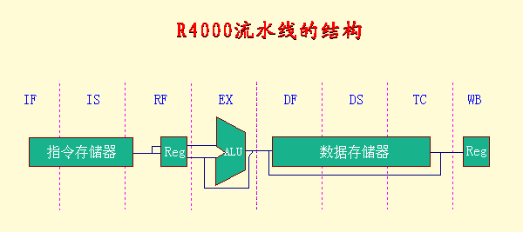
3. 流水线中各段的功能

Slide 96
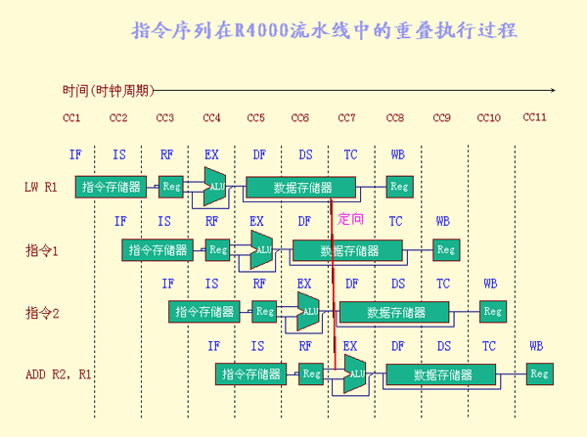
4．指令序列在流水线中的重叠执行过程

Slide 97
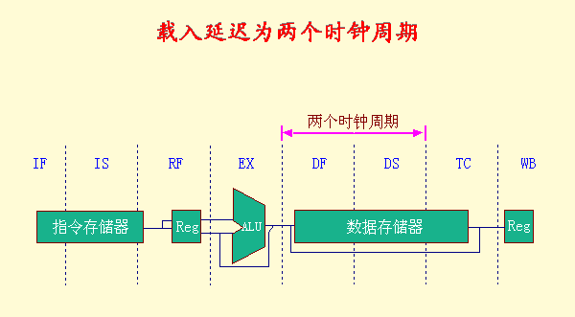
5. 载入延迟为两个时钟周期

Slide 98
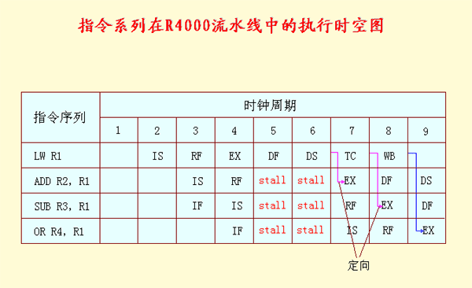
6. 指令序列在流水线中的执行时空图

Slide 99
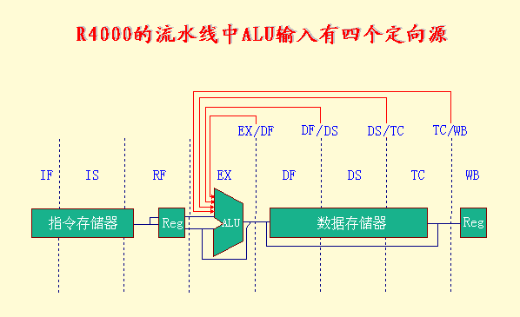
7. R4000流水线的定向路径比DLX流水线的多
ALU输入端的定向源有4个：EX/DF，DF/DS，DS/TC，TC/WB

Slide 100
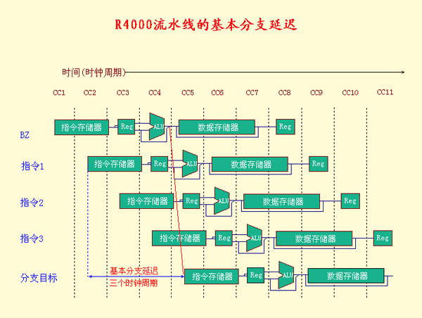
8. 分支处理
◆ 在EX段完成分支条件的计算
基本分支延迟：3个时钟周期

Slide 101
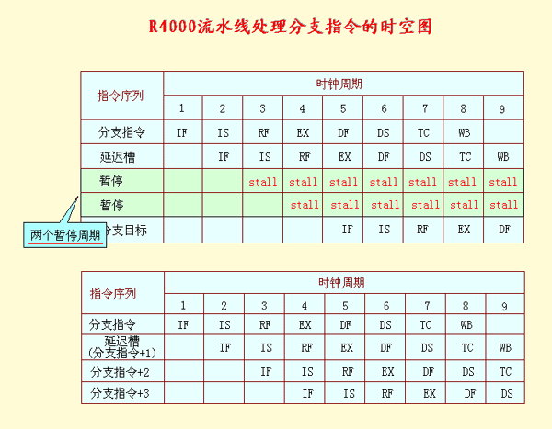
◆ 采用单周期延迟分支
◆ 预测分支：失败分支
◆ 处理分支指令的时空图

Slide 102
MIPS R4000 浮点流水线
1. R4000浮点部件
◆ 1个浮点除法器
◆ 1个浮点乘法器
◆ 1个浮点加法器
2．8个流水段 (表3.8）
3. R4000浮点流水线是一种多功能非线性流水线
4. 双精度浮点操作指令的延迟、启动间隔以及
流水段的使用情况 （表3.9）

Slide 103
表3.8
_{流水段}
_{功能部件}
_{描 述}
_{A}
_{浮点加法器}
_{尾数加流水段}
_{D}
_{浮点除法器}
_{除法流水段}
_{E}
_{浮点乘法器}
_{例外测试段}
_{M}
_{浮点乘法器}
_{乘法器第一个流水段}
_{N}
_{浮点乘法器}
_{乘法器第二个流水段}
_{R}
_{浮点加法器}
_{舍入段}
_{S}
_{浮点加法器}
_{操作数移位段}
_{U}
_{展开浮点数}

Slide 104
表3.9
_{浮点指令}
_{延 迟}
_{初始化}
_{间隔}
_{使用的流水段}
_{加、减}
₄
₃
_{U,S+A,A+R,R+S}
_{乘}
₈
₄
_{U,E+M,M,M,M,N,N+A,R}
_{除}
₃₆
₃₅
_{U,A,R,D28,D+A,D+R,D+A,D+R,A,R}
_{求平方根}
₁₁₂
₁₁₁
_{U,E,(A+R) 108,A,R}
_{取反}
₂
₁
_{U,S}
_{求绝对值}
₂
₁
_{U,S}
_{浮点比较}
₃
₂
_{U,A,R}

