Slide 1
Instruction Level Parallelism
指令级并行

Slide 2
Outline(1)
概念：指令级并行
5.1 ILP
5.2 Compiler techniques to increase ILP
6.1 Loop Unrolling
P80 Static Branch Prediction
5.4 Dynamic Branch Prediction
5.3.1 Overcoming Data Hazards with Dynamic Scheduling
5.3.2 Scoreboard Algorithm
5.3.3 (start) Tomasulo Algorithm
循环展开
分支预测
经典算法
CS2017 ILP

Slide 3
Outline(2)
5.4.3 Speculation
5.4.3 Speculative Tomasulo Example
5.3.1 Memory Disambiguation
5.3.1 Exceptions
5.5.1,5.5.2 Superscalar
5.5.3 VLIW
Increasing instruction bandwidth
Register Renaming vs. Reorder Buffer
Value Prediction
前瞻，推断（执行）
超标量
超长指令字
硬件技术和软件技术互相配合，最大限度地挖掘出程序中存在的指令级并行。
CS2017 ILP

Slide 4
Recall from Pipelining Review
Pipeline CPI = Ideal pipeline CPI + Structural Stalls + Data Hazard Stalls + Control Stalls
  Ideal pipeline CPI: measure of the maximum performance attainable by the implementation
  Structural hazards: HW cannot support this combination of instructions
  Data hazards: Instruction depends on result of prior instruction still in the pipeline
  Control hazards: Caused by delay between the fetching of instructions and decisions about changes in control flow (branches and jumps)
CS2017 ILP

Slide 5
Instruction Level Parallelism
Instruction-Level Parallelism (ILP): overlap the execution of instructions to improve performance
2 approaches to exploit ILP:
  1) Rely on hardware to help discover and exploit the parallelism dynamically (e.g., Pentium 4, AMD Opteron, IBM Power) , and
  2) Rely on software technology to find parallelism, statically at compile-time (e.g., Itanium 2)
CS2017 ILP
Notes:
覆盖hazards

Slide 6
Basic Concepts of ILP
Basic Block (BB) ILP is quite small
  BB: a straight-line code sequence with no branches in except to the entry and no branches out except at the exit 除入口和出口外没有其他分支的线性指令序列
  average dynamic branch frequency 15% to 25%
  => 4 to 7 instructions execute between a pair of branches
  Plus instructions in BB likely to depend on each other
To obtain substantial performance enhancements, we must exploit ILP across multiple basic blocks
Simplest: loop-level parallelism to exploit parallelism among iterations of a loop. E.g.,
for (i=1; i<=1000; i=i+1)
x[i] = x[i] + s（一个循环中的不同循环体并行执行）
CS2017 ILP

Slide 7
Basic Concepts of ILP
Exploit loop-level parallelism（循环级并行） to parallelism by “unrolling loop” either by
dynamic via branch prediction or
static via loop unrolling by compiler
(Another way is vectors, to be covered later)
Determining instruction dependence is critical to Loop Level Parallelism
If 2 instructions are
  parallel, they can execute simultaneously in a pipeline of arbitrary depth without causing any stalls (assuming no structural hazards)
  dependent, they are not parallel and must be executed in order, although they may often be partially overlapped
CS2017 ILP

Slide 8
Data Dependence and Hazards
Instr_{J} is data dependent (aka true dependence) on Instr_{I:}
  Instr_{J} tries to read operand before Instr_{I} writes it
  or Instr_{J} is data dependent on Instr_{K} which is dependent on Instr_{I}
If two instructions are data dependent, they cannot execute simultaneously or be completely overlapped
If data dependence caused a hazard in pipeline,
called a Read After Write (RAW) hazard
I: add r1,r2,r3
J: sub r4,r1,r3
CS2017 ILP
Notes:
AKA是Also Known As的缩写

Slide 9
ILP and Data Dependencies, Hazards
Data dependence in instruction sequence
⇒ data dependence in source code ⇒ effect of original data dependence must be preserved
HW/SW must preserve program order:
order instructions would execute in if executed sequentially as determined by original source program
  Dependences are a property of programs
Presence of dependence indicates potential for a hazard, but actual hazard and length of any stall is property of the pipeline
相关性是程序的特性； 冲突是流水线结构的特性；
相关性的存在只预示着存在有冲突的可能性。
CS2017 ILP

Slide 10
ILP and Data Dependencies, Hazards
Importance of the data dependencies
  indicates the possibility of a hazard
  determines order in which results must be calculated 计算顺序
  sets an upper bound on how much parallelism can possibly be exploited 决定可被开发的并行性的上界
HW/SW goal:
exploit parallelism by preserving program order only where it affects the outcome of the program
CS2017 ILP

Slide 11
A example of iteration
1 Loop: LD F0,0(R1)
2 ADDD F4,F0,F2
3 SD 0(R1),F4
4 SUBI R1,R1,#8
5 BNEZ R1,Loop ;delayed branch
整数寄存器R1：循环计数器，初值为向量中最高端地址元素的地址。
浮点寄存器F2：保存常数S。
假定最低端元素的地址为8。
CS2017 ILP
Notes:
Name Dependence

Slide 12
Example: same register Dependence
1 Loop: LD F0,0(R1)
2 ADDD F4,F0,F2
3 SD 0(R1),F4 ;drop SUBI & BNEZ
4 LD F0,-8(R1)
5 ADDD F4,F0,F2
6 SD -8(R1),F4 ;drop SUBI & BNEZ
7 LD F0,-16(R1)
8 ADDD F4,F0,F2
9 SD -16(R1),F4 ;drop SUBI & BNEZ
10 LD F0,-24(R1)
11 ADDD F4,F0,F2
12 SD -24(R1),F4
13 SUBI R1,R1,#32 ;alter to 4*8
14 BNEZ R1,LOOP
15 NOP
ADD F0 input to LD F0
LD F0 to output to next LD F0
CS2017 ILP

Slide 13
Name Dependence #1: Anti-dependence
Name dependence: when 2 instructions use same register or memory location, called a name, but no flow of data between the instructions associated with that name; 2 versions of name dependence
Instr_{J} writes operand before Instr_{I} reads it
Called an “anti-dependence” by compiler writers.
This results from reuse of the name “r1”
If anti-dependence caused a hazard in the pipeline, called a Write After Read (WAR) hazard
I: sub r4,r1,r3
J: add r1,r2,r3
K: mul r6,r1,r7
CS2017 ILP

Slide 14
Name Dependence #2: Output dependence
Instr_{J} writes operand before Instr_{I} writes it.
Called an “output dependence” by compiler writers
This also results from the reuse of name “r1”
If output dependence caused a hazard in the pipeline, called a Write After Write (WAW) hazard
Instructions involved in a name dependence can execute simultaneously if name used in instructions is changed so instructions do not conflict
  Register renaming resolves name dependence for regs
  Either by compiler or by HW
I: sub r1,r4,r3
J: add r1,r2,r3
K: mul r6,r1,r7
CS2017 ILP

Slide 15
Example: Rename the Register
1 Loop: LD F0,0(R1)
2 ADDD F4,F0,F2
3 SD 0(R1),F4 ;drop SUBI & BNEZ
4 LD F6,-8(R1)
5 ADDD F8,F6,F2
6 SD -8(R1),F8 ;drop SUBI & BNEZ
7 LD F10,-16(R1)
8 ADDD F12,F10,F2
9 SD -16(R1),F12 ;drop SUBI & BNEZ
10 LD F14,-24(R1)
11 ADDD F16,F14,F2
12 SD -24(R1),F16
13 SUBI R1,R1,#32 ;alter to 4*8
14 BNEZ R1,LOOP
15 NOP
CS2017 ILP

Slide 16
Control Dependencies
Every instruction is control dependent on some set of branches(第一个基本块除外), and, in general, these control dependencies must be preserved to preserve program order
控制相关决定了指令执行的顺序
  if p1 {
  S1;
  };
  if p2 {
  S2;
  }
S1 is control dependent on p1, and S2 is control dependent on p2 but not on p1.
指令控制相关于某分支，则不能移动到该分支前执行；
指令不控制相关某分支，则不能移动到该分支内执行；
CS2017 ILP

Slide 17
Control Dependence Ignored
Considering the branch control of Pipelining: Control dependence need not be preserved 不是必须严格保持的关键属性
  willing to execute instructions that should not have been executed (执行本不该执行的指令), thereby violating (违反) the control dependences, if can do so without affecting correctness of the program (除非不影响程序运行的正确性)
Instead, 2 properties critical to program correctness are
  exception behavior 异常行为 and
  data flow 数据流
CS2017 ILP
Notes:
只要不影响程序运行的正确性，控制相关并不是必须保留的关键因素

Slide 18
Exception Behavior
Preserving exception behavior
⇒ any changes in instruction execution order must not change how exceptions are raised in program
(⇒ no new exceptions)
Example:
DADDU R2,R3,R4
BEQZ R2,L1
LW R1,0(R2)
L1:
  (Assume branches not delayed)
Problem with moving LW before BEQZ?
可能引起内存保护异常
CS2017 ILP

Slide 19
Data Flow
Data flow: actual flow of data values among instructions that produce results and those that consume them
  branches make flow dynamic, determine which instruction is supplier of data
Example:
DADDU R1,R2,R3
BEQZ R4,L
DSUBU R1,R5,R6
L: …
OR R7,R1,R8
OR depends on DADDU or DSUBU?
Must preserve data flow on execution
CS2017 ILP

Slide 20
Outline
ILP
Compiler techniques to increase ILP
Loop Unrolling
Static Branch Prediction
Dynamic Branch Prediction
Overcoming Data Hazards with Dynamic Scheduling
Scoreboard Algorithm
(Start) Tomasulo Algorithm
Conclusion
CS2017 ILP

Slide 21
Software Techniques - Example
This code, add a scalar to a vector:
for (i=1000; i>0; i=i–1)
x[i] = x[i] + s;
Assume following latencies for all examples
  Ignore delayed branch in these examples
Instruction Instructio Latency（等待时间）producing result using result in cycles
FP ALU op Another FP ALU op 3
FP ALU op Store double 2
Load double FP ALU op 1
Load double Store double 0
Integer op Integer op 1
CS2017 ILP

Slide 22
FP Loop: Where are the Hazards?
First translate into MIPS code:
  -To simplify, assume 8 is lowest address
Loop: L.D F0,0(R1) ;F0=vector element
ADD.D F4,F0,F2 ;add scalar from F2
S.D 0(R1),F4 ;store result
DADDUI R1,R1,-8 ;decrement pointer 8 bytes (DW)
BNEZ R1,Loop ;branch R1!=zero
CS2017 ILP

Slide 23
FP Loop Showing Stalls
1 Loop: L.D F0,0(R1) ;F0=vector element
2 stall
3 ADD.D F4,F0,F2 ;add scalar in F2
4 stall
5 stall
6 S.D 0(R1),F4 ;store result
7 DADDUI R1,R1,-8 ;decrement pointer 8B (DW)
8 stall ;assumes can’t forward to branch
9 BNEZ R1,Loop ;branch R1!=zero
Instruction Instruction Latency in
producing result using result clock cycles
FP ALU op Another FP ALU op 3
FP ALU op Store double 2
Load double FP ALU op 1
Integer op Integer op 1
9 clock cycles: Rewrite code to minimize stalls?
CS2017 ILP

Slide 24
Revised FP Loop Minimizing Stalls
1 Loop: L.D F0,0(R1)
2 DADDUI R1,R1,-8
3 ADD.D F4,F0,F2
4 stall
5 stall
6 S.D 8(R1),F4 ;altered offset when move DSUBUI
7 BNEZ R1,Loop
Swap DADDUI and S.D by changing address of S.D
7 clock cycles, but just 3 for execution (L.D, ADD.D,S.D), 4 for loop overhead(stall, branch, sub)系统开销;
How make faster?
CS2017 ILP

Slide 25
Unroll Loop Four Times (straightforward way)
1 cycle stall
Rewrite loop to minimize stalls?
1 Loop: L.D F0,0(R1)
3 ADD.D F4,F0,F2
6 S.D 0(R1),F4 ;drop DSUBUI & BNEZ
7 L.D F6,-8(R1)
9 ADD.D F8,F6,F2
12 S.D -8(R1),F8 ;drop DSUBUI & BNEZ
13 L.D F10,-16(R1)
15 ADD.D F12,F10,F2
18 S.D -16(R1),F12 ;drop DSUBUI & BNEZ
19 L.D F14,-24(R1)
21 ADD.D F16,F14,F2
24 S.D -24(R1),F16
25 DADDUI R1,R1,#-32 ;alter to 4*8
27 BNEZ R1,LOOP
27 clock cycles, or 6.75 per iteration
(Assumes R1 is multiple of 4)
2 cycles stall
CS2017 ILP
Notes:
消除了3次分支转移和3次R1-8操作

Slide 26
Unrolled Loop Detail
Do not usually know upper bound of loop
Suppose it is n, and we would like to unroll the loop to make k copies of the body (n=30,k=4)
Instead of a single unrolled loop, we generate a pair of consecutive loops 一组连续的循环:
  1st executes (n mod k) times and has a body that is the original loop (30 mod 4=2)
  2nd is the unrolled body surrounded by an outer loop that iterates (n/k) times (30/4=7)
For large values of n, most of the execution time will be spent in the unrolled loop
CS2017 ILP

Slide 27
Codes Rescheduling That Minimizes Stalls
1 Loop: L.D F0,0(R1)
2 L.D F6,-8(R1)
3 L.D F10,-16(R1)
4 L.D F14,-24(R1)
5 ADD.D F4,F0,F2
6 ADD.D F8,F6,F2
7 ADD.D F12,F10,F2
8 ADD.D F16,F14,F2
9 S.D 0(R1),F4
10 S.D -8(R1),F8
11 S.D -16(R1),F12
12 DSUBUI R1,R1,#32
13 S.D 8(R1),F16 ; 8-32 = -24
14 BNEZ R1,LOOP
14 clock cycles, or 3.5 per iteration
CS2017 ILP

Slide 28
5 Loop Unrolling Decisions
Requires understanding how one instruction depends on another and how the instructions can be changed or reordered given the dependences:
Determine loop unrolling useful by finding that loop iterations were independent (except for the loop maintenance code)
Use different registers to avoid unnecessary constraints forced by using same registers for different computations
Eliminate the extra test and branch instructions and adjust the loop termination and iteration code
Determine that loads and stores in unrolled loop can be interchanged by observing that loads and stores from different iterations are independent
  Transformation requires analyzing memory addresses and finding that they do not refer to the same address
Schedule the code, preserving any dependences needed to yield the same result as the original code
CS2017 ILP

Slide 29
3 Limits to Loop Unrolling
Decrease in amount of overhead amortized with each extra unrolling（通过额外的循环展开，降低了整体开销）
Growth in code size
  For larger loops, concern it increases the instruction cache miss rate
Register pressure: potential shortfall (不足) in registers created by aggressive unrolling and scheduling
  If not be possible to allocate all live values to registers, may lose some or all of its advantage
Loop unrolling reduces impact of branches on pipeline; another way is branch prediction
CS2017 ILP
Notes:
与每个额外的展开摊销的开销数额减少
Amortized 分期偿还

Slide 30
Outline
ILP
Compiler techniques to increase ILP
Loop Unrolling
Static Branch Prediction
Dynamic Branch Prediction
Overcoming Data Hazards with Dynamic Scheduling
Scoreboard Algorithm
(Start) Tomasulo Algorithm
Conclusion
CS2017 ILP

Slide 31
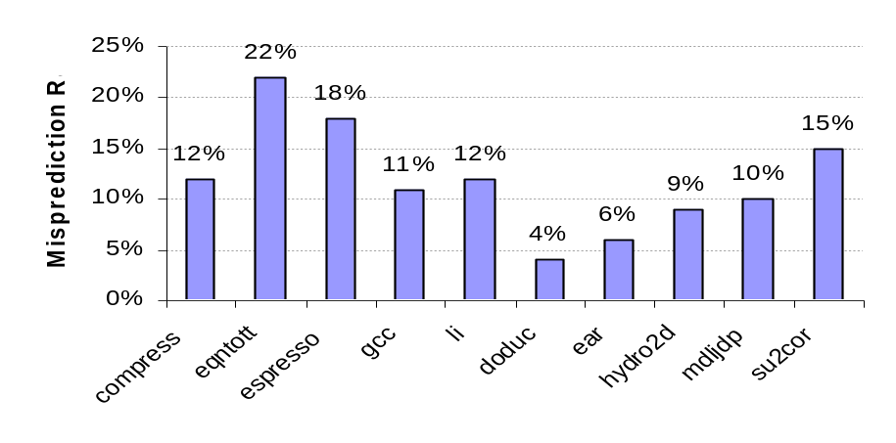
Static Branch Prediction
Lecture of Pipelining showed scheduling code around delayed branch
To reorder code around branches, need to predict branch statically when compile
Simplest scheme is to predict a branch as taken
  Average misprediction = untaken branch frequency = 34% SPEC
Integer
Floating Point
More accurate scheme predicts branches using profile information collected from earlier runs, and modify prediction based on last run.
CS2017 ILP
Notes:
配置文件

Slide 32
Dynamic Branch Prediction
Why does prediction work? 规律性！
  Underlying algorithm has regularities
  Data that is being operated on has regularities
  Instruction sequence has redundancies(冗余) that are artifacts of way that humans/compilers think about problems 静态预测有时无意义
Is dynamic branch prediction better than static branch prediction?
  Seems to be
  There are a small number of important branches in programs which have dynamic behavior
CS2017 ILP

Slide 33
Dynamic Branch Prediction
Performance = ƒ(accuracy, cost of misprediction)
The simplest dynamic branch-prediction scheme is a branch-prediction buffer or branch history table.
Branch History Table: Lower bits of PC address index table of 1-bit values
  Says whether or not branch taken last time
Problem: in a loop, 1-bit BHT will cause two mispredictions (avg is 9 iterations before exit):
  End of loop case, when it exits instead of looping as before 最后一次预测错误不可避免，因为前面分支总是成功
  First time through loop on next time through code, when it predicts exit instead of looping 第一次预测错误是源于上次程序的执行，因为上一次程序最后一次分支不成功
CS2017 ILP
Notes:
这种固定的预测将会在第一次和最后一次循环中出现预测错误。
第一次预测错误是源于上次程序的执行，因为上一次程序最后一次分支是不成功的。
最后一次预测错误是不可避免的，因为前面的分支总是成功，共九次。

Slide 34
Dynamic Branch Prediction
Solution: 2-bit scheme where change prediction only if get misprediction twice
Red: stop, not taken
Green: go, taken
Adds hysteresis(滞后) to decision making process
T
NT
Predict Taken
11
10
Predict Taken
T
T
NT
NT
Predict Not
Taken
01
00
Predict Not
Taken
T
NT
CS2017 ILP

Slide 35
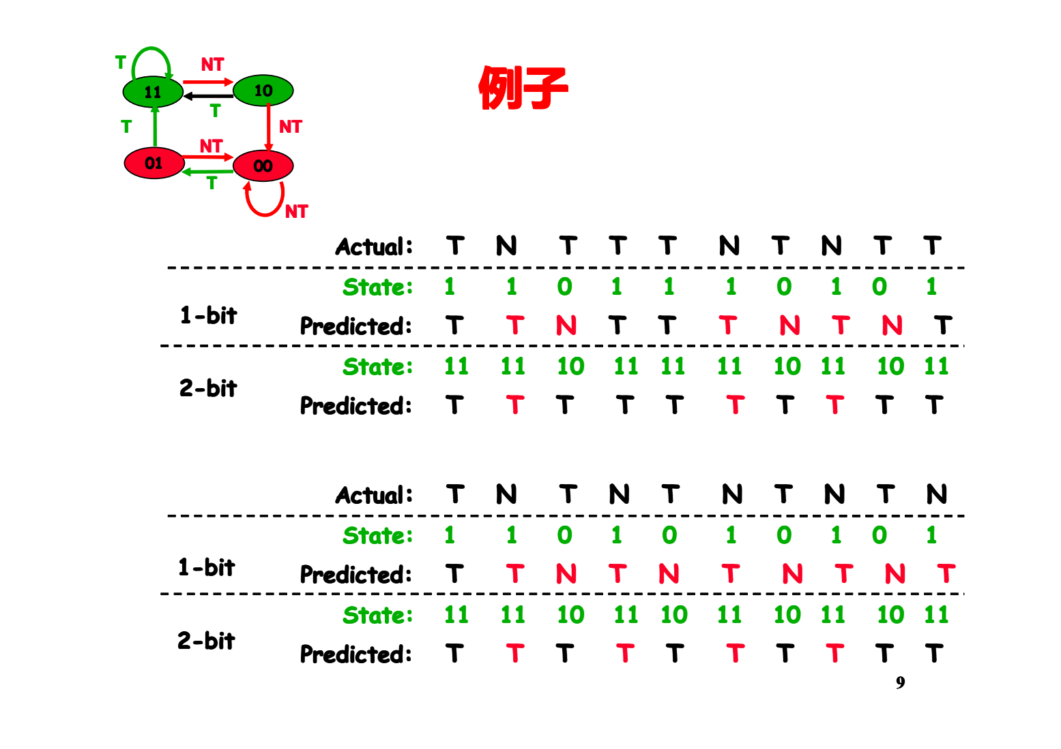
CS2017 ILP

Slide 36
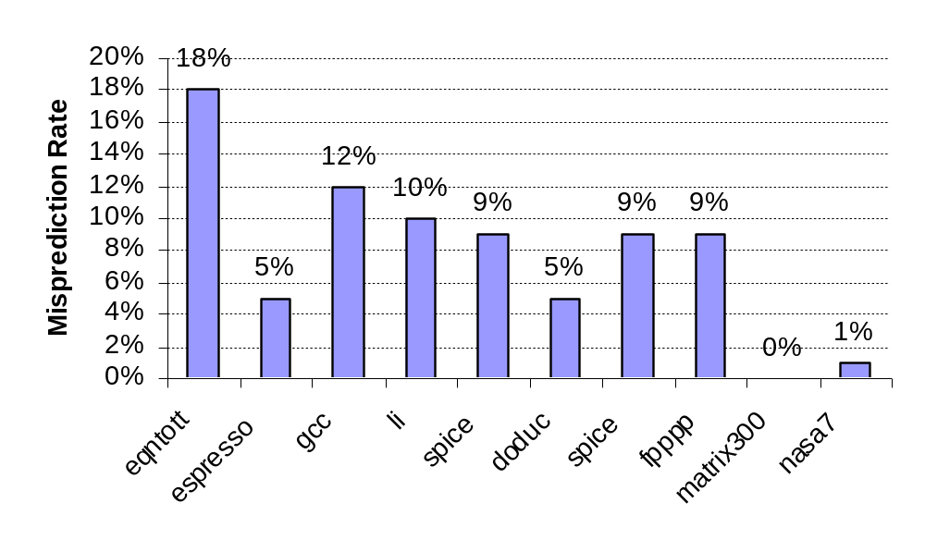
BHT Accuracy
Mispredict because either:
  Wrong guess for that branch
  Got branch history of wrong branch when index the table
  (由于使用PC的低位查找BHT表，可能得到错误的分支历史记录)
4096 entry table:
Integer
Floating Point

Slide 37
Correlated (相关) Branches
Consider a small code fragment
    if (aa==2) aa=0;
    if (bb==2) bb=0;
    if (aa!=bb) {
Translate to MIPS code
  DADDIU R3,R1,#–2
  BNEZ R3,L1 ;branch b1 (aa!=2)
  DADD R1,R0,R0 ;aa=0
  L1: DADDIU R3,R2,#–2
  BNEZ R3,L2 ;branch b2 (bb!=2)
  DADD R2,R0,R0 ;bb=0
  L2: DSUBU R3,R1,R2 ;R3=aa-bb
  BEQZ R3,L3 ;branch b3 (aa==bb)
CS2017 ILP

Slide 38
Correlated Branch Prediction
The key observation is that the behavior of branch b3 is correlated with the behavior of branches b1 and b2. Clearly, if branches b1 and b2 are both not taken then b3 will be taken.
Branch predictors that use the behavior of other branches to make a prediction are called correlating predictors or two-level predictors.
Existing correlating predictors add information about the behavior of the most recent branches to decide how to predict a given branch.
For example, a (1,2) predictor uses the behavior of the last branch to choose from among a pair of 2-bit branch predictors in predicting a particular branch.
CS2017 ILP

Slide 39
Correlated Branch Prediction
Idea: record m most recently executed branches as taken or not taken, and use that pattern to select the proper n-bit branch history table
In general, (m,n) predictor means record last m branches to select between 2^{m} history tables, each with n-bit counters
  Thus, old 2-bit BHT is a (0,2) predictor
Each entry in table has m n-bit predictors.
Global Branch History: m-bit shift register keeping T/NT status of last m branches.
CS2017 ILP
Notes:
2^{m} history tables 用来记录历史上此m个分支的预测情况。

Slide 40
Correlating Branches
(2,2) predictor
  – Behavior of recent branches selects between four predictions of next branch, updating just that prediction
Branch address
4
2-bits per branch predictor
00 01 10 11
Prediction
0 1
2-bit global branch history
CS2017 ILP
Notes:
01

Slide 41
An Example
Address
 |  | 00 |  | 01 |  | 10 |  | 11
0X20 |  | 01 |  | 01 |  | 11 |  | 01
0X24 |  | 11 |  | 11 |  | 00 |  | 11
0X32 |  | 11 |  | 00 |  | 11 |  | 10
0X36 |  | 00 |  | 11 |  | 00 |  | 11
0X48 |  | 11 |  | 11 |  | 01 |  | 11
0X60 |  | 10 |  | 10 |  | 11 |  | 10
0X48 |  | Global Branch History |  |  |  | 10
 |  | Predicted |  | ?
CS2017 ILP

Slide 42
An Example
Address
 |  | FF |  | FT |  | TF |  | TT
0X20 |  | 01 |  | 01 |  | 11 |  | 01
0X24 |  | 11 |  | 11 |  | 00 |  | 11
0X32 |  | 11 |  | 00 |  | 11 |  | 10
0X36 |  | 00 |  | 11 |  | 00 |  | 11
0X48 |  | 11 |  | 11 |  | 01 |  | 11
0X60 |  | 10 |  | 10 |  | 11 |  | 10
0X48 |  | Global Branch History |  |  |  | TF
 |  | Predicted |  | ?
CS2017 ILP

Slide 43
Accuracy of Different Schemes
20%
4096 Entries 2-bit BHT
Unlimited Entries 2-bit BHT
1024 Entries (2,2) BHT
18%
16%
14%
12%
11%
Frequency of Mispredictions
10%
8%
6%
6%
6%
6%
5%
5%
4%
4%
2%
1%
1%
0%
0%
nasa7
matrix300
tomcatv
doducd
spice
fpppp
gcc
expresso
eqntott
li
4,096 entries: 2-bits per entry
Unlimited entries: 2-bits/entry
1,024 entries (2,2)
CS2017 ILP

Slide 44
Tournament(竞赛) Predictors
Adaptively combine local and global predictors
  Multiple predictors
    One based on global information: Results of recently executed m branches
    One based on local information: Results of past executions of the current branch instruction
  Selector to choose which predictors to use
    E.g.: 2-bit saturating counter, incremented whenever the “predicted” predictor is correct and the other predictor is incorrect, and it is decremented in the reverse situation
CS2017 ILP
Notes:
This counter has four states. Every time the branch is taken, the counter goes up to the next state, unless it already is in the highest state. Every time the branch is not taken, the counter goes down one step, unless it already is in the lowest state. When the counter is in one of the highest two states, it predicts that the branch will be taken the next time. When the counter is in one of the lowest two states, it predicts that the branch will not be taken the next time. If the branch has been not taken several times in a row, then the counter will be in the lowest state, called "strongly not taken". The branch then has to be taken twice for the prediction to change to taken. Likewise, if the branch has been taken several times in a row, it will be in state "Strongly taken". It has to be not taken twice before the prediction changes to not taken. In other words, the branch has to deviate twice from what it has done most in the past before the prediction changes.
Consider the behavior of the counter in figure 3.1 for a branch that is taken every second time. If it starts in state "strongly not taken", then the counter will alternate between state
"strongly not taken" and "weakly not taken". The prediction will always be "not taken", which will be right only 50% of the time. Likewise, if it starts in state "strongly taken" then it will
predict "taken" all the time. The worst case is if it happens to start in state "weakly taken" and alternates between "weakly not taken" and "weakly taken". In this case, the branch will be mispredicted all the time

Slide 45
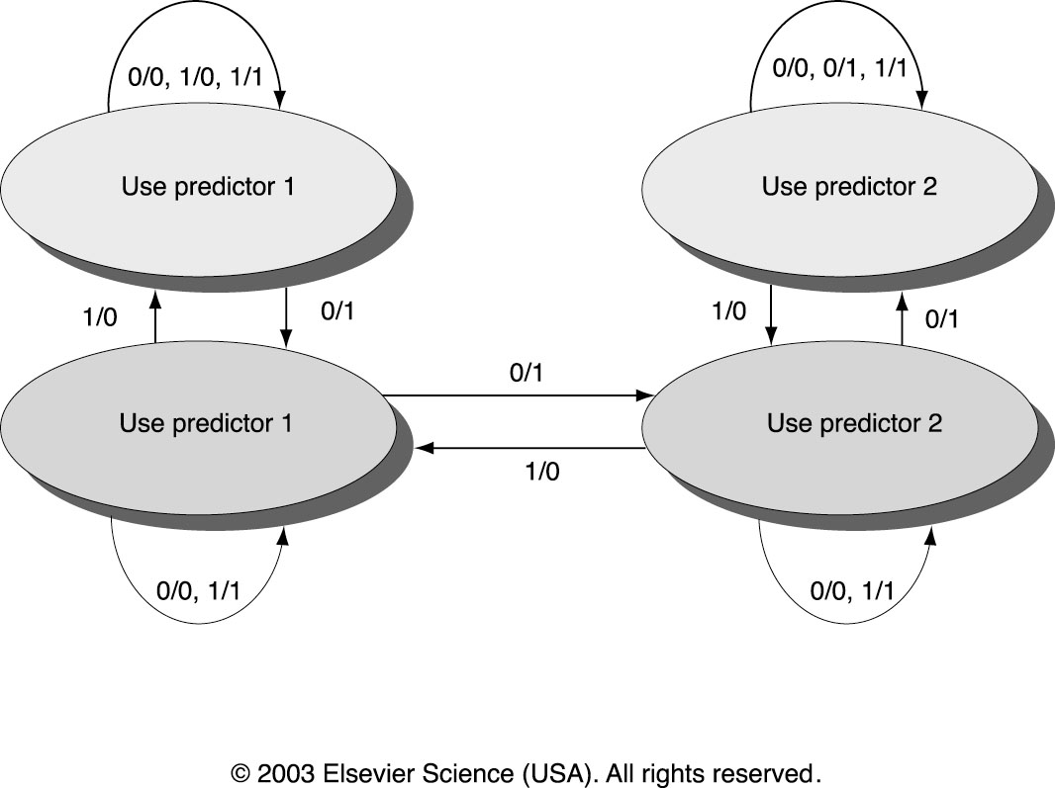
Tournament Predictors
State Transition Diagram for a Tournament Predictor
1/0 : predictor is correct and the other predictor is incorrect
CS2017 ILP
Notes:
1/0 表示 predictor is correct and the other predictor is incorrect

Slide 46
Alpha 21264 - Tournament Predictors
The most advanced of these predictors has been on the Alpha 21264. Tournament predictor using, say, 4K 2-bit counters indexed by local branch address. Chooses between:
Global predictor
  4K entries index by history of last 12 branches (m=12, 2¹² ⁼ 4K)
  Each entry is a standard 2-bit predictor
Local predictor: consists of a two-level predictor.
  Local history table: 1024 10-bit entries recording last 10 branches, index by branch address
  The pattern of the last 10 occurrences of that particular branch used to index table of 1K entries with 3-bit saturating counters
CS2017 ILP
Notes:
indexed by local branch address
Alpha 21264 康柏电脑公司2001年2月发布，833MHz

Slide 47
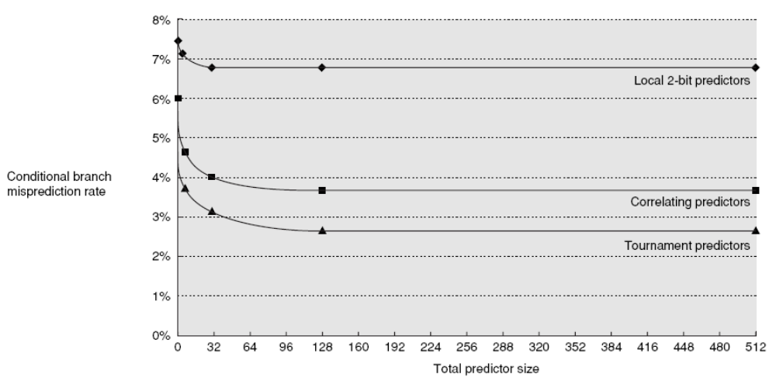
Comparing Predictors
Advantage of tournament predictor is ability to select the right predictor for a particular branch
  Particularly crucial (至关紧要的) for integer benchmarks：A typical tournament predictor will select the global predictor almost 40% of the time for the SPEC integer benchmarks and less than 15% for FP benchmarks
Misprediction rate on different predictor size
CS2017 ILP

Slide 48
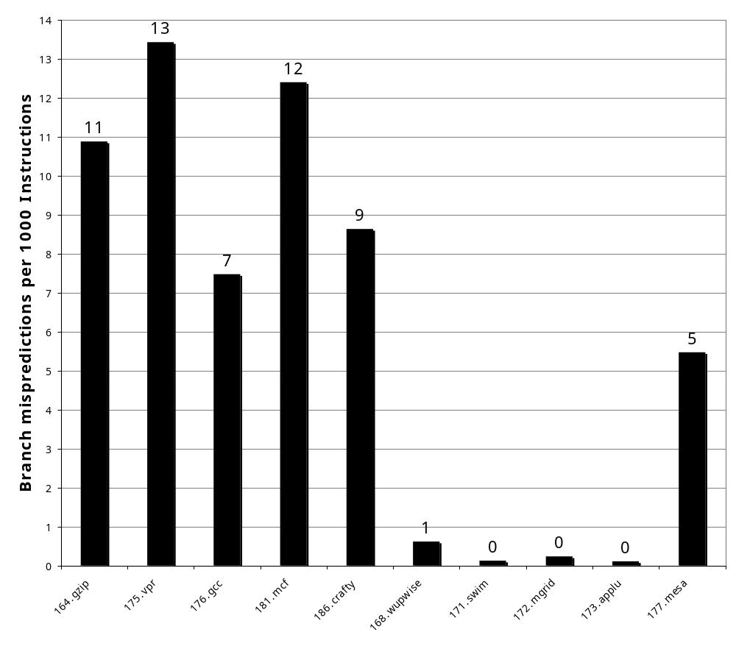
Pentium 4 Misprediction Rate
(per 1000 instructions, not per branch)
≈6% misprediction rate per branch SPECint
(19% of INT instructions are branch)
≈2% misprediction rate per branch SPECfp
(5% of FP instructions are branch)
SPECint2000
SPECfp2000
CS2017 ILP

Slide 49
Branch Target Buffers (BTB)
分支目标缓冲
Branch target calculation is costly and stalls the instruction fetch.
BTB stores PCs the same way as caches
The PC of a branch is sent to the BTB
When a match is found the corresponding Predicted PC is returned
If the branch was predicted taken, instruction fetch continues at the returned predicted PC

Slide 50
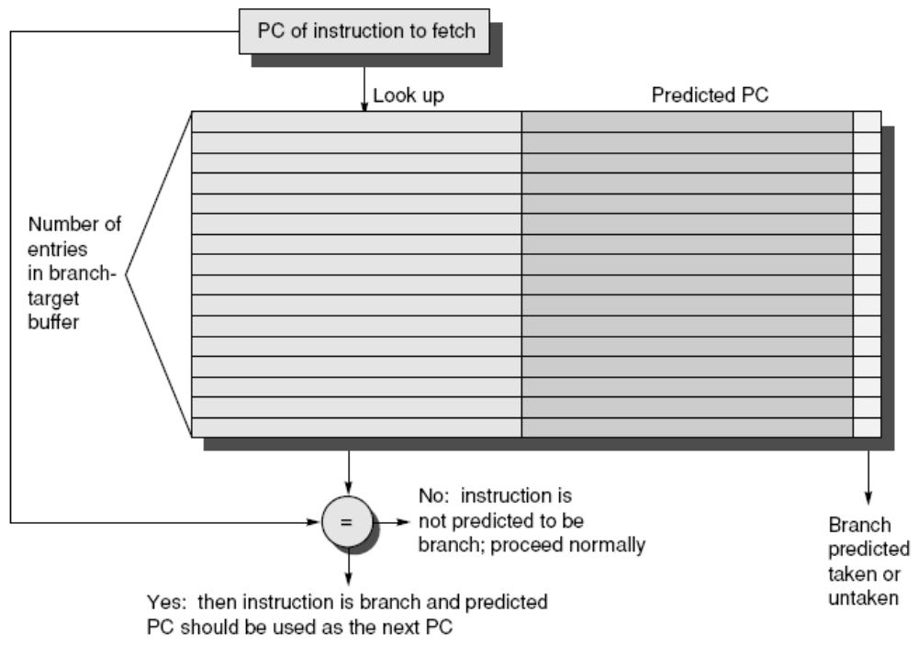
Branch Target Buffers
Notes:
Figure 2.22 A branch-target buffer. The PC of the instruction being fetched is matched
against a set of instruction addresses stored in the first column; these represent the
addresses of known branches. If the PC matches one of these entries, then the instruction
being fetched is a taken branch, and the second field, predicted PC, contains the prediction
for the next PC after the branch. Fetching begins immediately at that address. The
third field, which is optional, may be used for extra prediction state bits.

Slide 51
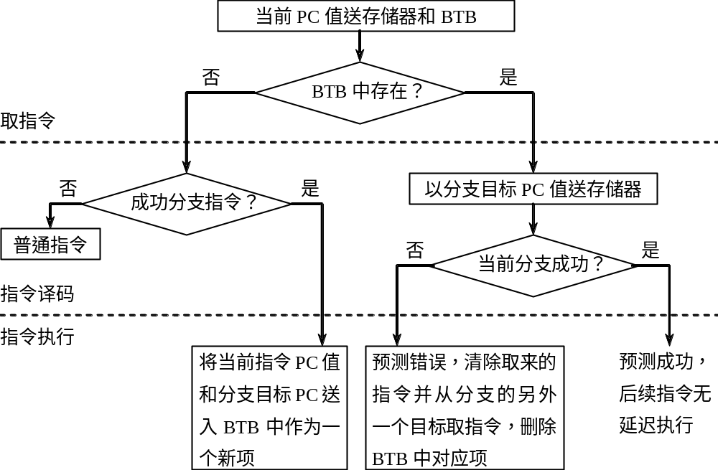
BTB工作过程
CS2017 ILP

Slide 52
Dynamic Branch Prediction Summary
Prediction becoming important part of execution
Branch History Table: 2 bits for loop accuracy
Correlation: Recently executed branches correlated with next branch
  Either different branches
  Or different executions of same branches
Tournament predictors take insight to next level, by using multiple predictors
  usually one based on global information and one based on local information, and combining them with a selector
  In 2006, tournament predictors using ≈ 30K bits are in processors like the Power5 and Pentium 4
Branch Target Buffer: include branch address & prediction
CS2017 ILP

Slide 53
Outline
ILP
Compiler techniques to increase ILP
Loop Unrolling
Static Branch Prediction
Dynamic Branch Prediction
Overcoming Data Hazards with Dynamic Scheduling
Scoreboard Algorithm
(Start) Tomasulo Algorithm
Conclusion
CS2017 ILP

Slide 54
Advantages of Dynamic Scheduling
Dynamic scheduling - hardware rearranges the instruction execution to reduce stalls while maintaining data flow and exception behavior
It handles cases when dependences unknown at compile time
  it allows the processor to tolerate unpredictable delays such as cache misses, by executing other code while waiting for the miss to resolve
It allows code that compiled for one pipeline to run efficiently on a different pipeline
It simplifies the compiler
Hardware speculation(推测), a technique with significant performance advantages, builds on dynamic scheduling (next lecture)
CS2017 ILP

Slide 55
HW Schemes: Instruction Parallelism
Key idea: Allow instructions behind stall to proceed
DIVD F0,F2,F4
ADDD F10,F0,F8
SUBD F12,F8,F14
Enables out-of-order execution and allows out-of-order completion (e.g., SUBD)
  In a dynamically scheduled pipeline, all instructions still pass through issue stage in order (in-order issue)
Will distinguish when an instruction begins execution and when it completes execution; between 2 times, the instruction is in execution
Note: Dynamic execution creates WAR and WAW hazards and makes exceptions harder
CS2017 ILP

Slide 56
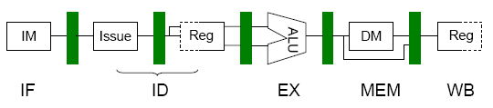
Dynamic Scheduling Step 1
Simple pipeline had 1 stage to check both structural and data hazards: Instruction Decode (ID), also called Instruction Issue
Split the ID pipe stage of simple 5-stage pipeline into 2 stages:
  Issue—Decode instructions, check for structural hazards
  Read operands—Wait until no data hazards, then read operands
CS2017 ILP

Slide 57
WAR & WAW May Arise When Dynamic Scheduling
Both WAW and WAR hazards can be solved by
– Scoreboard (Appendix A, used in CDC6600 first) and
– Tomasulo approach (used in IBM 360/91 Floating-point Unit)
CS2017 ILP

Slide 58
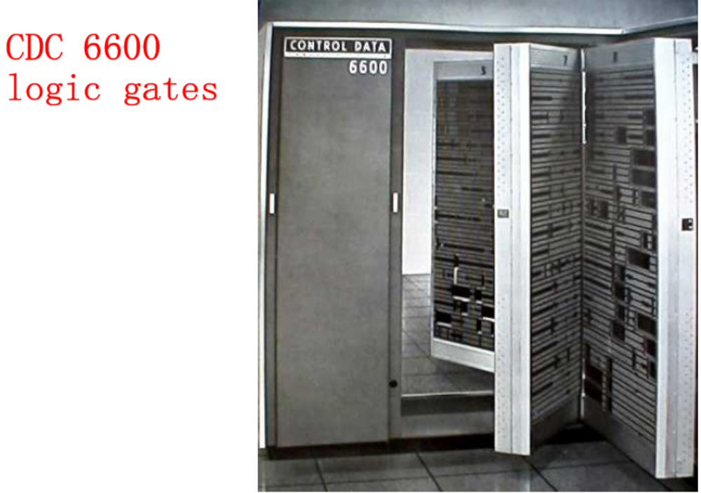
1963年8月，西蒙·克雷
（S. Cray）设计的 CDC6600巨型机公布于世。
CS2017 ILP

Slide 59
Scoreboard Algorithm
Idea:
  to maintain CPI=1 by executing an instruction as early as possible
  when stalled, other instructions can be issued and executed if they do not depend on any active or stalled instruction
The scoreboard takes full responsibility for instruction issue and execution, including hazard detection (centralized control)
Each instruction undergoes four steps in executing. (Since we are concentrating on the FP operations, we will not consider a step for memory access.) The four steps, which replace the ID, EX, and WB steps in the standard MIPS pipeline, are as follows:
Issue->Read operands->Execution->Write result
CS2017 ILP

Slide 60
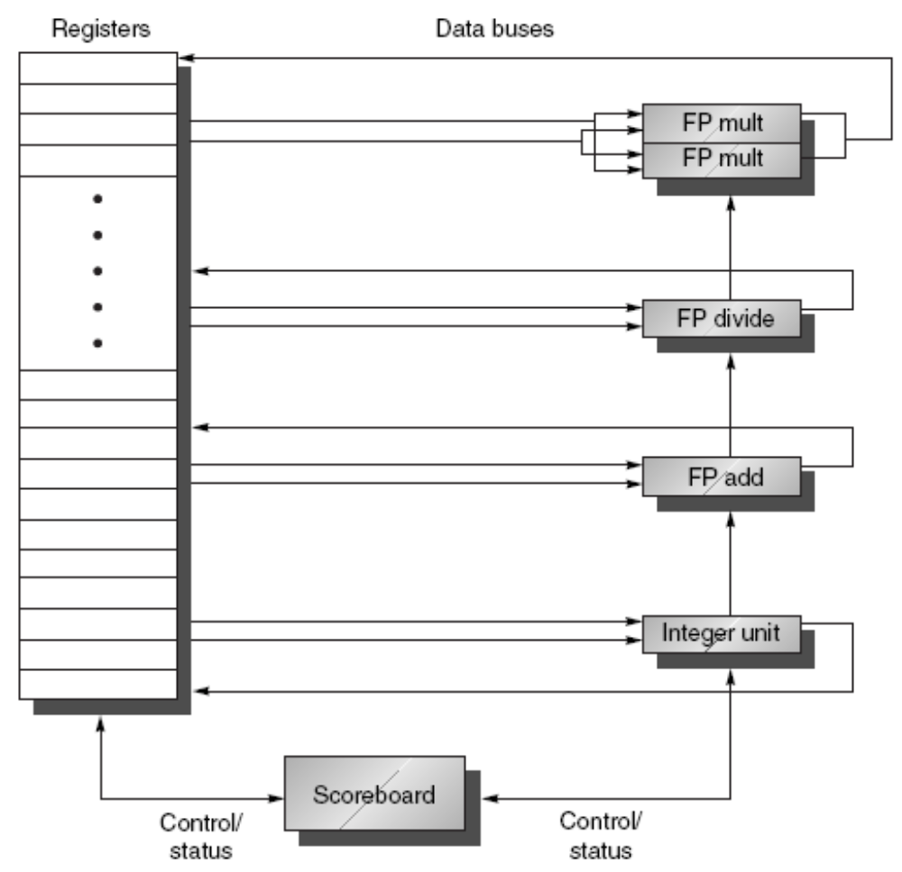
The Basic Structure of a MIPS Processor with a Scoreboard
FU latencies:
Add 2,
Mult 10,
Div 40
clocks
CS2017 ILP

Slide 61
3 Parts to the Scoreboard
Instruction status: indicating the pipeline stage of the instruction
Functional Unit Status: 9 fields
  – Busy
  – Op – operation performing (e.g. add, sub)
  – Fi – destination register
  – Fj, Fk – source register
  – Qj, Qk – FU that produces Fj, Fk
  – Rj, Rk – flags of Fj, Fk to indicate being read or not (set to No after operands are read)
Register result status: which FU will write the result to register
CS2017 ILP
Notes:
What you might have thought
1. 4 stages of instruction execution
2.Status of FU: Normal things to keep track of (RAW & structura for busyl):
Fi from instruction format of the mahine (Fi is dest)
Add unit can Add or Sub
Rj, Rk - status of registers (Yes means ready)
Qj,Qk - If a no in Rj, Rk, means waiting for a FU to write result; Qj, Qk means which FU waiting for it
3.Status of register result (WAW &WAR)s:
which FU is going to write into registers
Scoreboard on 6600 = size of FU
FU latencies: Add 2, Mult 10, Div 40 clocks

Slide 62
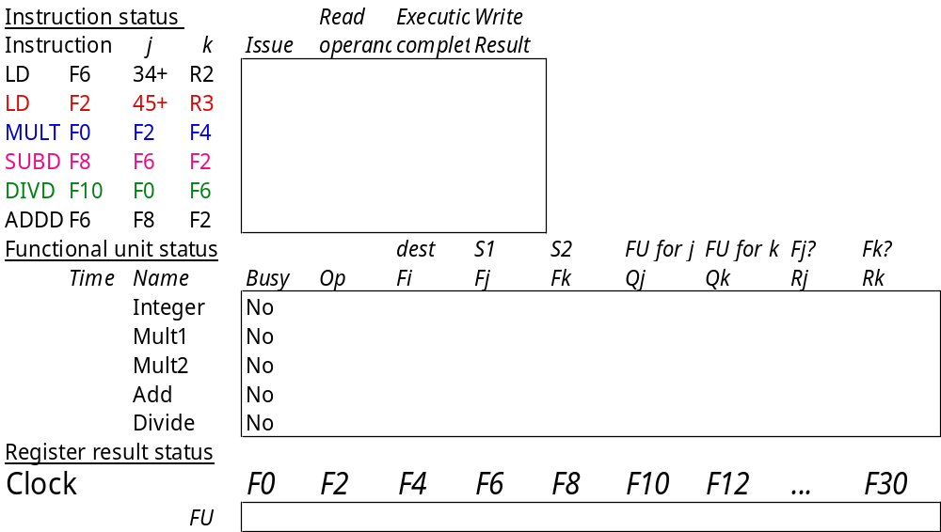
Scoreboard Example
CS2017 ILP

Slide 63
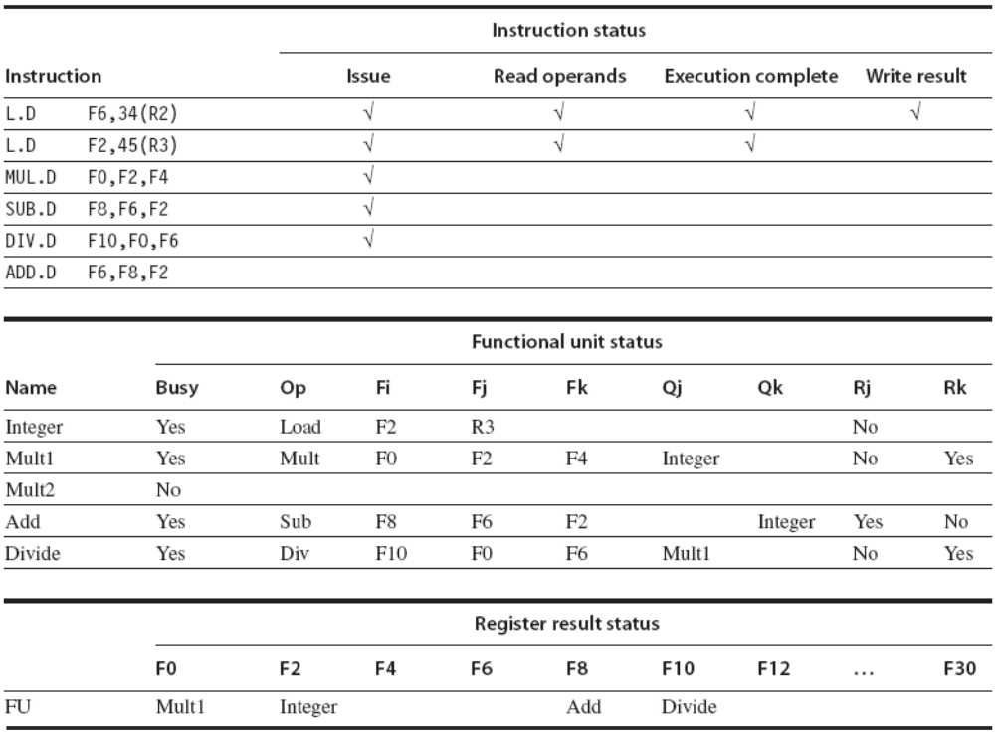
(1/3) Components of the scoreboard
CS2017 ILP

Slide 64
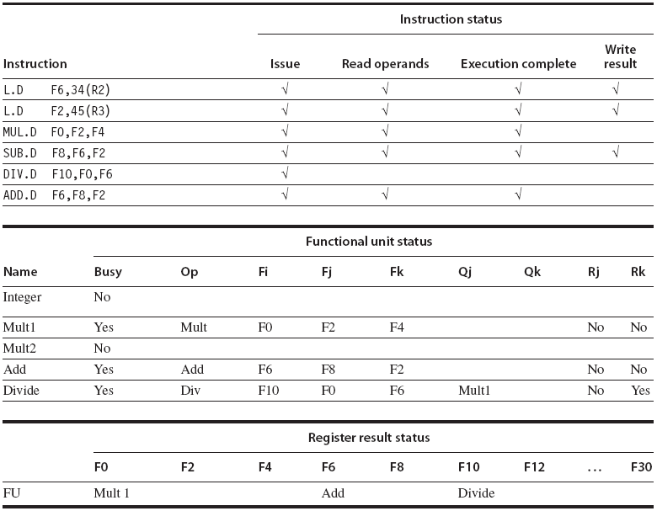
(2/3) Scoreboard tables just before the MUL.D goes to write result
CS2017 ILP
Notes:
The DIV.D has not yet read either of its operands, since it has a dependence on the result of the multiply.
The ADD.D has read its operands and is in execution, although it was forced to wait until the SUB.D finished to get the functional unit. ADD.D cannot proceed to write result because of the WAR hazard on F6, which is used by the DIV.D.
The Q fields are only relevant when a functional unit is waiting for another unit.

Slide 65
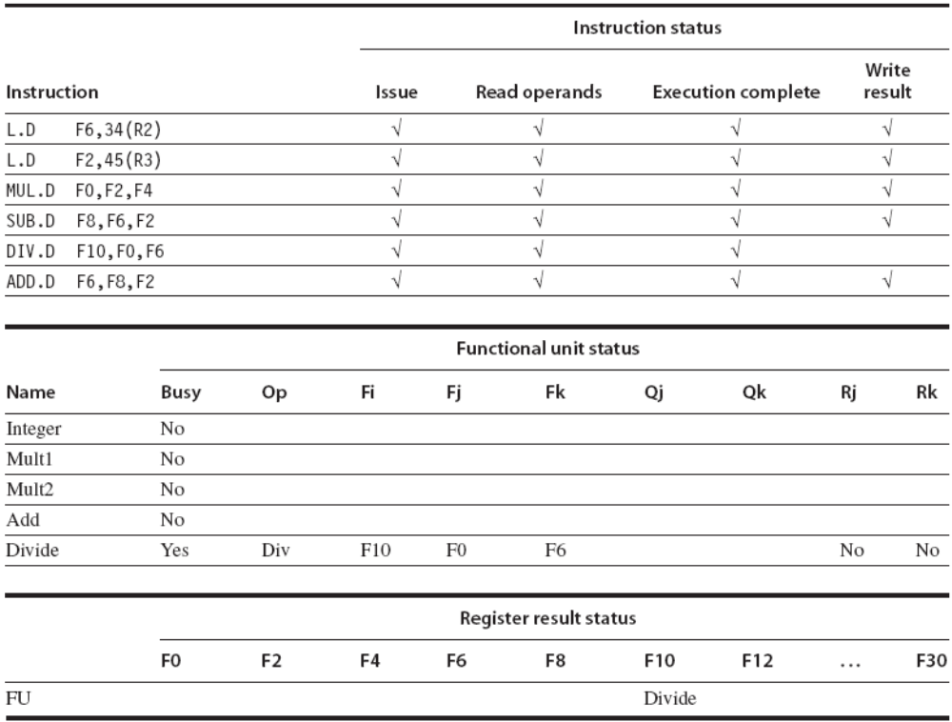
(3/3) Scoreboard tables just before the DIV.D goes to write result
CS2017 ILP
Notes:
ADD.D was able to complete as soon as DIV.D passed through read operands and got a copy of F6.
Only the DIV.D remains to finish.

Slide 66
Remarks
The scoreboard identifies what requires for each instruction to advance and bookkeeping action necessary when the instruction does advance
The scoreboard records operand specifier information, such as register number
Costs and benefits of scoreboard
  The amount of parallelism available among the instructions
    Whether independent instructions can be found ?
  The number of scoreboard entries
    The instrs. window the pipeline can look for independent instr.
  The number and types of FUs
  The presence of anti-dependence and output dependence
Recently, the dynamic scheduling is motivated by attempts to issue more instructions per clock and by speculation.
CS2017 ILP

Slide 67
Another Dynamic Algorithm: Tomasulo’s
For IBM 360/91 (before caches!)
  ⇒ Long memory latency 较长的内存访问和浮点操作延迟
Goal: High Performance without special compilers
Small number of floating point registers (4 in 360) prevented interesting compiler scheduling of operations 限制了编译器调度的有效性
  This led Tomasulo to try to figure out how to get more effective registers — renaming in hardware!
Why Study 1966 Computer?
The descendants(后代) of this have flourished!
  Alpha 21264, Pentium 4, AMD Opteron, Power 5, …
CS2017 ILP
Notes:
Tomasulo算法是由Robert Tomasulo 设计的，因而以他的名字命名。

Slide 68
Tomasulo Algorithm
Control & buffers distributed with Function Units (FU)
  FU buffers called “reservation stations”(RS); 保留站
  have pending(未决的) operands 缓存了即将执行指令所需的操作数
Registers in instructions replaced by values or pointers to RS; called register renaming ;
  Renaming avoids WAR, WAW hazards
  More reservation stations than registers, so can do optimizations compilers can’t
Results to FU from RS, not through registers, over Common Data Bus that broadcasts results to all FUs
  Avoids RAW hazards by executing an instruction only when its operands are available
Load and Stores treated as FUs with RSs as well
Integer instructions can go past branches (predict taken), allowing FP ops beyond basic block in FP queue
CS2017 ILP
Notes:
控制和缓存分布在各部件中 vs. 控制和缓存集中在记分牌

Slide 69
Tomasulo Organization
Integer unit executes in parallel
From Mem
FP Op
Queue
FP Registers
Load Buffers
Load1
Load2
Load3
Load4
Load5
Load6
Store
Buffers
Add1
Add2
Add3
Mult1
Mult2
Reservation
Stations
To Mem
FP adders
FP multipliers
Common Data Bus (CDB)
CS2017 ILP
Notes:
Resolve RAW memory conflict? (address in memory buffers)

Slide 70
Reservation Station Components
Busy: Indicates reservation station or FU is busy
Op: Operation to perform in the unit (e.g., + or –)
Vj, Vk: Value of Source operands
  Store buffers has V field, result to be stored
Qj, Qk: Reservation stations producing source registers (value to be written) 产生结果的保留站号
  Note: Qj,Qk=0 => ready
  Store buffers only have Qi for RS producing result
A: Used to hold information for the memory address calculation for a load or store.
Register result status—Indicates which FU will write each register, if one exists. Blank when no pending instructions that will write that register.
CS2017 ILP

Slide 71
Three Stages of Tomasulo Algorithm
1. Issue—get instruction from FP Op Queue
  If reservation station free (no structural hazard),
  control issues instr & sends operands (renames registers).
2. Execute—operate on operands (EX)
  When both operands ready then execute;
  if not ready, watch Common Data Bus for result
3. Write result—finish execution (WB)
  Write on Common Data Bus to all awaiting units;
  mark reservation station available
Normal data bus: data + destination (“go to” bus)
Common data bus: data + source (“come from” bus)
  64 bits of data + 4 bits of Functional Unit source address
  Write if matches expected Functional Unit (produces result)
  Does the broadcast
Example speed:
2 clocks for Fl .pt. +,-,load; 10 clocks for * ; 40 clocks for /
CS2017 ILP
Notes:
2 clocks for Fl.pt.（float point）ADD,SUB and LOAD; 10 for MULT; 40 clocks for DIV
FU latencies

Slide 72
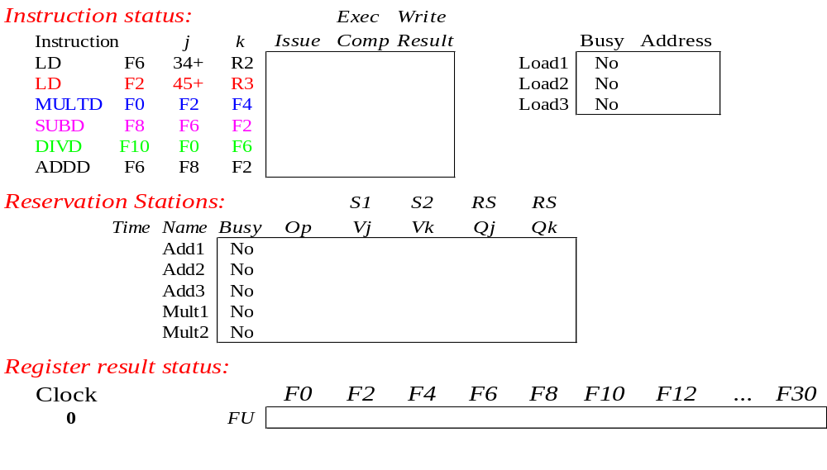
Tomasulo Example
Instruction stream
3 Load/Buffers
FU count
down
3 FP Adder R.S.
2 FP Mult R.S.
Clock cycle
counter
CS2017 ILP

Slide 73
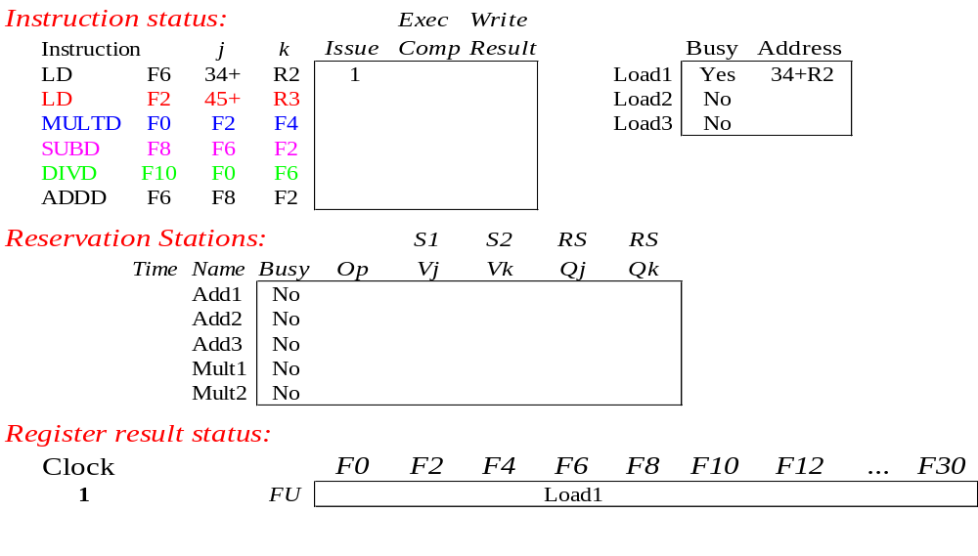
Tomasulo Example Cycle 1
CS2017 ILP

Slide 74
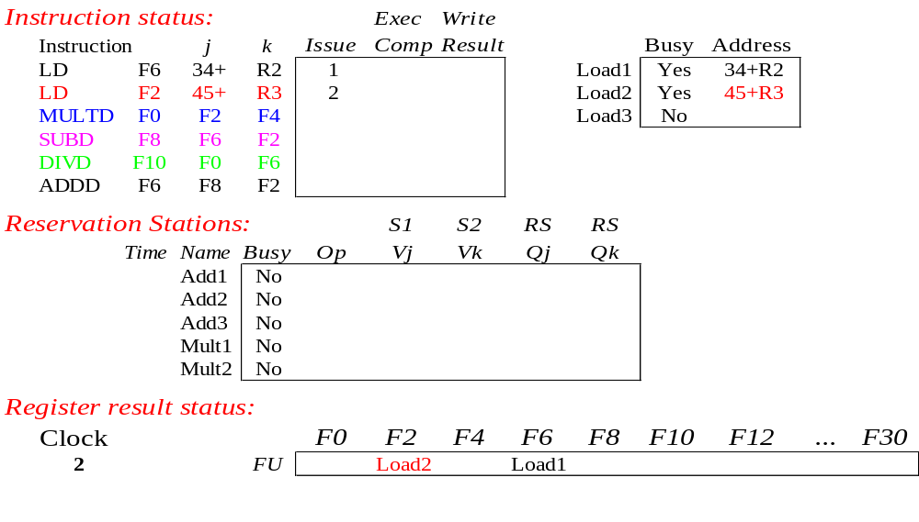
Tomasulo Example Cycle 2
Note: Can have multiple loads outstanding
CS2017 ILP

Slide 75
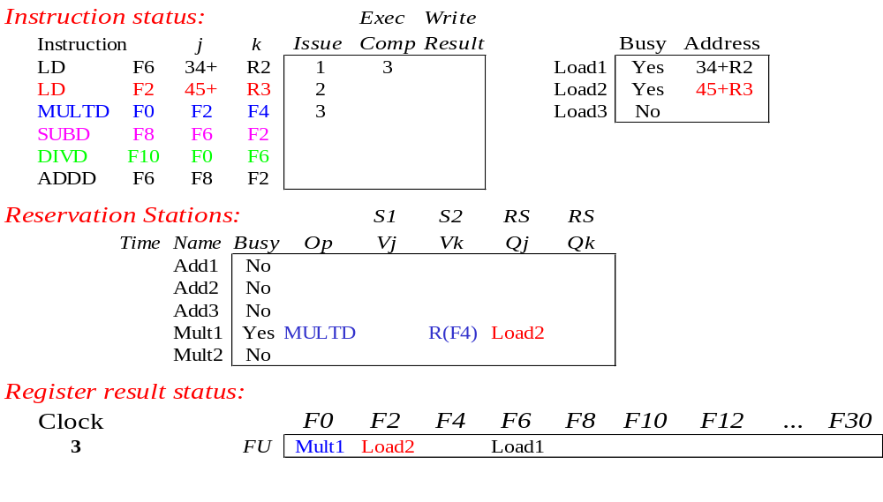
Tomasulo Example Cycle 3
Note: registers names are removed (“renamed”) in Reservation Stations; MULT issued
Load1 completing; what is waiting for Load1?
CS2017 ILP
Notes:
LOAD 发射1，执行2，写回1，共4Cycles

Slide 76
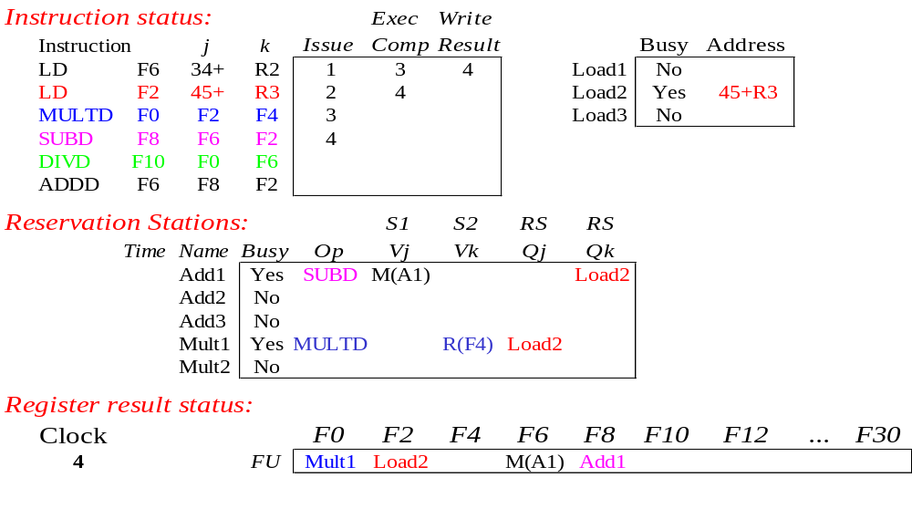
Tomasulo Example Cycle 4
Load2 completing; what is waiting for Load2?
CS2017 ILP

Slide 77
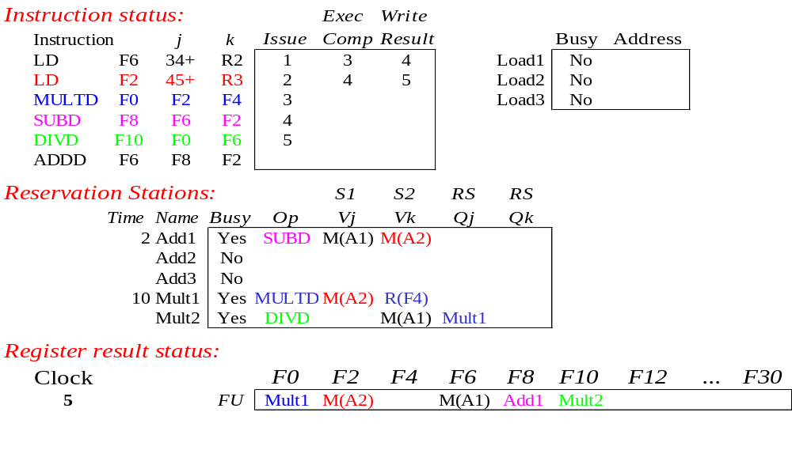
Tomasulo Example Cycle 5
Timer starts down for Add1, Mult1
CS2017 ILP
Notes:
SUBD等了一拍才开始计数

Slide 78
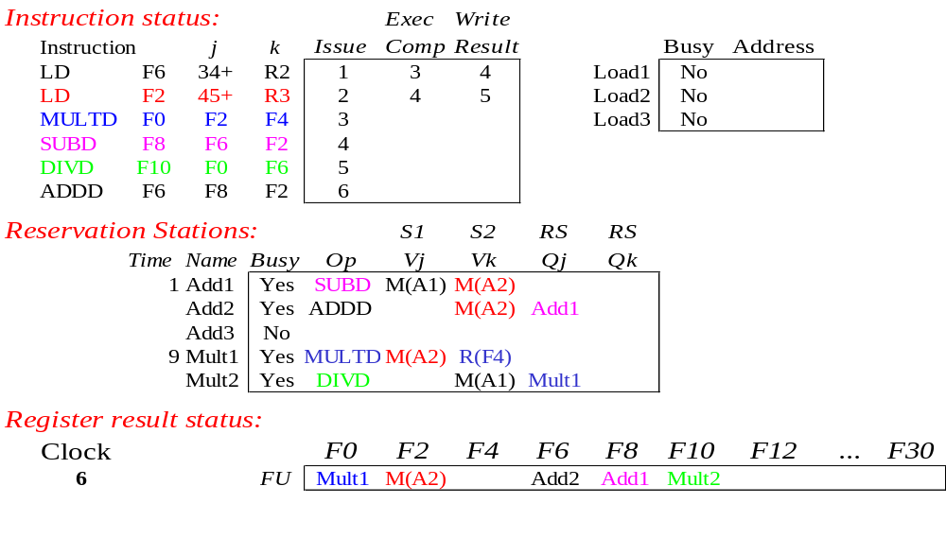
Tomasulo Example Cycle 6
Issue ADDD here despite name dependency on F6?
CS2017 ILP
Notes:
DIVD has name dependency on F6

Slide 79

Tomasulo Example Cycle 7
Add1 (SUBD) completing; what is waiting for it?
CS2017 ILP

Slide 80
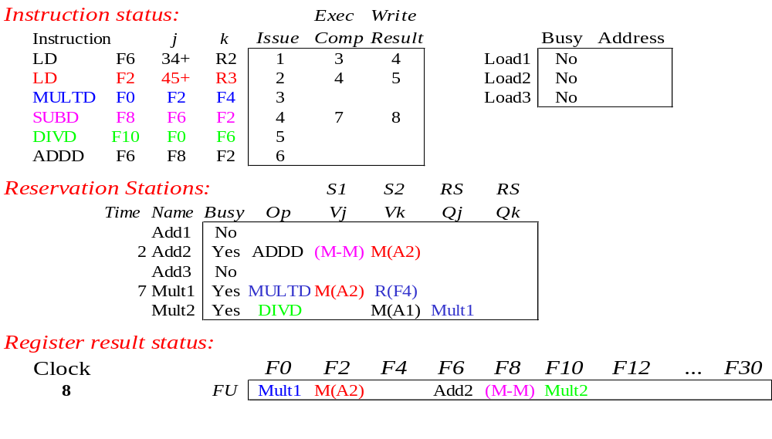
Tomasulo Example Cycle 8
CS2017 ILP

Slide 81

Tomasulo Example Cycle 9
CS2017 ILP

Slide 82

Tomasulo Example Cycle 10
Add2 (ADDD) completing; what is waiting for it?
CS2017 ILP

Slide 83
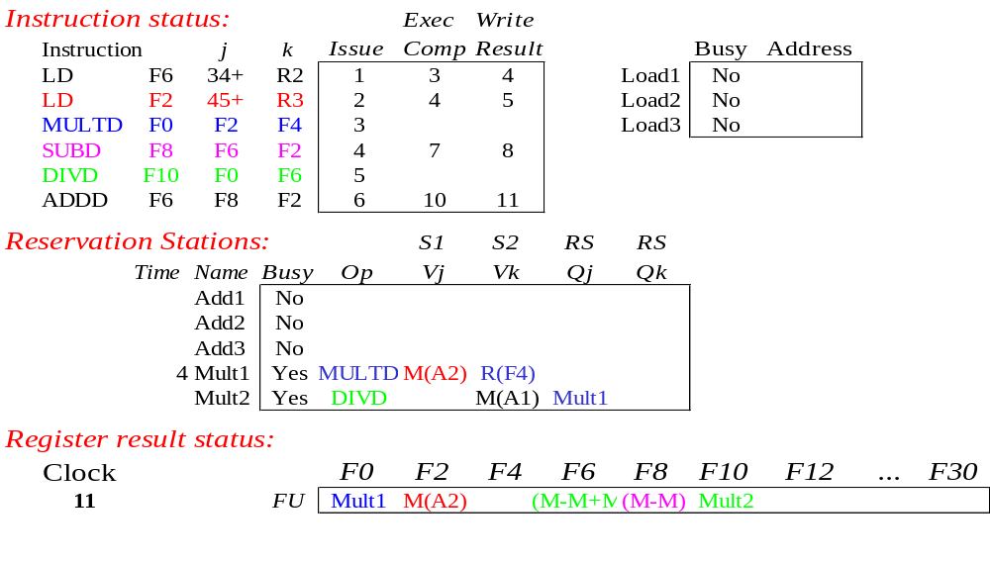
Tomasulo Example Cycle 11
Write result of ADDD here?
All quick instructions complete in this cycle!
CS2017 ILP

Slide 84

Tomasulo Example Cycle 12
CS2017 ILP

Slide 85

Tomasulo Example Cycle 13
CS2017 ILP

Slide 86

Tomasulo Example Cycle 14
CS2017 ILP

Slide 87
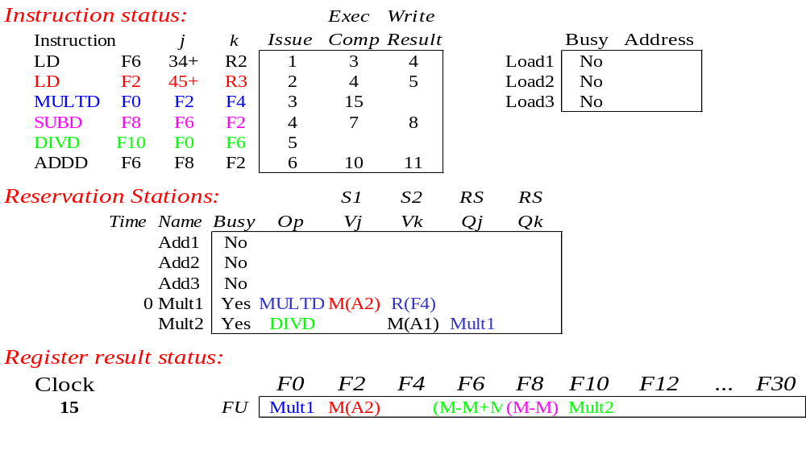
Tomasulo Example Cycle 15
Mult1 (MULTD) completing; what is waiting for it?
CS2017 ILP

Slide 88
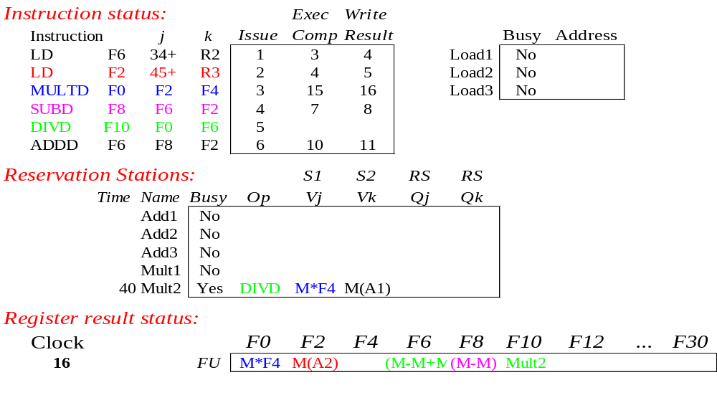
Tomasulo Example Cycle 16
Just waiting for Mult2 (DIVD) to complete
CS2017 ILP

Slide 89
Faster than light computation
(skip a couple of cycles)
CS2017 ILP

Slide 90
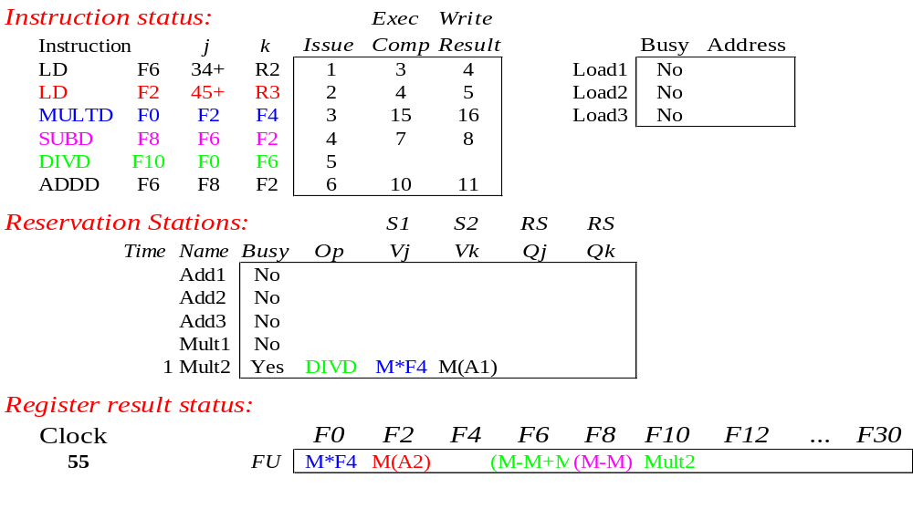
Tomasulo Example Cycle 55
CS2017 ILP

Slide 91
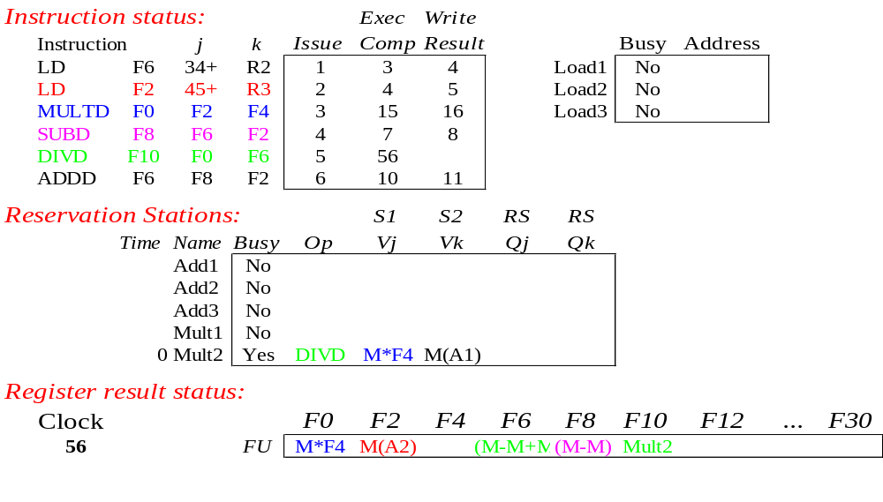
Tomasulo Example Cycle 56
Mult2 (DIVD) is completing; what is waiting for it?
CS2017 ILP

Slide 92
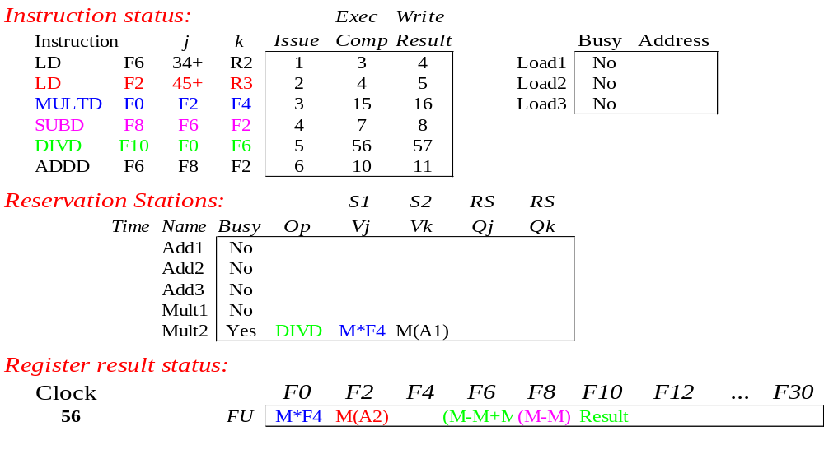
Tomasulo Example Cycle 57
Once again: In-order issue, out-of-order execution and out-of-order completion.
CS2017 ILP

Slide 93
Tomasulo’s scheme offers 2 major advantages
Distribution of the hazard detection logic
  distributed reservation stations and the CDB
  If multiple instructions waiting on single result, & each instruction has other operand, then instructions can be released simultaneously by broadcast on CDB (同时获取需要的操作数)
  If a centralized register file were used, the units would have to read their results from the registers when register buses are available
Elimination of stalls for WAW and WAR hazards
CS2017 ILP

Slide 94
Tomasulo Drawbacks
Complexity
  delays of 360/91, MIPS 10000, Alpha 21264,
  IBM PPC 620 in CA:AQA 2/e, but not in silicon!
Many associative stores (CDB) at high speed
需要大量高速的相联存储，保存相关中间结果
Performance limited by Common Data Bus
  Each CDB must go to multiple functional units
  ⇒high capacitance, high wiring density
  Number of functional units that can complete per cycle limited to one! 单总线限制了同时完成的指令数
    Multiple CDBs ⇒ more FU logic for parallel assoc stores
Non-precise interrupts! (精确中断)
  We will address this later
CS2017 ILP
Notes:
相联存储器的基本原理是把存储单元所存内容的某一部分作为检索项(即关键字项)，去检索该存储器，并将存储器中与该检索项符合的存储单元内容进行读出或写入。 （用于检索的地址/索引也存在表的内容中）
乱序完成加大了实现精确中断的难度：在前面指令还没有完成时，寄存器文件中可能会有后面指令的运行结果.
如果这些前面的指令执行时有中断产生，怎么办？需要“rollback” 寄存器文件到原来的状态:
精确中断的含义是其返回地址为：该地址之前的所有指令都已完成, 其后的指令还都没有完成
如果分支操作的开销不大，Tomasulo算法的动态调度机制能得到非常高的性能。这种方法的主要缺点是Tomasulo算法实现的复杂性，实现它需要大量的硬件，尤其是保存大量相关中间结果的高速缓冲寄存器和复杂的控制逻辑。此外，性能还受限于公共数据总线，因为它是单总线，如果增加公共数据总线的数量，与总线连接的缓冲和保留站的接口硬件将会加倍。

Slide 95
And In Conclusion … #1
Leverage Implicit Parallelism for Performance: Instruction Level Parallelism
Loop unrolling by compiler to increase ILP
Branch prediction to increase ILP
Dynamic HW exploiting ILP
  Works when can’t know dependence at compile time
  Can hide L1 cache misses
  Code for one machine runs well on another
CS2017 ILP

Slide 96
And In Conclusion … #2
Reservations stations: renaming to larger set of registers + buffering source operands
  Prevents registers as bottleneck
  Avoids WAR, WAW hazards
  Allows loop unrolling in HW
Not limited to basic blocks
(integer units gets ahead, beyond branches)
Helps cache misses as well
Lasting Contributions
  Dynamic scheduling
  Register renaming
  Load/store disambiguation 消除二义性
360/91 descendants are Intel Pentium 4, IBM Power 5, AMD Athlon/Opteron, …
CS2017 ILP

Slide 97
Instruction Level Parallelism
(Con.)

Slide 98
Outline(2)
Speculation 推断（执行）
Speculative Tomasulo Example
Memory Disambiguation
Exceptions
Superscalar
VLIW
Increasing instruction bandwidth
Register Renaming vs. Reorder Buffer
Value Prediction
CS2017 ILP

Slide 99
Speculation to greater ILP
前瞻技术 允许在处理器还未判断指令是否能执行之前就提前执行，以克服控制相关。
Greater ILP: Overcome control dependence by hardware speculating on outcome of branches and executing program as if guesses were correct
  Speculation ⇒ fetch, issue, and execute instructions as if branch predictions were always correct
  Dynamic scheduling ⇒ only fetches and issues instructions
Essentially a data flow execution model: (数据流驱动) Operations execute as soon as their operands are available
CS2017 ILP
Notes:
实质：数据流驱动运行（data-flow execution） 只要操作数有效，指令就可以执行。

Slide 100
Speculation to greater ILP 三种思想
3 components of HW-based speculation:
Dynamic branch prediction to choose which instructions to execute
采用动态的分支预测技术来选择后续执行语句；
Speculation to allow execution of instructions before control dependences are resolved + ability to undo effects of incorrectly speculated sequence
在控制相关消除之前指令前瞻执行+undo；
Dynamic scheduling to deal with scheduling of different combinations of basic blocks
对基本块组合采用动态调度
CS2017 ILP

Slide 101
Adding Speculation to Tomasulo
Must separate execution from allowing instruction to finish or “commit”; This additional step called instruction commit 指令确认
When an instruction is no longer speculative, allow it to update the register file or memory
前瞻执行的指令产生的结果要一直到指令处于非前瞻执行状态时，才能确定为最终结果，才允许最终写到寄存器或存储器中去。
Requires additional set of buffers to hold results of instructions that have finished execution but have not committed
This reorder buffer (ROB) 再定序缓冲 is also used to pass results among instructions that may be speculated
CS2017 ILP
Notes:
关键思想：允许指令乱序执行，但必须顺序确认 。

Slide 102
ReOrder Buffer (ROB)
In Tomasulo’s algorithm, once an instruction writes its result, any subsequently issued instructions will find result in the register file
With speculation, the register file is not updated until the instruction commits
  we know definitively that the instruction should execute
  保存那些执行完毕但未经确认的指令及其结果。
Thus, the ROB supplies operands in interval between completion of instruction execution and instruction commit 这段时间里，提供其他指令需要的操作数
  ROB is a source of operands for instructions, just as reservation stations (RS) provide operands in Tomasulo’s algorithm
  ROB extends architectured registers like RS
CS2017 ILP
Notes:
保存那些执行完毕但未经确认的指令及其结果。在指令执行完毕和确认之间这段时间里，由再定序缓冲提供所有其他指令需要的作为操作数的数据。再定序缓冲区还可以取代取（load）缓冲区。
A register file is an array of processor registers in a central processing unit (CPU). Modern integrated circuit-based register files are usually implemented by way of fast static RAMs with multiple ports. Such RAMs are distinguished by having dedicated read and write ports, whereas ordinary multiported SRAMs will usually read and write through the same ports.

Slide 103
Reorder Buffer Entry
Each entry in the ROB contains four fields:
Instruction type
  a branch (has no destination result), a store (has a memory address destination), or a register operation (ALU operation or load, which has register destinations)
Destination
  Register number (for loads and ALU operations) or memory address (for stores) where the instruction result should be written
Value
  Value of instruction result until the instruction commits
Ready
  Indicates that instruction has completed execution, and the value is ready
CS2017 ILP

Slide 104
Reorder Buffer operation
Holds instructions in FIFO order, exactly as issued
When instructions complete, results placed into ROB
  Supplies operands to other instruction between execution
  complete & commit ⇒ more registers like RS
  Tag results with ROB buffer number instead of reservation station
Instructions commit ⇒values at head of ROB placed in registers
As a result, easy to undo
speculated instructions
on mispredicted branches
or on exceptions
Reorder
Buffer
FP
Op
Queue
FP Regs
Commit path
Res Stations
Res Stations
FP Adder
FP Adder
CS2017 ILP

Slide 105
4 Steps of Speculative Tomasulo Algorithm
1. Issue—get instruction from FP Op Queue
  If reservation station & reorder buffer slot free, issue instr & send operands & reorder buffer no. for destination (this stage sometimes called “dispatch” 分派)
2. Execution—operate on operands (EX)
  When both operands ready then execute; if not ready, watch CDB for result; when both in reservation station, execute; checks RAW (sometimes called “issue”)
3. Write result—finish execution (WB)
  Write on Common Data Bus to all awaiting FUs & reorder buffer; mark reservation station available.
4. Commit—update register with reorder result
  When instr. at head of reorder buffer & result present, update register with result (or store to memory) and remove instr from reorder buffer. Mispredicted branch flushes reorder buffer (sometimes called “graduation” 校准)
CS2017 ILP

Slide 106
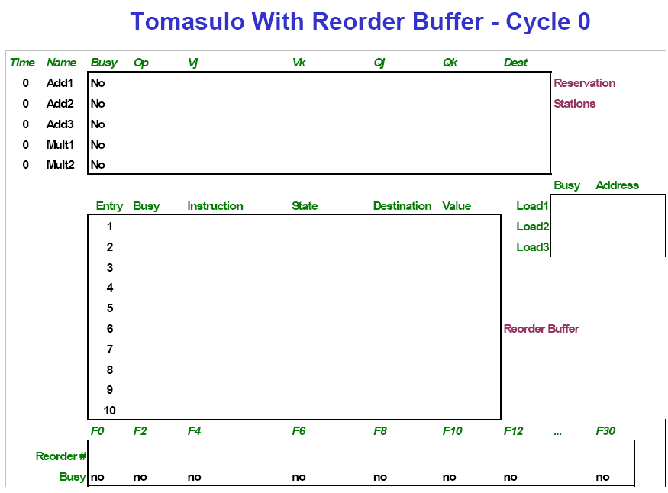
CS2017 ILP

Slide 107
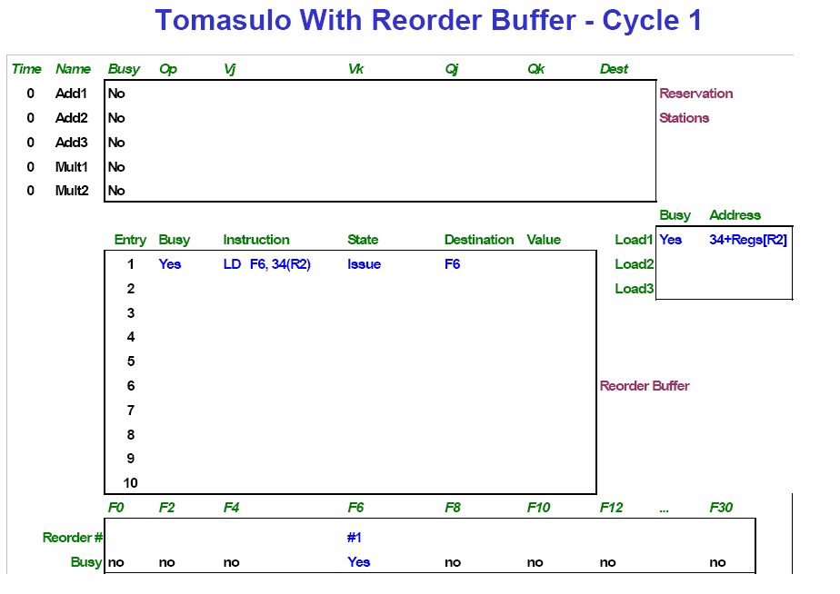
CS2017 ILP

Slide 108
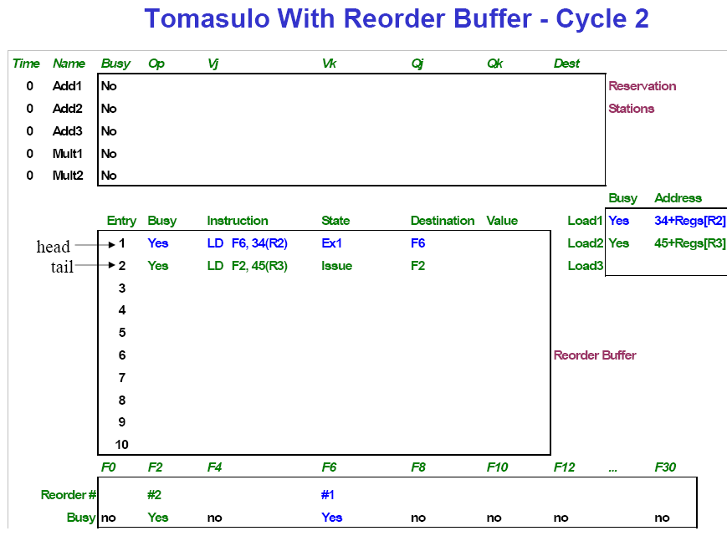
CS2017 ILP

Slide 109
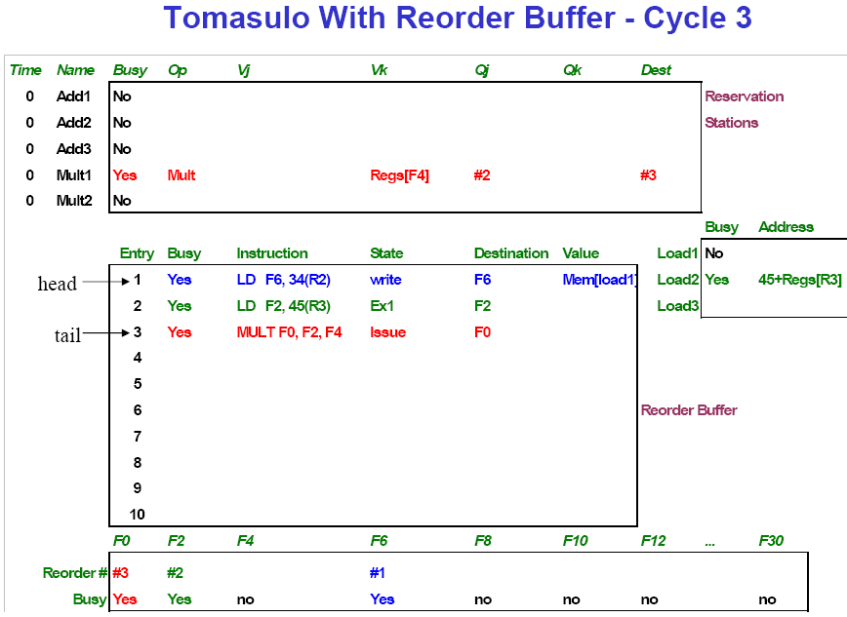
CS2017 ILP

Slide 110
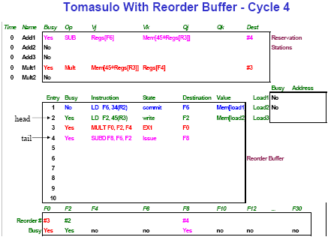
CS2017 ILP

Slide 111
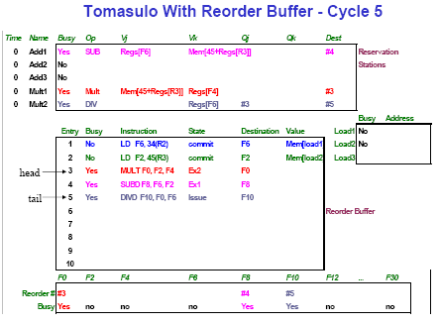
CS2017 ILP

Slide 112
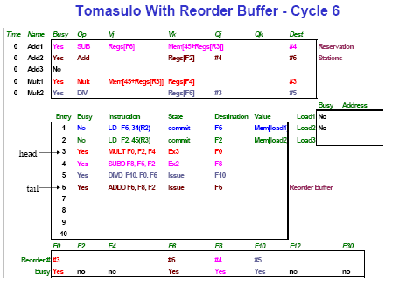
CS2017 ILP

Slide 113
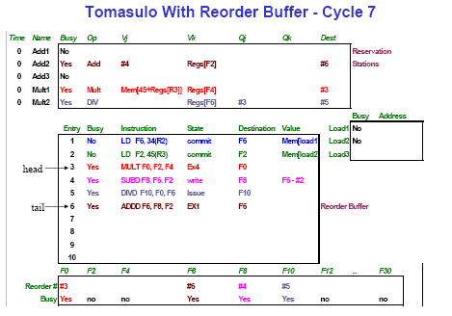
CS2017 ILP

Slide 114
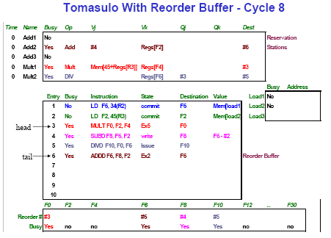
CS2017 ILP

Slide 115
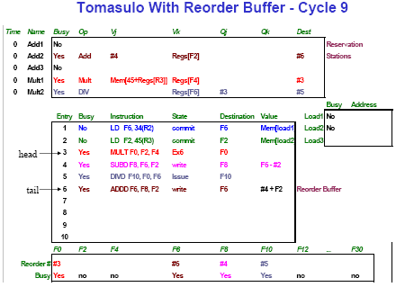
CS2017 ILP

Slide 116
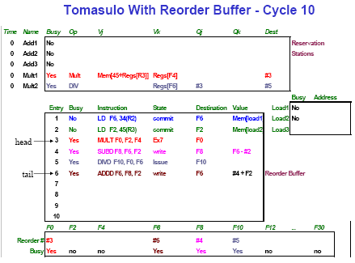
CS2017 ILP

Slide 117
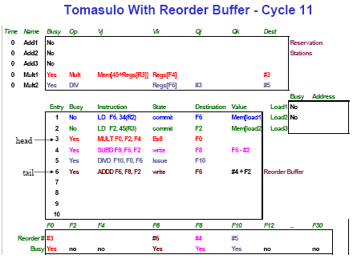
CS2017 ILP

Slide 118

CS2017 ILP

Slide 119
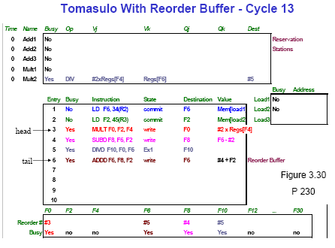
CS2017 ILP

Slide 120
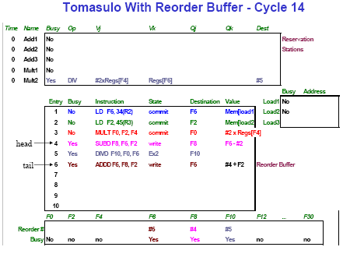
CS2017 ILP

Slide 121
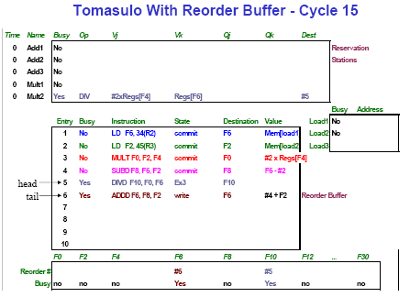
CS2017 ILP

Slide 122
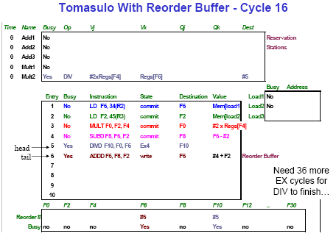
CS2017 ILP

Slide 123
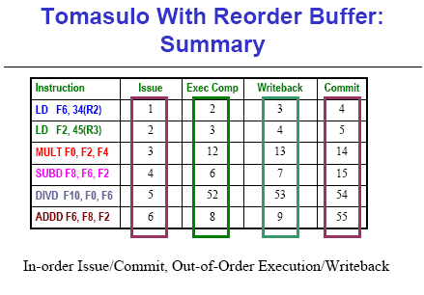
CS2017 ILP

Slide 124
Memory Disambiguation 消除存储器歧义 :
处理对存储器引用的RAW相关
Question: 给定一个指令序列，store，load 是否有关？
  即下列代码是否有相关问题?
  Eg: ST 0(R3),F4
  LD F0,32(R2)
我们是否可以较早启动load?
  Store的地址可能会延迟很长时间才能得到.
  我们也许想在同一个周期开始这两个操作的执行.
两种方法:
  No Speculation: 不进行load，直到我们确信地址 0(R3) ≠ 32(R2)
  Speculation: 我们可以假设他们相关还是不相关 (called “dependence speculation”) ，如果推测错误通过ROB来修正
CS2017 ILP

Slide 125
Memory Disambiguation 消除歧义
Memory disambiguation is a set of techniques employed by high-performance out-of-order execution microprocessors that execute memory access instructions (loads and stores) out of program order.
The mechanisms for performing memory disambiguation, implemented using digital logic inside the microprocessor core, detect true dependencies between memory operations at execution time and allow the processor to recover when a dependence has been violated.
They also eliminate spurious 假的 memory dependencies and allow for greater instruction-level parallelism by allowing safe out-of-order execution of loads and stores.
http://en.wikipedia.org/wiki/Memory_disambiguation
CS2017 ILP

Slide 126
Avoiding Memory Hazards
WAW and WAR hazards through memory are eliminated with speculation because actual updating of memory occurs in order, when a store is at head of the ROB, and hence, no earlier loads or stores can still be pending
由于实际的store顺序提交，所以不会有 WAR/WAW 相关
CS2017 ILP

Slide 127
Avoiding Memory Hazards (Con.)
RAW hazards through memory (load after store) are maintained by two restrictions:
  not allowing a load to initiate the second step of its execution if any active ROB entry occupied by a store has a Destination field that matches the value of the A field (address) of the load, and (有地址值)
  maintaining the program order for the computation of an effective address of a load with respect to all earlier stores. (无地址值)
these restrictions ensure that any load that accesses a memory location written to by an earlier store cannot perform the memory access until the store has written the data
CS2017 ILP

Slide 128
Memory Disambiguation:
Done?
FP Op
Queue
ROB7
ROB6
ROB5
ROB4
ROB3
ROB2
ROB1
Newest
Reorder Buffer
--
LD F4, 10(R3)
N
F2
ST 10(R3), F5
N
F0
LD F0,32(R2)
N
Oldest
--
<val 1>
ST 0(R3), F4
Y
Registers
To
Memory
Dest
Dest
from
Memory
Dest
Reservation
Stations
2 32+R2
4 ROB3
FP adders
FP multipliers
CS2017 ILP
Notes:
Resolve RAW memory conflict? (address in memory buffers)
Integer unit executes in parallel

Slide 129
Exceptions and Interrupts
IBM 360/91 invented “imprecise interrupts” 精确中断
Technique for both precise interrupts/exceptions and speculation: in-order completion and in-order commit
  If we speculate and are wrong, need to back up and restart execution to point at which we predicted incorrectly
  This is exactly same as need to do with precise exceptions
Exceptions are handled by not recognizing(认可) the exception until instruction that caused it is ready to commit in ROB
  If a speculated instruction raises an exception, the exception is recorded in the ROB
  This is why reorder buffers in all new processors
CS2017 ILP
Notes:
实现精确中断的技术：顺序完成（或提交）
即提交指令完成的顺序必须与指令发射的顺序相同
乱序完成加大了实现精确中断的难度
在前面指令还没有完成时，寄存器文件中可能会有后面指令的运行结果.
如果这些前面的指令执行时有中断产生，怎么办？
需要“rollback” 寄存器文件到原来的状态:
精确中断的含义是其返回地址为：
该地址之前的所有指令都已完成
其后的指令还都没有完成

Slide 130
Outline
Speculation 推断（执行）
Speculative Tomasulo Example
Memory Disambiguation
Exceptions
Superscalar 超标量
VLIW 超长指令字
Increasing instruction bandwidth
Register Renaming vs. Reorder Buffer
Value Prediction
多指令流出技术
CS2017 ILP

Slide 131
Getting CPI below 1
CPI ≥ 1 if issue only 1 instruction every clock cycle
Goal: CPI < 1 => Instructions Per Clock cycle (IPC) >1
Vector Processing: Explicit coding of independent loops as operations on large vectors of numbers
  Multimedia instructions being added to many processors
Superscalar: varying no. instructions/cycle (1 to 8), scheduled by compiler or by HW (Tomasulo)
  IBM PowerPC, Sun UltraSparc, DEC Alpha, Pentium III/4
(Very) Long Instruction Words (V)LIW:
fixed number of instructions (4-16) scheduled by the compiler; put ops into wide templates
CS2017 ILP

Slide 132
Issuing Multiple Instructions/Cycle
Multiple-issue processors come in 3 flavors:
  statically-scheduled superscalar processors,
  dynamically-scheduled superscalar processors, and
  VLIW (very long instruction word) processors
2 types of superscalar processors issue varying numbers of instructions per clock
  use in-order execution if they are statically scheduled, or
  out-of-order execution if they are dynamically scheduled
VLIW processors, in contrast, issue a fixed number of instructions formatted either as one large instruction or as a fixed instruction packet with the parallelism among instructions explicitly indicated by the instruction (Intel/HP Itanium)
CS2017 ILP

Slide 133
Superscalar
Superscalar MIPS: 2 instructions, 1 FP & 1 anything
  1 anything：load, store, 分支或定点ALU操作
  – Fetch 64-bits/clock cycle; Int on left, FP on right
  – Can only issue 2nd instruction if 1st instruction issues
  – More ports for FP registers to do FP load & FP op in a pair
Type Pipe Stages
Int. instruction IF ID EX MEM WB
FP instruction IF ID EX MEM WB
Int. instruction IF ID EX MEM WB
FP instruction IF ID EX MEM WB
Int. instruction IF ID EX MEM WB
FP instruction IF ID EX MEM WB
1 cycle load delay expands to 3 instructions in Superscalar
  instruction in right half can’t use it, nor instructions in next slot
  load指令的结果不能在本周期和下个周期（3条指令）使用。
CS2017 ILP
Notes:
第2条指令仅在第1条指令发射后才能发射；
Load操作有一个时钟周期的延迟，即load指令的结果不能在本周期和下个周期（3条指令）使用。

Slide 134
Recall: Unrolled Loop that Minimizes Stalls for Scalar
L.D to ADD.D: 1 Cycle
ADD.D to S.D: 2 Cycles
1 Loop: L.D F0,0(R1)
2 L.D F6,-8(R1)
3 L.D F10,-16(R1)
4 L.D F14,-24(R1)
5 ADD.D F4,F0,F2
6 ADD.D F8,F6,F2
7 ADD.D F12,F10,F2
8 ADD.D F16,F14,F2
9 S.D 0(R1),F4
10 S.D -8(R1),F8
11 S.D -16(R1),F12
12 DSUBUI R1,R1,#32
13 BNEZ R1,LOOP
14 S.D 8(R1),F16 ; 8-32 = -24
14 clock cycles, or 3.5 per iteration
CS2017 ILP

Slide 135
Loop Unrolling in Superscalar
Integer instruction FP instruction Clock cycle
Loop: LD F0,0(R1) 1
LD F6,-8(R1) 2
LD F10,-16(R1) ADDD F4,F0,F2 3
LD F14,-24(R1) ADDD F8,F6,F2 4
SD 0(R1),F4 ADDD F12,F10,F2 5
SD -8(R1),F8 ADDD F16,F14,F2 6
SD -16(R1),F12 7
SUBI R1,R1,#32 8
BNEZ R1,LOOP 9
SD ＋8(R1),F16 10
Unrolled 4 times
will produce delays
L.D to ADD.D: 1 Cycle
ADD.D to S.D: 2 Cycles
CS2017 ILP

Slide 136
Loop Unrolling in Superscalar
Integer instruction FP instruction Clock cycle
Loop: LD F0,0(R1) 1
LD F6,-8(R1) 2
LD F10,-16(R1) ADDD F4,F0,F2 3
LD F14,-24(R1) ADDD F8,F6,F2 4
LD F18,-32(R1) ADDD F12,F10,F2 5
SD 0(R1),F4 ADDD F16,F14,F2 6
SD -8(R1),F8 ADDD F20,F18,F2 7
SD -16(R1),F12 8
SD -24(R1),F16 9
SUBI R1,R1,#40 10
BNEZ R1,LOOP 11
SD ＋8(R1),F20 12
Unrolled 5 times to avoid delays(+1 due to SS)
12 clocks, or 2.4 clocks per iteration (1.5X)
CS2017 ILP

Slide 137
Multiple Issue Issues
issue packet: group of instructions from fetch unit that could potentially issue in 1 clock
  If instruction causes structural hazard or a data hazard either due to earlier instruction in execution or to earlier instruction in issue packet, then instruction does not issue
  0 to N instruction issues per clock cycle, for N-issue
Performing issue checks in 1 cycle could limit clock cycle time: O(n²-n) comparisons
  => issue stage usually split and pipelined
  1st stage decides how many instructions from within this packet can issue, 2nd stage examines hazards among selected instructions and those already been issued
  => higher branch penalties => prediction accuracy important
CS2017 ILP
Notes:
最多发射N条指令。

Slide 138
Multiple Issue Challenges
While Integer/FP split is simple for the HW, get CPI of 0.5 only for programs with:
  Exactly 50% FP operations AND No hazards
If more instructions issue at same time, greater difficulty of decode and issue:
  Even 2-scalar => examine 2 opcodes, 6 register specifiers, & decide if 1 or 2 instructions can issue; (N-issue ~O(N²-N) comparisons)
  Register file: need 2x reads and 1x writes/cycle
CS2017 ILP

Slide 139
Multiple Issue Challenges (Con.)
  Rename logic: must be able to rename same register multiple times in one cycle! For instance, consider 4-way issue:
  add r1, r2, r3 add p11, p4, p7
  sub r4, r1, r2 ⇒ sub p22, p11, p4
  lw r1, 4(r4) lw p23, 4(p22)
  add r5, r1, r2 add p12, p23, p4
  Imagine doing this transformation in a single cycle!
  Result buses: Need to complete multiple instructions/cycle
    So, need multiple buses with associated matching logic at every reservation station.
    Or, need multiple forwarding paths
CS2017 ILP

Slide 140
Dynamic Scheduling in Superscalar
The easy way
How to issue two instructions and keep in-order instruction issue for Tomasulo?
  Assume 1 integer + 1 floating point
  1 Tomasulo control for integer, 1 for floating point
Issue 2X Clock Rate, so that issue remains in order
用Tomasulo如何发射两条指令并保持指令序
  假设有1 浮点操作，1个整数操作
  Tomasulo控制器一个控制整型操作，一个控制浮点型操作的发射
  如果每个周期发射两条不同的指令，还是可以保持指令序（整型类操作序，浮点类操作序）
CS2017 ILP
Notes:
P215

Slide 141
VLIW: Very Large Instruction Word 静态
VLIW issue a fixed number of instructions formatted either as one large instruction or as a fixed instruction packet with the parallelism among instructions explicitly indicated by the instruction
采用多个独立的功能部件，将多条指令的操作组装成固定格式的指令包，形成一条非常长的指令。超长指令字的格式固定，处理过程简单，处理器所需硬件量比超标量要少。
Each “instruction” has explicit coding for multiple operations
CS2017 ILP
Notes:
In IA-64, grouping called a “packet”
In Transmeta Crusoe, grouping called a “molecule” (with “atoms” as ops)
Transmeta公司Crusoe处理器
highly efficient x86-compatible software-based microprocessors

Slide 142
VLIW (Con.)
Tradeoff instruction space for simple decoding
  The long instruction word has room for many operations
  By definition, all the operations the compiler puts in the long instruction word are independent => execute in parallel
  E.g., 2 integer operations, 2 FP ops, 2 Memory refs, 1 branch
    16 to 24 bits per field => 7*16 or 112 bits to 7*24 or 168 bits wide
  Need compiling technique that schedules across several branches
CS2017 ILP
Notes:
In IA-64, grouping called a “packet”
In Transmeta Crusoe, grouping called a “molecule” (with “atoms” as ops)
Transmeta公司Crusoe处理器
highly efficient x86-compatible software-based microprocessors

Slide 143
Loop Unrolling in VLIW
Memory Memory FP FP Int. op/ Clock
reference 1 reference 2 operation 1 op. 2 branch
L.D F0,0(R1) L.D F6,-8(R1) 1
L.D F10,-16(R1) L.D F14,-24(R1) 2
L.D F18,-32(R1) L.D F22,-40(R1) ADD.D F4,F0,F2 ADD.D F8,F6,F2 3
L.D F26,-48(R1) ADD.D F12,F10,F2 ADD.D F16,F14,F2 4
ADD.D F20,F18,F2 ADD.D F24,F22,F2 5
S.D 0(R1),F4 S.D -8(R1),F8 ADD.D F28,F26,F2 6
S.D -16(R1),F12 S.D -24(R1),F16 7
S.D -32(R1),F20 S.D -40(R1),F24 DSUBUI R1,R1,#48 8
S.D -0(R1),F28 BNEZ R1,LOOP 9
Unrolled 7 times to avoid delays
7 results in 9 clocks, or 1.3 clocks per iteration (1.8X)
Average: 2.5 ops per clock, 50% efficiency
Note: Need more registers in VLIW (15 vs. 6 in SS)
CS2017 ILP

Slide 144
Loop-carried Dependence（6.5）
循环携带相关，是限制循环结构并行性开发的一个重要因素，它是指一个循环的某个迭代中的指令与其他迭代中的指令之间的数据相关。
Observation: if iterations from loops are independent, then can get more ILP by taking instructions from different iterations
CS2017 ILP

Slide 145
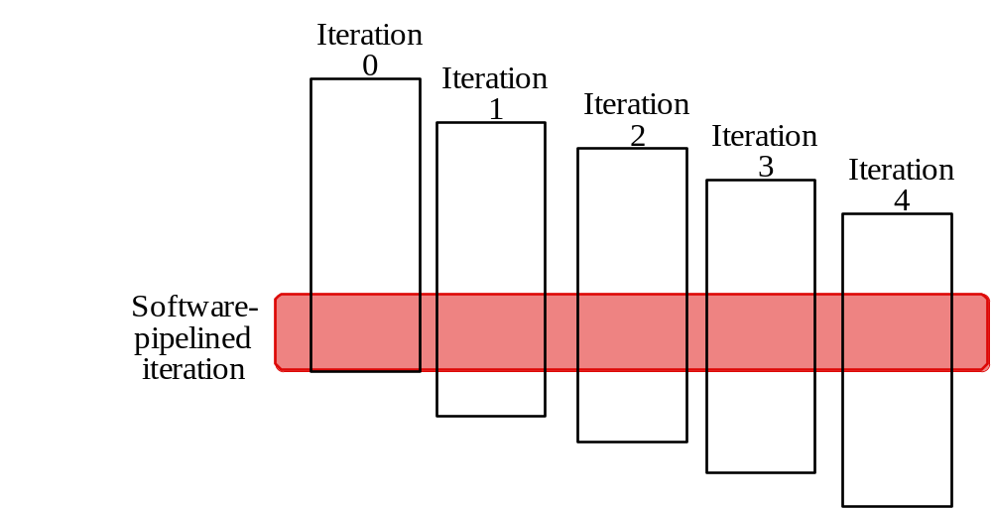
Software Pipelining
核心思想：从循环的不同迭代中抽取一部分指令（循环控制指令除外）拼成一个新的循环迭代。
Software pipelining: reorganizes loops so that each iteration is made from instructions chosen from different iterations of the original loop (~ Tomasulo in SW)
CS2017 ILP

Slide 146
Software Pipelining Example
Before: Unrolled 3 times
1 L.D F0,0(R1)
2 ADD.D F4,F0,F2
3 S.D 0(R1),F4
4 L.D F6,-8(R1)
5 ADD.D F8,F6,F2
6 S.D -8(R1),F8
7 L.D F10,-16(R1)
8 ADD.D F12,F10,F2
9 S.D -16(R1),F12
10 DSUBUI R1,R1,#24
11 BNEZ R1,LOOP
After: Software Pipelined
1 S.D 0(R1),F4 ; Stores M[i]
2 ADD.D F4,F0,F2 ; Adds to M[i-1]
3 L.D F0,-16(R1); Loads M[i-2]
4 DSUBUI R1,R1,#8
5 BNEZ R1,LOOP
SW Pipeline
overlapped ops
Time
Loop Unrolled
Symbolic Loop Unrolling
Maximize result-use distance
Less code space than unrolling
Fill & drain pipe only once per loop
vs. once per each unrolled iteration in loop unrolling
Time
CS2017 ILP
Notes:
Because the load and store are separated by offsets of 16 (two iterations), the loop should run for two fewer iterations.
循环展开主要减少的是分支指令和修改循环索引变量引起的循环控制开销，但充满和排空流水线的开销不会减少（m/n，即新的迭代次数）。

Slide 147
Software Pipelining with
Loop Unrolling in VLIW
Memory Memory FP FP Int. op/ Clock
reference 1 reference 2 operation 1 op. 2 branch
L.D F0,-48(R1) ST 0(R1),F4 ADD.D F4,F0,F2 1
L.D F6,-56(R1) ST -8(R1),F8 ADD.D F8,F6,F2 DSUBUI R1,R1,#24 2
L.D F10,-64(R1) ST -16(R1),F12 ADD.D F12,F10,F2 BNEZ R1,LOOP 3
Software pipelined across 9 iterations of original loop
  In each iteration of above loop, we:
    Store to m,m-8,m-16 (iterations I-3,I-2,I-1)
    Compute for m-24,m-32,m-40 (iterations I,I+1,I+2)
    Load from m-48,m-56,m-64 (iterations I+3,I+4,I+5)
9 results in 9 cycles, or 1 clock per iteration
Average: 3.3 ops per clock, 66% efficiency
Note: Need fewer registers for software pipelining
(only using 7 registers here, was using 15)
CS2017 ILP

Slide 148
Trace Scheduling 踪迹调度 （6.2.2）
Parallelism across IF branches vs. LOOP branches?
Two steps:
  Trace Selection 选择执行频率较高的路径
    Find likely sequence of basic blocks (trace)
    of (statically predicted or profile predicted)
    long sequence of straight-line code
  Trace Compaction 调度和优化，缩短执行时间
    Squeeze trace into few VLIW instructions
    Need bookkeeping code in case prediction is wrong
优化执行效率高的trace，减少其执行开销
  Subtle compiler bugs mean wrong answer
  vs. poorer performance; no hardware interlocks (联动)
This is a form of compiler-generated speculation
  Compiler must generate “fixup” (修正，补偿) code to handle cases in which trace is not the taken branch
  Needs extra registers: undoes bad guess by discarding
CS2017 ILP
Notes:
应该是VLIW技术的一种延伸，目标是跨越分支进行IW的填充；
消除分支的一种策略
Trace内可以有分支，但一定不能有循环。

Slide 149
Advantages of HW (Tomasulo) vs. SW (VLIW) Speculation
HW advantages:
  HW better at memory disambiguation since knows actual addresses确定地址冲突
  HW better at branch prediction since lower overhead 分支预测较好，预测准确率较高
  HW maintains precise exception model 可支持精确中断模型
  HW does not execute bookkeeping instructions 不必执行保存环境和恢复环境的指令
  Same software works across multiple implementations
  Smaller code size (not as many nops filling blank instructions)
SW advantages:
  Window of instructions that is examined for parallelism much higher
  Much less hardware involved in VLIW (unless you are Intel…!)
  More involved types of speculation can be done more easily 推断执行比HW设计简单的多
  Speculation can be based on large-scale program behavior, not just local information
CS2017 ILP

Slide 150
Superscalar v. VLIW
Simplified Hardware for decoding, issuing instructions
No Interlock detection Hardware (compiler checks?)
More registers, but simplified Hardware for Register Ports (multiple independent register files?)
Smaller code size
Binary compatibility across generations of hardware
CS2017 ILP

Slide 151
Problems with 1st Generation VLIW
Increase in code size
  generating enough operations in a straight-line code fragment requires ambitiously unrolling loops
  whenever VLIW instructions are not full, unused functional units translate to wasted bits in instruction encoding
Operated in lock-step; no hazard detection HW
  a stall in any functional unit pipeline caused entire processor to stall, since all functional units must be kept synchronized
  Compiler might prediction function units, but caches hard to predict
Binary code compatibility
  Pure VLIW => different numbers of functional units and unit latencies require different versions of the code
CS2017 ILP

Slide 152
Intel/HP IA-64 “Explicitly 明确地 Parallel Instruction Computer (EPIC)” （6.4）
IA-64: instruction set architecture
128 64-bit integer regs + 128 82-bit floating point regs
  Not separate register files per functional unit as in old VLIW
Hardware checks dependencies
(interlocks => binary compatibility over time)
Predicated execution (select 1 out of 64 1-bit flags)
=> 40% fewer mispredictions?
Itanium™ was first implementation (2001)
  Highly parallel and deeply pipelined hardware at 800Mhz
  6-wide, 10-stage pipeline at 800Mhz on 0.18 µ process
Itanium 2™ is name of 2nd implementation (2005)
  6-wide, 8-stage pipeline at 1666Mhz on 0.13 µ process
  Caches: 32 KB I, 32 KB D, 128 KB L2I, 128 KB L2D, 9216 KB L3
CS2017 ILP

Slide 153
IA-64 的技术变革
显式并行指令计算技术（EPIC）
编译器分析源代码，以确定哪些指令可以并行，优化这些代码，然后产生合适的机器码。即由编译器告诉微处理器哪些指令来做并行处理。
预测技术（Predication）
编译器同时调度一些等待执行的分支。预测可以把分支移到任何可能的地方。
推理技术（Speculation）
从主存或缓存尽可能早地装入指令，甚至在代码分支发生以前进行。即推理是把指令和数据缓存在CPU本身中，避免内存等待时间。
IA-64将预测和推测结合起来，辅以大量的内部硬件资源，通过预测消除许多分支，通过推理加快推理执行或提高对剩余分支的分支预测。
CS2017 ILP

Slide 154
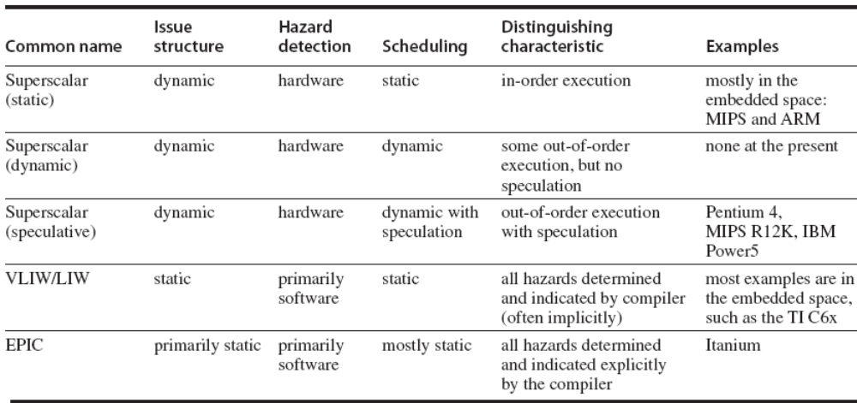
The five primary approaches in use for multiple-issue processors
CS2017 ILP

Slide 155
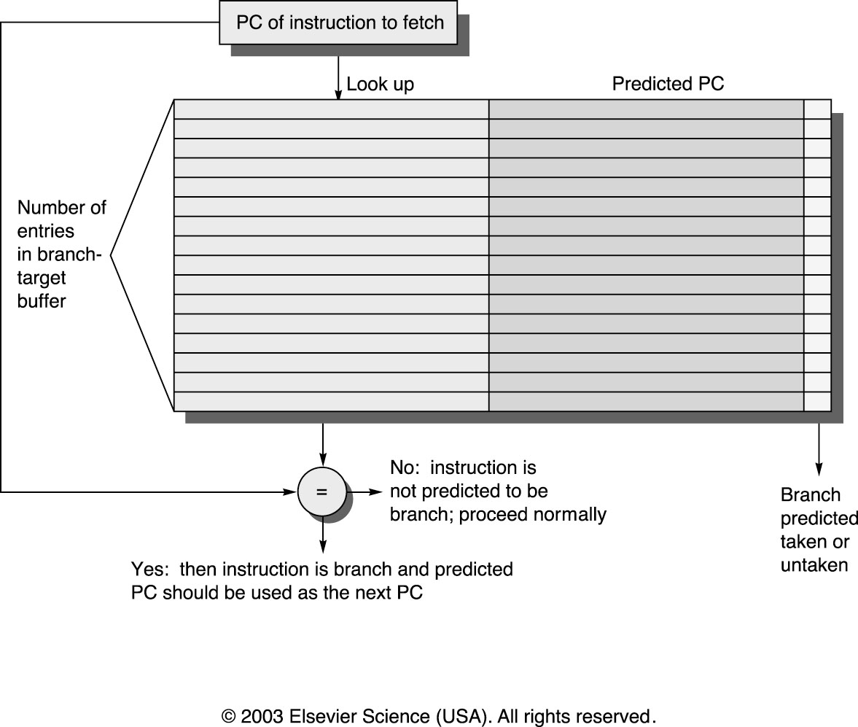
Increasing Instruction Fetch Bandwidth
Predicts next instruct address, sends it out before decoding instructuction
PC of branch sent to BTB
When match is found, Predicted PC is returned
If branch predicted taken, instruction fetch continues at Predicted PC
Recall: Branch Target Buffer (BTB)
CS2017 ILP

Slide 156
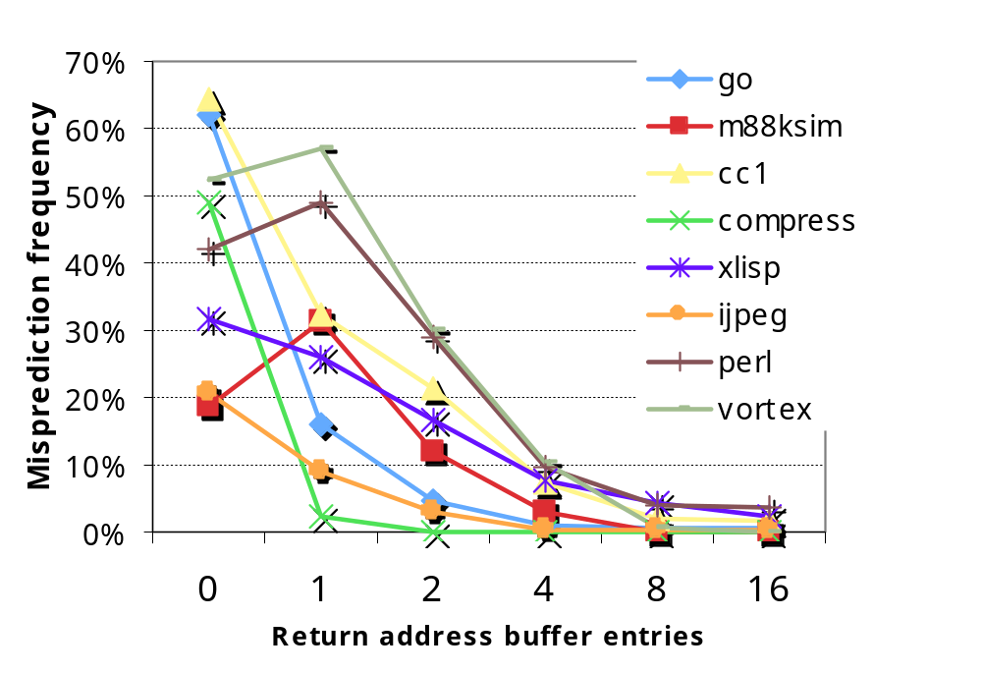
IF BW: Return Address Predictor
Small buffer of return addresses acts as a stack
Caches most recent return addresses
Call ⇒ Push a return address
on stack
Return ⇒ Pop an address off stack & predict as new PC
CS2017 ILP

Slide 157
More Instruction Fetch Bandwidth
Integrated branch prediction branch predictor is part of instruction fetch unit and is constantly predicting branches
Instruction prefetch Instruction fetch units prefetch to deliver multiple instructions per clock, integrating it with branch prediction
Instruction memory access and buffering Fetching multiple instructions per cycle:
  May require accessing multiple cache blocks (prefetch to hide cost of crossing cache blocks)
  Provides buffering, acting as on-demand unit to provide instructions to issue stage as needed and in quantity needed
CS2017 ILP

Slide 158
Speculation:
Register Renaming vs. ReOrderBuffer
Alternative to ROB is a larger physical set of registers combined with register renaming
  Extended registers replace function of both ROB and reservation stations
Instruction issue maps names of architectural registers to physical register numbers in extended register set
  On issue, allocates a new unused register for the destination (which avoids WAW and WAR hazards)
  Speculation recovery easy because a physical register holding an instruction destination does not become the architectural register until the instruction commits
Most Out-of-Order processors today use extended registers with renaming
CS2017 ILP

Slide 159
Value Prediction
Attempts to predict value produced by instruction
  E.g., Loads a value that changes infrequently
Value prediction is useful only if it significantly increases ILP
  Focus of research has been on loads; so-so results, no processor uses value prediction
Related topic is address aliasing prediction
  RAW for load and store or WAW for 2 stores
Address alias prediction is both more stable可靠 and simpler since need not actually predict the address values, only whether such values conflict
  Has been used by a few processors
CS2017 ILP

Slide 160
Perspective 观点
Interest in multiple-issue because wanted to improve performance without affecting uniprocessor programming model
Taking advantage of ILP is conceptually simple, but design problems are amazingly complex in practice
Conservative 保守的 in ideas, just faster clock and bigger Cache
Processors of last 5 years (Pentium 4, IBM Power 5, AMD Opteron) have the same basic structure and similar sustained issue rates (3 to 4 instructions per clock) as the 1st dynamically scheduled, multiple-issue processors announced in 1995
  Clocks 10 to 20X faster, caches 4 to 8X bigger, 2 to 4X as many renaming registers, and 2X as many load-store units
  ⇒ performance 8 to 16X
Peak v. delivered performance gap increasing
CS2017 ILP

