Slide 1
Limits to ILP and Simultaneous Multithreading
（中文教材 10.5节）

Slide 2
Review from Last Time
Interest in multiple-issue because wanted to improve performance without affecting uniprocessor programming model.
As we indicated in the last chapter, exploiting ILP was the primary focus of processor designs for about 20 years starting in the mid-1980s.
For the first 15 years, we saw a progression of successively more sophisticated 非常复杂精密的 schemes for pipelining, multiple issue, dynamic scheduling and speculation.
Since 2000, designers have focused primarily on optimizing designs or trying to achieve higher clock rates without increasing issue rates.
As we indicated in the close of the last chapter, this era of advances in exploiting ILP appears to be coming to an end.
CS2017 Limits and SMT

Slide 3
Review from Last Time
Taking advantage of ILP is conceptually simple, but design problems are amazingly complex in practice
Conservative in ideas 保守想法, just faster clock and bigger Cache
Processors of last 5 years (Pentium 4, IBM Power 5, AMD Opteron) have the same basic structure and similar sustained issue rates (3 to 4 instructions per clock) as the 1st dynamically scheduled, multiple-issue processors announced in 1995
  Clocks 10 to 20X faster, caches 4 to 8X bigger, 2 to 4X as many renaming registers, and 2X as many load-store units ⇒ performance 8 to 16X
Peak v. delivered performance gap increasing
CS2017 Limits and SMT

Slide 4
Outline
Review
Limits to ILP (another perspective 观点)
Thread Level Parallelism
Multithreading
Simultaneous Multithreading
Power 4 vs. Power 5
Head to Head: VLIW vs. Superscalar vs. SMT
Commentary & Conclusion
CS2017 Limits and SMT

Slide 5
Limits to ILP
Conflicting studies of amount
  Benchmarks (vectorized Fortran FP vs. integer C programs)
  Hardware sophistication 完善度，复杂度
  Compiler sophistication
How much ILP is available using existing mechanisms with increasing HW budgets?
Do we need to invent new HW/SW mechanisms to keep on processor performance curve?
  Intel MMX, SSE (Streaming SIMD Extensions): 64 bit ints
  Intel SSE2: 128 bit, including 2 64-bit Fl. Pt. per clock
  Intel AVX (Advanced Vector Extensions)：256 bit SIMD
  Motorola AltaVec: 128 bit ints and FPs
  Supersparc Multimedia ops, etc.
CS2017 Limits and SMT
Notes:
如果给设计者更多的预算，ILP还能进步多少呢？
MMX 指令集
MMX（Multi Media eXtension，多媒体扩展指令集）指令集是Intel公司于1996年推出的一项多媒体指令增强技术。MMX指令集中包括有57条多媒体指令，通过这些指令可以一次处理多个数据，在处理结果超过实际处理能力的时候也能进行正常处理，这样在软件的配合下，就可以得到更高的性能。MMX的益处在于，当时存在的操作系统不必为此而做出任何修改便可以轻松地执行MMX程序。但是，问题也比较明显，那就是MMX指令集与x87浮点运算指令不能够同时执行，必须做密集式的交错切换才可以正常执行，这种情况就势必造成整个系统运行质量的下降。
SSE指令集
SSE（Streaming SIMD Extensions，单指令多数据流扩展）指令集是Intel在Pentium III处理器中率先推出的。是MMX的超集。其实，早在PIII正式推出之前，Intel公司就曾经通过各种渠道公布过所谓的KNI（Katmai New Instruction）指令集，这个指令集也就是SSE指令集的前身，并一度被很多传媒称之为MMX指令集的下一个版本，即MMX2指令集。究其背景，原来“KNI”指令集是Intel公司最早为其下一代芯片命名的指令集名称，而所谓的“MMX2”则完全是硬件评论家们和媒体凭感觉和印象对“KNI”的 评价，Intel公司从未正式发布过关于MMX2的消息。
SSE2是Intel在Pentium 4处理器的最初版本中引入的。
SSE3是Intel在Pentium 4处理器的 Prescott 核心中引入的第三代SIMD指令集
SSE4是Intel在Penryn核心的Core 2 Duo与Core 2 Solo处理器时，新增的。
2008年3月宣布Sandy Bridge微架构将引入全新的AVX指令集，同年4月英特尔公布AVX指令集规范，随后开始不断进行更新，业界普遍认为支持AVX指令集是Sandy Bridge最重要的进步，没有之一。AVX（Advanced Vector Extensions，高级矢量扩展）指令集借鉴了一些AMD SSE5的设计思路，进行扩展和加强，形成一套新一代的完整SIMD指令集规范。Windows 7 SP1已经开始支持英特尔AVX指令集了。

Slide 6
Overcoming Limits
理论上：
Advances in compiler technology + significantly new and different hardware techniques may be able to overcome limitations assumed in studies
实际上：
However, unlikely such advances when coupled with realistic hardware will overcome these limits in near future
CS2017 Limits and SMT

Slide 7
Limits to ILP – 完美机器模型定义
Initial HW Model here; MIPS compilers.
Assumptions for ideal/perfect machine to start:
1. Register renaming – infinite virtual registers
=> all register WAW & WAR hazards are avoided
2. Branch prediction – perfect; no mispredictions
3. Jump prediction – all jumps perfectly predicted (returns, case statements)
2 & 3 ⇒ no control dependencies; perfect speculation & an unbounded buffer of instructions available
4. Memory-address alias analysis – addresses known & a load can be moved before a store provided addresses not equal; 1&4 eliminates all but RAW
Also: perfect caches; 1 cycle latency for all instructions (FP *,/); unlimited instructions issued/clock cycle;
CS2017 Limits and SMT

Slide 8
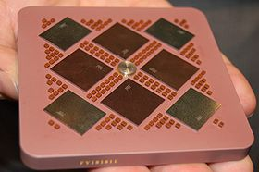
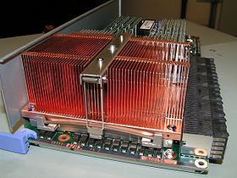
POWER5 – 对比用的实际机器
The POWER5 is a dual-core microprocessor developed and fabricated by IBM which were first presented at 2003.
The principal improvements are support for simultaneous multithreading (SMT) and an on-die memory controller.
A MCM containing four POWER5 dies and four 36 MB L3 cache dies
Processor module from a IBM i5 system, containing a POWER5+ DCM .
CS2017 Limits and SMT
Notes:
It is an improved version of the highly successful POWER4. The POWER5 is a dual-core microprocessor, with each core supporting one physical thread and two logical threads, for a total of two physical threads and four logical threads.
POWER5 芯片被封装在一个单独的模块中来组成一个 8路 对称式多处理器SMP（symmetric multiprocessing.），即多芯片模块MCM（Multichip module）。每一个 MCM 包含4个 POWER5 芯片（chip）(8个处理器内核) 通过芯片间的端口进行互连，并拥有各自相关的L3缓存。
POWER5 也能被封装在一个处理器卡上，该处理器卡包含一个双芯片模块（Dual-chip Module (DCM)）和内存；或者作为一个DCM ，一个 DCM 只包含一个POWER5 芯片（chip）和一块 L3 缓存。

Slide 9
Limits to ILP HW Model comparison
 | Model | Power 5
Instructions Issued per clock | Infinite | 4
Instruction Window Size | Infinite | 200
Renaming Registers | Infinite | 48 integer + 40 Fl. Pt.
Branch Prediction | Perfect | 2% to 6% misprediction (Tournament Branch Predictor)
Cache | Perfect | 64KI, 32KD, 1.92MB L2, 36 MB L3
Memory Alias Analysis | Perfect | ??
CS2017 Limits and SMT

Slide 10
Window Size
The set of instructions that is examined for simultaneous execution is called the window
在窗口中寻找可以被同时发射的指令
The window size will be determined by the cost of determining whether n issuing register-register instructions have any register dependences among them
  In theory, the cost is about O(n²-n)
    50 instructions requires about 2500 comparisons
Each instruction in the window must be kept in processor
Window size is limited by the required storage, the comparisons, and a limited issue rate
CS2017 Limits and SMT

Slide 11
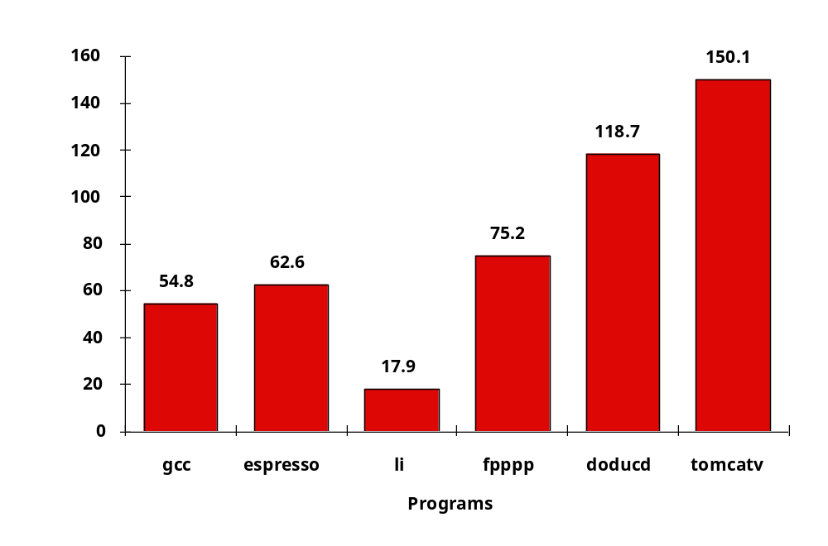
Upper Limit to ILP: Ideal Machine
the average amount of parallelism available for six of the SPEC92 benchmarks.
FP: 75 - 150
Integer: 18 - 60
Instructions Per Clock
CS2017 Limits and SMT

Slide 12
Limits to ILP HW Model comparison
 | New Model | Model | Power 5
Instructions Issued per clock | Infinite | Infinite | 4
Instruction Window Size | Infinite, 2K, 512, 128, 32 | Infinite | 200
Renaming Registers | Infinite | Infinite | 48 integer + 40 Fl. Pt.
Branch Prediction | Perfect | Perfect | 2% to 6% misprediction (Tournament Branch Predictor)
Cache | Perfect | Perfect | 64KI, 32KD, 1.92MB L2, 36 MB L3
Memory Alias | Perfect | Perfect | ??
CS2017 Limits and SMT

Slide 13
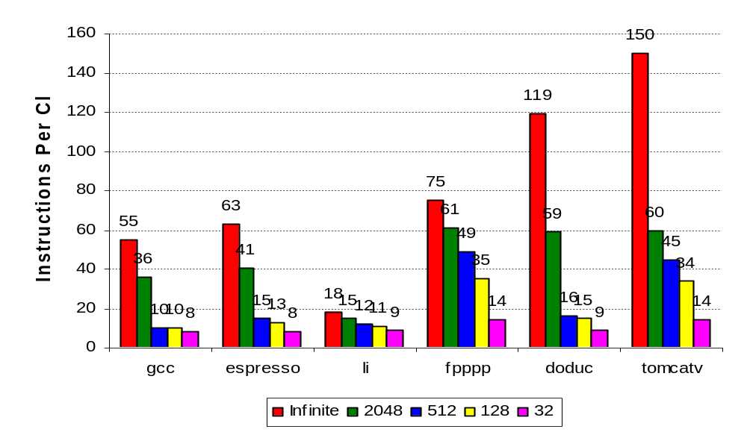
More Realistic HW: Window Impact
Change from Infinite window 2048, 512, 128, 32
FP: 9 - 150
Integer: 8 - 63
IPC
CS2017 Limits and SMT
Notes:
the effects of restricting the size of the window from which an instruction can execute.
Large window size helps FP programs more

Slide 14
Limits to ILP HW Model comparison
 | New Model | Model | Power 5
Instructions Issued per clock | 64 | Infinite | 4
Instruction Window Size | 2048 | Infinite | 200
Renaming Registers | Infinite | Infinite | 48 integer + 40 Fl. Pt.
Branch Prediction | Perfect vs. 8K Tournament vs. 512 2-bit vs. profile vs. none | Perfect | 2% to 6% misprediction (Tournament Branch Predictor)
Cache | Perfect | Perfect | 64KI, 32KD, 1.92MB L2, 36 MB L3
Memory Alias | Perfect | Perfect | ??
CS2017 Limits and SMT
Notes:
2K窗口，64发射足够

Slide 15
Effects of realistic branch prediction
Perfect
Tournament-based(97% accurate with 48K bits)
  Uses a correlating 2 bit and non-correlating 2 bit plus a selector to choose between the two
  Prediction buffer has 8K (13 address bits from the branch)
  3 entries per slot - non-correlating, correlating, select
Standard 2 bit
  512 (9 address bits) entries
  Plus 16 entry buffer to predict RETURNS
Static
  Based on profile 配置文件- predict either T or NT but it stays fixed
None
CS2017 Limits and SMT
Notes:
Tournament-based branch predictor —The prediction scheme uses a correlating 2-bit predictor and a noncorrelating 2-bit predictor together with a selector, which chooses the best predictor for each branch.
The prediction buffer contains 2¹³ (8K) entries, each consisting of three 2-bit fields, two of which are predictors and the third a selector.
The correlating predictor is indexed using the exclusive-or of the branch address and the global branch history.
The noncorrelating predictor is the standard 2-bit predictor indexed by the branch address.
The selector table is also indexed by the branch address and specifies whether the correlating or noncorrelating predictor should be used.
The selector is incremented or decremented just as we would for a standard 2-bit predictor.
This predictor, which uses a total of 48K bits, achieves an average misprediction rate of 3% for these six SPEC92 benchmarks and is comparable
in strategy and size to the best predictors in use in 2005. Jump prediction is done with a pair of 2K-entry predictors, one organized as a circular
buffer for predicting returns and one organized as a standard predictor and used for computed jumps (as in case statements or computed gotos).
These jump predictors are nearly perfect.

Slide 16
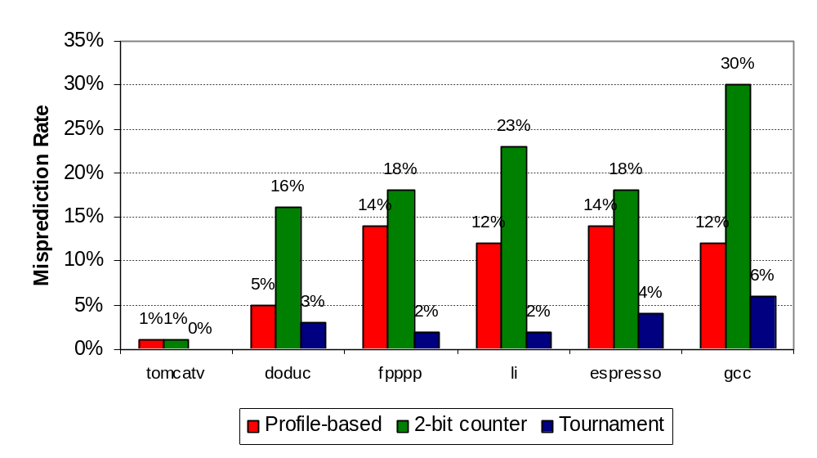
Misprediction Rates
CS2017 Limits and SMT

Slide 17
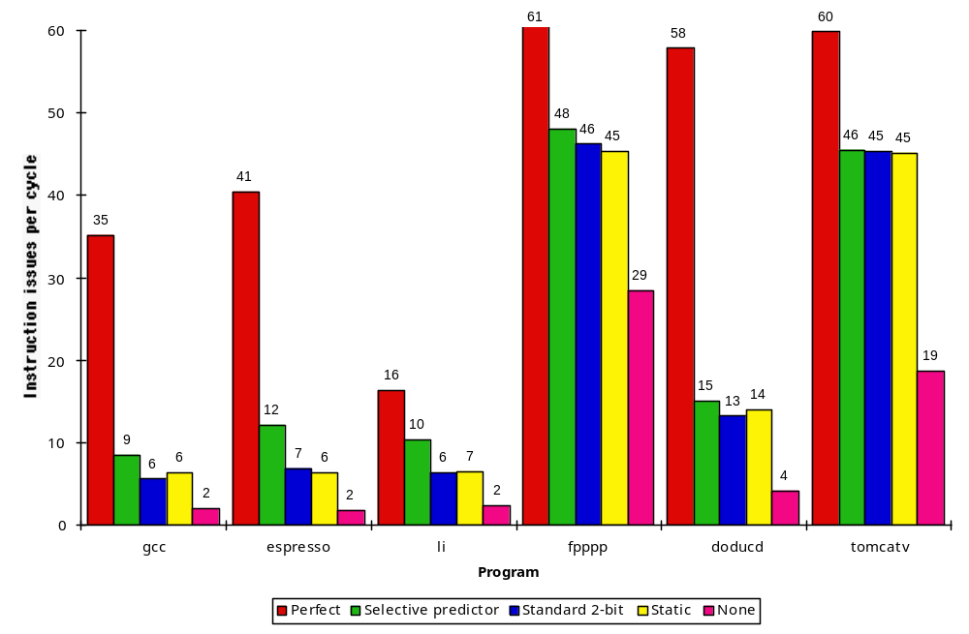
More Realistic HW: Branch Impact
Change from Infinite window to examine to 2048 and maximum issue of 64 instructions per clock cycle
FP: 14 - 45
Integer: 6 - 12
IPC
Perfect
Tournament
BHT (512)
Profile-Base
No prediction

Slide 18
Remarks
Imperfect branch prediction impacts INT programs significantly
FP programs have much fewer branches that are more predictable
CS2017 Limits and SMT

Slide 19
Limits to ILP HW Model comparison
 | New Model | Model | Power 5
Instructions Issued per clock | 64 | Infinite | 4
Instruction Window Size | 2048 | Infinite | 200
Renaming Registers | Infinite v. 256, 128, 64, 32, none | Infinite | 48 integer + 40 Fl. Pt.
Branch Prediction | 8K 2-level Tournament | Perfect | Tournament Branch Predictor
Cache | Perfect | Perfect | 64KI, 32KD, 1.92MB L2, 36 MB L3
Memory Alias | Perfect | Perfect | ??
CS2017 Limits and SMT

Slide 20
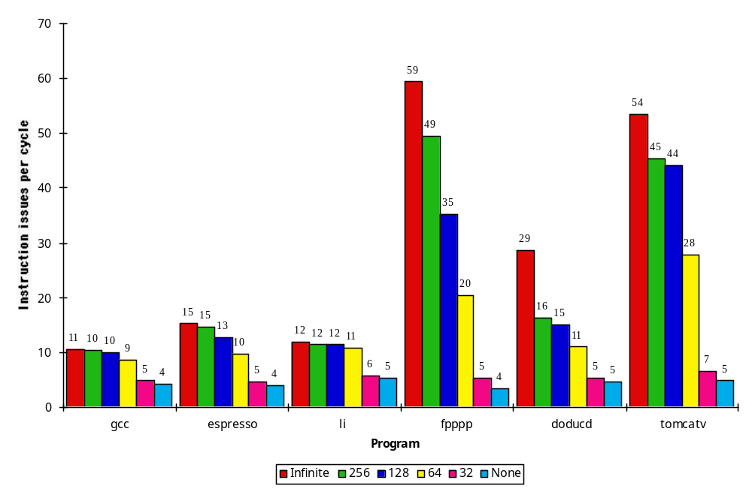
More Realistic HW:
Renaming Register Impact (N int + N fp)
FP: 5 - 49
Change 2048 instr window, 64 instr issue, 8K 2 level Prediction
Integer: 5 - 15
IPC
Infinite
256
128
64
32
None

Slide 21
Limits to ILP HW Model comparison
 | New Model | Model | Power 5
Instructions Issued per clock | 64 | Infinite | 4
Instruction Window Size | 2048 | Infinite | 200
Renaming Registers | 256 Int + 256 FP | Infinite | 48 integer + 40 Fl. Pt.
Branch Prediction | 8K 2-level Tournament | Perfect | Tournament
Cache | Perfect | Perfect | 64KI, 32KD, 1.92MB L2, 36 MB L3
Memory Alias | Perfect v. Stack v. Inspect v. none | Perfect | Perfect

Slide 22
Effects of Memory Aliasing
Perfect
  No mistakes - the unrealistic limit
Global/Stack Perfect：
  Similar to best compiler methods to date
  Perfect job on global and stack areas
  Assume all heap addresses conflict (improvement here is likely)
Inspection ：This model examines the accesses to see if they can be determined not to interfere at compile time.
  If pointer is to different allocation areas then no conflict
  Also no conflict using same register with different offsets
None
  All memory references are assumed to conflict
CS2017 Limits and SMT
Notes:
Global/stack perfect—This model does perfect predictions for global and stack references and assumes all heap references conflict.
Inspection—This model examines the accesses to see if they can be determined not to interfere at compile time.

Slide 23
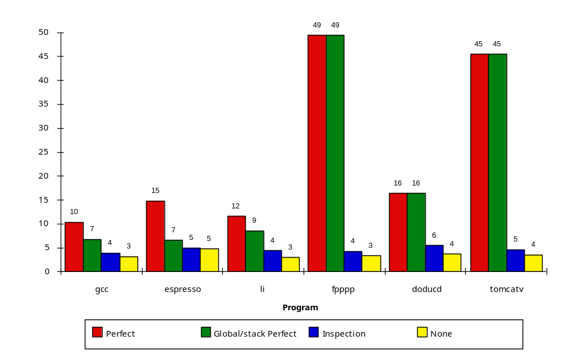
More Realistic HW:
Memory Address Alias Impact
Change 2048 instr window, 64 instr issue, 8K 2 level Prediction, 256 renaming registers
FP: 4 - 45
(Fortran,
no heap)
Integer: 4 - 9
IPC
Perfect
Global/Stack perf;
heap conflicts
Inspec.
Assem.
None
Notes:
HW disambiguation？
没有办法在编译器阶段找到所有的地址相关。
In practice, dynamically scheduled processors rely on dynamic memory disambiguation.

Slide 24
Limits to ILP HW Model comparison
 | New Model | Model | Power 5
Instructions Issued per clock | 64 (no restrictions) | Infinite | 4
Instruction Window Size | Infinite vs. 256, 128, 64, 32 | Infinite | 200
Renaming Registers | 64 Int + 64 FP | Infinite | 48 integer + 40 Fl. Pt.
Branch Prediction | 1K 2-bit Tournament | Perfect | Tournament
Cache | Perfect | Perfect | 64KI, 32KD, 1.92MB L2, 36 MB L3
Memory Alias | Perfect HW disambiguation | Perfect | Perfect
CS2017 Limits and SMT

Slide 25
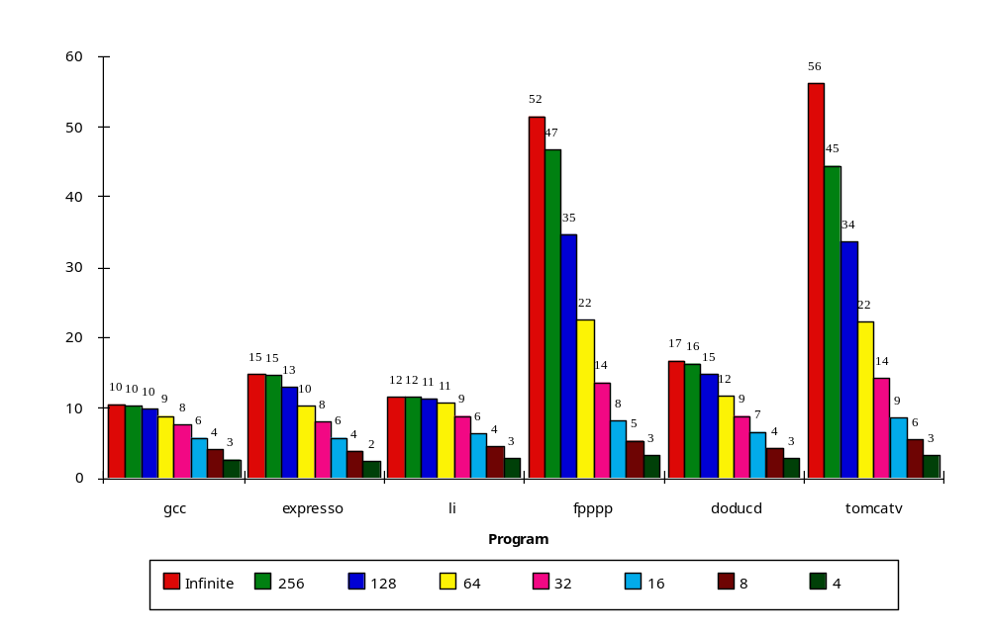
Realistic HW: Window Impact
Perfect disambiguation (HW), 1K Selective Prediction, 16 entry return, 64 registers, issue as many as window
FP: 8 - 45
IPC
Integer: 6 - 12
Infinite
256
128
64
32
16
8
4

Slide 26
Remarks
We can’t possibly cover everything in class
  Without skipping important fundamental concepts
So read the Intel P4 (2.10) and Appendix G
  Every machine has some goals and a lot of balance points
  Instructive to follow the list of possibilities we have discussed with a real case study
  If there’s another machine you are interested in then go read about it
Analyze as much as you can
  Do battle with the problem in a serious way
  Try to understand why a particular decision was made
  From normal literature, the real reasons are possible hard to find
  But you must try to get it right based on your knowledge
CS2017 Limits and SMT

Slide 27
Outline
Review
Limits to ILP (another perspective)
Thread Level Parallelism
Multithreading
Simultaneous Multithreading
Power 4 vs. Power 5
Head to Head: VLIW vs. Superscalar vs. SMT
Commentary
Conclusion
CS2017 Limits and SMT

Slide 28
How to Exceed ILP Limits of this study?
These are not laws of physics; just practical limits for today, and perhaps overcome via research
Compiler and ISA advances could change results
WAR and WAW hazards through memory: eliminated WAW and WAR hazards through register renaming, but not in memory usage
  Can get conflicts via allocation of stack frames as a called procedure reuses the memory addresses of a previous procedure on the stack
CS2017 Limits and SMT
Notes:
A called procedure reuses the memory locations of a previous procedure on the stack, and
this can lead to WAW and WAR hazards that are unnecessarily limiting.

Slide 29
HW v. SW to increase ILP
Memory disambiguation: HW best
Speculation:
  HW best when dynamic branch prediction better than compile time prediction
  Exceptions easier for HW
  HW doesn’t need bookkeeping code or compensation code
  Very complicated to get right
Scheduling: SW can look ahead to schedule better
Compiler independence: does not require new compiler, recompilation重新编译 to run well
CS2017 Limits and SMT
Notes:
The major disadvantage of supporting speculation in hardware is the complexity and additional hardware resources required.

Slide 30
Performance beyond single thread ILP
There can be much higher natural parallelism in some applications
  (e.g., Database or Scientific codes)
Explicit Thread Level Parallelism or Data Level Parallelism
Thread: process with own instructions and data
  thread may be a process part of a parallel program of multiple processes, or it may be an independent program
  Each thread has all the state (instructions, data, PC, register state, and so on) necessary to allow it to execute
Data Level Parallelism: Perform identical 同样的operations on data, and lots of data
CS2017 Limits and SMT

Slide 31
Thread Level Parallelism (TLP)
ILP exploits implicit (隐含的) parallel operations within a loop or straight-line code segment
TLP explicitly (明确地) represented by the use of multiple threads of execution that are inherently (固有地) parallel
Goal: Use multiple instruction streams to improve
  Throughput of computers that run many programs
  Execution time of multi-threaded programs
TLP could be more cost-effective(合算的) to exploit than ILP
CS2017 Limits and SMT

Slide 32
线程级并行的产生
由于程序代码中存在的数据及控制依赖，单线程中所能发掘的指令并行潜力是有限的。为了发掘有限的指令级并行潜力而一味强化乱序执行和分支预测，以至于处理器复杂度和功耗急剧上升，有时候得不偿失。
ILP本身也不再适应计算应用类型的变化：ILP更适用于传统的计算密集型应用，其中ILP程度较高。而当代以商用事务处理和Web应用为代表的数据密集型的应用，其控制流非常不规则，ILP非常低，难以有效利用ILP技术提升性能。
现代微处理器多采用硬件多线程技术来发掘线程之间的线程级并行潜力。具有多线程能力的系统包括对称多处理机(SMP)、多内核处理器(CMP)以及芯片级多处理(Chip-level multithreading,CMT=CMP＋MT )或同时多线程(Simultaneous multithreading,SMT/软件多线程)处理器。
CS2017 Limits and SMT
Notes:
SMP=Symmetrical Multi-Processing
CMP=Chip multiprocessors
CMT＝CMP＋MT

Slide 33
New Approach: Mulithreaded Execution
Multithreading: multiple threads to share the functional units of 1 processor via overlapping
  processor must duplicate independent state of each thread e.g., a separate copy of register file, a separate PC, and for running independent programs, a separate page table
  memory shared through the virtual memory mechanisms, which already support multiple processes 进程
  HW for fast thread switch; much faster than full process switch ≈ 100s to 1000s of clocks
CS2017 Limits and SMT

Slide 34
When switch?
Alternate instruction per thread
(fine grain 细粒度)
Switches between threads on each instruction, causing the execution of multiples threads to be interleaved 它在每条指令间都能进行线程的切换，从而导致多个线程的交替执行。
When a thread is stalled, perhaps for a cache miss, another thread can be executed (coarse grain 粗粒度)
Switches threads only on costly stalls, such as L2 cache misses 粗粒度多线程之间的切换只在发生代价较高、时间较长的阻塞出现时。
CS2017 Limits and SMT

Slide 35
Fine-Grained Multithreading
Usually done in a round-robin fashion 轮叫调度, skipping any stalled threads
CPU must be able to switch threads every clock
Advantage is it can hide both short and long stalls, since instructions from other threads executed when one thread stalls 能够隐藏由任何或长或短的阻塞带来的吞吐率的损失
Disadvantage is it slows down execution of individual threads, since a thread ready to execute without stalls will be delayed by instructions from other threads 减慢了每个独立线程的执行
Used on Sun’s Niagara
CS2017 Limits and SMT
Notes:
CPU中可以同时执行多个线程的指令

Slide 36
Coarse-Grained Multithreading
Advantages
  Relieves need to have very fast thread-switching
  Doesn’t slow down thread, since instructions from other threads issued only when the thread encounters a costly stall
Disadvantage is hard to overcome throughput losses from shorter stalls, due to pipeline start-up costs 不能有效地减少吞吐率的损失
  Since CPU issues instructions from 1 thread, when a stall occurs, the pipeline must be emptied or frozen 必须排空或暂停
  New thread must fill pipeline before instructions can complete
Because of this start-up overhead, coarse-grained multithreading is better for reducing penalty of high cost stalls, where pipeline refill << stall time
Used in IBM AS/400
CS2017 Limits and SMT
Notes:
由流水线建立时间的开销造成的。由于这种CPU只执行单个线程的指令，因此当发生阻塞时，流水线必须排空或暂停。
阻塞后切换的新的线程在指令执行产生结果之前必须先填满整个流水线。

Slide 37
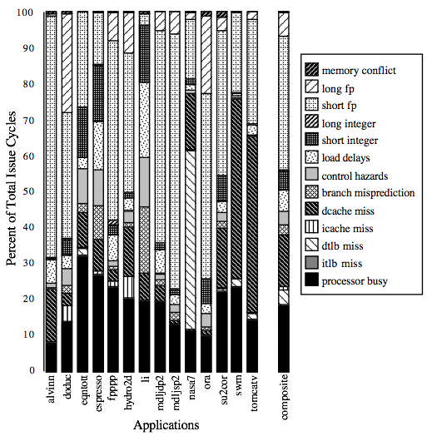
For most apps, most execution units lie idle
For an 8-way superscalar.
Sources of all unused issue cycles in an 8-issue superscalar processor. Processor busy represents the utilized issue slots; all others represent wasted issue slots.
From: Tullsen, Eggers, and Levy,
“Simultaneous Multithreading: Maximizing On-chip Parallelism, ISCA 1995.
Notes:
Long fp 应该指 long fp RAW
只有Processor Busy才是真正的工作状态

Slide 38
Do both ILP and TLP?
TLP and ILP exploit two different kinds of parallel structure in a program
Could a processor oriented at ILP to exploit TLP?
  functional units are often idle in data path designed for ILP because of either stalls or dependences in the code
Could the TLP be used as a source of independent instructions that might keep the processor busy during stalls?
Could TLP be used to employ the functional units that would otherwise lie idle when insufficient ILP exists?
CS2017 Limits and SMT

Slide 39
Simultaneous Multi-threading ...
One thread, 8 units
Two threads, 8 units
Cycle
M
M
FX
FX
FP
FP
BR
CC
Cycle
M
M
FX
FX
FP
FP
BR
CC
1
2
3
4
5
6
7
8
9
1
2
3
4
5
6
7
8
9
IDLE
Func. Units
STALL
M = Load/Store, FX = Fixed Point, FP = Floating Point, BR = Branch, CC = Condition Codes

Slide 40
Simultaneous Multithreading (SMT)
同时多线程技术是一种在多流出、动态调度处理器上同时开发线程级并行和指令级并行的改进的多线程技术。
Simultaneous multithreading : insight that dynamically scheduled processor already has many HW mechanisms to support multithreading (next page)使用动态调度技术的处理器已经具有了开发线程级并行所需的硬件设置。
Just adding a per thread renaming table and keeping separate PCs
  Independent commitment can be supported by logically keeping a separate reorder buffer for each thread
CS2017 Limits and SMT

Slide 41
HW mechanisms supporting multithreading
Large set of virtual registers that can be used to hold the register sets of independent threads 动态调度超标量处理器有大量的虚拟寄存器组，可以用来保存每个独立线程的寄存器状态。
Register renaming provides unique register identifiers, so instructions from multiple threads can be mixed in datapath without confusing sources and destinations across threads 由于寄存器重命名机制提供了唯一的寄存器标识符，多个线程的指令可以在数据路径上混合执行，而不会导致各线程间源操作数和目的操作数的混乱。
Out-of-order completion allows the threads to execute out of order, and get better utilization of the HW 为每个线程设置重命名表、保留各自的PC值、提供多个线程的指令结果提交的能力来实现。
CS2017 Limits and SMT

Slide 42
Multithreaded Categories
Simultaneous
Multithreading
Time (processor cycle)
Superscalar
Fine-Grained
Coarse-Grained
Multiprocessing
Issue Slots
Thread 1
Thread 3
Thread 5
Thread 2
Thread 4
Idle slot
CS2017 Limits and SMT

Slide 43
CMT与SMT: 殊途同归
经常有这样的提问，片上多线程技术(CMT，Chip Multi-threading)与同时多线程技术(SMT，Simultaneously Multi-threading)相比，谁代表了未来的芯片技术发展方向?
这是一个很难轻易下结论的问题，这个问题其实是反映了目前两大阵营之争，即以Sun的SPARC为代表的CMT和以IBM的Power 5与Intel的安腾为代表的SMT之争。
CS2017 Limits and SMT

Slide 44
SMT & CMT
IBM的Power 5以及Intel的安腾所强调的是增强每一个CPU的运算速度，为此，IBM采用的是SMT技术，即提高每个CPU处理线程的能力，安腾则通过提高CPU频率以提高执行指令的速度。
Sun采用的CMT技术理念是希望在一个芯片上事务处理能力要足够的强，单位时间内处理事务交易的能力要强，而并不强调每一个CPU的速度有多么快。
一个芯片上晶体管的数量是有限的，Sun公司的CMT技术能够将更多的晶体管压缩到一个芯片中，同时能够简化每一个CPU的设计，把更多的CPU压在一个芯片当中以提高整个芯片处理交易事务的能力。
显然，这是两个完全不同的技术发展方向。IBM也曾经推出过多核技术，但是其设计思路同Sun相比存在很大差别。
CS2017 Limits and SMT

Slide 45
O-o-O Simultaneous Multithreading
[Tullsen, Eggers, Emer, Levy, Stamm, Lo,
DEC/UW, Washington大学1996]
Add multiple contexts and fetch engines and allow instructions fetched from different threads to issue simultaneously
Utilize wide out-of-order superscalar processor issue queue to find instructions to issue from multiple threads
OOO instruction window already has most of the circuitry required to schedule from multiple threads
Any single thread can utilize whole machine
CS2017 Limits and SMT

Slide 46
Design Challenges in SMT
Since SMT makes sense only with fine-grained implementation, impact of fine-grained scheduling on single thread performance?
同时多线程只有在细粒度的实现方式下才有意义，并发多个同优先级的线程不可避免地影响单个线程的执行时间
  A preferred thread approach sacrifices(牺牲) neither throughput nor single-thread performance?
  通过指定一个优先线程来减小这种影响，只要一有可能，处理器就运行指定的优先线程。从而在整体性能提高的同时对单个指定的线程性能只产生较小的影响。
  Unfortunately, with a preferred thread, the processor is likely to sacrifice some throughput, when preferred thread stalls
CS2017 Limits and SMT

Slide 47
Design Challenges in SMT (con.)
Larger register file needed to hold multiple contexts
设置用来保存多个上下文所需的庞大的寄存器文件
Not affecting clock cycle time, especially in
必须保持每个时钟周期的低开销，特别是在关键步骤上
  Instruction issue - more candidate instructions need to be considered
  Instruction completion - choosing which instructions to commit may be challenging
Ensuring that cache and TLB conflicts generated by SMT do not degrade使降级 performance
需要保证由于并发执行多个线程带来的cache冲突不会导致显著的性能下降。
CS2017 Limits and SMT
Notes:
A translation lookaside buffer (TLB) is a CPU cache that memory management hardware uses to improve virtual address translation speed. 地址变换后备缓存

Slide 48
Design Challenges in SMT - Example
The IBM Power5 used the same pipeline as the Power4
The IBM Power5 added SMT support
The IBM Power5 increased a number of structures in the processor so as to minimize the negative performance consequences from fine-grained threaded iteration.
CS2017 Limits and SMT

Slide 49
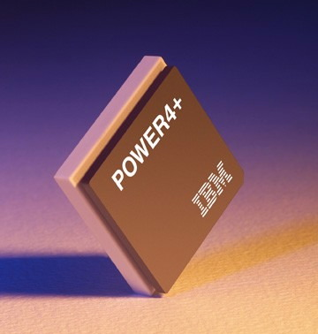
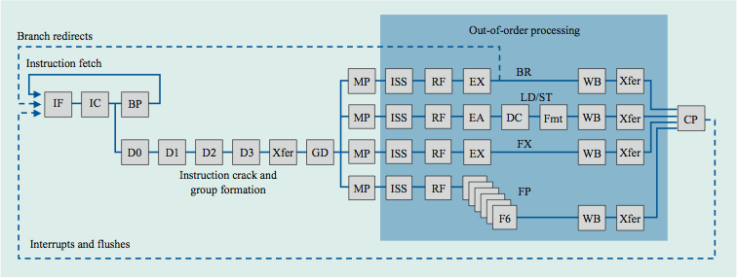
Power 4
Single-threaded predecessor to Power 5. 8 execution units in
out-of-order engine, each may
issue an instruction each cycle.
CP 为group提交阶段
D1-D3 这些阶段形成指令group
GD 阶段根据group中不同指令的类型把指令dispath到不同的功能部件流水线上
主要分为分支指令、存取指令、定点指令和浮点指令4条流水线
CS2017 Limits and SMT
Notes:
IF 取指部件
IC 指令Cache
BP 分支预测
D0 即指令buffer；D1-D3 这些阶段形成指令group
GD 阶段根据group中不同指令的类型把指令dispath到不同的功能部件流水线上
CP 为group提交阶段

Slide 50
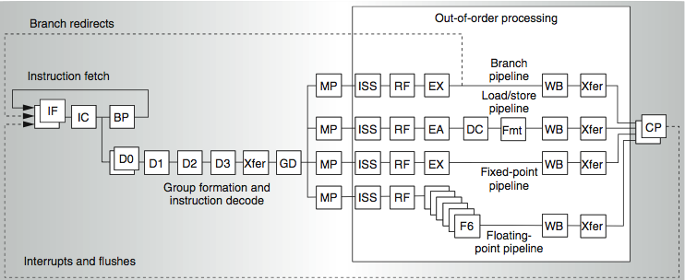
Power 4
2 commits (architected register sets)
Power 5
2 fetch (PC),
2 initial decodes
CS2017 Limits and SMT

Slide 51
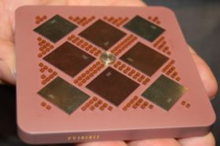
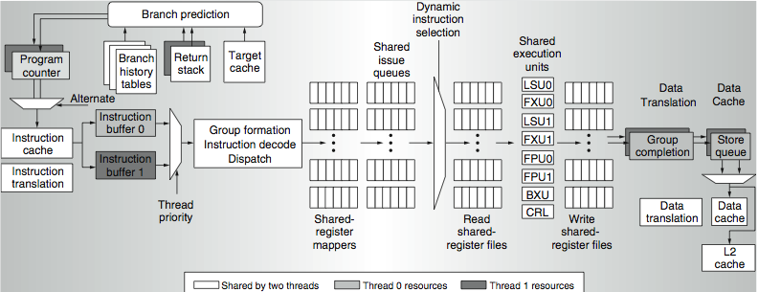
Power 5 data flow ...
Why only 2 threads? With 4, one of the shared resources (physical registers, cache, memory bandwidth) would be prone to bottleneck
CS2017 Limits and SMT

Slide 52
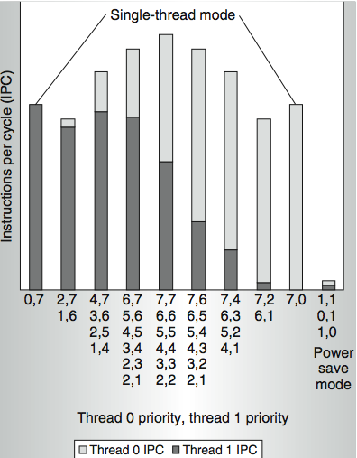
Power 5 thread performance ...
Relative priority of each thread controllable in hardware.
For balanced operation, both threads run slower than if they “owned” the machine.
CS2017 Limits and SMT

Slide 53
Changes in Power 5 to support SMT
Increased associativity of L1 instruction cache and the instruction address translation buffers
Added per thread load and store queues
Increased size of the L2 (1.92 vs. 1.44 MB) and L3 caches
Added separate instruction prefetch and buffering per thread
Increased the number of virtual registers from 152 to 240
Increased the size of several issue queues
The Power5 core is about 24% larger than the Power4 core because of the addition of SMT support
CS2017 Limits and SMT

Slide 54
Initial Performance of SMT
Pentium 4 Extreme SMT yields 1.01 speedup for SPECint_rate benchmark and 1.07 for SPECfp_rate
  Pentium 4 is dual threaded SMT
  SPECRate requires that each SPEC benchmark be run against a vendor-selected number of copies of the same benchmark
Running on Pentium 4 each of 26 SPEC benchmarks paired with every other (26² runs) speed-ups from 0.90 to 1.58; average was 1.20
Power 5, 8 processor server 1.23 faster for SPECint_rate with SMT, 1.16 faster for SPECfp_rate
Power 5 running 2 copies of each app speedup between 0.89 and 1.41
  Most gained some
  Fl.Pt. apps had most cache conflicts and least gains
CS2017 Limits and SMT
Notes:
双线程SMT，所以在benchmark中同时运行两个应用程序

Slide 55
Head to Head ILP competition
Processor | Micro architecture | Fetch / Issue / Execute | FU | Clock Rate (GHz) | Transis-tors Die size | Power
Intel Pentium 4 Extreme | Speculative dynamically scheduled; deeply pipelined; SMT | 3/3/4 | 7 int. 1 FP | 3.8 | 125 M 122 mm² | 115 W
AMD Athlon 64 FX-57 | Speculative dynamically scheduled | 3/3/4 | 6 int. 3 FP | 2.8 | 114 M 115 mm² | 104 W
IBM Power5 (1 CPU only) | Speculative dynamically scheduled; SMT; 2 CPU cores/chip | 8/4/8 | 6 int. 2 FP | 1.9 | 200 M 300 mm² (est.) | 80W (est.)
Intel Itanium 2 | Statically scheduled VLIW-style | 6/5/11 | 9 int. 2 FP | 1.6 | 592 M 423 mm² | 130 W
CS2017 Limits and SMT

Slide 56
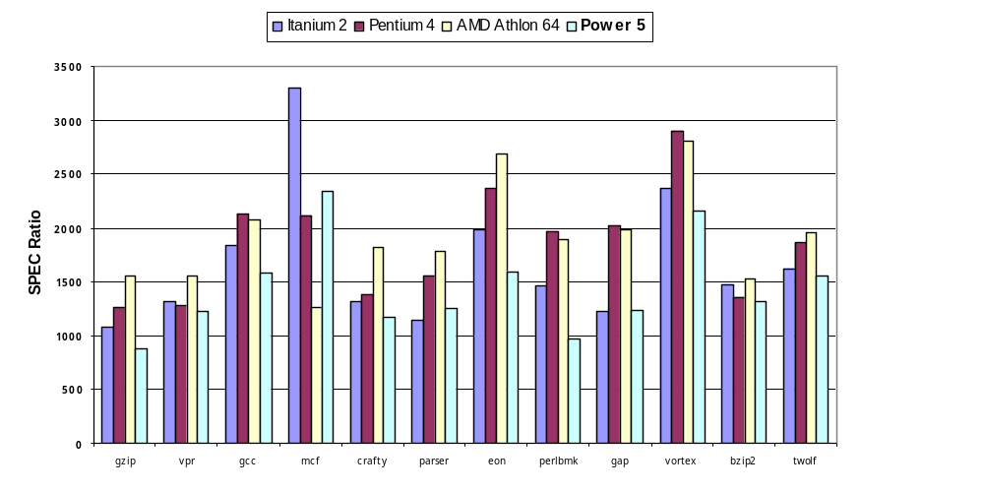
Performance on SPECint2000
CS2017 Limits and SMT

Slide 57
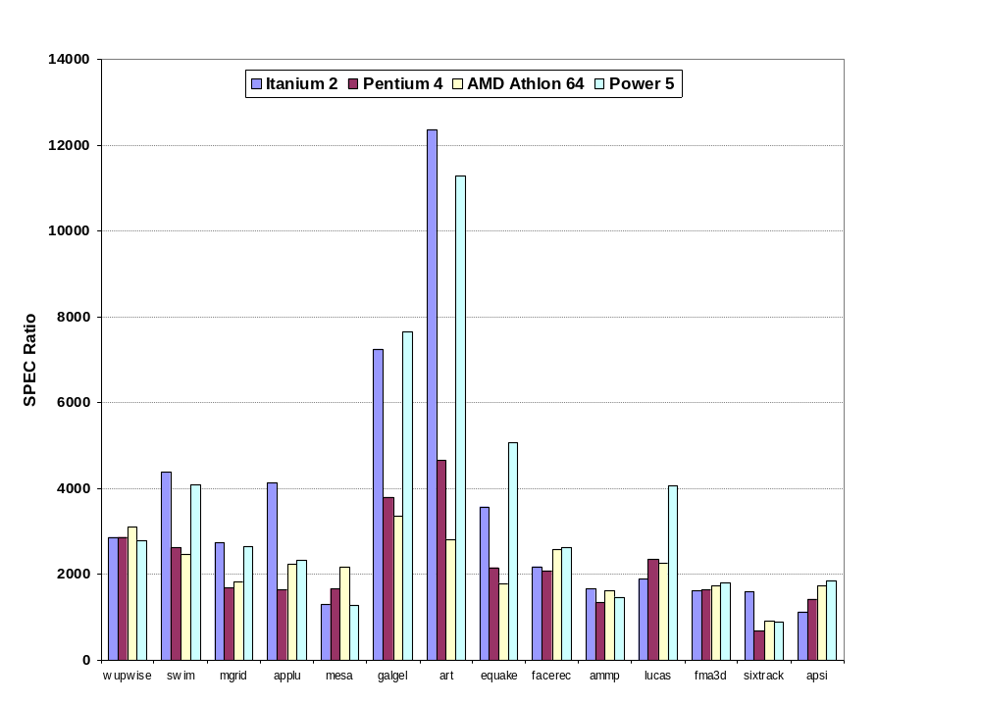
Performance on SPECfp2000
CS2017 Limits and SMT

Slide 58
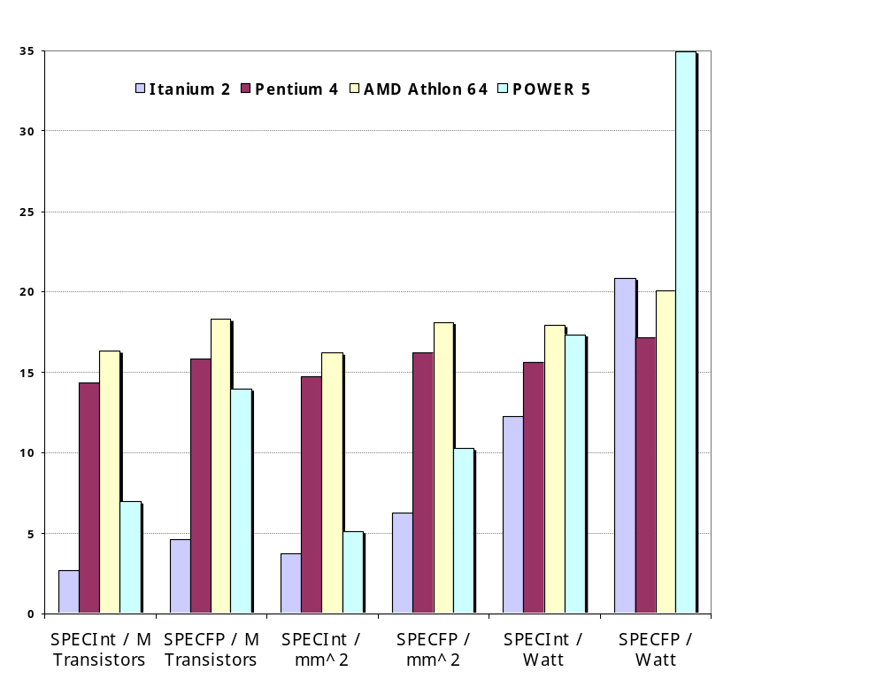
Normalized Performance: Efficiency
Rank | I tanium2 | Pen t I um4 | A t h l on | Powe r 5
Int/Trans | 4 | 2 | 1 | 3
FP/Trans | 4 | 2 | 1 | 3
Int/area | 4 | 2 | 1 | 3
FP/area | 4 | 2 | 1 | 3
Int/Watt | 4 | 3 | 1 | 2
FP/Watt | 2 | 4 | 3 | 1
CS2017 Limits and SMT
Notes:
规格化

Slide 59
No Silver Bullet for ILP
No obvious over all leader in performance
The AMD Athlon leads on SPECInt performance followed by the Pentium 4, Itanium 2, and Power5
Itanium 2 and Power5, which perform similarly on SPECFP, clearly dominate the Athlon and Pentium 4 on SPECFP
Itanium 2 is the most inefficient processor both for Fl. Pt. and integer code for all but one efficiency measure (SPECFP/Watt)
Athlon and Pentium 4 both make good use of transistors and area in terms of efficiency,
IBM Power5 is the most effective user of energy on SPECFP and essentially tied on SPECINT
CS2017 Limits and SMT
Notes:
Silver Bullet n.喻指新技术，尤指人们寄予厚望的某种新科技;

Slide 60
Limits to ILP
Doubling issue rates above today’s 3-6 instructions per clock, say to 6 to 12 instructions, probably requires a processor to 更复杂
  issue 3 or 4 data memory accesses per cycle,
  resolve 2 or 3 branches per cycle,
  rename and access more than 20 registers per cycle, and
  fetch 12 to 24 instructions per cycle.
The complexities of implementing these capabilities is likely to mean sacrifices in the maximum clock rate
  E.g, widest issue processor is the Itanium 2, but it also has the slowest clock rate, despite the fact that it consumes the most power! 代价更大
CS2017 Limits and SMT

Slide 61
Limits to ILP
Most techniques for increasing performance increase power consumption
The key question is whether a technique is energy efficient: does it increase power consumption faster than it increases performance?
Multiple issue processors techniques all are energy inefficient:
  Issuing multiple instructions incurs some overhead in logic that grows faster than the issue rate grows
  Growing gap between peak issue rates and sustained performance
Number of transistors switching = f(peak issue rate), and performance = f( sustained rate),
growing gap between peak and sustained performance
⇒ increasing energy per unit of performance
CS2017 Limits and SMT
Notes:
transistors switching = 晶体管开关

Slide 62
Commentary
Itanium architecture does not represent a significant breakthrough突破 in scaling ILP or in avoiding the problems of complexity and power consumption
Instead of pursuing more ILP, architects are increasingly focusing on TLP implemented with single-chip multiprocessors
In 2000, IBM announced the 1st commercial single-chip, general-purpose multiprocessor, the Power4, which contains 2 Power3 processors and an integrated L2 cache
  Since then, Sun Microsystems, AMD, and Intel have switch to a focus on single-chip multiprocessors rather than more aggressive uniprocessors.
Right balance of ILP and TLP is unclear today
  Perhaps right choice for server market, which can exploit more TLP, may differ from desktop, where single-thread performance may continue to be a primary requirement
CS2017 Limits and SMT

Slide 63
And in conclusion …
Limits to ILP (power efficiency, compilers, dependencies …) seem to limit to 3 to 6 issue for practical options
Explicitly parallel (Data level parallelism or Thread level parallelism) is next step to performance
Coarse grain vs. Fine grained multihreading
  Only on big stall vs. every clock cycle
Simultaneous Multithreading if fine grained multithreading based on OOO superscalar microarchitecture
  Instead of replicating registers, reuse rename registers
Itanium/EPIC/VLIW is not a breakthrough in ILP
Balance of ILP and TLP decided in marketplace 市场
CS2017 Limits and SMT
Notes:
OOO：Out-of-Order

