Slide 1
Lecture 08: I/O Systems
Notes:
柯尔斯基．阿桑利克教授 ( Prof. Krste Asanovic )
Asanovic received his B.A. degree in Electrical and Information Sciences from Cambridge University in 1987, and his Ph.D. in Computer Science from U.C. Berkeley in 1998.
Krste Asanovic is an Associate Professor in the Computer Science and Artificial Intelligence Laboratory at MIT.
His main research interests are computer architecture and VLSI design and his current focus is on energy-efficient computing.
The SCALE group is developing technologies for future high-performance low-power computing systems.

Slide 2
I/O性能对整机性能的影响——例子
假设一台计算机的I/O处理占10％，当其CPU性能改进，而I/O性能保持不变时，系统总体性能会出现什么变化？
  如果CPU的性能提高10倍
  如果CPU的性能提高100倍
解：假设原来的程序执行时间为1个单位时间。如果CPU的性能提高10倍，程序的计算（包含I/O处理）时间为：
(1 - 10%)/10 + 10% = 0.19 加速比 1/0.19 = 5.26
即整机性能只能提高约5倍，差不多有50％的CPU性能浪费在I/O上。
如果CPU性能提高100倍，程序的计算时间为：
(1 - 10%)/100 + 10% = 0.109 加速比 1/0.109 = 9.17
而整机性能只能提高约10倍，表示有90％的性能浪费在没有改进的I/O上了。
Lec08 IO Systems
Notes:
这是从硬件系统角度做的推论
如果从应用角度会有所不同（任务量CPU属性比例）
S=1/(a+(1-a)/n)
其中，a为串行计算部分所占比例，n为并行处理结点个数。这样，当a=0时，最大加速比s=n；当a=1时，最小加速比s=1；当n→∞时，极限加速比s→ 1／a，这也就是加速比的上限。例如，若串行代码占整个代码的25％，则并行处理的总体性能不可能超过4。这一公式已被学术界所接受，并被称做“阿姆达尔定律”(Amdahl law)。

Slide 3
Contents
I/O Buses
Disk Storage
RAID
Storage Systems
IO Performance
Lec08 IO Systems

Slide 4
I/O Systems
interrupts
Processor
Cache
Memory - I/O Bus
Main
Memory
I/O
Controller
I/O
Controller
I/O
Controller
Disk
Disk
Graphics
Network
Lec08 IO Systems

Slide 5
What is a bus?
A Bus Is:
shared communication link
single set of wires used to connect multiple subsystems
A Bus is also a fundamental tool for composing large, complex systems
  systematic means of abstraction
Processor
Input
Control
Memory
Datapath
Output
Lec08 IO Systems

Slide 6
Advantages of Buses
I/O Device
I/O Device
I/O Device
Processer
Memory
Versatility 多功能性:
  New devices can be added easily
  Peripherals 外围设备 can be moved between computer
  systems that use the same (industry) bus standard
Low Cost:
  A single set of wires is shared in multiple ways
Lec08 IO Systems
Notes:
By versatility, we mean new devices can easily be added. Furthermore, if a device is designed according to a industry bus standard, it can be move between computer systems that use the same bus standard.
The bus organization is a low cost solution because a single set of wires is shared in multiple ways.

Slide 7
Disadvantage of Buses
I/O Device
I/O Device
I/O Device
Processer
Memory
It creates a communication bottleneck
  The bandwidth of that bus can limit the maximum I/O throughput
The maximum bus speed is largely limited by:
  The length of the bus
  The number of devices on the bus
  The need to support a range of devices with:
    Widely varying latencies 等待时间（反应时间）
    Widely varying data transfer rates
Lec08 IO Systems
Notes:
The major disadvantage of the bus organization is that it creates a communication bottleneck. When I/O must pass through a single bus, the bandwidth of that bus can limit the maximum I/O throughput.
The maximum bus speed is also largely limited by:
(a) The length of the bus.
(b) The number of I/O devices on the bus.
(C) And the need to support a wide range of devices with a widely varying latencies and
data transfer rates.

Slide 8
The General Organization of a Bus
Control Lines
Data Lines
Control lines:
  Signal requests and acknowledgments 请求和确认
  Indicate what type of information is on the data lines
Data lines carry information between the source and the destination:
  Data and Addresses
  Complex commands
Lec08 IO Systems
Notes:
A bus generally contains a set of control lines and a set of data lines.
The control lines are used to signal requests and acknowledgments and to indicate what type of information is on the data lines.
The data lines carry information between the source and the destination.
This information may consists of data, addresses, or complex commands.
A bus transaction includes tow parts: (a) sending the address and (b) then receiving or sending the data.

Slide 9
Master versus Slave
Master issues command
Bus
Master
Bus
Slave
Data can go either way
A bus transaction includes two parts:
  Issuing the command (and address) – request
  Transferring the data – action
Master is the one who starts the bus transaction by:
  issuing the command (and address)
Slave is the one who responds to the address by:
  Sending data to the master if the master ask for data
  Receiving data from the master if the master wants to send data
Lec08 IO Systems
Notes:
The bus master is the one who starts the bus transaction by sending out the address.
The slave is the one who responds to the master by either sending data to the master if the master asks for data.
Or the slave may end up receiving data from the master if the master wants to send data.
In most simple I/O operations, the processor will be the bus master but as I will show you later in today’s lecture, this is not always be the case.
+1 = 11 min. (X:51)

Slide 10
Types of Buses (1)
Processor-Memory Bus (design specific)
  Short and high speed
  Only need to match the memory system
    Maximize memory-to-processor bandwidth
  Connects directly to the processor
  Optimized for cache block transfers
前端总线，Front Side Bus（FSB），是将CPU连接到北桥芯片的总线。北桥芯片负责联系内存、显卡等数据吞吐量最大的部件，并和南桥芯片连接 。
Lec08 IO Systems
Notes:
Buses are traditionally classified as one of 3 types: processor memory buses, I/O buses, or backplane buses.
The processor memory bus is usually design specific while the I/O and backplane buses are often standard buses.
In general processor bus are short and high speed. It tries to match the memory system in order to maximize the memory-to-processor BW and is connected directly to the processor.

Slide 11
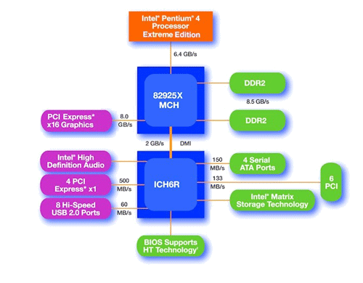
Main components of Intel Chipset: Pentium 4
Northbridge:
  Handles memory
  Graphics
Southbridge: I/O
  PCI bus
  Disk controllers
  USB controllers
  Audio
  Serial I/O
  Interrupt controller
  Timers
Lec08 IO Systems

Slide 12
Types of Buses (2)
I/O Bus (industry standard)
  Usually is lengthy and slower
  Need to match a wide range of I/O devices
  Connects to the processor-memory bus or backplane bus
Backplane Bus 背板总线 (standard or proprietary)
  Backplane: an interconnection structure within the chassis 背板/底盘
  Allow processors, memory, and I/O devices to coexist
  Cost advantage: one bus for all components
  如 VME总线 ，Compact PCI
Serial Buses (wholescale move to serial interconnects)
Lec08 IO Systems
Notes:
I/O bus usually is lengthy and slow because it has to match a wide range of I/O devices and it usually connects to the processor-memory bus or backplane bus.
Backplane bus receives its name because it was often built into the backplane of the computer--it is an interconnection structure within the chassis.
It is designed to allow processors, memory, and I/O devices to coexist on a single bus so it has the cost advantage of having only one single bus for all components.
A backplane (or "backplane system") is a circuit board (usually a printed circuit board) that connects several connectors in parallel to each other, so that each pin of each connector is linked to the same relative pin of all the other connectors[1], forming a computer bus. It is used as a backbone to connect several printed circuit boards together to make up a complete computer system.

Slide 13
A Computer System with One Bus:
Backplane Bus
Backplane Bus
Processor
Memory
I/O Devices
A single bus (the backplane bus) is used for:
  Processor to memory communication
  Communication between I/O devices and memory
Advantages: Simple and low cost
Disadvantages: slow and the bus can become a major bottleneck
Example: IBM PC - AT
Lec08 IO Systems
Notes:
Here is an example showing a single bus, the backplane bus is used to provide communication between the processor and memory.
As well as communication between I/O devices and memory.
The advantage here is of course low cost.
One disadvantage of this approach is that the bus with so many things attached to it will be lengthy and slow.
Furthermore, the bus can become a major communication bottleneck if everybody wants to use the bus at the same time.
The IBM PC is an example that uses only a backplane bus for all communication.

Slide 14
A Two-Bus System
Processor Memory Bus
Processor
Memory
Bus
Adaptor
Bus
Adaptor
Bus
Adaptor
I/O
Bus
I/O
Bus
I/O
Bus
I/O buses tap (与…进行联接) into the processor-memory bus via bus adaptors:
  Processor-memory bus: mainly for processor-memory traffic
  I/O buses: provide expansion slots for I/O devices
Apple Macintosh-II
  NuBus: Processor, memory, and a few selected I/O devices
  SCSI Bus: the rest of the I/O devices
Lec08 IO Systems
Notes:
Right before the break, I showed you a system with one bus only.
Here is an example using two buses where multiple I/O buses tap into the processor-memory bus via bus adaptors.
The Processor-memory bus is used mainly for processor-memory traffic while the I/O buses are used to provide expansion slots for the I/O devices.
The Apple Macintosh-II adopts this organization where the NuBus is used to connect processor, memory, and a few selected I/O devices together.
The rest of the I/O devices reside on an industry standard bus, the SCCI Bus, which is connected to the NuBus via a bus adaptor.
+2 = 25 min. (Y:05)

Slide 15
A Three-Bus System (+ backside cache)
Processor Memory Bus
Processor
Memory
Bus
Adaptor
Backside
Cache bus
Bus
Adaptor
I/O Bus
L2 Cache
Bus
Adaptor
I/O Bus
A small number of backplane buses tap into the processor-memory bus
  Processor-memory bus is only used for processor-memory traffic
  I/O buses are connected to the backplane bus
Advantage: loading on the processor bus is greatly reduced
Lec08 IO Systems
Notes:
Finally, in a 3-bus system, a small number of backplane buses (in our example here, just 1) tap into the processor-memory bus.
The processor-memory bus is used mainly for processor memory traffic while the I/O buses are connected to the backplane bus via bus adaptors.
An advantage of this organization is that the loading on the processor-memory bus is greatly reduced because of the small number of taps into the high-speed processor-memory bus.

Slide 16
The move from Parallel to Serial I/O
CPU I/O IF
I/O 1
I/O 2
Central Bus Arbiter
Shared Parallel Bus Wires
Parallel bus clock rate limited by clock skew 偏离 across long bus (~100MHz)
High power to drive large number of loaded bus lines
Central bus arbiter 仲裁器 adds latency to each transaction, sharing limits throughput
Expensive parallel connectors and backplanes/cables (all devices pay costs)
Examples: VMEbus, Sbus, ISA bus, PCI, SCSI, IDE
Lec08 IO Systems
Notes:
这是因为并行通信线数远多于串行总线导致了一些问题，从而限制了并行总线的时钟频率提高（时钟频率越高，总线传输速度越快）： 时钟偏移， 电容耦合，线路串扰，电磁干扰

Slide 17
The move from Parallel to Serial I/O
I/O 1
Dedicated Point-to-point Serial Links
CPU I/O IF
I/O 2
Point-to-point links run at multi-gigabit speed using advanced clock/signal encoding (requires lots of circuitry at each end)
Lower power since only one well-behaved load
Multiple simultaneous transfers
Cheap cables and connectors (trade greater endpoint transistor cost for lower physical wiring cost), customize bandwidth per device using multiple links in parallel
Examples: Ethernet, Infiniband, PCI Express, SATA, USB, Firewire, etc.
Lec08 IO Systems
Notes:
Trade … for 用。。。交换。。。
InfiniBand技术是一种开放标准的、目前全球带宽最高的高速网络互联技术，InfiniBand产品是目前主流的高性能计算机互连设备之一。目前基于InfiniBand技术的网络卡的单端口带宽最大可达到20Gbps，基于InfiniBand的交换机的单端口带宽最大可达60Gbps，单交换机芯片可以支持达480Gbit每秒的带宽。到2006年，InfiniBand技术可以达到单端口120Gbps，其单端口的带宽甚至远高于目前的主流交换机的总带宽, 为目前和未来对于网络带宽要求非常苛刻的应用提供了可靠的解决方案

Slide 18
I/O联接标准 主要应用 最大带宽 距离
InfiniBand 1x 串行存储 IPC 网络 2.5Gb/s 10公里
InfiniBand 4x 串行－多链路 存储、IPC、网络 10Gb/s 10公里
InfiniBand 12x 串行－多链路 存储、IPC、网络 30Gb/s 10公里
光纤通道 串行存储 IPC、网络 2Gb/s 10公里
Ultra2 SCSI 16位并行 存储 0.6Gb/s 12米
IDE/Ultra ATA 100 32位并行 存储 0.8Gb/s 1米
IEEE-1394a (FireWire) 串行 存储 0.4Gb/s 4.5米
SATA 1.0 串行 存储 1.5Gb/s 1米
串行连接SCSI 串行 存储 6Gb/s 10米
PCI 2.2 (33/66MHz) 32/64位并行 底板 1 / 2 Gb/s 主板
PCI-X 1.0 (133MHz) 64位并行 底板 8.5Gb/s 主板
PCI-X 2.0 (DDR-QDR) 64位并行 底板 34 Gb/s 主板
Lec08 IO Systems

Slide 19
Contents
I/O Buses
Disk Storage
RAID
Storage Systems
IO Performance
Lec08 IO Systems

Slide 20
Disk Storage
Shift in focus from computation to communication and storage of information
  E.g., Cray Research/Thinking Machines vs. Google/Yahoo
  “The Computing Revolution” (1960s to 1980s)
  ⇒ “The Information Age” (1990 to today)
Storage emphasizes reliability 可靠性 and scalability 可扩展性 as well as cost-performance
What is “Software king” that determines which HW features actually used?
  Operating System for storage
  Compiler for processor
Lec08 IO Systems
Notes:
云计算

Slide 21
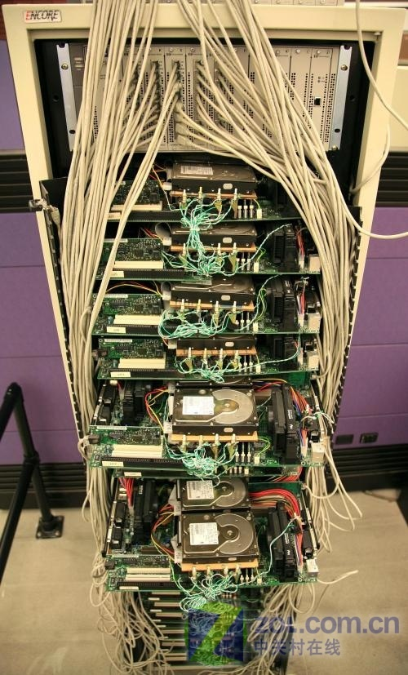
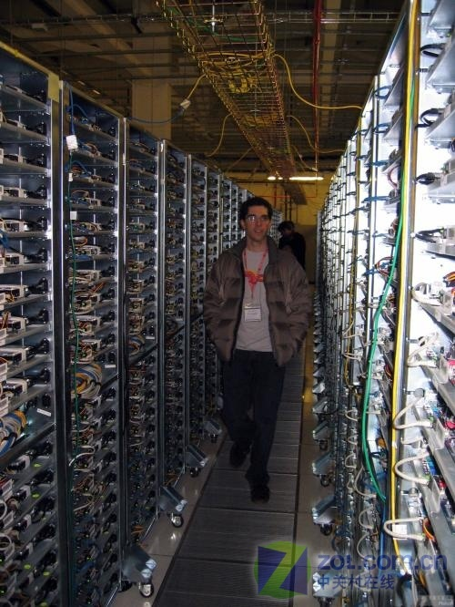
Google第一台服务器和现在
Lec08 IO Systems

Slide 22
Al Hoagland a pioneer of magnetic disks, (1982)
I think Silicon Valley was misnamed. If you look back at the dollars shipped in products in the last decade, there has been more revenue from magnetic disks than from silicon. They ought to rename the place Iron Oxide Valley.
Lec08 IO Systems
Notes:
revenue 收益、收入

Slide 23
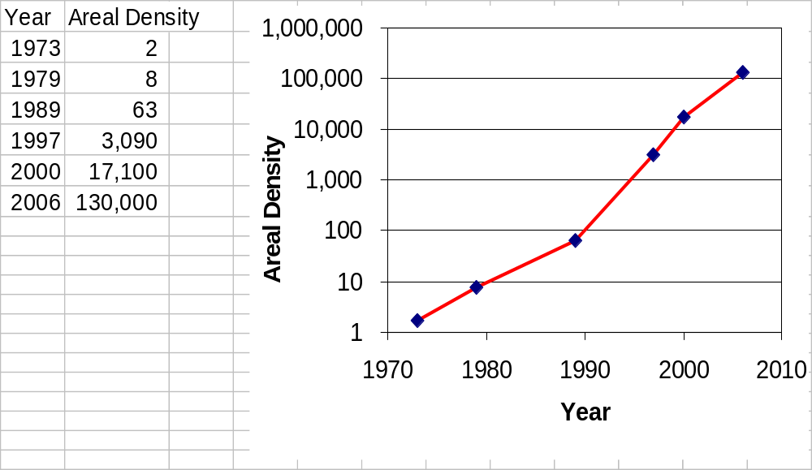
Disk Figure of Metric: Areal Density 磁路密度
Bits recorded along a track
  Metric is Bits Per Inch (BPI)
Number of tracks per surface
  Metric is Tracks Per Inch (TPI)
Disk designs brag about bit density per unit area
  Metric is Bits Per Square Inch: Areal Density = BPI x TPI
Lec08 IO Systems

Slide 24
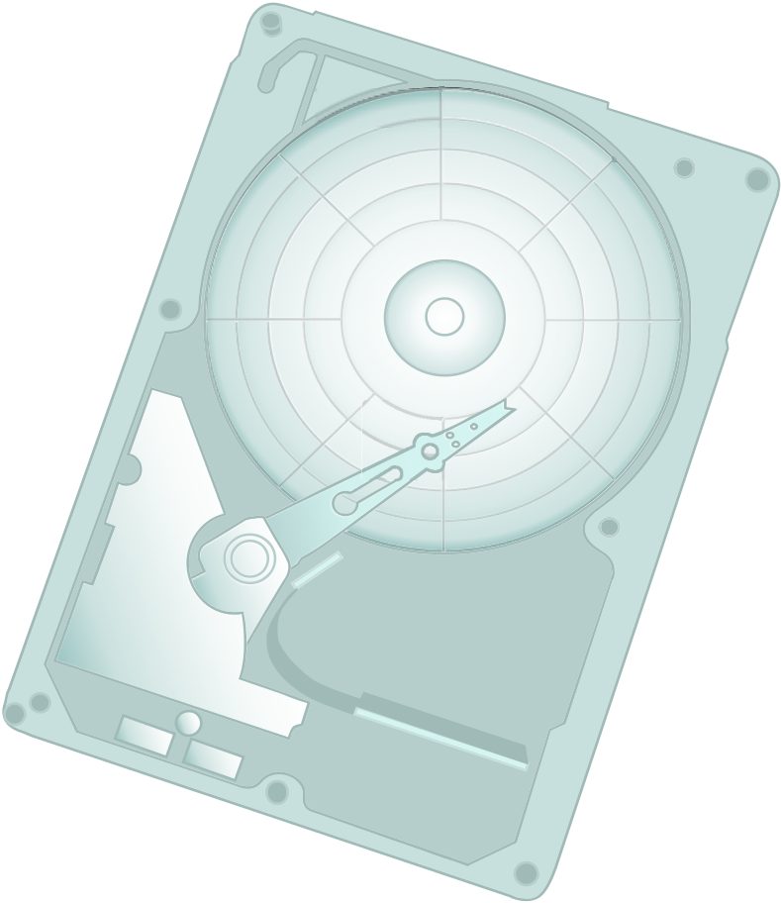
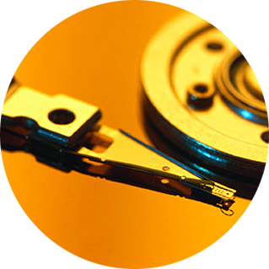
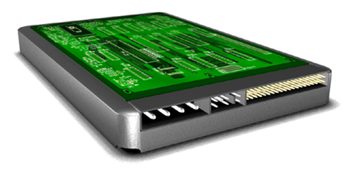
Disk Drive Components
Controller
HDA
Interface
Storage System Environment
Power
- <number>
Connector
Notes:
Copyright © 2009 EMC Corporation. Do not Copy - All Rights Reserved.
HDA是使用了ide接口的硬盘的名称.SDA是sata接口的硬盘的名称
在较早的Linux系统中，第一个IDE硬盘驱动器是/dev/hda

Slide 25


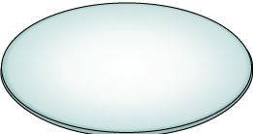
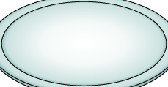
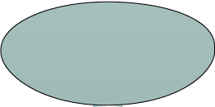




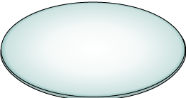
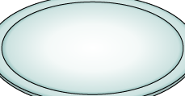
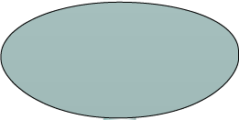




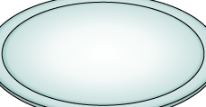




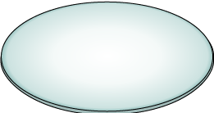
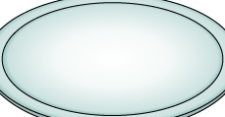
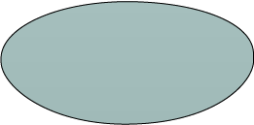


Physical Disk Structure
Spindle
Sector
Track
Sector
Cylinder
Track
Platter
- <number>
Storage System Environment
Notes:
Copyright © 2009 EMC Corporation. Do not Copy - All Rights Reserved.
Spindle：主轴。 Cylinder：柱面。 Platter：盘面

Slide 26
Logical Block Addressing
Sector 10
Block 0
Head 0
(Upper Surface)
Block 8
Cylinder 2
(Lower Surface)
Block 16
Block 32
Block 48
Physical Address= CHS
(a)
Logical Block Address= Block#
(b)
- <number>
Notes:
Copyright © 2009 EMC Corporation. Do not Copy - All Rights Reserved.
CHS寻址模式将硬盘划分为磁头（Heads）、柱面(Cylinder)、扇区(Sector)。
磁头(Heads)：每张磁片的正反两面各有一个磁头，一个磁头对应一张磁片的一个面。因此，用第几磁 头就可以表示数据在哪个磁面。
柱面(Cylinder)：所有磁片中半径相同的同心磁道构成“柱面"，意思是这一系列的磁道垂直叠在一起，就形成一个柱面的形状。简单地理解，柱面数=磁道数。
扇区(Sector)：将磁道划分为若干个小的区段，就是扇区。虽然很小，但实际是一个扇子的形状，故称为扇区。每个扇区的容量为512字节。

Slide 27
Disk Drive Performance
Electromechanical device
  Impacts the overall performance of the storage system
Disk Service Time
  Time taken by a disk to complete an I/O request is sum of
    Seek Time
    Rotational Latency
    Data Transfer Rate
- <number>
Storage System Environment
Notes:
Copyright © 2009 EMC Corporation. Do not Copy - All Rights Reserved.

Slide 28
Utilization vs. Response time
Knee of curve: disks at
about 70% utilization
Low Queue Size
0%
Utilization
70%
100%
Consider a disk I/O system in which an I/O request arrives at a rate of 100 I/Os per second. The service time, R_{s}, is 4 ms.
  Utilization of I/O controller (U=a × R_{s})
  Total response time (R=R_{s} /1-U)
Calculate the response time at different % of utilization
- <number>
Storage System Environment
Notes:
Copyright © 2009 EMC Corporation. Do not Copy - All Rights Reserved.

Slide 29
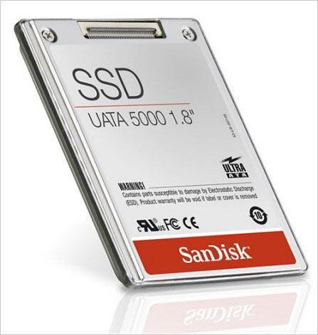
Historical Perspective
1956 IBM Ramac — early 1970s Winchester
  Developed for mainframe computers, proprietary interfaces
  Steady shrink in form factor: 27 in. to 14 in.
Form factor 型式 and capacity drives market more than performance
1970s developments
  8” & 5.25” floppy disk form factor (microcode into mainframe)
  Emergence of industry standard disk interfaces
Early 1980s: PCs and first generation workstations
Mid 1980s: Client/server computing
  Centralized storage on file server
    accelerates disk downsizing: 8 inch to 5.25
  Mass market disk drives become a reality
    industry standards: SCSI, IPI, IDE
    5.25 inch to 3.5 inch drives for PCs, End of proprietary interfaces
1990s: Laptops => 2.5 inch drives
2000s: What new devices leading to new drives?
Solid State Disk 固态硬盘
Lec08 IO Systems
Notes:
固态硬盘的存储介质分为两种，一种是采用闪存（FLASH芯片）作为存储介质，另外一种是采用DRAM作为存储介质。

Slide 30
Flash: The future of disks?
Advent of digital cameras, mp3 players, has driven market for low-cost non-volatile flash memory (Other promising technologies in development: phase-change RAM, magnetic RAM (core returns!), but flash has big lead)
In 2007, several announcements of flash-based disk replacement for laptops/servers (SanDisk, Samsung, I/O fusion, …)
Potential benefit of flash hidden behind standard disk interface
  Scope for massive rethinking of storage architecture if non-volatile moves into memory hierarchy and accessed via processor loads/stores not seek/read/write
Lec08 IO Systems

Slide 31
Flash: The future of disks?(Cont.)
Flash drive advantages:
  Lower power (no moving parts)
  Much faster seek time, 100X IOs per second (no moving parts)
  Greater reliability (no moving parts)
  Lower noise (no moving parts)
Flash disadvantages
  Cost (20-100x disk cost/GB)
  Slow writes with current design (competitive with disks)
  write endurance - not an issue for most applications since use write-leveling to spread wear around blocks on chip
Lec08 IO Systems
Notes:
Wear：磨损

Slide 32
Future Disk Size and Performance
Continued advance in capacity (60%/yr) and bandwidth (40%/yr)
Slow improvement in seek, rotation (8%/yr)
Time to read whole disk
Year Sequentially Randomly
(1 sector/seek)
1990 4 minutes 6 hours
2000 12 minutes 1 week(!)
2006 56 minutes 3 weeks (SCSI)
2006 171 minutes 7 weeks (SATA)
As of 2012, 2.5-inch and 3.5-inch hard disks were the most popular sizes. Largest capacity = 4T
Lec08 IO Systems
Notes:
Capacity: 80 GB * 2^5 = 2.5 TB
BW 30 MB/s * 1.4^5 = 160 MB/s
seek 6 / 1.1^5 = 4 ms
RPM每分钟转数 10000 => 20000? (3 to 1.5)
to read sequentially = 260 minutes or 4.4 hours!
To read randomly = 316 days or 1 year

Slide 33
Contents
I/O Buses
Disk Storage
RAID
Storage Systems
IO Performance
Lec08 IO Systems

Slide 34
Use Arrays of Small Disks?
Katz and Patterson asked in 1987:
  “Can smaller disks be used to close gap in performance between disks and CPUs?”
Conventional: 4 disk designs
3.5”
5.25”
10”
14”
Low End
High End
Disk Array: 1 disk design
3.5”
Lec08 IO Systems

Slide 35
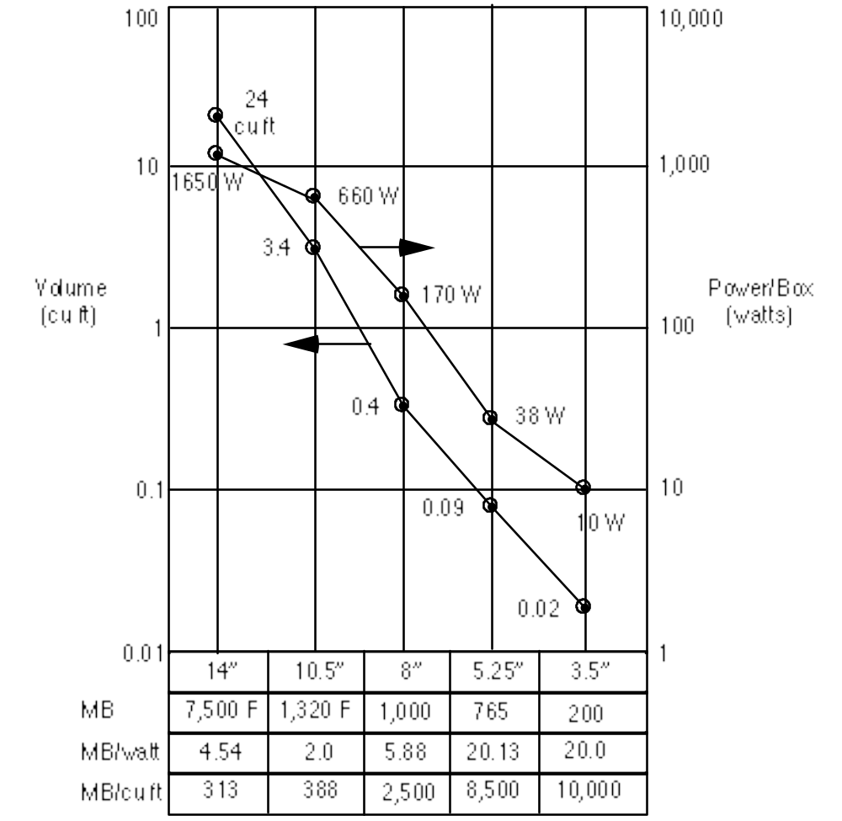
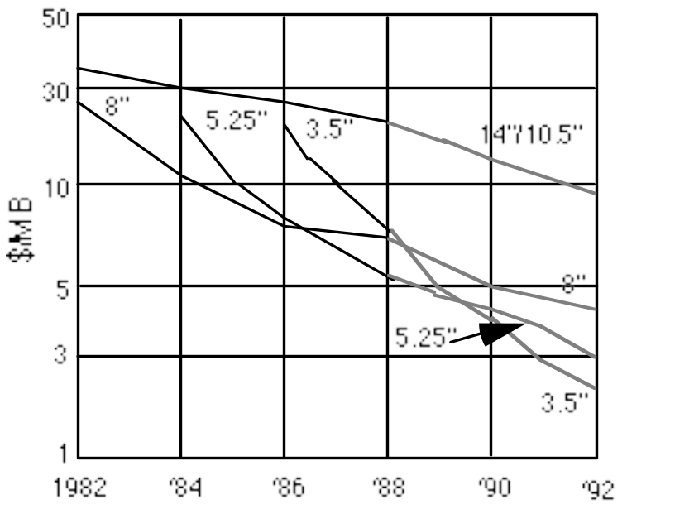
Advantages of Small Formfactor Disk Drives
CUFT = CUBIC FEET
Low cost/MB
High MB/volume
High MB/watt
Low cost/Actuator
传动装置
Cost and Environmental Efficiencies
Lec08 IO Systems
Notes:
Actuator 动臂机构，传动器，传动装置
1立方英尺的英文缩写CUFT： CUBIC FEET

Slide 36
Replace Small Number of Large Disks with Large Number of Small Disks! (1988 Disks)
IBM 3390K
20 GBytes
97 cu. ft.
3 KW
15 MB/s
600 I/Os/s
250 KHrs
$250K
IBM 3.5" 0061
320 MBytes
0.1 cu. ft.
11 W
1.5 MB/s
55 I/Os/s
50 KHrs
$2K
x70
23 GBytes
11 cu. ft.
1 KW
120 MB/s
3900 IOs/s
??? Hrs
$150K
Capacity
Volume
Power
Data Rate
I/O Rate
MTTF
Cost
9X
3X
8X
6X
Disk Arrays have potential for large data and I/O rates, high MB per cu. ft., high MB per KW, but what about reliability?
1立方英尺CUFT： CUBIC FEET
MTTF 平均无故障时间
Lec08 IO Systems
Notes:
Volume 体积
对外存储系统而言,I/O率是一个非常重要的指标,计算机系统的I/O瓶颈主要对此而言。
磁盘阵列存储系统的主要设计目标之一就是提高I/O率,以缓解甚至彻底突破I/O瓶颈。

Slide 37
反映存储外设可靠性能的参数
系统可靠性（Reliability）
  系统从初始状态开始一直提供服务的能力
  用平均无故障时间MTTF (Mean Time to Failure) 来衡量
系统可用性（Availability）
  系统正常工作时间在连续两次正常服务间隔时间中所占的比率,用MTTF / MTTF + MTTR （Mean Time To Repair, 平均修复时间）来衡量
  MTTF + MTTR = MTBF（Mean Time Between Failure, 平均故障间隔时间）
系统可信性（Dependability）
  多大程度上可以合理地认为服务是可靠的
  可信性不可度量
Lec08 IO Systems
Notes:
可信度量，没有准确数学描述

Slide 38
Array Reliability
Reliability of N disks = Reliability of 1 Disk ÷ N
  50,000 Hours ÷ 70 disks = 700 hours
Disk system MTTF: Drops from 6 years to 1 month!
• Arrays (without redundancy) too unreliable to be useful!
Hot spares （热备件）support reconstruction in parallel with access:
very high media availability can be achieved
Lec08 IO Systems
Notes:
热备份(Hot Spare)：与CPU系统电连接的硬盘，它能替换下系统中的故障盘。与冷备份的区别是，冷备份盘平时与机器不相连接，硬盘故障时才换下故障盘。
热修复(Hot Fix)：指用一个硬盘热备份来替换发生的故障的硬盘。要注意故障盘并不是真正地被物理替换了。用作热备份的盘被加载上故障盘原来的数据，然后系统恢复工作。

Slide 39
Redundant Arrays of (Inexpensive) Disks
廉价磁盘冗余阵列
Files are “striped” 条带 across multiple disks
Redundancy yields high data availability 可用性
  Availability: service still provided to user, even if some components failed
Disks will still fail
Contents reconstructed from data redundantly stored in the array
  ⇒ Capacity penalty 损失 to store redundant info
  ⇒ Bandwidth penalty to update redundant info
Lec08 IO Systems
Notes:
Redundant Arrays of Independent Disks

Slide 40
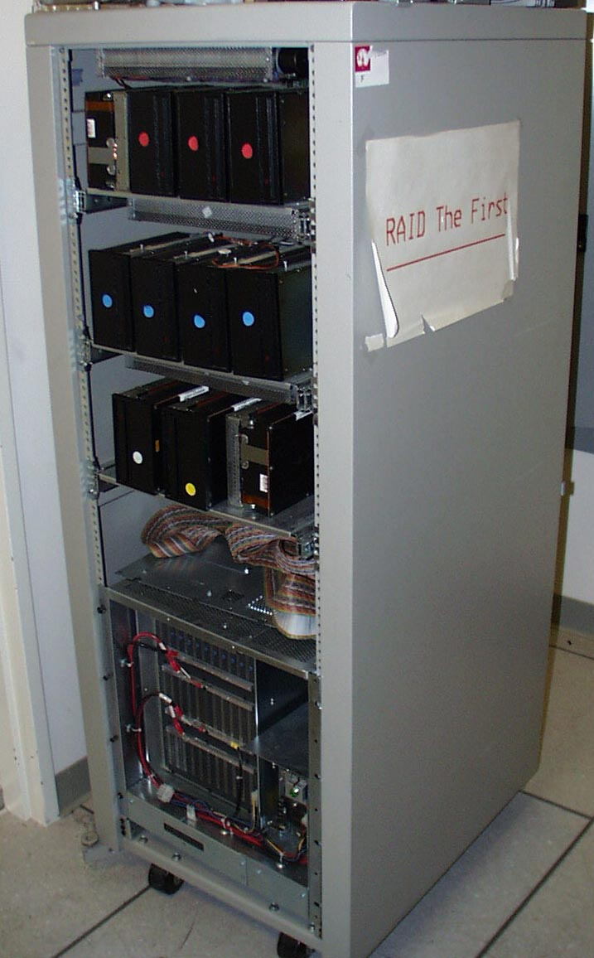
Berkeley History: RAID-I
RAID-I (1989)
  Consisted of a Sun 4/280 workstation with 128 MB of DRAM, four dual-string SCSI controllers, 28 5.25-inch SCSI disks and specialized disk striping software
Today RAID is $24 billion dollar industry, 80% nonPC disks sold in RAIDs
Lec08 IO Systems

Slide 41
RAID 0：严格说，不属于RAID系列
逻辑盘
物理盘
0
物理盘
1
物理盘
2
物理盘
3
条带
0
Strip
条带
0
条带
1
条带
2
条带
3
条带
1
条带
4
条带
5
条带
6
条带
7
条带
2
条带
8
条带
9
条带
10
条带
11
条带
3
条带
4
条带
5
条带
6
条带
7
阵列管理
条带
8
条带
9
◆ 数据分块，即把数据分布在多个盘上。
◆ 非冗余阵列、无冗余信息。
条带
10
条带
11
Lec08 IO Systems

Slide 42
RAID 1: Disk Mirroring/Shadowing
recovery
group
• Each disk is fully duplicated onto its “mirror”
Very high availability can be achieved
• Bandwidth sacrifice on write:
Logical write = two physical writes
• Reads may be optimized 读性能好
• Most expensive solution 最昂贵的解决方案:
100% capacity overhead
Lec08 IO Systems

Slide 43
RAID2：位交叉式海明编码阵列
各个数据盘上的相应位计算海明Hamming 校验码，编码位被存放在多个校验（Ecc）磁盘的对应位上。
A0
A1
A2
A3
Ecc/Ax
Ecc/Ay
Ecc/Az
B0
B1
B2
B3
Ecc/Bx
Ecc/By
Ecc/Bz
C0
C1
C2
C3
Ecc/Cx
Ecc/Cy
Ecc/Cz
D0
D1
D2
D3
Ecc/Dx
Ecc/Dy
Ecc/Dz
需要多个磁盘来存放海明校验码信息，冗余磁盘数量与数据磁盘数量的对数成正比（log₂m，m为数据盘的个数）。
并未被广泛应用，目前还没有商业化产品
Lec08 IO Systems

Slide 44
RAID 3: Bit-interleaved Parity Disk
位交叉奇偶校验盘阵列
10100011
11001101
10100011
. . .
P
logical record
1
0
1
0
0
0
1
1
1
1
0
0
1
1
0
1
1
0
1
0
0
0
1
1
1
1
0
0
1
1
0
1
Striped physical
records
P contains sum of
other disks per stripe
mod 2 (“parity”)
If disk fails, subtract
P from sum of other
disks to find missing information
Lec08 IO Systems

Slide 45
RAID 3
单盘容错并行传输 Logically, a single high capacity, high transfer rate disk: good for large transfers
Sum computed across recovery group to protect against hard disk failures, stored in P disk
33% capacity cost for parity if 3 data disks and 1 parity disk
保护组中有N个数据盘的冗余代价为1/N （冗余盘和数据盘之比）。
Wider arrays reduce capacity costs, but decreases reliability/availability
Lec08 IO Systems

Slide 46
RAID3 读写特点？？
  假定：有4个数据盘和一个冗余盘
  ◆ 读出数据，一共需要5次磁盘读操作；
  ◆ 写数据需要3次磁盘读和2次磁盘写操作。
读操作
读操作
读操作
D0 '
D0
D1
D2
D3
P
异或
D0 '
D1
D2
D3
P '
写操作
写操作
Lec08 IO Systems
Notes:
写数据：假设写到D0中，则需要读D1, D2, D3的数据，异或后写入

Slide 47
Inspiration（灵感） for RAID 4
块交叉奇偶校验磁盘阵列
RAID 3 relies on parity disk to discover errors on Read
RAID 4 数据以块（块大小可变）交叉的方式存于各盘， 奇偶校验信息存在一台专用盘上，冗余代价与RAID3相同，访问数据的方法与RAID3不同。
But every sector (扇区)has an error detection field（检错码）——每个磁盘独立的进行读操作；Allows independent reads to different disks simultaneously
To catch errors on read, rely on error detection field vs. the parity disk
在RAID3中，一次磁盘访问将对磁盘阵列中的所有磁盘进行操作。RAID4出现的原因：希望使用较少的磁盘参与操作，以使磁盘阵列可以并行进行多个数据的磁盘操作。
Lec08 IO Systems
Notes:
（专用奇偶校验独立存取盘阵列）

Slide 48

RAID 4: High I/O Rate Parity
Increasing
Logical
Disk
Address
D0
D1
D2
D3
P
Insides of 5 disks
D4
D5
D6
D7
P
此时D0…是一个数据块，不是RAID3中的数据位
D8
D9
D10
D11
P
Example:
small read D0 & D5,
large write D12-D15
D12
D13
D14
D15
P
Stripe
D16
D17
D18
D19
P
large write 写的内容超出一个磁盘，会引起奇偶盘的复杂操作
D20
D21
D22
D23
P
.
.
.
.
.
.
.
.
.
.
.
.
.
.
.
Disk Columns
Notes:
Large write 应该是指要写出的内容超出一个磁盘，会引起奇偶盘的复杂操作

Slide 49
Inspiration for RAID 5
RAID 4 works well for small reads
Small writes (write to one disk):
  Option 1: read other data disks, create new sum and write to Parity Disk
  Option 2: since P has old sum, compare old data to new data, add the difference to P
Small writes are limited by Parity Disk: Write to D0, D5 both also write to P disk
D0
D1
D2
D3
P
D4
D5
D6
D7
P
Lec08 IO Systems

Slide 50
RAID 5: High I/O Rate Interleaved Parity
块交叉分布式奇偶校验盘阵列
D0
D1
D2
D3
P
Increasing
Logical
Disk
Addresses
Independent writes
possible because of
interleaved parity
D4
D5
D6
P
D7
D8
D9
P
D10
D11
D12
P
D13
D14
D15
数据以块交叉的方式存于各盘，无专用冗余盘，奇偶校验信息均匀分布在所有磁盘上。
Example: write to D0, D5 uses disks 0, 1, 3, 4
P
D16
D17
D18
D19
D20
D21
D22
D23
P
.
.
.
.
.
.
.
.
.
.
.
.
.
.
.
Disk Columns

Slide 51
Problems of Disk Arrays: Small Writes
RAID-5: Small Write Algorithm
1 Logical Write = 2 Physical Reads + 2 Physical Writes
D0'
D0
D1
D2
D3
P
new
data
old
data
old
parity
(1. Read)
(2. Read)
+
XOR
+
XOR
(3. Write)
(4. Write)
D0'
D1
D2
D3
P'

Slide 52
RAID 6: Recovering from 2 failures
双维奇偶校验独立存取盘阵列
Why > 1 failure recovery?
  operator accidentally replaces the wrong disk during a failure
  since disk bandwidth is growing more slowly than disk capacity, the Mean Time To Repair a disk in a RAID system is increasing 恢复数据
  ⇒increases the chances of a 2nd failure during repair since takes longer (MTBF)
  reading much more data during reconstruction meant increasing the chance of an uncorrectable media failure, which would result in data loss
Lec08 IO Systems

Slide 53
RAID6 特点
1. 双维奇偶校验独立存取盘阵列
2. 数据以块（块大小可变）交叉方式存于各盘，检、纠错信息均匀分布在所有磁盘上。
3. RAID6 特点
  ◆在RAID5的基础上增加了一个独立的校验信息，放在另一个校验盘中；
  ◆ 写入数据要访问1个数据盘和2个冗余盘；
  ◆ 可容忍双盘出错；
  ◆ 存储开销是RAID5的两倍，RAID6的写过
  程需要6次磁盘操作（3读3写）。
Lec08 IO Systems

Slide 54
Summary: RAID Techniques: Goal was performance, popularity due to reliability of storage
• Disk Mirroring, Shadowing (RAID 1)
1
0
0
1
0
0
1
1
1
0
0
1
0
0
1
1
Each disk is fully duplicated onto its "shadow"
Logical write = two physical writes
100% capacity overhead
• Parity Data Bandwidth Array (RAID 3)
1
0
0
1
0
0
1
1
1
1
0
0
1
1
0
1
1
0
0
1
0
0
1
1
0
0
1
1
0
0
1
0
Parity computed horizontally
Logically a single high data bw disk
• High I/O Rate Parity Array (RAID 5)
Interleaved parity blocks
Independent reads and writes
Logical write = 2 reads + 2 writes
Lec08 IO Systems

Slide 55
RAID的实现
实现盘阵列的方式主要有三种：
◆ 软件方式：阵列管理软件由主机来实现
优点：成本低；
缺点：过多地占用主机时间，带宽指标上不去。
◆ 阵列卡方式：把RAID管理软件固化在I/O控制卡上，从而可不占用主机时间，一般用于工作站和PC机。
◆ 子系统方式：这是一种基于通用接口总线的开放式平台，可用于各种主机平台和网络系统。
Lec08 IO Systems

Slide 56
Contents
I/O Buses
Disk Storage
RAID
Storage Systems
IO Performance
Lec08 IO Systems

Slide 57
Connectivity Protocols
Protocol = a defined format for communication – allows the sending and receiving devices to agree on what is being communicated.
Tightly
Connected
Entities
Directly
Attached
Entities
Network Connected
Entities
  Tightly connected entities – such as central processor to RAM, or storage buffers to controllers – use standard BUS technology;
  Directly attached entities are devices connected at moderate distances – such as host to printer or host to storage (Just a Bunch Of Disks (JBOD磁盘簇) or Direct Attached Storage (DAS))
  Network connected entities – such as networked hosts, Network Attached Storage (NAS) or Storage Area Networks (SAN)
Notes:
Protocol is a defined format, in this case for communication between hardware or software components.
Communication protocols are defined for systems and components that are:
Tightly connected entities – such as central processor to RAM, or storage buffers to controllers – use standard BUS technology (e.g. System bus or I/O – Local Bus).
Directly attached entities are devices connected at moderate distances – such as host to printer or host to storage (JBOD or Direct Attached Storage (DAS))
Network connected entities – such as networked hosts, Network Attached Storage (NAS) or Storage Area Networks (SAN)
We will discuss the communication protocols (logical components) found in each of these connectivity models. Let’s start with the tightly connected or bus protocols.

Slide 58
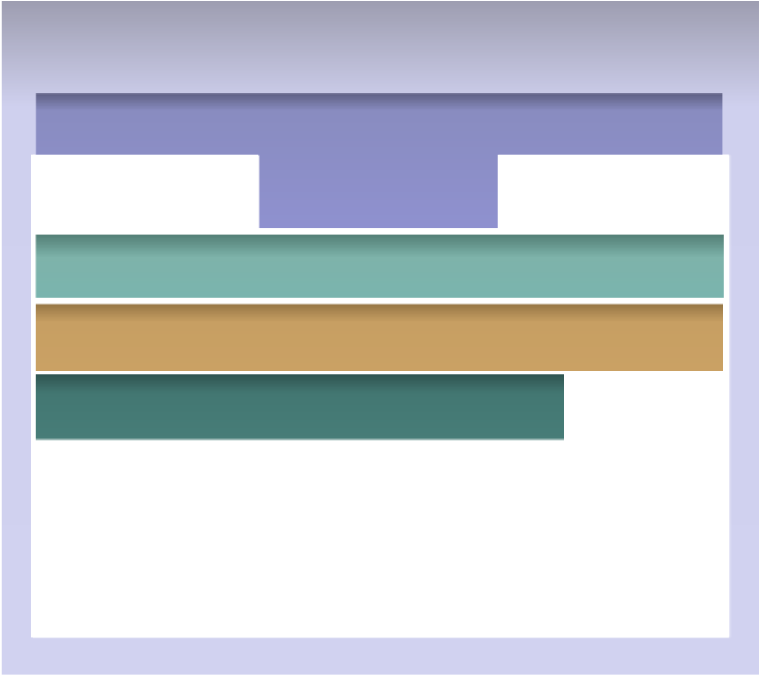
Communication Protocols
Host
Apps
Operating System
PCI
SCSI or IDE/ATA Device Drivers
Notes:
The protocols for the local (I/O) bus and for connections to an internal disk system include:
PCI
IDE/ATA
SCSI
Let’s look at each.

Slide 59
Bus Technology - PCI
Peripheral Component Interconnect (PCI) defines the local bus system within a computer
It is an interconnection between microprocessor and attached devices, in which expansion slots are spaced closely for high-speed operation.
Has Plug and Play functionality.
PCI is 32/64 bit
Throughput is 133 MB/sec
Notes:
The Peripheral Component Interconnect (PCI) is a specification defining the local bus system within a computer. The specification standardizes how PCI expansion cards, such as network cards or modems, install themselves and exchange information with the central processing unit (CPU).
In more detail, a Peripheral Component Interconnect (PCI) includes:
an interconnection system between a microprocessor and attached devices, in which expansion slots are spaced closely for high-speed operation.
plug and play functionality that makes it easy for a host to recognize a new card
32 or 64 bit data
a throughput of 133 MB/sec.
PCI Express is an enhanced PCI bus with increased bandwidth.

Slide 60
IDE/ATA
Integrated Device Electronics (IDE) / Advanced Technology Attachment (ATA)
Most popular interface used with modern hard disks
Good performance at low cost
Desktop and laptop systems
Inexpensive storage interconnect
Notes:
The most popular interface protocol used in modern hard disks is the one most commonly known as IDE. This interface is also known as ATA.
IDE/ATA hard disks are used in most modern PCs, and offer excellent performance at relatively low cost.

Slide 61
SCSI - Small Computer System Interface
Most popular hard disk interface for servers.
Higher cost than IDE/ATA.
Supports multiple simultaneous data access.
Currently both parallel and serial forms.
Used primarily in “higher end” environments.
Notes:
Small Computer Systems Interface (SCSI)
The second-most popular hard disk interface protocol used in PCs today is SCSI. It has several advantages over IDE that make it preferable for many situations such as in higher-end machines. It is far less commonly used than IDE/ATA, due to its higher cost and the fact that its advantages are not useful for the typical home, or business desktop user.
It's important to remember that SCSI is a system interface. SCSI began as a parallel interface, allowing the connection of devices to a PC, or other systems, with data being transmitted across multiple data lines. SCSI itself, however, has been broadened greatly in terms of its scope, and now includes a wide variety of related technologies and standards.

Slide 62
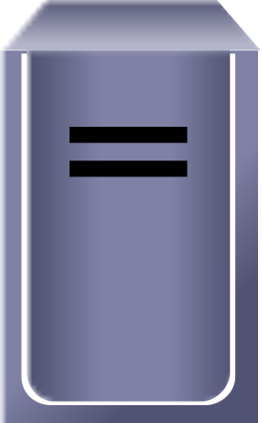
SCSI Model
Target
Initiator
A SCSI device that starts a communication is an initiator.
A SCSI device that services a request is a target.
Notes:
A SCSI device that starts a communication is an initiator.
A SCSI device that services a request is a target.
Note: If the initiator is a host, it will release the communication connection and continue processing other events while the target (usually a slower mechanical disk) executes the command. The host will await an interrupt signal from the storage device to complete the transaction.

Slide 63
SCSI Model
Target ID
LUNs
Initiator ID
Components of a SCSI communication include:
  Initiator ID – uniquely identifies an initiator that is used as an “originating address”.
  Target ID – uniquely identifies a target. Used as the address for exchanging commands and status information with initiators.
  Logical Unit Numbers (LUNs) – identifies a specific Logical Unit in a target. Logical Units can be more than a single disk.
Notes:
Components of a SCSI communication include:
Initiator ID – uniquely identifies an initiator that is used as an “originating address”.
Target ID – uniquely identifies a target. Used as the address for exchanging commands and status information with initiators.
Logical Unit Numbers (LUNs) – identifies a specific Logical Unit in a target. Logical Units can be more than a single disk.

Slide 64
SCSI Addressing
Initiator ID
Target ID
LUN
Initiator ID - the original initiator ID number; a number from 0 to 15 with the most common value being 7.
Target ID - Value for a specific storage device; a number from 0 to 15.
LUN - Logical Unit Number of the device; a number that specifies a device addressable through a target.
Notes:
Initiator ID = the original initiator ID number (used to send responses back to the initiator from the storage device). A SCSI host bus adapter (referred to as a controller) can be implemented in two ways:
An onboard interface or
An ‘add in’ card plugged into the system I/O bus.
Target ID = Value for a specific storage device. An address that is set on the interface of the device such as a disk, tape or CDROM.
LUN = Logical Unit Number of the device – reflects the actual address of the device, as seen by the target.

Slide 65
Disk Identifier - Addressing
Host Addressing
  Controller
  Target
  LUN
c0 t0 d0
t0
LUNs
Peripheral
Controller
d0
d1
d2
Target
c0 - Controller
Initiator, HBA
Notes:
For example, a logical device name (used by a host) for a disk drive may be: cn|tn|dn where
cn is the controller
tn is the target ID of the devices such as t0, t1, t2 and so on
dn is the device number, which reflects the actual address of the device unit. This is usually d0 for most SCSI disks because there is only one disk attached to the target controller. In intelligent storage systems, discussed later, each target may address many LUNs.

Slide 66
SCSI - Pros and Cons
Pros:
  Fast transfer speeds, up to 320 megabytes per second
  Reliable, durable components
  Can connect many devices with a single bus, more than just HDs
  SCSI host cards can be put in almost any system
  Full backwards compatibility
Cons:
  Configuration and setup specific to one computer
  Unlike IDE, few BIOS support the standard
  Overwhelming number of variations in the standard, hardware, and connectors
  No common software interfaces and protocol
Notes:
SCSI has many significant advantages in relation to IDE. SCSI
Has a faster transfer speed (Note: 320 MB/s refers to parallel SCSI. Serial SCSI may be different.)
Has robust software and hardware
Can connect many devices to a computer
Allows SCSI Host Adapter cards to be put into almost any system, and
SCSI supports a remarkable level of backwards compatibility.

Slide 67
Comparison IDE/ATA vs SCSI
Feature
IDE/ATA
SCSI
Connectivity Market
Internal Storage
Internal and External Storage
Speed (MB/sec)
100/133/150
320
Hot Pluggable
No
Yes
Expandability
Easier to set up
Very good but very
expensive to set up
Cost/Performance
Good
High cost/Fast
transfer speed
Notes:
Expandability and Number of Devices, SCSI is superior to IDE/ATA. This advantage of SCSI only matters if you actually need this much expansion capability, because SCSI is more involved and expensive to set up.
Device Type Support – SCSI holds a significant advantage over IDE/ATA in terms of the types of devices each interface supports.
Cost – the IDE/ATA interface is superior to the SCSI interface.
Performance – These factors influence system performance for both interfaces:
Maximum Interface Data Transfer Rate: Both interfaces presently offer very high maximum interface rates, so this is not an issue for most PC users. However, if you are using many hard disks at once, for example in a RAID array, SCSI will offer better overall performance.
Device-Mixing Issues: IDE/ATA channels that mix hard disks and CD-ROMs are subject to significant performance hits due to the fact that these devices are operating at different speeds (hard disks read and write relatively quickly when compared to CDROM drives) and the IDE channel that can only support a single device at a time, must wait for the slower Optical drive to complete a task. SCSI does not have this problem.
Device Performance: When looking at particular devices, SCSI can support multiple devices simultaneously while IDE/ATA can only support a single device at a time.
Configuration and set-up – IDE/ATA is easier to set up, especially if you are using a reasonably new machine and only a few devices. SCSI has a significant advantage over IDE/ATA in terms of hard disk addressing issues.

Slide 68


Physical Components – Host with External Storage
Port
Bus
CPU
Host
HBA
Host Bus Adapter
主机总线适配器
Cable
Port
CPU
BUS
HBA
Cable
Disk
Disk
Port
Notes:
A host with external storage is usually a large enterprise server. Most of the components are internal to the host enclosure, though the cable and disk(s) will be external. Components are identical to those of a host with internal storage.
.

Slide 69


Fibre Channel
Host
Apps
DBMS
Mgmt Utils
File System
LVM
Multipathing Software
Device Drivers
HBA
HBA
HBA
Fibre Channel
Storage Arrays
Notes:
Fibre Channel is a high–speed interconnect used in networked storage to connect servers to shared storage devices. Fibre Channel components include HBAs, hubs, switches, cabling., and disks.
The term Fibre Channel refers to both the hardware components and the storage protocol that communicates across the channel elements.

Slide 70
External Storage Interfaces
– A Comparison
SCSI
  Limited distance
  Limited device count
  Usually limited to single initiator
  Single-ported drives
Fibre Channel
  Greater distance
  High device count in SANs
  Multiple initiators
  Dual-ported drives
Notes:
The 2 most popular interfaces for external storage devices are SCSI and Fibre Channel (FC). SCSI is also commonly used for internal storage in hosts; FC is almost never used internally.

Slide 71

Fibre Channel Connectivity
Hosts
Switches
Storage
sophisticated equipment to connect hosts to storage devices
Notes:
When computing environments require high speed connectivity, they use sophisticated equipment to connect hosts to storage devices.
Physical connectivity components in networked storage environments include:
HBA (Host-side interface) – Host Bus Adapters connect the host to the storage devices.
Optical cables – fiber optic cables to increase distance, and reduce cable bulk.
Switches – used to control access to multiple attached devices
Directors – sophisticated switches with high availability components
Bridges – connections to different parts of a network.

Slide 72
Disk Based Storage
From a historical perspective, we will explore the following disk based storage solutions:
  DASD: Direct Access Storage Device
  JBOD: “Just a Bunch Of Disks”
  Disk Arrays
  “Intelligent” Disk Arrays
Notes:
Disk drives, since their inception, have been the preferred media for storing data. The growth of data demanded larger and larger capacities of these drives leading to the media storage array. An array is capable of serving data to multiple severs concurrently. As data storage needs started exceeding the capacities of individual drives, solutions emerged to make a collection of drives available to either a single server or multiple servers. The components of the modern arrays with built-in intelligence will be discussed in Section 2.

Slide 73
Types of Disk Systems: DASD
Disk
Mainframe
Introduced by IBM in 1956.
The ‘oldest’ of the techniques for accessing disks from a host computer.
Disks are accessed directly by a single host, historically a mainframe system.
Notes:
DASD – Direct Access Storage Device (Originally introduced by IBM in 1956) is the ‘oldest’ of the techniques for accessing disks from a host computer. Disks are directly accessed from the host (historically a mainframe system) and tightly coupled to the host environment. A hard drive in a personal computer is an example of a DASD system. Typically one can view the DASD as a one-to-one relationship between a server/computer and its disk drive.
All access to the data on the disk has to be routed through the server/computer. Prior to the advent of networking technologies, such routing involved submission of a job request to the operators. Whereas the server/computer had direct access to data, the individual did not. In addition to the inconvenience of locating and loading the correct reels/cartridges of tape, DASD disk packs had to be swapped in and out for specific job runs. Despite their slowness, they did offer a faster alternative than tapes. If a disk in the pack failed, all data was lost or at the very least was suspect.

Slide 74

Types of Disk Systems: JBOD
Multiple physical disks in an external cabinet.
Array connects to a single server only.
Provides higher storage capacity with increased number of drives.
Data not protected by JBOD
Host
Disk
Disk
Disk
Disk
Disk
Array
Notes:
JBOD is an acronym for “just a bunch of disks”. The drives in a JBOD array can be independently addressed and accessed by the Server.

Slide 75
Types of Disk Systems: Disk Arrays
Array controllers for optimized I/O operations and RAID calculations.
Higher speed interconnects between drives than JBODs.
Multiple host I/O channels.
Can be partitioned to allow each host to access its own set of drives.
Host A
Host B
Host C
Disk Array
Controller
Disk 1
Disk 2
Disk 3
Disk 4
Disk 5
Host A
Host B
Host C
Notes:
Disk arrays extend the concept of JBODs by improving performance and reliability. They have multiple host I/O ports. This enables connecting multiple hosts to the same disk array. Array management software allows the partitioning or segregation of array resources, so that a disk or group of disks can be allocated to each of the hosts. Typically they have controllers that can perform RAID (Redundant Array of Independent Disks) calculations.

Slide 76
Types of Disk Systems: “Intelligent” Disk Arrays
Highly optimized for I/O processing.
Cache for improving I/O performance.
Operating environments provide:
  Intelligence for managing Cache,
  Array resource allocation,
  Host access to Array resources,
  Connectivity for heterogeneous Hosts
Host B
Host C
Host A
Disk Array
Controller
Disk 1
Disk 2
Disk 3
Disk 4
Disk 5
Notes:
Intelligent Disk Arrays have an operating environment. This can be viewed as an “operating system” for the array. They also have large amounts of Cache. Sophisticated algorithms manage Cache to optimize the read/write requests from the Hosts. Large capacity drives can be partitioned or “sliced” into smaller units. These smaller units in turn can be presented to Hosts as individual disk drives. Array management software can also enable multiple hosts to access the array via the same I/O channel. The operating environment ensures that each host can only access the disk resources allocated to it.

Slide 77
Storage Environment
Upon completion of this lesson, you will be able to:
Describe Direct Attached Storage (DAS) features.
Describe Storage Area Network (SAN) features.
Describe Network Attached Storage (NAS) features.
Notes:
There are different types of Storage Environments:
DAS – Direct Attached Storage
Networked Storage:
Storage Area Network – SAN
Network Attached Storage – NAS

Slide 78




Direct Attached Storage – DAS
Client 1
Server A
Application A
Disks for Server A
Local Area
Network
Disks for Server B
Client 2
Server B
Application B
Disks for Server C
Client 3
Servers connect directly to the disk array typically via a SCSI interface.
Server C
Application C
Notes:
In a Direct Attached Storage (DAS) environment, servers connect directly to the disk array typically via a SCSI interface. The same connectivity port on the Disk array cannot be shared between multiple servers. Clients connect to the Servers through the Local Area Network The distance between the Server and the Disk array is governed by the SCSI limitations. With the advent of Storage Area Networks and Fibre Channel interface, this method of Disk array access is becoming less prevalent.

Slide 79
Network Attached Storage – NAS
Server A
File System A
Client 1
NAS Device A
File System A
Disks for File System A
Local Area
Network
Internal/External connectivity
to disks or arrays
Client 2
NAS Device B
File System B
Disks for File System B
Client 3
NAS Devices access the disks in an array via direct connection or through external connectivity
Server B
File System B
Notes:
In a Network Attached Storage (NAS) environment, NAS Devices access the disks in an array via direct connection or through external connectivity. The NAS heads are optimized for file serving. They are setup to export/share file systems. Servers called NAS clients access these file systems over the Local Area Network (LAN) to run applications. The clients connect to these servers also over the LAN.

Slide 80
Storage Area Network – SAN
Client 1
Server A
Application A
Disks for Server A
Local Area
Network
SAN
Client 2
Disks for Server B
Server B
Application B
Disks for Server C
Client 3
Disk Array
Server C
Application C
Servers access the disk array through a dedicated network designated as SAN (consists of Fibre Channel switches )
Notes:
In a Storage Area Network (SAN) environment, servers access the disk array through a dedicated network designated as SAN in the slide. SAN consists of Fibre Channel switches that provide connectivity between the servers and the disk array. In this model, multiple servers can access the same Fibre Channel port on the disk array. The distance between the server and the disk array can also be greater than that permitted in a direct attached SCSI environment. Clients communicate with the servers over the Local Area Network (LAN).

Slide 81
In this Section …
This section contains the following modules:
  Direct Attached Storage (DAS)
  Networked Attached Storage (NAS)
  Fibre Channel Storage Area Networks (FC SAN)
  IP Storage Area Networks (IP SAN)
  Content Addressed Storage (CAS)
Notes:
Direct Attached Storage (DAS) - storage devices directly connected host either via an internal or external connection.
Network Attached Storage (NAS) - storage devices accessed over a network, in front of the server. Is made up of computing/storage devices running an operating system that has been optimized for file service.
Storage Area Network (SAN) - a dedicated network that carries data between computer systems and storage devices.
Content Addressed Storage (CAS) – an object-oriented, location independent approach to data storage. It can be implemented using a number of different technologies.

Slide 82


Block Storage over IP – Protocol options
iSCSI
  SCSI over IP
    IP encapsulation done on host / HBA
    Hardware-based gateway to Fibre Channel storage
FCIP
  Fibre Channel-to-IP bridge / tunnel (point to point)
    Fibre Channel end points
iFCP
  IP as the inter-switch fabric
    Fibre Channel end points
IP
FC
IP
IP
FC
IP
IP
FC
IP
FC/
IP
IP/ FC
IP
FC/
IP
IP/
FC
Notes:
“Block storage over IP” represents several different approaches to moving block-level (channel) I/O over IP networks. The three protocols that are gaining most visibility today are iSCSI, FCIP, and iFCP. Each of these protocols leverages IP to extend and add value to the connectivity between hosts and external storage. Following are brief descriptions of each of these protocols.
iSCSI – Host-based encapsulation of SCSI I/O over IP using an Ethernet NIC card. IP traffic routed over network to either a box that extracts the SCSI I/O from the IP packets and sends these on to FC-based external storage, or an iSCSI storage array that handles the conversion and I/O “natively” inside the box.
FCIP – Tunneling involving a pair of bridges with Fibre Channel that uses IP as the transport protocol. It is typically used to extend Fibre Channel networks over greater distances and/or over existing IP-based infrastructures.
iFCP – Fibre Channel switches that use IP as the inter-switch “fabric” protocol. Again, utilizes existing IP infrastructure (cabling, switches, etc.) to support server-to-storage communications.

Slide 83
Contents
I/O Buses
Disk Storage
RAID
Storage Systems
IO Performance
Lec08 IO Systems

Slide 84
I/O Performance
300
Response
Time (ms)
Metrics:
Response Time
vs. Throughput
200
100
0
100%
0%
Queue
Throughput
(% total BW)
Proc
IOC
Device
Response time = Queue + Device Service time
Lec08 IO Systems

Slide 85
Disk Drive Performance: Data Transfer Rate
Average amount of data per unit time
Internal Transfer Rate
  Speed at which data moves from a track to disk internal buffer
External Transfer Rate
  The advertised speed of the interface
External transfer rate measured here
Internal transfer rate measured here
Disk Drive
HBA
Buffer
Head Disk Assembly
Interface
Transfer time = Block size/Transfer rate
Storage System Environment
- <number>
Notes:
Copyright © 2009 EMC Corporation. Do not Copy - All Rights Reserved.

Slide 86
Fundamental Laws Governing Disk Performance
Little’s Law 排队论中最简单的一个定理，描述了平均队长、等待时间和到达率之间的关系
  Describes the relationship between the number of requests in a queue and the response time.
  N = a × R
    “N” is the total number of requests in the system
    “a” is the arrival rate
    “R” is the average response time
Utilization law
  Defines the I/O controller utilization
  U = a × R_{S}
    “U” is the I/O controller utilization
    “R_{S}“ is the service time
I/O Queue
Arrival
6
5
4
3
2
1
I/O
Controller
Processed I/O Request
- <number>
Storage System Environment
Notes:
Copyright © 2009 EMC Corporation. Do not Copy - All Rights Reserved.
In the mathematical theory of queues, Little's result, theorem, lemma, law or formula^{[1]} says:
The long-term average number of customers in a stable system L is equal to the long-term average effective arrival rate, λ, multiplied by the (Palm-)average time a customer spends in the system, W; or expressed algebraically: L = λW. It is a restatement of the Erlang formula, based on the work of Danish mathematician Agner Krarup Erlang (1878 – 1929). The offered traffic, E (in erlangs), is related to the call arrival rate, λ, and the average call-holding time, h, by:
Although it looks intuitively reasonable, it's a quite remarkable result, as it implies that this behavior is entirely independent of any of the probability distributions involved, and hence requires no assumptions about the schedule according to which customers arrive or are serviced.
John Little's proof was published in 1961, when he was at Case Western Reserve University. The result applies to any system, and particularly, it applies to systems within systems. So in a bank, the customer line might be one subsystem, and each of the tellers another subsystem, and Little's result could be applied to each one, as well as the whole thing. The only requirements are that the system is stable and non-preemptive; this rules out transition states such as initial startup or shutdown.
In some cases it is possible to mathematically relate not only the average number in the system to the average wait but relate the entire probability distribution (and moments) of the number in the system to the wait.

Slide 87
Utilization vs. Response time
Knee of curve: disks at
about 70% utilization
Low Queue Size
0%
Utilization
70%
100%
Consider a disk I/O system in which an I/O request arrives at a rate of 100 I/Os per second. The service time, R_{s}, is 4 ms.
  Utilization of I/O controller (U=a × R_{s})
  Total response time (R=R_{s} /1-U)
Calculate the response time at different % of utilization
- <number>
Storage System Environment
Notes:
Copyright © 2009 EMC Corporation. Do not Copy - All Rights Reserved.

Slide 88
I/O Benchmarks
For better or worse, benchmarks shape a field
  Processor benchmarks classically aimed at response time for fixed sized problem
  I/O benchmarks typically measure throughput, possibly with upper limit on response times (or 90% of response times)
Transaction Processing (TP) (or On-line TP=OLTP)
  If bank computer fails when customer withdraw 提款 money, TP system guarantees account debited 计入借方 if customer gets $ & account unchanged if no $
  Airline reservation systems & banks use TP
Atomic transactions make this work
Classic metric is Transactions Per Second (TPS)
Lec08 IO Systems

Slide 89
I/O Benchmarks: Transaction Processing
Early 1980s great interest in OLTP
  Expecting demand for high TPS (e.g., ATM machines, credit cards)
  天腾 Tandem’s success implied medium range OLTP expands
  Each vendor 卖主 picked own conditions for TPS claims, report only CPU times with widely different I/O
  Conflicting claims led to disbelief of all benchmarks ⇒ chaos
1984 Jim Gray (Tandem) distributed paper to Tandem + 19 in other companies propose standard benchmark
Published “A measure of transaction processing power,” Datamation, 1985 by Anonymous et. al
  To indicate that this was effort of large group
Led to Transaction Processing Council in 1988
  事务处理性能委员会（TPC）是创建于1988年的非盈利组织，其宗旨是为了制定事务处理和数据库性能测试基准程序的Benchmark标准规范。 www.tpc.org
Lec08 IO Systems
Notes:
Tandem(天腾)公司 OLTP的先驱，以大型容错服务器著称
事务处理性能委员会（TPC）是创建于1988年的非盈利组织，其宗旨是为了制定事务处理和数据库性能测试基准程序的Benchmark标准规范，目前被广泛用于计算机系统和数据库性能评估。

Slide 90
I/O Benchmarks: TP1 by Anon et. al
DebitCredit 借贷 Scalability: size of account, branch, teller, history function of throughput
  TPS Number of ATMs Account-file size
  10 1,000 0.1 GB
  100 10,000 1.0 GB
  1,000 100,000 10.0 GB
  10,000 1,000,000 100.0 GB
  Each input TPS =>100,000 account records, 10 branches, 100 ATMs
  Accounts must grow since a person is not likely to use the bank more frequently just because the bank has a faster computer!
Response time: 95% transactions take ≤ 1 second
Report price (initial purchase price + 5 year maintenance = cost of ownership)
Hire auditor 核数师 to certify results
Lec08 IO Systems

Slide 91
Unusual Characteristics of TPC
Price is included in the benchmarks
  cost of HW, SW, and 5-year maintenance agreements included ⇒ price-performance as well as performance
The data set generally must scale in size as the throughput increases
  trying to model real systems, demand on system and size of the data stored in it increase together
The benchmark results are audited 核数，审计
  Must be approved by certified TPC auditor, who enforces TPC rules ⇒ only fair results are submitted
Throughput is the performance metric but response times are limited
  eg, TPC-C: 90% transaction response times < 5 seconds
An independent organization maintains the benchmarks
  COO ballots 投票 on changes, meetings, to settle disputes...
Lec08 IO Systems
Notes:
COO(Chief operating officer)

Slide 92
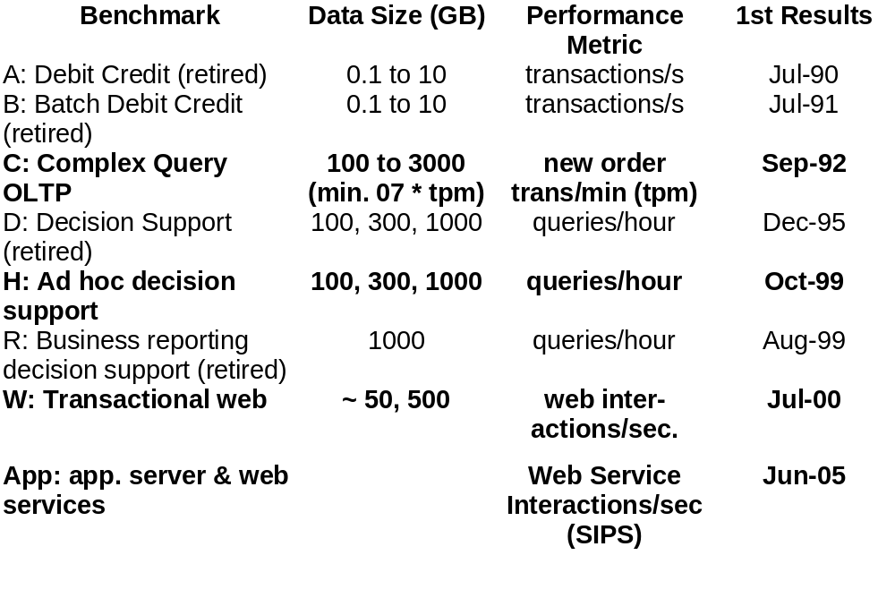
TPC Benchmark History/Status
Lec08 IO Systems

Slide 93
TPC-C基准的数据库Benchmark工具
基准程序TPC-C用于测试联机事务处理（OLTP）的性能，规范的最新版本是5.10。
测试过程模拟一个真实的货物管理环境，批发公司有N个仓库，每个仓库供应M个地区，在每个地区为上千名客户提供服务。在测试启动后，N×M个终端操作员向数据库发出新订单（New-Order）、付款（Payment）、订单状态（Order-Status）、库存级别（Stock-Level）、发货（Delivery）等5类事物请求，而性能指标tpmC则代表事务在满足响应时间要求的前题下，每分钟系统处理新订单（New-Order）的数目。
面向数据库系统的TPC-C基准测试，有多种程序实现，商用软件有QUEST公司的Benchmark Factory，以及HP的LoadRunner，也有小巧的开源工具。
Lec08 IO Systems

Slide 94
I/O Benchmarks via SPEC
SPEC SFS系统文件服务器 3.0 Attempt by NFS 网络文件系统 companies to agree on standard benchmark
  Run on multiple clients & networks (to prevent bottlenecks)
  Same caching policy in all clients
  Reads: 85% full block & 15% partial blocks
  Writes: 50% full block & 50% partial blocks
  Average response time: 40 ms
  Scaling: for every 100 NFS ops/sec, increase capacity 1GB
Results: plot 图表 of server load (throughput) vs. response time & number of users
  Assumes: 1 user => 10 NFS ops/sec
  3.0 for NSF 3.0
Added SPECMail (mailserver), SPECWeb (webserver) benchmarks
Lec08 IO Systems
Notes:
SPEC SFS 3.0 (SFS97_R1) is the latest version of the Standard Performance Evaluation Corp.'s benchmark that measures NFS file server throughput and response time. It provides a standardized method for comparing performance across different vendor platforms. This is an incremental release that based upon the design of SFS 2.0 (SFS97) and address several critical problems uncovered in that release, additional it addresses several tools issues and revisions to the run and reporting rules.

Slide 95
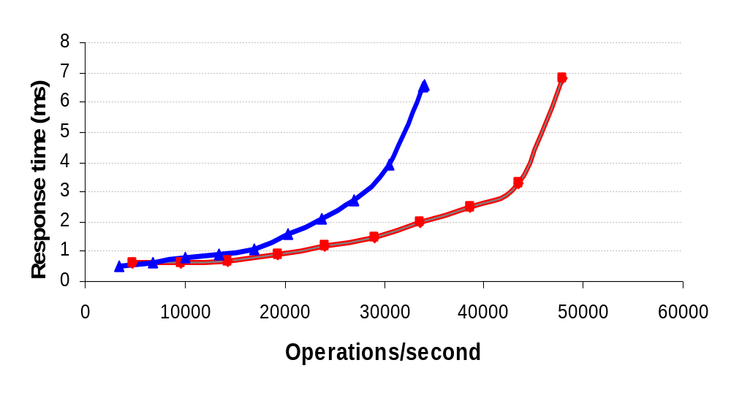
2005 Example SPEC SFS Result: NetApp FAS3050c NFS servers
2.8 GHz Pentium Xeon microprocessors, 2 GB of DRAM per processor, 1GB of Non-volatile memory per system
4 FDDI networks; 32 NFS Daemons, 24 GB file size
168 fibre channel disks: 72 GB, 15000 RPM, 2 or 4 FC controllers
Lec08 IO Systems

Slide 96
Summary
I/O in Amdahl’s Law or import in a system
I/O Buses
Storage : traditional disks
RAID
Storage Systems
Benchmark
Lec08 IO Systems

