Slide 1
Lecture 09:
Supercomputers,
Vector Computers and Array Computers
Notes:
柯尔斯基．阿桑利克教授 ( Prof. Krste Asanovic )
Asanovic received his B.A. degree in Electrical and Information Sciences from Cambridge University in 1987, and his Ph.D. in Computer Science from U.C. Berkeley in 1998.
Krste Asanovic is an Associate Professor in the Computer Science and Artificial Intelligence Laboratory at MIT.
His main research interests are computer architecture and VLSI design and his current focus is on energy-efficient computing.
The SCALE group is developing technologies for future high-performance low-power computing systems.

Slide 2

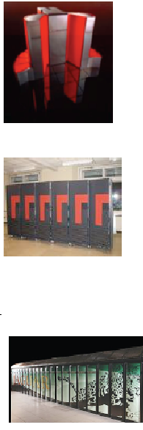
Looking at the Gordon Bell Prize
每年ACM SC Conference颁发
1 GFlop/s; 1988; Cray Y-MP; 8 Processors
    Static finite element analysis
1 TFlop/s; 1998; Cray T3E; 1024 Processors
    Modeling of metallic magnet atoms, using a variation of the locally self-consistent multiple scattering method.
1 PFlop/s; 2008; Cray XT5; 1.5x10⁵ Processors
    Superconductive materials
1 EFlop/s; ~2018; ?; 1x10⁷ Processors (10⁹ threads)
Notes:
贝尔•戈登奖由美国计算机协会与电气和电子工程师学会联合授予的，每年在超级计算机大会上颁发，旨在奖励在高性能计算应用方面的杰出成就，并大幅提升计算机性能者。该奖项的主要目的是评估并行计算的进展。该奖项于1987年

Slide 3
Supercomputers
Definition of a supercomputer:
Fastest machine in world at given task
A device to turn a compute-bound problem into an I/O bound problem
Any machine costing $30M+
Any machine designed by Seymour Cray
CDC6600 (Cray, 1964) regarded as first supercomputer
CDC 6600的推出，使得CDC公司成为市场上真正的主导者，1969年CDC 7600推出，这台每秒运行1000万次的机器被公认是当时第一台真正意义上的超级计算机。
Notes:
1963年CDC 6600的推出，使得CDC公司成为了市场上真正的主导者，再到后来CDC 7600的推后，这台每秒运行1000万次的机器被公认是当时第一台真正意义上的超级计算机，克雷也成了举世闻名的超级计算机专家，CDC公司从此开始独霸整个超级计算机市场。

Slide 4
Supercomputer Applications
Typical application areas
  Military research (nuclear weapons, cryptography)
  Scientific research
  Weather forecasting
  Oil exploration
  Industrial design (car crash simulation)
All involve huge computations on large data sets
In 70s-80s, Supercomputer ≡ Vector Machine
L09 Vector Computers
Notes:
但好景不长，到了20世纪80年代后期，PC的发展如日中天，大型机和超级计算机都受到了较大的冲击，最终CRAY-3在商业市场上惨淡收场。此时的克雷再一次与公司的意见出现分歧，1989年他退出了自己一手创办的克雷研究公司，另行成立了克雷计算机公司，全力研究CRAY-4，但是这个设计目标为每秒1000亿次的机型最终没有完成，1995年克雷计算机公司被迫宣布破产。
面对事业的几次大起大落，克雷一直没有放弃过，到1996年，70余岁的克雷再一次创办了SRC公司，希望再一次能为世界创造出奇迹，可惜天不作美，厄运突然降临，1996年9月，一场意外的交通事故让克雷永远的停止了呼吸，享年71岁。

Slide 5

Vector Processors
I’m certainly not inventing vector processors. There are three kinds that I know of existing today. They are represented by the Illiac-IV, the (CDC) Star processor, and the TI (ASC) processor. Those three were all pioneering processors. . . . One of the problems of being a pioneer is you always make mistakes and I never, never want to be a pioneer. It’s always best to come second when you can look at the mistakes the pioneers made.
Seymour Cray
Public lecture at Lawrence Livermore Laboratories
on the introduction of the Cray-1 (1976)
西摩·克雷被誉为无可非议的“超级计算机之父”
Notes:
1957年，克雷和其它几位工程研究协会(ERA)的同事辞职后，创办了CDC。
1963年CDC 6600的推出，使得CDC公司成为了市场上真正的主导者，再到后来CDC 7600的推出，这台每秒运行1000万次的机器被公认是当时第一台真正意义上的超级计算机，克雷也成了举世闻名的超级计算机专家，CDC公司从此开始独霸整个超级计算机市场。
1972年，克雷自立门户，创立了克雷研究公司，公司的宗旨是只生产超级计算机。此后的十余年中，克雷先后创造了CRAY-1，CRAY-2等机型，他亲手设计了Cray机型的全部硬件与操作系统，其中的作业系统更是他用机器码编写完成。
1964年 · CDC 6600, 3 MFLOPS,
1969年 · CDC 7600, 36 MFLOPS,
1974年 · CDC STAR-100, 100 MFLOPS,

Slide 6
Look at the Fastest Computers
Strategic importance of supercomputing
  Essential for scientific discovery
  Critical for national security
  Fundamental contributor to the economy and competitiveness through use in engineering and manufacturing
Supercomputers are the tool for solving the most challenging problems through simulations

Slide 7
Applications in Engineering and Design
Design of airfoils (optimizing lift, drag, stability), internal combustion engines (optimizing charge distribution, burn), high-speed circuits (layouts for delays and capacitive and inductive effects), and structures (optimizing structural integrity, design parameters, cost, etc.).
Design and simulation of micro- and nano-scale systems.
Process optimization, operations research.
机翼（优化升力，阻力，稳定性）内燃机（优化加载分布，燃烧）高速电路（分布延迟、电容和电感）和结构（优化结构整合，设计参数，造价等）
Notes:
机翼（优化升力，阻力，稳定性）内燃机（优化加载分布，燃烧）高速电路（分布延迟、电容和电感）和结构（优化结构整合，设计参数，造价等）
nano-scale 纳米级
CS258 S99

Slide 8
Scientific Applications
Functional and structural characterization of genes and proteins.
Advances in computational physics and chemistry have explored new materials, understanding of chemical pathways, and more efficient processes.
Applications in astrophysics have explored the evolution of galaxies, thermonuclear processes, and the analysis of extremely large datasets from telescopes.
Weather modeling, mineral prospecting, flood prediction, etc., are other important applications.
Bioinformatics and astrophysics also present some of the most challenging problems with respect to analyzing extremely large datasets.

Slide 9
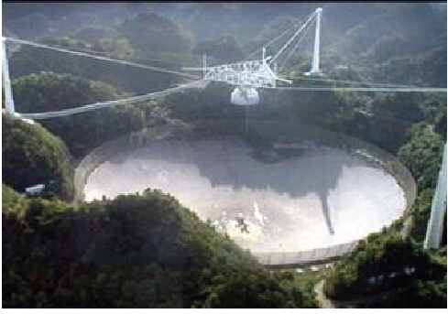

SETI@home: Global Distributed Computing
Running on 500,000 PCs, ~1000 CPU Years per Day
  485,821 CPU Years so far
Sophisticated Data & Signal Processing Analysis
Distributes Datasets from Arecibo Radio Telescope
Notes:
seti@home 是一项利用全球联网的计算机共同搜寻地外文明的科学实验计划
阿雷西博射电望远镜

Slide 10

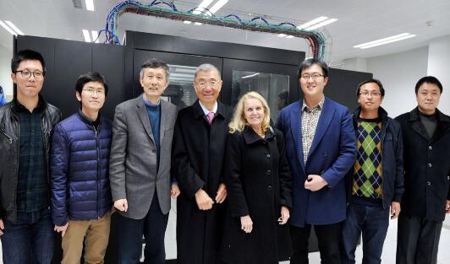
云计算助力暗物质发现
东南大学参与的国际大科学工程在国际空间站上运行五年以来，收集到超过900亿个宇宙线事件，推进了人类对宇宙线产生、加速以及传播的认识，并为探测暗物质提供重要证据。东南大学AMS数据处理中心数据处理和分析的总量在AMS实验全球七个地区数据处理中心排行第一。

Slide 11
Contents
1. Why Vector Processors?
2. Basic Vector Architecture
3. How Vector Processors Work
4. Vector Length and Stride
5. Effectiveness of Compiler Vectorization
6. Enhancing Vector Performance
7. Performance of Vector Processors
L09 Vector Computers

Slide 12
1. Why Vector Processors?
A single vector instruction specifies a great deal of work—it is equivalent to executing an entire loop.
The computation of each result (for one element) in the vector is independent of the computation of other results in the same vector and so hardware does not have to check for data hazards within a vector instruction.
Hardware need only check for data hazards between two vector instructions once per vector operand, not once for every element within the vectors.
Vector instructions that access memory have a known access pattern.
Because an entire loop is replaced by a vector instruction whose behavior is predetermined, control hazards that would normally arise from the loop branch are nonexistent.
L09 Vector Computers
Notes:
◆ 向量处理机：具有向量数据表示和相应向量指令的流水线处理机。
◆ 标量处理机: 不具有向量数据表示和相应向量指令的处理机。

Slide 13
2. Basic Vector Architecture
There are two primary types of architectures for vector processors:
vector-register processors
and
memory-memory vector processors.
  In a vector-register processor, all vector operations—except load and store—are among the vector registers.
  In a memory-memory vector processor, all vector operations are memory to memory.
L09 Vector Computers

Slide 14
Vector Memory-Memory vs.
Vector Register Machines
The first vector machines, CDC Star-100 (‘73) and TI ASC (‘71), were memory-memory machines
Cray-1 (’76) was first vector register machine
Vector Memory-Memory Code
Example Source Code
ADDV C, A, B
SUBV D, A, B
for (i=0; i<N; i++)
{
C[i] = A[i] + B[i];
D[i] = A[i] - B[i];
}
Vector Register Code
LV V1, A
LV V2, B
ADDV V3, V1, V2
SV V3, C
SUBV V4, V1, V2
SV V4, D
注意指令的变化
L09 Vector Computers
Notes:
Vector memory-memory instructions hold all vector operands in main memory

Slide 15
Vector Memory-Memory vs.
Vector Register Machines
Vector memory-memory architectures (VMMA) require greater main memory bandwidth, why?
  All operands must be read in and out of memory
VMMAs make it difficult to overlap execution of multiple vector operations, why?
  Must check dependencies on memory addresses
VMMAs incur greater startup latency
  Scalar code was faster on CDC Star-100 for vectors < 100 elements
  For Cray-1, vector/scalar breakeven point was around 2 elements
Apart from CDC follow-ons (Cyber-205, ETA-10) all major vector machines since Cray-1 have had vector register architectures
(we ignore vector memory-memory from now on)
L09 Vector Computers

Slide 16
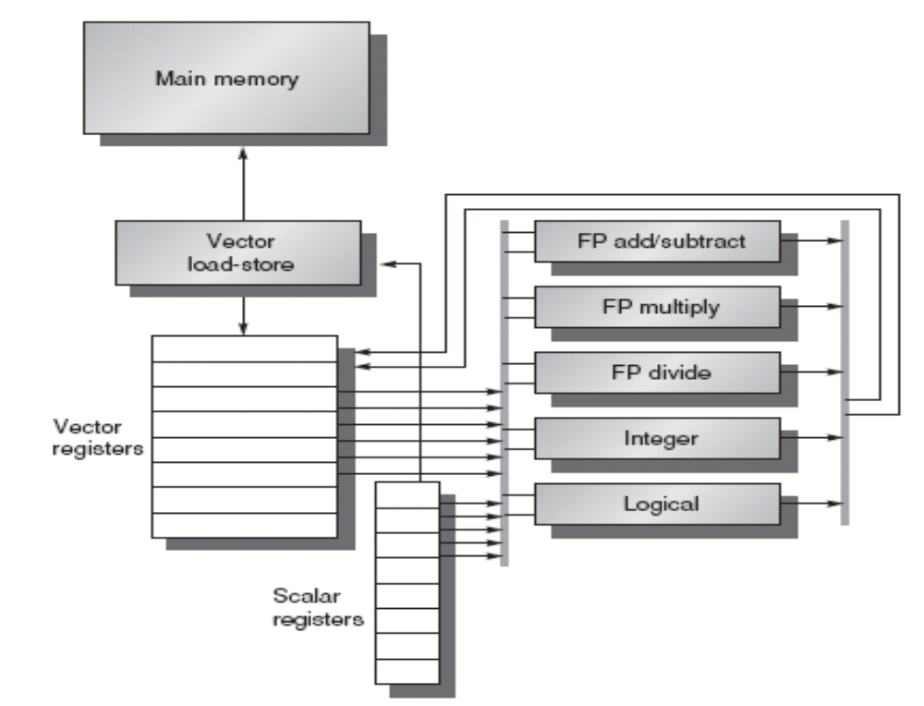
The basic structure of a vector-register architecture
VMIPS
L09 Vector Computers
Notes:
A vector processor typically consists of an ordinary pipelined scalar unit plus a vector unit.
This processor, which is loosely based on the Cray-1, is the foundation for discussion throughout most of this lesson.
We call it VMIPS; its scalar portion is MIPS, and its vector portion is the logical vector extension of MIPS.

Slide 17
Primary Components of VMIPS
Vector registers — VMIPS has eight vector registers, and each holds 64 elements. Each vector register must have at least two read ports and one write port.
Vector functional units — Each unit is fully pipelined and can start a new operation on every clock cycle.
Vector load-store unit —The VMIPS vector loads and stores are fully pipelined, so that words can be moved between the vector registers and memory with a bandwidth of 1 word per clock cycle, after an initial latency.
A set of scalar registers —Scalar registers can also provide data as input to the vector functional units, as well as compute addresses to pass to the vector load-store unit.
L09 Vector Computers

Slide 18
Vector Supercomputers
Epitomized 缩影 by Cray-1, 1976:
Scalar Unit + Vector Extensions
Load/Store Architecture
Vector Registers
Vector Instructions
Hardwired Control
Highly Pipelined Functional Units
Interleaved 交叉存取的 Memory System
No Data Caches
No Virtual Memory
L09 Vector Computers

Slide 19
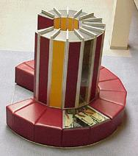
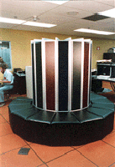
Cray-1 (1976)
L09 Vector Computers

Slide 20
Cray-1 (1976)
V0
V_{i}
V. Mask
V1
V_{j}
Single Port
Memory
16 banks of 64-bit words
+
8-bit SECDED
80MW/sec data load/store
320MW/sec instruction
buffer refill
64 Element Vector Registers
V2
V. Length
V3
V_{k}
V4
V5
V6
V7
FP Add
S0
S_{j}
FP Mul
( (A_{h}) + j k m )
S1
S2
S_{k}
FP Recip
64
T Regs
S_{i}
S3
(A₀)
S4
S_{i}
Int Add
T_{jk}
S5
S6
Int Logic
S7
Int Shift
( (A_{h}) + j k m )
A0
Pop Cnt
A1
A_{i}
A2
A_{j}
(A₀)
64
B Regs
A3
A_{k}
Addr Add
B_{jk}
A4
A5
A_{i}
Addr Mul
A6
A7
64-bitx16
NIP
CIP
4 Instruction Buffers
LIP
memory bank cycle 50 ns processor cycle 12.5 ns (80MHz)
L09 Vector Computers
Notes:
向量运算使用的功能部件有：整数加、逻辑运算、移位、浮点加、浮点乘、浮点迭代求倒数。
它们都是流水处理部件，且六个部件可并行工作。
单纠错、双错误检测代码（SECDED）逻辑
Pop Cnt: Population/leading zero count unit, counts the number of bits having a value of one in an operand, and counts the number of bits of zero preceding a one bit in the operand
迭代求倒数: Reciprocal approximation unit
The CIP (current instruction parcel)register holds the instruction waiting to issue. The NIP register holds a parcel of program code prior to entering the CIP register. If issue of the instruction in the CIP register is delayed, the data in the NIP register is held over for the next clock period. LIP which stands for lower instruction parcel
64 T Regs = The 64 (维) address intermediate registers =>8 Scalar Registers
64 B Regs = The 64 (维) scalar intermediate registers =>8 Address Registers
Their purpose is to reduce memory references made by the scalar and address registers.
instruction parcels may be held in the next instruction parcel (NIP), lower instruction parcel (LIP) and cutrent instruction parcel (CIP) registers.

Slide 21
Vector Programming Model
Scalar Registers
Vector Registers
r7
v7
r0
v0
[0]
[1]
[2]
[VLRMAX-1]
Vector Length Register
VLR
v1
Vector Arithmetic Instructions
ADDV v3, v1, v2
v2
+
+
+
+
+
+
v3
[0]
[1]
[VLR-1]
Vector Load and Store Instructions
LV v1, r1, r2
Vector Register
v1
Memory
Base, r1
Stride, r2
L09 Vector Computers

Slide 22
补充：Multimedia Extensions (aka SIMD extensions)
64b
32b
32b
16b
16b
16b
16b
8b
8b
8b
8b
8b
8b
8b
8b
Very short vectors added to existing ISAs for microprocessors 仅定义几种操作
Use existing 64-bit registers split into 2x32b or 4x16b or 8x8b
  Lincoln Labs TX-2 from 1957 had 36b datapath split into 2x18b or 4x9b
  Newer designs have wider registers
    128b for PowerPC Altivec, Intel SSE2/3/4
    256b for Intel AVX
Single instruction operates on all elements within register
16b
16b
16b
16b
16b
16b
16b
16b
4x16b adds
+
+
+
+
16b
16b
16b
16b

Slide 23
补充： Multimedia Extensions versus Vectors
Limited instruction set:
  no vector length control
  no strided load/store or scatter/gather
  unit-stride loads must be aligned to 64/128-bit boundary
Limited vector register length:
  requires superscalar dispatch to keep multiply/add/load units busy
  loop unrolling to hide latencies increases register pressure
Trend towards fuller vector support in microprocessors
  Better support for misaligned memory accesses
  Support of double-precision (64-bit floating-point)
  New Intel AVX spec (announced April 2008), 256b vector registers (expandable up to 1024b)
Notes:
AVI Advanced Vector Instruction

Slide 24
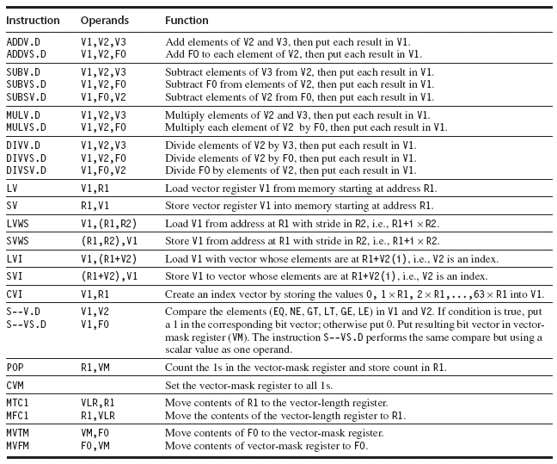
In VMIPS, vector operations use the same names as MIPS operations, but with the letter “V” appended.
L09 Vector Computers

Slide 25
Vector Code Example
# C code
for (i=0; i<64; i++)
C[i] = A[i] + B[i];
# Scalar Code
LI R4, 64
loop:
L.D F0, 0(R1)
L.D F2, 0(R2)
ADD.D F4, F2, F0
S.D F4, 0(R3)
DADDIU R1, 8
DADDIU R2, 8
DADDIU R3, 8
DSUBIU R4, 1
BNEZ R4, loop
# Vector Code
LI VLR, 64
LV V1, R1
LV V2, R2
ADDV.D V3, V1, V2
SV V3, R3
L09 Vector Computers

Slide 26
Vector Instruction Set Advantages
Compact
  one short instruction encodes N operations
Expressive, tells hardware that these N operations:
  are independent
  use the same functional unit
  access disjoint registers
  access registers in the same pattern as previous instructions
  access a contiguous block of memory (unit-stride load/store)
  access memory in a known pattern (strided load/store)
Scalable
  can run same object code on more parallel pipelines or lanes
L09 Vector Computers
Notes:
•一个短的指令包含多个操作
•是相互独立的
•使用相同的功能单元
•访问相互独立的寄存器
•和前一指令相同的方式访问寄存器
•访问一个连续的整块的内存单元（单元步幅的装入/存储）
•以一种已知的方式访问内存（一步加载/存储）
•可以在更多的流水线上运行相同的对象代码

Slide 27
3. How Vector Processors Work
3.1 An Example
Let’s take a typical vector problem, X and Y are vectors, a is a scalar.
Y = a×X + Y
This is the socalled SAXPY or DAXPY loop that forms the inner loop of the Linpack benchmark(a collection of linear algebra 代数学 routines).
Example Show the code for MIPS and VMIPS for the DAXPY loop.
Assume that the starting addresses of X and Y are in Rx and Ry. And the number of elements, or length, of a vector register(64) matches the length of the vector operation.
L09 Vector Computers
Notes:
SAXPY stands for single-precision a⋅X plus Y; DAXPY for double-precision a ⋅ X plus Y.)
Linpack is a collection of linear algebra routines, and the routines for performing Gaussian elimination constitute what is known as the Linpack benchmark.

Slide 28
Here is the MIPS code.
L.D F0,a ;load scalar a
DADDIU R4,Rx,#512 ;last address to load
Loop: L.D F2,0(Rx) ;load X(i)
MUL.D F2,F2,F0 ;a × X(i)
L.D F4,0(Ry) ;load Y(i)
ADD.D F4,F4,F2 ;a × X(i) + Y(i)
S.D 0(Ry),F4 ;store into Y(i)
DADDIU Rx,Rx,#8 ;increment index to X
DADDIU Ry,Ry,#8 ;increment index to Y
DSUBU R20,R4,Rx ;compute bound
BNEZ R20,Loop ;check if done
L09 Vector Computers
Notes:
64bit双精度数
64×8=512

Slide 29
Here is the VMIPS code for DAXPY.
L.D F0,a ;load scalar a
LV V1,Rx ;load vector X
MULVS.D V2,V1,F0 ;vector-scalar multiply
LV V3,Ry ;load vector Y
ADDV.D V4,V2,V3 ;add
SV Ry,V4 ;store the result
The most dramatic comparison is that the vector processor greatly reduces the dynamic instruction bandwidth.
Another important difference is the frequency of pipeline interlocks. (Pipeline stalls are required only once per vector operation, rather than once per vector element.)
L09 Vector Computers
Notes:
On the vector processor, each vector instruction will only stall for the first element in each vector, and then subsequent elements will flow smoothly down the pipeline.

Slide 30
Vector Arithmetic Execution
V1
V2
V3
Use deep pipeline (=> fast clock) to execute element operations
Simplifies control of deep pipeline because elements in vector are independent (=> no hazards!)
Six stage multiply pipeline
V3 <- v1 * v2
L09 Vector Computers
Notes:
The behavior of the load-store vector unit is significantly more complicated than that of the arithmetic functional units.

Slide 31
3.2 Vector Load-Store Units and Vector Memory Systems
Operation | Start-up penalty
Vector add | 6
Vector multiply | 7
Vector divide | 20
Vector load / store | 12
Start-up penalties (in clock cycles) on VMIPS
To maintain an initiation rate of 1 word fetched or stored per clock, the memory system must be capable of producing or accepting this much data. This is usually done by spreading accesses across multiple independent memory banks.
L09 Vector Computers

Slide 32
Vector Memory System
Cray-1, 16 banks, 4 cycle bank busy time, 12 cycle latency
  Bank busy time: Cycles between accesses to same bank
Base
Stride
Vector Registers
Address Generator
+
0
1
2
3
4
5
6
7
8
9
A
B
C
D
E
F
Memory Banks
L09 Vector Computers

Slide 33
An Example
Suppose we want to fetch a vector of 64 elements starting at byte address 136, and a memory access takes 6 clocks. How many memory banks must we have to support one fetch per clock cycle? With what addresses are the banks accessed? When will the various elements arrive at the CPU?
Answer
Six clocks per access require at least 6 banks, but because we want the number of banks to be a power of two, we choose to have 8 banks. Figure on next page shows the timing for the first few sets of accesses for an eight-bank system with a six-clock-cycle access latency.
L09 Vector Computers

Slide 34
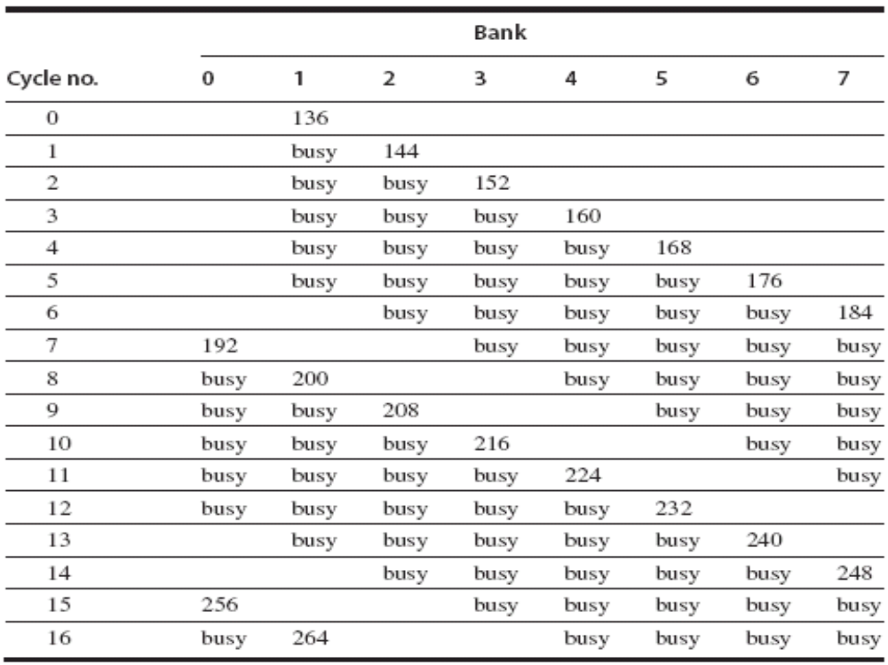
The CPU cannot keep all eight banks busy all the time because it is limited to supplying one new address and receiving one data item each cycle.
L09 Vector Computers

Slide 35
4. Two Real-World Issues:
Vector Length and Stride
What do you do when the vector length in a program is NOT exactly 64?
How do you deal with nonadjacent elements in vectors that reside in memory?
4.1 Vector-Length Control
do 10 i = 1,n
10 Y(i) = a × X(i) + Y(i)
n may not even be known until run time
L09 Vector Computers
Notes:
A vector-register processor has a natural vector length determined by the number of elements in each vector register. This length, which is 64 for VMIPS, is unlikely to match the real vector length in a program. Moreover, in a real program the length of a particular vector operation is often unknown at compile time.

Slide 36
The solution is to create a vector-length register (VLR), which controls the length of any vector operation.
The value in the VLR, however, cannot be greater than the length of the vector registers — maximum vector length (MVL).
If the vector is longer than the maximum length, a technique called stripmining is used.
L09 Vector Computers

Slide 37
Vector Stripmining 分段开采
Problem: Vector registers have finite length
Solution: Break loops into pieces that fit into vector registers, “Stripmining”
ANDI R1, N, #63 ; N mod 64
MTC1 VLR, R1 ; Do remainder
loop:
LV V1, RA
DSLL R2, R1, #3 ; Multiply by 8
DADDU RA, RA, R2 ; Bump pointer
LV V2, RB
DADDU RB, RB, R2
ADDV.D V3, V1, V2
SV V3, RC
DADDU RC, RC, R2
DSUBU N, N, R1 ; Subtract elements
LI R1, #64
MTC1 VLR, R1 ; Reset full length
BGTZ N, loop ; Any more to do?
for (i=0; i<N; i++)
C[i] = A[i]+B[i];
A
B
C
+
Remainder
+
64 elements
+
L09 Vector Computers
Notes:
BGTZ 大于0跳转
DSLL 双字逻辑左移
R2=R1*8，因为每个元素是8字节（64位精度）

Slide 38
4.2 Vector Stride 跨距
do 10 i = 1,100
do 10 j = 1,100
A(i,j) = 0.0
do 10 k = 1,100
10 A(i,j) = A(i,j)+B(i,k)*C(k,j)
At the statement labeled 10 we could vectorize the multiplication of each row of B with each column of C.
When an array is allocated memory, it is linearized and must be laid out in either row-major or column-major order. This linearization means that either the elements in the row or the elements in the column are not adjacent in memory. 总有一种是不连续的
L09 Vector Computers
Notes:
For example, if the preceding loop were written in FORTRAN, which allocates column-major order, the elements of B that are accessed by iterations in
the inner loop are separated by the row size times 8 (the number of bytes per entry) for a total of 800 bytes.
In the current example, using column-major layout for the matrices means that matrix C has a stride of 1, or 1 double word (8 bytes), separating
successive elements, and matrix B has a stride of 100, or 100 double words (800 bytes).

Slide 39
Vector Stride
This distance separating elements that are to be gathered into a single register is called the stride.
The vector stride, like the vector starting address, can be put in a general-purpose register.
Then the VMIPS instruction LVWS (load vector with stride) can be used to fetch the vector into a vector register.
Likewise, when a nonunit stride vector is being stored, SVWS (store vector with stride) can be used.
L09 Vector Computers

Slide 40
5. Effectiveness of Compiler Vectorization
Two factors affect the success with which a program can be run in vector mode.
  The first factor is the structure of the program itself. This factor is influenced by the algorithms chosen and by how they are coded.
  The second factor is the capability of the compiler.
L09 Vector Computers
Notes:
Do the loops have true data dependences, or can they be restructured so as not to have such dependences?

Slide 41
Automatic Code Vectorization
for (i=0; i < N; i++)
C[i] = A[i] + B[i];
Scalar Sequential Code
Vectorized Code
load
load
load
Iter. 1
load
load
load
Time
add
add
add
store
store
store
load
Iter. 1
Iter. 2
Iter. 2
load
Vector Instruction
Vectorization is a massive compile-time reordering of operation sequencing
⇒ requires extensive loop dependence analysis
add
store
L09 Vector Computers

Slide 42
6. Enhancing Vector Performance
In this section we present five techniques for improving the performance of a vector processor.
Chaining 链接
Conditionally Executed Statements 有条件执行的表达
Sparse Matrices 稀疏矩阵
Multiple Lanes
Pipelined Instruction Start-Up
L09 Vector Computers
Notes:
The first, chaining, deals with making a sequence of dependent vector operations run faster, and originated in the Cray-1 but is now supported on most vector processors. The next two deal with expanding the class of loops that can be run in vector mode by combating 抗击 the effects of conditional execution and sparse matrices with new types of vector instruction. The fourth technique increases the peak performance of a vector machine by adding more parallel execution units in the form of additional lanes. The fifth technique reduces start-up overhead by pipelining and overlapping instruction start-up.

Slide 43
(1) Vector Chaining
the Concept of Forwarding Extended to Vector Registers
making a sequence of dependent vector operations run faster
Vector version of register bypassing
  introduced with Cray-1
V1
V2
V3
V4
V5
LV v1
MULV v3,v1,v2
ADDV v5, v3, v4
Chain
Chain
Load Unit
Mult.
Add
Memory
L09 Vector Computers
Notes:
Chaining allows a vector operation to start as soon as the individual elements of its vector source operand become available:
The results from the first functional unit in the chain are “forwarded” to the second functional unit.

Slide 44
Forwarding (Bypassing or Short-circuiting) to Avoid Data Hazard
旁路（直接通路/短路）
Recall
Time (clock cycles)
I
n
s
t
r.
O
r
d
e
r
add r1,r2,r3
Ifetch
Reg
ALU
DMem
Reg
sub r4,r1,r3
Ifetch
Reg
ALU
DMem
Reg
and r6,r1,r7
Ifetch
Reg
ALU
DMem
Reg
or r8,r1,r9
Ifetch
Reg
ALU
DMem
Reg
xor r10,r1,r11
Ifetch
Reg
ALU
DMem
Reg
L09 Vector Computers

Slide 45
Vector Chaining Advantage
Without chaining, must wait for last element of result to be written before starting dependent instruction
Load
Mul
Time
Add
With chaining, can start dependent instruction as soon as first result appears
Load
Mul
Add
L09 Vector Computers

Slide 46
Implementations of Chaining
Early implementations worked like forwarding, but this restricted the timing of the source and destination instructions in the chain.
Recent implementations use flexible chaining, 柔性链接 which requires simultaneous access to the same vector register by different vector instructions, which can be implemented either by adding more read and write ports or by organizing the vector-register file storage into interleaved banks in a similar way to the memory system.
L09 Vector Computers
Notes:
柔性链接

Slide 47
(2) Vector Conditional Execution
Problem: Want to vectorize loops with conditional code:
      for (i=0; i<N; i++)
      if (A[i]>0) then
      A[i] = B[i];
Solution: Add vector mask (or flag) registers 向量屏蔽寄存器
  vector version of predicate 判定 registers, 1 bit per element
…and maskable vector instructions
  vector operation becomes NOP at elements where mask bit is clear
Code example:
  CVM ; Turn on all elements
  LV VA, RA ; Load entire A vector
  L.D F0,#0 ; Load FP zero into F0
  SGTVS.D VA, F0 ; Set bits in mask register where A>0
  LV VA, RB ; Load B vector into A under mask
  SV VA, RA ; Store A back to memory under mask
L09 Vector Computers
Notes:
This loop cannot normally be vectorized because of the conditional execution of the body;
however, if the inner loop could be run for the iterations for which A(i) <= 0, then the loop could be vectorized.
Conditionally executed instructions could turn such control dependences into data dependences, enhancing the ability to parallelize the loop.

Slide 48
Masked Vector Instructions
Simple Implementation
  execute all N operations, turn off result writeback according to mask
Density-Time Implementation
  scan mask vector and only execute elements with non-zero masks
M[7]=1
A[7]
B[7]
M[7]=1
M[6]=0
A[6]
B[6]
M[6]=0
A[7]
B[7]
M[5]=1
A[5]
B[5]
M[5]=1
M[4]=1
A[4]
B[4]
M[4]=1
M[3]=0
A[3]
B[3]
M[3]=0
C[5]
M[2]=0
C[4]
M[1]=1
M[2]=0
C[2]
M[0]=0
M[1]=1
C[1]
C[1]
Write data port
M[0]=0
C[0]
Write Enable
Write data port
L09 Vector Computers

Slide 49
Compress/Expand Operations
Compress packs non-masked elements from one vector register contiguously at start of destination vector register
  population count of mask vector gives packed vector length
Expand performs inverse operation
M[7]=1
A[7]
A[7]
A[7]
M[7]=1
M[6]=0
A[6]
A[5]
B[6]
M[6]=0
M[5]=1
A[5]
A[4]
A[5]
M[5]=1
M[4]=1
A[4]
A[1]
A[4]
M[4]=1
M[3]=0
A[3]
A[7]
B[3]
M[3]=0
M[2]=0
A[2]
A[5]
B[2]
M[2]=0
M[1]=1
A[1]
A[4]
A[1]
M[1]=1
M[0]=0
A[0]
A[1]
B[0]
M[0]=0
Compress
Expand
Used for density-time conditionals and also for general selection operations
L09 Vector Computers

Slide 50
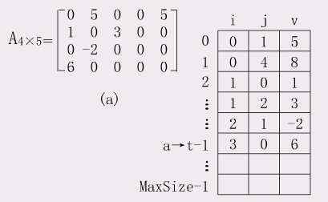
(3) Sparse Matrices 稀疏矩阵
In a sparse matrix, the elements of a vector are usually stored in some compacted form and then accessed indirectly.
L09 Vector Computers
Notes:
当二维数组A[m][n]有k个非零元素，若k<<m*n，则称A为稀疏矩阵。矩阵中大多数元素为零 。
In a sparse matrix, the elements of a vector are usually stored in some compacted form and then accessed indirectly.
三元组表

Slide 51
Vector Scatter/Gather 分散/集中
Want to vectorize loops with indirect accesses:
(index vector D designate the nonzero elements of C)
下标向量D表示C的非零元素（共有N个，C的维数>>N）
  for (i=0; i<N; i++)
  A[i] = B[i] + C[D[i]]
Indexed load instruction (Gather)
  LV VD, RD ; Load indices in D vector
  LVI VC,(RC, VD) ; Load indirect from RC base
  LV VB, RB ; Load B vector
  ADDV.D VA, VB, VC ; Do add
  SV VA, RA ; Store result
L09 Vector Computers
Notes:
下标向量D表示C的非零元素。
The primary mechanism for supporting sparse matrices is scatter-gather operations using index vectors. 分散集中操作
The goal of such operations is to support moving between a dense representation (i.e., zeros are not included) and normal representation (i.e., the zeros are included) of a sparse matrix.
A gather operation takes an index vector and fetches the vector whose elements are at the addresses given by adding a base address to the offsets given in the index vector. The result is a nonsparse vector in a vector register.

Slide 52
Vector Scatter/Gather
Scatter example:
  for (i=0; i<N; i++)
  A[B[i]]++;
  (A[B[i]] = A[B[i]] + 1;)
Is following a correct translation?
  LV VB, RB ; Load indices in B vector
  LVI VA,(RA, VB) ; Gather initial A values
  ADDV VA, VA, 1 ; Increment
  SVI VA,(RA, VB) ; Scatter incremented values
L09 Vector Computers
Notes:
After these elements are operated on in dense form, the sparse vector can be stored in expanded form by a scatter store, using the same index vector.

Slide 53
(4) Multiple Lanes
ADDV C,A,B
increase the peak performance of a vector machine by adding more parallel execution units
Execution using one pipelined functional unit
Execution using four pipelined functional units
A[6]
B[6]
A[24]
B[24]
A[25]
B[25]
A[26]
B[26]
A[27]
B[27]
A[5]
B[5]
A[20]
B[20]
A[21]
B[21]
A[22]
B[22]
A[23]
B[23]
A[4]
B[4]
A[16]
B[16]
A[17]
B[17]
A[18]
B[18]
A[19]
B[19]
A[3]
B[3]
A[12]
B[12]
A[13]
B[13]
A[14]
B[14]
A[15]
B[15]
C[2]
C[8]
C[9]
C[10]
C[11]
C[1]
C[4]
C[5]
C[6]
C[7]
C[0]
C[0]
C[1]
C[2]
C[3]
L09 Vector Computers
Notes:
The parallel semantics of a vector instruction allows an implementation to execute these elemental operations using :
either a deeply pipelined functional unit, or by using an array of parallel functional units, or a combination of parallel and pipelined functional units.
Using multiple functional units to improve the performance of a single vector add instruction
The machine shown in (a) has a single add pipeline and can complete one addition per cycle.
The machine shown in (b) has four add pipelines and can complete four additions per cycle.

Slide 54
Vector Unit Structure
Functional Unit
ADD
Vector
Registers
Elements 0, 4, 8, …
Elements 1, 5, 9, …
Elements 2, 6, 10, …
Elements 3, 7, 11, …
MUL
Lane
Memory Subsystem (Load/Store Unit)
Notes:
As with a traffic highway, we can increase the peak throughput of a vector unit by adding more lanes.
The structure of a four-lane vector unit is shown in Figure.
The vector-register storage is divided across the lanes, with each lane holding every fourth element of each vector register.
There are three vector functional units shown, an FP add, an FP multiply, and a load-store unit. Each of the vector arithmetic units contains four execution pipelines,
one per lane, that act in concert 一致地 to complete a single vector instruction.

Slide 55
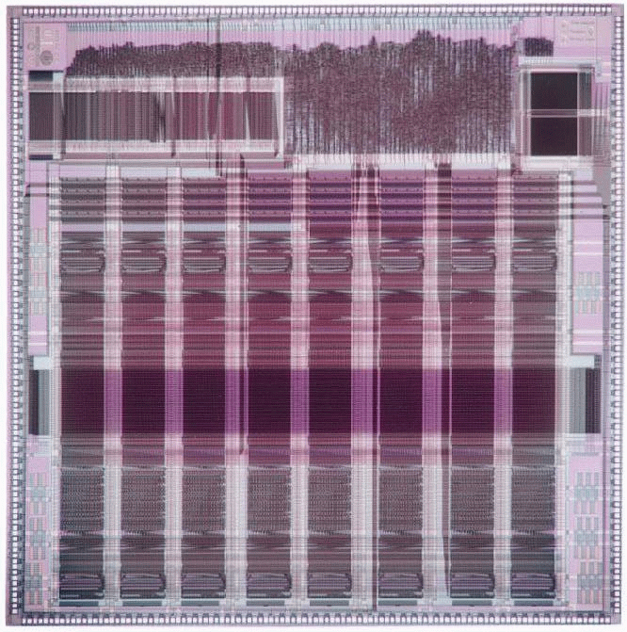
T0 Vector Microprocessor (1995)
Vector register elements striped over lanes
Lane
[24]
[25]
[26]
[27]
[28]
[29]
[30]
[31]
[16]
[17]
[18]
[19]
[20]
[21]
[22]
[23]
[8]
[9]
[10]
[11]
[12]
[13]
[14]
[15]
[0]
[1]
[2]
[3]
[4]
[5]
[6]
[7]
L09 Vector Computers

Slide 56
T0 Vector Microprocessor (1995)
T0 was developed as part of the CNS-1 project in a collaboration between researchers in the Computer Science Division of the University of California at Berkeley and the Realization Group at the International Computer Science Institute.
T0 (Torrent-0) is a single-chip fixed-point vector microprocessor designed for multimedia, human-interface, neural network, and other digital signal processing tasks.
T0 includes a MIPS-II compatible 32-bit integer RISC core, a 1KB instruction cache, a high performance fixed-point vector coprocessor, a 128-bit wide external memory interface, and a byte-serial host interface.
L09 Vector Computers

Slide 57
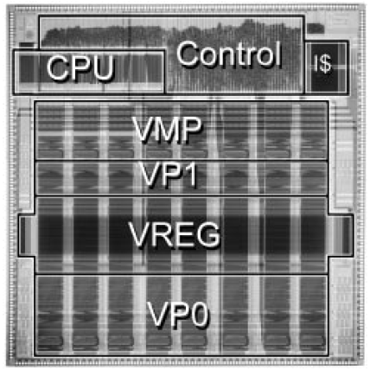
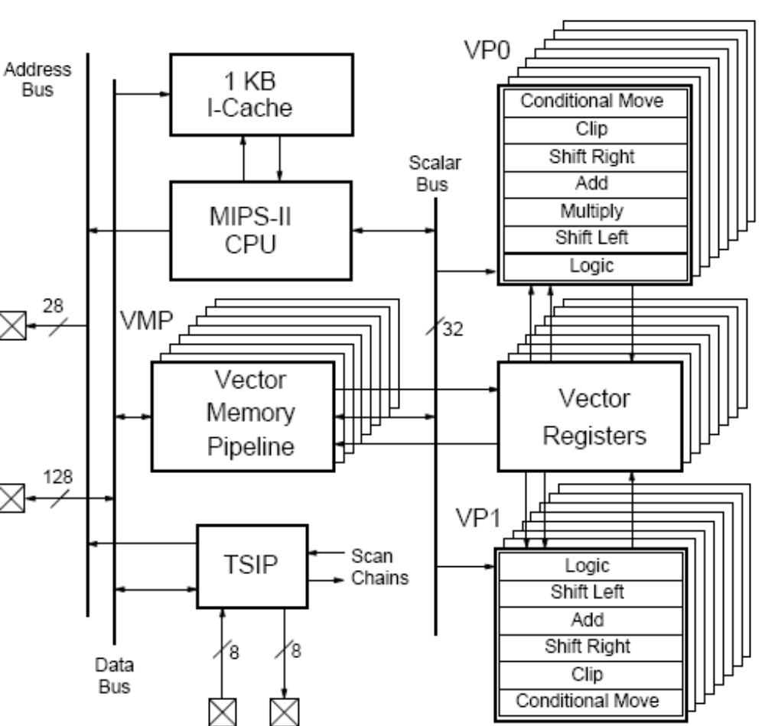
T0 Die Photograph and Block Diagram
L09 Vector Computers

Slide 58
Vector Instruction Parallelism
Can overlap execution of multiple vector instructions
  example machine has 32 elements per vector register and 8 lanes
Load Unit
Multiply Unit
Add Unit
load
mul
add
time
load
mul
add
Instruction issue
Complete 24 operations/cycle while issuing 1 short instruction/cycle

Slide 59
(5) Pipelined Instruction Start-Up
The simplest case to consider is when two vector instructions access a different set of vector registers.
For example, in the code sequence
ADDV.D V1,V2,V3
ADDV.D V4,V5,V6
It becomes critical to reduce start-up overhead by allowing the start of one vector instruction to be overlapped with the completion of preceding 在前的vector instructions.
An implementation can allow the first element of the second vector instruction to immediately follow the last element of the first vector instruction down the FP adder pipeline.
L09 Vector Computers
Notes:
Adding multiple lanes increases peak performance, but does not change start-up latency, and so it becomes critical to reduce start-up overhead by allowing the start of one vector instruction to be overlapped with the completion of preceding vector instructions.
The simplest case to consider is when two vector instructions access a different set of vector registers.

Slide 60
Vector Startup
Two components of vector startup penalty
  functional unit latency (time through pipeline)
  dead time or recovery time (time before another vector instruction can start down pipeline)
Functional Unit Latency
R
X
X
X
W
R
X
X
X
W
First Vector Instruction
R
X
X
X
W
R
X
X
X
W
R
X
X
X
W
Dead Time
R
X
X
X
W
R
X
X
X
W
R
X
X
X
W
Dead Time
R
X
X
X
W
Second Vector Instruction
R
X
X
X
W
Notes:
some vector machines require some recovery time or dead time in between two vector instructions dispatched to the same vector unit.

Slide 61
Dead Time and Short Vectors
No dead time
4 cycles dead time
T0, Eight lanes
No dead time
100% efficiency with 8 element vectors
Cray C90, Two lanes
4 cycle dead time
Maximum efficiency 94% with 128 element vectors
64 cycles active
L09 Vector Computers

Slide 62
Example The Cray C90 has two lanes but requires 4 clock cycles of dead time between any two vector instructions to the same functional unit. For the maximum vector length of 128 elements, what is the reduction in achievable peak performance caused by the dead time? What would be the reduction if the number of lanes were increased to 16?
Answer A maximum length vector of 128 elements is divided over the two lanes and occupies a vector functional unit for 64 clock cycles. The dead time adds another 4 cycles of occupancy, reducing the peak performance to 64/(64 + 4) = 94.1% of the value without dead time.
If the number of lanes is increased to 16, maximum length vector instructions will occupy a functional unit for only 128/16 = 8 cycles, and the dead time will reduce peak performance to 8/(8 + 4) = 66.6% of the value without dead time.
L09 Vector Computers

Slide 63
7. Performance of Vector Processors
Vector Execution Time
The execution time of a sequence of vector operations primarily depends on three factors:
the length of the operand vectors
structural hazards among the operations
data dependences
L09 Vector Computers

Slide 64
Convoy and Chime 编队与节拍
Convoy is the set of vector instructions that could potentially begin execution together in one clock period.
  The instructions in a convoy must not contain any structural or data hazards; if such hazards were present, the instructions in the potential convoy would need to be serialized and initiated in different convoys.
A chime is the unit of time taken to execute one convoy.
  A chime is an approximate measure of execution time for a vector sequence; a chime measurement is independent of vector length.
  A vector sequence that consists of m convoys executes in m chimes, and for a vector length of n, this is approximately m × n clock cycles.
L09 Vector Computers
Notes:
Although the concept of a convoy is used in vector compilers, no standard terminology exists. Hence, we created the term convoy.
Placing vector instructions into a convoy is analogous to placing scalar operations into a VLIW instruction.
Accompanying the notion of a convoy is a timing metric, called a chime, that can be used for estimating the performance of a vector sequence consisting of convoys.
A chime approximation ignores some processor-specific overheads, many of which are dependent on vector length. Hence, measuring time in chimes is a better approximation for long vectors. We will use the chime measurement, rather than clock cycles per result, to explicitly indicate that certain overheads are being ignored.

Slide 65
Example1 Show how the following code sequence lays out in convoys, assuming a single copy of each vector functional unit:
LV V1,Rx ;load vector X
MULVS.D V2,V1,F0 ;vector-scalar multiply
LV V3,Ry ;load vector Y
ADDV.D V4,V2,V3 ;add
SV Ry,V4 ;store the result
How many chimes will this vector sequence take?
L09 Vector Computers

Slide 66
Answer The first convoy is occupied by the first LV instruction. The MULVS.D is dependent on the first LV, so it cannot be in the same convoy. The second LV instruction can be in the same convoy as the MULVS.D. The ADDV.D is dependent on the second LV, so it must come in yet a third convoy, and finally the SV depends on the ADDV.D, so it must go in a following convoy.
1. LV
    2. MULVS.D / LV
    3. ADDV.D
    4. SV
The sequence requires four convoys and hence takes four chimes.
L09 Vector Computers

Slide 67
Start-up overhead
The most important source of overhead ignored by the chime model is vector start-up time.
The start-up time comes from the pipelining latency of the vector operation and is principally determined by how deep the pipeline is for the functional unit used.
Unit | Start-up overhead (cycles)
Load and store unit | 12
Multiply unit | 7
Add unit | 6
L09 Vector Computers

Slide 68
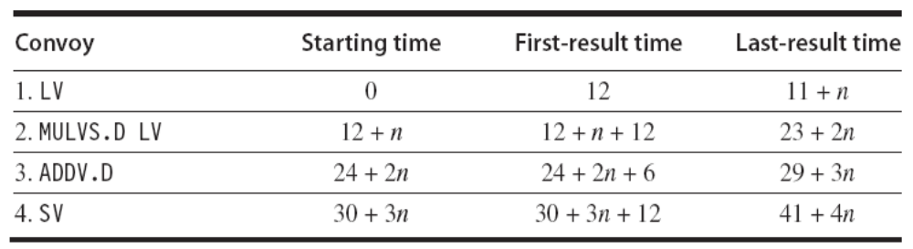
Example2 Assume the start-up overhead for functional units is shown in Figure of the previous page.
Show the time that each convoy can begin and the total number of cycles needed. How does the time compare to the chime approximation for a vector of length 64?
Answer
The time per result for a vector of length 64 is (42 + 4*64) / 64= 4 + (42/64) = 4.65 clock cycles, while the chime approximation would be 4.
L09 Vector Computers

Slide 69
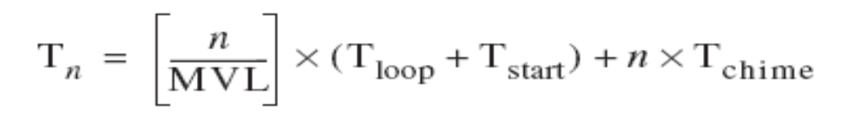
Running Time of a Strip-mined Loop
There are two key factors that contribute to the running time of a strip-mined loop consisting of a sequence of convoys:
1. The number of convoys in the loop, which determines the number of chimes. We use the notation Tchime for the execution time in chimes.
2. The overhead for each strip-mined sequence of convoys. This overhead consists of the cost of executing the scalar code for strip-mining each block, Tloop, plus the vector start-up cost for each convoy, Tstart.
the total running time for a vector sequence operating on a vector of length n:
L09 Vector Computers
Notes:
MVL. Maximum vector length

Slide 70
Example3 What is the execution time on VMIPS for the vector operation A = B × s, where s is a scalar and the length of the vectors A and B is 200?
Answer
  Assume the addresses of A and B are initially in Ra and Rb, s is in Fs, and recall that for MIPS (and VMIPS) R0 always holds 0.
  The first iteration of the strip-mined loop will execute for a vector length of (200 mod 64) = 8 elements, and the following iterations will execute for a vector length of 64 elements.
  Since the vector length is either 8 or 64, we increment the address registers by 8 × 8 = 64 after the first segment and 8 × 64 = 512 for later segments. The total number of bytes in the vector is 8 × 200 = 1600, and we test for completion by comparing the address of the next vector segment to the initial address plus 1600.
L09 Vector Computers

Slide 71
Here is the actual code:
DADDUI R2,R0,#1600 ;total # bytes in vector
DADDU R2,R2,Ra ;address of the end of A vector
DADDUI R1,R0,#8 ;loads length of 1st segment
MTC1 VLR,R1 ;load vector length in VLR
DADDUI R1,R0,#64 ;length in bytes of 1st segment
DADDUI R3,R0,#64 ;vector length of other segments
Loop: LV V1,Rb ;load B
MULVS.D V2,V1,Fs ;vector * scalar
SV Ra,V2 ;store A
DADDU Ra,Ra,R1 ;address of next segment of A
DADDU Rb,Rb,R1 ;address of next segment of B
DADDUI R1,R0,#512 ;load byte offset next segment
MTC1 VLR,R3 ;set length to 64 elements
DSUBU R4,R2,Ra ;at the end of A?
BNEZ R4,Loop ;if not, go back
L09 Vector Computers

Slide 72
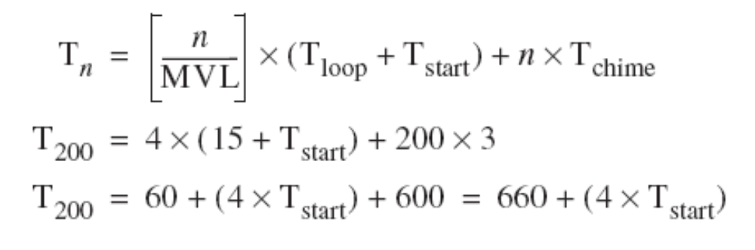
The three vector instructions in the loop are dependent and must go into three convoys, hence Tchime = 3.
Given Tloop = 15.
Use our basic formula:
The value of Tstart is given by Tstart = 12 + 7 + 12 = 31
So, the overall value becomes T200 = 660 + 4 × 31= 784
The execution time per element with all start-up costs is then 784/200 = 3.9, compared with a chime approximation of three.
L09 Vector Computers
Notes:
The value of Tstart is the sum of
the vector load start-up of 12 clock cycles
a 7-clock-cycle start-up for the multiply
a 12-clock-cycle start-up for the store

Slide 73
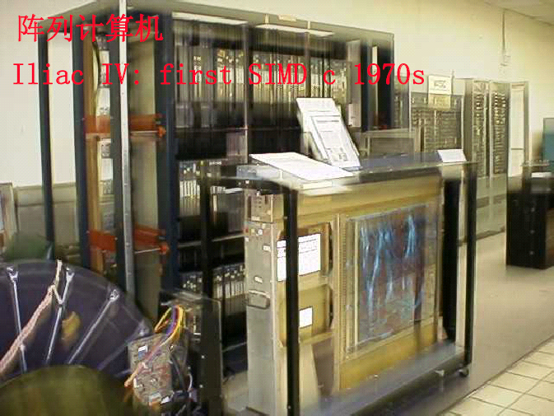

Slide 74
Array Processors
Basic idea:
A single control unit provides the signals to drive many processing elements
Run in lockstep前后紧接,步伐一致的前进
Control unit
Broadcasts Instructions
Processing
Element
(PE)
Processor
Memory
An array processor of the ILLIAC IV type
Notes:
CS258 S99
lockstep
n.前后紧接,步伐一致的前进

Slide 75
Illiac Ⅳ Array Processor 阵列处理机
B6700外围设备
激光存储器
阵列控制器CU
B6700多路开关
缓冲器
译码器
控制器
B6700
RAM
48
B6700 I/O管理计算机
总线控制器
标量执行部件
48
B6700
CPU
模式位
总线
公共数据总线
CDB
指令控制
总线
64
48
控制描述字
控制器CDC
I/O缓冲存储
器BIOM
64×8
PE₀
PE₁
…
PE₆₃
128
闭合螺旋线阵列
磁盘文件系统DFS
CU总线
256
256
PEM₀
PEM₁
…
PEM₆₃
I/O总线
实时
装置
取指令
IO开关
1024
1024
Notes:
CS258 S99

Slide 76
Illiac Ⅳ 阵列
由64个PE、64个PEM(包括存储器逻辑部件)组成。
PE阵列结构：闭合螺旋线阵列
东 南 西 北
来自PEM
来自CDB(来自CU)
PE₀
PE₁
…
PE₇
PE₈
PE₉
…
PE₁₅
驱动/接收器
操作数选择门
…
…
…
…
REGR
通用REG
REGM
CU
PE₅₆
PE₅₇
…
PE₆₃
算术单元
AU
逻辑单元
LU
地址加法
器ADA
PE组成：
各部件受控制部件控制；
控制部件受指令控制总线控制。
REGA
移位单元
SU
REGX
MAR
存储器逻辑部件MLU
REGR—被乘数和互连REG；REGM—模式REG；
REGX—变址REG；MAR—存储器地址REG

Slide 77
阵列存储器
PEM--2048×64位的容量。
阵列存储器—64个PEM组成，存放数据和指令；
双重编址：公共编址(按阵列顺序—管理机)、
PE编址(按行顺序—各PE)
存储器访问—
每个PE只能访问自己的PEM(存取数据)；
CU可通过CU总线访问整个阵列存储器取得指令和数据(如标量指令操作数)；
B6700可通过I/O总线访问整个阵列存储器。
Notes:
CS258 S99
类似一个阵列，各PE访问某一行，CU或B6700按列访问。

Slide 78
阵列控制器
实现所有指令的译码与控制、标量的执行、PE执行控制等功能。
CU与PE通信途径：
①CU总线—指令和公共数据(CU使用和PE需要)到达CU的通路；
②CDB—CU向64个PE广播公共数据的通路；
③模式位总线—PE状态通过该总线送到CU中，状态包括“活动”状态位，各PE的模式位拼成一个模式字为CU所用；
④指令控制线—CU控制各PE执行向量指令。

