Slide 1
Lecture 10:
Multiprocessing (parallel computer architecture)
Notes:
CS258 S99

Slide 2
Outline
MP Motivation
History of multiprocessing
Classification of computer architecture
  Flynn’s Taxonomy: SISD v. SIMD v. MIMD
SIMD
  Vector Processor & Array Processor
MIMD
  Communication Models
  Cluster vs. MPP
  Centralized vs. Distributed Memory
Related techniques
  Interconnection Networks
  Cache Coherence and Coherence Protocol
    Consistency, Coherency, Write Serialization
    Write Invalidate Protocol
    Example
Challenges to Parallel Programming

Slide 3
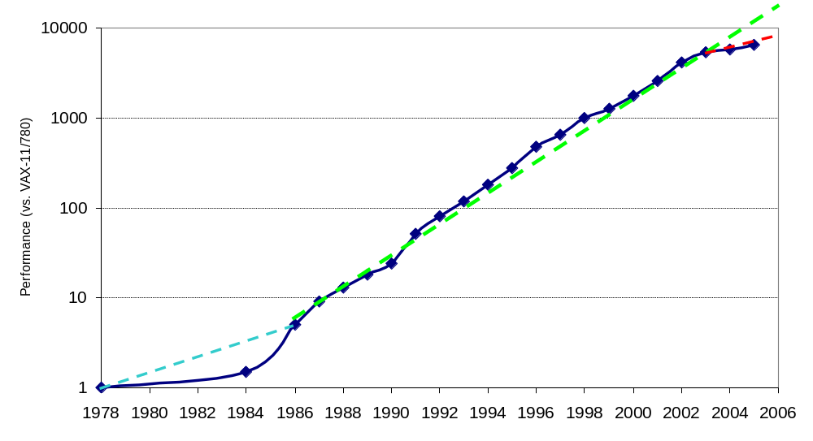
Uniprocessor Performance (SPECint)
3X
From Hennessy and Patterson, Computer Architecture: A Quantitative Approach, 4th edition, 2006
VAX : 25%/year 1978 to 1986
RISC + x86: 52%/year 1986 to 2002
RISC + x86: ??%/year 2002 to present
Notes:
CS258 S99

Slide 4
Other Factors ⇒ Multiprocessors
Growth in data-intensive applications
  Data bases, file servers, …
Growing interest in servers, server perf.
Increasing desktop perf. less important
Improved understanding in how to use multiprocessors effectively
  Especially server where significant natural TLP
Advantage of leveraging design investment by replication
  Rather than unique design

Slide 5
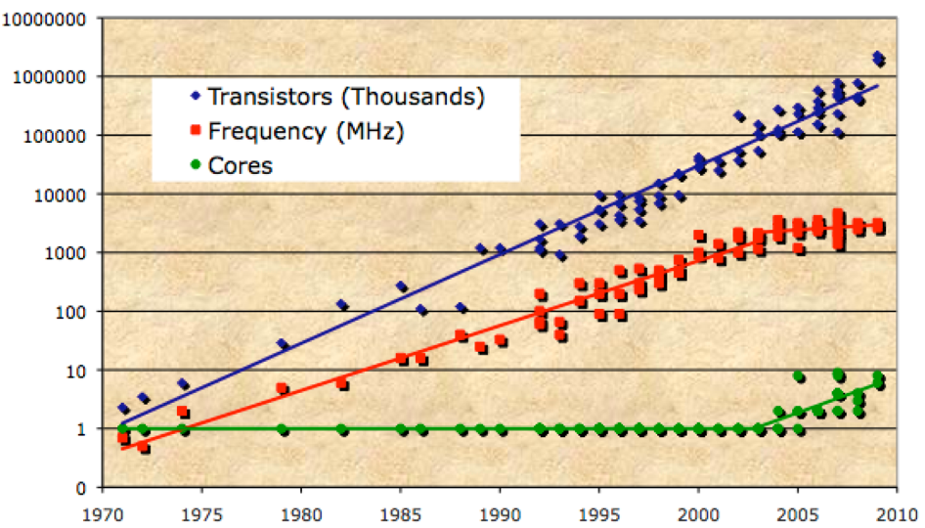
Technology Trends
The Future of Computing Performance: Game Over or Next Level? The National Academies Press, Washington, DC, 2011.

Slide 6
History of multiprocessing
Multiprocessing originated in the mid-1950s at a number of companies (IBM, Digital Equipment Corporation, Control Data Corporation).
In the early 1960s, Burroughs Corporation introduced a symmetrical MIMD multiprocessor with four CPUs and up to sixteen memory modules connected via a crossbar switch (the first SMP architecture).
The popular and successful CDC 6600 was introduced in 1964 and provided a CPU with ten subprocessors (peripheral processing units).
In the late 1960s, Honeywell delivered the first Multics system, another symmetrical multiprocessing system of eight CPUs.
Notes:
CS258 S99
多处理起源于 20 世纪 50 年代中期的一些公司，这些公司中有些您可能知道，而另一些您可能就不记得了（IBM、Digital Equipment Corporation、Control Data Corporation）。20 世纪 60 年代早期，Burroughs Corporation 引入了一种对称 MIMD 多处理器，它带有四个 CPU 并通过交叉开关可连接最多十六个内存模块（第一种 SMP 架构）。1964 年引入了 CDC 6600，它的使用比较成功并得到流行，它提供了一个带有十个子处理器（外围处理单元）的 CPU。20 世纪 60 年代末，Honeywell 发布了它的第一个 Multics 系统，这是带八个 CPU 的另一种对称多处理系统

Slide 7
History of multiprocessing
While multiprocessing systems were being developed, technologies also advanced the ability to shrink the processors and operate at much higher clock rates. In the 1980s, companies like Cray Research introduced multiprocessor systems and UNIX®-like operating systems that could take advantage of them (CX-OS).
The late 1980s, with the popularity of uniprocessor personal computer systems such as the IBM PC, saw a decline in multiprocessing systems. But now, twenty years later, multiprocessing has returned to these same personal computer systems through symmetric multiprocessing
Notes:
CS258 S99
在开发多处理系统的同时，各种技术的使用也提高了缩小处理器体积和运行更快的时钟频率的能力。20 世纪 80 年代，Cray Research 等公司引入了多处理器系统和类似 UNIX® 的操作系统（CX-OS），以便利用这些能力。
20 世纪 80 年代末期，随着单处理器个人计算机系统（如 IBM PC）的流行，多处理系统的使用呈下降趋势。但是到了二十年后的现在，多处理利用对称多处理技术又回到了个人计算机系统中。

Slide 8
Outline
MP Motivation
History of multiprocessing
Classification of computer architecture
  Flynn’s Taxonomy: SISD v. SIMD v. MIMD
SIMD
  Vector Processor & Array Processor
MIMD
  Communication Models
  Cluster vs. MPP
  Centralized vs. Distributed Memory
Related techniques
  Interconnection Networks
  Cache Coherence and Coherence Protocol
    Consistency, Coherency, Write Serialization
    Write Invalidate Protocol
    Example
Challenges to Parallel Programming

Slide 9
计算机系统的分类
1989 IEEE电气与电子工程师委员会提出的计算机分类：
  个人计算机 Personal Computer (PC)
  工作站 WorkStation (WS)
  小型机 Mini Computer
  中型机 Mainframe
  小巨型机 Minisupercomputer
  巨型机 Supercomputer
Flynn分类法，冯氏分类法， Handler分类法等

Slide 10
价
最佳性能价格比
格
最高性能
巨型机
大型机
等性能线
中型机
小型机
最低价格
微型机
(
超微型机
)
t-3 t-2
t-1
t
t+1
时期
Notes:
三个区域

Slide 11
Flynn分类法
1966 Flynn分类法：根据指令流和数据流的多倍性对计算机系统结构进行分类，
基本思想：计算机工作过程是指令流的执行和数据流的处理。
  指令流：机器执行的指令序列
  数据流：由指令流调用的数据序列（包括输入数 据和中间结果）
  多倍性：在系统性能的瓶颈部件上处于同一执行 阶段的指令或数据的最大个数。

Slide 12
Flynn’s Taxonomy
M.J. Flynn, "Very High-Speed Computers",
Proc. of the IEEE, V 54, 1900-1909, Dec. 1966.
Flynn classified by data and control streams in 1966
SIMD ⇒ Data Level Parallelism
MIMD ⇒ Thread (Process) Level Parallelism
MIMD popular because
  Flexible: N pgms and 1 multithreaded pgm
  Cost-effective: same MPU in desktop & MIMD
Single Instruction Single Data (SISD) (Uniprocessor) | Single Instruction Multiple Data SIMD (single PC: Vector, CM-2)
Multiple Instruction Single Data (MISD) (????) | Multiple Instruction Multiple Data MIMD (Clusters, SMP servers)
Notes:
CS258 S99
80年代初期的阵列机CM-2

Slide 13
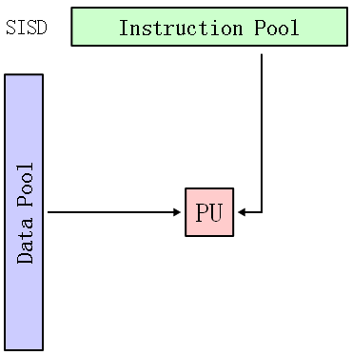
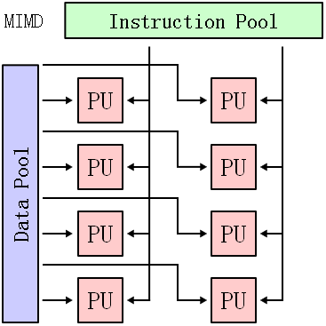
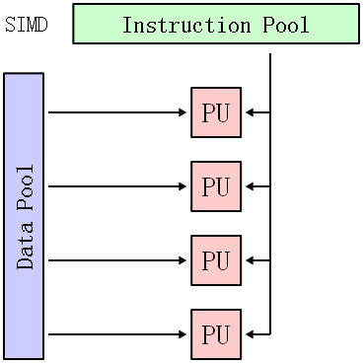
SISD v. SIMD v. MIMD

Slide 14
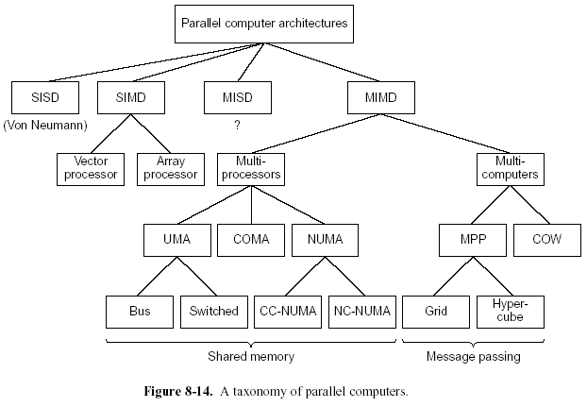
Taxonomy of Parallel Computers
Multi-Core
Notes:
CS258 S99

Slide 15
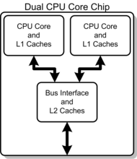
On multicores
Reason for multicores: physical limitations can cause significant heat dissipation 散热 and data synchronization 数据同步 problems
In addition to operating system (OS) support, adjustments to existing software are required to maximize utilization of the computing resources provided by multi-core processors.
Intel Core 2 dual core processor, with CPU-local Level 1 caches+ shared, on-die Level 2 cache.
Notes:
CS258 S99
Virtual machine approach again in focus.

Slide 16
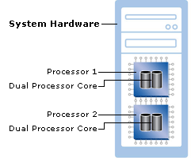
On multicores (cont)
Also possible
(figure from www.microsoft.com/licensing/highlights/multicore.mspx)
Notes:
CS258 S99
双核服务器与双路服务器
表面看来都是两个处理核心，但是还是有一些差别。对于双核处理器而言，可以采用单路服务器的主板，因而在价格上相对便宜；双路服务器采用主板相对昂贵。如果单就操作系统来看，双核和双路并没有太大区别。对于并行计算而言，需要应用程序编制并行计算模式，才可以发挥并行计算的能力。对于串行的程序，无论是双路还是双核都不能提供并行计算的能力。

Slide 17
操作系统是否需要“双核”版本？
据微软的产品市场经理介绍，目前的双核服务器并不需要定制专门的操作系统，操作系统内部的分时机制可以很好地在两个核之间分配任务，因而可以发挥双核处理器的性能。
2007年5月29日，在Future in Review 2007大会上，Microsoft公司主管Ty Carlson谈及了Windows的未来发展。他说：未来版本的Windows操作系统将会发生根本的变化，会充分利用多核处理器的技术。目前，Windows已经可以分发不同的进程和线程，但还有很多方面需要改进。
SQL Server 2005 Express Edition，替换了微软的桌面引擎，免费提供使用，是以尝试SQL Server 2005为目的的用户理想选择。它支持1 CPU，1GB内存，4GB数据库容量。
SQL Server 2005标准版支持4 CPU，无限量内存，数据库镜像，报告服务器等功能。

Slide 18
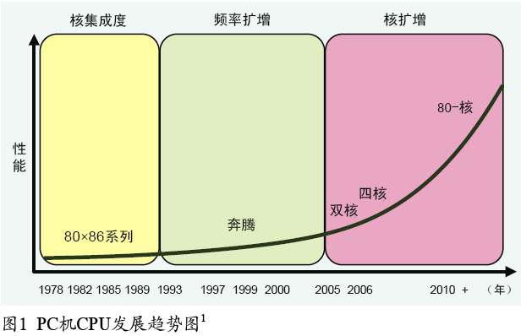
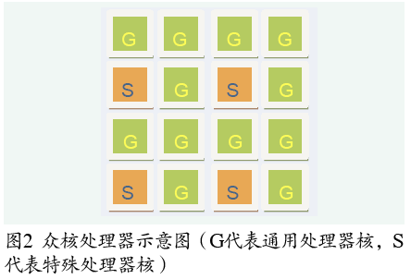
中国计算机大会 2009
复旦大学 臧斌宇：《面向多核环境的操作系统设计》
现代处理器多核技术的发展

Slide 19
多核环境的异构性与对传统操作系统的挑战
系统多样性：PC机系统开始呈现多样性的趋势，如核间联接、分级存储体系与输入输出（IO）子系统等都出现不同的设计。
处理器核心的异构性：不同的计算核心会有不同的计算性能；甚至可能还会加入特殊用途的计算核心（如GPU、FPGA），它们拥有不同的指令集架构（ISA）。
核间拓扑结构：双核以及四核处理器一般使用共享总线的联接方式。随着计算核心的增加，核间联接将采用类似于信息传递的网络方式进行。
高速缓存一致性：同步协议的代价越来越大，所以一些系统设计可能会抛弃缓存一致性或者绕过同步协议。比如GPU与CPU之间就没有保持高速缓存的一致性。

Slide 20
Outline
MP Motivation
History of multiprocessing
Classification of computer architecture
  Flynn’s Taxonomy: SISD v. SIMD v. MIMD
SIMD
  Vector Processor & Array Processor
MIMD
  Communication Models
  Cluster vs. MPP
  Centralized vs. Distributed Memory
Related techniques
  Interconnection Networks
  Cache Coherence and Coherence Protocol
    Consistency, Coherency, Write Serialization
    Write Invalidate Protocol
    Example
Challenges to Parallel Programming

Slide 21
SIMD Control
SIMD excels for computations with regular structure
  media processing, scientific kernels (e.g. linear algebra, FFT)
Activity mask
  per PE predicated execution: turn off operations on certain PEs
    each PE tests own conditional and sets own activity mask
    PE can conditionally perform operation predicated on mask value

Slide 22
SIMD Examples
Many early parallel computers
  Illiac IV, MPP, DAP, Connection Machine CM-1/2, and MasPar MP-1/2
Today
  vector units
    SSE, SSE2, Altivec (Velocity Engine, VMX)
    128-bit vector registers; 16 8-bit chars, 8 16-bit short int,
    4 32-bit ints, 4 32-bit FP variables
    SSE2 also operates on 2 64-bit double precision values
    Intel MIC (Xeon Phi)
    32 512-bit vector registers; 16 32-bit FP, 8 64-bit FP
  co-processors
    ClearSpeed array processor (control PE + array of 96 PEs)
    nVidia Kepler GK110 GPGPU
Notes:
基于MIC（集成众核）的计算加速协处理器Xeon Phi, 2012-6
CS258 S99

Slide 23
Outline
MP Motivation
History of multiprocessing
Classification of computer architecture
  Flynn’s Taxonomy: SISD v. SIMD v. MIMD
SIMD
  Vector Processor & Array Processor
MIMD
  Communication Models
  Cluster vs. MPP
  Centralized vs. Distributed Memory
Related techniques
  Interconnection Networks
  Cache Coherence and Coherence Protocol
    Consistency, Coherency, Write Serialization
    Write Invalidate Protocol
    Example
Challenges to Parallel Programming

Slide 25
Multi-processors & Multi-computers
多处理机系统——基于共享存储器 Shared Memory
  系统中只有唯一的地址空间，所有的处理器共享该地址空间。
  唯一的地址空间并不意味着在物理上只有一个存储器。共享地址空间可以通过一个物理上共享的存储器实现，也可以通过分布式存储器在硬件和软件的支持下实现。
多计算机系统——基于消息传递 Message Passing
  每个处理器有自己的存储器，该存储器只能被该处理器访问而不能被其它处理器直接访问，这种存储器称为局部存储器或私有存储器。
  当处理器A需要向处理器B传送数据时，A把数据以消息的形式发送给B。

Slide 26
Multi-processors & Multi-computers
MIMD多处理机系统的不同访存模型
UMA 一致性存储访问模型
  Uniform Memory Access ( Centralized memory architectures )
COMA 只高速缓存存储访问模型
  Cache only memory access
NUMA 非一致性存储访问模型
  NonUniform Memory Access ( Distributed Memory Multi-Processor)
  CC-NUMA Cache coherent NUMA
  NC-NUMA NonCoherent NUMA
MIMD多计算机系统的进一步划分
MPP大规模并行处理机
  Massively Parallel Processors
COW (cluster)工作站集群
  Cluster of Workstations

Slide 27
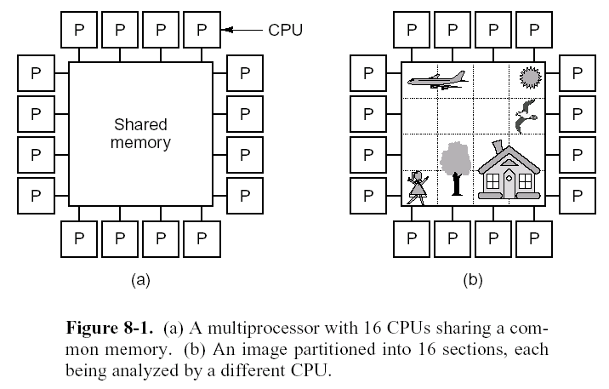
MIMD Communication Models (1)
Multiprocessors 多处理机
  shared memory system 共享存储系统
  share a single virtual address space
Notes:
CS258 S99

Slide 28
MIMD Communication Models (1)
Multiprocessors
  with a shared address space 共享地址空间
  to communicate by load and store operations
  由取操作和存操作实现通信
  low overhead for communication
  e.g.
    SUN Enterprise 10000
    Sequent NUMA-Q
    SGI Origin 2000
    HP Convex Exemplar
Notes:
CS258 S99

Slide 29
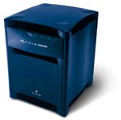
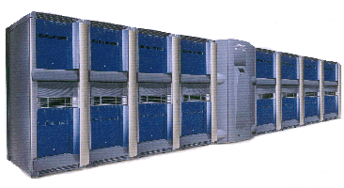
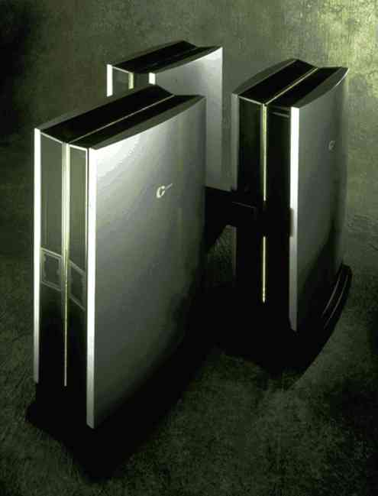
MIMD Communication Models (1)
Silicon Graphics Origin 2000: MIPS R12000 400 MHz scalar processors
8 CPUs go in a module, 2 modules go in a rack, and up to 16 racks (and two meta-routers) can be joined to make a single shared-memory computer.
HP Convex Exemplar SPP1200/XA: 128 PA-7200 120 MHz scalar processors
8 CPUs are connected together in a shared-memory node, and these nodes are connected together with a crossbar to form the 128 CPU distributed-memory system.
Notes:
CS258 S99

Slide 30
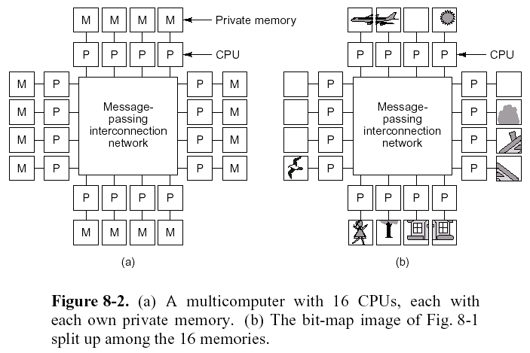
MIMD Communication Models (2)
Multicomputers 多计算机
  distributed memory system 分布存储系统
  private local memory 私有局部存储器
Notes:
CS258 S99

Slide 31
MIMD Communication Models (2)
Multicomputers
  The address space can consist of multiple private address spaces.
  Each processor-memory module is essentially a separate computer
  to communicate by passing message
  由消息传送实现通信
  communication is explicit 显式通信
Notes:
CS258 S99

Slide 32
MIMD Communication Models
Dilemma困难的选择
  Multiprocessors are hard to build but easy to program
  多处理机：搭建难、编程易
  Whereas multicomputers are easy to build but hard to program
  多计算机：搭建易、编程难
Build hybrid systems
  Relatively easy to build
  Relatively easy to program
Notes:
CS258 S99

Slide 33
Outline
MP Motivation
History of multiprocessing
Classification of computer architecture
  Flynn’s Taxonomy: SISD v. SIMD v. MIMD
SIMD
  Vector Processor & Array Processor
MIMD
  Communication Models
  Cluster vs. MPP
  Centralized vs. Distributed Memory
Related techniques
  Interconnection Networks
  Cache Coherence and Coherence Protocol
    Consistency, Coherency, Write Serialization
    Write Invalidate Protocol
    Example
Challenges to Parallel Programming

Slide 34

Computer cluster
A computer cluster is a group of coupled computers that work together closely so that in many respects they can be viewed as though they are a single computer.
The components of a cluster are commonly, but not always, connected to each other through fast local area networks.
MPI is a widely-available communications library that enables parallel programs to be written in C, Fortran, Python, OCaml, and many other programming languages.

Slide 35
Cluster categorizations
High-availability (HA) clusters 高可用性
  failover clusters 故障转移集群
  operate by having redundant nodes, which are then used to provide service when system components fail.
Load-balancing clusters 负载平衡
  operate by distributing a workload evenly over multiple back end nodes.
Grid computing
  grid clusters, a technology closely related to cluster computing.
  The key differences are that grids connect collections of computers which do not fully trust each other, or which are geographically dispersed.
  more like a computing utility than like a single computer.
  support more heterogeneous 不同种类的 collections

Slide 36
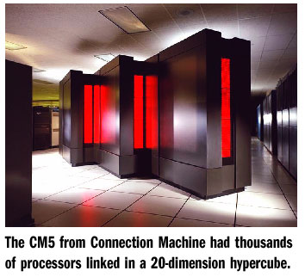
MPP - Massive parallel processing
In computing, massively parallel refers to the use of a large number of processors (or separate computers) to perform a set of coordinated computations in parallel.
  MPP系统是由成百上千台处理机组成的大规模并行计算机系统。
  过去主要用于科学计算、工程模拟等以计算为主的场合，目前也广泛应用于商业和网络应用中。
  开发困难，价格高，市场有限。是国家综合实力的象征。
系统特点
  MPP系统一般使用标准的商用CPU作为它们的处理器。
  MPP系统使用了高性能的私用的互连网络，可以在低延时和高带宽的条件下传递消息。
  MPP系统具有强大的输入/输出能力。
  MPP系统能够进行特殊的容错处理。

Slide 37
两种不同的多计算机系统
Cluster与MPP的区别（体系结构方面）
  第一， Cluster的结点是更完整的计算机，计算机可以是同构的也可以是异构的。结点都有自己的磁盘，驻留有自己的完成的操作系统；并且，一般都有一定的自主性。结点计算机脱离Cluster照样能运行。而MPP系统结点一般没有磁盘，只驻留操作系统内核。
  第二，MPP使用制造厂商专有（或者说是有专利权）的高速通信网络； Cluster一般采用公开销售的标准高速局域网或系统域网，网络通常是与结点计算机的I/O总线相连（松散耦合），而MPP的网络接口是连到处理结点的存储总线上（紧耦合） 。

Slide 38
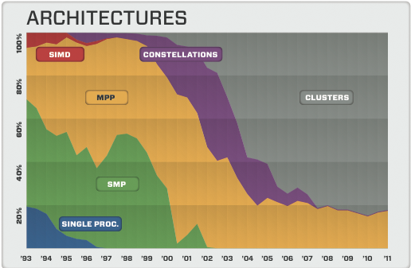
Top500超级计算机结构分析

Slide 39
Outline
MP Motivation
History of multiprocessing
Classification of computer architecture
  Flynn’s Taxonomy: SISD v. SIMD v. MIMD
SIMD
  Vector Processor & Array Processor
MIMD
  Communication Models
  Cluster vs. MPP
  Centralized vs. Distributed Memory
Related techniques
  Interconnection Networks
  Cache Coherence and Coherence Protocol
    Consistency, Coherency, Write Serialization
    Write Invalidate Protocol
    Example
Challenges to Parallel Programming

Slide 40
Back to Basics
“A parallel computer is a collection of processing elements that cooperate and communicate to solve large problems fast.”
Parallel Architecture = Computer Architecture + Communication Architecture
2 classes of multiprocessors WRT memory:
Centralized Memory Multiprocessor
  < few dozen processor chips (and < 100 cores) in 2006
  Small enough to share single, centralized memory
Physically Distributed-Memory multiprocessor
  Larger number chips and cores than 1.
  BW demands ⇒ Memory distributed among processors
Notes:
CS258 S99
关于(With respect to)

Slide 41
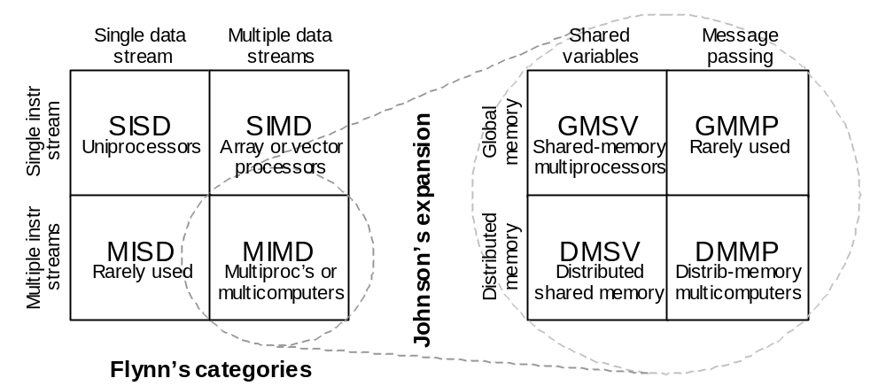

The Flynn-Johnson classification of computer systems
Shared memory
Notes:
SV=shared variables

Slide 42
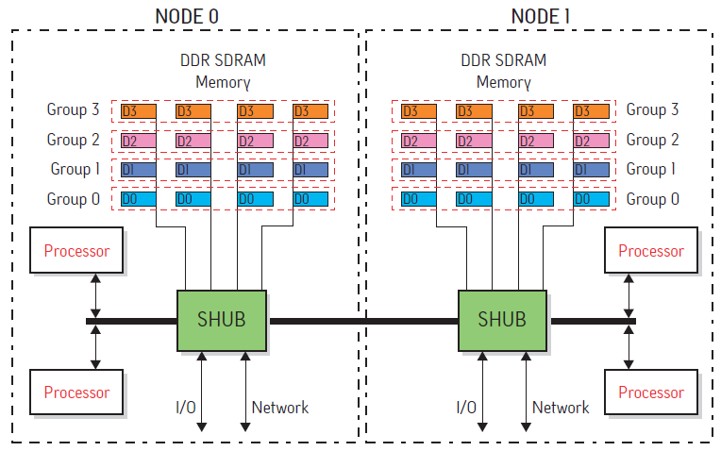
Distributed Shared Memory Example
下图为 SGI Altix3000 系统的两个结点，每个结点由2 个Itanium2 CPU和本地内存组成。
Notes:
CS258 S99
前国外著名的服务器厂商都先后推出了基于 NUMA 架构的高性能服务器，如 HP 的 Superdome、SGI 的 Altix 3000、IBM 的 x440、NEC 的 TX7、AMD 的Opteron 等。

Slide 43
Centralized vs. Distributed Memory
Scale
P
P
P
1
n
P
n
1
$
$
$
$
Mem
Mem
Interconnection network
Inter
connection network
Mem
Mem
Centralized Memory
Distributed Memory

Slide 44
Centralized Memory Multiprocessor
  Also called symmetric multiprocessors (SMPs) because single main memory has a symmetric relationship to all processors
  Large caches ⇒ single memory can satisfy memory demands of small number of processors
  Can scale to a few dozen processors by using a switch and by using many memory banks
  Although scaling beyond that is technically conceivable 可能的, it becomes less attractive as the number of processors sharing centralized memory increases
Notes:
CS258 S99
Conceivable adj. 可能的, 想得到的, 可想像的

Slide 45
Distributed Memory Multiprocessor
  Pro 赞成观点: Cost-effective way to scale memory bandwidth
    If most accesses are to local memory
  Pro: Reduces latency of local memory accesses
  Con 反对论点: Communicating data between processors more complex
  Con: Must change software to take advantage of increased memory BW
Notes:
CS258 S99
Pro n.（名词）赞成的观点
Con n.（名词）反对论点

Slide 46
2 Models for Communication and Memory Architecture
Communication occurs by explicitly passing messages among the processors:
message-passing multiprocessors
Communication occurs through a shared address space (via loads and stores):
shared memory multiprocessors either
  UMA (Uniform Memory Access time) for shared address, centralized memory MP
  NUMA (Non Uniform Memory Access time multiprocessor) for shared address, distributed memory MP
In past, confusion whether “sharing” means sharing physical memory (Symmetric MP) or sharing address space
Notes:
CS258 S99
访问时间依赖于数据在存储器中的存放位置=>NUMA

Slide 47
Outline
MP Motivation
History of multiprocessing
Classification of computer architecture
  Flynn’s Taxonomy: SISD v. SIMD v. MIMD
SIMD
  Vector Processor & Array Processor
MIMD
  Communication Models
  Cluster vs. MPP
  Centralized vs. Distributed Memory
Related techniques
  Interconnection Networks
  Cache Coherence and Coherence Protocol
    Consistency, Coherency, Write Serialization
    Write Invalidate Protocol
    Example
Challenges to Parallel Programming

Slide 48
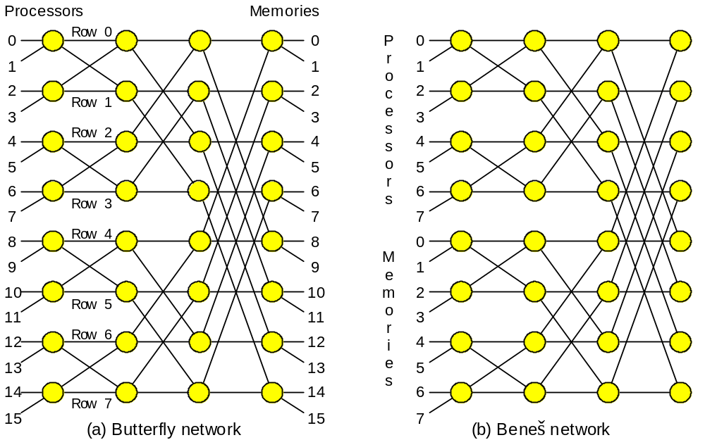
Processor-to-Memory Interconnection Network
  互连网络：由开关元件按照一定的拓扑结构和控制方式构成的网络，实现计算机系统结点之间的相互连接。
Butterfly and the related Beneš network as examples
of processor-to-memory interconnection network in a multiprocessor.
Notes:
CS258 S99
it was discussed and analyzed by others before Vaclav E. Benes , a Czech-American mathematician

Slide 49
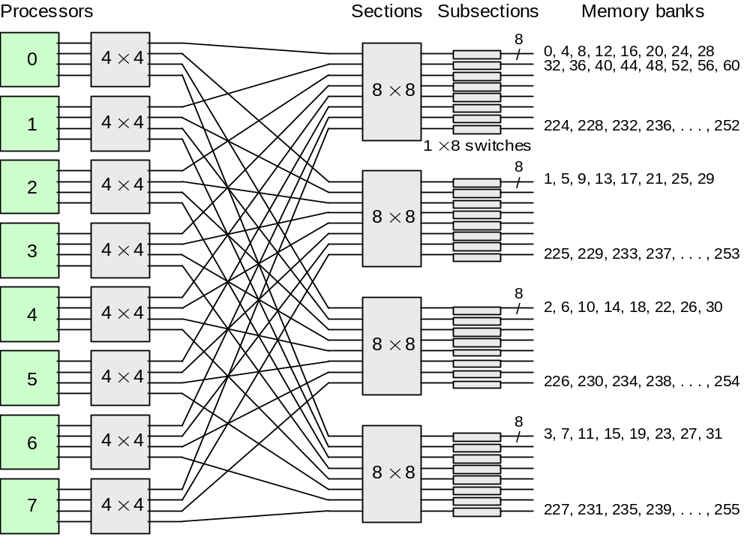
Processor-to-Memory Interconnection Network
Interconnection of eight processors to 256 memory banks in Cray Y-MP, a supercomputer with multiple vector processors.
  互连函数：反映网络输入数组和输出数组之间对应的置换关系或排列关系。

Slide 50
设计和分析互连网络的几个重要问题
互连网络的拓扑结构
  互连网络的拓扑结构描述了链路和交换结点是如何组织安排的。拓扑结构可以用图来表示，链路用边表示，交换结点用结点表示。
互连网络的寻径方式
  交换结点所做的工作就是接收到达输入端口的分组然后把分组发送到正确的输出端口，具有多种不同的工作方式。
互连网络的寻径算法
  寻径算法：决定一个分组从源结点到达目的结点的过程中经过的结点序列的算法。

Slide 51
互连网络的参数
结点度：与结点相连接的边数，表示节点所需要的端口数，根据链路到结点的方向，结点度可进一步表示为：结点度 = 入度 + 出度，其中入度是进入结点的链路数，出度是从结点出来的链路数。
链路的长度：链路中包含的边数
距离：与两个结点之间相连的最少边数。
网络直径：网络中任意两个结点间距离的最大值。
网络规模：网络中结点数，表示该网络功能连结部件的多少。
等分宽度：某一网络被切成相等的两半时，沿切口的最小边数称为该网络的等分宽度。
对称性：从任何结点看，拓扑结构都一样，这种网络实现和编程都很容易。

Slide 52
互连网络的分类
静态网络
  静态网络(Static Networks)是指结点间有着固定连接通路且在程序执行期间，这种连接保持不变的网络。
动态网络
  动态网络(Dynamic Networks)由开关单元构成，可按应用程序的要求动态地改变连接状态。如总线、交叉开关，多级交换网络等。

Slide 53
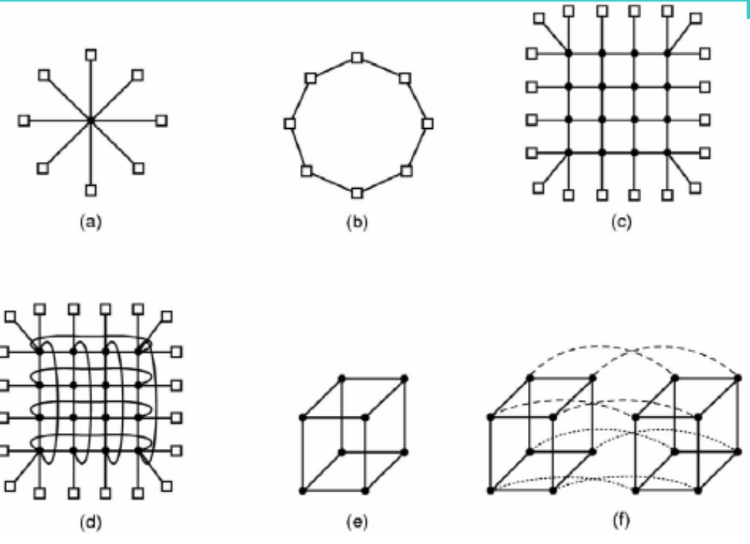
Interconnection topologies
(a) single switch (b) ring (c) grid
(d) double torus (e) cube (f) hypercube
Notes:
CS258 S99
double torus 双环

Slide 54
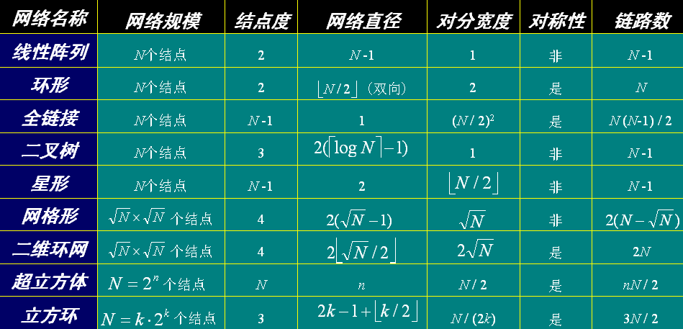
静态互连网络特性一览表

Slide 55
动态互连网络
网络特点
  动态网络中的连接不固定，在程序执行过程中可根据需要改变。
  网络的开关元件有源，链路可通过设置这些开关的状态来重构。
  只有在网络边界上的开关元件才能与处理机相连。
  动态网络主要有总线、交叉开关、多级交换网络。

Slide 56
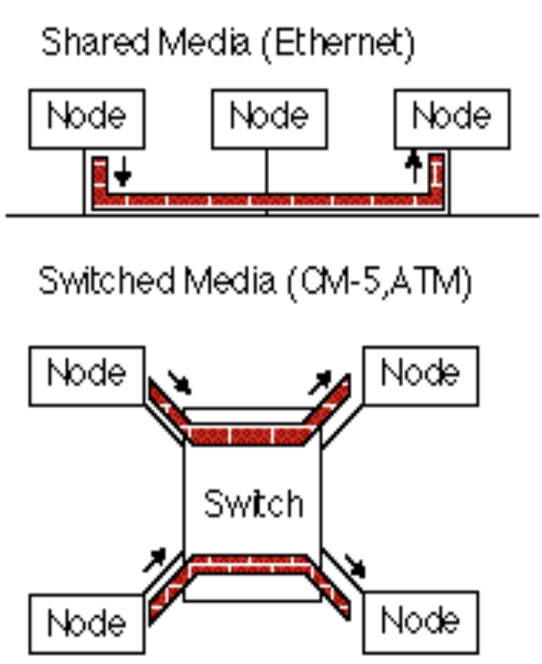
Connecting Multiple Computers
Shared Media vs. Switched:
pairs communicate at same time vs. “point-to-point” connections
Aggregate BW in switched network is many times shared
  point-to-point faster since no arbitration 仲裁, simpler interface
Arbitration in Shared network?
  Central arbiter for LAN?
  Listen to check if being used (“Carrier Sensing”)
  Listen to check if collision
  (“Collision Detection”)
  Random resend to avoid repeated collisions; not fair arbitration;
  OK if low utilization
(A. K. A. data switching
interchanges, multistage
interconnection networks,
interface message processors)
Notes:
CS258 S99
Communication by Message Passing

Slide 57
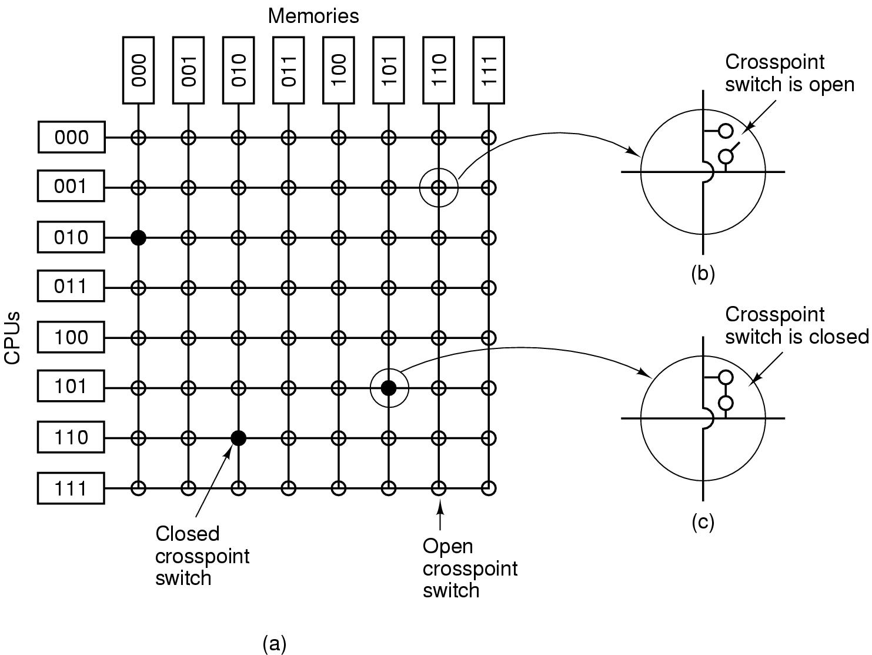
Switching scheme: Circuit switching

Slide 58
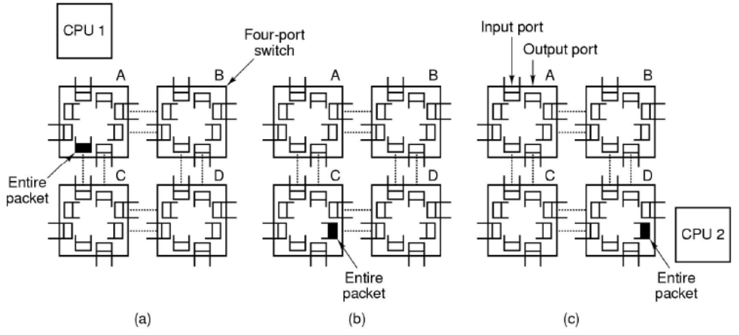
Switching scheme: Packet switching
store-and-forward packet switching

Slide 59
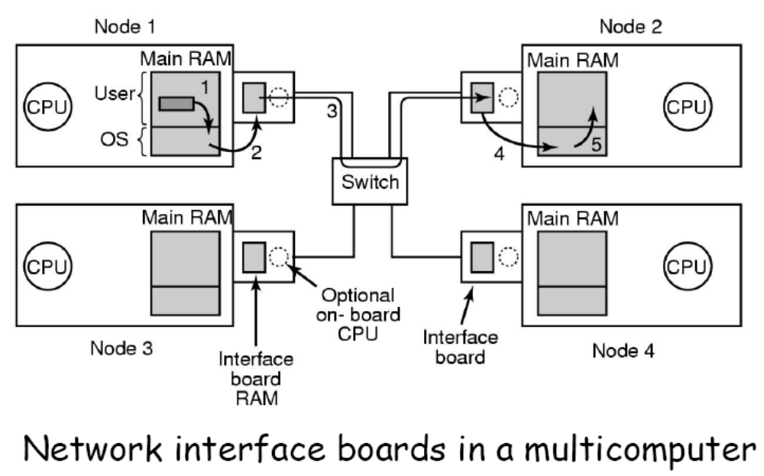
Network interface boards

Slide 60
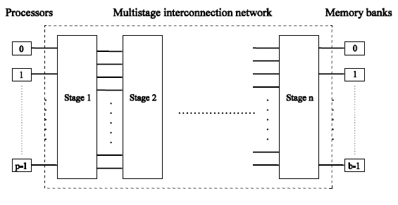
Multistage Network
Schematic of processor-to-memory
multistage interconnection network
(e.g., BBN Monarch)

Slide 61
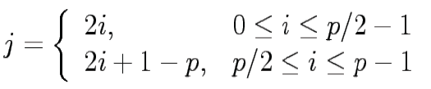
Multistage Omega Network
Organization
  log p stages
  p inputs/outputs
At each stage, input i is connected to output j if:
if p = 2^{k} then j = left_rotate(i)

Slide 62
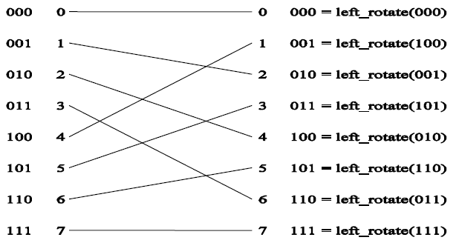
Omega Network Stage
Each Omega stage is connected in a perfect shuffle
A perfect shuffle interconnection for eight inputs and outputs
Notes:
perfect shuffle 全混洗

Slide 63
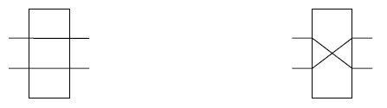
Omega Network Switches
2×2 switches connect perfect shuffles
Each switch operates in two modes
Pass-through Cross-over

Slide 64
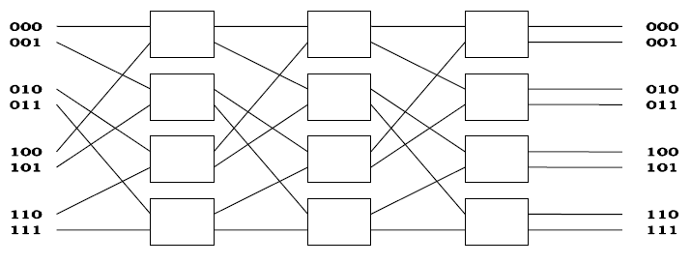
Multistage Omega Network
Omega network connecting eight inputs and eight outputs
Cost: p/2 × log p switching nodes → O(p log p)

Slide 65
无阻塞的Omega交换
第0级
第1级
第2级
0
0
1
1
2
2
3
3
4
4
5
5
6
6
7
7

Slide 66
Outline
MP Motivation
History of multiprocessing
Classification of computer architecture
  Flynn’s Taxonomy: SISD v. SIMD v. MIMD
SIMD
  Vector Processor & Array Processor
MIMD
  Communication Models
  Cluster vs. MPP
  Centralized vs. Distributed Memory
Related techniques
  Interconnection Networks
  Cache Coherence and Coherence Protocol
    Consistency, Coherency, Write Serialization
    Write Invalidate Protocol
    Example
Challenges to Parallel Programming

Slide 67
Symmetric Shared-Memory Architectures
From multiple boards on a shared bus to multiple processors inside a single chip
Caches both
  Private data are used by a single processor
  Shared data are used by multiple processors
Caching shared data
⇒ reduces latency to shared data, memory bandwidth for shared data,
and interconnect bandwidth
⇒ cache coherence 一致 problem

Slide 68
Example Cache Coherence Problem
P
1
P
2
P
3
u
= ?
u
= ?
3
$
4
$
5
$
u
:5
u
:5
u
= 7
1
u
:5
2
I/O devices
Memory
Processors see different values for u after event ③
With write back caches, value written back to memory depends on happenstance of which cache flushes or writes back value when
  Processes accessing main memory may see very stale 旧的 value
Unacceptable for programming, and its frequent!
Notes:
CS258 S99
Stale：陈旧的

Slide 69
Intuitive Memory Model
P
Reading an address should return the last value written to that address
  Easy in uniprocessors, except for I/O
Too vague 含糊的 and simplistic; 2 issues
L1
100:67
L2
100:35
Memory
Disk
100:34
Coherence defines values returned by a read
返回给读操作的是什么值
Consistency determines when a written value will be returned by a read
什么时候才能将已写入的值返回给读操作
Coherence defines behavior to same location, Consistency defines behavior to other locations
Notes:
一致性；连贯性

Slide 70
Defining Coherent Memory System
Preserve Program Order: A read by processor P to location X that follows a write by P to X, with no writes of X by another processor occurring between the write and the read by P, always returns the value written by P
Coherent view of memory: Read by a processor to location X that follows a write by another processor to X returns the written value if the read and write are sufficiently separated in time and no other writes to X occur between the two accesses
Write serialization: 2 writes to same location by any 2 processors are seen in the same order by all processors
  For example, if the values 1 and then 2 are written to a location, processors can never read the value of the location as 2 and then later read it as 1

Slide 71
Cache一致性需满足的条件
处理器P对X进行一次写之后又对X进行读，读和写之间没有其它处理器对X进行写，则读的返回值总是写进的值。
一个处理器对X进行写之后，另一处理器对X进行读，读和写之间无其它写，则读X的返回值应为写进的值。
对同一单元的写是顺序化的，即任意两个处理器对同一单元的两次写，从所有处理器看来顺序都应是相同的。

Slide 72
Write Consistency
For now assume
A write does not complete (and allow the next write to occur) until all processors have seen the effect of that write 直到所有的处理器均看到了写的结果，一次写操作才算完成。
2. The processor does not change the order of any write with respect to any other memory access
⇒ if a processor writes location A followed by location B, any processor that sees the new value of B must also see the new value of A
These restrictions allow the processor to reorder reads, but forces the processor to finish writes in program order 允许处理器无序读，但必须以程序规定的顺序进行写。
Notes:
CS258 S99
；

Slide 73
Basic Schemes for Enforcing Coherence
Program on multiple processors will normally have copies of the same data in several caches
Rather than trying to avoid sharing in SW, SMPs use a HW protocol to maintain coherent caches
  Migration and Replication key to performance of shared data
Migration 迁移 – data can be moved to a local cache and used there in a transparent fashion
  Reduces both latency to access shared data that is allocated remotely and bandwidth demand on the shared memory
Replication 复制 – for shared data being simultaneously read, since caches make a copy of data in local cache
  Reduces both latency of access and contention for read shared data 不仅降低了访存的延迟，也减少了访问共享数据所产生的冲突。
Notes:
CS258 S99
共享数据的迁移
降低了对远程共享数据的访问延迟。
共享数据的复制
不仅降低了访存的延迟，也减少了访问共享数据所产生的冲突。

Slide 74
2 Classes of Cache Coherence Protocols
Directory based — Sharing status of a block of physical memory is kept in just one location, the directory
Snooping 监听 — Every cache with a copy of data also has a copy of sharing status of block, but no centralized state is kept
  All caches are accessible via some broadcast medium (a bus or switch)
  All cache controllers monitor or snoop on the medium to determine whether or not they have a copy of a block that is requested on a bus or switch access
Notes:
CS258 S99
目录
物理存储器中共享数据块的状态及相关信息均被保存在一个称为目录的地方。
监听（snooping）
每个Cache除了包含物理存储器中块的数据拷贝之外，也保存着各个块的共享状态信息。

Slide 75
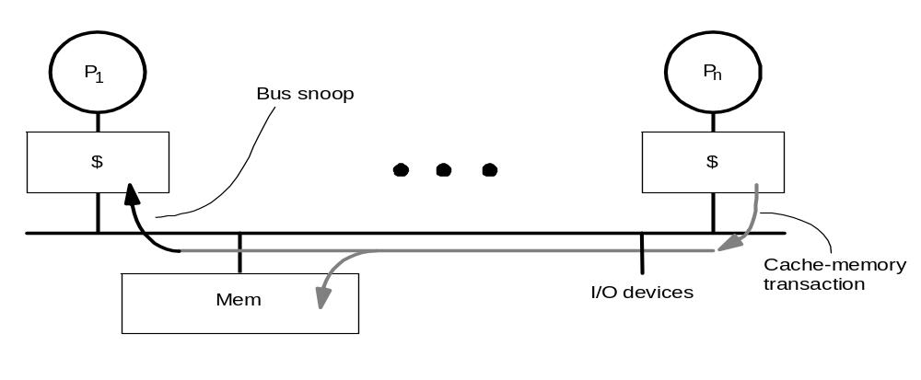
Snoopy Cache-Coherence Protocols
State
Address
Data
Cache Controller “snoops” all transactions on the shared medium (bus or switch)
  relevant transaction if for a block it contains
  take action to ensure coherence
    Invalidate, update, or supply value
  depends on state of the block and the protocol
Either get exclusive access 唯一访问权 before write via write invalidate or update all copies on write 写作废 与 写更新
Notes:
CS258 S99
写某个数据项之前保证它对该数据项有唯一的访问权——写作废

Slide 76
Example: Write-thru Invalidate
P
P
2
P
1
3
u
= ?
u
= ?
3
$
4
$
5
$
u
:5
u
:5
u
= 7
1
I/O devices
u
:5
2
u = 7
Memory
Must invalidate before step 3
Write update uses more broadcast medium BW
⇒ all recent MPUs use write invalidate
Notes:
CS258 S99
对同一数据的多个写而中间无读操作的情况，写更新协议需进行多次写广播操作，而在写作废协议下只需一次作废操作。
对同一块中多个字进行写，写更新协议对每个字的写均要进行一次广播，而在写作废协议下仅在对本块第一次写时进行作废操作。

Slide 77
Basic Implementation Techniques
Cache block state transition diagram 状态转换图
  FSM 有限状态机 specifying how disposition of block changes
    invalid, valid, dirty
Broadcast Medium Transactions (e.g., bus)
  To perform an invalidate, the processor acquires bus access and broadcasts the address to be invalidated on the bus.
  All processors snoop on the bus, watching the addresses.
  The processors check whether the address on the bus is in their cache. If so, the corresponding data are invalidated.
Notes:
CS258 S99
FSM ：Finite state machine ，有限状态机
In addition to invalidating outstanding copies of a cache block that is being written into, we also need to locate a data item when a cache miss occurs.
Broadcast Medium Transactions (e.g., bus)
Fundamental system design abstraction
Logically single set of wires connect several devices
Protocol: arbitration, command/addr, data
Every device observes every transaction

Slide 78
Basic Implementation Techniques
Broadcast medium enforces serialization of read or write accesses ⇒ Write serialization 写顺序化：通过总线实现
  1st processor to get medium invalidates others copies
  the serialization enforced by the bus also serializes their writes
  Implies cannot complete write until it obtains bus
  All coherence schemes require serializing accesses to same cache block
Also need to find up-to-date copy of cache block
Notes:
CS258 S99

Slide 79
Locate up-to-date copy of data
Write-through: get up-to-date copy from memory
  Write through simpler if enough memory BW
Write-back harder
  Most recent copy can be in a cache
Can use same snooping mechanism
  Snoop every address placed on the bus
  If a processor has dirty (newest) copy of requested cache block, it provides it in response to a read request and aborts the memory access
    Complexity from retrieving cache block from a processor cache, which can take longer than retrieving it from memory
Write-back needs lower memory bandwidth
⇒ Support larger numbers of faster processors
⇒ Most multiprocessors use write-back

Slide 80
Cache Resources for WB Snooping
Normal cache tags can be used for snooping
Valid bit per block makes invalidation easy
To track whether a cache block is shared, add extra state bit associated with each cache block, like valid bit and dirty bit
Read misses easy since rely on snooping
  whether generated by an invalidation or by some other event
Writes ⇒ we’d like to know whether any other copies of the block are cached
  No other copies ⇒ No need to place write on bus for in a write-back cache
  Other copies ⇒ Need to place invalidate on bus
Notes:
CS258 S99
The normal cache tags can be used to implement the process of snooping, and
the valid bit for each block makes invalidation easy to implement. Read misses,
whether generated by an invalidation or by some other event, are also straightforward
since they simply rely on the snooping capability. For writes we’d like to
know whether any other copies of the block are cached because, if there are no
other cached copies, then the write need not be placed on the bus in a write-back
cache. Not sending the write reduces both the time taken by the write and the
required bandwidth.

Slide 81
Cache behavior in response to bus
Every bus transaction must check the cache-address tags
  could potentially interfere with processor cache accesses
A way to reduce interference is to duplicate tags
  One set for caches access, one set for bus accesses
Another way to reduce interference is to use L2 tags
  Since L2 less heavily used than L1
  ⇒ Every entry in L1 cache must be present in the L2 cache, called the inclusion property
  If Snoop gets a hit in L2 cache, then it must arbitrate for the L1 cache to update the state and possibly retrieve the data, which usually requires a stall of the processor
Notes:
CS258 S99
Every bus transaction must check the cache-address tags, which could potentially interfere with processor cache accesses.
One way to reduce this interference is to duplicate the tags.
The interference can also be reduced in a multilevel cache by directing the snoop requests to the L2 cache, which the processor uses only
when it has a miss in the L1 cache. For this scheme to work, every entry in the L1 cache must be present in the L2 cache, a property called the
inclusion property. If the snoop gets a hit in the L2 cache, then it must arbitrate for the L1 cache to update
the state and possibly retrieve the data, which usually requires a stall of the processor.
Sometimes it may even be useful to duplicate the tags of the secondary cache to further decrease contention between the processor and the snooping activity.

Slide 82
Example Protocol
Snooping coherence protocol is usually implemented by incorporating (包含) a finite-state controller in each node
  Write-through Invalidate Protocol
  Write Back Snoopy Protocol
Notes:
CS258 S99
at time
adv.
偶而

Slide 83
Write-through Invalidate Protocol
2 states per block in each cache
  as in uniprocessor
  state of a block is a p-vector of states
  Hardware state bits associated with blocks that are in the cache
  other blocks can be seen as being in invalid (not-present) state in that cache
Writes invalidate all other cache copies
  can have multiple simultaneous readers of block, but write invalidates them
PrRd/ -
PrWr / BusWr
V
BusWr / -
PrRd / BusRd
I
PrWr / BusWr
(No-write allocate)
State Tag Data
State Tag Data
PrRd: Processor Read
PrWr: Processor Write
BusRd: Bus Read
BusWr: Bus Write
P
P
1
n
$
$
Bus
Mem
I/O devices
Notes:
CS258 S99
In differential geometry, a p-vector is the tensor obtained by taking linear combinations of the wedge product of p tangent vectors, for some integer p ≥ 1. It is the dual concept to a p-form.
For p = 2 and 3, these are often called respectively bivectors and trivectors; they are dual to 2-forms and 3-forms.

Slide 84
Example Write Back Snoopy Protocol
Invalidation protocol, write-back cache
  Snoops every address on bus
  If it has a dirty copy of requested block, provides that block in response to the read request and aborts the memory access
Each memory block is in one state:
  Clean in all caches and up-to-date in memory (Shared)
  OR Dirty in exactly one cache (Exclusive)
  OR Not in any caches
Each cache block is in one state (track these):
  Shared : block can be read
  OR Exclusive : cache has only copy, its writeable, and dirty
  OR Invalid : block contains no data (in uniprocessor cache too)
Read misses: cause all caches to snoop bus
Writes to clean blocks are treated as misses

Slide 85
Write-Back State Machine - CPU
CPU Read hit
State machine
for CPU requests
for each
cache block
Non-resident blocks invalid
CPU Read
Shared
(read/only)
Invalid
Place read miss
on bus
CPU Write
Place Write
Miss on bus
CPU Write
Place Write Miss on Bus
Cache Block
State
Same Block
Different Addr
Exclusive
(read/write)
CPU read hit
CPU write hit
CPU Write Miss?
Write back cache block
Place write miss on bus
Notes:
CS258 S99
Invalid:
read => shared
write => dirty
shared looks the same

Slide 86
Block-replacement
CPU Read hit
State machine
for CPU requests
for each
cache block
CPU Read
Shared
(read/only)
Invalid
Place read miss
on bus
CPU Write
Place Write
Miss on bus
CPU read miss
Write back block,
Place read miss
on bus
CPU Read miss
Place read miss
on bus
CPU Write
Place Write Miss on Bus
Cache Block
State
Exclusive
(read/write)
CPU read hit
CPU write hit
CPU Write Miss
Write back cache block
Place write miss on bus
Notes:
CS258 S99
Invalid:
read => shared
write => dirty
shared looks the same

Slide 87
Write-Back State Machine- Bus request
State machine
for bus requests
for each
cache block
Write miss
for this block
Invalid
Shared
(read/only)
Write miss
for this block
Write Back
Block; (abort
memory access
已不是最新，
没必要写内存了)
Read miss
for this block
Write Back
Block; (abort
memory access，提供给需求者)
Exclusive
(read/write)
Notes:
CS258 S99
从Bus来的Request，就是监听来的。

Slide 88
Write-back State Machine-III
CPU Read hit
State machine
for CPU requests
for each
cache block and
for bus requests
for each
cache block
Write miss
for this block
CPU Read
Shared
(read/only)
Invalid
Place read miss
on bus
CPU Write
Place Write
Miss on bus
Write miss
for this block
CPU read miss
Write back block,
Place read miss
on bus
CPU Read miss
Place read miss
on bus
Write Back
Block; (abort
memory access)
CPU Write
Place Write Miss on Bus
Cache Block
State
Read miss
for this block
Write Back
Block; (abort
memory access)
Exclusive
(read/write)
CPU read hit
CPU write hit
CPU Write Miss
Write back cache block
Place write miss on bus
Notes:
CS258 S99
Invalid:
read => shared
write => dirty
shared looks the same

Slide 89
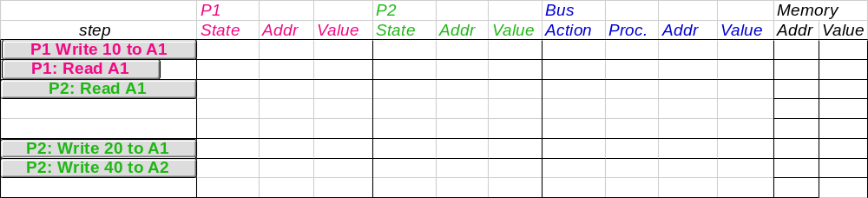
Example
Assumes A1 and A2 map to same cache block,
initial cache state is invalid

Slide 90
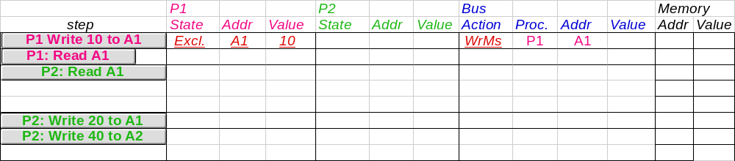
Example
Assumes A1 and A2 map to same cache block

Slide 91
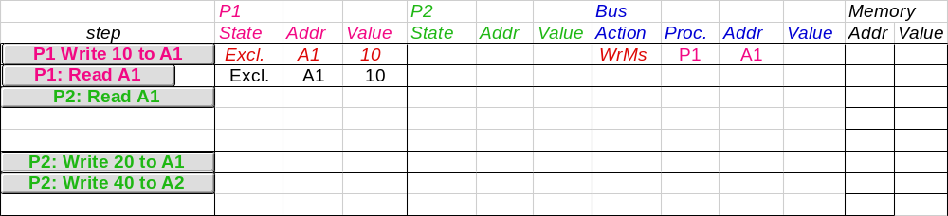
Example
Assumes A1 and A2 map to same cache block

Slide 92
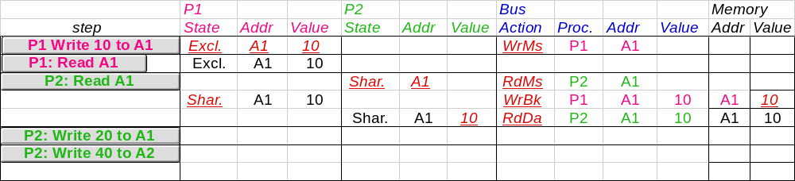
Example
Assumes A1 and A2 map to same cache block

Slide 93
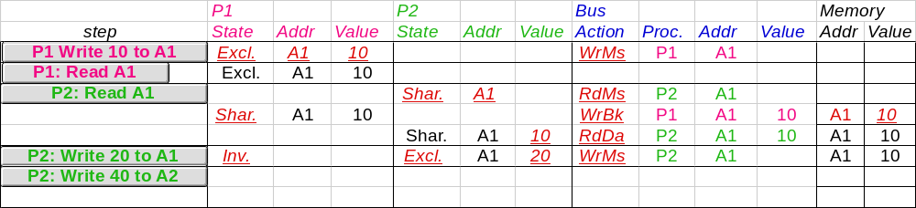
Example
Assumes A1 and A2 map to same cache block

Slide 94
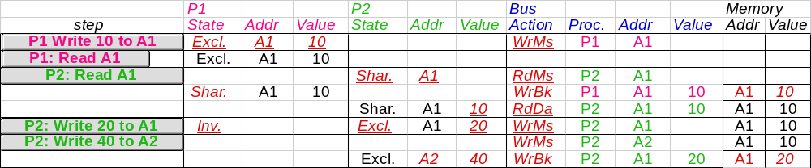
Example
Assumes A1 and A2 map to same cache block,
but A1 != A2
Notes:
CS258 S99
Why write miss first?
Because in general, only write a piece of block, may need to read it first so that can have a full vblock; therefore, need to get
Write back is low priority event.

Slide 95
Outline
MP Motivation
History of multiprocessing
Classification of computer architecture
  Flynn’s Taxonomy: SISD v. SIMD v. MIMD
SIMD
  Vector Processor & Array Processor
MIMD
  Communication Models
  Cluster vs. MPP
  Centralized vs. Distributed Memory
Related techniques
  Interconnection Networks
  Cache Coherence and Coherence Protocol
    Consistency, Coherency, Write Serialization
    Write Invalidate Protocol
    Example
Challenges to Parallel Programming

Slide 96
Challenges of Parallel Processing 1
First challenge is % of program inherently sequential
Suppose 80X speedup from 100 processors. (100个处理器达到80倍的加速比) What fraction of original program can be sequential?
  10%
  5%
  1%
  <1%
Notes:
CS258 S99
100个处理器达到80倍的加速比

Slide 97
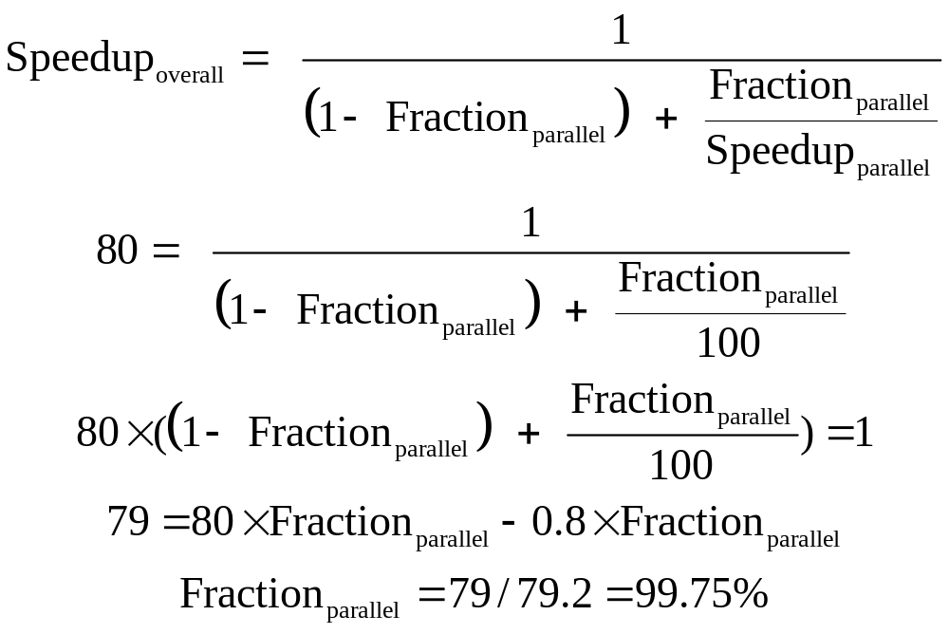
Amdahl’s Law Answers

Slide 98
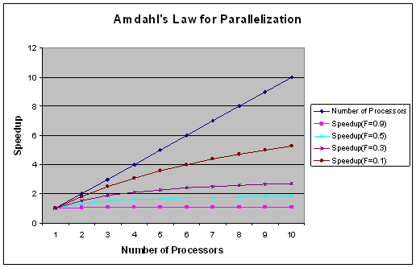
Amdahl's law for up to ten CPUs
At the bottom (purple line) is the case of a problem that is 90% sequential. In the best case for this graph, the brown line shows a problem that's 10% sequential and, therefore, 90% parallelizable.
Notes:
CS258 S99
In Figure 2, the top line shows the number of processors. Ideally, this is what you'd like to see when you add additional processors to solve a problem. Unfortunately, because not all of the problem can be parallelized and there's overhead in managing the processors, the speedup is quite a bit less. At the bottom (purple line) is the case of a problem that is 90% sequential. In the best case for this graph, the brown line shows a problem that's 10% sequential and, therefore, 90% parallelizable. Even in this case, ten processors perform only slightly better than five.

Slide 99
Challenges of Parallel Processing 2
Second challenge is long latency to remote memory
Suppose 32 CPU MP, 2GHz, 200 ns remote memory, all local accesses hit memory hierarchy and base CPI is 0.5.
What is performance impact if 0.2% instructions involve remote access?
  1.5X
  2.0X
  2.6X
Notes:
CS258 S99

Slide 100
CPI Equation
Remote access cost = 200ns*2GHz = 400 clock cycles.
CPI = Base CPI +
Remote request rate
x Remote request cost
CPI = 0.5 + 0.2% x 400 = 0.5 + 0.8 = 1.3
No communication (the MP with all local reference) is 1.3/0.5 or 2.6 faster than 0.2% instructions involve remote access
Notes:
CS258 S99
Remote access = 200/0.5 = 400 clock cycles. （原文写法，我认为不对）

Slide 101
Challenges of Parallel Processing
Application parallelism ⇒ primarily via new algorithms that have better parallel performance
Long remote latency impact ⇒ both by architect and by the programmer
For example, reduce frequency of remote accesses either by
  Caching shared data (HW)
  Restructuring the data layout to make more accesses local (SW)
Today’s lecture on HW to help latency via caches

Slide 102

Challenge of Parallel Programming
John Hennessy (Computing Legend, Leading inventor of RISC and President of Stanford University)
“…when we start talking about parallelism and ease of use of truly parallel computers, we’re talking about a problem that’s as hard as any that computer science has faced.”
“A conversation with Hennessy and Patterson,”
ACM Queue Magazine, 4:10, 1/07

